Slide 1

Personal Digital Storage and Secure Sharing
-Using AWS and Angular Framework
01

Slide 2
Why Do We Need a Digital Storage?

Slide 3
Why AWS is Best Solution?

Slide 4


CloudDriven

Slide 5

Solving all problems
What Do We Provide???
Personal Storage for Customers where everything can be stored from files to folders to pictures to zip files and even your secret private data.
Features
Serverless Login and Signup using aws cognito
Files Upload and Download using drag and drop.
Creating folders and storing files in a organized manner.
Sharing Of files using Link Sharing and also using QR scan code.
Providing facilites for Security using AWS Encryption.
02

Slide 6
Internally….
What Do We Use???
AWS-S3 is a Object Store Service. we use it to store all folders and valuable data of our various clients.
AWS-SDK is used to provide AWS services to angular framework.
AWS-Amplify is Used as a development platform for building secure, scalable mobile and web applications. We use it for working with cognito and storing our website on aws cloud.
Using AWS-Amplify we can access our website through aws cloud network.
02

Slide 7
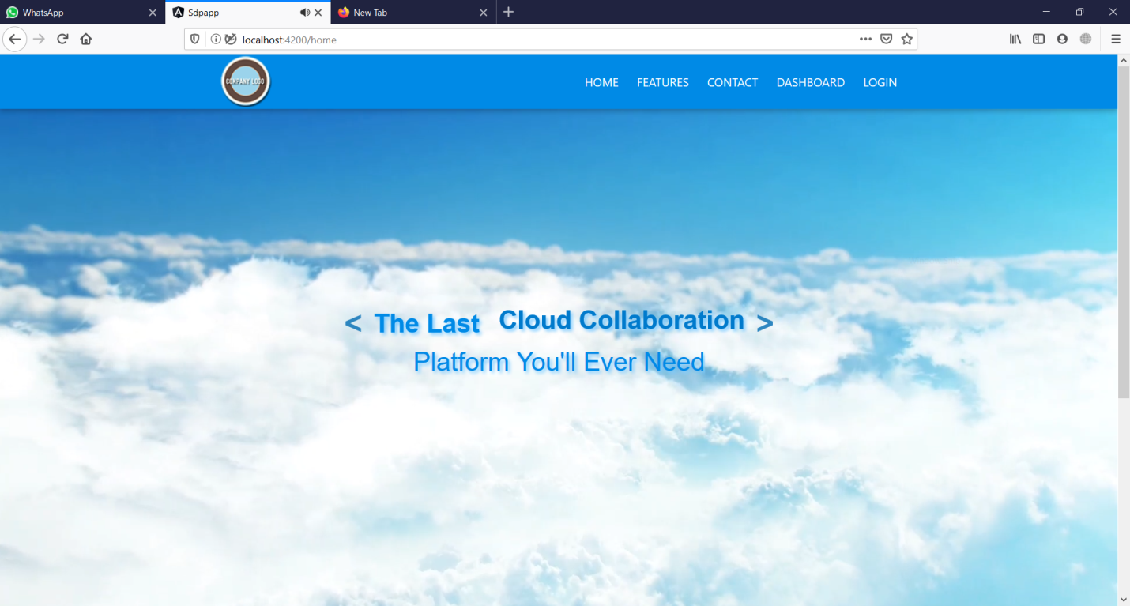
ScreenShots
Home Page

Slide 8
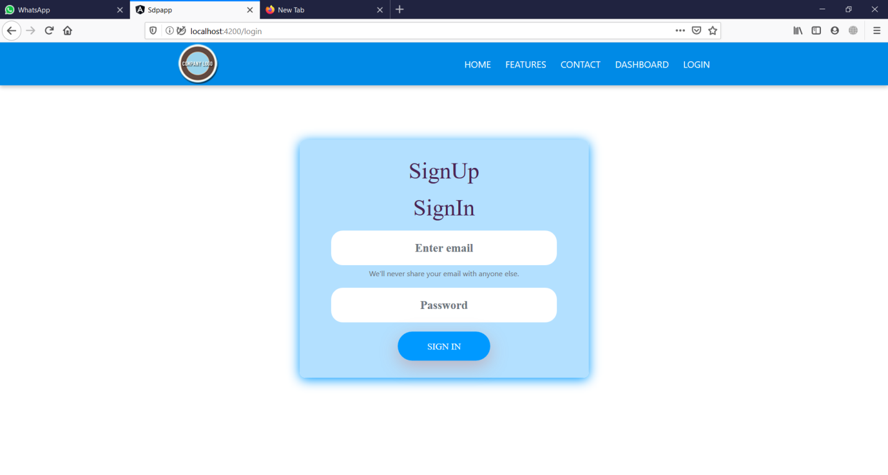
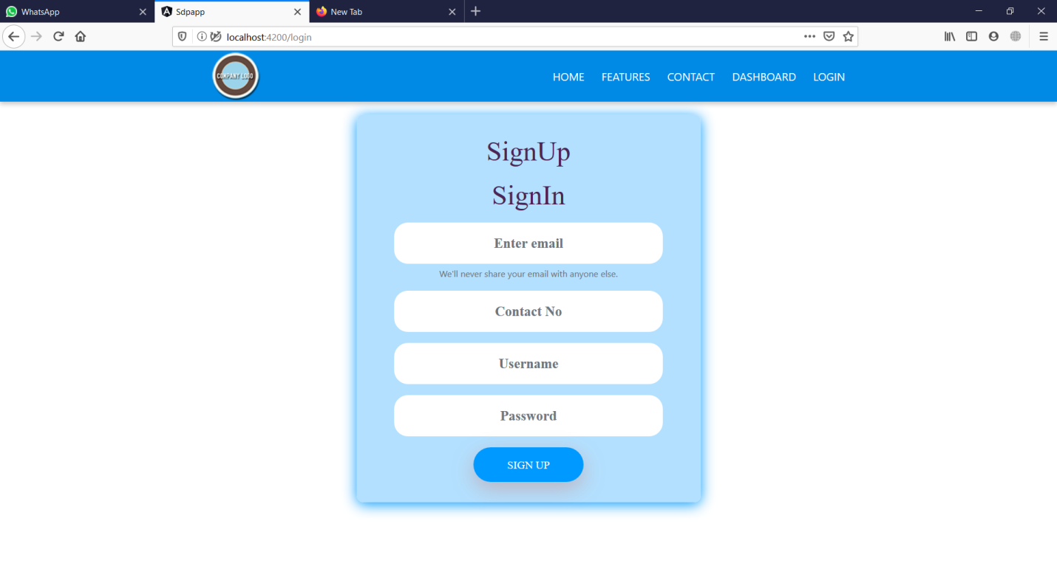
Signin
Signup

Slide 9
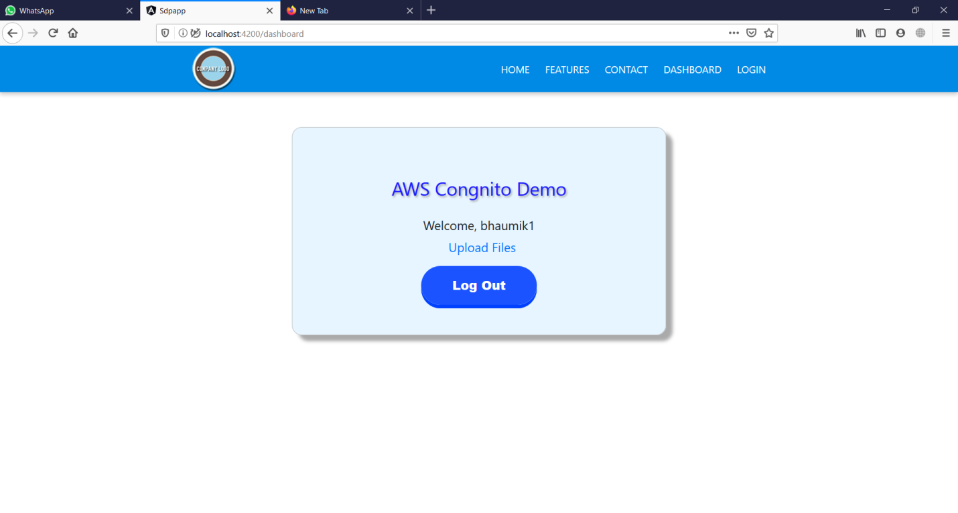
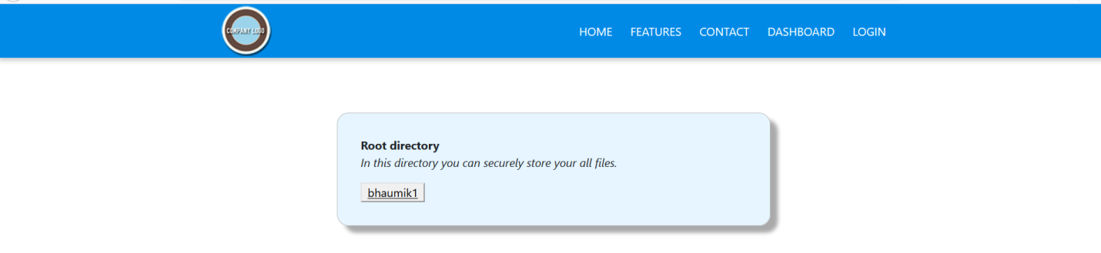
Dashboard

Slide 10
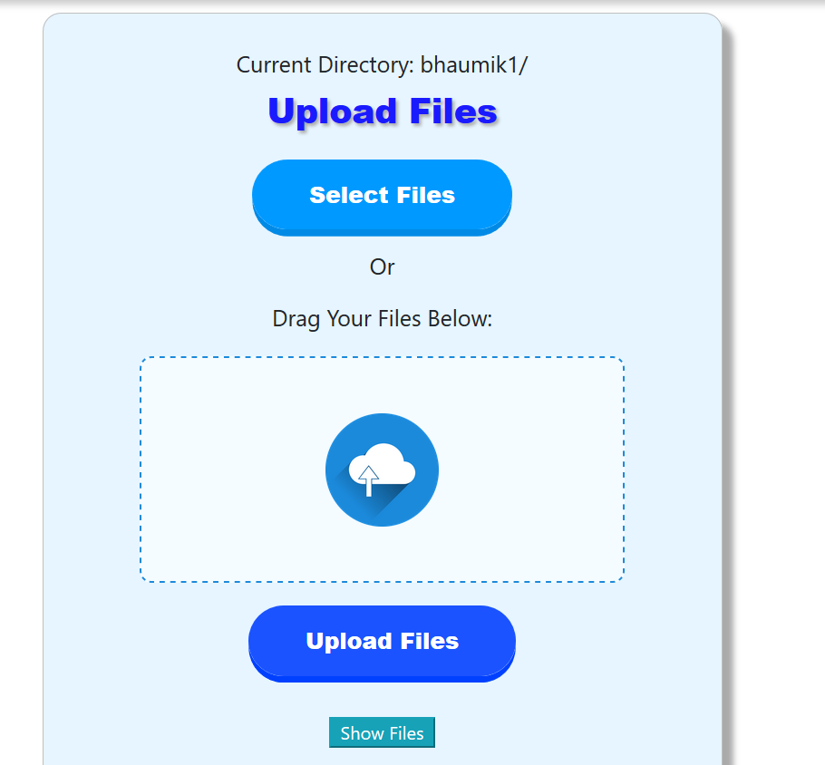
Upload files

Slide 11
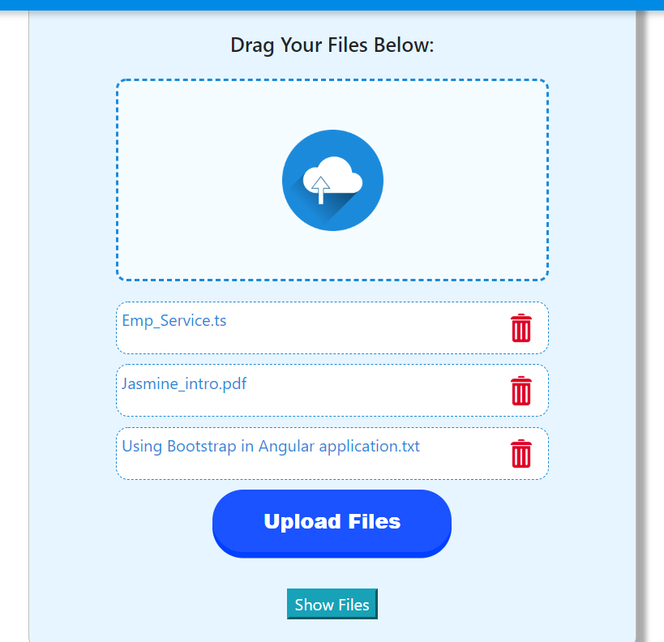
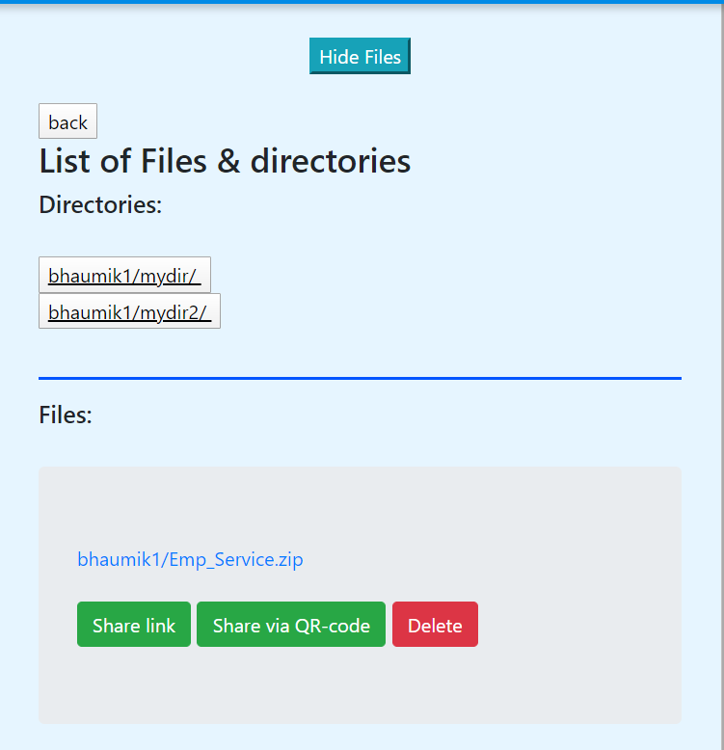
Display list of Files with option to share link share via QR code and delete files.

Slide 12
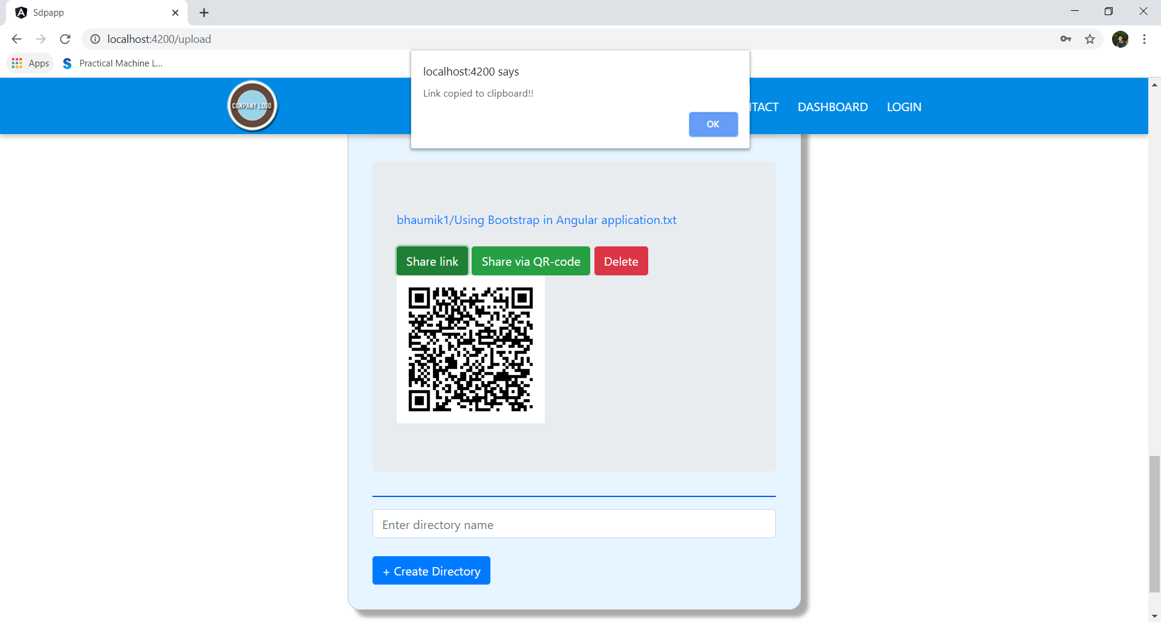
QR Code functionality

Slide 13


What Is Left To be Done
Making the website publically Accessible.
Developing Features To Send Updates.
Extra Level Security Encryption Techniques.

Slide 14

A whopping 85% of data is transferred through cloud services.
Source: Demand Gen Report, 2016
09

Slide 15
Cloud storage is becoming one of the most favorite ways to save your data.
Security measures
3/4 of service providers intend to increase or have increased their budget for the safety measures in 2016.
The number of users is going through the roof
There are about 1600 millions of cloud storage personal users worldwide, which equals to 1,6 billion.
Global cloud service revenue from storage services
Global cloud service revenue from storage services is about 4 billion in U.S. dollars.

Slide 16

“Data that is Loved Tends to Survive.”
From CloudDriven

Slide 17



Name: Adit Modi
Id: 17CEUBS097
CE-70
Role: AWS Expert
Name: Bhaumik Joshi
Id: 17CEUOS030
CE-50
Role: Angular Framework
Name: Smit Panchal
Id: 17CEUBS054
CE-75
Role : Frontend Developer
03

Slide 18
Thank You!

