Slide 1
RNN

Slide 2
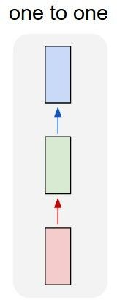
“Vanilla” Neural Network
Vanilla Neural Networks

Slide 3
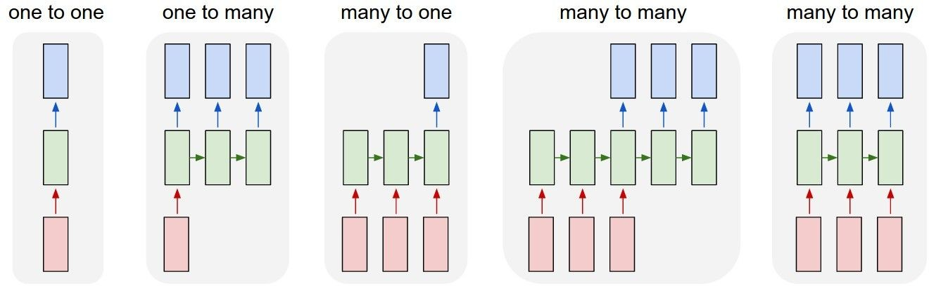
Recurrent Neural Networks: Process Sequences
e.g. Image Captioning
image -> sequence of words

Slide 4
Recurrent Neural Networks: Process Sequences
e.g. Machine Translation
seq of words -> seq of words

Slide 5
Recurrent Neural Networks: Process Sequences
e.g. Video classification on frame level

Slide 6
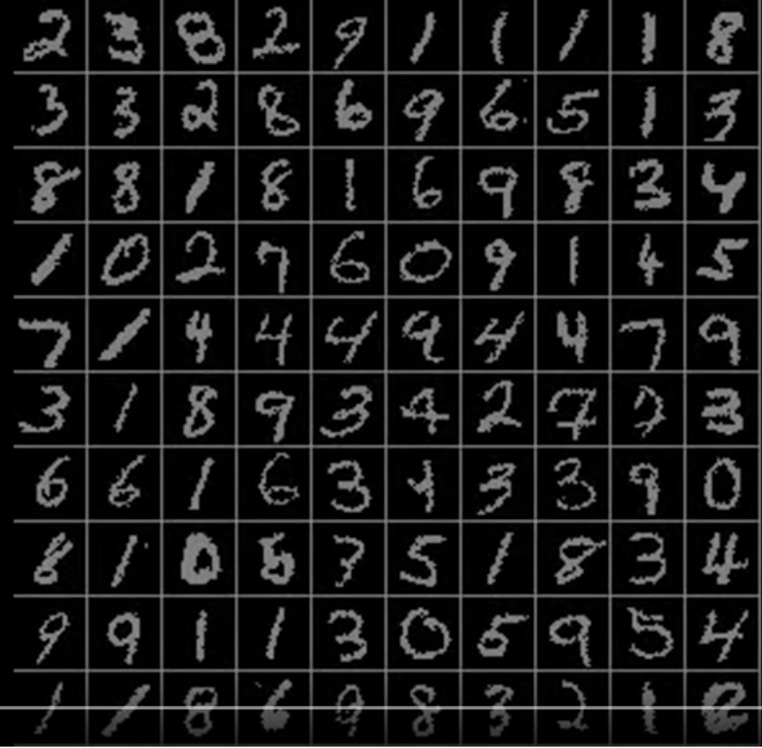
Sequential Processing of Non-Sequence Data
Classify images by taking a series of “glimpses”
Ba, Mnih, and Kavukcuoglu, “Multiple Object Recognition with Visual Attention”, ICLR 2015.

Slide 7
Recurrent Neural Network
RNN
x

Slide 8
y
usually want to predict a vector at some time steps
RNN
x

Slide 9

We can process a sequence of vectors x by applying a recurrence formula at every time step:
y
RNN
new state old state input vector at
some time step
x
some function
with parameters W

Slide 10
Recurrent Neural Network
We can process a sequence of vectors x by applying a recurrence formula at every time step:
y
RNN
x
Notice: the same function and the same set of parameters are used at every time step.

Slide 11

(Vanilla) Recurrent Neural Network
The state consists of a single “hidden” vector h:
y
RNN
x

Slide 12
RNN: Computational Graph
h₀
f_{W}
h₁
x₁

Slide 13
RNN: Computational Graph
Re-use the same weight matrix at every time-step
h₂
h₃
…
h_{T}
h₀
f_{W}
h₁
f_{W}
f_{W}
x₁
x₂
x₃
W

Slide 14
RNN: Computational Graph: Many to Many
y₁
y₂
y₃
y_{T}
L₁
L₂
L₃
L_{T}
h₂
h₃
…
h_{T}
h₀
f_{W}
h₁
f_{W}
f_{W}
x₁
x₂
x₃
W

Slide 15
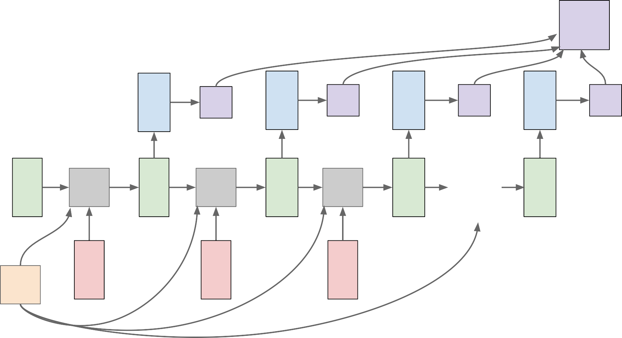
RNN: Computational Graph: Many to Many
L
y₁
L₁
y₂
L₂
y₃
L₃
y_{T}
L_{T}
…
h₀
f_{W}
h₁
f_{W}
h₂
f_{W}
h₃
h_{T}
x₁
x₂
x₃
W

Slide 16
RNN: Computational Graph: Many to One
y
h₂
h₃
…
h_{T}
h₀
f_{W}
h₁
f_{W}
f_{W}
x₁
x₂
x₃
W

Slide 17
Sequence to Sequence: Many-to-one + one-to-many
Many to one: Encode input sequence in a single vector
h
0
f_{W}
h
1
f_{W}
h
2
f_{W}
h
3
…
h
T
x
1
x
2
x
3
W
1

Slide 18
Sequence to Sequence: Many-to-one + one-to-many
One to many: Produce output sequence from single input vector
Many to one: Encode input
sequence in a single vector
y
1
y
2
h
0
f_{W}
h
1
f_{W}
h
2
f_{W}
h
3
…
h
T
f_{W}
h
1
f_{W}
h
2
f_{W}
…
x
1
x
2
x
3
W
W
1
2

Slide 19


Forward through entire sequence to compute loss, then backward through entire sequence to compute gradient
Backpropagation through time
Loss

Slide 20
Truncated Backpropagation through time
Loss
Run forward and backward through chunks of the sequence instead of whole sequence

Slide 21
Truncated Backpropagation through time
Loss
Carry hidden states forward in time forever, but only backpropagate for some smaller number of steps

