Slide 1



Theme 3: PDF EXTRACTION

Slide 2
Our Team
Dhruv Bhojraj {RA2211003010522}
Aditya P {RA2211003010548}
SECTION : H1 DEPARTMENT : COMPUTING TECHNOLOGIES
SECTION : I1 DEPARTMENT : COMPUTING TECHNOLOGIES

Slide 3
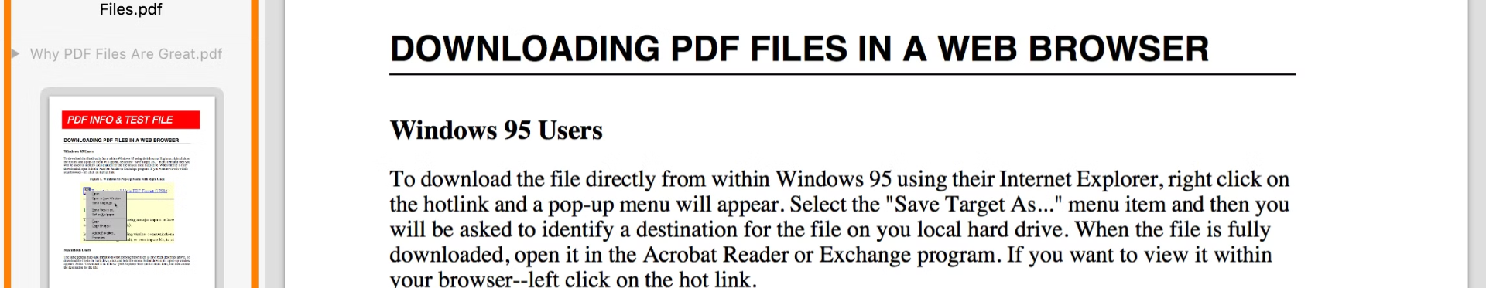
What is PDF Extraction?
1
Data Capture
2
Data Engineering
Extracting text, tables, and other structured data from PDF files.
Process the extracted information.
3
Transformation
4
Export
Transform or Normalize the extracted information into manageable structures.
Converting the chunks of data into human-readable form like excel or CSV

Slide 4

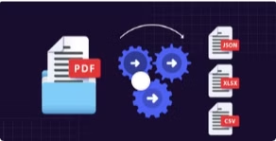
Our Product
Appealing UI
Export Option
Our PDF extraction solution tool has a pleasant and easy-to-use User Interface
Users can not only preview but also download the csv files for external use!
Tick Mark and Shade Detection
Scalable Platform
Our tool can be readily deployed on cloud and scaled
Our tool uses OCR technology to identify both tick marks and shaded box.

