Slide 1

TELECOM_CHURN_PROJECT
PREPARED BY :-
ADIT BAGDAI
GCP DS 5 , DECEMBER 2023

Slide 2
UNDERSTANDING THE BUSINESS PROBLEM
In the telecom Industry , Customers according to the law are able to choose from Multiple Service Providers available in the Market .
As it is a highly competitive market , since there are many players available and offering various Plans to suit the Customer’s needs and demands in the market , it becomes Extremely necessary for the Companies to take the decisions which are Data Driven and Market Trends .
On an Average Telecom Industry experience churn of the customers 15-20% annually .
This churn is very difficult for the operators in the market as it costs 5-10% more to the companies than to retain the existing ones and maintain them and meet their demands .
Looking at the above scenario it is extremely important for the companies to Retain their original Customers and not losing them and try to retain them .
Therefore , for the incumbent operators , their primary goal is to retain the existing customers rather than acquiring the new customers .
To reduce the churn of the customers , companies need to Predict that which all highly profitable customers are at the risk of churning .
There are basically two types of churn – A) Postpaid and B) Prepaid .
Predicting the Prepaid users churn is more difficult than the Postpaid ones since in Prepaid companies cannot decide as to the customers have stopped using the services or they have churned to the different companies .

Slide 3
The data set of the company which we have been provided is of 4 months .
From the above four months data , The Business objective is to predict the churn in the last month , using the features available to us from the first three months and depict it accordingly to the company .
To make the predictions , we need to understand the behaviour of the Churn of the customers according to the different months data provided to us . There are 4 months , so first month is “GOOD PHASE” , which states that Customers are happy and behaves well .
Second phase is “ACTION PHASE’ , which is of the next 2 months , i.e. , 2nd and 3rd month . In this phase , the customers gets a good and compelling offer from the other service providers or the competitors , or they are being uncharged fairly , or they are unhappy with the quality service , etc. In this phase customers generally shows different behaviour than the Good Phase . Since this is the crucial phase for the company it is very important for the company to retain the High Churn Risk customers and to match the needs and demands of the customers like matching the competitor’s offers , offering them good quality service , offering them discounts , etc .
Last phase is “CHURN PHASE” , where customers churn to the other companies . This is of the last month where maximum amount of the Churn takes place since the customers are not happy .
The last month’s data is what we have to prepare , where the Churn rates would be defined as well as the churn would be available based on the past month’s data.

Slide 4
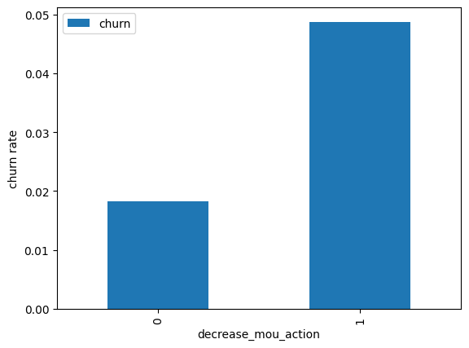
CHURN RATE OF THE CUSTOMERS DEPENDING UPON THE MINUTES OF USAGE OF THE CUSTOMERS .
As you can see in the Chart , i.e. , it is predicting the Churn rate for the customers .
Here we can see that as the Minutes of the usage for the customers are decreasing , the churn rate is also decreasing for the same .
This chart implies that the minutes of usage has a great impact on the Churn rate of the customers .
More the minutes of usage , more the churn rates .
This implies that company needs to retain the customers whose minutes of usage are very high .
This data is derived from the data provided to us .

Slide 5
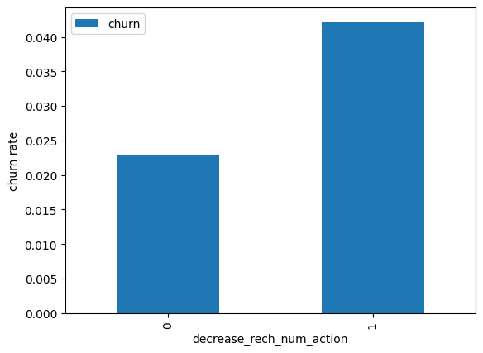
CHURN RATE OF THE CUSTOMERS DEPENDING UPON THE RECHARGE AMOUNT DONE BY THE CUSTOMERS .
From the graph given besides , it can be clearly depicted that in Prepaid users where the Recharge amount is less , in those cases Churn Rate is far more than that of those whose Recharge amount is more .
This chart depicts that the amount of Recharge done by the customers has a great impact on the churn rate done by the customers .
This implies that company needs to retain the customers whose recharge amount is done less in comparison whose recharge amount is done more since those are at high risk of getting churned .
This graph is prepared by the data provided to us .

Slide 6
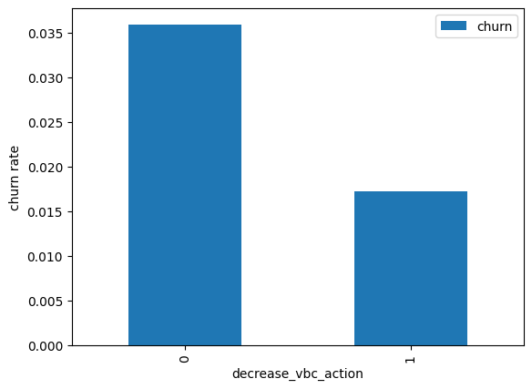
CHURN RATE OF THE CUSTOMERS DEPENDING UPON THE VOLUME BASED ACTION DONE BY THEM.
As we can see in the Graph besides , we can see that more the volume cost , more the churn rate.
VBC states that , the customers are paying as per their usage and no specific plans , or discounts offered by the company is being purchased .
So it is being seen that more the Volume of the original plan purchased , more the Churn rate .
The company needs to focus more on the customers who are not going for any specific plan offered by the company , or lets say any discount being offered by the company .
The company needs to retain these kind of customers as they are at high risk of churning.
This graph is being prepared as per the data provided to us .

Slide 7
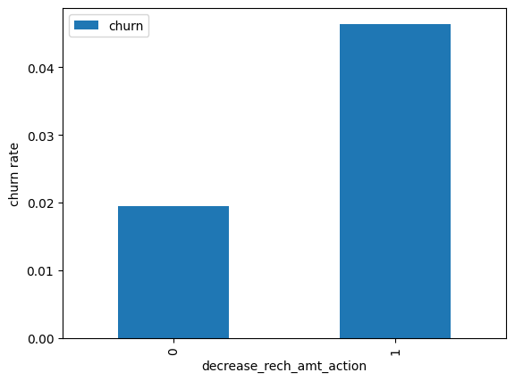
CHURN RATE OF THE CUSTOMERS DEPENDING UPON THE AMOUNT OF RECHARGE BEING DONE BY THE CUSTOMERS .
It is being clearly shown in the graph , that lesser the amount of recharge being done by the customers in the Action phase than the good phase are at higher risk of getting churned .
The company needs to focus on the customers whose recharge amount is less than the customers who are recharging more in Action phase than the good phase .
The customers who are doing less recharge at higher risk of Churning .
The graph is being made as per the data given to us .

Slide 8
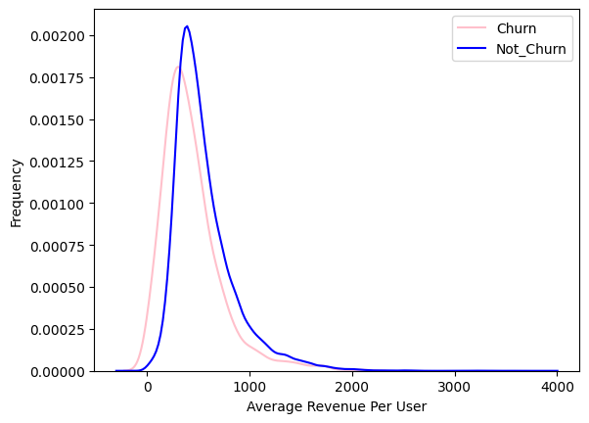
CHURN & NOT CHURN FREQUENCY OF THE CUSTOMERS DEPENDING UPON THE AVERGAE REVENUE.
In this graph we can say that Customers who are getting churned , are generating a comparatively lesser revenue to the company than those of the customers who are not churning themselves .
It states that people who are happy with the company and not planning to churn are doing more recharge and generating more revenue to the company .
Therefore , the company needs to focus more on the customers who are generating less amount of revenue as compared to the customers who are generating more revenue to the company .
This graph is being prepared as per the data provided to us .

Slide 9
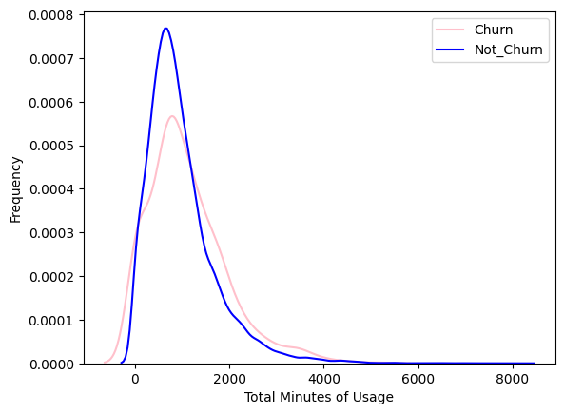
CHURN FREQUENCY OF THE CUSTOMERS DEPENDING MINUTES OF THE USAGE DONE BY THE CUSTOMERS .
In this Plot we can see that People who are using in the range of 0-2000 minutes are the customers who are not churning .
The higher risk of customers churning , are the customers who are using the services in the range of 0-2500 .
Their frequency of churning is far more than the customers who are using in the range of 0-2000.
The company needs to focus on the Minutes of Usage being done by the customers .
This plot is being prepared on the data given to us .

Slide 10
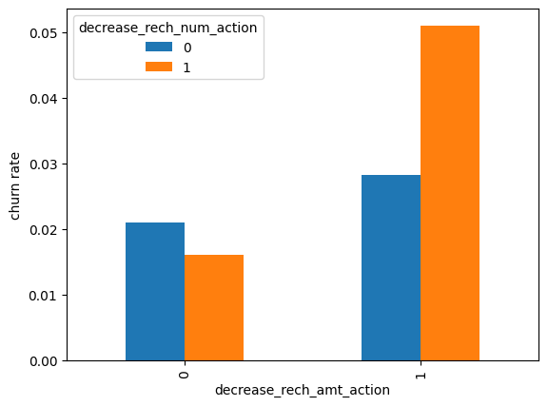
CHURN RATE OF THE CUSTOMERS DEPENDING RECHARGE AMOUNT & NO OF RECHARGE TAKING PLACE .
In this Bi Variate analysis, we can see that churn rate is more for the customers, whose recharge amount as well as number of recharge have decreased in the action phase than the good phase.
By looking at this graph , it can be stated that Churn rate is more where the more for the customers , whose recharge amount as well as number of recharge has decreased In the Action phase than in the Good Phase .
So by understanding that customer has started reducing Recharge amount and the number of recharges , it states that customer is planning to churn .
Therefore , company needs to have a close look at the customers whose recharge is decreasing .
These graphs are made by the data provided to us.

Slide 11
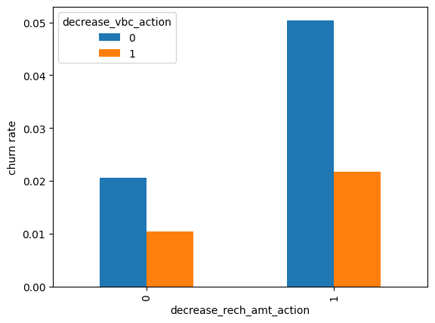
CHURN RATE OF THE CUSTOMERS DEPENDING RECHARGE AMOUNT & THE VOLUME BASED ACTION.
By seeing this Graph , it is clearly being seen that churn rate is more for the customers, whose recharge amount is decreased along with the volume based cost is increased in the action month.
As the Recharge amount is decreased , Customers tend to churn more .
In the action months , as the recharge amount is decreased , Volume is increasing .
Therefore , Company needs to focus on the customers whose recharge amount is decreasing but the volume is increasing to the company.
This graph is being prepared by the data given to us .

Slide 12
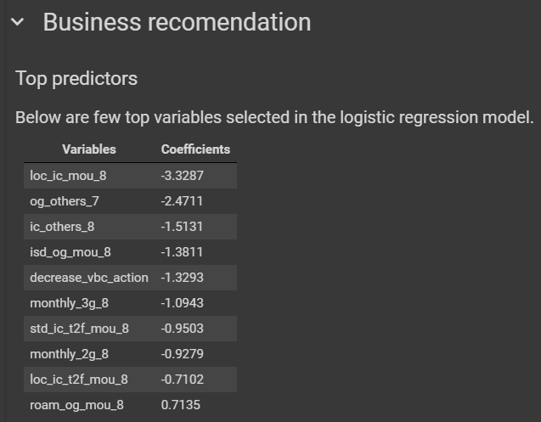

Slide 13
CONCLUSIONS :-
1) Target the customers, whose minutes of usage of the incoming local calls and outgoing ISD calls are less in the action phase (mostly in the month of August).
2) Target the customers, whose outgoing others charge in July and incoming others on August are less.
3) Also, the customers having value based cost in the action phase increased are more likely to churn than the other customers. Hence, these customers may be a good target to provide offer.
4) Customers, whose monthly 3G recharge in August is more, are likely to be churned.
5) Customers having decreasing STD incoming minutes of usage for operators T to fixed lines of T for the month of August are more likely to churn.
6) Cutomers decreasing monthly 2g usage for August are most probable to churn.
7) Customers having decreasing incoming minutes of usage for operators T to fixed lines of T for August are more likely to churn.
8) roam_og_mou_8 variables have positive coefficients (0.7135). That means for the customers, whose roaming outgoing minutes of usage is increasing are more likely to churn.

Slide 14


