Slide 1
Final Project Presentation
Aditya Barulhadi M– JC Data Science Batch 2

Slide 2
Diamonds Dataset
Source : https://www.kaggle.com/shivam2503/diamonds

Slide 3
Problem
In fact, every diamond is unique. Diamonds come in many sizes, shapes, colors, and with various internal characteristics.
All polished diamonds are valuable. That value is based on a combination of factors. Rarity is one of those factors. Diamonds with certain qualities are more rare and more valuable than diamonds that lack them.
Diamonds are Rare because of the Incredibly powerful forces needed to create them.

Slide 4
Goal
Membantu menyelesaikan masalah untuk mengetahui bagaimana memprediksi harga suatu diamond, karena semakin unik atau semakin rare suatu diamond dpt mempengaruhi harga diamond itu sendiri

Slide 5
Topics :
Exploring dataset
Correlation between Features
Visualizations
Preprocessing Data
Model Prediction with some method
Comparing model score

Slide 6
Price of Diamond affected by :
Carat : Carat weight of the diamond
Color : Color of the diamond, with D being the best and J the worst
Cut : Describe cut quality of the diamond. Quality in increasing order Fair, Good, Very Good, Premium, Ideal
Clarity : How obvious inclusions are within the diamond:(in order from best to worst, FL = flawless, I3= level 3 inclusions) FL,IF, VVS1, VVS2, VS1, VS2, SI1, SI2, I1, I2, I3
Depth : The depth % of a diamond is calculated by dividing the depth by the width of the diamond. So, if a diamond is 3 mm in depth, and 4.5 mm in width, its depth % is 66.7. The lower the depth %, the larger a diamond of a given carat weight will appear (since most of the diamond's size is in its width vs. in its depth).
Table : The width of the diamond's table expressed as a percentage of its average diameter
X : length mm
Y : width mm
Z : depth mm

Slide 7
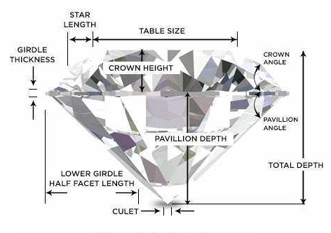
Anatomy of Diamonds

Slide 8
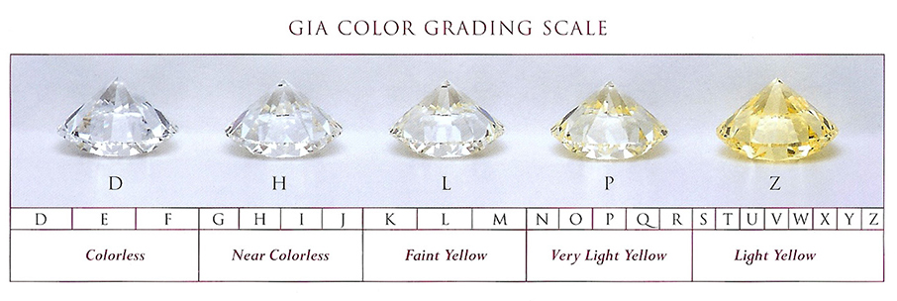
Color of Diamonds

Slide 9
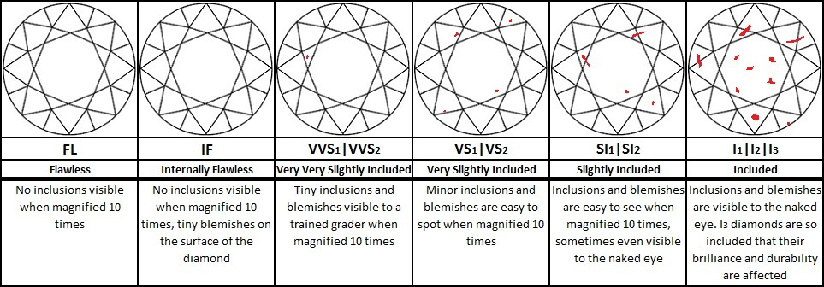
Clarity of Diamonds

Slide 10
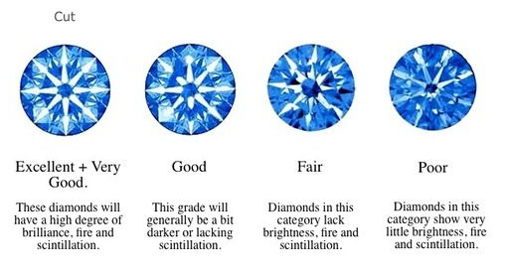
Cut of Diamonds

Slide 11
Model :
Linear Regression
Lasso Regression
Decision Tree Regressor
Random Forest Regressor
KNN Regressor

Slide 12
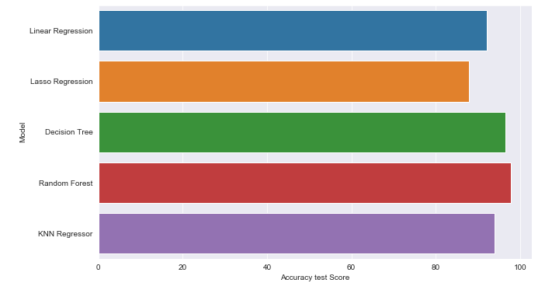
Conclusion
Best Model for Predicting Diamonds Price Using Random Forest Regressor

Slide 13
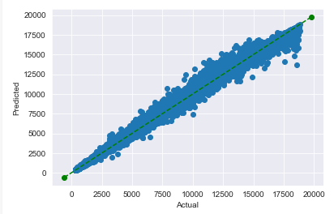

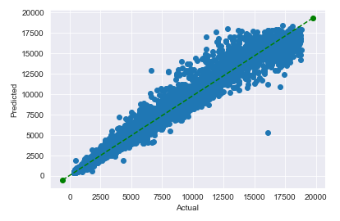
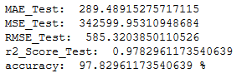
Random Forest Regressor
Random Forest Train :
Random Forest Test :

Slide 14
Conclusion :
Model Random Forest Regressor bisa dipakai tetapi ada sekitar 190 data yg angka errornya berselisih 2500 keatas. Dan error berada di kisaran karat 1 sampai dengan 3 dengan range harga diatas 4000

Slide 15
Bibliography :
https://www.kaggle.com/shivam2503/diamonds
https://www.gia.edu/diamond-quality-factor
https://www.lumeradiamonds.com/diamond-education/diamond-cut

