Slide 1
Graphene
Team
Adith Tekur Srinivasamurthy
(Codemonkey)
Neha Rastogi
(Codemonkey)
Pooja Kalpana Prakash
(Codemonkey)
Sarah Panda
(Codemonkey)
Sumiran Rajesh Shah
(Codemonkey)
So what’s the most efficient way to spam all your Facebook friends?

Slide 2
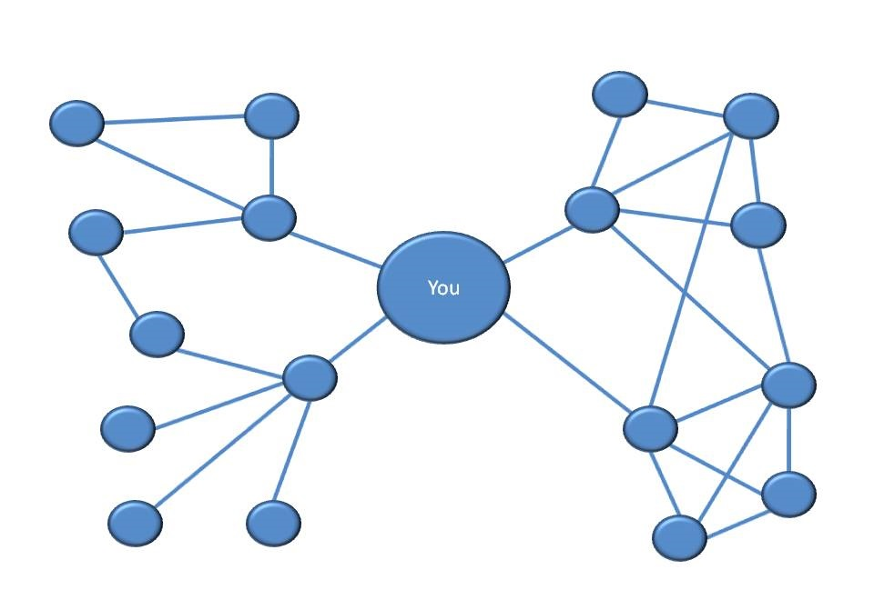
Why Graphene
Web 2.0. Cloud. Big Data. Social Networking.
Need to analyze common patterns, find trends
Useful for advertisers, market researchers, beginner programmers who just need another language with easy to use graph interfaces

Slide 3
What Graphene
Graphene is:
Duck-typed
Interpreted
Concise
High level
Graphene enables users to perform common and complex graph manipulations on user defined or imported data
Graphene features a visualization library to display graphs or input them manually
Graphene can be invoked by a REPL to perform small, quick operations

Slide 4
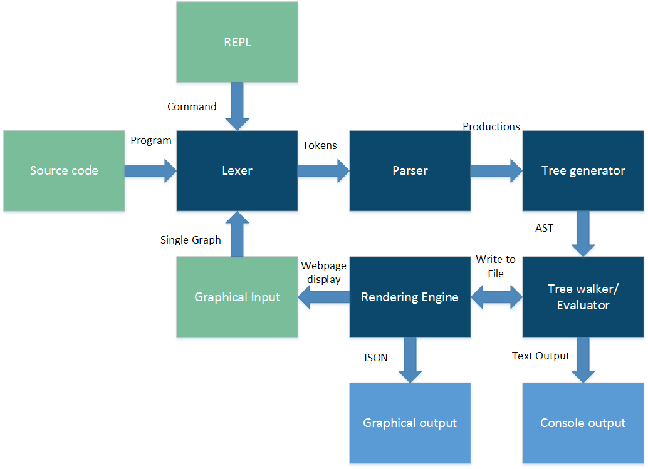
How Graphene
Flow diagram

Slide 5
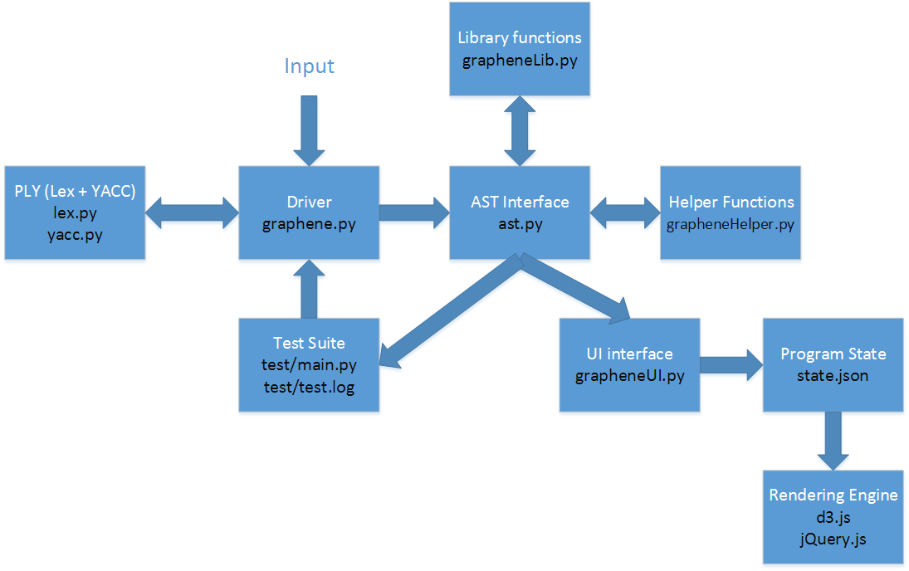
How Graphene
Compiler and supporting architecture

Slide 6
Writing Graphene
No main function. Script is executed line by line
Dynamically typed data
Specialized Graph and Node data types and operations
Features basic constructs such as if, for, foreach, while, functions
More advanced constructs such as multiple return arguments, lambdas(first class functions), inbuilt libraries for clustering nodes, graph manipulation

Slide 7
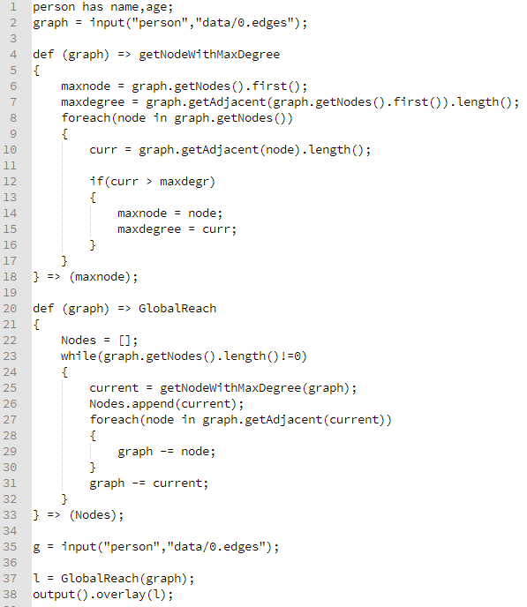
Code Example
Define a type of node of type person and read file dump
User function to find the node with max degree from a graph
Return maxnode variable
List type
Node removal operator
Visualize!

Slide 8
More Code

Slide 9
Demo

Slide 10



Development Environment
v/s

Slide 11




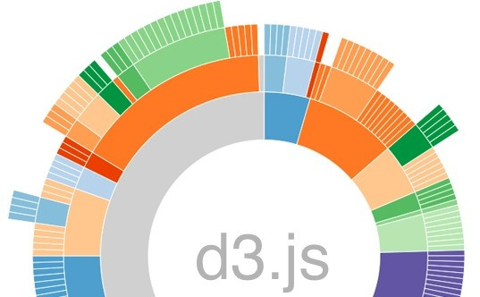
Cross platform tools and technologies

Slide 12
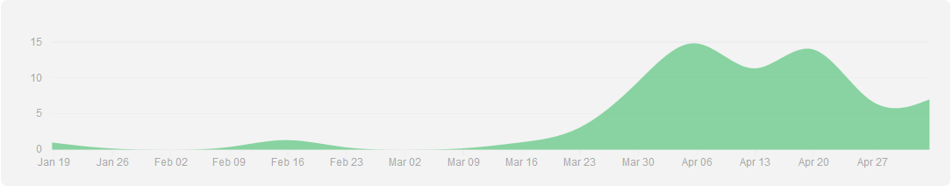
Project Management

Slide 13
gexit()
~~What we would do better~~
~~What we would stick to~~

