Slide 1
Dissertation Project
Customer Life Time Value In Indian Consumer Markets
Adith Naren Kadadi | MBA – AI & DS, Semester 4 | 1RUB24MBA0003
Under Guidance Ms. Suma Mn
Associate Professor

Slide 2
Businesses often waste resources chasing low-potential segments; this study aims to redirect marketing budgets toward "look-alike" audiences who share high-value characteristics.
Introduction
Business Context
Objective
Mass marketing in a fractured market like India is costly and often ineffective; CLTV identifies high-value segments for precision targeting.
It shifts the perspective from historical transaction tracking to treating customers as future financial assets
CLTV is a metric that captures the total value a customer brings to a brand throughout their entire lifetime relationship
The findings from this research provide businesses with precisely the level of targeting accuracy that will enable them to identify and grow high value customer segments
India is shifting from a focus on single, target-shot sales to a strategic compass model that treats households as future financial assets to ensure long-term business sustainability.
Retaining an existing customer is five times more cost-effective than winning a new one, making the identification of high-value segments critical for reducing Customer Acquisition Cost (CAC).
Businesses often waste resources chasing low-potential segments; this study aims to redirect marketing budgets toward "look-alike" audiences who share high-value characteristics.
With over 60% of national consumption originating from metropolitan areas, organizations must precisely understand the socio-economic foundations such as education, digital literacy, and asset ownership that drive future spending.

Slide 3
Literature Review
Sl. No. | Research Paper Name | Content | Analysis | Research Gap | Dissertation Covered
1 | Berger & Nasr (1998) | Defined CLTV as the present value of all expected profits from a customer over their relationship life cycle | Argued for a shift from mass marketing to a segmented, customer-driven approach. | Foundational research is primarily rooted in Western contractual markets (like subscriptions). | Moved beyond contractual definitions to model fragmented and non-contractual Indian retail.
2 | Fader, Hardie & Lee (2005) | Introduced probabilistic models (BG/NBD) to predict future behavior based on purchase frequency and recency. | Proved that statistically viable "alive" probabilities can be attained with relatively few data points. | Relies on longitudinal transaction data, which breaks down in diverse markets with many socio-economic factors. | Transitioned from traditional probabilistic models to cutting-edge machine learning (XGBoost) for segmentation.
3 | Benoit & Van den Poel (2009) | Explored ensemble methods like Random Forest to handle non-linear relationships in consumer attributes | Identified that demographic predictors significantly improve classification accuracy into value tiers. | Models often ignore non-transactional factors like digital literacy and standardized asset-based wealth | Closed the Feature Integration Gap by adding an "Online Score" and an "Asset Score" as value multipliers.
4 | Khare(2011) | Studied how education and geography drive the acceptance of modern retail formats in India | Found that spending moves from survival services to luxury as consumers climb the economic ladder | Existing literature focuses on descriptive statistics rather than using drivers for predictive classification | Used socio-economic drivers to build a predictive framework that classifies households into specific value tiers
5 | Venkatesan & Kumar(2004) | Provided a framework for resource allocation based on predicted future value rather than past behavior. | Showed that firms using predictive CLV models achieve significantly higher returns on investment | There is an Asset Standardization Gap; it is difficult to find a stable wealth proxy across diverse regional land units. | Created a technical conversion logic to map disparate land units into a standardized "Total Square Footage" aggregate.
6 | Modigliani & Brumberg (1954) | Developed the Life-Cycle Hypothesis, where consumption is smoothed over an individual's lifetime. | Recognized that a customer's value is constrained by their biological and economic life stages. | Most models suffer from the "Infinite Horizon Flaw," assuming linear systems or infinite loyalty. | Applied the "Remaining Life Concept" using SRS mapping to bound estimates by realistic biological life-cycles

Slide 4
Research Methodology
Research Design
a quantitative, descriptive approach using secondary data to analyze consumption patterns across the entire Indian consumer market.
Data Source
the Household Consumer Expenditure Survey (HCES) from the Ministry of Statistics and Program Implementation (MOSPI), covering diverse demographics across India.
https://microdata.gov.in/NADA/index.php/catalog/237
Data Synthesis
Involves merging high-dimensional datasets into a single master file, followed by rigorous data cleaning, outlier treatment, and normalization and by converting various measurements and extracting metrics.
Using heatmaps, distribution plots, and cross-tabulations to identify patterns based on region, sector, education, and gender.
EDA
Using PCA for feature redundancy implemented K-Means Clustering and deployed the XGBoost algorithm to build a predictive model, achieving a classification accuracy of 70% in assigning households to CLTV segments with validation techniques like confusion matrix and classification report
Segmentation & Model Building

Slide 5
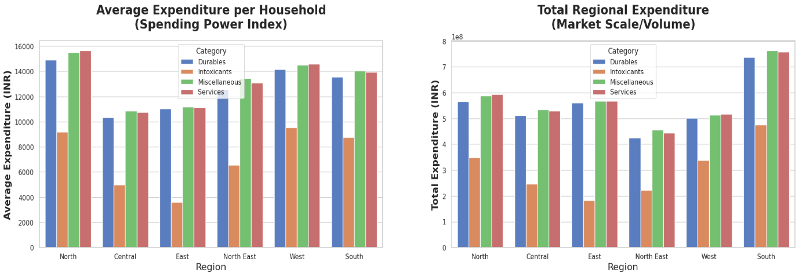
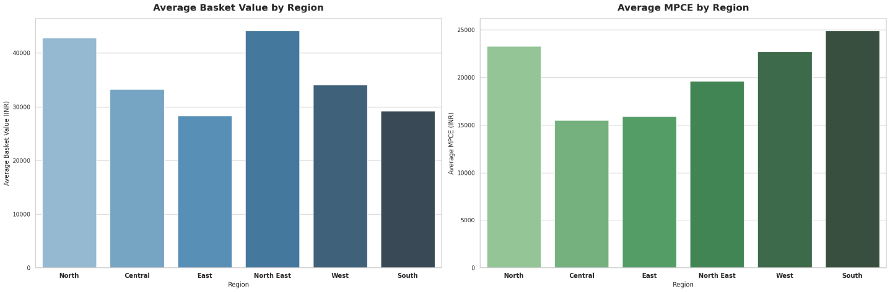
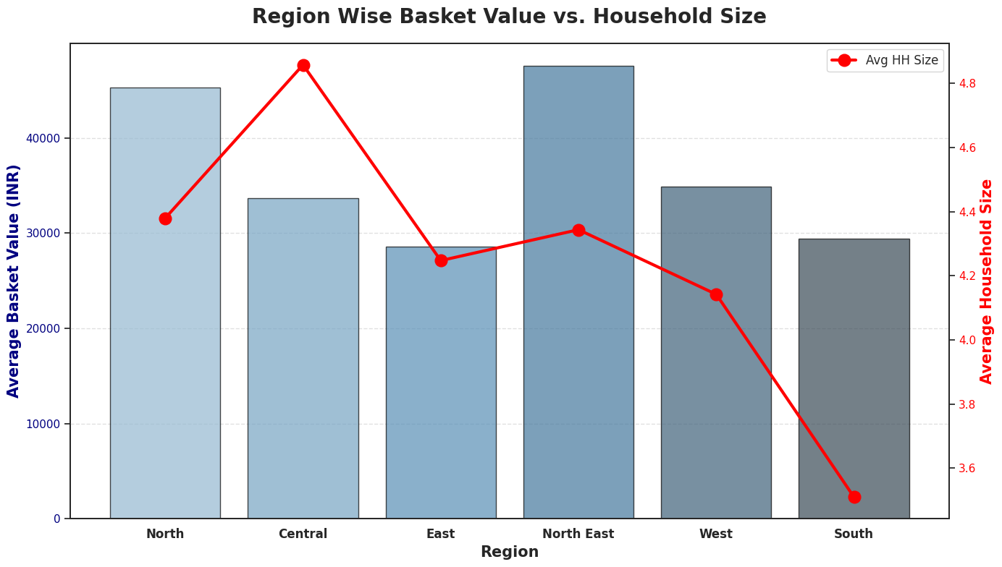
Data Analysis
Regional Analysis
South for high individual spending and the North for large family purchases. These regions offer the best long-term value because customers spend more frequently on premium services and goods.
East and West have lower individual spending but a massive total market size.
Smaller households in the South spend more per person, while large families in the North buy more durables.
Most regions spend heavily on Miscellaneous and Services, showing a shift toward lifestyle and comfort

Slide 6
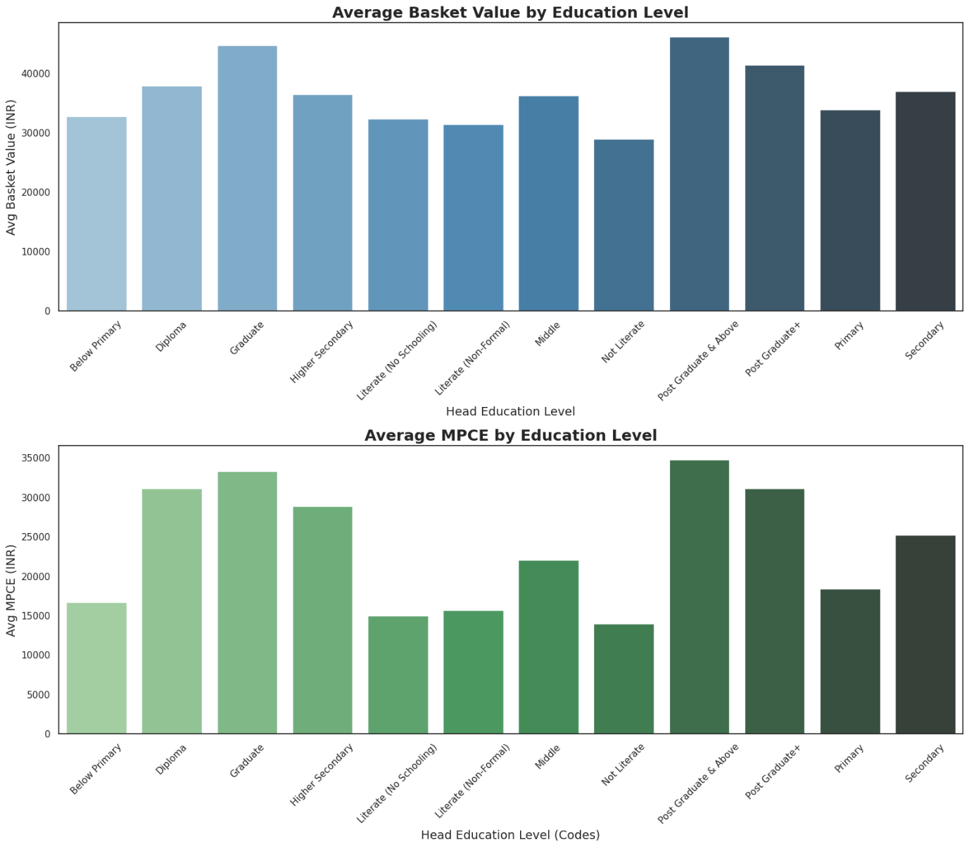
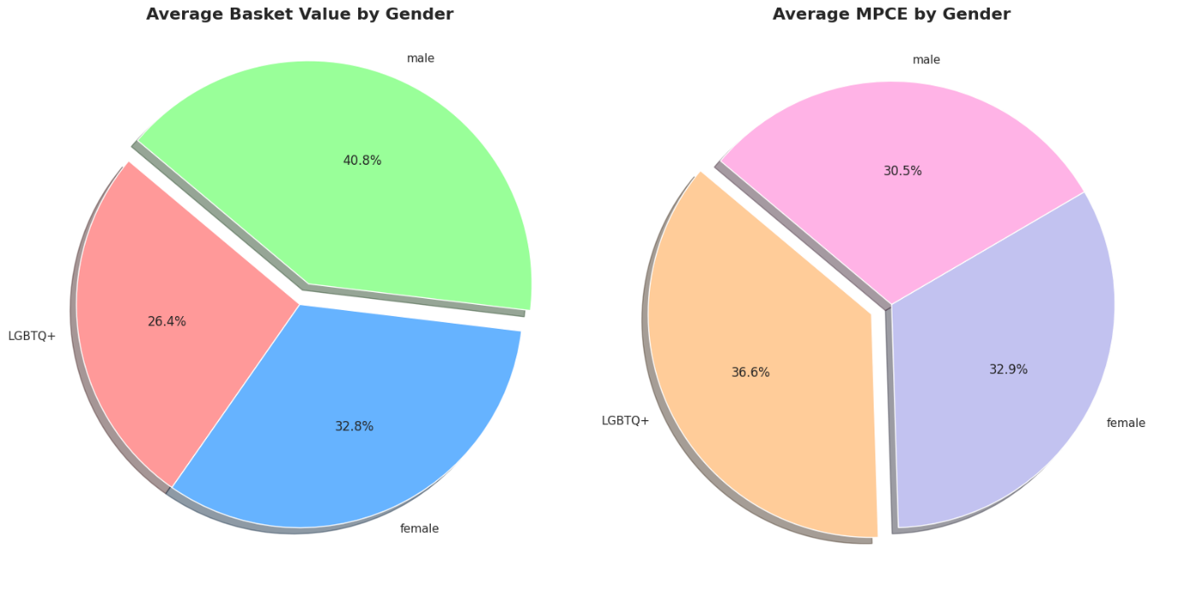
Data Analysis
Demographic Analysis
It is very evidently visible higher the education higher the basket value and MPCE this indicates that education is the primary driver for high clv.
Graduates and those with higher secondary education show a strong, steady basket value of over 35,000 INR
one-time purchases (like appliances) should focus on the male segment, while lifestyle and frequent-use services should target the LGBTQ+ and female segments to capture their higher per-capita spending.
Since the Female Market is the most stable it indicates most households are female led purchases

Slide 7
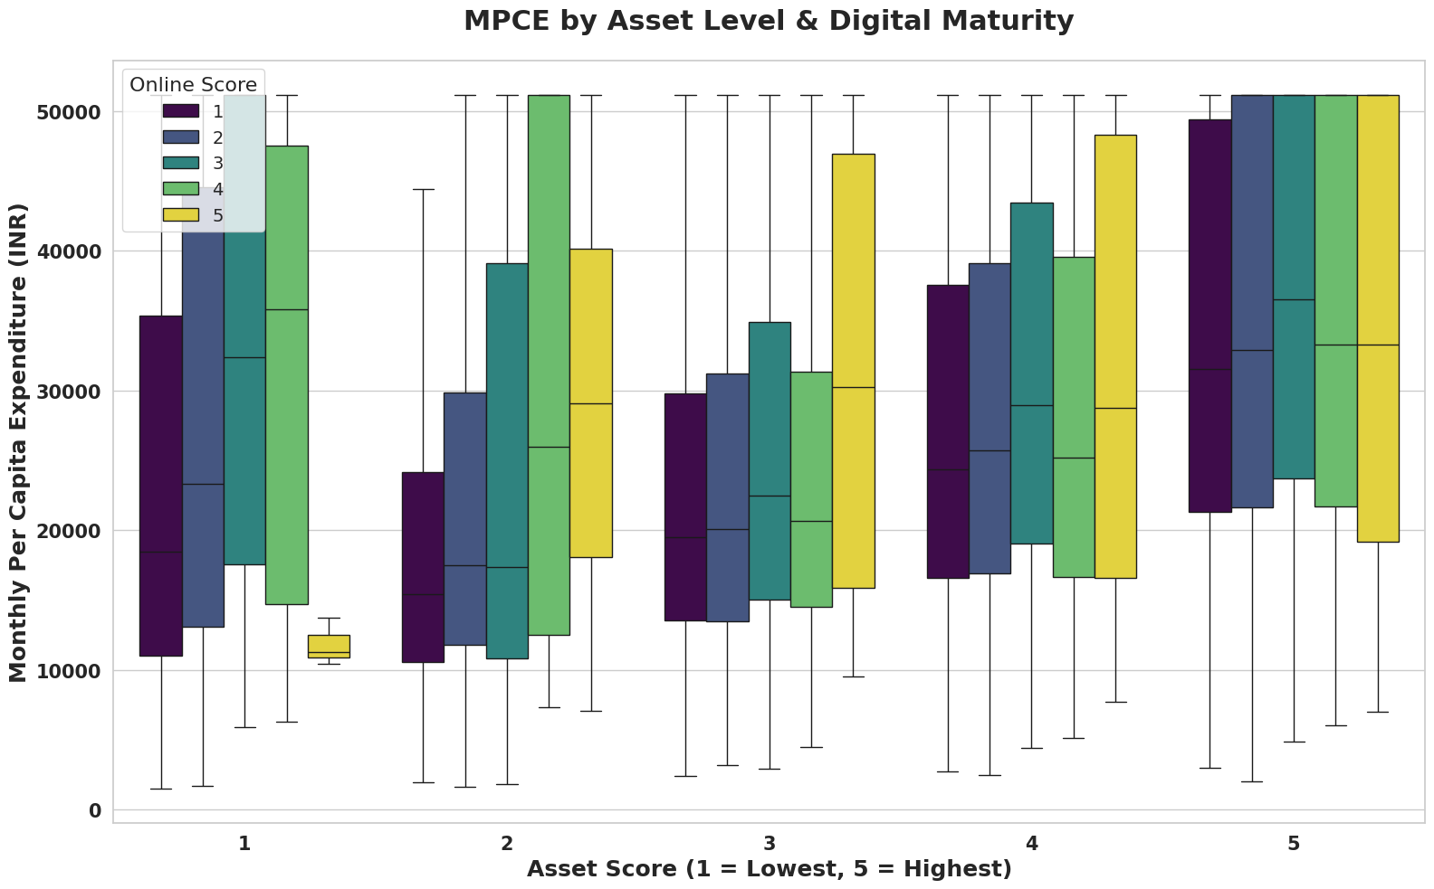
Data Analysis
Digital Analysis
the graph describes even with low asset score if the households are digitally equipped the expenditure on the asset score has more impact leading to increase in purchases.
we also observe households with an online score between 2-4 have higher expenditure and are most valuable customers.
we also observe households with an online score between 2-4 have higher expenditure and are most valuable customers.
Businesses should focus marketing budgets on users with an Online Score of 4 or 5. They provide the best Customer Lifetime Value

Slide 8
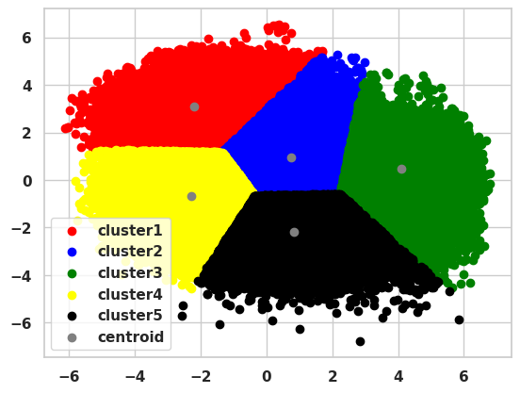
Data Analysis
Cluster Analysis
C1
C2
C3
C4
C5
Young nuclear HH, high MPCE, 46 remaining years. Future gold-mine consumers.
Mid-aged nuclear families, consistent shoppers trending toward High Value.
Highest CLTV. Mature adults with highest affordability most profitable cluster.
Price-conscious mature families. Essential-needs buyers with limited savings.
Largest joint families, bulk buyers with limited years bundle purchase pattern.
Clusters | hh_size | head_age | total_basket_value | mpce | expected_remaining_years | CLTV | CLTV Type
1 | 1.730248 | 28.174379 | 24039.728909 | 33551.380573 | 46.400327 | 3.964224e+06 | High Value Asset
2 | 3.725133 | 42.672449 | 41932.872535 | 32490.545949 | 33.506614 | 3.663947e+06 | Emerging Asset
3 | 4.445821 | 49.194870 | 56586.368965 | 44633.599416 | 28.174056 | 4.797810e+06 | High Value Asset
4 | 4.374490 | 50.599037 | 36058.805363 | 13722.838871 | 26.684829 | 1.458884e+06 | Budgeted Asset
5 | 5.891834 | 61.843302 | 56415.053546 | 19624.808790 | 17.913109 | 1.806224e+06 | Budgeted Asset

Slide 9
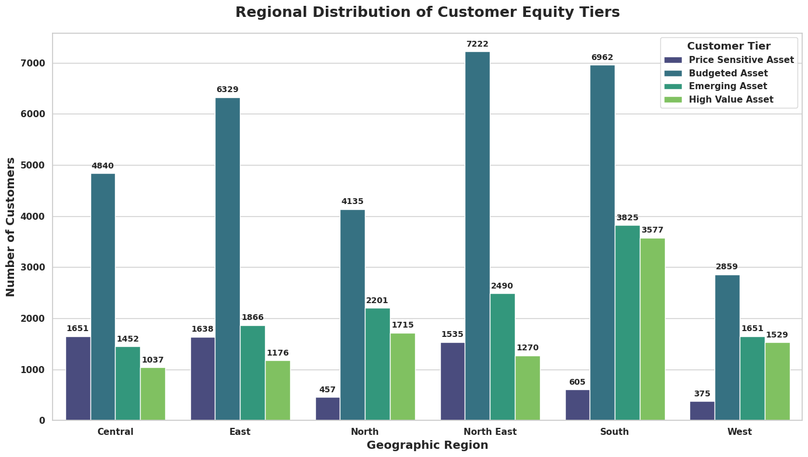
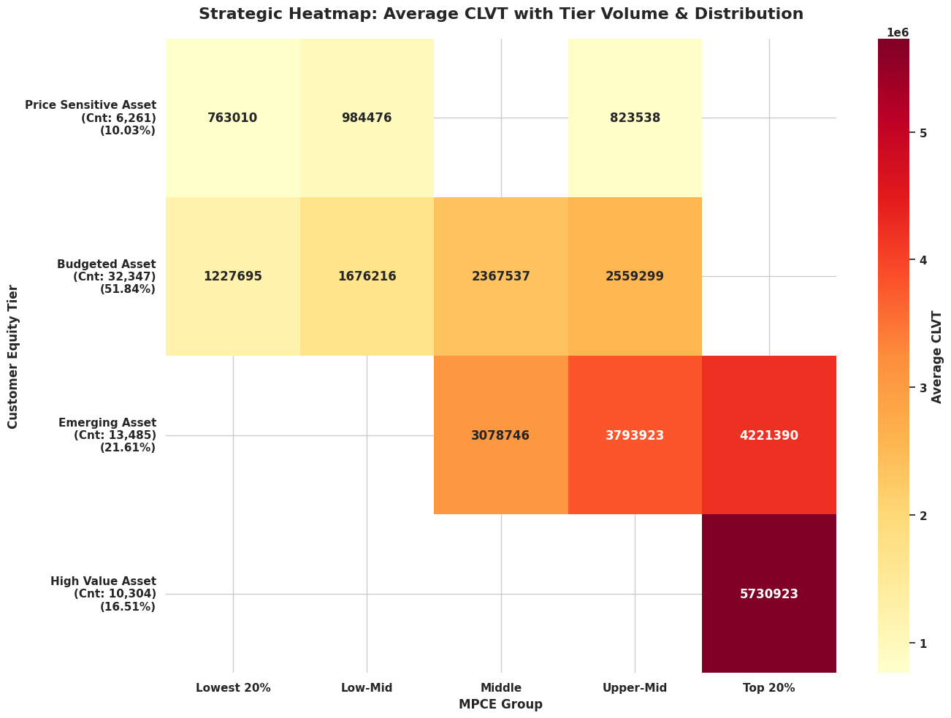
Key Findings
The South has the highest concentration of Emerging and High Value assets. Since these tiers correlate with the heatmap
The heatmap shows that as customers move from Price Sensitive to High Value, their lifetime value jumps from 760k to 5.7M INR
The Top 20% of spenders (MPCE) contribute a staggering 5.7M INR in CLVT, which is over 7 times more than the lowest group.
The East and North East have the largest number of "Budgeted Asset" customers. Marketing here should focus on high-volume, low-cost goods to capture this massive middle-tier audience

Slide 10
Conclusion & Recommendations
Conclusion
To maximize profitability in the Indian market, businesses must replace broad marketing with precise segmentation into four tiers: Price Sensitive, Budgeted, Emerging, and High Value Assets. For long-term value, brands should focus their messaging on female heads of households, who act as the primary decision-makers in domestic spending. firms should invest in high-touch loyalty programs for the High Value and Emerging segments to secure massive lifetime returns. Conversely, low-cost, value-driven campaigns should be used for Price Sensitive tiers to keep acquisition costs low which could lead to low customer acquisition cost.
Recommendation
Targeted Marketing - Since women make most of the shopping choices at home, businesses should target their ads specifically to them. This simple shift lowers the cost of finding new customers and builds much better long-term loyalty and sales. Also, on the consumer with high education levels since they form the complete high customer segment.
Budgeted Segmentation – Lower middle and Middle class is India's largest group and main source of steady income. Instead of pushing for one-time expensive sales, use loyalty subscriptions and bulk discounts to keep them buying frequently, turning their massive numbers into reliable, long-term profit.
Premium Profiling - high value customers buy based on status and comfort, regardless of the economy. To keep them loyal, businesses must offer Platinum access and exclusive perks that make the brand a permanent part of their luxury lifestyle.
South and West as your high-profit digital hubs and the North as your market for physical growth the East and Central regions as your volume engine these areas may have lower spending per person, but their huge population is perfect for selling everyday items at scale.

