Slide 1
ADO.NET
A Brief :
ADO.NET provides a bridge between the front end controls and the back end database. The ADO.NET objects encapsulate all the data access operations and the controls interact with these objects to display data, thus hiding the details of movement of data.

Slide 2
What is ADO.NET?
ADO stands for ActiveX Data Objects
ADO.NET is a database technology of .NET Framework used to connect application system and database server.
ADO.NET is a part of the .NET Framework
ADO.NET consists of a set of classes used to handle data access
ADO.NET uses XML to store and transfer data among applications, which is not only an industry standard but also provide fast access of data for desktop and distributed applications.
ADO.NET is scalable and interoperable.

Slide 3
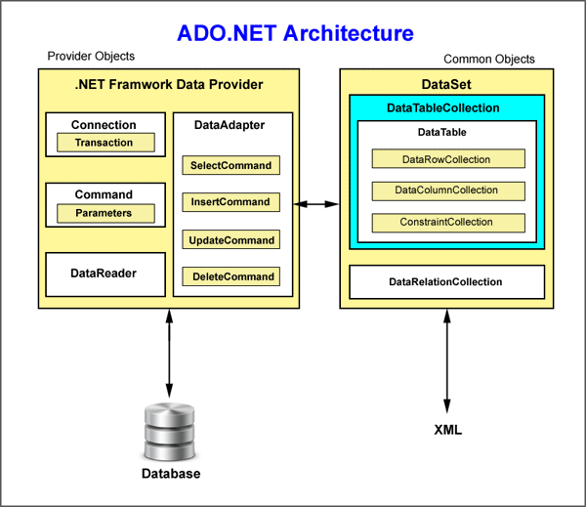

Slide 4
Advantages of ADO.Net
Single Object-oriented API
ADO.NET provides a single object-oriented set of classes. There are different data providers to work with different data sources but the programming
model for all these data providers work in the same way. You should be aware of only one data provider. You just need to change class names and connection strings.
The ADO.NET classes are easy to use and understand, as they are object-oriented in nature.
Managed Code
The ADO.NET classes are managed classes. CLR takes care of language independency and automatic resource management.

Slide 5
Deployment
Microsoft uses MDAC (Microsoft Data Access Component), which is used as ActiveX component in .NET Framework (X is extensible component, when X is written
after a term means extensible). .NET components takes care of deployment which was difficult previous technologies used in deployment.
XML Support
ADO.NET data is cached and transferred in XML (EXtensible Markup Language) format. XML provide fast access of data for desktop and distributed applications.
XML is plain text designed to transport and store data and is self-descriptive.

Slide 6
Visual Data Components
.NET offers ADO.NET components and data-bound control to work in visual form. You can use these components without writing long codes and can achieve result in no time.
Performance and scalability
Performance and scalability are two major factors when developing web-based application and services. Disconnected cached data in XML help in performance and scalability.

Slide 7
Various Connection Architectures
There are the following two types of connection architectures:
Connected architecture: the application remains connected with the database throughout the processing.
Disconnected architecture: the application automatically connects/disconnects during the processing. The application uses temporary data on the application side called a DataSet.

Slide 8
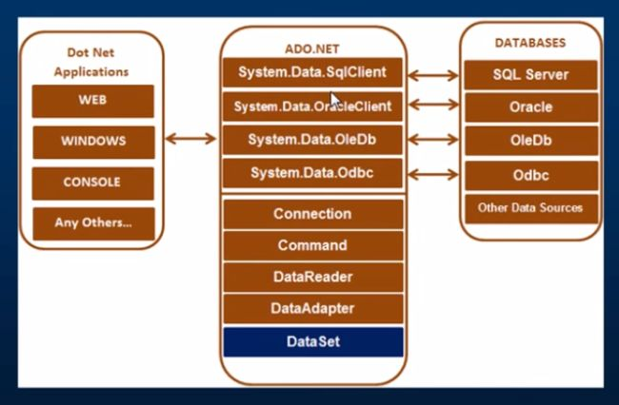
Understanding ADO.NET and its class library

Slide 9
Important Classes in ADO.NET
Connection Class
Command Class
DataReader Class
DataAdapter Class
DataSet.Class

Slide 10
Classes in ADO.Net
Connection Class In ADO.NET, we use these connection classes to connect to the database. These connection classes also manage transactions and connection pooling. 2. Command Class The Command class provides methods for storing and executing SQL statements and Stored Procedures. The following are the various commands that are executed by the Command Class.
ExecuteReader: Returns data to the client as rows. This would typically be an SQL select statement or a Stored Procedure that contains one or more select statements. This method returns a DataReader object that can be used to fill a DataTable object or used directly for printing reports and so forth.
ExecuteNonQuery: Executes a command that changes the data in the database, such as an update, delete, or insert statement, or a Stored Procedure that contains one or more of these statements. This method returns an integer that is the number of rows affected by the query.

Slide 11
Classes in ADO.Net contd..
DataReader Class The DataReader is used to retrieve data. It is used in conjunction with the Command class to execute an SQL Select statement and then access the returned rows. 4. DataAdapter Class The DataAdapter is used to connect DataSets to databases. The DataAdapter is most useful when using data-bound controls in Windows Forms, but it can also be used to provide an easy way to manage the connection between your application and the underlying database tables, views and Stored Procedures.

Slide 12
Classes in ADO.Net contd..
DataSet Class
The DataSet is the heart of ADO.NET. The DataSet is essentially a collection of DataTable objects. In turn each object contains a collection of DataColumn and DataRow objects. The DataSet also contains a Relations collection that can be used to define relations among Data Table Objects.

Slide 13
DbCommand and DbConnection Objects
The DbConnection object represents a connection to the data source. The connection could be shared among different command objects.
The DbCommand object represents the command or a stored procedure sent to the database for retrieving or manipulating data.

Slide 14
To Connect to the Database
A connection string is required as a parameter to SQLConnection. A ConnectionString is a string variable (not case sensitive). This contains key and value pairs, like provider, server, database, userid and password as in the following:
Server="nameof the server or IP Address of the server" Database="name of the database" userid="user name who has permission to work with database" Password="the word of userid“
Example : SQL Authentication String constr="server=.;database=institute;user id=newuser123#;word=password"; Or: String constr="data source=.;initial catalog=institute;uid=newuser123#;pwd=password";

Slide 15
Windows Authentication String constr="server=.;database=institute;trusted_connection=true" Or: String constr="server=.;initial catalog=institute;integrated security=true"

Slide 16
Retrieve and display data from a database
Procedure:
You must use the System.Data.SqlClient namespace
Create a SqlConnection object using a connection string.
Handle exceptions.
Open the connection.
Create a SQLCommand. To represent a SQLCommand . Specify the type of SQLCommand (text/storedprocedure).
Execute the command (use executereader).
Get the Result (use SqlDataReader). This is a forwardonly/readonly dataobject.
Close the connection
Process the result
Display the Result

Slide 18
Entity Framework
Entity Framework is an open-source ORM framework for .NET applications supported by Microsoft. It enables developers to work with data using objects of domain specific classes without focusing on the underlying database tables and columns where this data is stored. With the Entity Framework, developers can work at a higher level of abstraction when they deal with data, and can create and maintain data-oriented applications with less code compared with traditional applications.

Slide 19
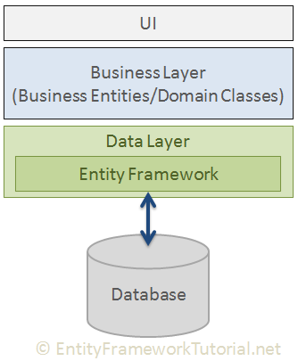
EF - Basic Architecture

Slide 20
Entity Framework Features
Cross-platform: EF Core is a cross-platform framework which can run on Windows, Linux and Mac.
Modelling: EF (Entity Framework) creates an EDM (Entity Data Model) based on POCO (Plain Old CLR Object) entities with get/set properties of different data types. It uses this model when querying or saving entity data to the underlying database.
Querying: EF allows us to use LINQ queries (C#/VB.NET) to retrieve data from the underlying database. The database provider will translate this LINQ queries to the database-specific query language (e.g. SQL for a relational database). EF also allows us to execute raw SQL queries directly to the database.

Slide 21
Change Tracking: EF keeps track of changes occurred to instances of your entities (Property values) which need to be submitted to the database.
Saving: EF executes INSERT, UPDATE, and DELETE commands to the database based on the changes occurred to your entities when you call the SaveChanges() method. EF also provides the asynchronous SaveChangesAsync() method.
Concurrency: EF uses Optimistic Concurrency by default to protect overwriting changes made by another user since data was fetched from the database.
Transactions: EF performs automatic transaction management while querying or saving data. It also provides options to customize transaction management.

Slide 22
Caching: EF includes first level of caching out of the box. So, repeated querying will return data from the cache instead of hitting the database.
Built-in Conventions: EF follows conventions over the configuration programming pattern, and includes a set of default rules which automatically configure the EF model.
Configurations: EF allows us to configure the EF model by using data annotation attributes or Fluent API to override default conventions.
Migrations: EF provides a set of migration commands that can be executed on the NuGet Package Manager Console or the Command Line Interface to create or manage underlying database Schema.

Slide 23
EF - API
The very first task of EF API is to build an Entity Data Model (EDM). EDM is an in-memory representation of the entire metadata: conceptual model, storage model, and mapping between them.

Slide 24
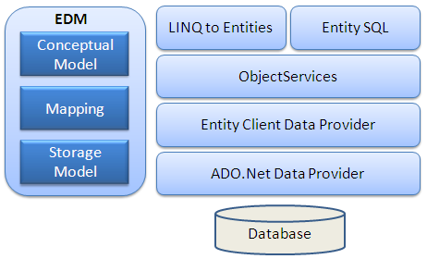
EF – In Depth Architecture

Slide 25
Conceptual Model: The conceptual model contains the model classes and their relationships. This will be independent from your database table design.
Storage Model: The storage model is the database design model which includes tables, views, stored procedures, and their relationships and keys.
Mapping: Mapping consists of information about how the conceptual model is mapped to the storage model.

Slide 26
LINQ to Entities: LINQ-to-Entities (L2E) is a query language used to write queries against the object model. It returns entities, which are defined in the conceptual model. You can use your LINQ skills here.
Entity SQL: Entity SQL is another query language (For EF 6 only) just like LINQ to Entities. However, it is a little more difficult than L2E and the developer will have to learn it separately.
Object Service: Object service is a main entry point for accessing data from the database and returning it back. Object service is responsible for materialization, which is the process of converting data returned from an entity client data provider (next layer) to an entity object structure.

Slide 27
Entity Client Data Provider: The main responsibility of this layer is to convert LINQ-to-Entities or Entity SQL queries into a SQL query which is understood by the underlying database. It communicates with the ADO.Net data provider which in turn sends or retrieves data from the database.
ADO.Net Data Provider: This layer communicates with the database using standard ADO.Net.

Slide 28
Development Approaches with Entity Framework
There are three different approaches you can use while developing your application using Entity Framework:
Database-First - In the database-first development approach, you generate the context and entities for the existing database using EDM wizard integrated in Visual Studio or executing EF commands.
Code-First - Use this approach when you do not have an existing database for your application. In the code-first approach, you start writing your entities (domain classes) and context class first and then create the database from these classes using migration commands.

Slide 29
Model-First - In the model-first approach, you create entities, relationships, and inheritance hierarchies directly on the visual designer integrated in Visual Studio and then generate entities, the context class, and the database script from your visual model.
Persistence in Entity Framework
There are two scenarios when persisting (saving) an entity to the database using Entity Framework:
The Connected Scenario and
The Disconnected Scenario.

