Slide 1
Category review: Chips
June 2020
Retail Analytics
Brand note: If client logo is not required, use alternate title page layout right click slide thumbnail > Layout > Title

Slide 2
Notes:
To view Privacy video explaining how important data privacy is to Quantium, please click here: https://www.youtube.com/watch?v=Zq1QDAkoRzU
or here Q:\Company Reference\Brand & Design\Brand videos\Q Privacy.mp4
At Quantium, we believe that data is the behavioural footprint of humanity and that it has to be treated with the utmost care and responsibility.
Histories, attitudes, indeed lives are stored within it in ways that aren’t always apparent – and that’s what makes its potential so powerful.
To work with it responsibly, sensitively, we set ourselves the highest data privacy protection and governance standards.
We have spent 17 years perfecting privacy-by-design and secure-by-design principles. Central to this is not holding any personally identifiable information about people –
we neither receive it, and put the necessary protections in place to be unable to decipher it.
Every aspect of handling data is safeguarded: from its de-identification, to its encryption – data security is paramount and of the highest grade.
We pride ourselves on gaining the trust of iconic organisations around the world through years of securely working with their data,
and in turn the trust that builds with their stakeholders.

Slide 3
Executive summary
01
Chip Category Review
Chip sales are concentrated among family and older life-stage customers, primarily driven by higher repeat purchasing rather than larger basket sizes.
Pack size and brand preferences remain stable across customer segments, indicating limited opportunity to drive growth through mix changes alone.
Purchase frequency varies meaningfully by life stage, making customer behavior a more effective growth lever than pricing or pack size.
02
Trial Store Analysis
Trial stores demonstrated a positive and sustained uplift in performance compared to matched control stores.
The uplift aligns with customer segments identified as high-frequency purchasers in the category analysis.
Results support extending the trial strategy to additional stores with similar customer profiles.

Slide 4
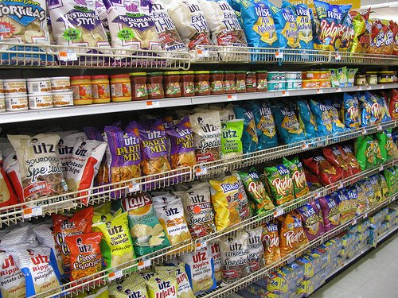
01
Category Analysis
This Photo by Unknown Author is licensed under CC BY-NC-ND

Slide 5
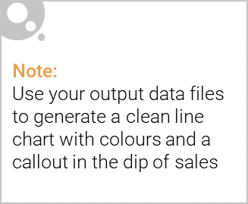
Chip transactions have remained stable over the past year, with a seasonal uplift around Christmas

Slide 6

Affluence has minimal impact, while family shoppers purchase the highest units per transaction
Snack Food - Chips – Average units per transaction by affluence and life stage profile

Slide 7
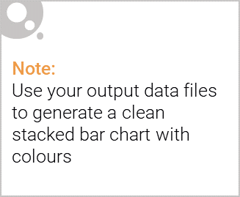
Editable (delete this)
Mainstream Young Singles & Couples make up the largest proportion of Snacking Chips shoppers; Mainstream Retirees also have a significant share
Snack Food - Chips – Proportion of Customers by affluence and life stage profile
Proportion of customers

Slide 8

02
Trial store performance

Slide 9
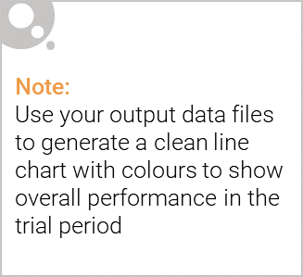
The control store is constructed to reflect performance of the trial store rather than the average of other stores
Snack Food - Chips – Avg monthly store sales over time
Sales

Slide 10
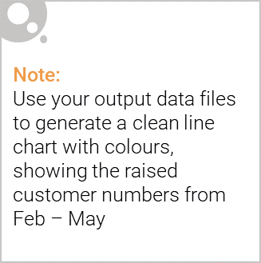
From Feb to May the trial store outperformed the control store highlighting the success of the new store layout
Snack Food – Chips – Number of customers over time
Number of customers

