Slide 1




DOG BREED DETECTION AND GAME
Adith Singh

Slide 2

Project Objectives
Problem Statement
Project Overview – Introduction
End Users
Wow Factor in Project
Modelling/Block Diagram/Flow of Project
Result/outcomes
Conclusion
Future Perspective

Slide 3
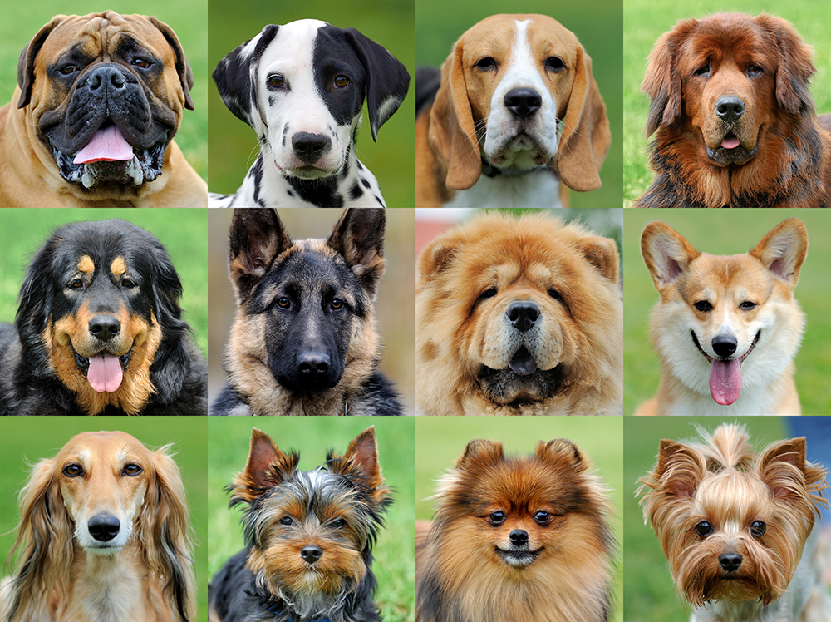
Problem Statement
Identifying dog breeds accurately can be challenging, especially for new pet owners, shelters, and veterinarians. Many people struggle to recognize the breed of a dog based on appearance alone, leading to difficulties in breed-specific care, training, and adoption. Traditional methods rely on expert opinions or generic image searches, which can be inaccurate and time-consuming.

Slide 4
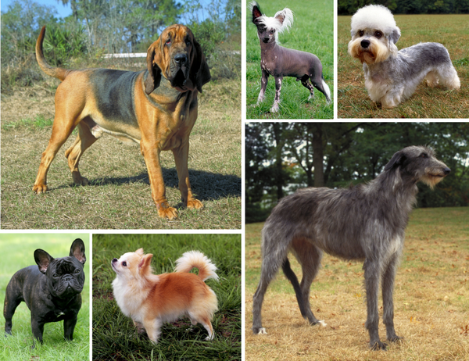
Project overview - Introduction
The Dog Breed Detector is a deep learning-powered web application that accurately identifies dog breeds from user-uploaded images. Using Convolutional Neural Networks (CNNs) and a pretrained InceptionV3 model, the system classifies dogs into 70-80 different breeds with high accuracy. The application is deployed using Streamlit, making it accessible via a simple web interface.
This Photo by Unknown Author is licensed under CC BY-SA

Slide 5
End User
Pet Owners – Identify their dog’s breed for better care.
Animal Shelters – Classify breeds to assist in adoption.
Veterinarians & Trainers – Offer breed-specific recommendations.
Dog Enthusiasts – Learn more about different breeds.

Slide 6
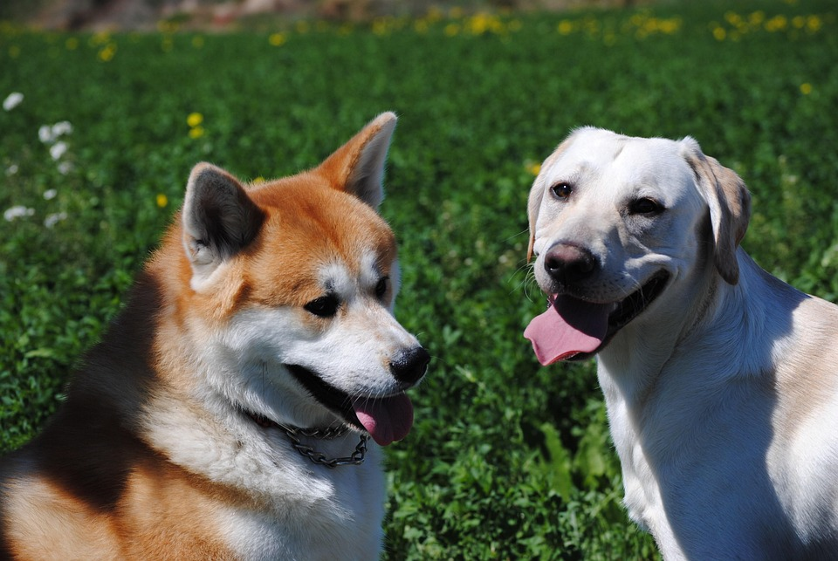
Wow Factor in Solution
Our solution provides an AI-powered image classification system that allows users to: 1. Upload an image of a dog. 2. Receive instant breed predictions with confidence scores. 3. Access an easy-to-use web interface for quick identification. 4. Improve accuracy with a continuously trained model.

Slide 7
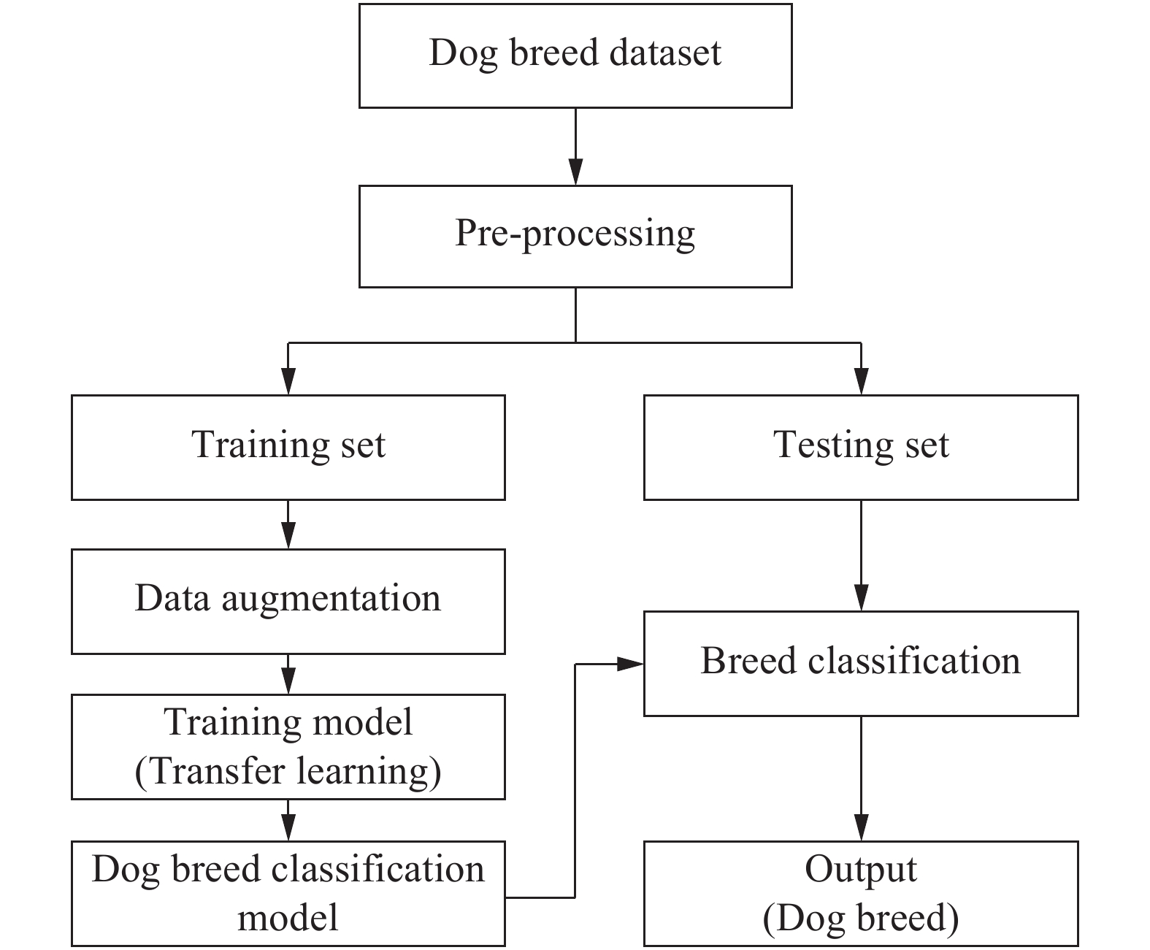
Modelling
​

Slide 8
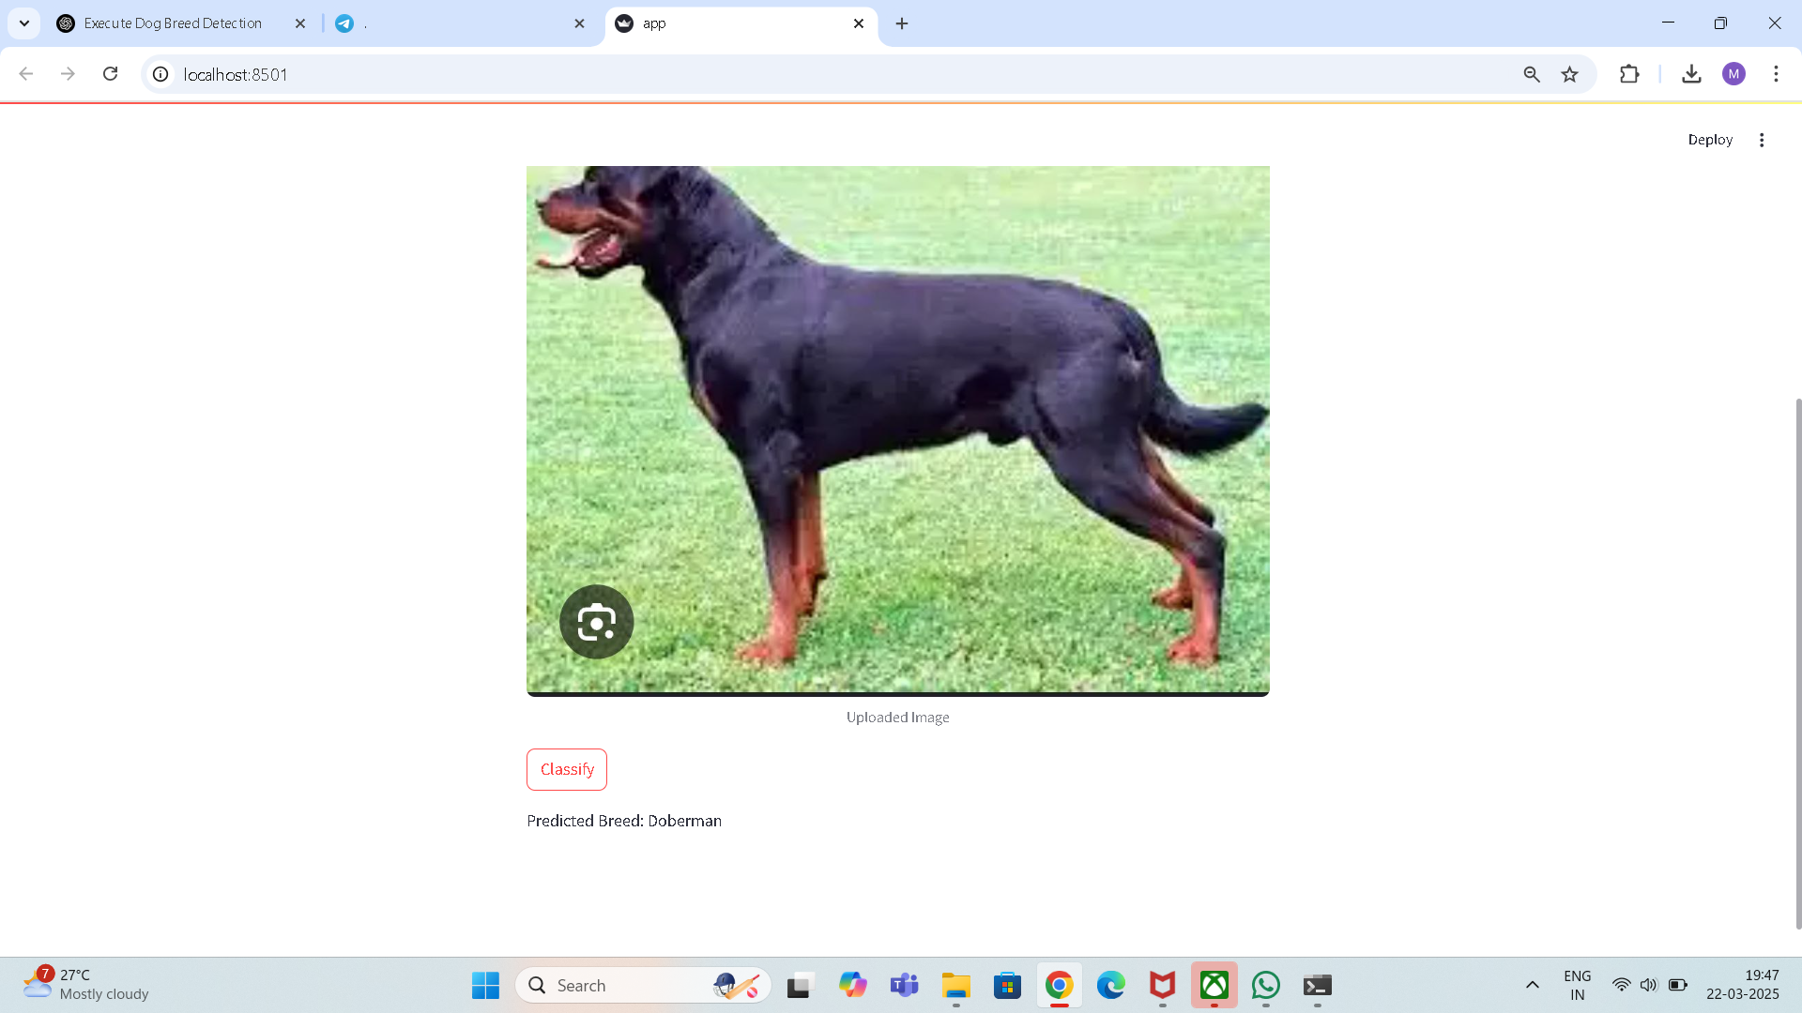

Result / Outcomes
​

Slide 9
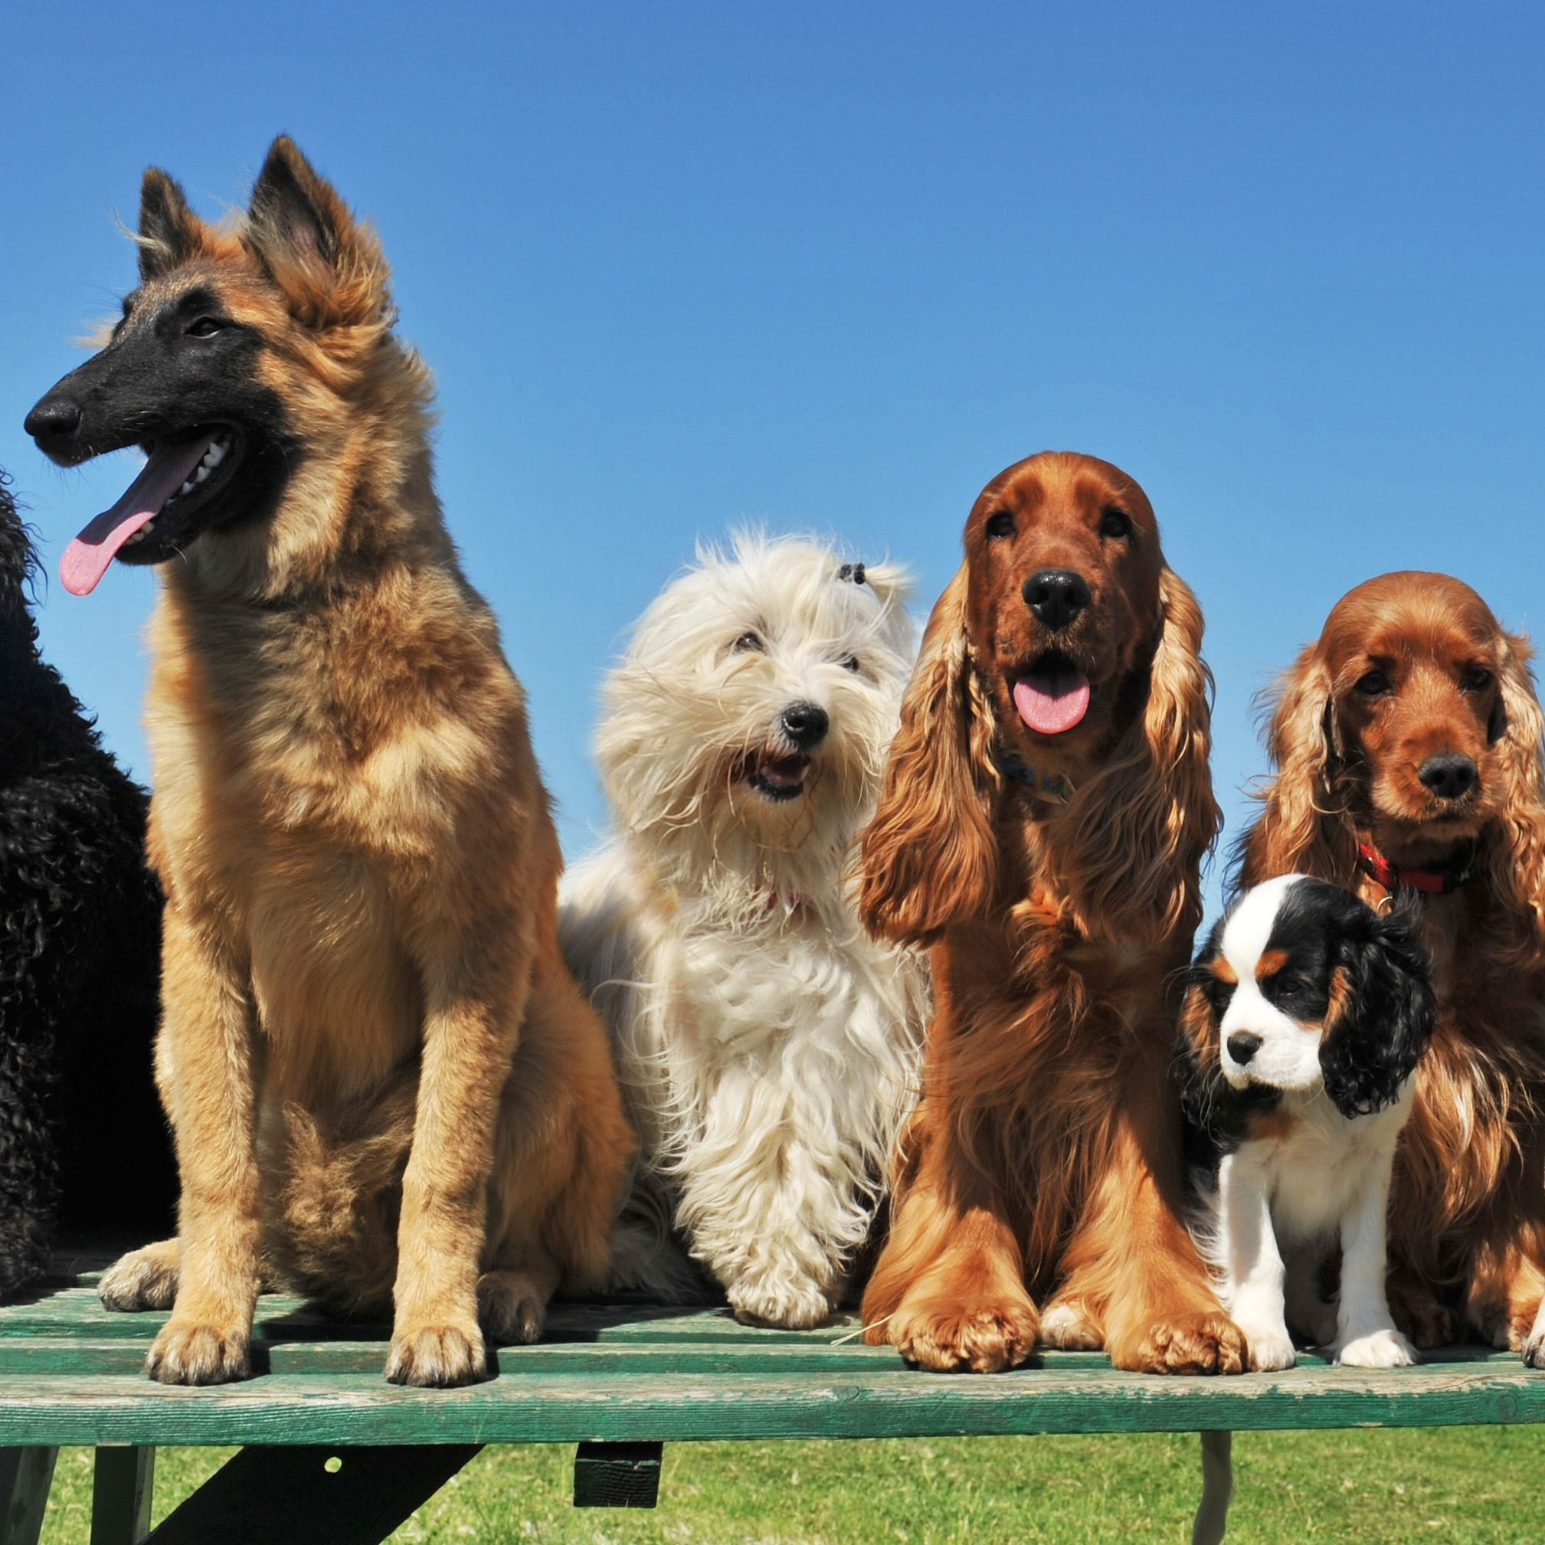
Conclusion
The Dog Breed Detector simplifies dog breed identification using deep learning, providing instant and accurate results.
By leveraging a fine-tuned InceptionV3 model, it classifies 70-80 breeds with high accuracy. The user-friendly Streamlit interface ensures easy access for pet owners, shelters, and veterinarians.
Continuous model improvements enhance prediction reliability over time. This AI-powered solution revolutionizes breed identification, making it more efficient and accessible.

Slide 10
Future Perspective
The future perspective of the Dog Breed Detector includes expanding the breed database for broader coverage and improved accuracy. Enhancing the model with real-time learning and user feedback will refine predictions.
Mobile app integration can increase accessibility for on-the-go users. Adding features like mixed-breed detection and health recommendations will enhance user value. Collaborating with shelters and veterinarians can further optimize adoption and pet care processes.

Slide 11

Thank you...!
Notes:
11

