Slide 1


Vivekananda College of Engineering & Technology
[A Unit of Vivekananda Vidyavardhaka Sangha, Puttur®] Affiliated to Visvesvaraya Technological University, Belagavi
Approved by AICTE New Delhi & Recognised by Govt of Karnataka
Mini Project Presentation on
“SiteSense” - Unified and actionable view of overall website health
Guided by
Prof. Pradeep Kumar K G
HOD, CSE
Presented by
Aashitha Prabhu B (4VP23CS001) Abhayraj Bhat N (4VP23CS002) Adithya (4VP23CS004)
Ashwini (4VP23CS017)

Slide 2
Contents
Abstract
Problem Identification
Objectives
Literature Survey
System Architecture
Proposed System
Modular Specifications
References

Slide 3
Abstract
SiteSense is a unified platform/tool for small scale and freelance web-developers/web-developing companies or even students, providing an overall health result of their website, which includes 4 decision making factors, Performance, Security, SEO & UX-Audit, and hence obtaining a priority-based fix suggestions to improve the performance and reliability of the website.

Slide 4
Problem Statement
Website audits are time-consuming and inconsistent, SiteSense solves it with an integrated audit pipeline that automates every test and creates a unified platform for the user.

Slide 5
Objectives
To evaluate and generate website health and reliability, holistically and offer insights through a lightweight dashboard.
To provide prioritised recommendations with clear impact analysis for improvements.

Slide 6
Literature Survey
Name | Technology / Focus | Advantage | Limitations
Van Riet et al. (2023) | Lighthouse-based performance benchmarking | Dramatic improvements via targeted optimizations; shows value of continuous performance engineering. | Single case study; limited generalization.
Fischer et al. (2025) | Automated accessibility checking tools | Reveals major WCAG coverage gaps; shows inconsistency across tools. | Tools incomplete and inconsistent.
Manca et al. (2022) | Transparency of accessibility tools | Identifies need for clearer, user-centered explanations. | Existing tools produce confusing, divergent results.

Slide 7
Literature Survey
Namoun et al. (2021) | Usability/SEO/accessibility/security tools | Broad audit coverage across multiple dimensions. | Reports often vague, contradictory, lacking actionable insights.
Heričko et al. (2021) | Lighthouse score reliability | Repeated runs greatly stabilize metrics. | Single-run results are unreliable.
Vepsäläinen et al. (2024) | Web performance optimization techniques | Reviews modern optimization strategies; links performance to SEO. | High‑level review; lacks actionable guidance.
Yang et al. (2023) | Visual-aware WPO testing | Identified 21 UI distortions caused by aggressive optimizers. | Focuses only on proxy-based WPO tools.

Slide 8
Literature Survey
Burkard et al. (2021) | Accessibility monitoring systems | Useful for continuous monitoring and suggestions. | None cover all guidelines; manual review needed.
Buchanan et al. (2017) | HTTP security header adoption | Shows increasing adoption trends; highlights gaps. | Single snapshot; does not track progression.
Yarphel & Rani (2025) | Web vulnerability scanner comparison | Burp Suite most accurate; ZAP good usability balance. | No single scanner finds all vulnerabilities.
Pezzuti et al. (2025) | Neural prioritization for crawling | Improves early crawl quality using semantic cues. | High computational cost; experimental.

Slide 9
Literature Survey
Alim (2025) | University website analysis | Reveals accessibility/security issues; usability high. | Only homepage analysis.
Laskar (2025) | CI/CD accessibility framework | 6× improvement in violation detection. | Focuses solely on accessibility.
Kerschbaumer et al. (2025) | Global HTTPS adoption | Majority HTTPS adoption; SEO benefits. | Some insecure configurations persist.
Król & Zdonek (2020) | Website quality indices | Explains trade-off between indices and detailed metrics. | Many indices overly superficial.

Slide 10
System Architecture
Modular architecture.
Frontend: Next.js
Backend: Express.js
Modules: Crawler, Performance, Security, Accessibility
JSON-based communication.

Slide 11
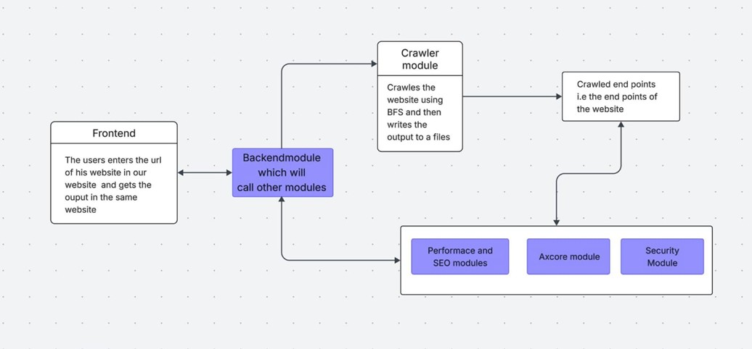
System Design
Notes:
Frontend & Dashboard → Adithya
Database & Crawler → Abhayraj
SEO, Performance Analyzer, UX-Audit → Aashitha
Security→ Ashwini

Slide 12
Module 1: Crawler
Discovers internal URLs using BFS.
Removes duplicates & off-domain links.
Generates endpoints for other modules.
Supports depth & page limits.
Used APIs:
  Cheerios - Fast, jQuery-like HTML parsing without browser overhead
  Axios - Industry-standard, reliable HTTP client with timeout support
Tech stack : Node.js

Slide 13
Module 2: Performance & SEO
Lighthouse-based metrics:
  Performance:
    FCP - First contentful Paint
    LCP - Largest Contentful Paint
    TBT - Total Blocking Time
    CLS - Cumulative layout shift
SEO:
  Meta description
  Document title
  Image alt text
  Link test quality
  Crawlable anchors

Slide 14
Module 3: Accessibility (UX-Audit)
WCAG compliance testing and accessibility evaluation.
Tests:
  Perceivable
  Operable
  Understandable
  Robust
Testing technology:
  Puppeteer - headless chrome browser
  Ax-core - accessibility rules complying with the WCAG

Slide 15
Module 4: Security
Vulnerability detection and risk management.
Testing technology: OWASP ZAP
  Broken Accessibility control.
  Cryptographic failure.
  Injection(SQL, XSS)
  Insecure designs
ZAP Scanning process:
  Start Zap daemon process
  Spider scan
  Active scan
  Collect results

Slide 16
Results
The output is in the form of dashboard containing combined results of all the pages.
A user-friendly way of representation of error by highlighting it using different colors.
PDF generation to share the results and to have a comparative analysis of different versions.

Slide 17
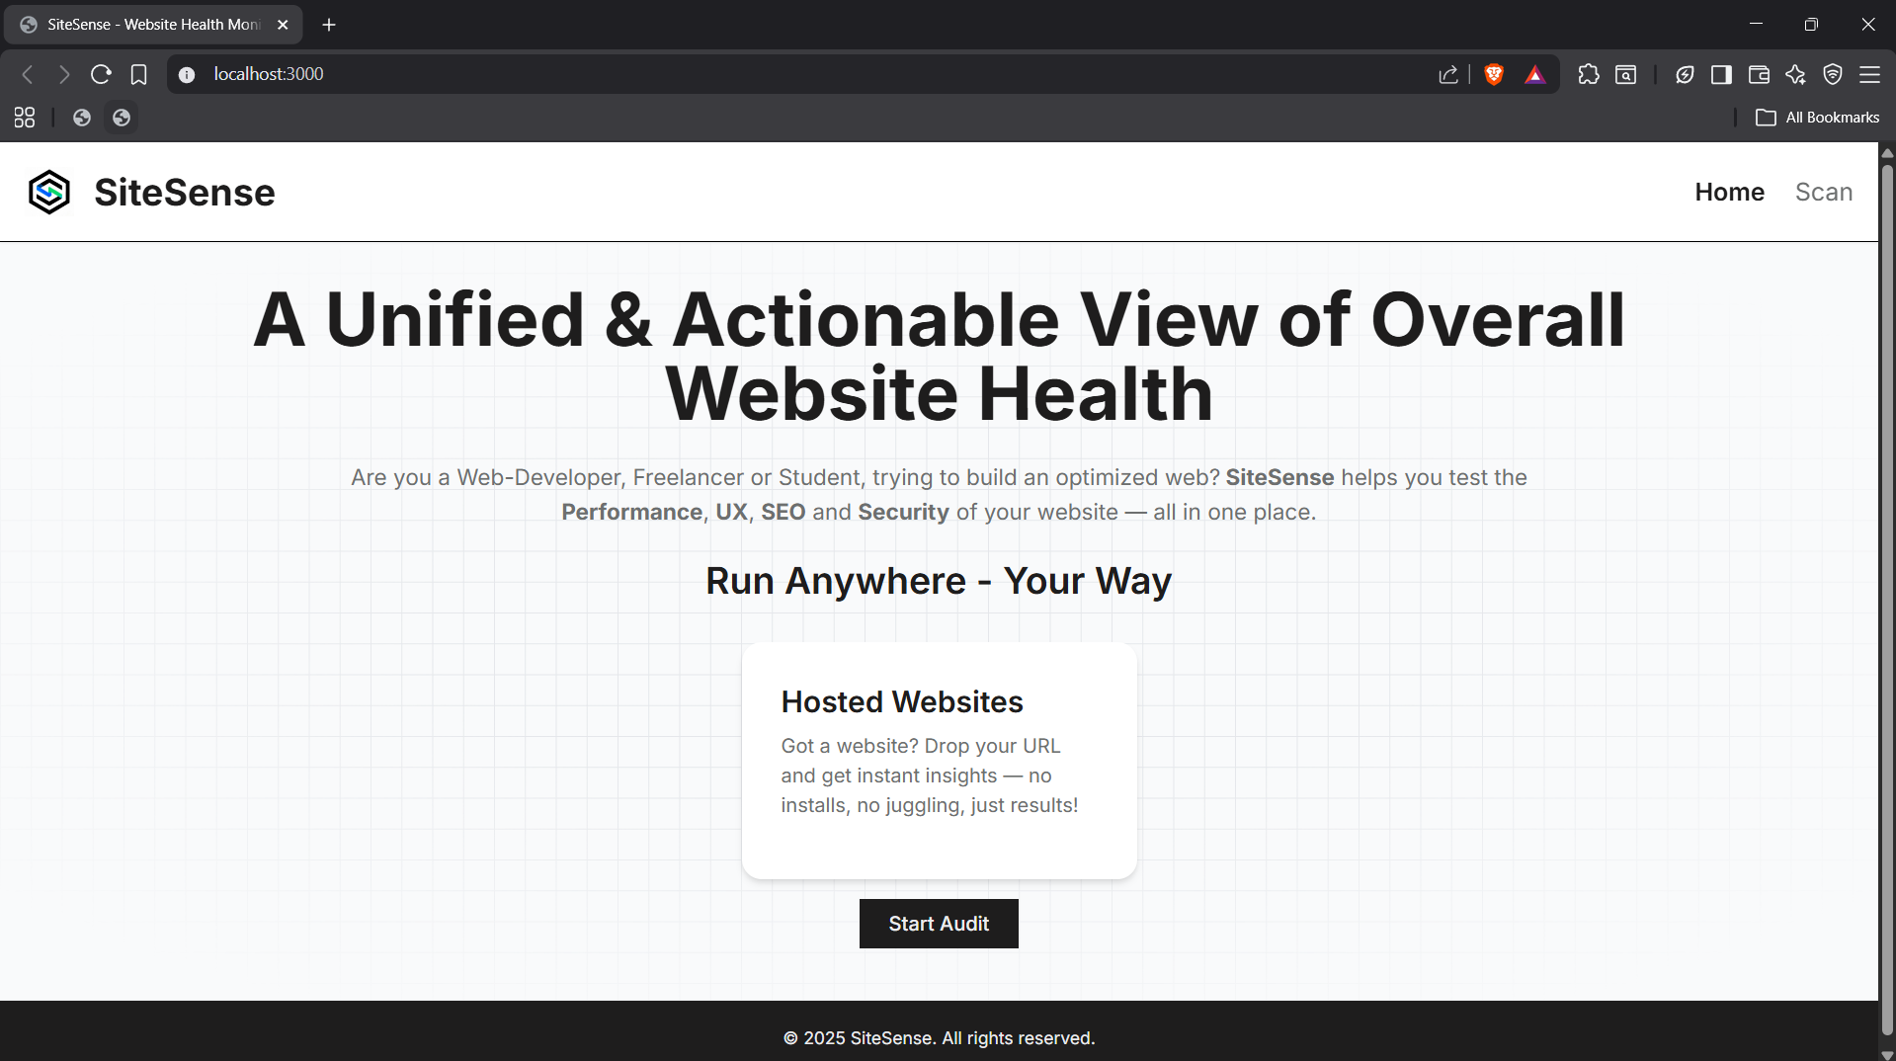
Results

Slide 18
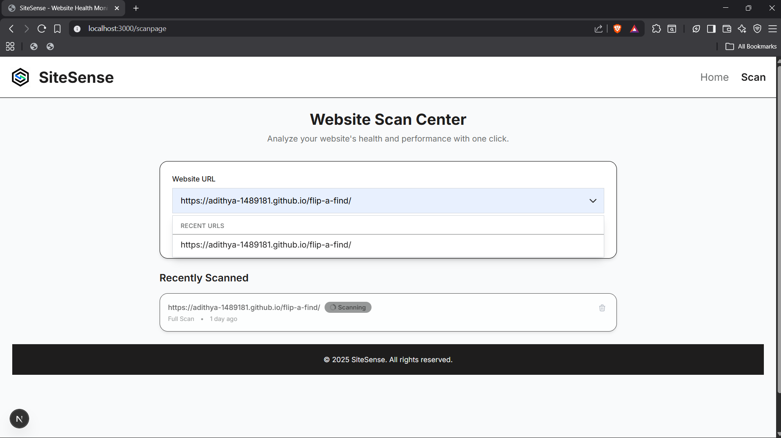
Results

Slide 19
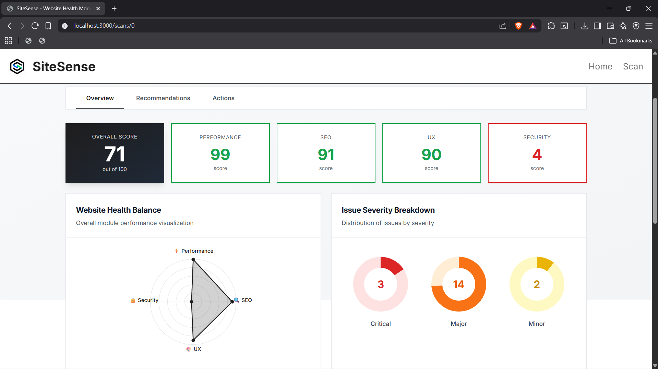
Results

Slide 20
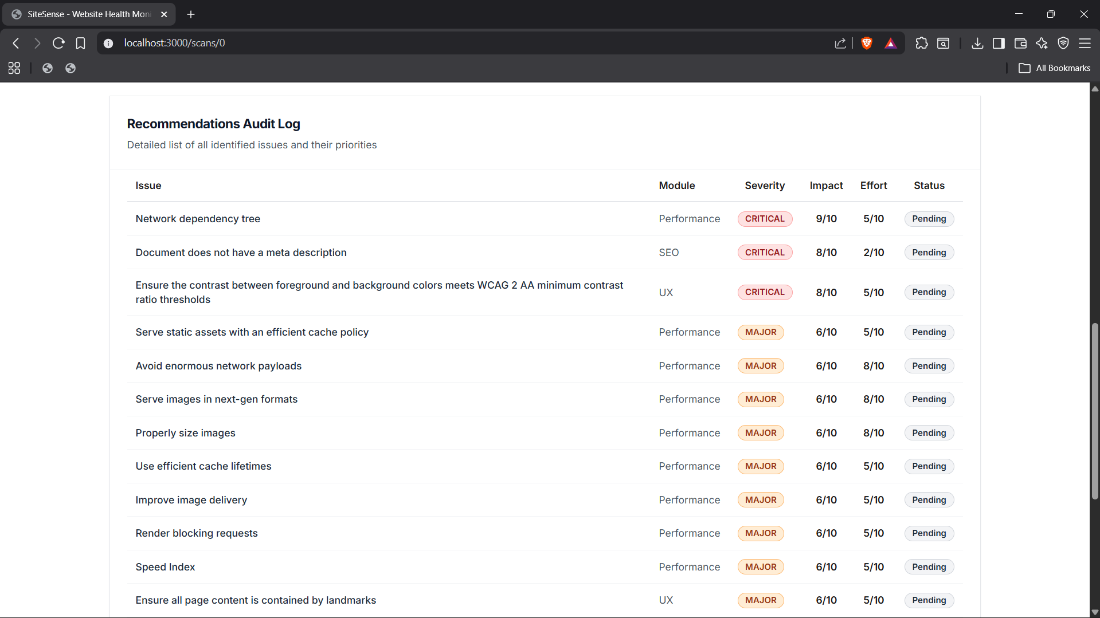
Results

Slide 21
Limitations & Future Enhancements
No support for local host websites.
Large E-Commerce websites are not completely parsed.
Can integrate AI to get personalized recommendations and can improve the issue understanding.
Making the website more interactive by having live error corrections and suggestions.
Can add continuous support for the user with version comparison.

Slide 22
Reference
• Van Riet, M., van Deursen, A. and Zaidman, A., 2023. Optimize along the way: An industrial case study on web performance. International Journal of Web Engineering.
• Fischer, A., Carlson, E. and Sandberg, H., 2025. Coverage of web accessibility guidelines provided by automated checking tools. Universal Access in the Information Society.
• Manca, M., Paternò, F. and Santoro, C., 2022. The transparency of automatic web accessibility evaluation tools: design criteria, state of the art, and user perception. ACM Transactions on Accessible Computing.
• Namoun, A., Alshanqiti, A. and Tellers, J., 2021. A review of automated website usability evaluation tools: research issues and challenges. In Proceedings of HCII.

Slide 23
Reference
• Heričko, M., Štrumbelj, A. and Gregorič, T., 2021. Towards representative web performance measurements with Google Lighthouse. In Proceedings of Web Engineering Conference.
• Vepsäläinen, T., Raitila, J. and Kaario, J., 2024. Overview of web application performance optimization techniques. arXiv preprint arXiv:2412.07892.
• Yang, F., Qian, F. and Sun, Y., 2023. Visual-aware testing and debugging for web performance optimization. In Proceedings of the Web Conference 2023.
• Martins, J. and Duarte, C., 2024. Large-scale study of web accessibility metrics. Universal Access in the Information Society, 23(4).

Slide 24
Reference
• Abu Doush, I. and Kassem, R., 2025. Evaluating AI-generated web code for accessibility compliance: A metric-driven approach. In Proceedings of the ACM Web Conference.
• Vigo, M., Brown, J. and Conway, V., 2013. Benchmarking web accessibility evaluation tools: Measuring the harm of sole reliance on automated tests. In Proceedings of the Web for All Conference.
• Burkard, S., Kuber, R. and Shinohara, K., 2021. Monitoring systems for checking websites on accessibility. Frontiers in Computer Science, 3, p.628770.
• Buchanan, B., Wang, Y. and Arshad, S., 2017. Analysis of the adoption of security headers in HTTP. IET Information Security, 11(6).

Slide 25
Reference
• Yarphel, A. and Rani, S., 2025. Comparative performance analysis of web vulnerability scanners. International Journal of Information Security, 4(1).
• Pezzuti, A., Demeester, A. and Buscaldi, D., 2025. Neural prioritisation for web crawling. arXiv preprint arXiv:2506.16146.
• Alim, S., 2025. Preliminary analysis of web accessibility, usability, and security of leading university websites. Journal of Web Research, 12(3).
• Laskar, S., 2025. Continuous accessibility testing with automated screen readers. SARC Journal of Engineering and Computer Science, 85.

Slide 26
Reference
• Kerschbaumer, S., Snyder, A. and Heidemann, J., 2025. The state of HTTPS adoption on the web. In MADWeb 2025.
• Król, K. and Zdonek, D., 2020. Aggregated indices in website quality assessment. Future Internet, 12(4).

Slide 27
THANK YOU

