Slide 1
Text Document Plagiarism Detector using Merkle Trees and Hashing Techniques
Course: Advanced Data Science and Algorithms
Group: B16
Team Members:
Adithya.R - CB.AI.U4AID25102
S.Manoj - CB.AI.U4AID25152

Slide 2
Introduction
Copy-pasting text across academic assignments, research papers, and web articles has become effortless and widespread.
Educational institutions and digital publishers handle thousands of submissions daily, rendering manual checking impossible.
Standard plagiarism detectors rely on document fingerprinting, converting text into hashes to compare against a central database.
Existing systems process files sequentially line-by-line or hash-by-hash, running in O(N) linear time.
Linearly comparing large files across massive repositories creates severe server latency, high computing costs, and processing bottlenecks.
Current tools re-scan an entire document from scratch even if only a single sentence or paragraph was modified.
Instead of flat, linear scans, we organize document hashes into a hierarchical Merkle Hash Tree paired with a Hash Table.
This structure enables O(1) instant detection at the root for identical files, and O(log N) targeted search to pinpoint exact copied paragraphs without re-checking clean text.

Slide 3
Why we chose this?
Practical implementation of core DSA concepts—Binary Trees, Hash Functions, and Sliding Windows
Traditional plagiarism detection tools are highly vulnerable to modern evasion tricks, failing when text is slightly rephrased, modified, or inserted.
Learning new concepts - Rabin Karp rolling hash algorithm, Lexicographical Sorting for trees and etc.
Problem Statement
Standard Merkle Tree plagiarism detectors rely on rigid block segmentation and strict positional ordering, causing minor insertions, deletions, or paragraph shuffling to break downstream hash alignment.
Leaf-level reliance on exact cryptographic hashes like SHA-256 fails to identify localized rephrasing, minor typos, and partial text modifications.
Sequential, single-threaded execution creates high computational latency and severe bottlenecks when scaling to large document repositories.

Slide 4
Literature Review
Authors
Title of Paper
Their Methods
Limitations
S. Schleimer, D. S. Wilkerson, & A. Aiken(2003)
Winnowing: Local Algorithms for Document Fingerprinting
Converts raw text into k-grams, computes rolling hashes across a sliding window, and selects local minimum hash values to create a compact fingerprint list.
Produces a flat list of hashes with linear O(N) comparison overhead; vulnerable to paragraph-level structural reordering.
B. Leonardo et al.(2017)
Text Documents Plagiarism Detection using Rabin-Karp and String Similarity Algorithms
Applies the Rabin-Karp rolling hash algorithm to text streams, evaluating overlapping substring hashes in O(1) constant time to identify verbatim sequence matches.
Does not construct hierarchical data structures for early pruning; highly sensitive to structural section reordering.
T. L. Trinh & M. T. Ta(2025)
pHash-Enhanced Merkle Tree: An Advanced Approach for Detecting Content Violations
Organizes content feature hashes into a binary Merkle Tree structure to enable hierarchical top-down similarity checking and sub-tree verification.
Standard binary tree nodes are strictly position-dependent, causing whole-tree mismatches if internal paragraph node order is swapped.

Slide 5
Novelty
Research Gap
Our Novelty
Flat fingerprint lists require linear O(N) scanning across database documents, slowing down large-scale checks.
We aggregate fingerprints into a Merkle Tree. If parent hashes match, we skip checking entire sub-trees, reducing comparison time from O(N) linear scanning to O(log N).
Standard cryptographic Merkle trees use exact hashes (e.g., SHA-256) at leaf nodes, breaking completely if a single character or typo is edited.
We embed Rabin-Karp rolling hashes directly at the leaf level inside dynamic sliding windows. This catches fine-grained rephrasing and micro-edits within tree chunks.
Standard Merkle trees fail when paragraph order is swapped because parent hashing is strictly position-dependent
We sort child hashes lexicographically before computing parent nodes. This makes the overall Merkle Root completely immune to paragraph/section reordering.

Slide 6
Objectives
Detect Micro-Edits & Localized Rephrasing: Catch fine-grained text modifications, minor typos, and word substitutions using Rabin-Karp rolling hashes.
Neutralize Structural Shuffling Evasion: Eliminate paragraph and section reordering vulnerabilities by making the Merkle Tree order-invariant through canonical sorting.
Accelerate Document Comparison Speed: Reduce search time complexity from linear O(N) scanning down to logarithmic O(log N) using sub-tree pruning.
Pinpoint Exact Plagiarized Content: Provide precise location highlights of copied text within documents rather than just a broad similarity score.
Optimize System Throughput: Implement a multi-threaded parallel pipeline to process and compare document trees efficiently at scale.

Slide 7
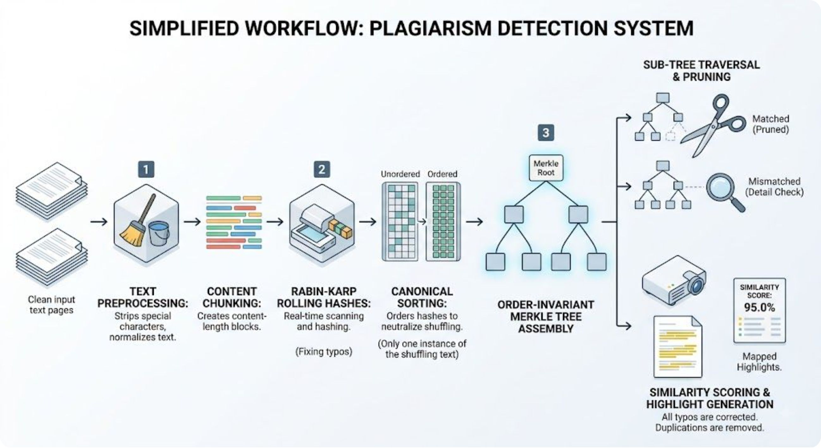
Workflow Diagram

Slide 8
Methodology
Text Preprocessing: Strip special characters, spaces, and convert text to lowercase to create a uniform string stream.
Document Chunking: Divide the cleaned text into sliding sub-string windows for localized content checking.
Rabin-Karp Leaf Hashing: Generate rolling sub-string hashes at the leaf level in constant O(1) time to catch micro-edits and rephrasing.
Canonical Child Sorting: Sort adjacent child hashes alphabetically before parent node computation so swapped paragraphs produce identical hashes.
Bottom-Up Merkle Tree Build: Recursively pair and hash the sorted child nodes up to a single top-level Merkle Root.
Top-Down Logarithmic Traversal: Compare tree nodes from the root down, pruning identical branches in O(log N) time to generate similarity scores and pinpoint copied text locations.

Slide 9
Expected Output
Plagiarism Similarity Score (%): A calculated similarity ratio based on matched leaf nodes:
{Similarity Score} = ( {Matched Leaf Hashes} / {Total Unique Leaf Hashes}) x 100
Detailed Match Offset Report: A mapped list of plagiarized sub-strings with exact start and end character positions in the target document.
Paragraph Shuffling Immunity Proof: Verification logs showing that swapped sections yield identical parent branch hashes.

Slide 10
Future Work
Dynamic Variable Chunking: Upgrade from fixed-size windows to feature-driven boundaries so adding a single word doesn't offset downstream leaf hashes.
Multi-Format File Support: Add parsing for .pdf and .docx files instead of relying only on plain .txt inputs.
Exportable PDF Summary Report: Use a simple library like reportlab or HTML-to-PDF to dump the final similarity percentage and matched text snippets into a downloadable PDF report.
Multi-Document Comparison: Increase the number of comparable documents from 1 one 1 comparison.

Slide 11
References
S. Schleimer, D. S. Wilkerson, and A. Aiken, "Winnowing: Local algorithms for document fingerprinting," Proceedings of the ACM SIGMOD International Conference on Management of Data, 2003.(Serves as the foundation for our dynamic chunking and local document fingerprinting algorithm.)
R. C. Merkle, "A Digital Signature Based on a Conventional Encryption Function," Advances in Cryptology — CRYPTO '87, Springer, 1988.(Provides the core cryptographic framework for hierarchical tree aggregation and hash verification.)
T. L. Trinh and M. T. Ta, "pHash-enhanced Merkle Tree: An advanced approach for detecting and preventing copyright violations in NFT marketplaces," Research Article, Oct. 2025.

