Slide 1
Capstone Project – Customer Churn Prediction
Presented By: Adithya Manivannan
PGP Data Science & Business Analytics

Slide 2
Business Problem Understanding
Business Problem:
Competitive Industry
Challenge in retaining existing customers
Churn Prediction is needed to target segmented offers at potential churners.
CAC is usually much higher than retention costs.
Business & Social effects of Churn:
It reduces the profitability
Poor brand image
Reduces the market share
Affects prospects of future business
Increased customer acquisition costs lead to lower profit margins

Slide 3
Modelling Approach Used & Why
Since we are looking to predict the accounts that will churn based on the different parameters that are provided, this is a classification problem. The model will classify each account into 0 & 1 where 0 means they do not churn and 1 means they churn.
We try different models that perform well in classification programs such as Logistic Regression, KNN, and Decision tree models to estimate which is the best performing among them based on different parameters such as the Accuracy & recall scores.
We then use different ensemble model techniques to improve the performance metrics.

Slide 4
Model Comparison Table
Model | Accuracy | Recall | F-1 Score | Precision | AUC
Logistic Regression | 0.81 | 0.72 | 0.56 | 0.46 | 0.908
Linear Discriminant Analysis | 0.80 | 0.73 | 0.55 | 0.45 | 0.907
Naïve Bayes | 0.31 | 0.96 | 0.32 | 0.19 | 0.998
KNN | 0.88 | 0.91 | 0.72 | 0.60 | 0.998
Decision Tree | 0.92 | 0.83 | 0.78 | 0.74 | 0.907
Random Forest | 0.97 | 0.89 | 0.91 | 0.93 | 1.0
ADA Boost | 0.86 | 0.75 | 0.64 | 0.57 | 1.0
Gradient Boost | 0.88 | 0.76 | 0.69 | 0.63 | 1.0
Bagging | 0.96 | 0.89 | 0.88 | 0.86 | 1.0
XGB Classifier | 0.87 | 0.79 | 0.68 | 0.59 | 0.953

Slide 5
Model Selection & Interpretation
The Random Forest model is the one that has performed best in terms of accuracy, recall, and other scores in both the train and test models.
Since we are predicting whether a customer will churn or not, the most important parameters to consider are Recall and Accuracy.
The recall tells us of all the customers who churned, how many we were able to predict as churned correctly. In our case, the recall of 0.9 shows that our model is able to predict 90% of all churned customers correctly as churned. And with an accuracy of 0.97, overall our model is able to correctly classify 97% of the customers on the basis of churn.

Slide 6
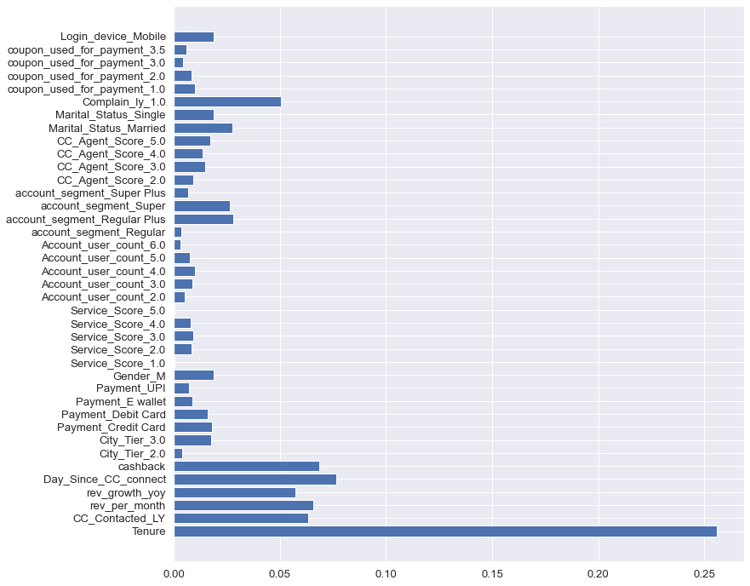
Random Forest Model
Upon selecting the RF model, we find out the best features i.e. the features that contribute the most to the model. We find the Gini index for each feature to select the important ones.
Based on it, the best features:
Tenure
CC_Contacted_LY
Day_Since_CC_Connect
Cashback
Complain_ly_1.0
Rev_per_month

Slide 7
Insights from Analysis
Based on the Random Forest model and the analysis done, we can draw upon the following insights:
Tenure is the most important feature that influences churn. The longer a customer has stayed with us, the less likely they will churn.
Another feature is whether Customer care was contacted in the last year or not. If a customer has not reached out to CC in the last year, that probably means they are happy with the service and hence less likely that they will churn.
Similarly, the longer it has been since customer care was contacted by a customer, the lesser probability of them churning.
Cashback has an inverse correlation to churn. More the cashback that a customer has received, the lesser the probability of churn.
There is a direct positive correlation between the revenue generated from the account per month and churn.

Slide 8
Further Insights
Some of the other insights from mapping the correlation between Churn and the parameters are:
Cash on delivery and e-wallet as the payment method has a higher probability of churn while customers using Credit cards are retained further.
Based on the high correlation to churn, customers who have complained in the last 12 months, belong to the “Regular Plus” segment and are Single have a higher probability of churning compared to other groups. So, we need to focus on these groups to provide them with better customer service, offer discounts and do all that we can to retain them.
Accounts with a user count of 5 & 6 tend to churn more than those with 1 or 2 users.
Customers who have not used a coupon for payment or used just 1 coupon churn more.

Slide 9
Recommendations
Provide loyalty programs with better offers and higher discounts for customers who have been our customers for over 12 months.
Give discounts ranging up to 25-40% if new users sign up for our annual membership with our Regular Plus, Super & Super Plus segments.
Analyse the common problems raised by customers and resolve the root cause so that customers do not have to raise complaints or reach out to customer care frequently.
Provide incentives for customers to use credit cards instead of COD or e-wallet in the form of cashback.
Increase the rate of coupons being provided. Eg: Instead of providing a coupon for Rs.100, we can instead provide 5 coupons for Rs.20 each. The more coupons available will promote the usage of the same.

Slide 10
Recommendations
Incentivize moving users from Regular & Regular plus segments to the Super & Super plus segments by giving a 25% discount if they upgrade and sign up for a 12-month membership along with a 6-month extended membership.
We could alternatively also provide some of the features available in the super/super plus segments to the regular/regular plus segment on a trial basis for 1 month to promote them to upgrade.
Thank You!

