Slide 1

MRA Project - MileStone 1
Submitted by: Adithya Manivannan
Pgp dsba

Slide 2
Problem Statement: An automobile parts manufacturing company has collected data of transactions for 3 years. They do not have any in-house data science team, thus they have hired you as their consultant. Your job is to use your magical data science skills to provide them with suitable insights about their data and their customers.

Slide 3
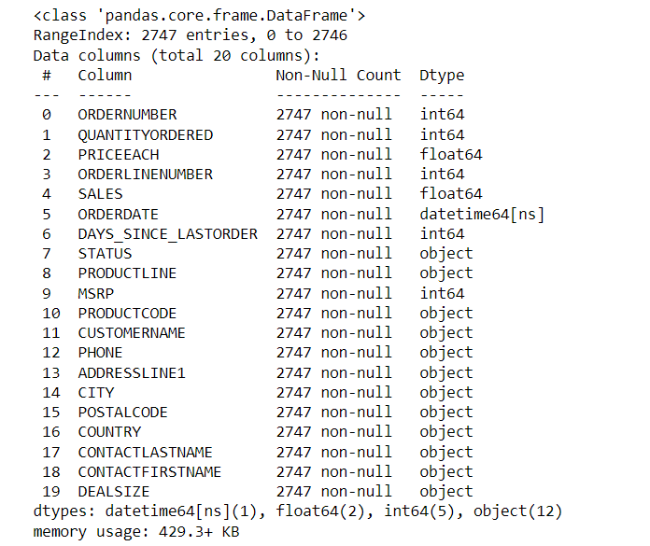
Data info:
Data Shape: (2747, 20)
Data Info:

Slide 4
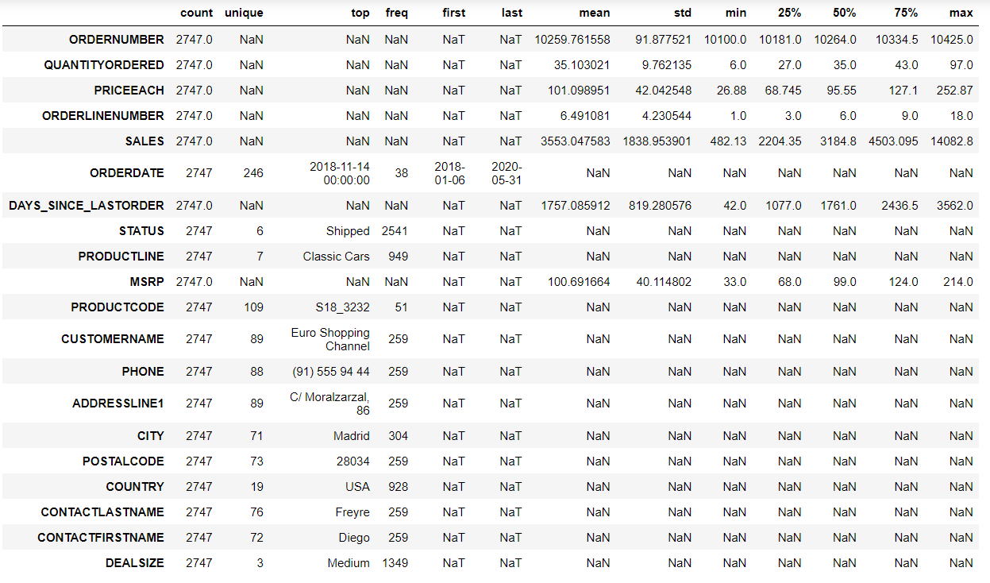
Null Values: 0
Duplicated Rows : 0
Summary:

Slide 5
Inferences:
There are 2747 rows of data with 20 columns.
There are 0 null and duplicated rows.
Sales and Price are the only float values among other int and object data types.
There average Price of each product is 101.09 while the average Sales from each order is 3553.047583.
There is a product that was last sold 3562 days earlier.
Product with code S18_3232 is the most sold while Product line of Classic Cars is the highest.
USA is the country with the most orders while Euro Shopping Channel is the biggest customer.
Medium deal sizes are the most common.
Maximum orders are in the shipped status.

Slide 6
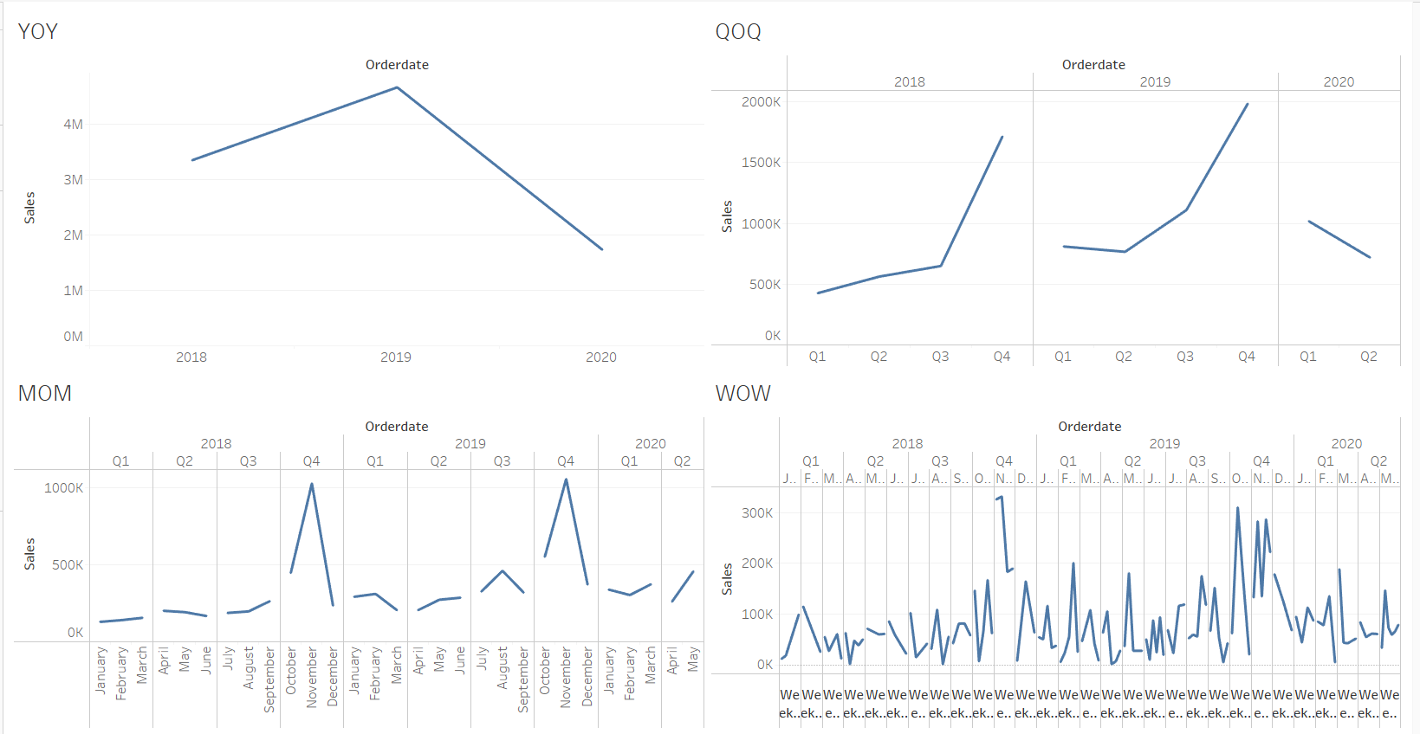
Exploratory Analysis:
Time Series

Slide 7
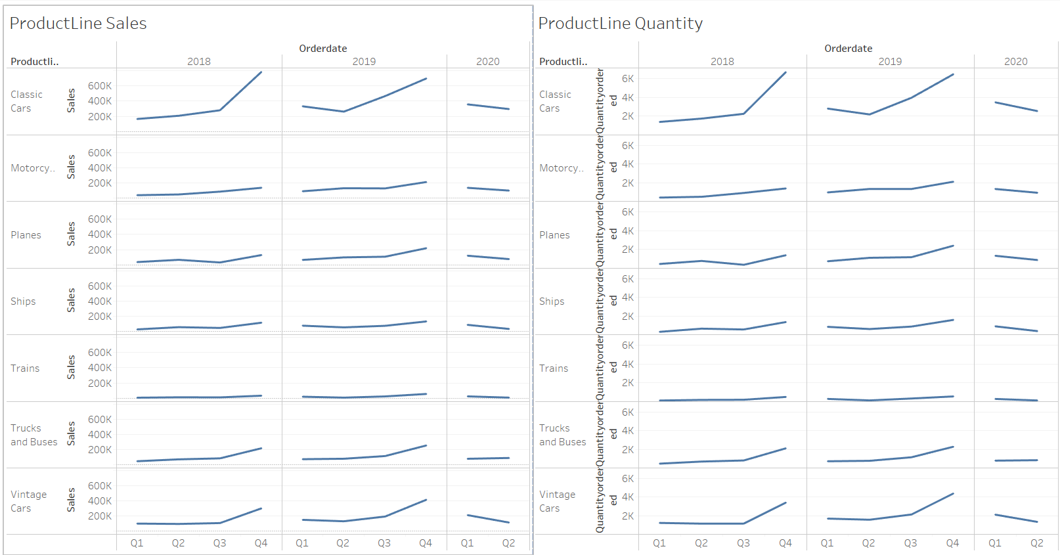
Product Line Vs Sales & Quantity Sold

Slide 8
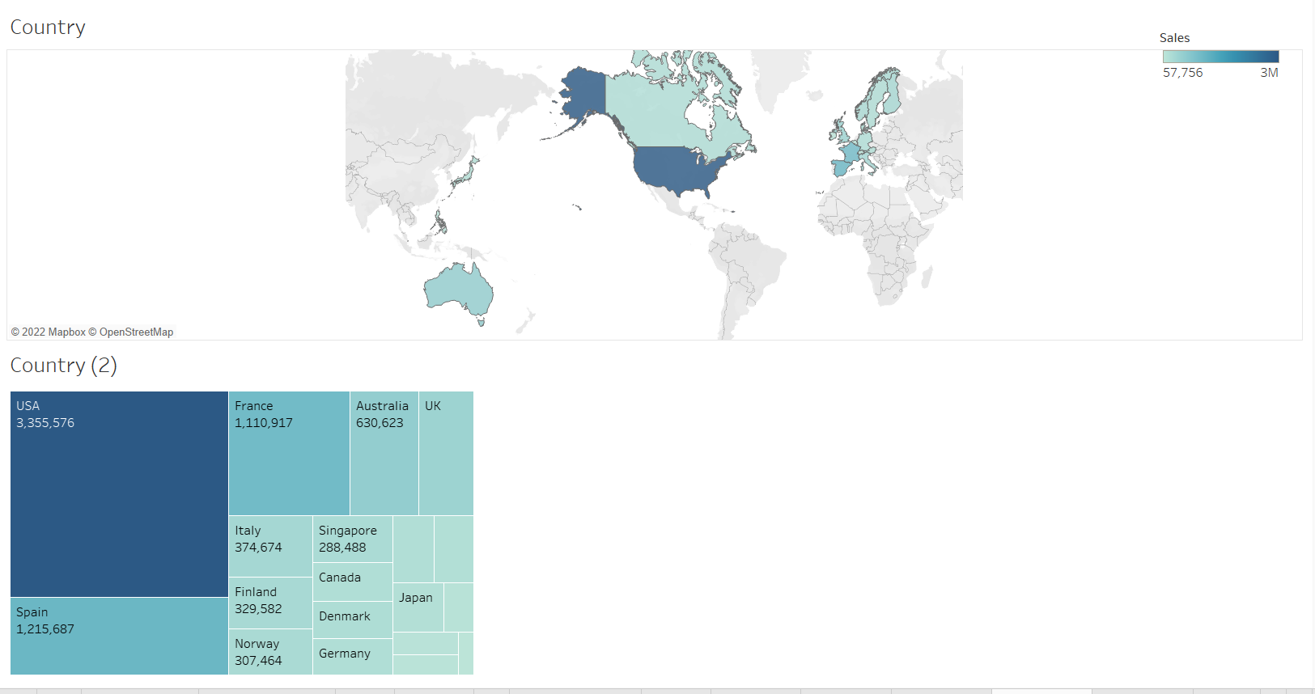
Country Vs Sales & Quantity

Slide 9
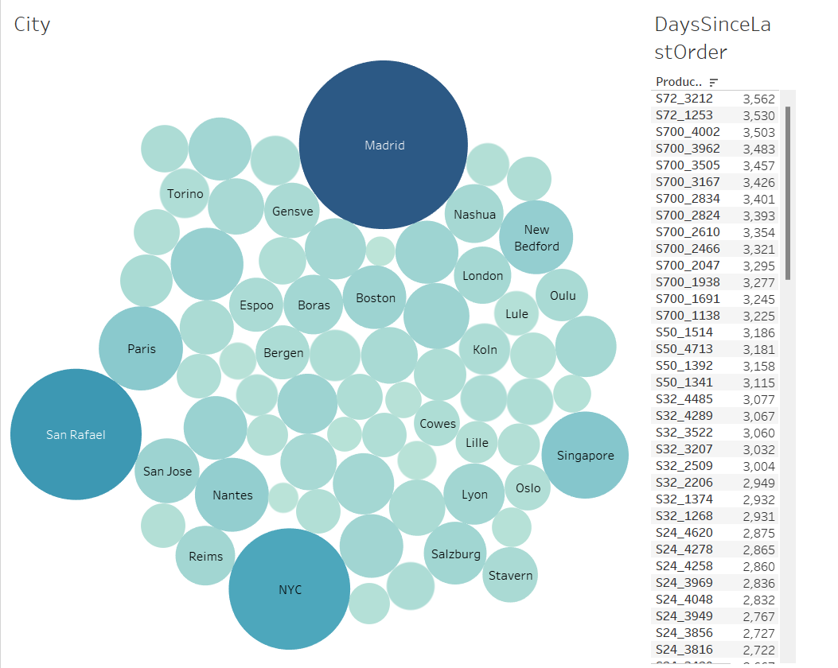
City Wise Sales & Descending order list of products based on Last Sold date

Slide 10
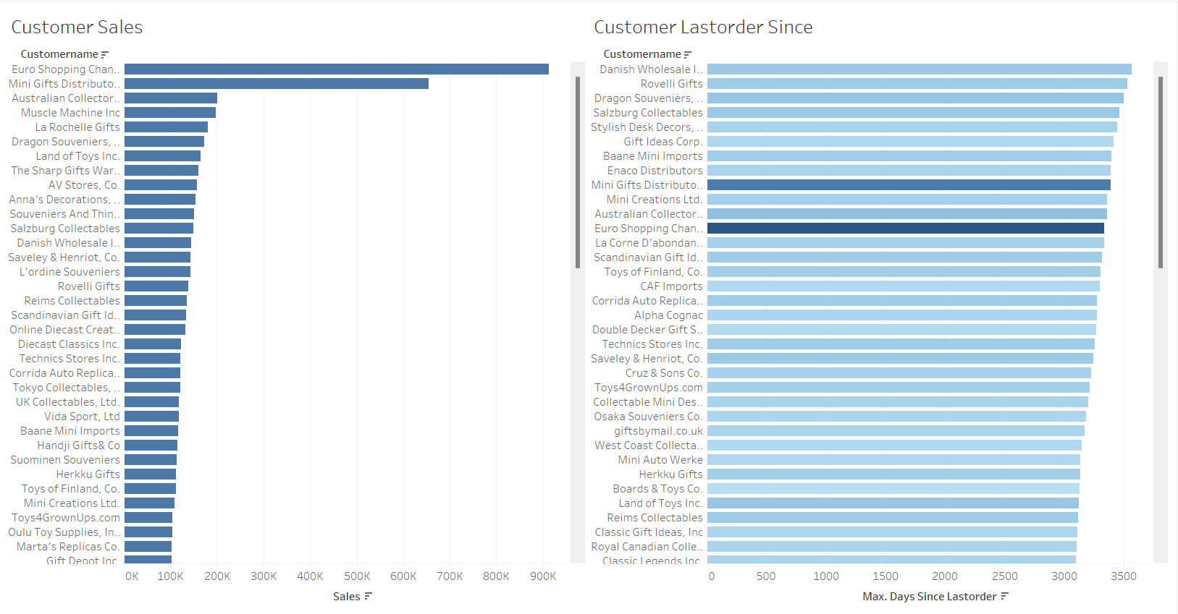
Customer Sales & Descending order list of Customers based on Last Sold date

Slide 11
Inferences from EDA:
The sales is highest in 2019 and dropped the lowest in 2020.
Quarter 4 saw the highest sales in 2018 and 2019 despite low profits in Q1 and Q2, so we can expect a rise in sales in Q4 of 2020 despite a descending slope so far.
November has been the most profitable month in both the years while there are no trends in terms of weeks.
Classic Cars have sold them most and made the most sales while Trains are the least in terms of sales and quantity.
All types of car sales have shown a upward trend in Q3 and Q4 across the range.
US, Spain and France have been the countries with the most sales and quantities sold.
Madrid is the city with the most sales followed by NYC and San Rafael.
It can be observed that despite making the most sales, there are not many single cities that dominate sales in the US except NYC and Boston. This could contribute to more cities in US where sales are made.
The product that has the highest days since it was sold is S72_3212 while S10_1678 was sold the most recently.
Euro Shopping Chanel is the biggest customer while Boards & Toys Co has provided the least sales.
Danish Wholesale Imports is the customer who has not ordered in the longest time. They contributed to 145,042 sales.

Slide 12
Customer Segmentation using RFM analysis:
What is RFM? What all parameters used and assumptions made?
The “RFM” in RFM analysis stands for recency, frequency and monetary value. RFM analysis is a way to use data based on existing customer behavior to predict how a new customer is likely to act in the future. An RFM model is built using three key factors:
How recently a customer has transacted with a brand
How frequently they’ve engaged with a brand
How much money they’ve spent on a brand’s products and services
RFM stands for Recency, Frequency and Monetary Value. Recency means how recently a customer bought from your store, Frequency means how frequently a customer is buying from you, and Monetary Value means what is the amount of money a customer spent. These three parameters altogether determine the importance of customer for your business.
Some of the assumptions made are that customers who purchased recently are more likely to purchase again than the customers who purchased a long time ago. Customers who have purchased more in the past are more likely to respond than the customers who have made fewer purchases

Slide 13
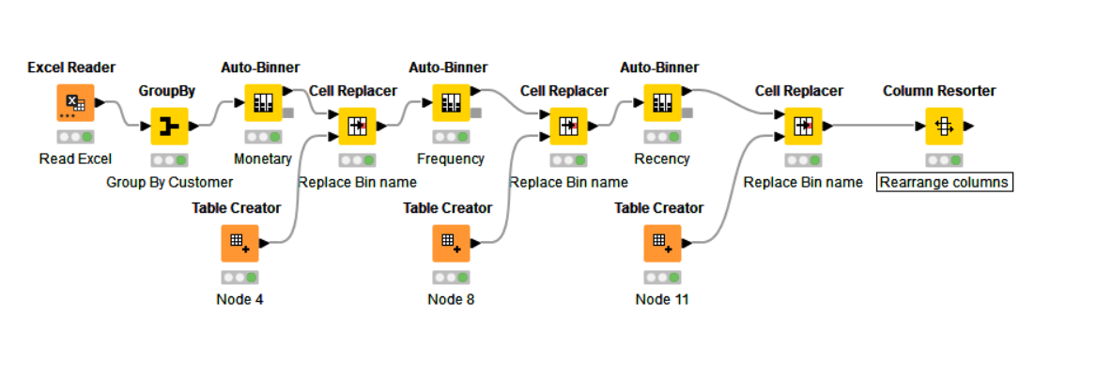
Customer Segmentation using RFM analysis:
Work Flow Image

Slide 14
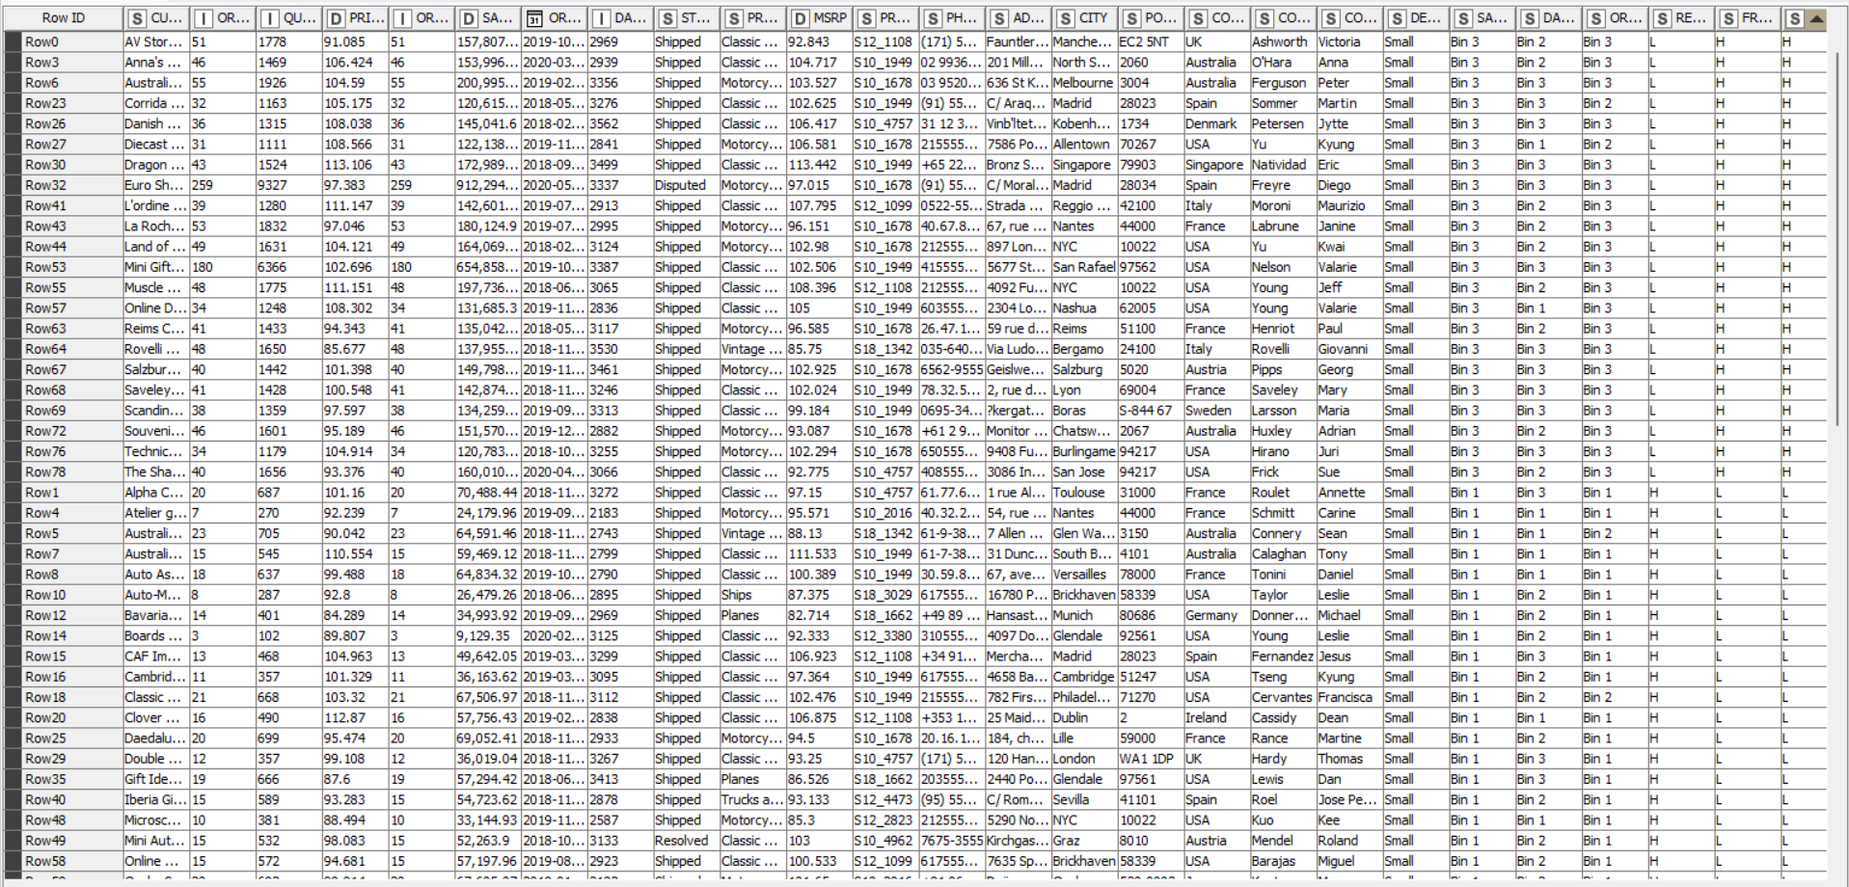
Output table head :

Slide 15
Customer Segmentation using RFM analysis:
Count of MONETORY | Column Labels
 | H | H Total | L | L Total | M | M Total | Grand Total
Row Labels | H |  | L |  | M
H |  |  | 23 | 23 |  |  | 23
L | 22 | 22 |  |  |  |  | 22
M |  |  |  |  | 44 | 44 | 44
Grand Total | 22 | 22 | 23 | 23 | 44 | 44 | 89
RFM Segments
HLL | 23
LHH | 22
MMM | 44
Based on the RFM analysis, the customers can be segmented into HLL, LHH & MMM.

Slide 16
Inferences from RFM Analysis
Segments:
LHH - These are customers who have purchased a long time ago but have made a lot of orders and contribute highly towards the sale. They are your Gold Customers.
MMM – These are customers who purchased a moderate while ago and have an average number of orders and sales. They are the Silver Customers.
HLL - These are customers who have purchased recently but they have a low frequency and a monetary value. They are the Bronze customers.

Slide 17
Who are your best customers?
These customers contribute a lot in sales and orders when they place order.
Euro Shopping Channel
Mini Gifts Distributors Ltd.
La Rochelle Gifts
Muscle Machine Inc
Australian Collectors, Co.
Which customers are on the verge of churning?
Tokyo Collectables, Ltd
UK Collectables, Ltd.
Vida Sport, Ltd
Baane Mini Imports
Handji Gifts& Co

Slide 18
Who are your lost customers?
Technics Stores Inc.
Corrida Auto Replicas, Ltd
Diecast Classics Inc.
Online Diecast Creations Co.
Scandinavian Gift Ideas
Who are your loyal customers?
Euro Shopping Channel
Mini Gifts Distributors Ltd.
La Rochelle Gifts
Muscle Machine Inc
Australian Collectors, Co.

Slide 19
Conclusion and suggestions:
For the LHH segment, the team should focus on getting the customers to purchase as they have not ordered in a while. They will churn if we do not target them soon.
For the MMM segment, the team should focus on improving the monetary, frequency and recency value of the customer.
For the HLL segment, these are customers who have ordered recently but generally do not place a lot of orders or add a lot of monetary value, Hence, they should try to sell more to these customers through offers or discounts.

