Slide 1

MRA Project - MileStone 2
Submitted by: Adithya Manivannan
Pgp dsba

Slide 2
Problem Statement: A Grocery Store shared the transactional data with you. Your job is to identify the most popular combos that can be suggested to the Grocery Store chain after a thorough analysis of the most commonly occurring sets of menu items in the customer orders. The Store doesn’t have any combo meals. Can you suggest the best combo meals?

Slide 3
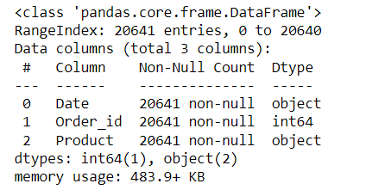
Data info:
Data Shape: (20641,3)
Data Info:

Slide 4
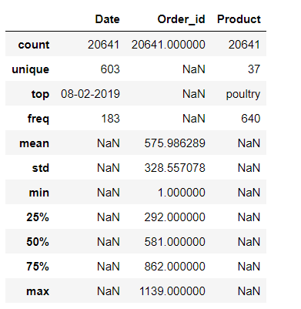
Null Values: 0
Duplicated Rows : 4730
Summary:

Slide 5
Inferences:
There are 20641 rows of data with 3columns.
There are 0 null values and 4730 duplicated rows.
Order_ID is the only int value while the other are object data types.
There are a total of 1139 order_ids that we have obtained.
There are 37 different categories that are analyzed.
The most sold product category is Poultry with a count of 640.

Slide 6
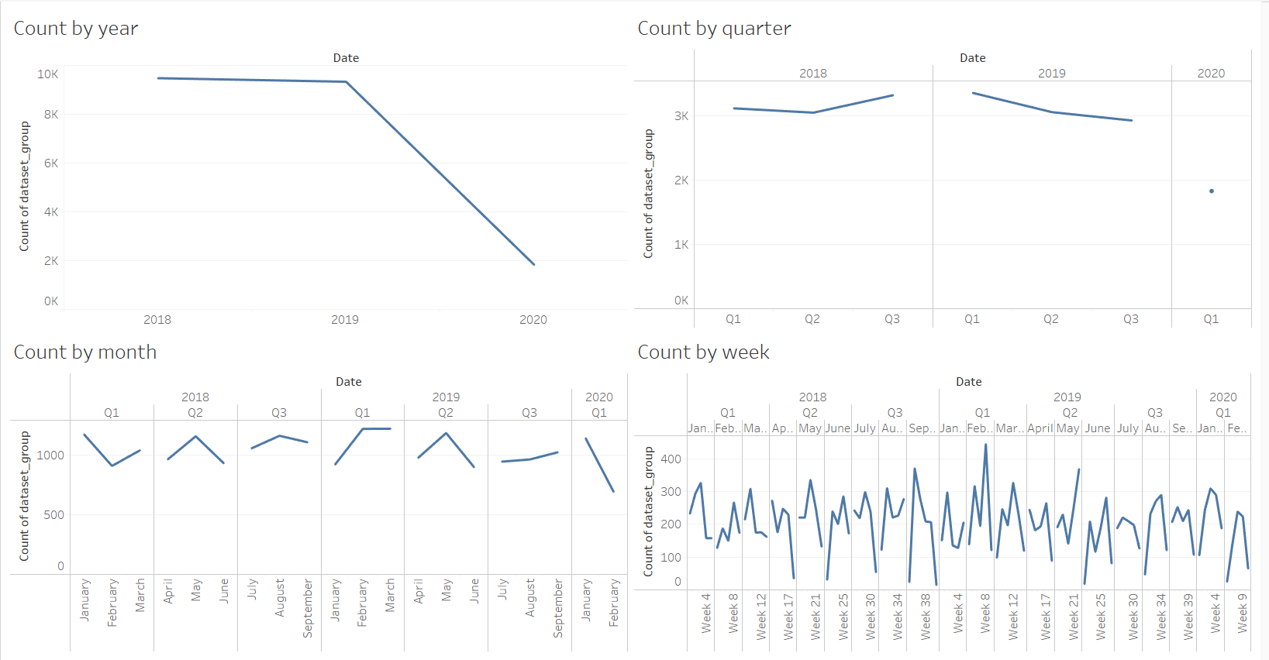
Exploratory Analysis:
Time Series

Slide 7
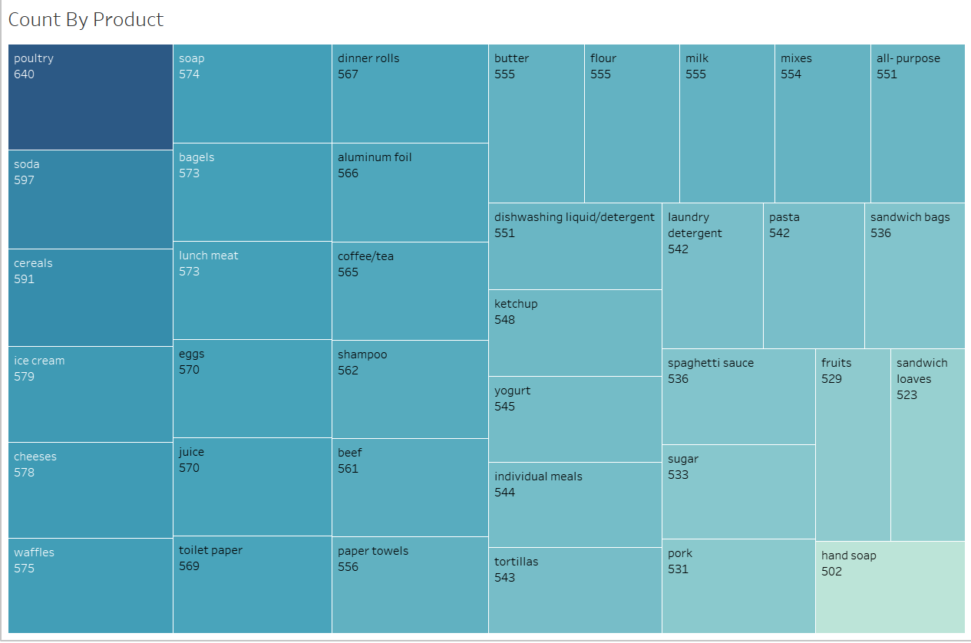
Product Line Vs Sales & Quantity Sold

Slide 8
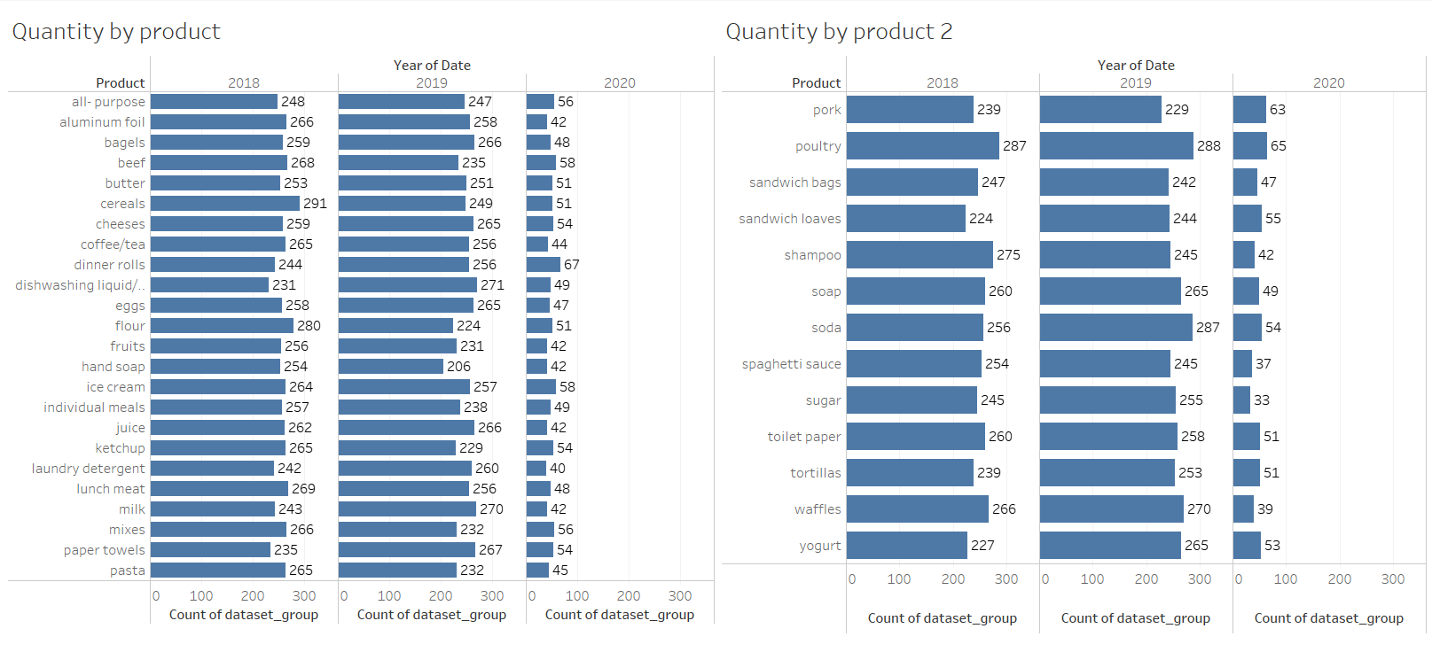
Quantity by Product

Slide 9
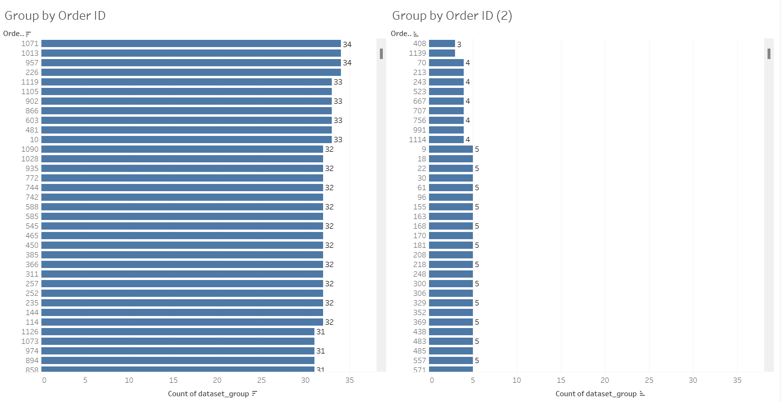
Customer Sales & Descending order list of Customers based on Last Sold date

Slide 10
Inferences from EDA:
The sales is highest in 2018 and dropped the lowest in 2020.
Q3 in 2018 and Q1 in 2019 saw the most products sold and since then there has been a gradual decline.
May has seen a peak in sales in both the years despite there being lower sales in April & June
There are no trends in the weekly count of products sold though.
Poultry is the category of products that has been sold the most, a count of 640. This is closely followed by Soda & Cereals.
Hand soap is the product category that is sold the least with a count of 502. Sandwich loaves and Fruits are the other lower sold products.
There are no major trends seen in terms of the quantity sold across the years by product. However, we can observe that Sugar& Waffles despite having decent sales in 2018 & 2019 but has shown a poor start in 2020.
Dinner rolls is the most sold product in 2020 despite being an average seller in the previous years.
Dishwashing Liquid has grown gradually across the years in terms of the sales.
We can see that the most number of products sold in a single order is 34 (4 different orders) while the least number of products sold in a single order is 3.

Slide 11
Market Basket Analysis using Association Rules:
Market Basket Analysis is one of the key techniques used by large retailers to uncover associations between items. It works by looking for combinations of items that occur together frequently in transactions. To put it another way, it allows retailers to identify relationships between the items that people buy.
Association Rules are widely used to analyze retail basket or transaction data, and are intended to identify strong rules discovered in transaction data using measures of interestingness, based on the concept of strong rules.
To perform a Market Basket Analysis and identify potential rules, a data mining algorithm called the ‘Apriori algorithm’ is commonly used, which works in two steps:
Systematically identify itemsets that occur frequently in the data set with a support greater than a pre-specified threshold.
Calculate the confidence of all possible rules given the frequent itemsets and keep only those with a confidence greater than a pre-specified threshold.

Slide 12
Key metrics for association rules:
There are 3 key metrics to consider when evaluating association rules:
Support: Percentage of orders that contain the item set.
Support = Freq(X,Y)/N
2. Confidence: Given two items, X and Y, confidence measures the percentage of times that item Y is purchased, given that item X was purchased. This is expressed as:
Confidence = Freq(X,Y)/Freq(X)
Confidence values range from 0 to 1, where 0 indicates that Y is never purchased when X is purchased, and 1 indicates that Y is always purchased whenever X is purchased. Note that the confidence measure is directional.
3. Lift: Unlike the confidence metric whose value may vary depending on direction (eg: confidence{X ->Y} may be different from confidence{Y ->X}), lift has no direction. This means that the lift{X,Y} is always equal to the lift{Y,X}. Lift can take the following values:
Lift = 1; implies no relationship between X and Y
Lift > 1; implies that there is a positive relationship between X and Y
Lift < 1; implies that there is a negative relationship between X and Y

Slide 13
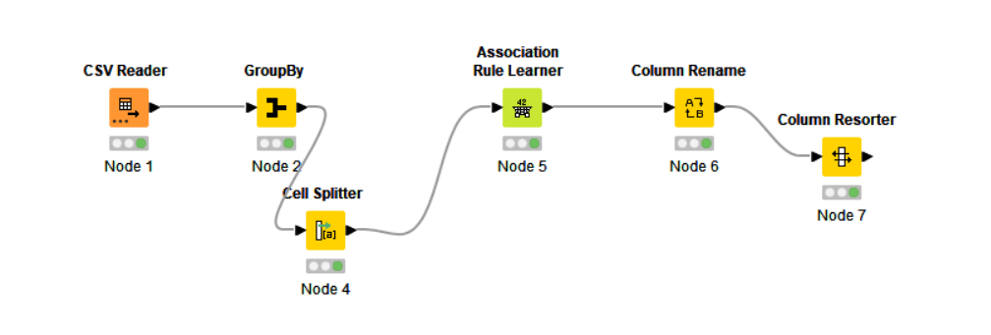
Market Basket Analysis using Association Rules:
Work Flow Image

Slide 14
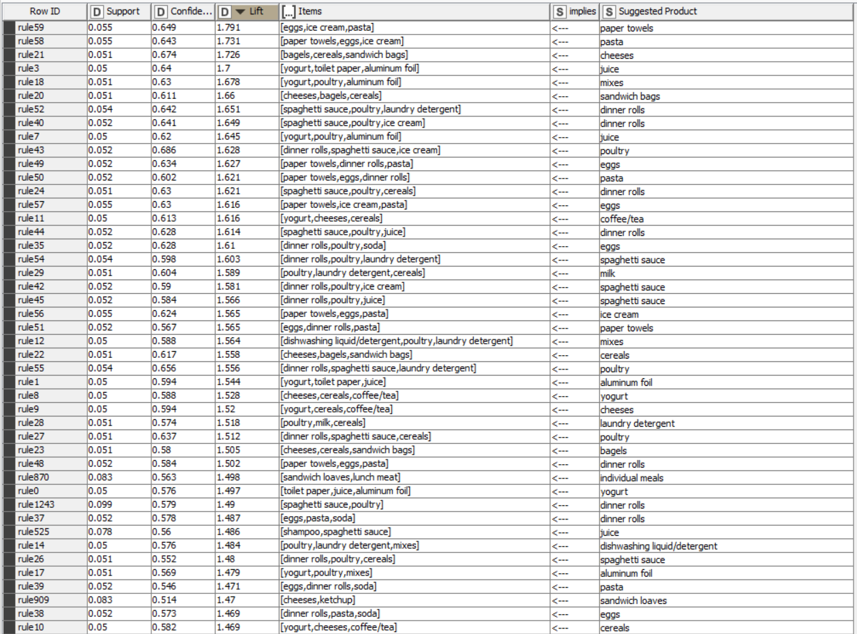
Output table head :

Slide 15
Market Basket Analysis using Association Rules:
Based on the Assoication Rules, we have obtained 1247 rows of baskets and recommendations. Off these, we use the Lift metric to shortlist the best combinations.
We have sorted the output table in the descending order of “Lift”. Some of the values are:
Basket Recommendation Lift
[eggs, ice cream, pasta] paper towels
1.7911934300192207
[paper towels, eggs, ice cream]
1.731003039513678
pasta
[bagels, cereals, sandwich bags]
1.7262085184217402
cheeses
1.700400722872633
[yogurt, toilet paper, aluminum foil]
juice
[yogurt, poultry, aluminum foil]
mixes
1.6777224705404308
dinner rolls
[spaghetti sauce, poultry, laundry detergent]
1.6509207556136392

Slide 16
Inferences from Market Basket Analysis:
Some other baskets and recommendations are:
[paper towels, dinner rolls, pasta]
eggs
[yogurt, cheeses, cereals]
coffee/tea
[spaghetti sauce, poultry, juice]
dinner rolls
[poultry, laundry detergent, cereals]
milk
[paper towels, eggs, pasta]
ice cream
[yogurt, toilet paper, juice]
aluminum foil

Slide 17
Inferences from Market Basket Analysis:
Based on this data, there are some combinations that can be packaged together or sold as an offer.
Recommended Combos:
Bucket 1: Pasta, egg, ice-cream, paper towels
Bucket 2: Bagels, cereals, sandwich bags, cheeses
Bucket 3: Yogurt, Toilet paper, aluminium foil, juice
Bucket 4: Yogurt, Poultry, Mixes, aluminium foil
Bucket 5: Spaghetti sauce, poultry, laundry detergent, dinner rolls
Bucket 6: Yogurt, cheeses, cereals, coffee/tea

Slide 18
Inferences from Market Basket Analysis:
Relevance of the key metrics of Lift, Confidence & Support
The lift values that vary from 1.79 to 1.186 shows the positive relationship between the basket and the suggested product. The higher the lift value, more the chance of the customer buying the suggested product.
The confidence values between 0.5 and 0.686 shows that the percentage of orders where the customer who bought the basket also bought the suggested product
The support values shows the percentage of orders which have the basket. A very low support shows that this has basket has not worked a lot of times.

Slide 19
Suggestion of Possible Combos:
Buy 3 Get 1 Free : Buy Pasta, Ice-cream & paper towels and Get Eggs Free
Buy the Picnic Basket & get 10% off: Bagels, cereals, sandwich bags, cheeses
Buy Yogurt, Juice & Aluminium Foil to get Toilet paper/Poultry
Buy Spaghetti sauce, poultry, dinner rolls, laundry detergent and get 20% off
Dairy Bucket: Buy Yogurt & cheeses, Get cereals & coffee/tea
We can look at further combinations and based on how customers respond to the above offers, we can modify and add new offers.
Thank You!

