Slide 1
Mobile App Update Impact and Failure Detection
Review 1
23CSE452 Business Analytics
Data Analysis and Predictive Modelling
Team number: 10
Members:
Aditya Monish Kumar K - CB.SC.U4CSE23103
Regella Krishna Saketh - CB.SC.U4CSE23649
Akshay KS - CB.SC.U4CSE23104
Harshini Vennela - CB.SC.U4CSE23455
Kanishka D - CB.SC.U4CSE23155
01
Notes:
Introduce the team and the topic: detecting problem reviews and failure patterns in Play Store reviews of 11 Indian consumer apps. All data was collected by us (no Kaggle/UCI). About 10 minutes, roughly 1 minute per slide.

Slide 2
Problem Statement and Research Gap
Problem statement: Apps like Flipkart, Blinkit and Zomato get 870 to 1,540 Play Store reviews every day. Teams cannot read them all, so failed payments, late deliveries, refund problems and bad app updates are noticed late.
Existing methods: Bug / feature-request classifiers (Maalej & Nabil, 2015), AR-Miner topic grouping (Chen et al., 2014), feature-level sentiment (Guzman & Maalej, 2014), VADER sentiment (Hutto & Gilbert, 2014).
Research gap: Reviews are studied as one fixed set with generic labels that do not fit delivery, shopping and payment apps, and the bias from how reviews are collected is rarely checked.
Proposed approach: Collect every review of 11 apps ourselves, tag 9 domain-specific issues, check the data for collection artefacts, compare app versions, and train a classifier that flags problem reviews.
Business objective: Show which problems hurt users most in each app, whether a new app version made things worse, and send the reviews that need attention to the support team first.
Our Review 1 pipeline
1
Collect 1.20M reviews, 11 apps
2
Clean 1.14M reviews kept
3
Tag + sentiment 9 issues, VADER
4
Explore versions, bias checks
5
Features TF-IDF → SVD + 15
Problem review = rated 1–2★ (the user's own judgement); the 9 issue tags name the failure when the text mentions one.
Update impact = ratings and complaints by app version: version-level comparison now, before/after each release in Review 2.
6
Classify LR and Random Forest
02
Notes:
The gap: published review mining treats reviews as one fixed set with generic labels and rarely checks collection bias. Our pipeline is built for Indian delivery, shopping and payment apps and checks the data for collection artefacts. Definitions: a problem review is a 1-2 star review; the classifier finds dissatisfied users and the issue tags say what failed. Update impact: Review 1 compares each app version with its app's average (EDA charts 12-13); Review 2 compares ratings just before and after each new version appears, which the continuous daily data makes possible.

Slide 3
Dataset Description
Source and method: Google Play Store via google-play-scraper (our own collection, no Kaggle/UCI). Sort NEWEST: every English/India review from 1 Apr to 20 Sep 2026.
Dataset size: 1,202,729 raw reviews; 1,137,987 after cleaning; 29 columns after tagging and sentiment.
Key variables: app_name, domain, score (1–5), content (text), thumbs_up, app_version, review_date, review_length, 9 issue flags, 4 VADER scores.
Prediction target: is_problematic = 1 if rating ≤ 2 stars (19.5% of reviews).
Period and limitations: 1 Apr – 20 Sep 2026 for every app. Median review is 2 words; written reviews are harsher than public ratings; positive reviews drop sharply 21 Apr – 5 May for 5 apps.
Domain | Apps | Reviews
Food & Grocery | Swiggy, Zomato, Blinkit, Domino's | 497,403
Shopping | Myntra, Flipkart, Amazon, Meesho | 487,071
Payments | Paytm, PhonePe, Google Pay | 153,513
Total | 11 apps | 1,137,987
Documentation: DATA_SOURCES.md (source, parameters, per-app counts, known issues). Files: data/raw, data/clean, data/tagged (one .csv.gz per app).
Data sample (data/tagged)
App | ★ | Review text | Date | Issue tag | Sentiment
Swiggy | 1 | assigning multiple orders for single delivery partner… all the orders are getting delayed | 2026-05-02 | delivery_delay | Negative
Amazon | 1 | i return my Order product... but didn't get any Refund even After waiting for 20 Days | 2026-07-14 | payment_refund | Neutral
Flipkart | 5 | nice app | 2026-08-20 | none | Positive
PhonePe | 5 | Yes my phone pe app not working | 2026-05-20 | none | Positive
03
Notes:
Every review from 1 April to 20 September, not a sample, so all apps share the same window. The last sample row is a real mis-rating: a complaint with 5 stars. Full documentation is in DATA_SOURCES.md.

Slide 4
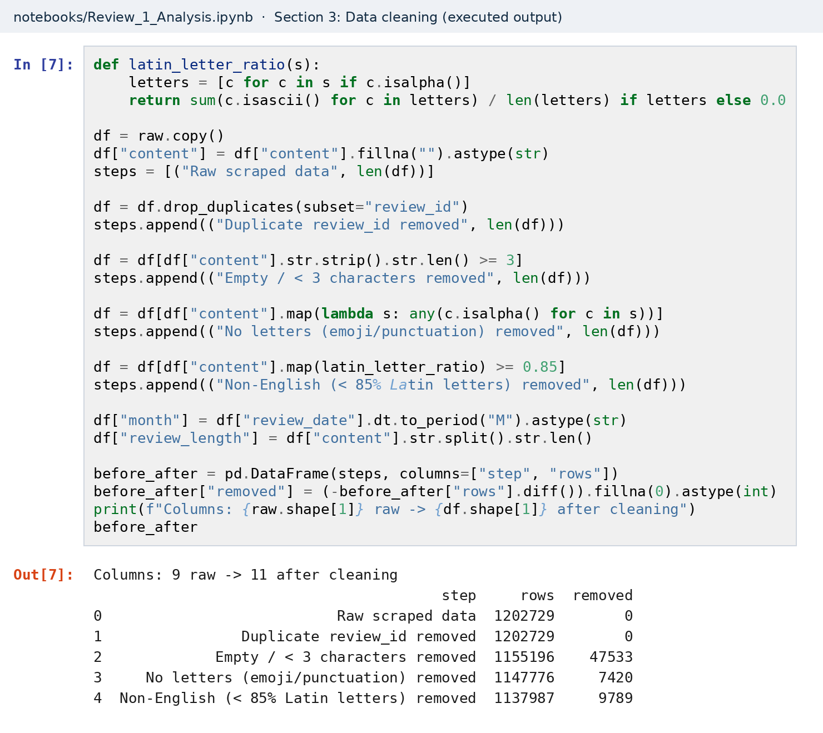
Data Cleaning and Preprocessing
Missing values: Only app_version is missing (152,017 rows, 13.4%); rows kept because version is not a model feature. Empty text set to "" and reviews under 3 characters removed (47,533).
Duplicates and outliers: 0 duplicate review IDs. Removed 7,420 reviews with no letters (emoji only) and 9,789 non-English reviews (< 85% Latin letters; emojis ignored, so "good 👍" is kept). thumbs_up (93.6% zero, max 11,165) and long reviews kept, handled with medians, log scale and rank tests.
Encoding and scaling: Text → TF-IDF; 9 issue categories as 0/1 columns; 15 structural features scaled with StandardScaler; month and review_length derived.
Before and after: 1,202,729 → 1,137,987 rows (64,742 removed, 5.4%). Columns: 9 raw → 11 after cleaning → 29 after tagging and sentiment.
04
Notes:
The screenshot is the executed notebook cell, running the cleaning on the raw files and matching the script output exactly. Most removals are very short reviews ('ok', a single emoji). The language check looks at letters only, so English reviews with emojis stay; the non-English removals are mostly Hindi (Devanagari), then Bengali and Telugu. An earlier version of the rule counted emojis as non-English and wrongly removed about 76,000 English reviews; we found and fixed it. No duplicates were found.

Slide 5
Exploratory Analysis and Visualization (1/2)
■ Food & Grocery ■ Shopping ■ Payments
Finding 1: Amazon (54%) and Swiggy (35%) are far harsher than the other nine apps (10–24%), throughout April–September. Business significance: these two have a lasting service problem.
Finding 2: Customer Support is the most common (4.1%) and most damaging issue (1.23★). Shopping is led by returns; delivery is almost absent in Payments. Business significance: each app should fix its own top issue first.
05
Notes:
Left: share of 1–2 star reviews per app. Right: the top issues per domain. Charts 02, 06 and 14 in data/charts/eda show the full detail. Only 10% of reviews carry an issue tag because most reviews are 1–3 words.

Slide 6
Exploratory Analysis and Visualization (2/2)
Finding 3: From 21 Apr to 5 May positive reviews drop 59–90% for these 5 apps while negative reviews drop only 3–37%: a Play Store feed gap, not a wave of complaints. Swiggy's weekly "% negative" jumps to 87%.
Business significance: Monitor negative reviews per day, not "% negative". We keep and flag these rows and exclude them from trends.
Feed gap
21 Apr – 5 May
Other checks
• No mid-year shift: no app's reviews per day rise after July, and median length is unchanged in 10 of 11 apps.
• 1★ reviews: median 14 words; 5★: 2 words.
• 1★ is 17% of reviews but 59% of upvotes.
06
Notes:
If users had become angrier, negative reviews would rise. Here negatives fell slightly (3-37%) while positives fell 59-90%, and a scraper error would remove all reviews alike. So this is a Play Store feed effect. Chart 15 in data/charts/eda has the per-app evidence. Chart 11 tests and rejects the July shift.

Slide 7
Feature Engineering or Dimensionality Reduction
Method: TF-IDF on review text (20,000 terms, single words and 2-word phrases, no stop-word list so "not good" is kept), reduced with Truncated SVD to 200 components and joined with 15 structural features.
Features used: 200 SVD text components + 9 issue flags + 4 VADER scores + review_length + thumbs_up = 215 features (structural features standardised).
Justification: A 1.1M × 20,000 sparse matrix is slow and noisy for a Random Forest. Issue flags and sentiment add meaning single words miss. Complaints are much longer than praise (14 vs 2 words), so length is kept explicitly.
Effect: Text columns 20,000 → 200 (100× smaller) while keeping 62.7% of the TF-IDF variance. Every group adds: text alone gives PR-AUC 0.85, sentiment alone 0.74–0.80, all 215 features 0.87. Sentiment scores are the top three Random Forest features.
Feature group | Count
Text components (SVD) | 200
Issue flags | 9
VADER sentiment scores | 4
review_length, thumbs_up | 2
Total | 215
07
Notes:
SVD components group the vocabulary: component 0 is 'good / very good / good service', component 1 'nice / very nice / nice app'. The structural features carry the strongest single signals; blue bars are sentiment, green is review length.

Slide 8
Predictive Model Development
Prediction task: Binary classification: is a review problematic (rated 1–2★) or not.
Model(s): Logistic Regression and Random Forest, compared against a majority-class baseline.
Model selection: Logistic Regression is a fast, interpretable linear baseline; Random Forest learns non-linear interactions and gives feature importance. One linear and one tree model show two kinds of error.
Data split: Stratified 80/20 (910,389 train / 227,598 test, random state 42), plus an out-of-time test: train April–August, test 1–20 September.
Model settings: Both use class_weight = balanced (only 19.5% positive). Logistic Regression: max_iter 1000. Random Forest: 150 trees, 30% bootstrap per tree, at least 100 reviews per leaf (model 9.8 MB). Checked on a validation split of the training data: C = 1 is best for Logistic Regression; 25 reviews per leaf adds only 0.004 PR-AUC to the Random Forest at 2.8× the size.
Random split (stratified)
Train 80% · 910,389
Test 20%
Out-of-time test
Apr – Aug · 1,008,932
1–20 Sep
08
Notes:
Because problem reviews are the minority (19.5%), both models use balanced class weights. The Random Forest is size-limited so the saved model fits in the repository. The out-of-time split checks that the model works on future weeks.

Slide 9
Model Evaluation and Result Interpretation
Model (test set, 227,598 reviews) | Accuracy | Precision | Recall | F1 | ROC-AUC | PR-AUC
Majority-class baseline | 0.805 | 0.000 | 0.000 | 0.000 | 0.500 | 0.195
Logistic Regression | 0.922 | 0.767 | 0.858 | 0.810 | 0.940 | 0.871
Random Forest | 0.914 | 0.737 | 0.870 | 0.798 | 0.941 | 0.873
Random Forest confusion matrix
pred. no
pred. yes
169,539
13,743
actual no
true negative
false positive
5,756
38,560
R², MAE, MSE, RMSE do not apply (classification). Out-of-time test (Apr–Aug → 1–20 Sep): PR-AUC 0.866 (RF), 0.862 (LR). RF PR-AUC by domain: Food & Grocery 0.895, Shopping 0.869, Payments 0.750. 95% bootstrap intervals: ±0.003 PR-AUC, ±0.001 accuracy.
actual yes
false negative
true positive
Results
Both models are over 91% accurate, with PR-AUC 0.87 vs 0.195 for random guessing. Random Forest finds 87% of complaints; Logistic Regression is more precise (77% vs 74%). Both hold on future weeks.
Interpretation
Accuracy alone misleads: never flagging anything scores 80.5%. Logistic Regression raises 16% fewer false alarms; Random Forest misses fewer complaints. Limits: the target is the star rating (some users mis-rate), most reviews are 1–3 words, payment apps are hardest.
Business findings
Triage reviews automatically: about 3 in 4 flagged reviews are real complaints. Each app should fix its own top issue first. Track negative reviews per day, not "% negative".
09
Notes:
Lead with PR-AUC: 0.87 against 0.195 for random. The confusion matrix shows the Random Forest misses 5,756 of 44,316 complaints and raises 13,743 false alarms out of 183,282 non-problem reviews. Logistic Regression raises 11,538 false alarms but misses 6,297 complaints. The differences between the models are small but real: the 95% bootstrap interval for the PR-AUC difference (Random Forest minus Logistic Regression) is 0.001 to 0.004. Per-app results are in MODEL_EVALUATION.md.

Slide 10
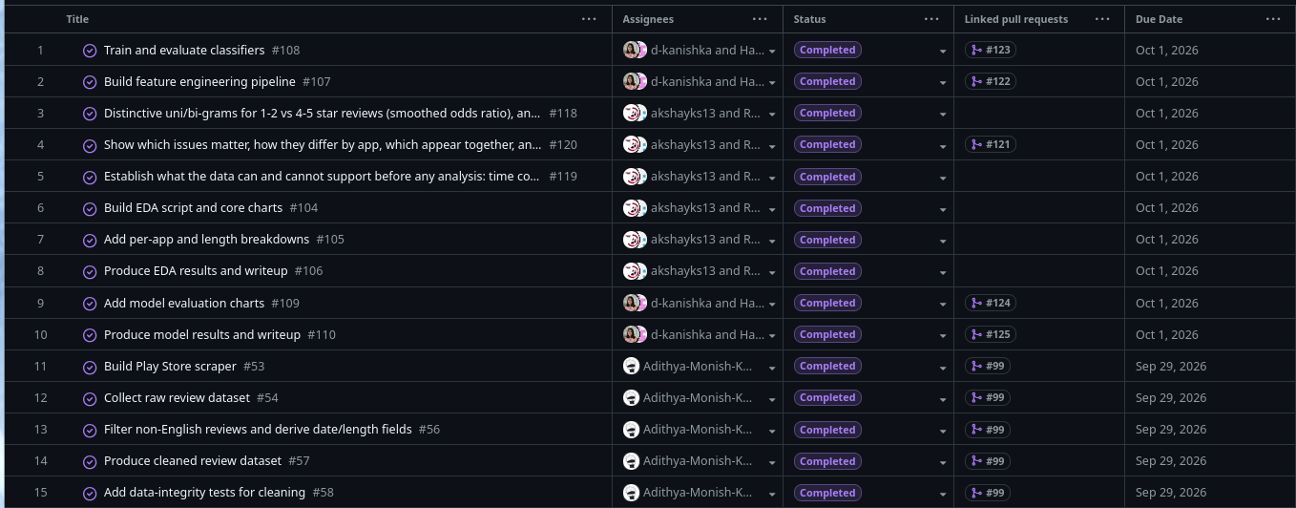
Project Tracking and Progress
Tool and board link: GitHub Projects — github.com/users/Adithya-Monish-Kumar-K/projects/4 (repository: github.com/Adithya-Monish-Kumar-K/ba-capstone-app-reviews)
Stages:
Backlog
To Do
In Progress
Review/Testing
Completed
15 of 15 tasks done
Evidence and activity history:
10
Notes:
Every task has one or two assignees and a due date on the GitHub Projects board, and every task is covered by a merged pull request. The screenshot is the board's table view: all 15 tasks with their assignees, status, linked pull request and due date.

Slide 11
Individual Contributions and Next Steps
Member / Register number | Completed tasks | Evidence
Aditya Monish Kumar K CB.SC.U4CSE23103 | Play Store scraper; full NEWEST collection (1.20M reviews, 11 apps); cleaning; dataset documentation; project board | scripts/01–02, apps.py, data_io.py, DATA_SOURCES.md
Regella Krishna Saketh CB.SC.U4CSE23649 | EDA script with Akshay: coverage and bias audit, issue analysis, statistical tests, version analysis | scripts/05_eda.py, EDA.md, data/charts/eda
Akshay KS CB.SC.U4CSE23104 | EDA script with Saketh: coverage and bias audit, issue analysis, statistical tests, version analysis | scripts/05_eda.py, EDA.md, data/charts/eda
Harshini Vennela CB.SC.U4CSE23455 | With Kanishka: TF-IDF + SVD features; Logistic Regression and Random Forest; evaluation and interpretation charts | scripts/05_feature_engineering.py, 06–13, MODEL_EVALUATION.md
Kanishka D CB.SC.U4CSE23155 | With Harshini: TF-IDF + SVD features; Logistic Regression and Random Forest; evaluation and interpretation charts | scripts/05_feature_engineering.py, 06–13, MODEL_EVALUATION.md
Pending work
None
Submission links
Notebook
github.com/Adithya-Monish-Kumar-K/ba-capstone-app-reviews/blob/master/notebooks/Review_1_Analysis.ipynb
Dataset
github.com/Adithya-Monish-Kumar-K/ba-capstone-app-reviews/tree/master/data
Data documentation
github.com/Adithya-Monish-Kumar-K/ba-capstone-app-reviews/blob/master/DATA_SOURCES.md
Board
github.com/users/Adithya-Monish-Kumar-K/projects/4
Summary (README)
github.com/Adithya-Monish-Kumar-K/ba-capstone-app-reviews/blob/master/README.md
Review 2 plan
Method 1: text mining. Method 2: time-series forecasting. Interactive dashboard and combined recommendations.
11
Notes:
Each member presents their own stage. Repository: github.com/Adithya-Monish-Kumar-K/ba-capstone-app-reviews.

