Slide 1
Mobile App Update: Impact & Failure Detection
23CSE452 Business Analytics
Team 10
Roll number | Name
CB.SC.U4CSE23103 | Aditya Monish Kumar K
CB.SC.U4CSE23649 | Regella Krishna Saketh
CB.SC.U4CSE23104 | Akshay KS
CB.SC.U4CSE23455 | Harshini Vennela
CB.SC.U4CSE23155 | Kanishka D

Slide 2
Problem Statement and Research Gap
Problem statement: Swiggy, Zomato, Myntra, Paytm and PhonePe get thousands of Play Store reviews a day. Teams cannot read them all, so real problems (failed payments, late delivery, crashes) are noticed late.
Existing methods: Review classification into bug / feature request (Maalej and Nabil, 2015), AR-Miner topic grouping (Chen et al., 2014), feature-level sentiment (Guzman and Maalej, 2014), VADER (Hutto and Gilbert, 2014).
Research gap: Reviews are studied as one fixed set and not followed over time. Labels are general and do not fit Indian delivery and payment apps. Collection bias is rarely checked.
Proposed approach: One pipeline on data we collected ourselves: issue tagging, sentiment, classifier, weekly forecast and a dashboard.
Business objective: Show which problems hurt users most in each app, which reviews need attention first, and whether this week's negative share is normal.
02

Slide 3
Dataset Description
Source and collection method: Google Play Store, collected with the google-play-scraper package (English, India, MOST_RELEVANT order, 3,000 reviews per app).
Dataset size: 15,000 raw reviews; 14,988 after cleaning; 28 columns after tagging and sentiment.
Key variables: app_name, score (1 to 5), content (text), thumbs_up, app_version, review_date, review_length, 9 issue flags, sentiment score and label.
Prediction target: is_problematic = 1 when the rating is 1 or 2 stars (74.1% of reviews).
Collection period and limitations: Collected 20 Sep 2026; review dates 15 Sep 2018 to 18 Sep 2026. The feed favours complaints: 69.2% are 1-star, while public ratings are 4.43 to 4.66.
App | Category | Reviews
Swiggy | Food and Drink | 3,000
Zomato | Food and Drink | 2,997
Myntra | Shopping | 2,998
Paytm | Finance | 2,998
PhonePe | Finance | 2,995
Reviews per app after cleaning
03

Slide 4
Cleaning and preprocessing
Missing values: Only app_version is missing (449 rows, 3.0%). Rows were kept because the version is not a model feature.
Duplicates and outliers: 0 duplicate review IDs. 12 non-English reviews removed (less than 85% ASCII). thumbs_up has 1,897 extreme values (max 46,743); these are real viral reviews, so we kept them and used medians and log scale.
Encoding and scaling: Text to TF-IDF; issue categories as 0/1 columns; 15 structural features scaled with StandardScaler.
Before and after: 15,000 rows to 14,988 rows (12 removed). Columns: 8 raw, 10 after cleaning, 28 after tagging.
04

Slide 5
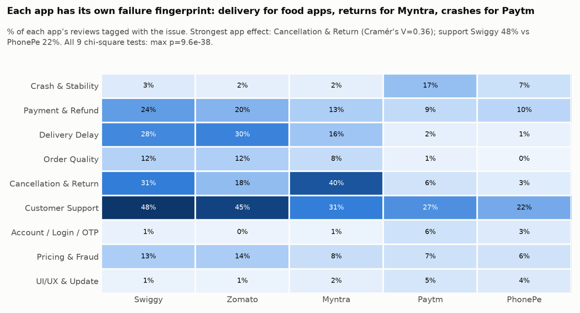
Exploratory Analysis and Visualization
Finding 1: Each app has its own problem. Delivery Delay is about 29% at Swiggy and Zomato but 1 to 2% at Paytm and PhonePe. Cancellation and Return is 40% at Myntra. Crash and Stability is 17% at Paytm.
Finding 2: Customer Support is the biggest issue overall (34.4% of reviews, average 1.19 stars). Order Quality is rare (6.6%) but rated worst (1.13 stars).
Business significance: One common fix will not work. Each company should fix its own top problem first.
05

Slide 6
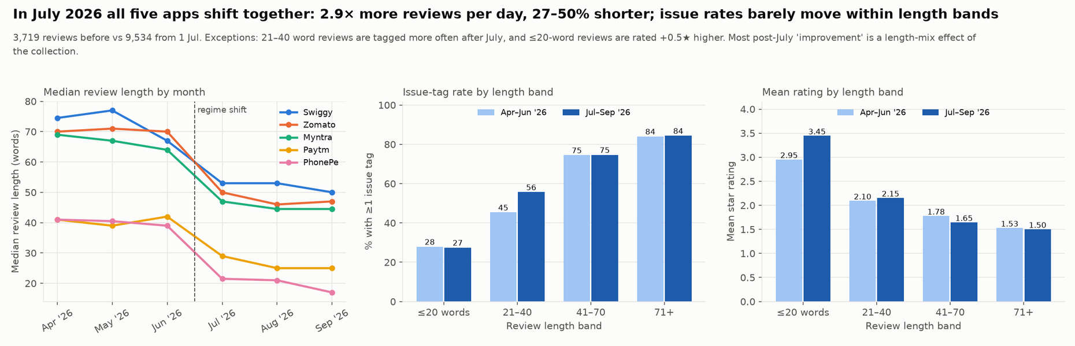
Finding 3: From July 2026 all five apps get 2.9 times more reviews per day and the reviews are 27 to 50% shorter. Issue rates seem to fall 7 to 16 points, but only 1 to 5 points when reviews of the same length are compared.
Business significance: This is a change in what the Play Store feed returned, not an improvement in the apps. Without this check we would report a false improvement.
06

Slide 7
Feature Engineering or Dimensionality Reduction
Feature group | Count
Text components (SVD) | 100
Issue flags | 9
VADER sentiment scores | 4
review_length, thumbs_up | 2
Total features | 115
Method: TF-IDF on review text (5,000 terms, single words and word pairs), reduced to 100 components with Truncated SVD.
Features used: 100 text components + 9 issue flags + 4 VADER sentiment scores + review_length + thumbs_up = 115 features.
Justification: A 5,000-column sparse matrix is slow and noisy for a Random Forest. Issue flags and sentiment add meaning that single words miss. Review length is kept as its own feature because longer reviews get more tags.
Effect: Text features are 50 times smaller (5,000 to 100) and keep 21.8% of the TF-IDF variance. Both models still reach ROC-AUC of about 0.95. Sentiment scores are the most important features in the Random Forest.
Top Random Forest features | Weight
Sentiment compound | 0.103
Sentiment negative | 0.093
Sentiment positive | 0.092
Text component 2 | 0.092
07

Slide 8
Predictive Model Development
Prediction task: Classification: is the review problematic (1 or 2 stars) or not.
Models: Logistic Regression and Random Forest.
Model selection: Logistic Regression is a simple, fast baseline that is easy to explain. Random Forest can learn non-linear patterns. One linear and one tree model let us compare two kinds of error.
Data split: 80% training (11,990 reviews) and 20% testing (2,998 reviews), stratified, random state 42.
Model settings: Logistic Regression: class_weight = balanced, max_iter = 1000. Random Forest: 200 trees, class_weight = balanced. Other parameters at default; no grid search.
08

Slide 9
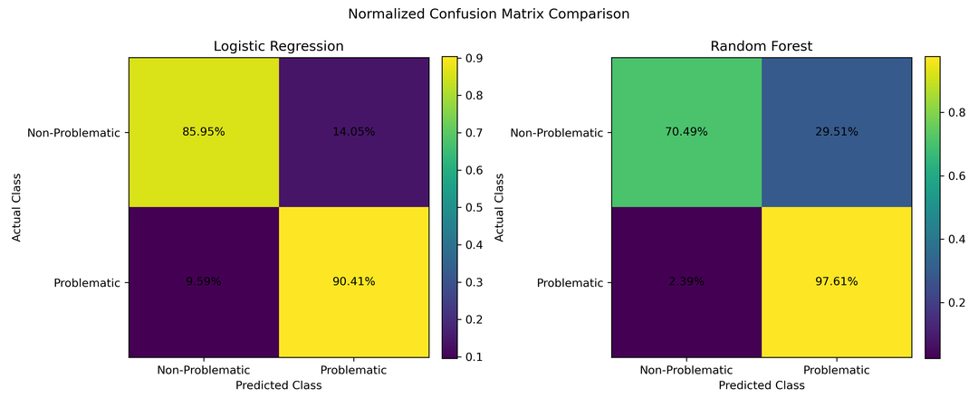
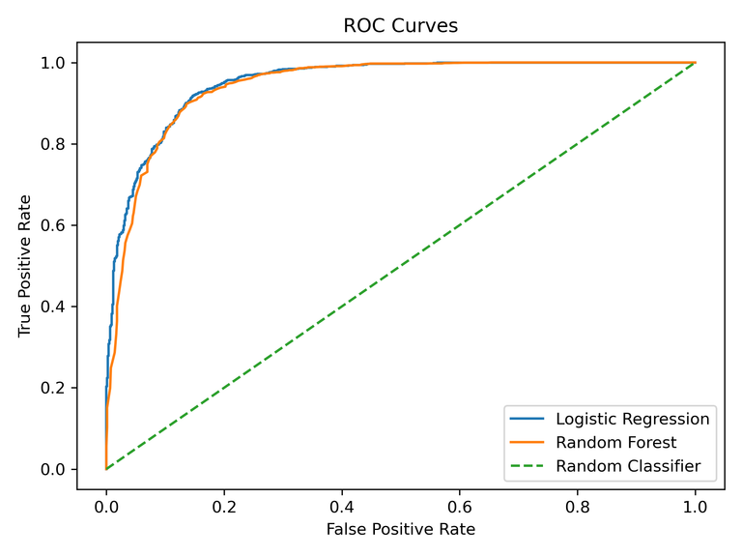
Model Evaluation and Result Interpretation
Model | Accuracy | Precision | Recall | F1 | ROC-AUC
Logistic Regression | 0.893 | 0.949 | 0.904 | 0.926 | 0.951
Random Forest | 0.906 | 0.905 | 0.976 | 0.939 | 0.944
Results: Both models are well above the 74.1% a model would get by always saying "problematic".
Interpretation: Random Forest misses only 53 problem reviews but gives 229 false alarms. Logistic Regression gives 109 false alarms but misses 213. Limits: target comes from the star rating; one random split.
Business findings: Reviews can be sorted automatically. Use Random Forest when no complaint should be missed, Logistic Regression when false alarms must be low.
09

Slide 10
Method 1: Text Mining – Data Preparation and Implementation
Input: 14,988 cleaned reviews (review text).
Issue tagging: 9 categories made for delivery, shopping and payment apps. Each has a list of keyword patterns. A review can get more than one tag; the category with the most matches is the primary issue.
Sentiment scoring: VADER (NLTK), a rule-based scorer made for short informal text. Compound score from -1 to +1; Negative at -0.05 or below, Positive at +0.05 or above.
Why these methods: Both are rule-based, so they need no labelled training data and are easy to explain.
Output: app_reviews_tagged.csv with 28 columns: 9 issue flags, issue summary fields and 5 sentiment fields.
Issue category | Reviews | %
Customer Support | 5,150 | 34.4
Cancellation and Return | 2,923 | 19.5
Delivery Delay | 2,301 | 15.4
Payment and Refund | 2,278 | 15.2
Pricing and Fraud | 1,414 | 9.4
Order Quality | 996 | 6.6
Crash and Stability | 938 | 6.3
UI/UX and Update | 364 | 2.4
Account, Login and OTP | 356 | 2.4
10

Slide 11
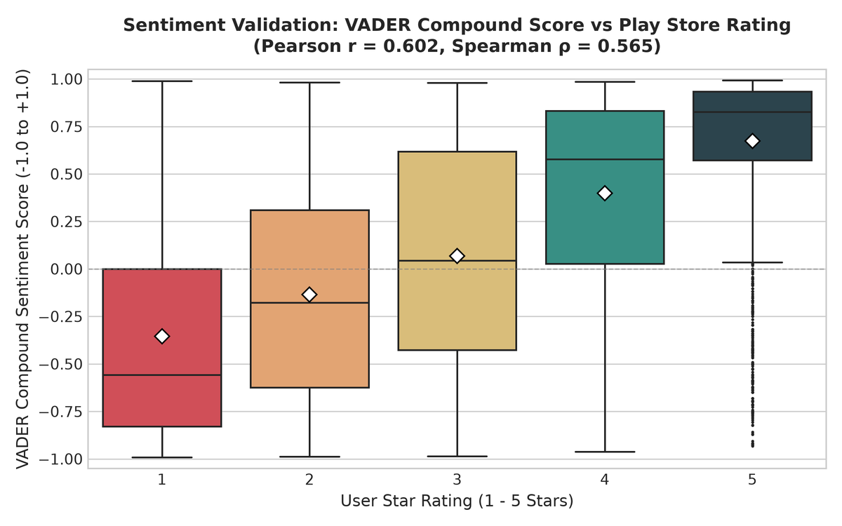
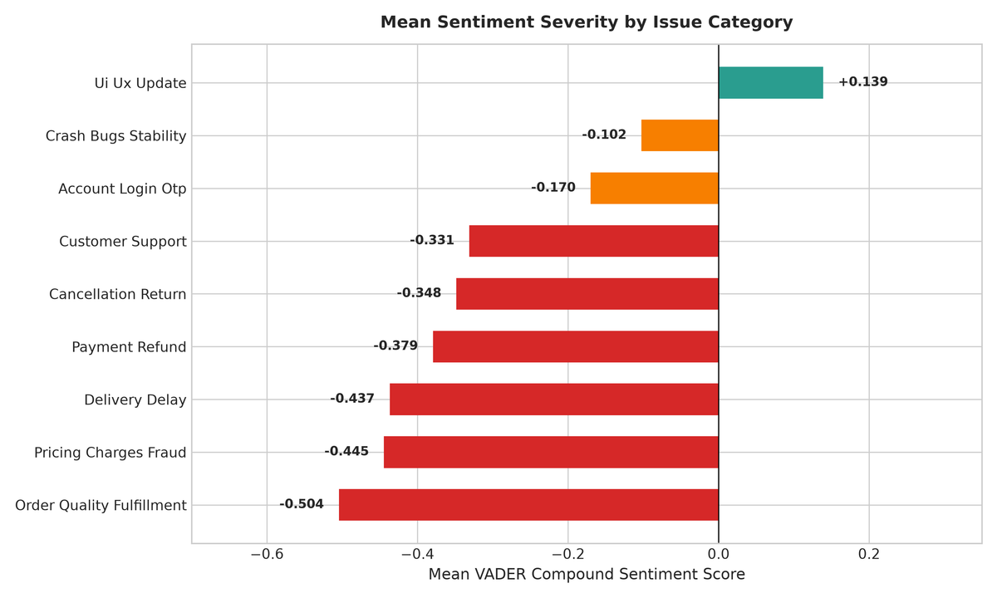
Evaluation: Sentiment score against star rating: Pearson 0.60, Spearman 0.56. The label matches the rating class for 72.0% of reviews. 65.4% of reviews get at least one issue tag.
Interpretation: Money and physical-goods problems make users angriest: Order Quality (-0.50), Pricing and Fraud (-0.44). Crash reviews use calmer language (-0.10).
Limits: VADER cannot detect sarcasm (24% of 1-star reviews score positive). The tagger cannot tell praise from complaint (Myntra "easy returns"), and 22% of low-star reviews get no tag.
11

Slide 12
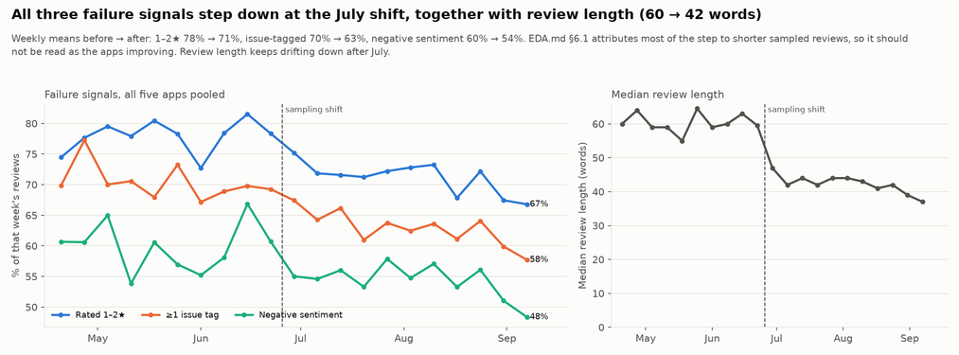
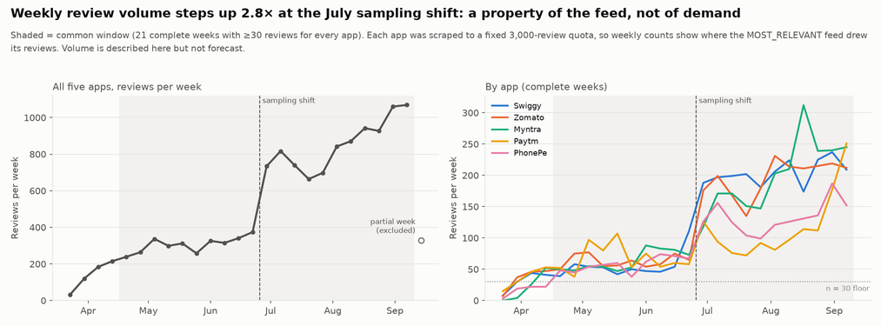
Method 2: Time-Series – Data Preparation and Implementation
Input: app_reviews_tagged.csv, using review_date.
Weekly aggregation: Monday to Sunday weeks, per app and pooled: review count, average rating, share of 1-2 star reviews, negative sentiment share, issue rates. Empty weeks kept as 0, not filled in.
Modelling window: 20 Apr to 13 Sep 2026: the 21 complete weeks where every app has at least 30 reviews (12,428 reviews, 82.9% of the data).
Models: Naive, mean of all history, level-shift mean, 4-week moving average, simple exponential smoothing (SES).
Why simple models: 21 weeks is too short for seasonal or ARIMA models, and the level changes suddenly in July.
Test setup: Last 6 weeks held out. Each test week forecast 1 to 4 weeks ahead from earlier weeks only, so there is no leakage. Review volume is not forecast because each app was capped at 3,000 reviews.
12

Slide 13
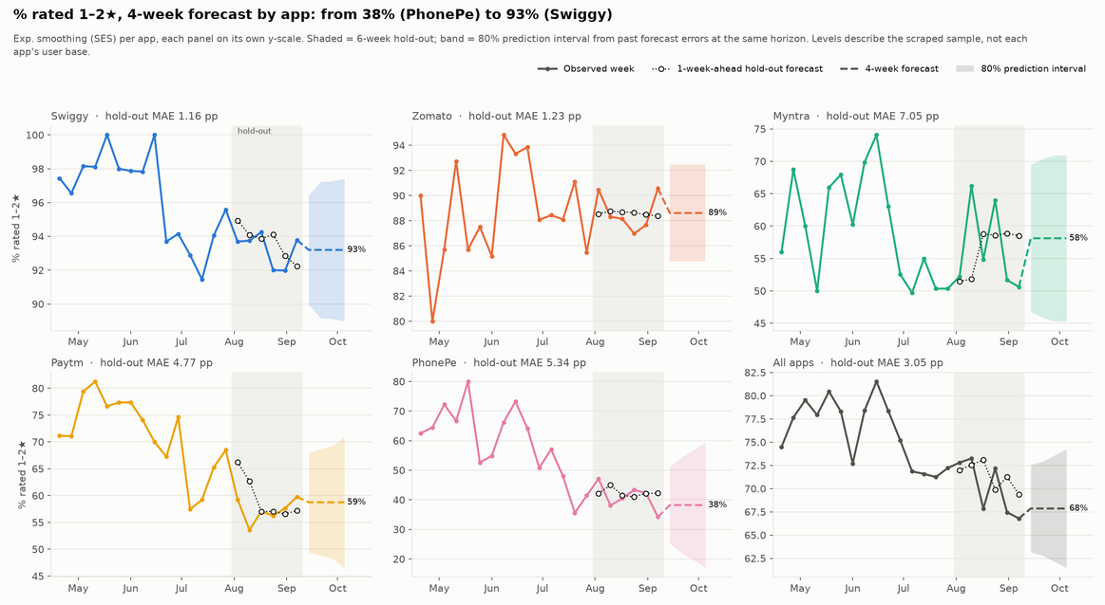
Test error (MAE, points) for share of 1-2 star reviews
Series | Naive | Level-shift | 4-wk avg | SES
Swiggy | 1.31 | 0.85 | 1.03 | 1.16
Zomato | 2.06 | 1.21 | 1.18 | 1.23
Myntra | 7.94 | 5.73 | 6.65 | 7.06
Paytm | 5.04 | 6.13 | 5.35 | 4.77
PhonePe | 5.04 | 5.97 | 4.89 | 5.34
All apps | 2.65 | 2.68 | 2.75 | 3.05
Evaluation: SES beats the naive forecast in 19 of 24 series. Error is 1.2 to 7.1 points. The mean of all history is worst in 18 of 24 because it ignores the July change.
Interpretation: The series steps down once in July (77.9% to 71.1% pooled) and is then flat; no app has a significant trend after that. Next 4 weeks: Swiggy 93%, Zomato 89%, Myntra 58%, Paytm 59%, PhonePe 38%.
Limits: Only 21 weeks; the forecast is a level, not a trend. 1 of 523 app-issue-weeks was flagged as a spike, which is what chance alone would give.
13

Slide 14
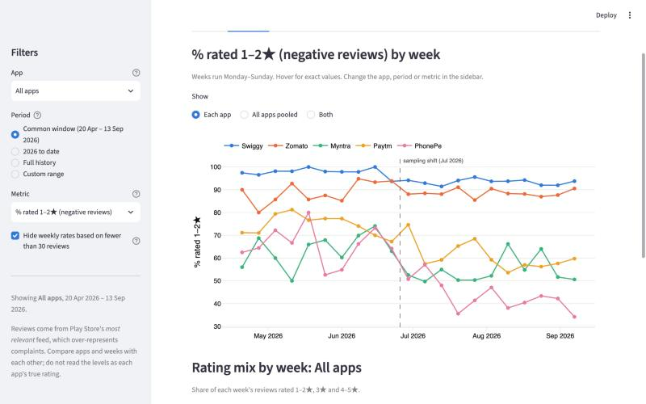
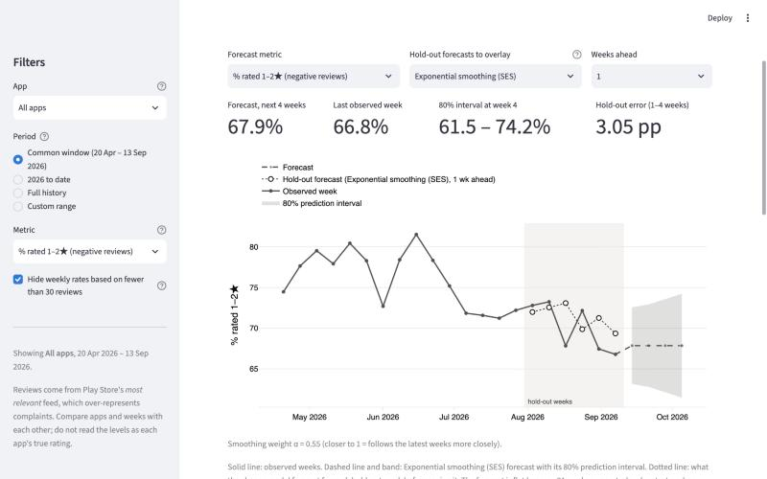
Interactive Dashboard
Tool: Streamlit + Plotly. Run with: streamlit run dashboard/app.py
Filters: App, period and metric. Every chart updates; hovering shows exact values.
Tabs: Overview, Weekly trends, Forecast with 80% band and model accuracy, Sentiment and issues, Key findings.
14

Slide 15
Combined Business Insights and Recommendations
What the methods say together: Text mining shows what the problems are, time-series shows when they move, and the classifier finds which reviews carry them. Weekly negative sentiment moves with the weekly share of 1-2 star reviews (correlation 0.82). Each app's issue mix stays the same week after week.
Swiggy and Zomato: Fix customer support first (48% and 45% of reviews, 1.19 stars), then delivery delay (about 29%).
Myntra: Review the cancellation and return process (40% of reviews).
Paytm: Look into crashes and stability (17%); the only major issue that did not fall after July.
All apps: Treat Order Quality complaints as high priority: few (6.6%) but worst rated (1.13 stars).
15

Slide 16
Project Tracking and Progress
Tool and board link: https://github.com/Adithya-Monish-Kumar-K/ba-capstone-app-reviews
Stages: To Do, In Progress, Review/Testing, Completed
Task | Issues | Member | Status | Evidence
Data collection and cleaning | Stage 1-2 | Aditya Monish Kumar K CB.SC.U4CSE23103 | Completed | scripts/01-02, DATA_SOURCES.md
Text mining | #101-#103 | Regella Krishna Saketh CB.SC.U4CSE23649 | Completed | scripts/03-04, TEXT_MINING.md
Exploratory data analysis | #104-#106 | Akshay KS CB.SC.U4CSE23104 | Completed | scripts/05_eda.py, EDA.md
Feature engineering and predictive model | #107-#110 | Harshini Vennela CB.SC.U4CSE23455 | Completed | scripts/05-12, MODEL_EVALUATION.md
Time-series forecasting, Interactive dashboard, report | #111-#114 | Kanishka D CB.SC.U4CSE23155 | Completed | scripts/13, TIME_SERIES.md, dashboard/, docs/, REPORT.md
16

Slide 17
References
[1] D. Pagano and W. Maalej, "User feedback in the AppStore: An empirical study," IEEE International Requirements Engineering Conference (RE), 2013.
[2] N. Chen, J. Lin, S. C. H. Hoi, X. Xiao and B. Zhang, "AR-Miner: Mining informative reviews for developers from mobile app marketplace," International Conference on Software Engineering (ICSE), 2014.
[3] E. Guzman and W. Maalej, "How do users like this feature? A fine grained sentiment analysis of app reviews," IEEE International Requirements Engineering Conference (RE), 2014.
[4] W. Maalej and H. Nabil, "Bug report, feature request, or simply praise? On automatically classifying app reviews," IEEE International Requirements Engineering Conference (RE), 2015.
[5] C. J. Hutto and E. Gilbert, "VADER: A parsimonious rule-based model for sentiment analysis of social media text," International AAAI Conference on Weblogs and Social Media (ICWSM), 2014.
[6] R. J. Hyndman and G. Athanasopoulos, Forecasting: Principles and Practice, 3rd edition, OTexts, 2021.
17

