Slide 1
23CSE452 BUSINESS ANALYTICS
Mobile App Update Impact and Failure Detection
Final Project Presentation
Team 10
Aditya Monish Kumar K CB.SC.U4CSE23103
Regella Krishna Saketh CB.SC.U4CSE23649
Akshay KS CB.SC.U4CSE23104
Harshini Vennela CB.SC.U4CSE23455
Kanishka D CB.SC.U4CSE23155
Guide / Faculty: Rohini S. Presentation date: 20/10/2026
01
Notes:
[Aditya, 20 s] Good morning. We are Team 10, and our project is Mobile App Update Impact and Failure Detection. We collected 1.14 million Play Store reviews of 11 Indian apps ourselves and took them through all three units: cleaning and EDA, a problem-review classifier, and two Unit 3 methods, text mining and time series, ending in a live dashboard.

Slide 2
PROJECT OVERVIEW
Business problem and objectives
Business problem: Product and support teams of 11 Indian consumer apps (Swiggy, Flipkart, Paytm and others) receive 117 to 1,539 Play Store reviews a day. Failed payments, refunds, late deliveries and bad updates are noticed late, because nobody can read them all.
Objectives: (1) Flag problem reviews automatically, far above the 19.5% base rate. (2) Find what users complain about, forecast daily 1–2★ reviews per app, and test every app release for harm.
Business decision: Which app, complaint and release to fix first, and how much support capacity to plan for next week.
Expected output: A problem-review classifier, complaint topics with sentiment, 4-week forecasts with unusual-day alerts, release verdicts and a per-app priority table with 65 recommendations, all in a live dashboard.
02
Notes:
[Aditya, 40 s] The users of our analysis are the product and support teams of apps like Swiggy, Flipkart and Paytm. They get up to 1,500 reviews a day, so real problems, failed payments, refunds, late deliveries, bad updates, are noticed late. We had two objectives: flag problem reviews automatically, and find what users complain about, forecast complaints and test each release. The decision this supports is what to fix first and how much support to plan. The output is a classifier, topics, forecasts, release verdicts and a priority table, all in a live dashboard.

Slide 3
UNITS 1 TO 3
Complete project workflow
Stage | Your implementation
Unit 1 | Own Play Store collection (1,202,729 raw → 1,137,987 validated reviews, 11 apps); cleaning; 9 keyword issue tags; VADER sentiment; EDA with 15 charts and bias checks
Unit 2 | TF-IDF → 200 SVD components + 15 structural features → Logistic Regression and Random Forest, tested on 227,598 held-out reviews (PR-AUC 0.87)
Unit 3 | Method 1: Text Mining (NMF topics + VADER) and Method 2: Time-Series Analysis (ARIMA/SARIMA forecasts + release impact)
Final application | Streamlit dashboard, 6 pages, live at team10-app-reviews.streamlit.app; priority table and 65 recommendations
Completion status: 100% implemented and integrated: every stage merged on GitHub, 29 of 29 board tasks Completed (15 in Review 1, 14 in Review 2).
03
Notes:
[Aditya, 30 s] This is the whole workflow. Unit 1: our own collection, cleaning, tagging, sentiment and EDA. Unit 2: a classifier tested on 227,598 held-out reviews. Unit 3: text mining and time-series analysis. And everything feeds one live dashboard with recommendations. All of it is implemented and merged; all 29 board tasks are completed.

Slide 4
DATASET ACROSS UNITS 1 TO 3
Overall dataset description
Source and collection method: Google Play Store, collected by us with the google-play-scraper package: every English review from India, newest first, for 11 apps. No Kaggle, UCI or GitHub dataset.
Final dataset size: 1,137,987 reviews × 29 variables (11 gzipped CSV files in data/tagged/; dictionary in DATA_DICTIONARY.md).
Coverage: 1 April – 20 September 2026 (173 days), same window for every app. Food & Grocery: Swiggy, Zomato, Blinkit, Domino's. Shopping: Myntra, Flipkart, Amazon, Meesho. Payments: Paytm, PhonePe, Google Pay.
Unit mapping: Unit 1: all 29 variables. Unit 2: content, 9 issue flags, 4 VADER scores, length and upvotes → target score ≤ 2. Unit 3 text mining: content of 1–2★ and 4–5★ reviews. Unit 3 time series: review_date, score and app_version → 11 daily series and 224 releases.
04
Notes:
[Aditya, 45 s] The data is our own. We used the google-play-scraper package to collect every English review from India for 11 apps, sorted newest first, from 1 April to 20 September 2026, so every app has exactly the same 173-day window. No pre-built dataset was used. The final dataset has 1,137,987 reviews and 29 variables. Each unit uses a different part of it: all variables for EDA, the text, tags and sentiment for the classifier, the text of complaints for text mining, and the dates, ratings and app versions for the time series.

Slide 5
FINAL PROJECT DATA
Sample dataset and key variables
app_name | content (review text) | primary_issue | sentiment_compound | score → is_problematic
Amazon | very bad service, no responsibility | customer_support | −0.74 | 1★ → 1
Flipkart | unexcepted delivey cancellation issue | cancellation_return | 0.00 | 1★ → 1
Zomato | Worst customer care support no customer care number | customer_support | +0.48 | 1★ → 1
Myntra | best shopping app and products are very good. fast dilivery | none | +0.81 | 5★ → 0
Key variables: score (integer 1–5); content (text); review_date (datetime); app_version (text, 13.4% empty); 9 issue flags (0/1, keyword rules); VADER compound (−1 to +1); full list of 29 in DATA_DICTIONARY.md
Method-specific subsets: text mining uses 167,303 complaint and 166,635 praise reviews with ≥ 3 content words; time series uses daily 1–2★ counts (11 apps × 173 days) and 224 release events. Sample: data/sample/final_dataset_sample.csv (110 rows)
05
Notes:
[Aditya, 35 s] These are four real rows of the final dataset. Each review has its app, text, rating, date and version, plus the fields we derived: issue tags and VADER sentiment. The target for Unit 2 is a rating of 1 or 2 stars. Notice the Zomato row: a clear complaint with a positive VADER score, which is why we never rely on sentiment alone. Unit 3 uses two subsets: complaint and praise texts for text mining, and daily complaint counts with release events for time series.

Slide 6
OVERALL VALIDATION FOR UNITS 1 TO 3
Dataset validation and preparation
Check | Finding | Correction / evidence
Missing values and duplicates | 0 duplicate review_id; 47,533 empty or < 3-character reviews, 7,420 without letters, 9,789 non-English; app_version empty for 13.4% | Removed (1,202,729 → 1,137,987); app_version kept, not a model input; 0 missing in the other 28 columns
Types, ranges and consistency | Ratings 1–5, dates in window, derived fields (month, length, tag counts, sentiment labels) agree with their sources | 18 automated checks, all pass: scripts/24_dataset_documentation.py → DATA_VALIDATION.md
Suitability across all units | Feed gap 21 Apr – 5 May drops positive reviews for 5 apps; Zomato has no reviews on 24 Jul | Flagged, not hidden: counts (not shares) for time series, gap as an ARIMA input, Zomato day filled for forecasting only
Synthetic data, if applicable | None: every record is a real Play Store review | Not applicable
Final validated dataset: 1,137,987 of 1,202,729 raw reviews retained (94.6%) · data/tagged/<app>.csv.gz (11 files, 29 variables)
06
Notes:
[Aditya, 45 s] Validation. There were no duplicate reviews; we removed empty, emoji-only and non-English reviews, keeping 94.6%. We then re-ran 18 automated checks on the final file: ranges, dates, and that every derived field agrees with its source; all pass. Two data issues are flagged, not hidden: a two-week Play Store gap in positive reviews for five apps, and one missing Zomato day. That is why our time series count complaints instead of using percentages. Nothing is synthetic. Akshay will now present the EDA.

Slide 7
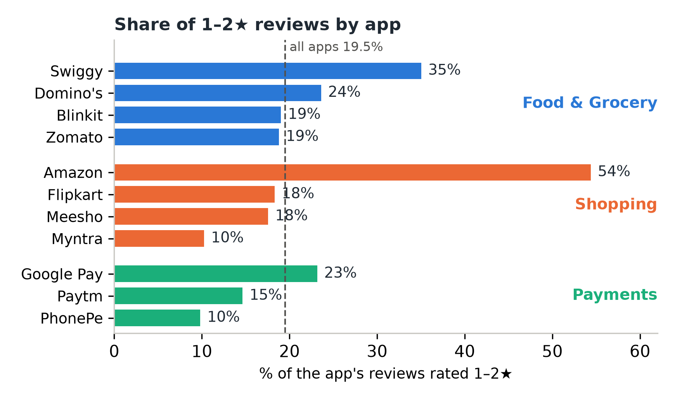
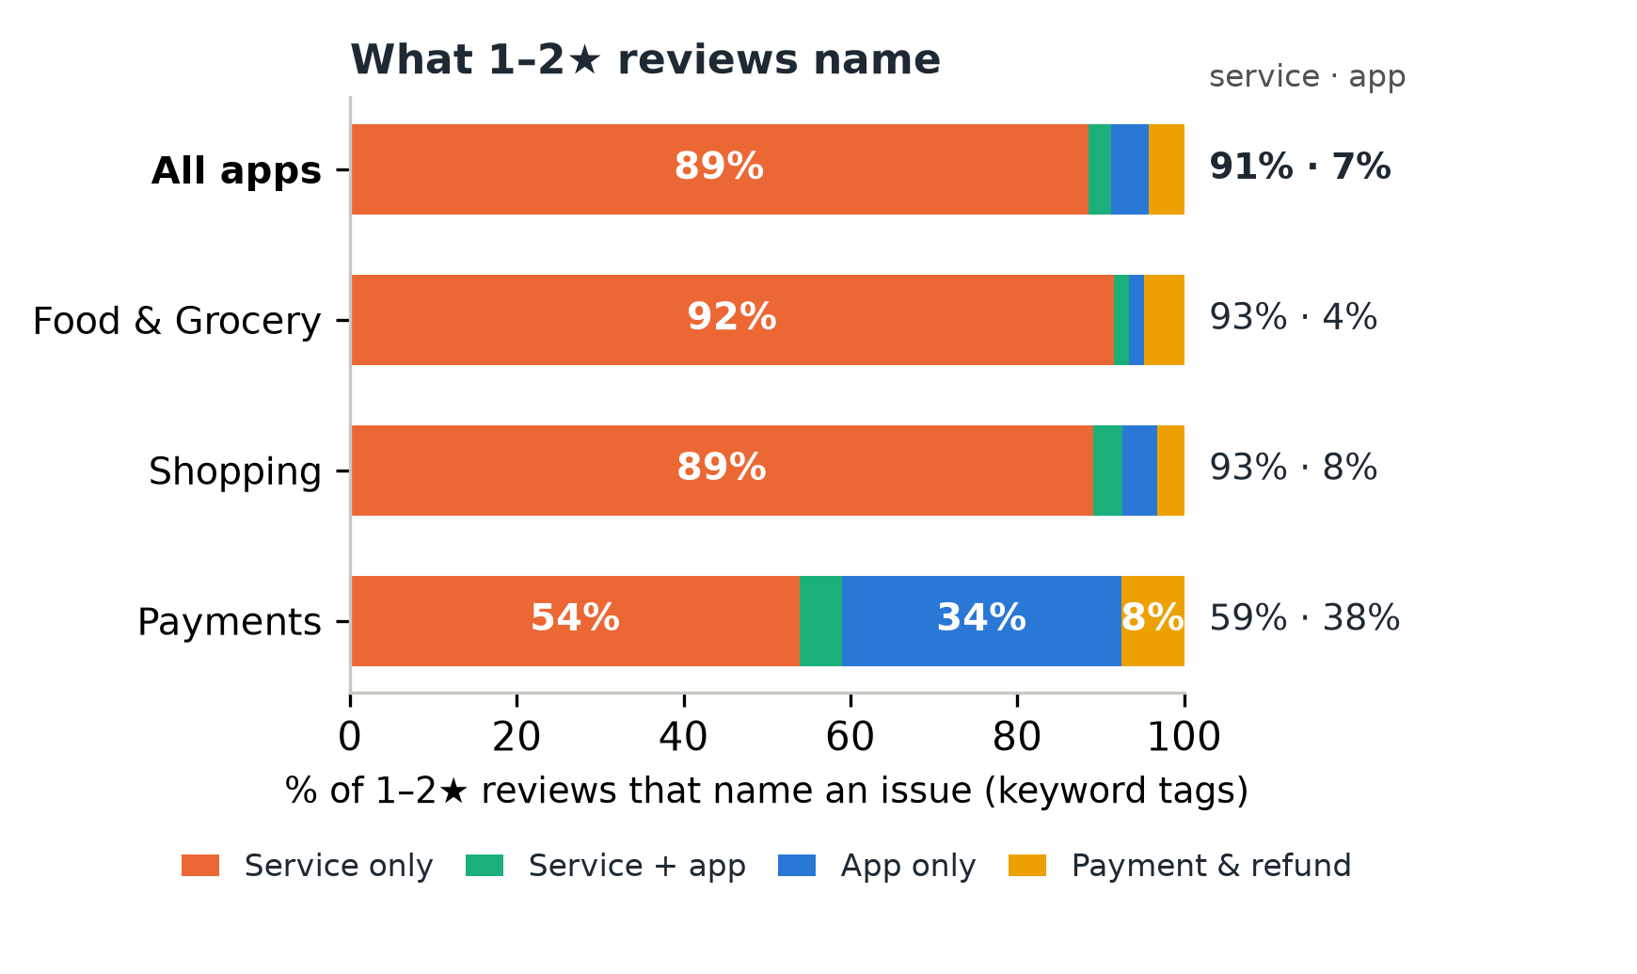
UNIT 1
Exploratory analysis and preprocessing
Key findings: (1) Apps differ widely even within a domain: 54% of Amazon's reviews are 1–2★ vs 10% for Myntra; Swiggy 35% vs Zomato 19%. (2) 91% of 1–2★ reviews that name an issue describe a service problem (support, delivery, refunds, returns), only 7% an app fault; payment apps are the exception (38% name an app fault).
Preparation: duplicates, empty, emoji-only and non-English reviews removed; 9 keyword issue flags and VADER scores added; the late-April feed gap flagged so it is not read as a wave of complaints.
07
Notes:
[Akshay, 55 s] Two findings from the EDA. Left: the share of 1–2 star reviews differs a lot even between apps that do the same job: 54% for Amazon against 10% for Myntra, and 35% for Swiggy against 19% for Zomato. Right: when a complaint names an issue, 91% of the time it is a service problem, support, delivery, refunds or returns, and only 7% an app fault. Payment apps are the exception: there, 38% name an app fault. So the business objective is mostly about operations, not code. For preparation, we cleaned the text, added the issue tags and sentiment, and flagged the late-April feed gap, which would otherwise look like a wave of complaints. Two more findings shaped Unit 3.

Slide 8
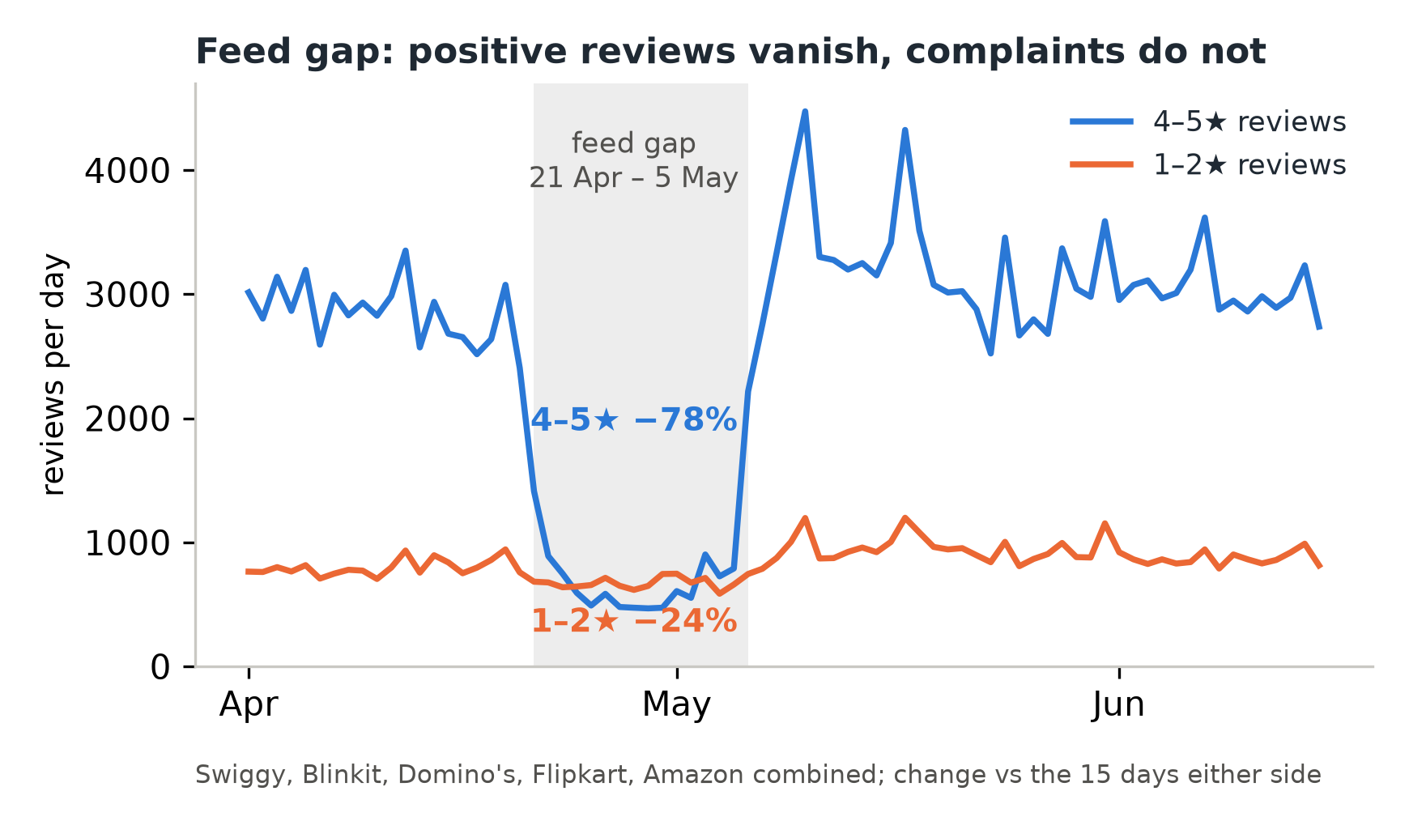
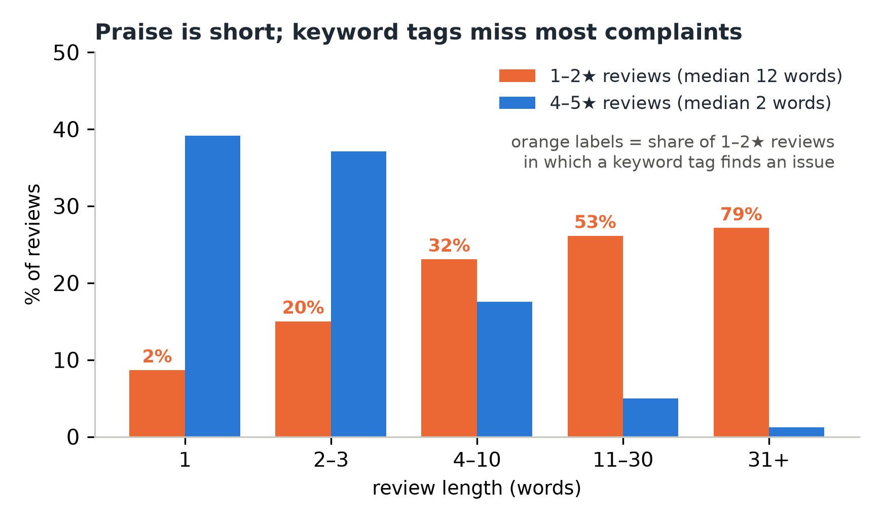
UNIT 1
Exploratory analysis: what shaped Unit 3
Key findings: (3) The 21 Apr – 5 May Play Store feed gap removed mostly positive reviews: for the five affected apps 4–5★ fell 78% but 1–2★ only 24%. (4) Praise is short (76% of 4–5★ reviews have 1–3 words) but complaints are not (median 12 words); keyword tags find an issue in only 46% of 1–2★ reviews.
What it changed: the time series model daily 1–2★ counts, not shares, with the gap as a 0/1 input; text mining uses topic models on the 1–2★ reviews with ≥ 3 content words instead of the keyword tags.
08
Notes:
[Akshay, 45 s] Two more findings from the EDA shaped Unit 3. Left: during the late-April Play Store gap, positive reviews for five apps fell 78%, but complaints only 24%. A share of 1–2 star reviews would therefore show a false wave of complaints, so the time series counts complaints and gives the gap to the model as an input. Right: praise is short, three quarters of it one to three words, while complaints have a median of twelve words; and the keyword tags find an issue in only 46% of complaints, under a third of the four-to-ten-word ones. That is why text mining uses topic models on the complaints with at least three content words, not the keyword tags. Harshini will present the predictive model.

Slide 9
UNIT 2
Predictive modelling and final evaluation
Model | Precision | Recall | F1 | PR-AUC
Baseline: always 'not a problem' | 0.000 | 0.000 | 0.000 | 0.195
Logistic Regression | 0.770 | 0.858 | 0.811 | 0.871
Random Forest (selected) | 0.736 | 0.870 | 0.798 | 0.874
Evaluation setup: target is_problematic = 1–2★ (19.5%); inputs: 200 SVD text components + 15 structural features; stratified 80/20 split, 910,389 training and 227,598 held-out test reviews. Re-checked with TF-IDF, SVD and the scaler fitted on training rows only (scripts/25): no metric changes by more than 0.003. Out-of-time test (train Apr–Aug, test Sep): PR-AUC 0.866.
Selected model and interpretation: Random Forest for triage: it finds 87% of problem reviews and about 3 in 4 flags are real; Logistic Regression is close with fewer false alarms. Limitation: the target is the user's rating, not a confirmed defect.
09
Notes:
[Harshini, 65 s] Unit 2 predicts whether a review is a problem review, rated 1 or 2 stars. The inputs are 200 text components from TF-IDF and SVD plus 15 structural features: the issue tags, the sentiment scores, length and upvotes. We trained on 80% and tested on 227,598 held-out reviews. Refitting the text features and scaler on the training rows only changes no metric by more than 0.003. A model that never flags anything gets a PR-AUC of 0.195, the base rate. Both models reach about 0.87. We chose Random Forest for triage because it finds 87% of problem reviews with about three in four flags correct; it also holds up on September, which it never saw. The limit is that the target is the user's rating, not a confirmed defect. Saketh will now present Unit 3.

Slide 10
UNIT 3
Selected advanced analytics methods
Selected method | Business question | Data used
Method 1: Text Mining | What are users complaining about in each domain and app, and which complaints are the angriest? | content of 1–2★ reviews with ≥ 3 content words (167,303), 4–5★ reviews as a contrast (166,635), VADER scores, the 9 keyword tags for comparison
Method 2: Time-Series Analysis | How many 1–2★ reviews will each app get in the next weeks, which days are unusual, and did a new release make things worse? | review_date + score → daily 1–2★ counts per app (11 × 173 days); app_version → 224 release events
Selected: Time-Series Analysis and Text Mining. Association rules not chosen: only 3.4% of reviews carry two or more issue tags.
10
Notes:
[Saketh, 30 s] For Unit 3 we chose the two methods that fit review data. Text mining answers what users complain about and how angry they are, using the text of 167,303 complaints. Time-series analysis answers how many complaints are coming, which days are unusual and whether a release made things worse, using daily counts and release events. We did not choose association rules because only 3.4% of reviews carry two or more issues, so there are few items to combine.

Slide 11
UNIT 3
Method 1 implementation
Selected method: Text mining with NMF topic models and VADER sentiment: find the complaint themes in each domain and how negative each one is.
Input and preparation: 167,303 complaint reviews (1–2★, ≥ 3 content words). Lowercase; keep negations ("not delivered"); Hinglish "nahi" → "not"; drop app names and brand phrases (incl. "phone pay"); lemmatise. One document-term matrix per domain with words and two-word phrases (in ≥ 10 reviews and ≤ 50% of them).
Implementation: scikit-learn: TF-IDF weights → NMF (nndsvda start, seed 42), K = 6 / 6 / 5 topics for Food & Grocery / Shopping / Payments, NPMI coherence over K = 3–10 (the peak for Food and Payments; a guide for Shopping, whose curve is flat). Log-odds with an informative prior for words distinctive to each app. Pipelines saved for the dashboard.
Output: 17 complaint topics, each with top terms, example reviews and sentiment: Order Cancellation & Refund is 35% of food complaints (VADER −0.27), Returns, Refunds & Product Quality 25% of shopping, Payment, UPI & Bank Account Problems 49% of payments; angriest specific fault: Poor Customer Support (−0.40, 56% strongly negative).
11
Notes:
[Saketh, 45 s] Method 1. The input is the 167,303 complaint reviews long enough to carry a topic. We cleaned them, keeping negations so 'not delivered' keeps its meaning, mapping Hinglish negations, and removing app and brand names, including 'phone pay'. Each domain gets its own matrix of words and two-word phrases. We fit NMF on TF-IDF weights with six, six and five topics, guided by coherence, and add VADER sentiment per topic. The output is 17 complaint topics. For example, order cancellation and refund is 35% of food complaints, and payment, UPI and bank-account problems are half of all payment complaints.

Slide 12
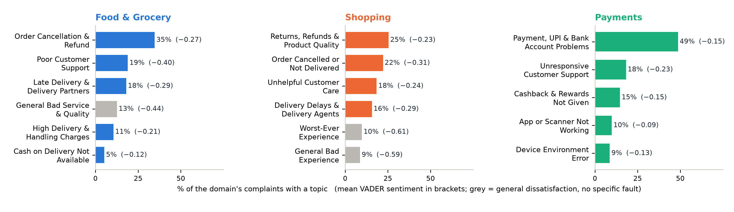
UNIT 3
Method 1 results: complaint topics and their sentiment
Key findings: one operational theme leads each domain: order cancellation and refunds (35% of food complaints), returns, refunds and product quality (25% of shopping), payment, UPI and bank-account problems (49% of payments). Among specific faults, support is the angriest (−0.40 in food apps); grey topics are general dissatisfaction with no specific fault.
Calm but serious: app or scanner failures (−0.09) and device errors (−0.13) are described factually, so a mild sentiment score does not mean a mild problem.
12
Notes:
[Saketh, 45 s] Here are the 17 topics. Each bar is the topic's share of the domain's complaints, and the bracket is its average sentiment. In every domain one operational theme leads: cancellations and refunds in food, returns in shopping, payment and UPI problems in payments, where a separate topic for cashback and rewards not given also appears. The grey topics are general anger without a specific fault. Among specific faults, support draws the angriest reviews, while app and device errors are described calmly.

Slide 13
UNIT 3
Method 1 evaluation and comparison
Approach / configuration | Held-out NPMI ↑ | Topic diversity ↑ | Largest topic share
NMF, TF-IDF (selected) · Food & Grocery | 0.190 | 0.92 | 35%
LDA, counts · Food & Grocery | 0.111 | 0.68 | 30%
NMF, TF-IDF (selected) · Shopping | 0.157 | 0.88 | 25%
LDA, counts · Shopping | 0.108 | 0.63 | 24%
NMF, TF-IDF (selected) · Payments | 0.188 | 0.90 | 55%
LDA, counts · Payments | 0.103 | 0.80 | 28%
Evaluation data: the same document-term matrices and K for both models; each fitted on 80% of a domain's complaints (133,841 reviews) and scored on the unseen 20% (33,462). K itself chosen by NPMI over K = 3–10. Topics vs the 9 keyword tags: 71,775 complaints (43%) match no tag but get a topic.
Interpretation: NMF gives more coherent and more distinct topics in every domain, so it is selected; LDA spreads reviews more evenly but mixes themes. Business meaning: refunds, returns and payment problems are the largest fixes; unanswered support drives the angriest specific complaints. Limitation: topic names are our reading of the top terms (3 topics are general “bad / worst” dissatisfaction); K was tuned for NMF; VADER underrates calm technical complaints.
13
Notes:
[Saketh, 65 s] To evaluate Method 1 fairly, we compared NMF with LDA on exactly the same matrices and number of topics. Each was fitted on 80% of the complaints and scored on the unseen 20%. Held-out NPMI measures how often a topic's top words really appear together; topic diversity measures how distinct the topics are. NMF wins both in all three domains, for example 0.19 against 0.11 coherence in food, so we selected it. LDA spreads reviews more evenly, but its topics overlap. We also checked the topics against the nine keyword tags: they agree where they should, and they cover the 43% of complaints that no keyword matched. For the business, refunds, returns and payment problems are the largest themes, and unanswered support is the angriest specific complaint. The limit is that topic names are our interpretation. The next slide shows what this means for the business.

Slide 14
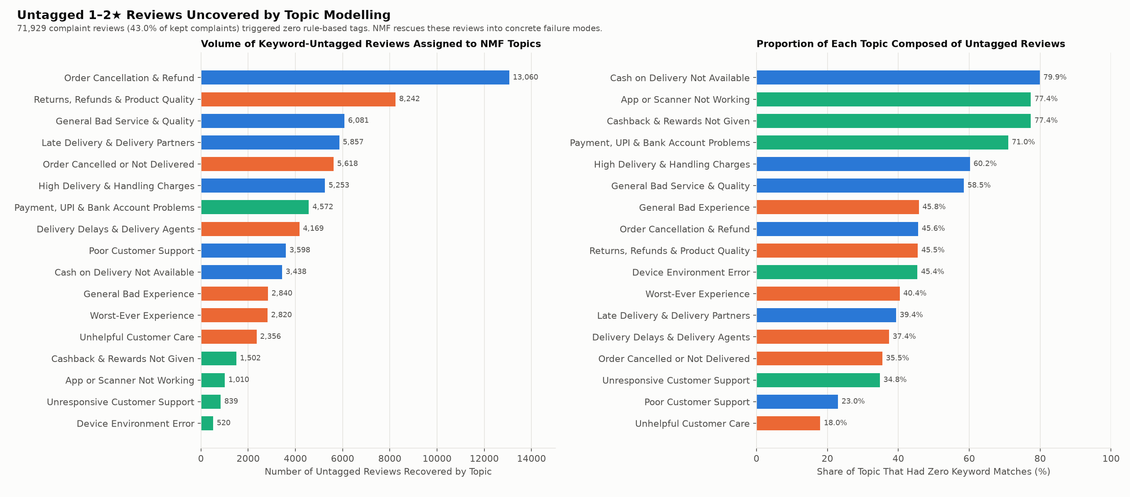
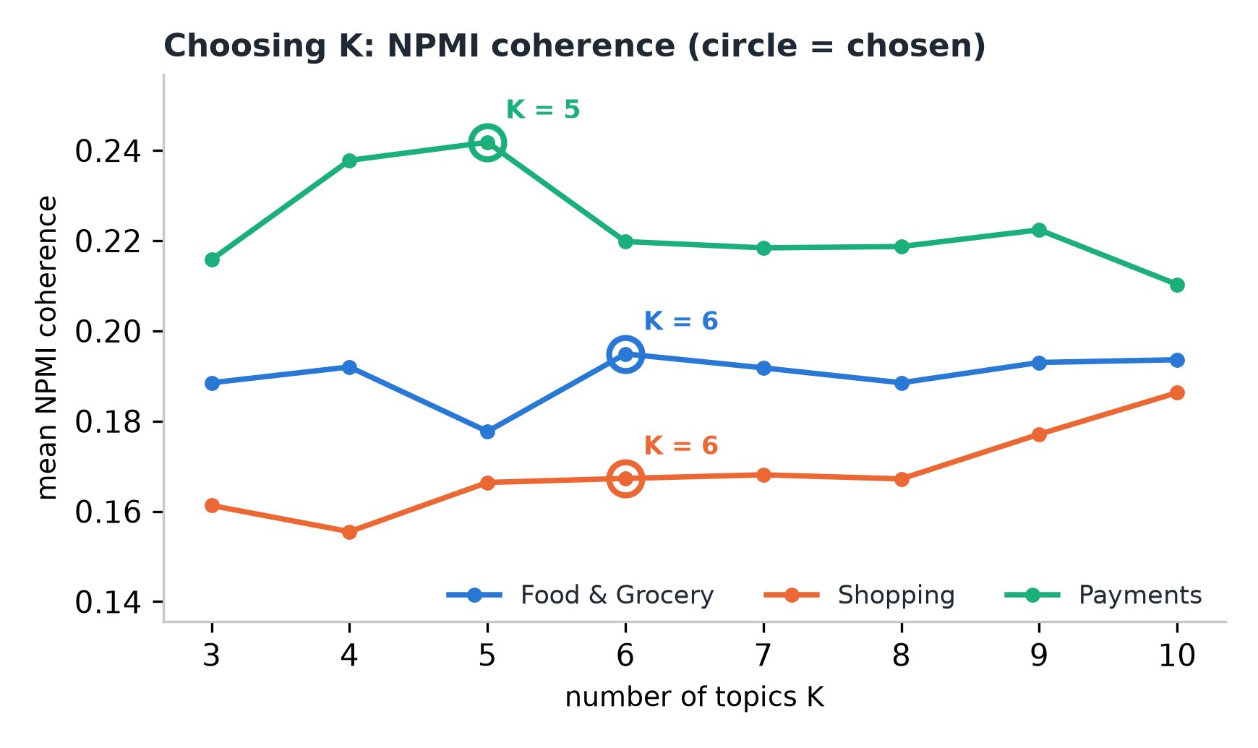
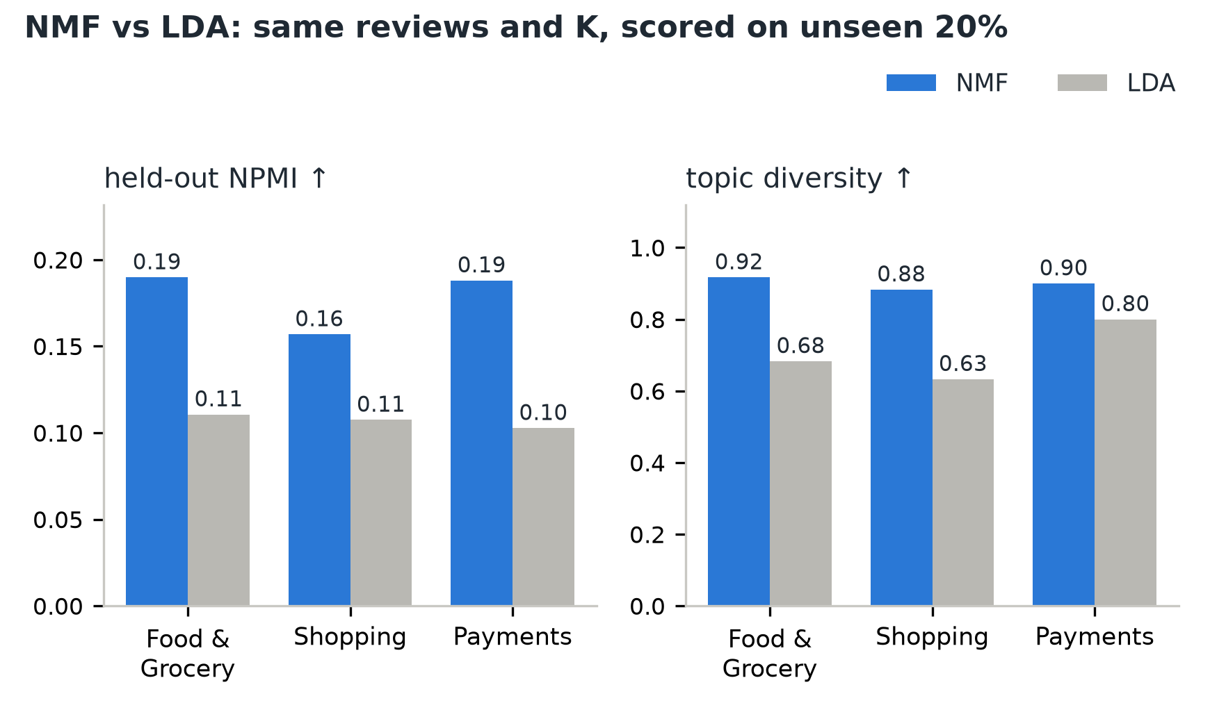
UNIT 3
Method 1 interpretation: what the keyword rules missed
Key findings: 71,775 complaints (43%) match no keyword tag but get a topic from the text-mining models. The largest hidden groups are order cancellation & refund (13,060) and returns, refunds & product quality (8,242); 80% of cash-on-delivery and 77% of cashback complaints carry no tag at all.
Business value: these complaints were invisible to keyword monitoring; with topics, every complaint can be counted and routed to the team that owns it.
14
Notes:
[Saketh, 40 s] What does text mining add for the business? The keyword rules from Review 1 found no issue in 43 percent of complaints, almost 72,000 reviews. The topic models give every one of them a theme. On the left, the largest hidden groups: thirteen thousand refund and cancellation complaints, eight thousand about returns and product quality. On the right, some themes are almost entirely invisible to keywords: 80 percent of cash-on-delivery complaints and 77 percent of cashback complaints carry no tag. Akshay will present Method 2.

Slide 15
UNIT 3
Method 2 implementation
Selected method: Time-series analysis: forecast daily 1–2★ reviews per app, flag unusual days, and test whether each new app version made things worse.
Input and preparation: daily 1–2★ counts per app, 11 series × 173 days (1 Apr – 20 Sep). Counts, not shares, because of the feed gap, which enters the model as a 0/1 input; Zomato's missing 24 Jul filled. ADF test on the training days decides differencing (final model: Zomato and Blinkit). 224 release events from app_version.
Implementation: statsmodels SARIMAX: weekly seasonal terms (lag 7) for the 4 food apps (Sundays +22–38%), differencing, weekly check and orders from the training days only: ACF/PACF + lowest AICc (384 fits). Time split: rolling origin, train on the first 84 days, forecast 28, move one week (9 origins). Baselines: seasonal naive and Holt-Winters. Releases: new- vs older-version 1–2★ share over the same 7 days, Benjamini–Hochberg corrected.
Output: 4-week forecast with 80% and 95% intervals, e.g. 21–27 Sep: Flipkart 1,830 (1,596–2,056), Swiggy 1,037 (889–1,180); 77 unusual days flagged; 4 of 205 releases worse, Paytm 10.84.5 confirmed (34 → 66 1–2★ per day).
15
Notes:
[Akshay, 45 s] Method 2 models the daily number of 1–2 star reviews for each app: 11 series of 173 days. We use counts because of the feed gap, which enters the model as an input. The model is ARIMA, with weekly seasonal terms for the food apps because of their Sunday peak; the differencing, the weekly check and the orders come from ADF, ACF, PACF and AICc on the training days only. For a fair time split we use a rolling origin: train on 84 days, forecast the next 28, move a week, nine times. The output is a four-week forecast with intervals, unusual-day alerts, and a verdict for each release. The next slide shows the pattern and the forecast.

Slide 16
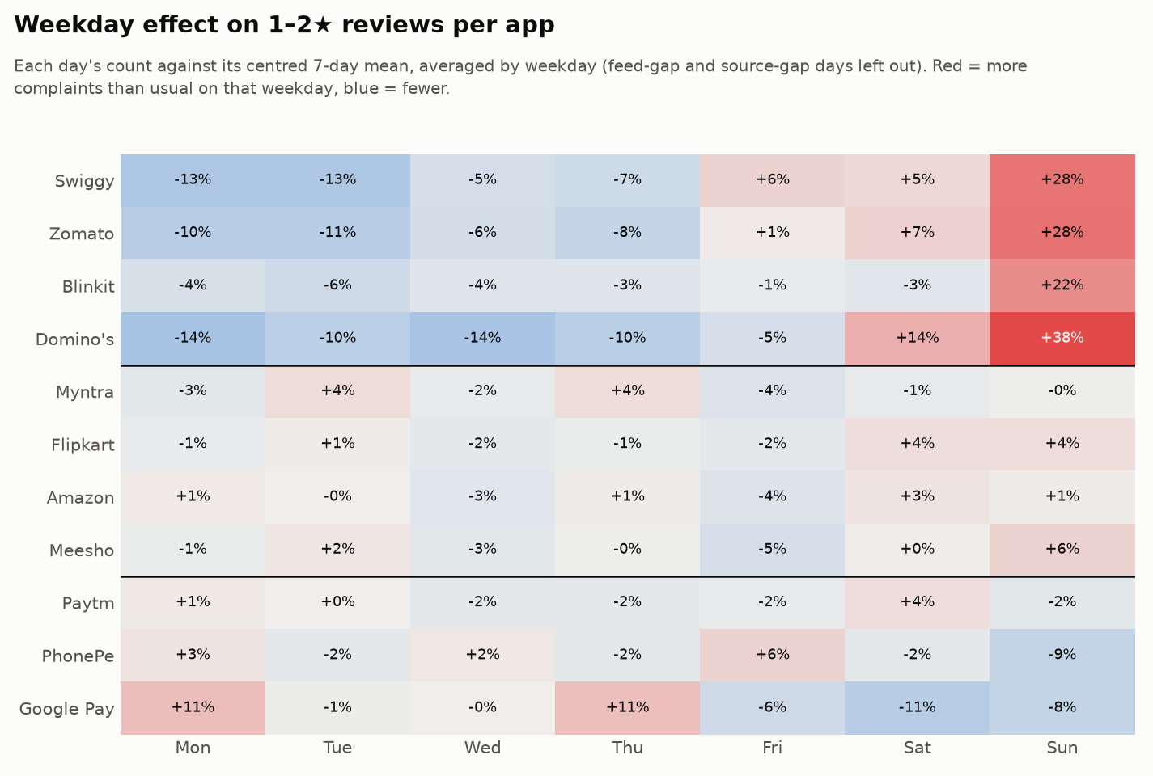
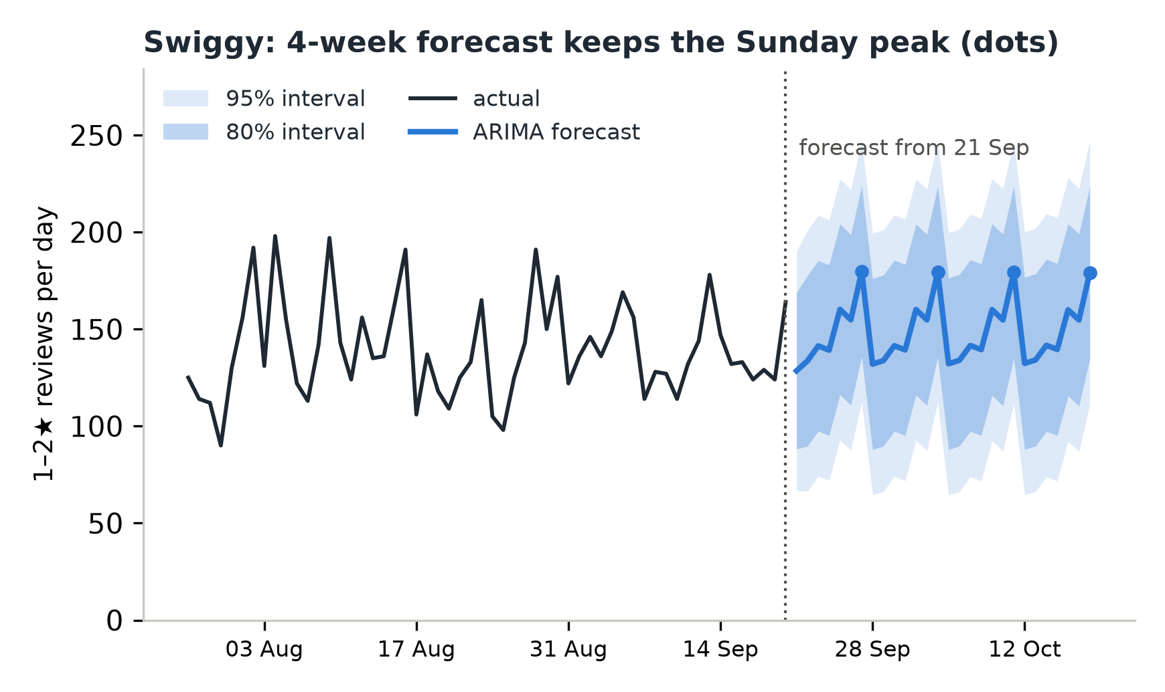
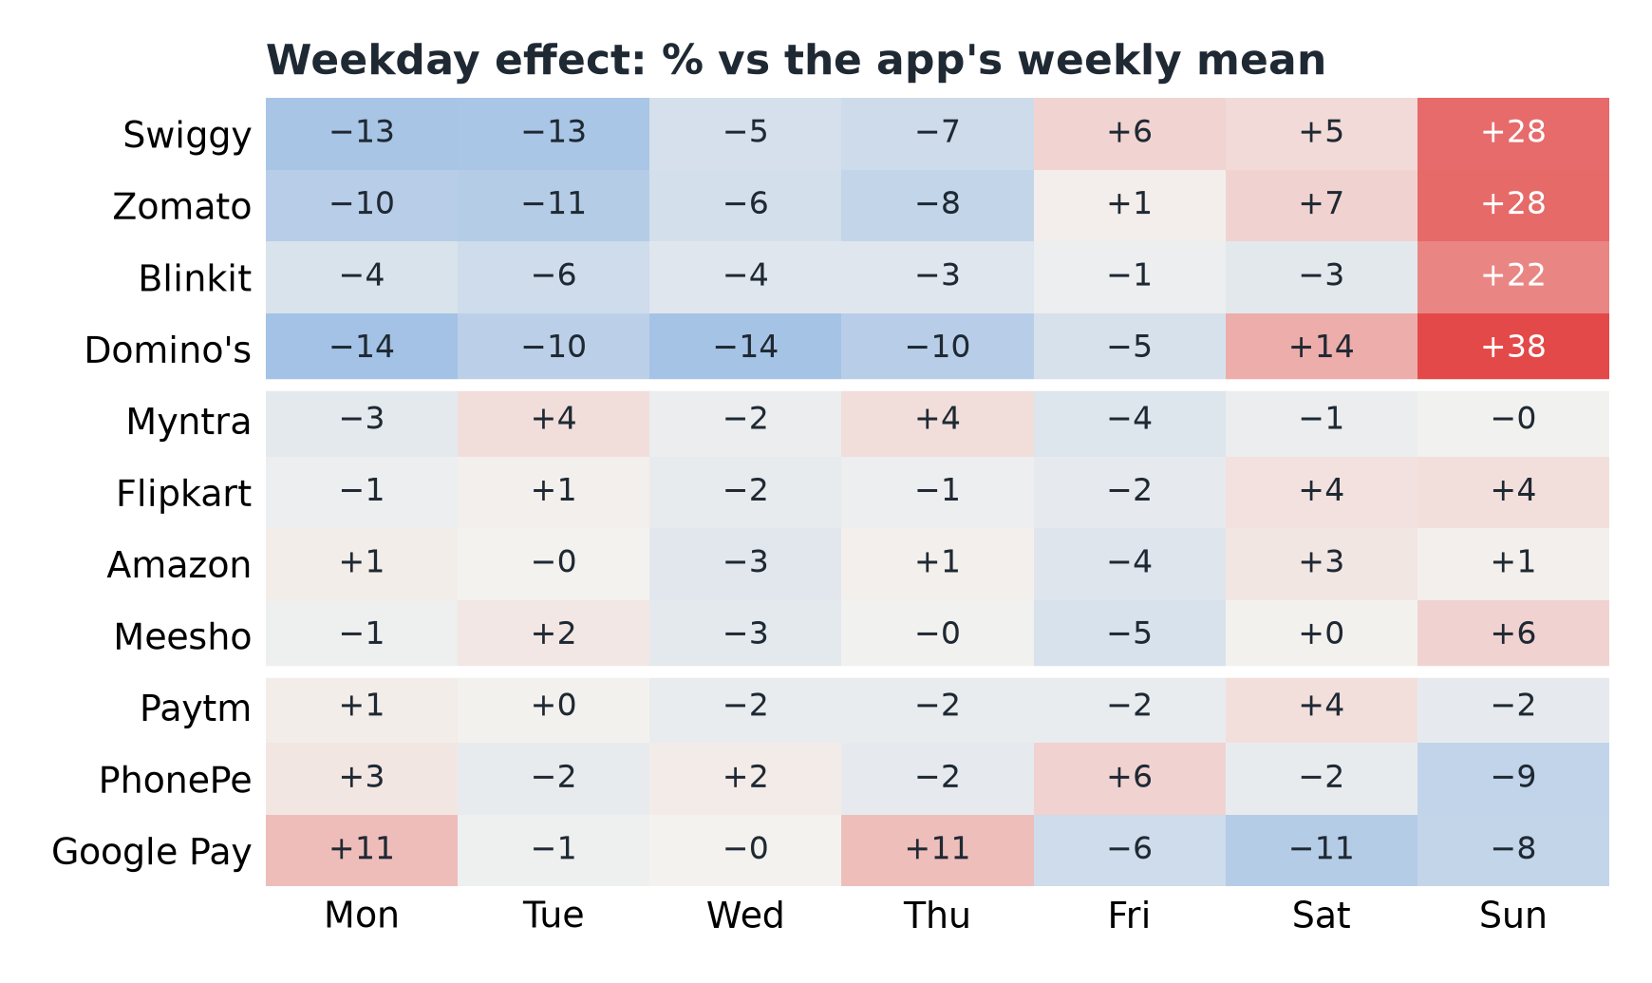
UNIT 3
Method 2 results: weekly pattern and forecast
Key findings: food apps get 22–38% more complaints on Sundays; shopping and payment apps have no strong weekday pattern, so only the four food apps get weekly seasonal terms. The forecast keeps that Sunday peak: Swiggy expects about 1,037 1–2★ reviews in 21–27 Sep (80% interval 889–1,180).
Use: weekly totals with intervals for support staffing; days outside the 95% interval become unusual-day alerts.
16
Notes:
[Akshay, 40 s] Left: the weekday effect for each app. The food apps peak on Sundays, by 22 to 38 percent; the other apps are almost flat, which is why only the food models have weekly terms. Right: Swiggy's next four weeks. The forecast keeps the Sunday peaks, and the bands are the 80 and 95 percent intervals: about 1,037 complaints in the first week. Harshini will evaluate it.

Slide 17
UNIT 3
Method 2 evaluation and comparison
Approach / configuration | MAE ↓ | RMSE ↓ | MASE ↓ | Beats baseline (MAE ÷ baseline)
ARIMA / SARIMA (selected) | 19.39 | 26.74 | 0.93 | 10 of 11 apps (0.93)
Holt-Winters (damped trend + weekly season) | 19.14 | 26.66 | 0.93 | 10 of 11 apps (0.88)
Seasonal naive (same weekday last week) | 21.99 | 31.07 | 1.08 | baseline (1.00)
Evaluation data: future held-out days only: 9 rolling origins × 28 days = 252 forecasts per app and model (2,772 per model), orders chosen on training days; mean over the 11 apps (1–2★ reviews per day). 95% intervals contain 94% of days; Ljung–Box finds no residual autocorrelation for 11 of 11 apps.
Interpretation: ARIMA and Holt-Winters are equally accurate (ARIMA better for 6 apps, Holt-Winters for the 4 food apps); ARIMA is selected because only it gives prediction intervals (daily alerts, capacity planning) and takes the feed gap as an input. Google Pay: the baseline wins; Paytm's September jump makes its forecast unreliable. Limitation: 173 days, no yearly season; level shifts cannot be predicted; intervals too narrow for shopping apps.
17
Notes:
[Harshini, 65 s] We evaluated all three models on the same future, held-out days: 252 forecasts per app and model, and every choice, the differencing, the weekly terms and the orders, was made on the training days only. Both ARIMA and Holt-Winters clearly beat the naive 'same weekday last week' forecast: MASE 0.93 against 1.08, and both win for 10 of the 11 apps. Between the two it is a tie, about 19 reviews a day of error each: ARIMA is better for six apps, Holt-Winters for the food apps. We keep ARIMA because only it gives prediction intervals, which we need for the alerts and for capacity planning, and it takes the feed gap as an input. Its 95% intervals contained 94% of the days, and the residuals show no leftover pattern. Days outside the interval become alerts: 77 unusual days. The limits: only 173 days, Google Pay is better served by the baseline, and level shifts like Paytm's in September cannot be predicted. Kanishka will show what the releases did.

Slide 18
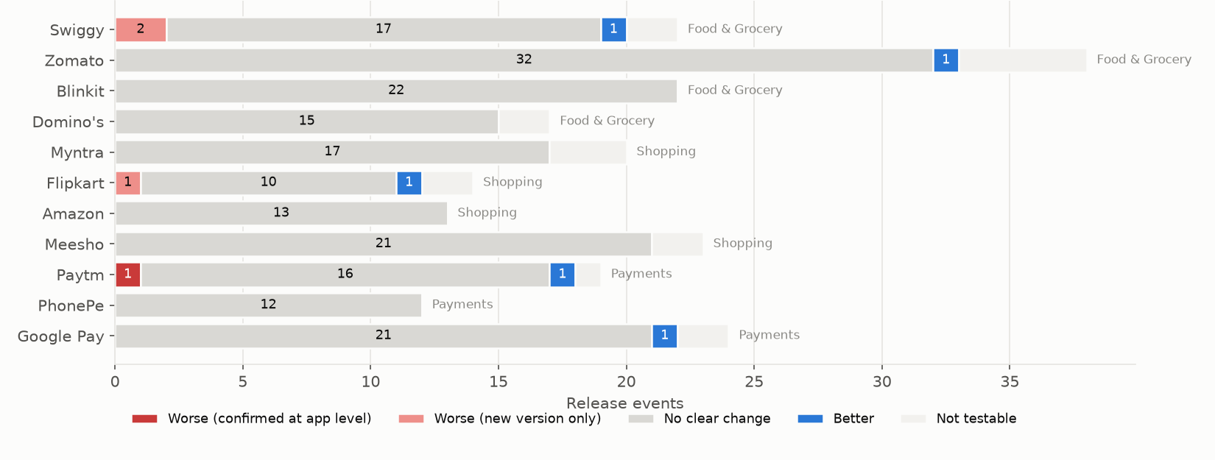
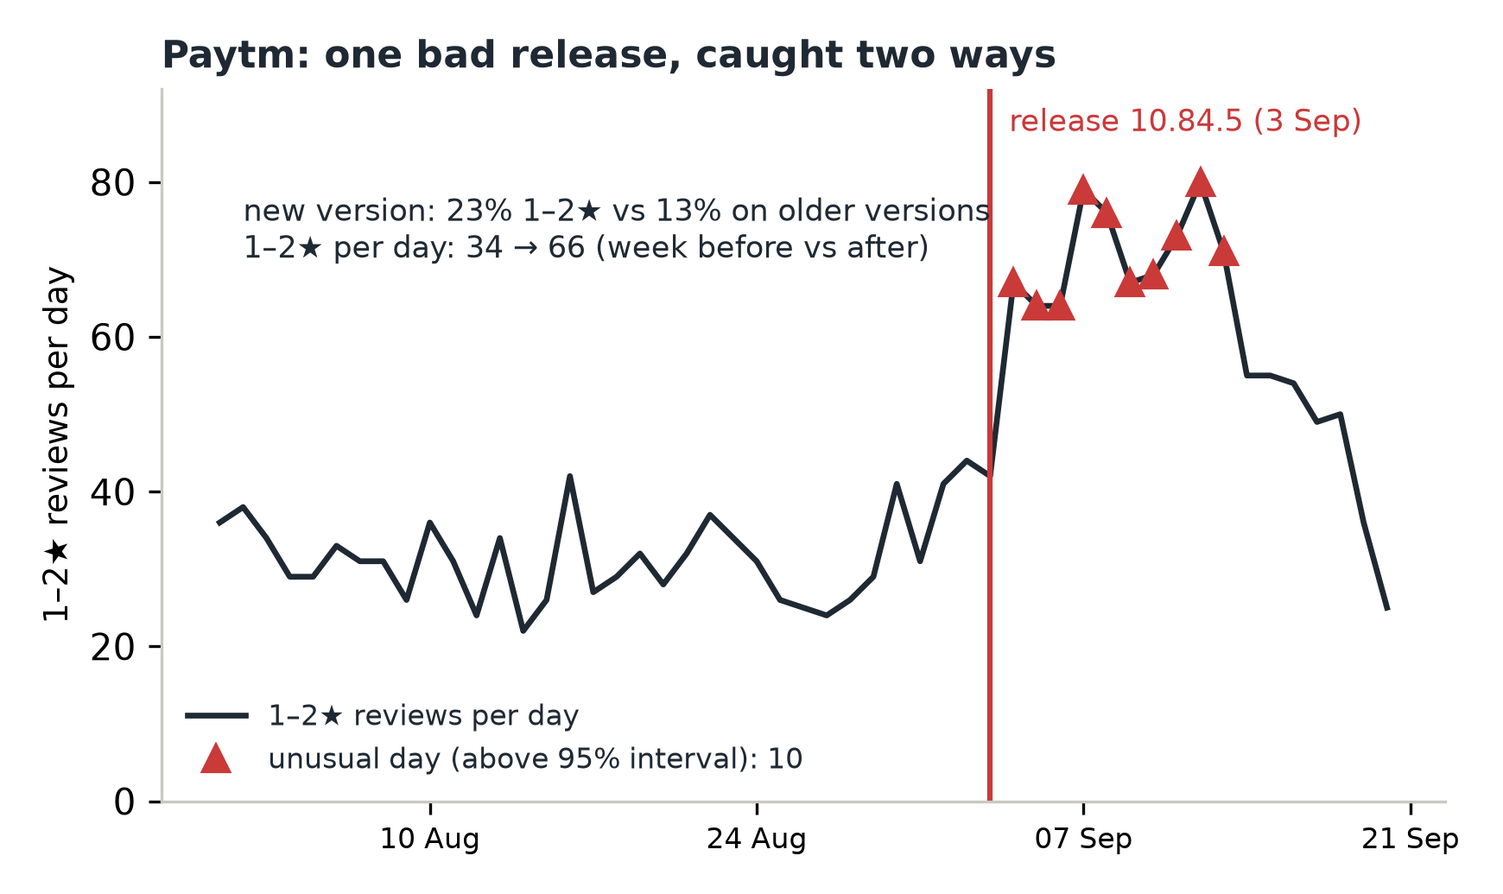
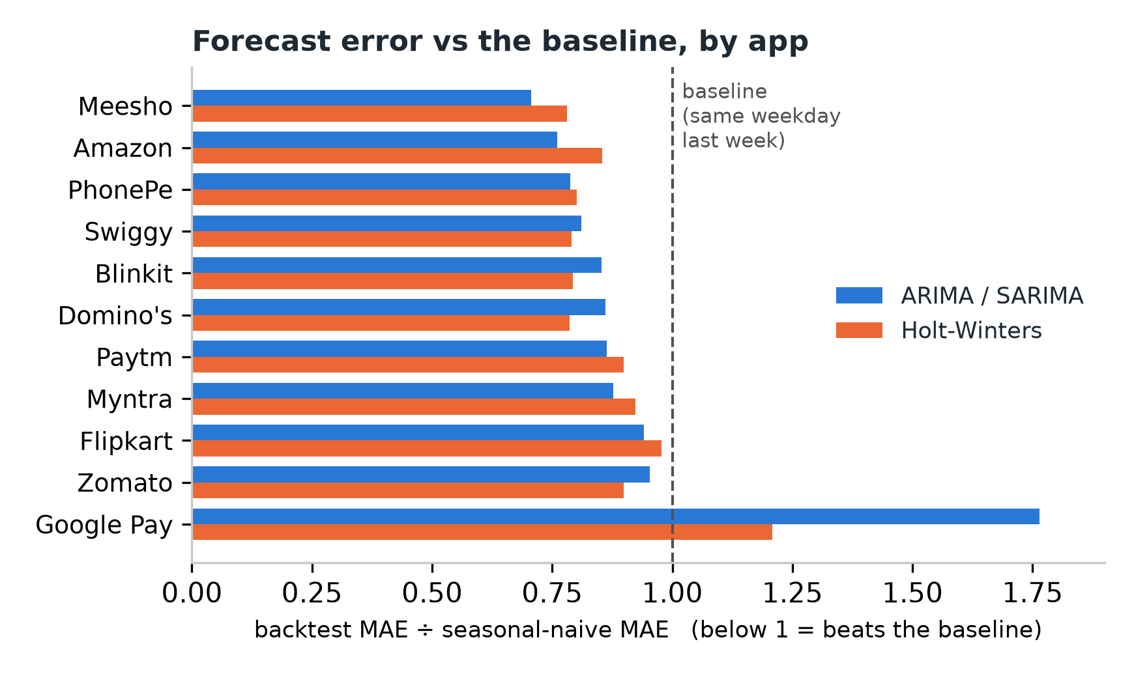
UNIT 3
Method 2: which releases made things worse
Key findings: of 205 testable releases, 196 changed nothing measurable, 5 made things better and 4 made things worse. Only Paytm 10.84.5 is confirmed at app level: 23% vs 13% 1–2★ on the new version, 34 → 66 a day, and 10 days above the forecast interval.
Action: investigate and patch Paytm 10.84.5 first; test every new release against the app's usual new-version gap before the full rollout.
18
Notes:
[Kanishka, 45 s] Did a new app version make things worse? On the left, every release of every app: almost all changed nothing measurable, five made things better and four made things worse. On the right, the one confirmed case: Paytm 10.84.5 on 3 September. The forecast raised ten alerts in the days after it, and the version test shows the cause: 23 percent of reviews on the new version were 1 or 2 stars, against 13 percent on older versions, and Paytm's complaints doubled from 34 to 66 a day. So this release is the first thing to fix.

Slide 19
BUSINESS OUTCOMES
Combined insights and recommendations
Evidence from the project | Recommended action | Expected benefit / limitation
Unit 2 + Unit 3: the classifier finds 87% of problem reviews; topics name them, including the 43% no keyword tag matched | Route flagged reviews by topic to the team that owns it (refunds, returns, payments, support) | Faster triage; assumes 1–2★ means a real problem; Paytm flags only 66% precise, so check by hand
Both Unit 3 methods: Paytm 10.84.5 users 23% vs 13% 1–2★, app rose 34 → 66 a day, 6 forecast alerts that week | Investigate and patch Paytm 10.84.5 first; test every release against the app's usual gap | Stops the September rise; three other worse releases overlap the feed gap
Text mining: refunds 35% of food complaints, returns 25% of shopping, payment & UPI problems 49% of payments | Fix these flows first in every app of the domain; speed up support replies, the angriest specific complaint (−0.40 in food apps) | Largest volume reduction; topic shares cover reviews with ≥ 3 words
Six warning signs from all stages: High priority = Swiggy, Flipkart, Amazon, Paytm | Focus on these four; staff support for the forecast (Swiggy ~1,037 1–2★ next week) | Equal weights and fixed thresholds; every sign is shown
Business objective addressed: teams can now see what is going wrong, whether it is getting worse, whether an update caused it, and what to fix first: 65 recommendations, each backed by a number.
19
Notes:
[Kanishka, 55 s] This slide combines the units. First, the Unit 2 classifier finds problem reviews and the Unit 3 topics name them, so flagged reviews can go straight to the right team. Second, both Unit 3 methods point at the same release: Paytm 10.84.5 made users more negative, the app's complaints doubled, and the forecast raised six alerts that week, so it is the first thing to fix. Third, text mining shows the largest fixes per domain. Finally, six warning signs from every stage make Swiggy, Flipkart, Amazon and Paytm the high-priority apps. In total there are 65 recommendations, each with its number.

Slide 20
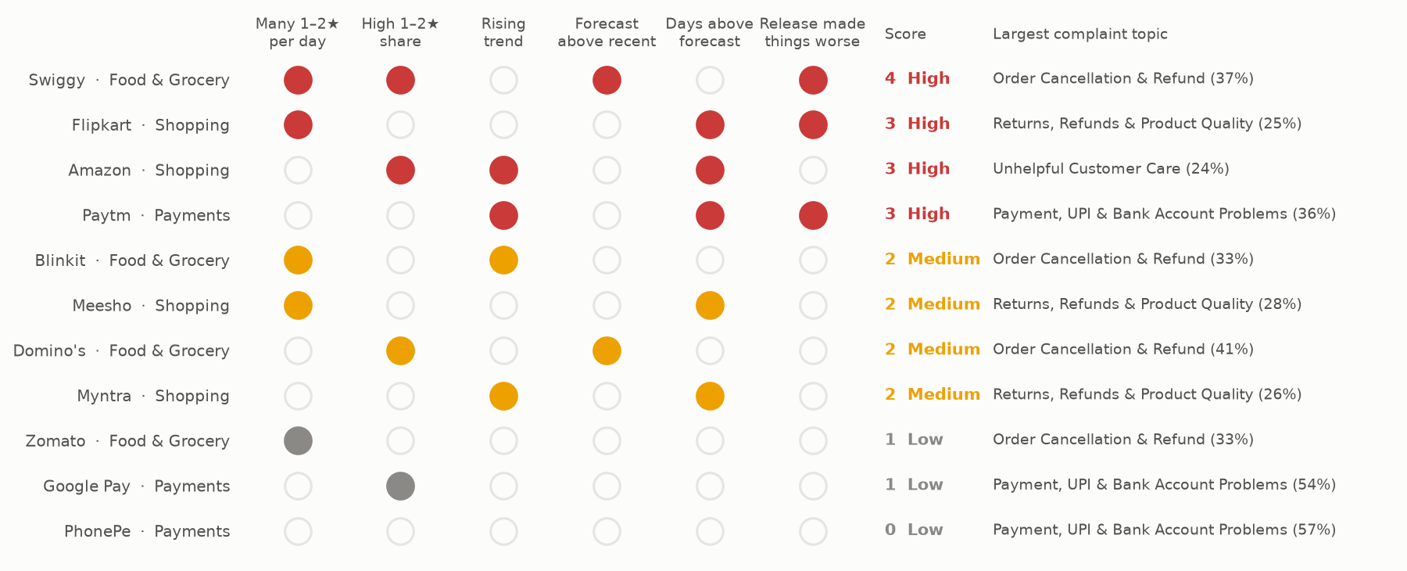
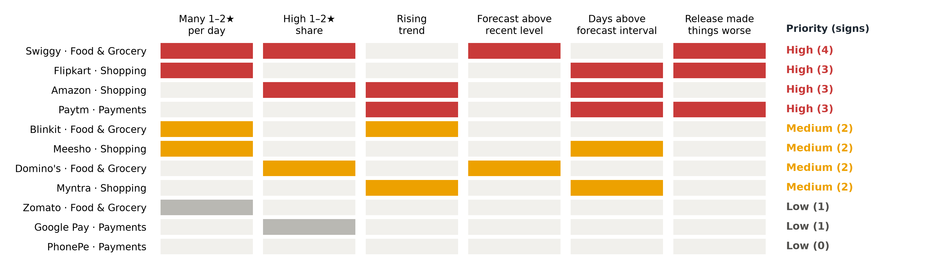
BUSINESS OUTCOMES
Priority by app: six warning signs from every stage
Key findings: each filled dot is one warning sign, from the time series (volume, share, trend, forecast, alerts) and the release test. Three or more signs make an app High priority: Swiggy (4), Flipkart, Amazon and Paytm (3 each); the last column names the complaint topic to fix first.
Traceable: every sign is one number from one stage with a fixed threshold (median, 10%, 5%, 5 days), so a manager can check it by hand; the 65 recommendations follow from these signs and the complaint topics.
20
Notes:
[Kanishka, 40 s] This is the priority table as a picture. Each column is one warning sign from an earlier stage, and a filled cell means the app shows it. Three or more signs make an app High priority: Swiggy with four, Flipkart, Amazon and Paytm with three. Every sign is one number with a fixed threshold, so anyone can check the result by hand.

Slide 21
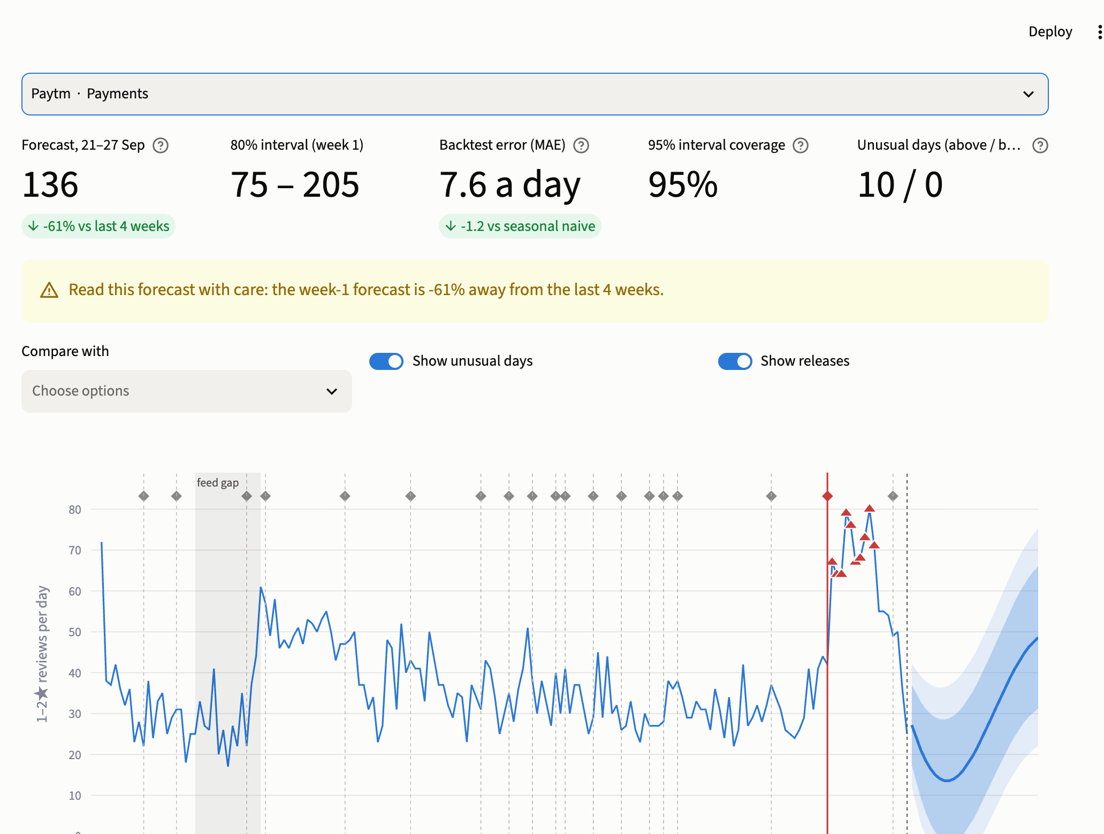
MANDATORY LIVE DEMONSTRATION
Interactive dashboard or website
Application: Streamlit dashboard, 6 pages (overview, text mining, forecasting, update impact, recommendations, check a review): team10-app-reviews.streamlit.app · local: streamlit run dashboard/app.py
Live demo: change the domain, app and date filters → KPIs and charts update; pick a topic → its terms and real reviews; switch the app on Forecasting; paste a review into Check a Review.
Business scenario: "Paytm's complaints jumped in September: why, and what do we do?" Forecasting (Paytm) shows alerts after 3 Sep and a red release marker → Update impact confirms 10.84.5 → Recommendations: High priority, investigate the release.
21
Notes:
[Kanishka, 120 s, live] Switch to the dashboard (open it 10 minutes before so it is awake). 1) Overview: change Domain to Payments and the date range to July–September; the KPIs and charts update. 2) Text mining: pick Food & Grocery, then the topic 'Order Cancellation & Refund': top terms, sentiment and real reviews. 3) Scenario: 'Paytm's complaints jumped in September, why?' Forecasting: choose Paytm; show the alerts after 3 Sep and the red release marker. Update impact: choose Paytm, open release 10.84.5: 23% vs 13% 1–2 star, 34 to 66 a day. Recommendations: Paytm is High priority; the first action is to investigate 10.84.5. 4) Check a Review: paste 'Money was deducted but the order failed and the refund has not come' → flagged, topic, sentiment. Then hand back to Aditya.

Slide 22
100% PROJECT IMPLEMENTATION
Completion and individual contribution
Team member | Completed responsibility | Evidence / project-board task
Aditya Monish Kumar K (CB.SC.U4CSE23103) | R1: scraper, collection, cleaning, integrity tests. R2: time-series and text preparation, dashboard base and deployment; validation, report, deck | #53, #54, #56–#58 (PR #52, #99); #131–#133 (PR #147–#149)
Regella Krishna Saketh (CB.SC.U4CSE23649) | R1: EDA and bias audit (with Akshay). R2: NMF topic models, sentiment per topic, coherence, keyword-tag comparison | #104–#106, #118–#120 (PR #121); #134, #136 (PR #150, #151)
Akshay KS (CB.SC.U4CSE23104) | R1: EDA and bias audit (with Saketh). R2: ARIMA/SARIMA forecasting with rolling backtest; text-mining page | #104–#106, #118–#120 (PR #121); #135, #139 (PR #152, #153)
Harshini Vennela (CB.SC.U4CSE23455) | R1: features and classifiers (with Kanishka). R2: forecast evaluation and alerts, forecast write-up; check-a-review page | #107–#110 (PR #122–#125); #137, #142, #146 (PR #154–#156)
Kanishka D (CB.SC.U4CSE23155) | R1: features and classifiers (with Harshini). R2: update impact, combined insights; forecasting, update-impact and recommendations pages; final notebook | #107–#110 (PR #122–#125); #138, #140, #141, #143 (PR #157, #158)
Project board: github.com/users/Adithya-Monish-Kumar-K/projects/4 (29 of 29 tasks Completed) Repository / deliverables: github.com/Adithya-Monish-Kumar-K/ba-capstone-app-reviews
22
Notes:
[Aditya, 45 s] Every part of the project is complete and every member owns a stage in both reviews. Each task is on our GitHub Projects board with an assignee, due date and the merged pull request as evidence: 29 tasks, all completed. The board history in the backup slides shows the stages done one after another. Each of us has presented the part we built and can answer questions on it.

Slide 23
FINAL PROJECT OUTCOME
Conclusion and limitations
Main outcome: a complete pipeline from 1.14 million self-collected reviews to a problem-review classifier (PR-AUC 0.87), 17 complaint topics, ARIMA forecasts that beat the baseline for 10 of 11 apps, release verdicts and a priority table, live in a dashboard.
Business value: the biggest fixes are refunds, returns and payment problems; Paytm 10.84.5 explains the September rise; Swiggy, Flipkart, Amazon and Paytm come first; next week's complaint volume is forecast with an interval.
Limitations: 173 days, so no yearly season; a 1–2★ review is the user's judgement, not a confirmed defect; VADER and keyword tags miss context; the feed gap and users choosing when to update limit the release tests.
Future scope: daily automatic collection and alerts; Hindi and Hinglish text models; store release notes to confirm release dates; the iOS App Store.
23
Notes:
[Aditya, 40 s] To conclude: from 1.14 million reviews we collected ourselves, we built a classifier, complaint topics, forecasts and release tests, and joined them in a live dashboard. The evidence says to fix refunds, returns and payment problems first, to investigate Paytm 10.84.5, and to start with Swiggy, Flipkart, Amazon and Paytm. The main limits are the six-month window and that a low rating is a judgement, not a confirmed defect. Next steps would be daily collection and alerts and Hindi text models. Thank you; we are happy to take questions.

Slide 24
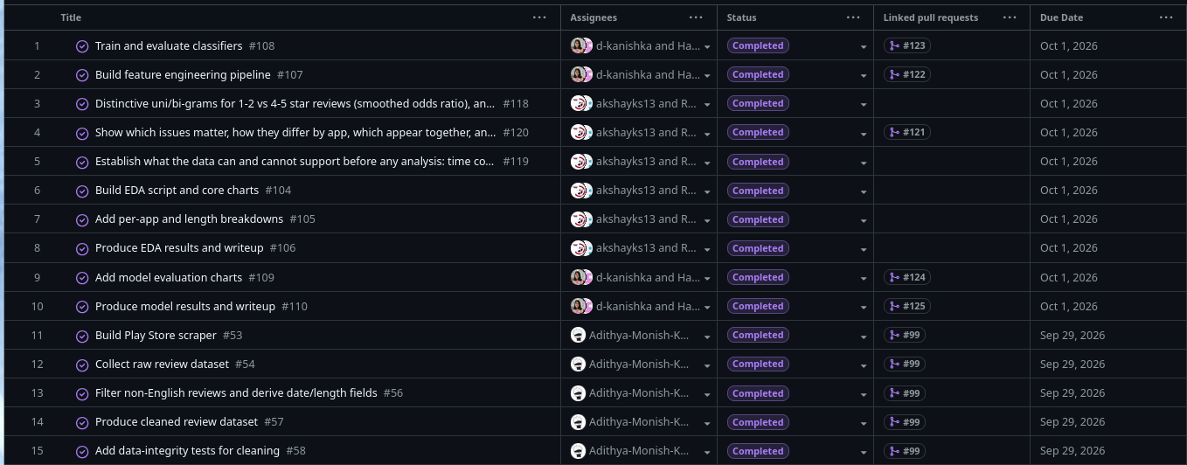
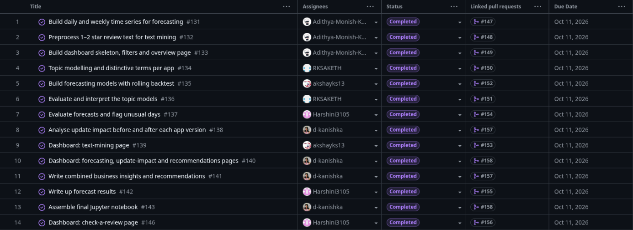
BACKUP · PROJECT BOARD
Project-board task history (Reviews 1 and 2)
Review 1: 15 tasks (data, EDA, models), due 29 Sep – 1 Oct, all Completed
Review 2: 14 tasks (both methods, dashboard, insights), due 11 Oct, all Completed
Activity history: Review 1 merged 28–30 Sep. Review 2 as a relay, each stage started on the merged work of the previous one: Stage 1 and 2 on 8 Oct, Stage 3 on 9 Oct, Stage 4 on 10 Oct, Stage 5 on 11 Oct. Every card moved Backlog → To Do → In Progress → Review/Testing → Completed; each is linked to its merged pull request.
B1
Notes:
[Backup, Aditya] Use if the panel asks for board evidence. Live board: github.com/users/Adithya-Monish-Kumar-K/projects/4.

Slide 25
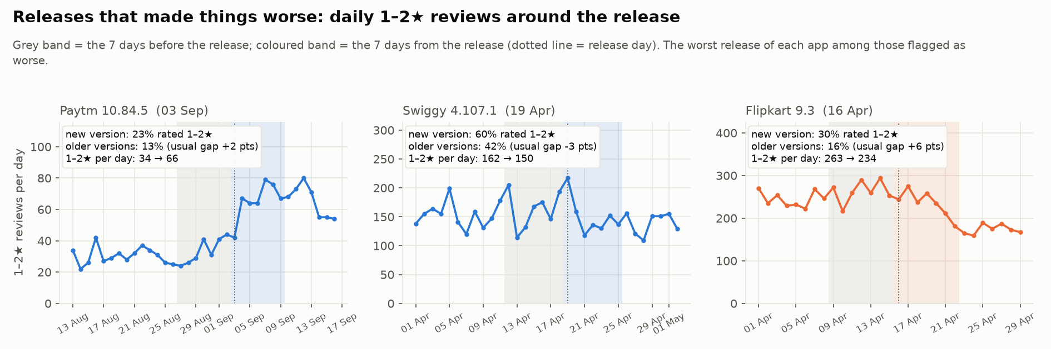
BACKUP · METHOD 2 DETAIL
Update impact: releases that made things worse
224 releases, 205 testable: 196 no clear change, 5 better, 4 worse. Paytm 10.84.5 (3 Sep) is the only one confirmed at app level: 23% vs 13% 1–2★ on the new version, 34 → 66 1–2★ reviews a day. Swiggy 4.107.1 / 4.107.2 and Flipkart 9.3 overlap the feed gap, so their shares are inflated.
B2
Notes:
[Backup, Kanishka] Method: same 7 days, new-version users vs older-version users, compared with the app's usual gap; Benjamini-Hochberg q < 0.05 and at least 5 points.

Slide 26
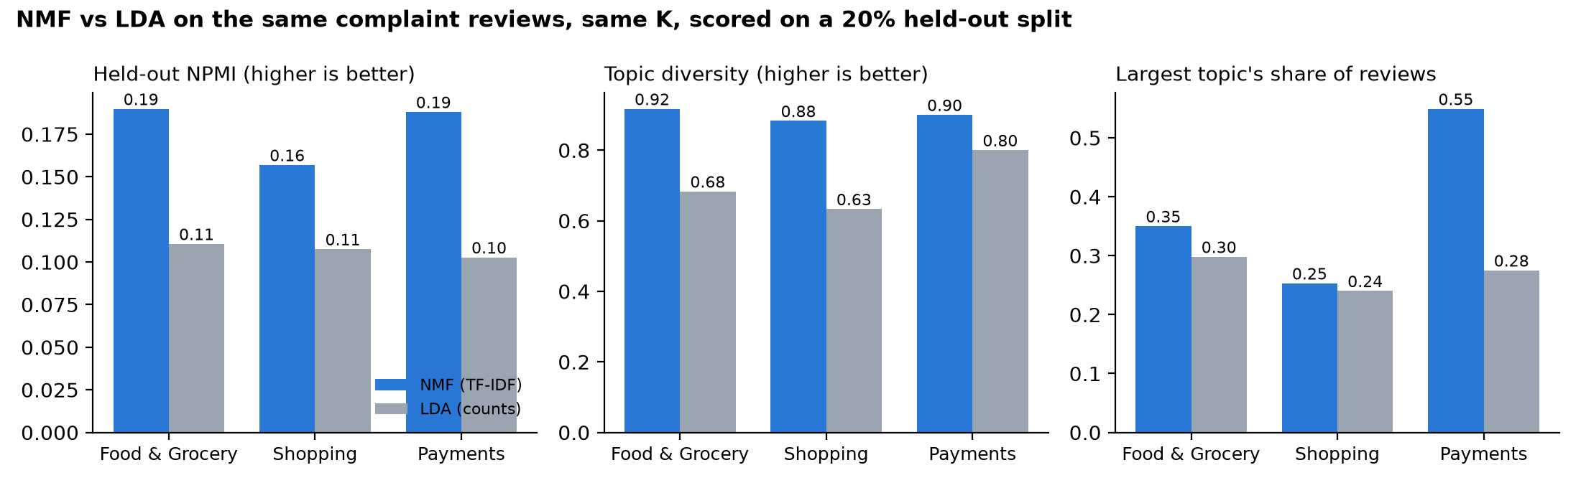
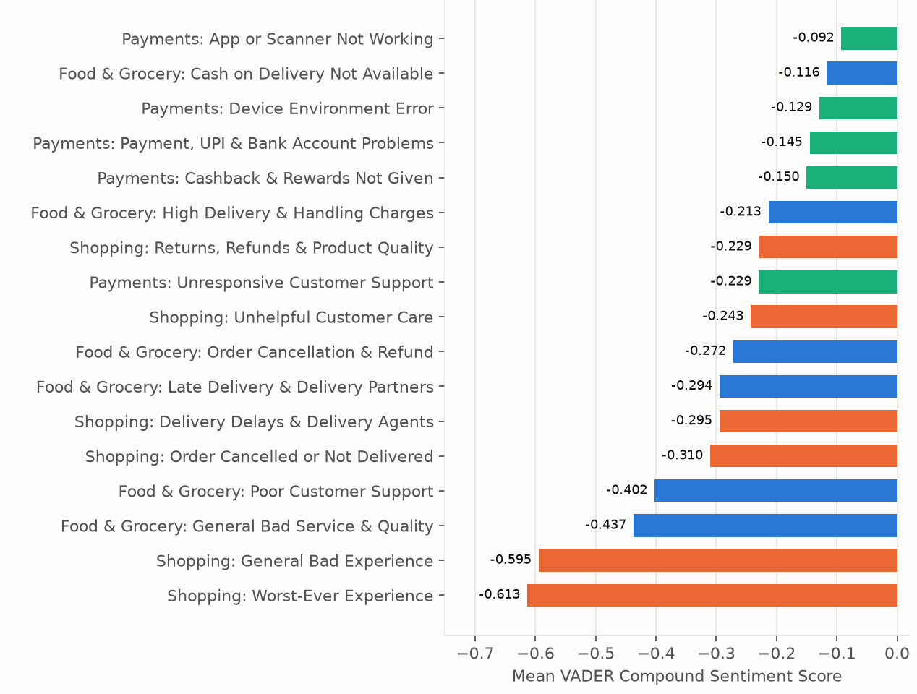
BACKUP · METHOD 1 DETAIL
Sentiment by complaint topic, and NMF vs LDA
Most negative: the general “worst ever” and “bad” topics (−0.61, −0.59) name no fault; the angriest specific fault is support (−0.40 food, −0.23 payments).
Calm but serious: ‘app or scanner not working’ (−0.09) is described factually, so tone is not severity.
NMF vs LDA: same data and K, 20% held out; NMF more coherent and more distinct in all 3 domains (scripts/23_topic_model_comparison.py).
B3
Notes:
[Backup, Saketh] Use for questions on sentiment by topic or the model choice.

Slide 27
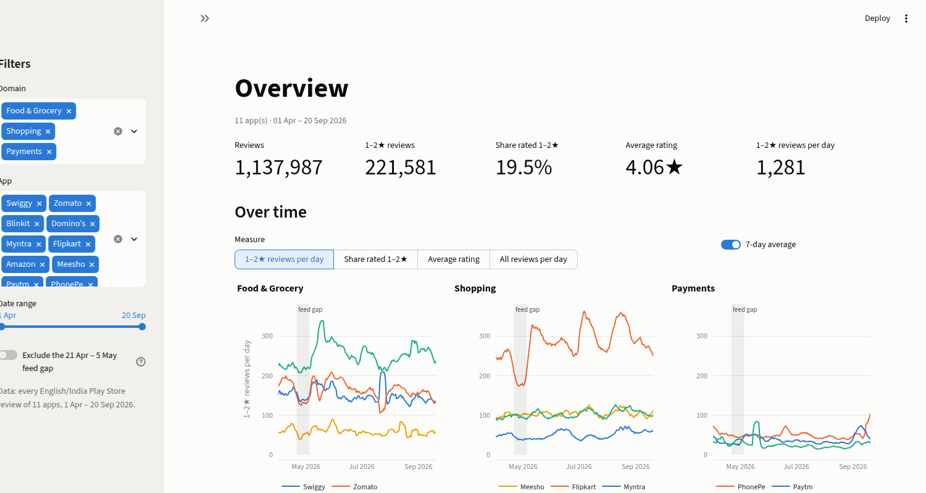
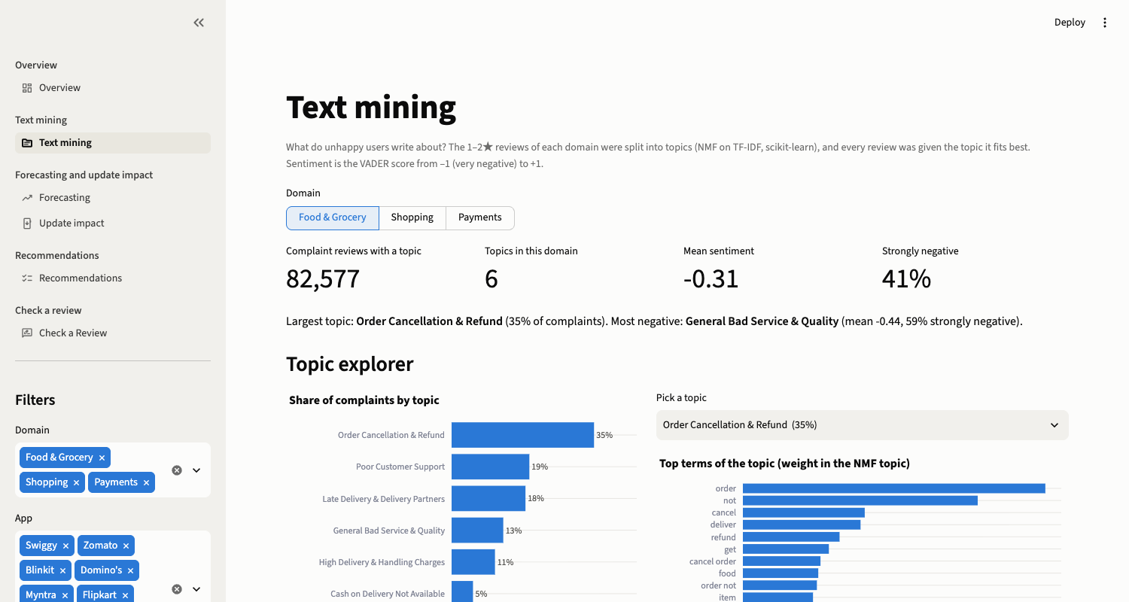
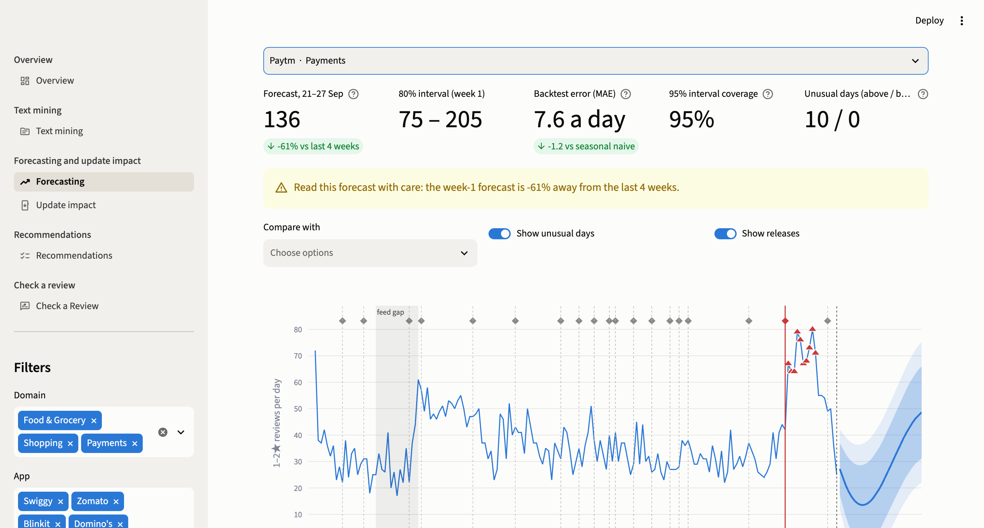
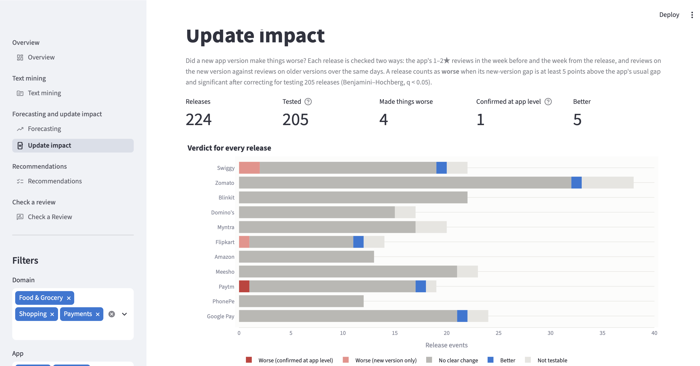
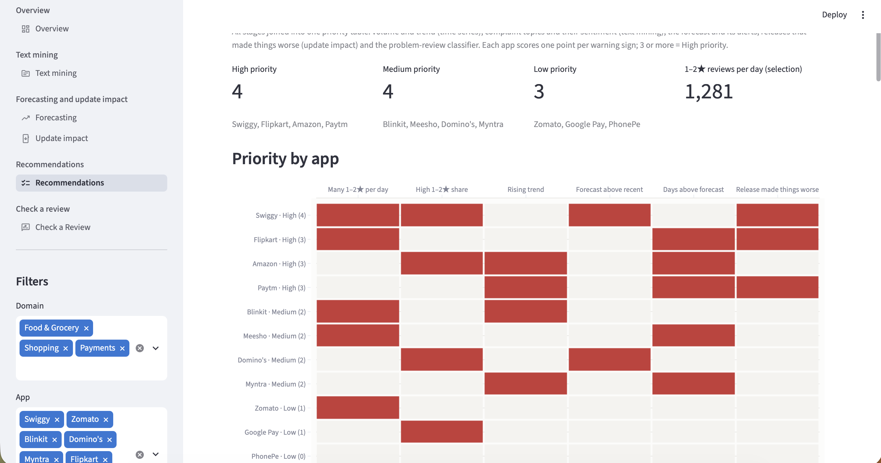
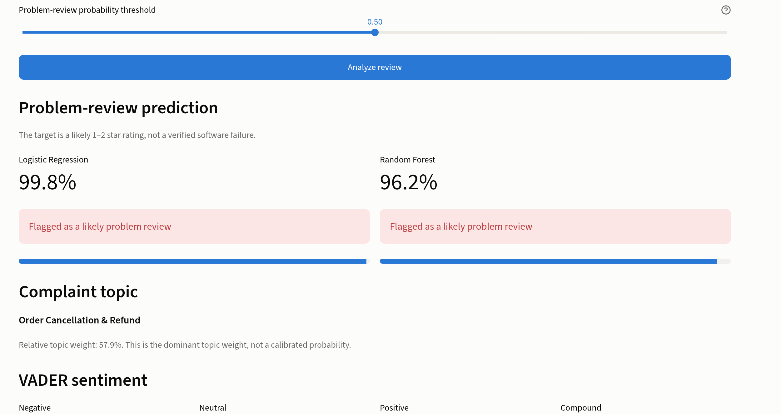
BACKUP · INTERACTIVE APPLICATION
Dashboard pages
Overview
Text mining
Forecasting
Update impact
Recommendations
Check a review
B4
Notes:
[Backup] If the live app is slow to wake, walk through these pages instead, then retry the link.

