Slide 1
QFlow
AI-Powered Smart Token & Queue Management System
Review 1 | Full Stack Development
Presented by: Adithya P K • 310624243009
Easwari Engineering College
Guide: Ms. D S K Harshitha • Technical Trainer, AI & DS

Slide 2
Agenda
02
• Scope of review
• Requirements
• System architecture
• Use case & database design
• Modules and technology stack
• UI, frontend & backend
• Database & APIs
• Implementation status
• Screenshots
• Challenges, next steps & references
QFlow • Review 1 • MERN Stack Project

Slide 3
Requirements
03
Functional
Non-Functional
• QR-based customer access
• Name, phone and service selection
• Sequential token generation
• Live token status and waiting time
• Call, Start, Complete, Skip, Transfer
• Dynamic counters and services
• Live analytics
• AI duration and counter recommendations
• Mobile-first customer UI
• Responsive staff dashboard
• Sub-second Socket.IO updates
• MongoDB as source of truth
• JWT + bcrypt security
• Local Wi-Fi operation
• Reliable database-first updates
QFlow • Review 1 • MERN Stack Project

Slide 4
System Architecture
04
Customer
Phone
React 19
+ Vite
Node +
Express
MongoDB
Staff/Admin
Dashboard
Axios REST API ↔ Express | Socket.IO for live updates
AI / Queue
Real-Time
• 500-record synthetic dataset
• Duration and wait-time estimation
• Counter workload recommendation
• FIFO queue handling
• MongoDB updated first
• Socket.IO broadcasts after write
• queue room → staff
• token:{id} room → customer
QFlow • Review 1 • MERN Stack Project

Slide 5
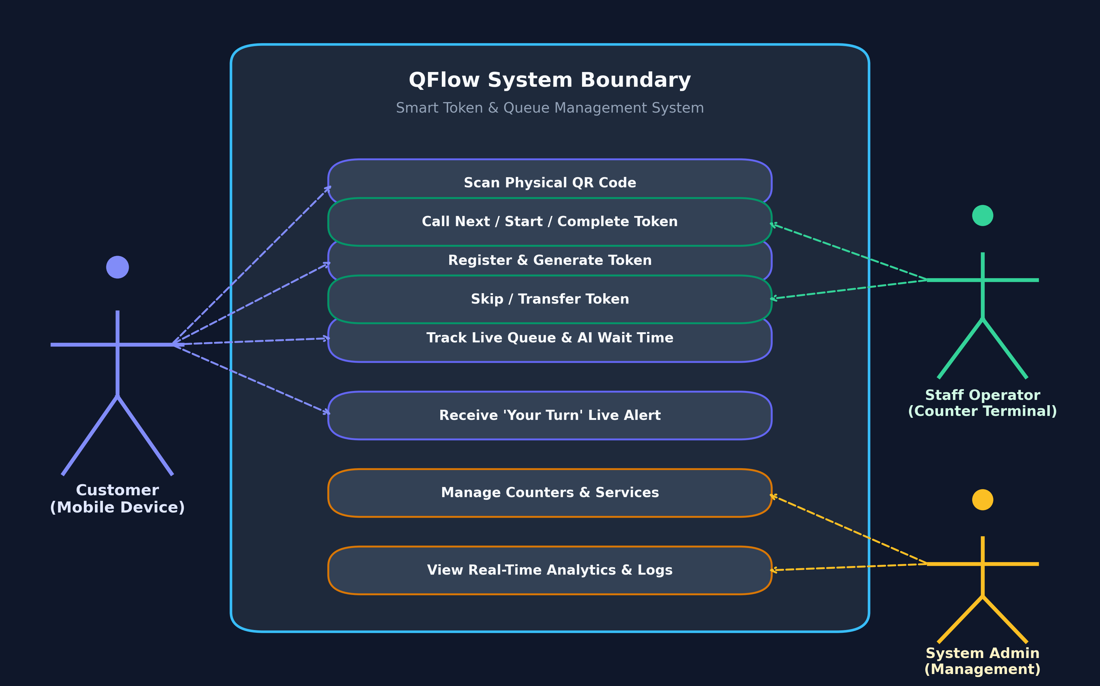
Use Case Diagram
05
Key Actions
• Customer: scan, register, get token, track, receive alert.
• Staff: login, view queue, call, start, complete, skip, transfer.
• Admin: manage counters, services and analytics.
QFlow • Review 1 • MERN Stack Project

Slide 6
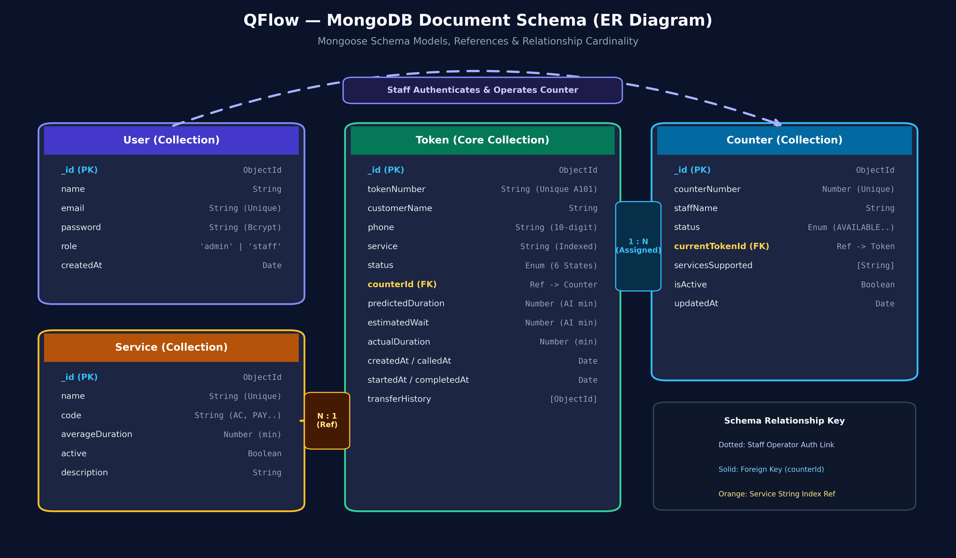
ER Diagram / Database Design
06
Collections
• User: name, email, role
• Counter: number, staff, status, current token
• Token: customer, service, status, counter, timings
• Service: name, code, duration
• Token references Counter.
QFlow • Review 1 • MERN Stack Project

Slide 7
Module Description
07
Module
Description
Key Functions
Customer Mobile
Check-in & tracking
QR, form, token, live status, vibration
Token Management
Token lifecycle
Sequential numbering, status, transfers
Counter Operations
Counter workflow
Call Next, Start, Complete, Skip, Transfer
AI Prediction
Time & workload
Duration, wait time, counter suggestion
Real-Time
Live synchronization
Socket rooms and event updates
Authentication
Staff/Admin security
JWT, bcrypt, protected routes
Analytics
Operational insights
Volume, wait/service averages, utilization
QFlow • Review 1 • MERN Stack Project

Slide 8
Technology Stack
08
Category
Technology
Purpose
Frontend
React 19 + Vite
Web application
Routing / UI
React Router 7 + Tailwind CSS
Navigation & responsive UI
Backend
Node.js + Express 4.18
Server & REST APIs
Database
MongoDB + Mongoose 8.3
Persistent data
Real-Time
Socket.IO 4.7
Live updates
Security
JWT + bcryptjs
Authentication
AI / Charts
Weighted regression + Recharts
Prediction & analytics
QR / HTTP
qrcode + qrcode.react + Axios
QR and API communication
Tools
VS Code, Git, Postman
Development & testing
QFlow • Review 1 • MERN Stack Project

Slide 9
UI Design / Wireframes
09
Customer UI
Staff / Admin UI
• Dark, high-contrast mobile design
• Single-column, thumb-friendly layout
• Large token and live status
• People-ahead and estimated-wait cards
• Live counter grid
• Turn alert + phone vibration
• Dark dashboard with indigo accents
• Summary metric cards
• Live counter monitoring
• AI recommendation panel
• Queue/history tables
• Counters, analytics and settings
Main screens: Customer Check-In • Token Status • Login • Dashboard • Queue • Counters • Analytics • Settings
QFlow • Review 1 • MERN Stack Project

Slide 10
Frontend Development
10
Application Structure
Key Screens
• React 19 + Vite
• Customer routes: /customer, /customer/token/:tokenId
• Staff routes: /, /queue, /counters, /analytics, /settings
• AuthContext for login session
• QueueContext for tokens, counters and live events
• Axios through /api proxy
• Socket.IO through current LAN origin
• CustomerPortal.jsx
• TokenStatus.jsx
• LoginPage.jsx
• Dashboard.jsx
• QueuePage.jsx
• CountersPage.jsx
• AnalyticsPage.jsx / SettingsPage.jsx
QFlow • Review 1 • MERN Stack Project

Slide 11
Backend Development
11
• Node.js + Express server with Socket.IO.
• Controllers for auth, tokens, counters, services, queue and analytics.
• Token actions: create, call, start, complete, skip and transfer.
• Counter actions: create, update, deactivate and Call Next.
• JWT middleware and bcrypt password handling.
• Central error handler for validation and duplicate-key errors.
• Local MongoDB with automatic embedded fallback.
• Socket events are emitted only after successful database writes.
QFlow • Review 1 • MERN Stack Project

Slide 12
Database Integration
12
Collection
Important Fields
Purpose
Users
name, email, password, role
Staff/Admin accounts
Counters
number, staff, status, currentTokenId, isActive
Service stations
Tokens
tokenNumber, customer, service, status, counter, timings
Queue records
Services
name, code, averageDuration, active
Service categories
Flow
Seed Data
• Request → Mongoose → MongoDB → successful write → Socket.IO
• Admin + staff • 5 services • 4 counters • 15 historical records
QFlow • Review 1 • MERN Stack Project

Slide 13
API Development
13
Method
Endpoint
Purpose
POST
/api/auth/login
Staff/Admin login
GET / POST
/api/tokens
View / create tokens
GET
/api/tokens/:id
Token details
POST
/api/tokens/:id/call
Call token
POST
/api/tokens/:id/start
Start service
POST
/api/tokens/:id/complete
Complete service
POST
/api/tokens/:id/skip
Skip token
POST
/api/tokens/:id/transfer
Transfer token
GET / POST / PUT / DELETE
/api/counters
Manage counters
GET / POST / PUT / DELETE
/api/services
Manage services
GET
/api/queue
Current active queue
GET
/api/analytics
Queue analytics
GET
/api/health
Server health
QFlow • Review 1 • MERN Stack Project

Slide 14
Module-wise Implementation Status
14
Module
Status
Result
Customer Mobile Portal
COMPLETED
Working on mobile through LAN
Token Sequence Generator
COMPLETED
Atomic A101, A102...
Real-Time Socket Sync
COMPLETED
Live mobile + desktop updates
Staff Dashboard & Actions
COMPLETED
Call, Start, Complete, Skip, Transfer
Counter Management
COMPLETED
Create, activate, deactivate
Service Management
COMPLETED
Create, update, deactivate
AI Prediction
COMPLETED
500-record weighted regression
Counter Recommendation
COMPLETED
Dynamic workload scoring
MongoDB Analytics
COMPLETED
Aggregation-based charts
Physical QR Generator
COMPLETED
PNG, SVG and A4 poster
Authentication & RBAC
COMPLETED
JWT + password hashing
Overall: 100% of the defined Review 1 scope is operational.
QFlow • Review 1 • MERN Stack Project

Slide 15
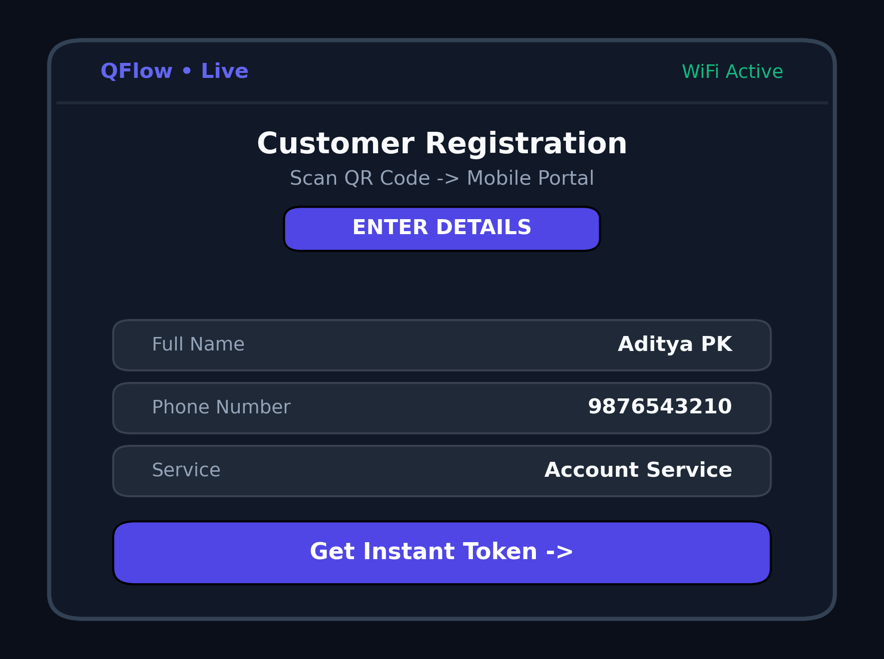
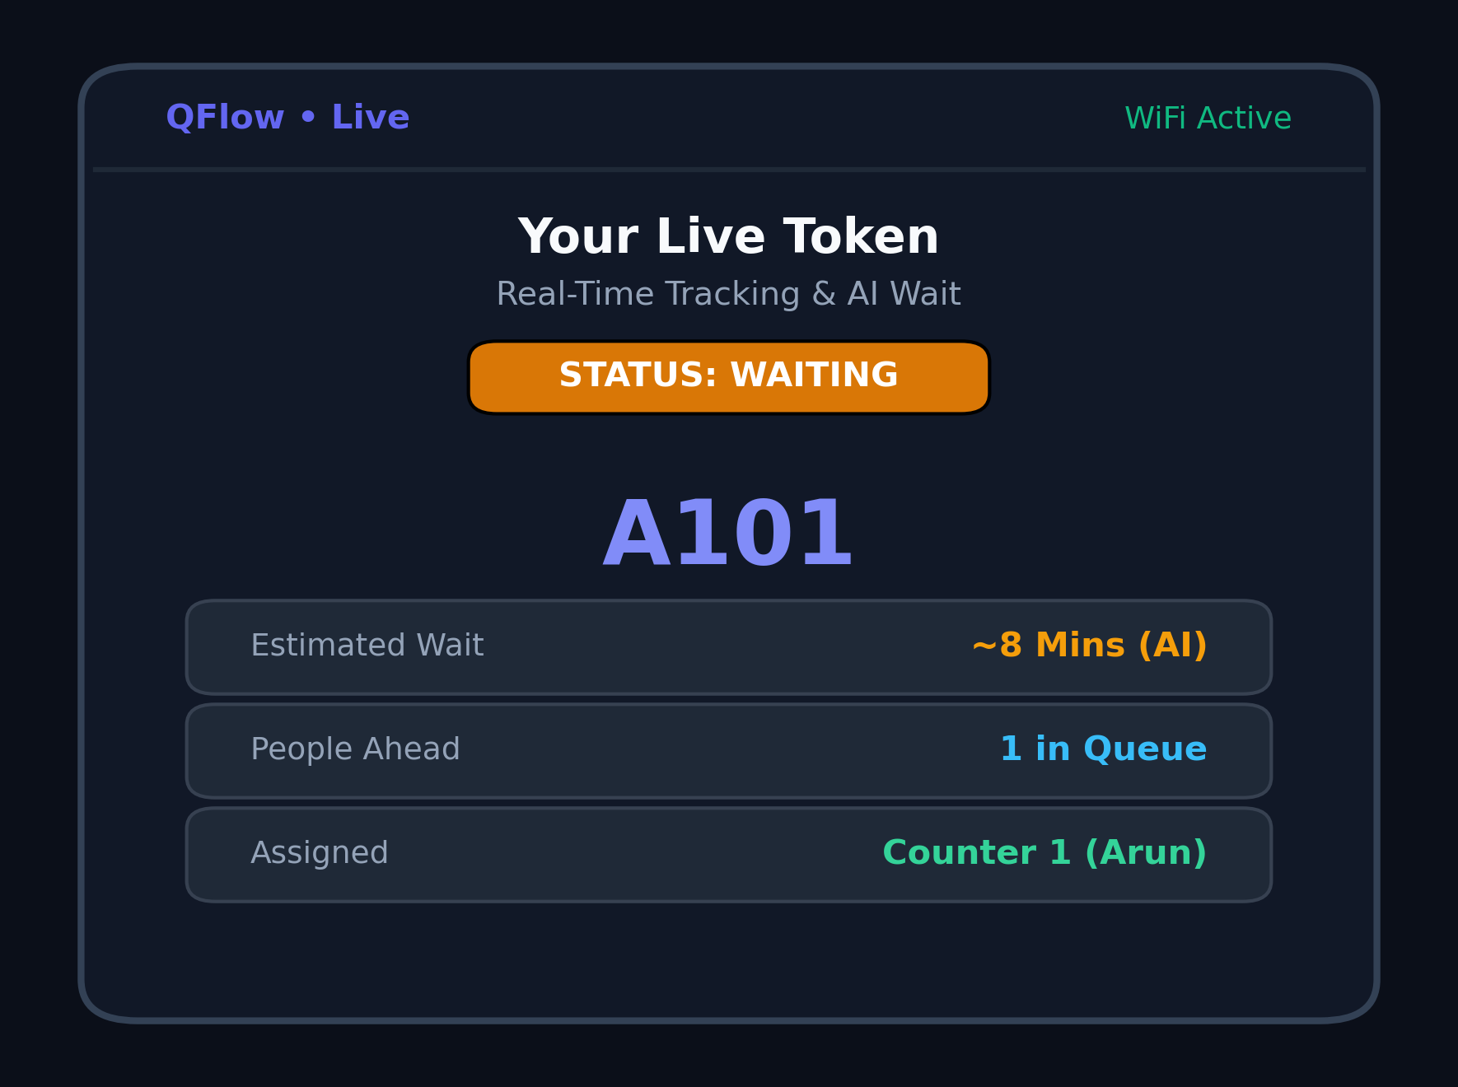
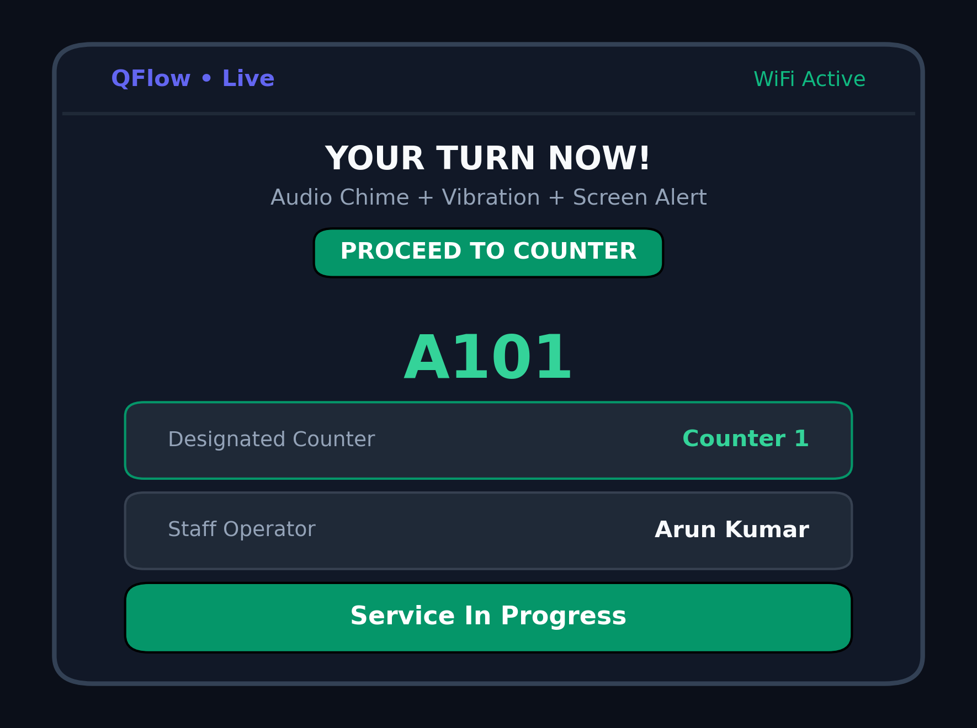
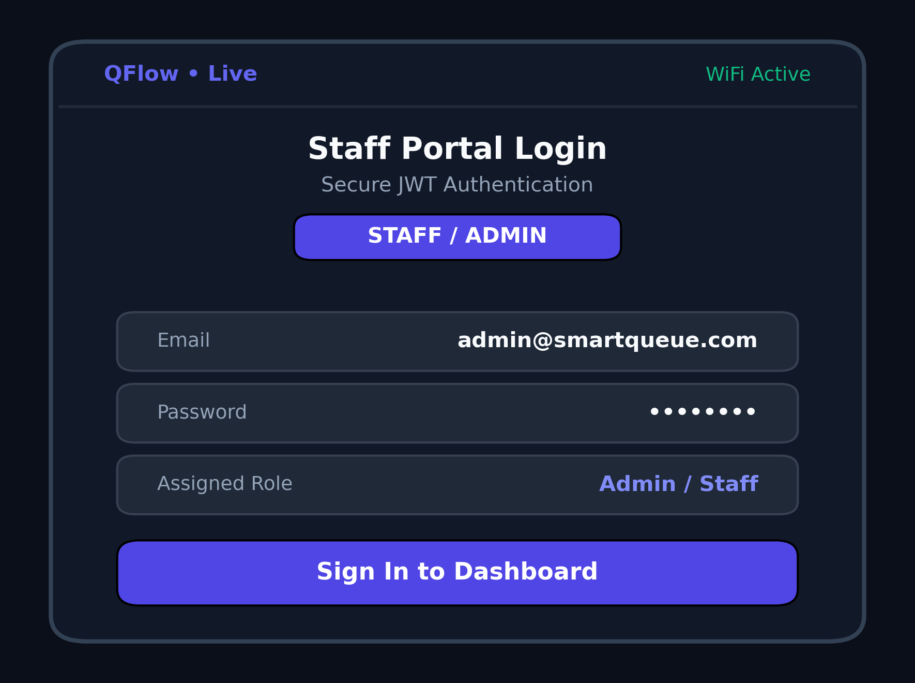
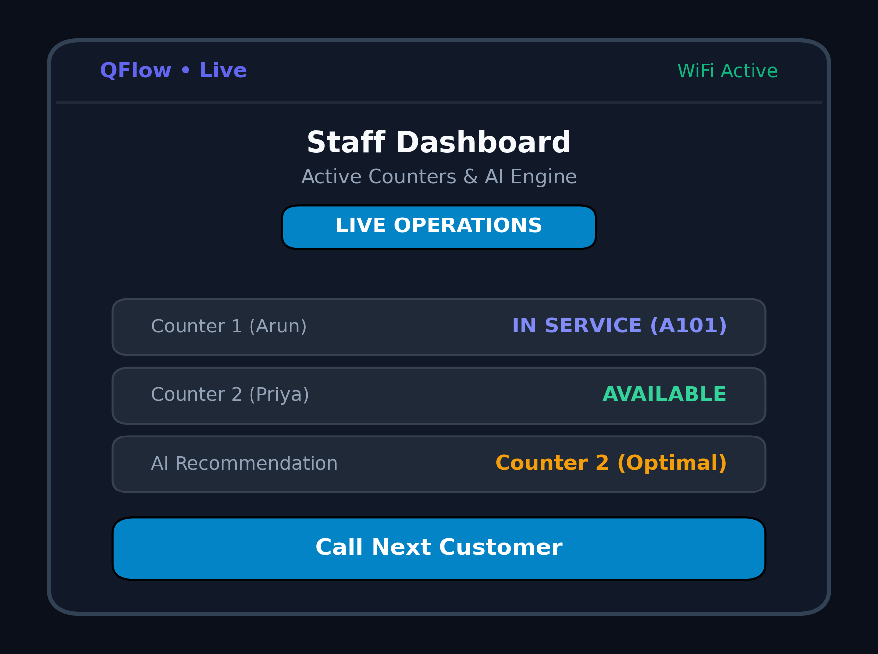
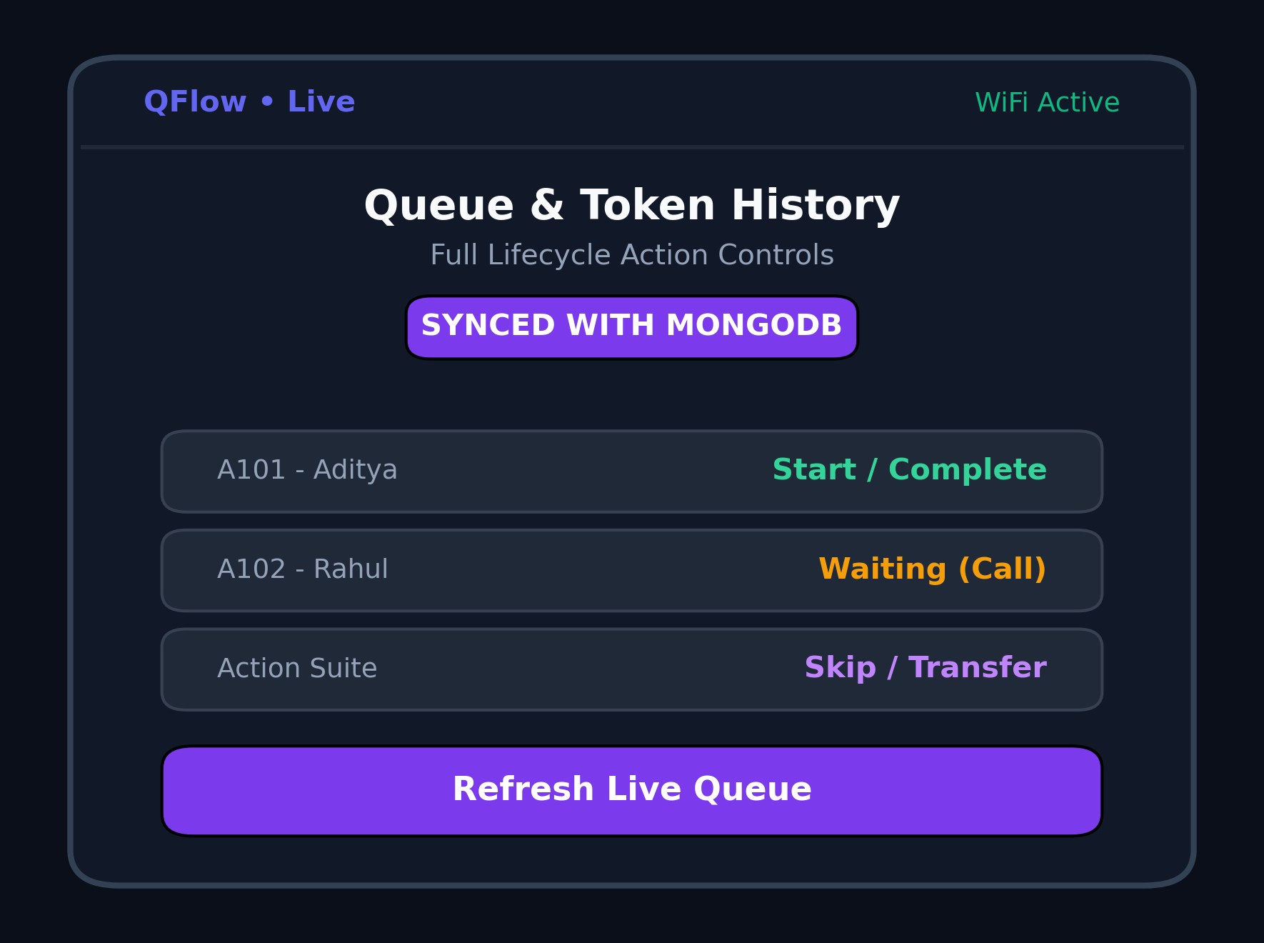
Screenshots
15
QFlow • Review 1 • MERN Stack Project

Slide 16
Challenges Faced & Solutions
16
Challenge
Solution
Phone could not directly reach backend
Vite reverse proxy forwards /api and /socket.io on the LAN-facing port.
Wrong LAN IP from virtual adapters
Filter virtual / WSL / loopback adapters and prioritize Wi-Fi/Ethernet.
MongoDB standalone did not support transactions
Use atomic findOneAndUpdate checks for safe token claiming.
Concurrent bookings could duplicate tokens
Scan stored token numbers atomically before incrementing.
Socket events could be missed after reconnect
Customer screens refetch current state when Socket.IO reconnects.
QFlow • Review 1 • MERN Stack Project

Slide 17
Remaining Work & References
17
Remaining Work
References
• Public TV queue display with audio announcements
• Automated Jest + Supertest testing
• Docker deployment setup
• Future: SMS / WhatsApp notifications
• Future: real-world ML training data
• Future: multi-branch support and PWA features
• React Documentation — react.dev
• Socket.IO Documentation — socket.io/docs/v4
• Express.js Documentation — expressjs.com
• Mongoose / MongoDB Documentation — mongoosejs.com/docs
• Tailwind CSS Documentation — tailwindcss.com/docs
• Vite Documentation — vitejs.dev/config
• Review 0 literature references — retain the original submitted sources
QFlow • Review 1 • MERN Stack Project

