Slide 1
Customer Churn Analysis of A certain Bank
Team Stat
Abhay Bhat – PES1UG19CS010
Adithya MS – PES1UG19CS027
Aditya Ramesh – PES1UG19CS033
Aniruddha Krishna Jha – PES1UG19CS064

Slide 2

Abstract and Scope
Data is everywhere in the world. Information is essentially the oil of the 21st century and analytics is the combustion engine. We set out to analyse the data of a certain banking organisation and evaluate its customer attrition rate or customer loss rate. This sort of predictive analysis model is termed as the ‘Churn Model’ or ‘Churn Analysis’. We further went on to draw meaningful inferences from our analysis. The data analysed was a sample provided by the organization for around 5000 customers.

Slide 3
Read the data
Data cleaning or pre-processing
Visualisation of the graph
Standardisation of the values/data
Hypothesis Testing
Workflow Model

Slide 4
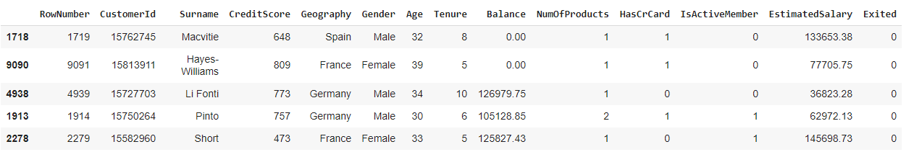
Data Reading
The dataset we will be working during the course of this project is that of a banking organisation. It is a churn model, the source of which can be found at Kaggle,
Source: https://www.kaggle.com/shrutimechlearn/churn-modelling

Slide 5
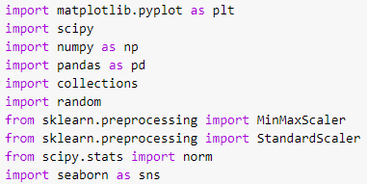
Data Reading
We import the necessary libraries and start with the reading of our data

Slide 6
Data Cleaning
Data cleaning is the process of preparing data for analysis by removing or modifying data that is incorrect, incomplete, irrelevant, duplicated, or improperly formatted.
Data cleaning is not simply about erasing information to make space for new data, but rather finding a way to maximize a data set’s accuracy without necessarily deleting information. There are several methods for cleaning data depending on how it is stored along with the answers being sought.

Slide 7
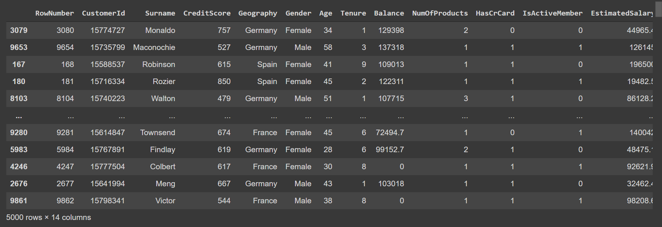
Data Cleaning –Missing values
missing_values=["na","n/a","--","NaN",""," "]
The total number of missing values were found using isnull().sum() and these missing or NaN values were handled by replacing them with appropriate values using the fillna() function.

Slide 8
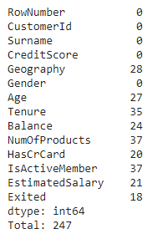
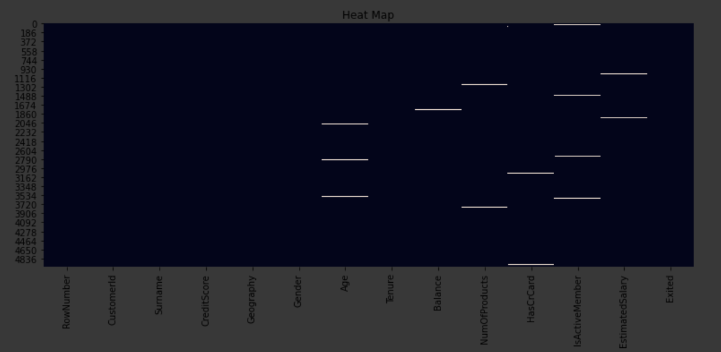
Data Cleaning –Handling missing values
Below is a heat map for the different missing values in the dataset
Fig: Missing Values

Slide 9
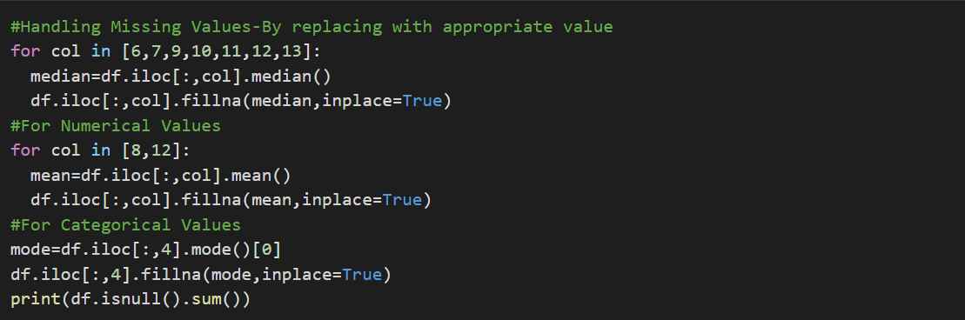
Data Cleaning –Handling missing values
Below is the code for Imputing the missing values.

Slide 10
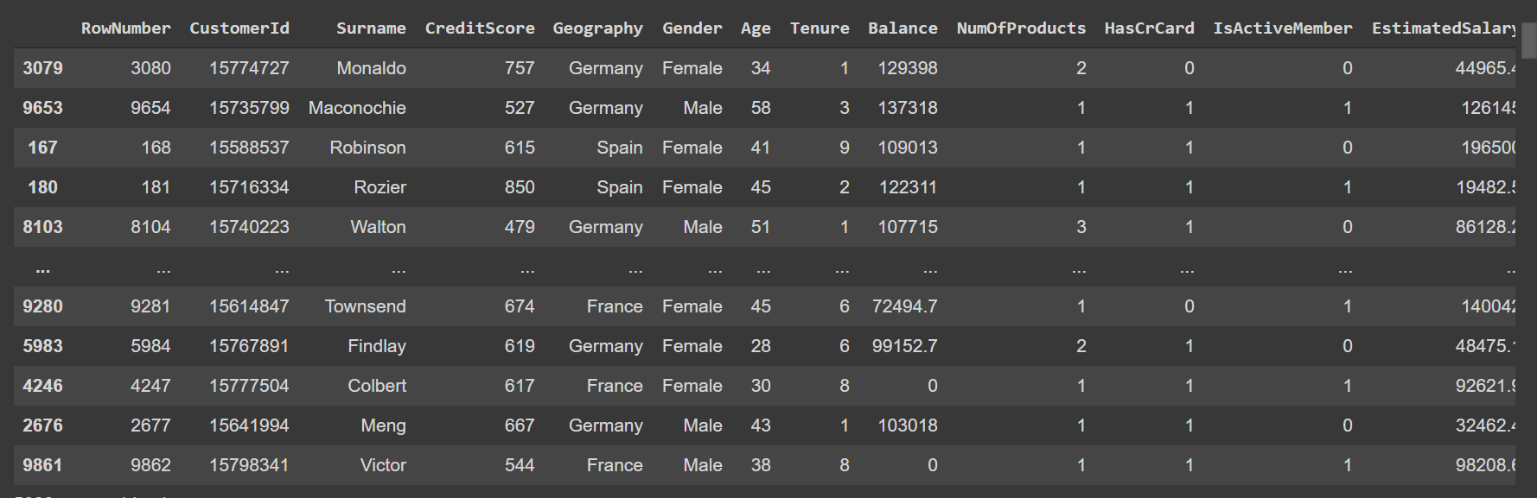
Data Cleaning –Inconsistent data
Here is the list of inconsistencies found in the sample, displayed in a tabular format.
The issue of inconsistencies in the form of capitalization was tackled using the str.lower() function which makes everything lowercase.

Slide 11
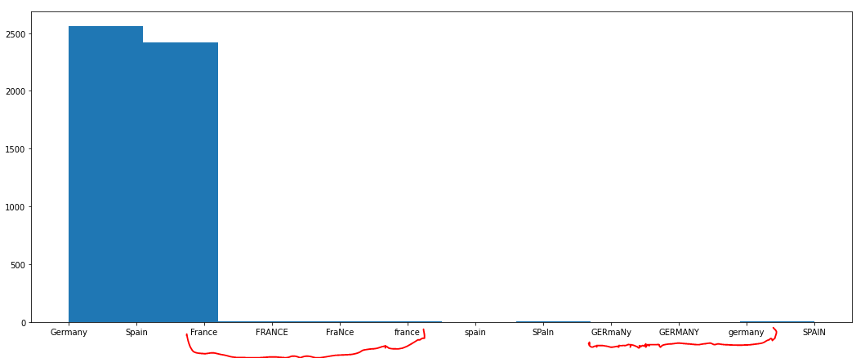
Data Cleaning –Handling inconsistent data
Here is another example of inconsistencies found in the sample, displayed using a histogram.

Slide 12
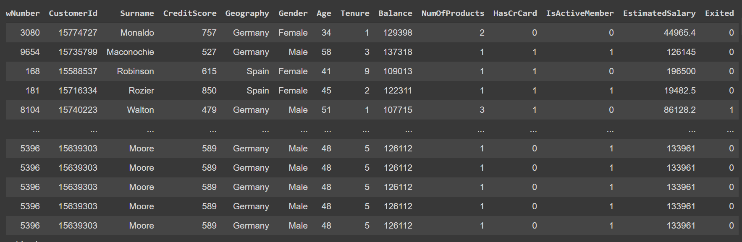
Data Cleaning – Repetitive data
From the table, we can observe that the last few rows have been repeated many times.

Slide 13
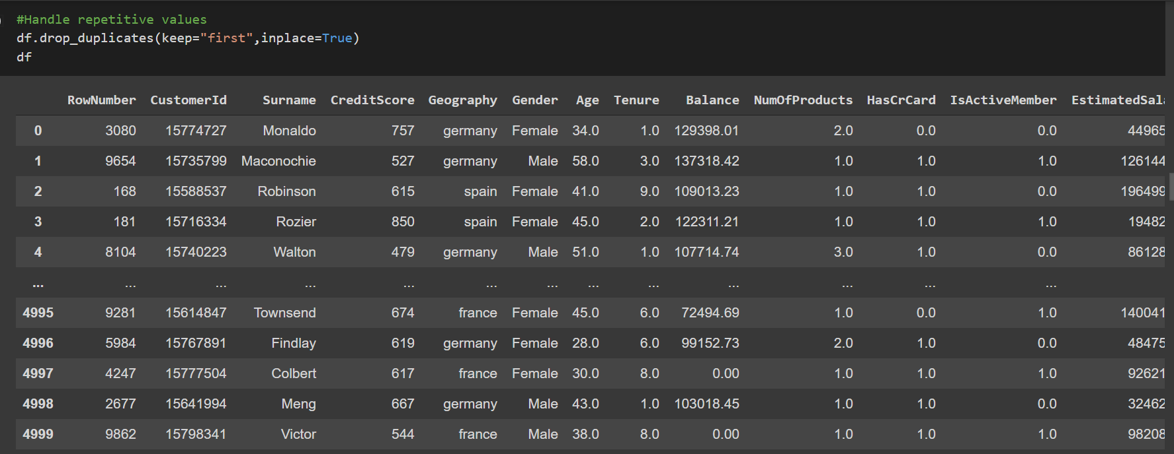
Data Cleaning – Handling repetitive data
Duplicate data could negatively affect analysis of the data at hand, so we use the drop_duplicates() function to eliminate all duplicate values.

Slide 14
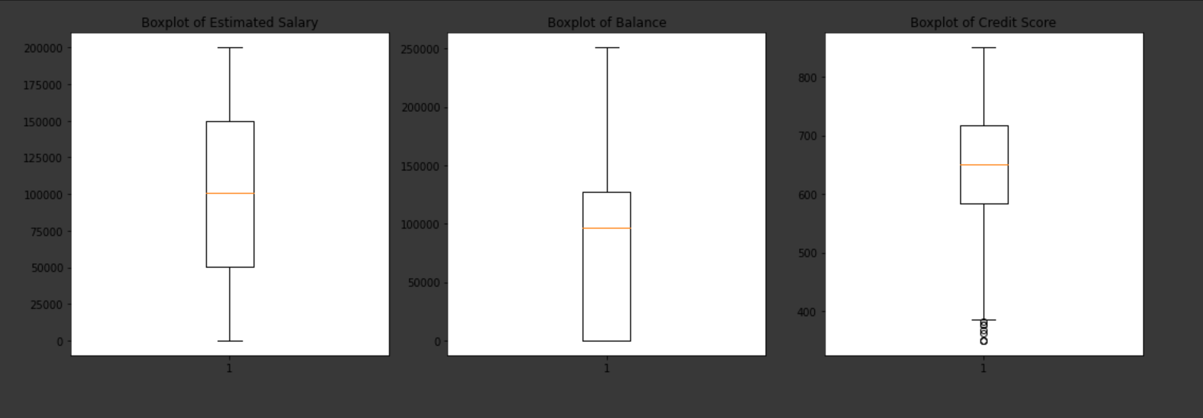
Data Cleaning – Outliers
In a data distribution, with extreme outliers, the distribution is skewed in the direction of the outliers which makes it difficult to analyze the data.

Slide 15
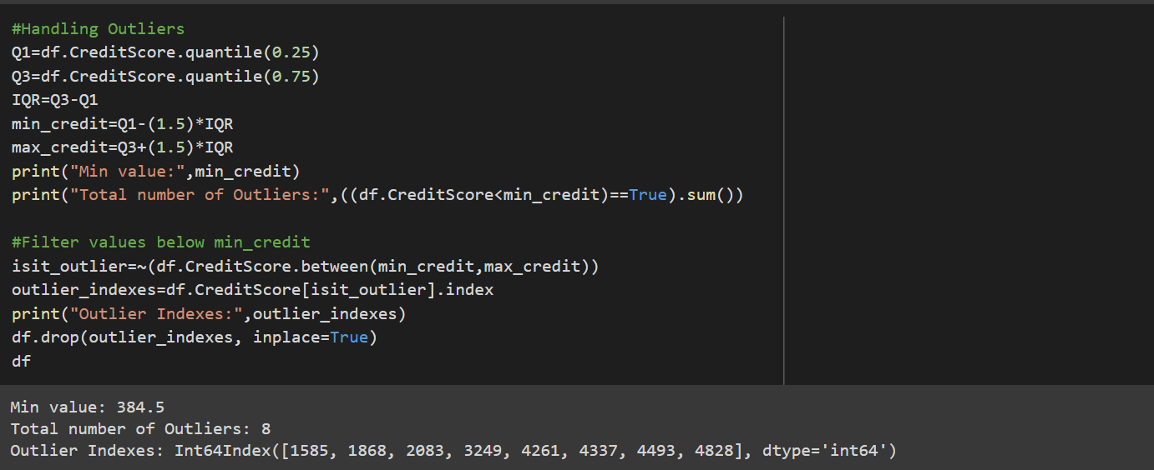
Data Cleaning – Handling outliers
Outliers are handled by first using the quantile() function to calculate minimum and maximum credit values, following which all values below the minimum credit and above the maximum credit are filtered out using drop() function.

Slide 16
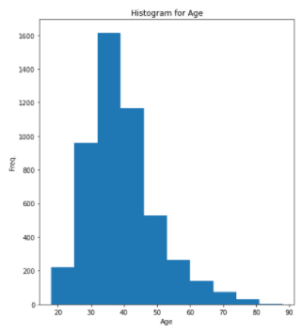
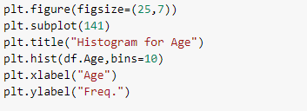
Data Visualisation – Histograms

Slide 17
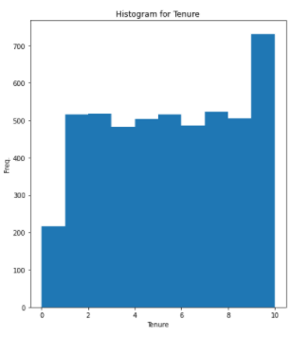
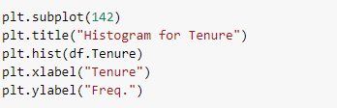
Data Visualisation – Histograms

Slide 18
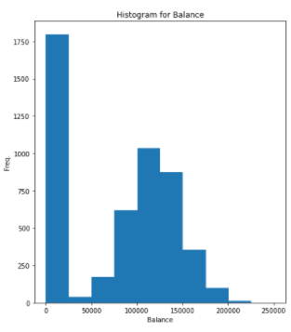
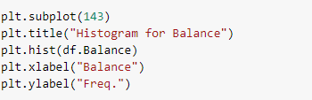
Data Visualisation – Histograms

Slide 19
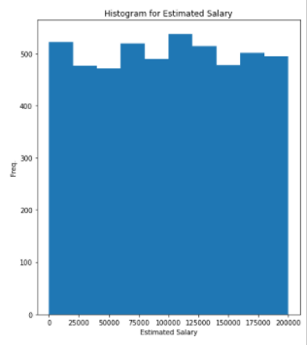
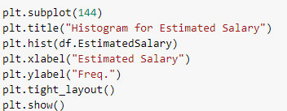
Data Visualisation – Histograms

Slide 20
Normalisation
Box-Cox method is a data transform method that is able to perform a range of power transforms, including the log(for exponential) and the square root(for skewed). Boxcox function takes an argument, called lambda, that controls the type of transform to perform.
lambda = -1. is a reciprocal transform.
lambda = -0.5 is a reciprocal square root transform.
lambda = 0.0 is a log transform.
lambda = 0.5 is a square root transform.
lambda = 1.0 is no transform.
KDE Plot described as Kernel Density Estimate is used for visualizing the Probability Density of a continuous variable. It depicts the probability density at different values in a continuous variable.

Slide 21
Normalisation
The intention of normalisation is to transform the data so that it is normally distributed. This is important since most statistical methods rely on normally distributed data. MinMaxScaler() function is used to scale all the data features in the range [0,1] and this scaling compresses all the inliers in the range [0, 0.005]
The training data is then transformed by using the fit() and transform() functions. fit() computes the mean and standard deviation to be used for scaling and transform uses these calculated values to autoscale the data.
Boxcox transformation is utilised to transform the non-normal distribution of our data to a normal distribution which allows us to run a lot more tests. The boxcox() function is imported from the scipy module.

Slide 22
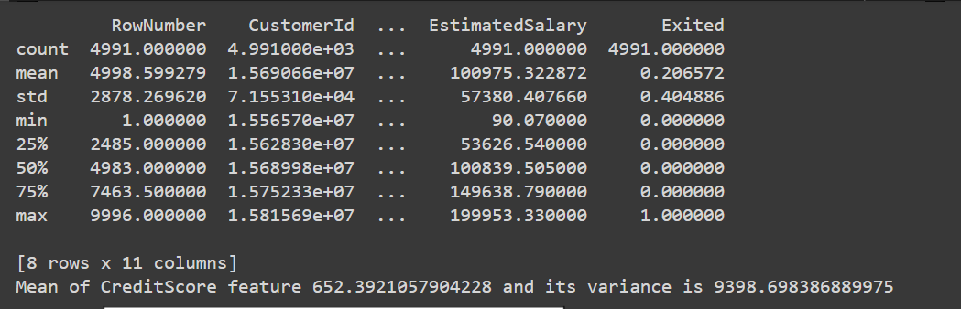
Descriptive Statistics

Slide 23
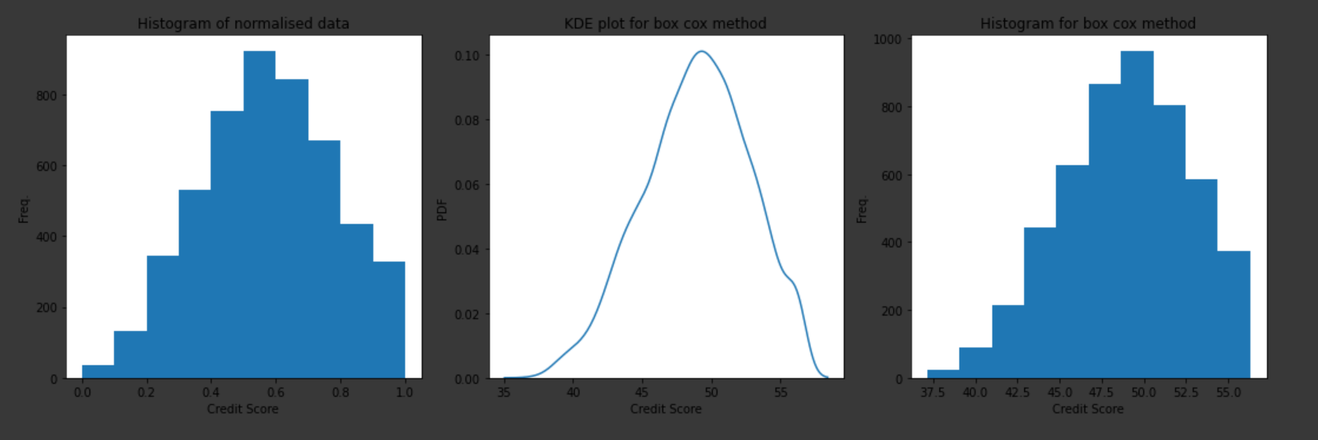
Normalisation

Slide 24
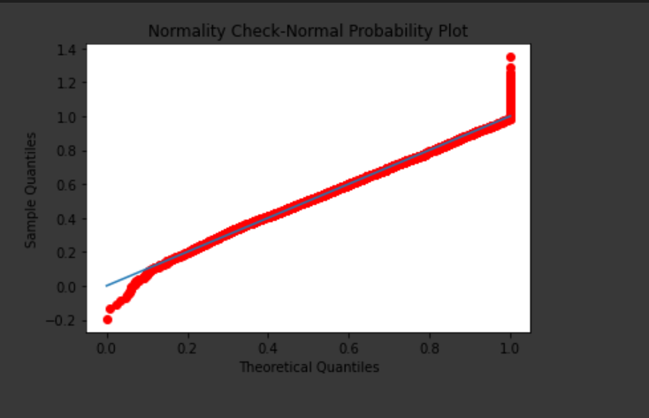
Normalisation : Normality check
Box-cox does not guarantee normality because it never checks for the normality which is necessary to be foolproof that it has correctly transformed the non-normal distribution or not. It only checks for the smallest standard deviation. So, a normality check is performed with the help of norm.ppf()

Slide 25
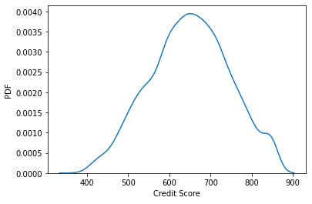
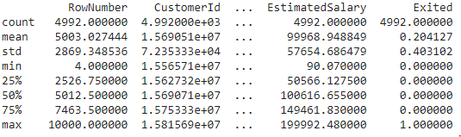
Standardisation of the Data
Standardization is about making sure that data is internally consistent, that is each data type has the same content and format. Standardised values are useful for tracking data that isn't easy to compare otherwise. StandardScaler() function is used which follows Standard Normal Distribution (SND). It takes mean = 0 and scales the data to unit variance. Then, the fit_transform() function is used to scale the data and learn the scaling parameters.

Slide 26
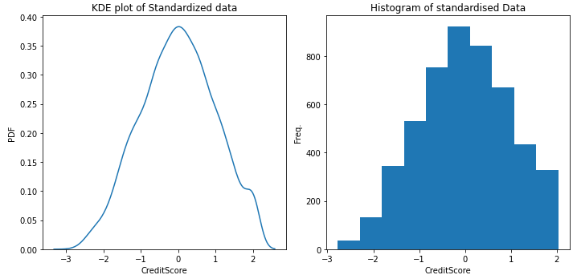
Visualisation of standardised data

Slide 27
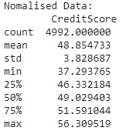
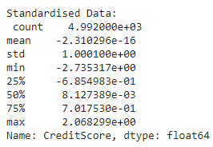
Post – Standardisation and Normalisation
Finally, the descriptive statistics of both the normalised and standardised data are viewed using the describe() function.
Contrast

Slide 28
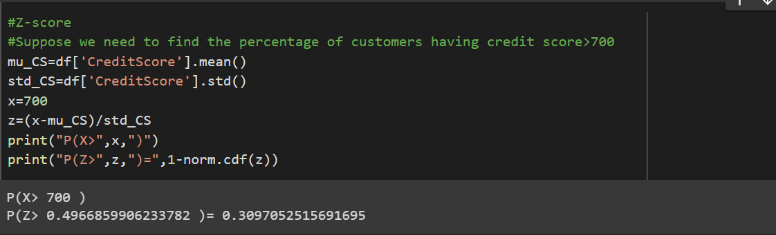
Z-Score
Suppose we need to determine the percentage of Customers having
Credit Score greater than 700.
Z-score can be used on the standardized data to determine the no.
of customers who satisfy the above mentioned condition.

Slide 29
Hypothesis Testing – Stating the hypothesis
Let’s consider a population of all the customers of the banking organization. We already have a sample of 5000 customers right now. We have also successfully obtained the measures of central tendency for the sample. In real-world scenarios it’s rare that the sample measures can be realized for a population measure. Hence we check the validity of Null Hypothesis in this case.

Slide 30
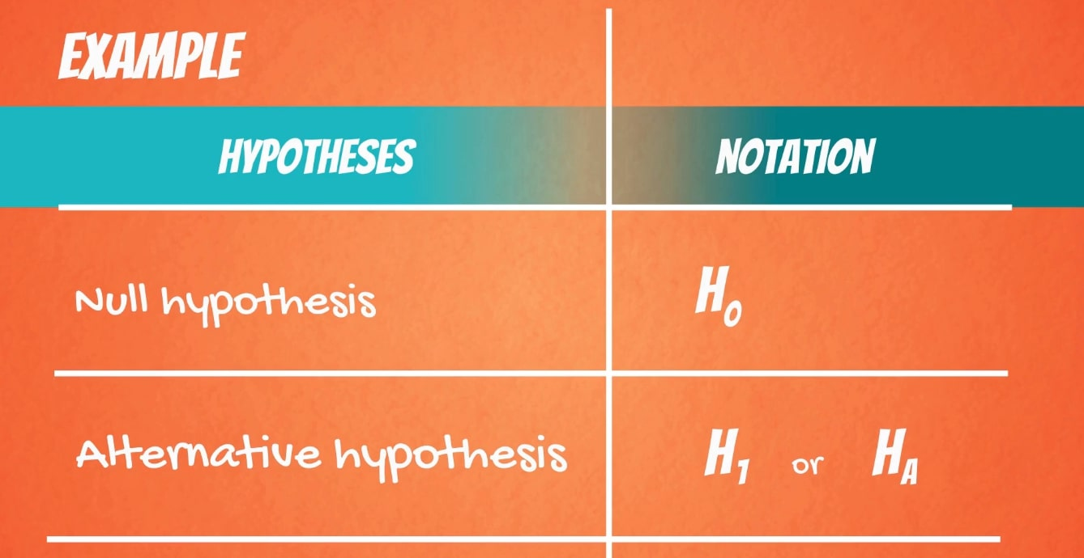
Hypothesis Testing –What is Null hypothesis?
In inferential statistics, the null hypothesis is a general statement or default position that there is no difference between two measured phenomena or that two samples derive from the same general population. Testing (rejecting or not rejecting ) the null hypothesis and drawing conclusions from the same tells that there are (or there are not) grounds for believing that there is a relationship between the two phenomena. An alternate hypothesis is often provided to dispute the null hypothesis.
It is generally assumed to be true until evidence states otherwise.

Slide 31
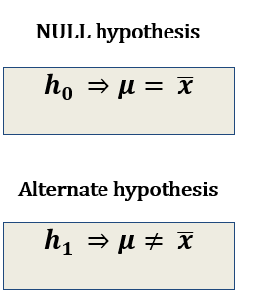
Hypothesis Testing – Applying Null hypothesis
Consider the estimated salary of the customers in the sample. The null hypothesis , h₀ , here proposes that mean estimated salary of the sample , can be generalised as the mean estimated salary of the population i.e., the mean estimated salary of all the customers of the bank, denoted by ‘μ’. Whereas the alternative hypothesis, h₁, proposes that there is there is no relation between these parameters.
NULL hypothesis
Alternate hypothesis

Slide 32
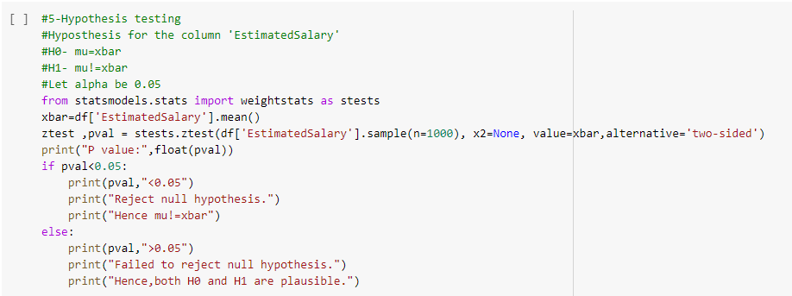
Hypothesis Testing – The Code

Slide 33

Hypothesis Testing – Inference
As we see here, the code on being run displays the p-value being greater than α, which further implies that we cannot reject the null hypothesis in this case. We can also infer that population parameter, μ, might or might not be equivalent to the sample parameter, .
Both the null and alternative hypotheses are plausible here.

Slide 34
Thank You

