Slide 1

Bootcamp 2021
Pattern-Matching

Slide 2
Team Details
Adithya M S PES1UG19CS027
Akanksha V Akkihal PES1UG19CS039
Abhiram Puranik PES1UG19CS018

Slide 3
Pattern Matching
Pattern matching is the process of checking whether a specific sequence of characters/tokens/data exists among the given data.
Regular programming languages make use of regular expressions (regex) for pattern matching.

Slide 4
1st Method: Using grep command
The grep filter searches a file for a particular pattern of characters, and displays all lines that contain that pattern. The pattern that is searched in the file is referred to as the regular expression.
grep stands for Globally search for Regular Expression and Print out.
Syntax:
grep [options] pattern [files]

Slide 5

“grep” screenshot
Command: grep –E -n "(1|0)*1(1|0){20}" input-data-file.txt
-E : Treats the pattern as an extended regular expression
-n : Gives the line number of the matching string with the pattern
This gives the line number and the string matching the given regex
Time taken using the ‘time’ linux command

Slide 6

2nd Method: FPGA Approach
Field Programmable Gate Arrays (FPGAs) are semiconductor devices which is an array of logic gates, and this array can be programmed/configured in the field, i.e., by the user of the device as opposed to the people who designed it.
FPGAs can be reprogrammed to desired application or functionality requirements after manufacturing.

Slide 7
Given regular expression
(1|0)*1(1|0){20}
Example: 110111100110101010110101, 110101101011101010101
String to match the given regex must have at least 21 characters of 1’s or 0’s as (1|0)* can be ε.

Slide 8
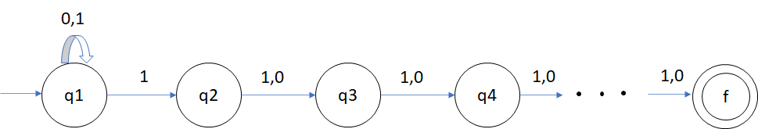
FSM(NFA) for the regex (1|0)*1(1|0)[20]

Slide 9
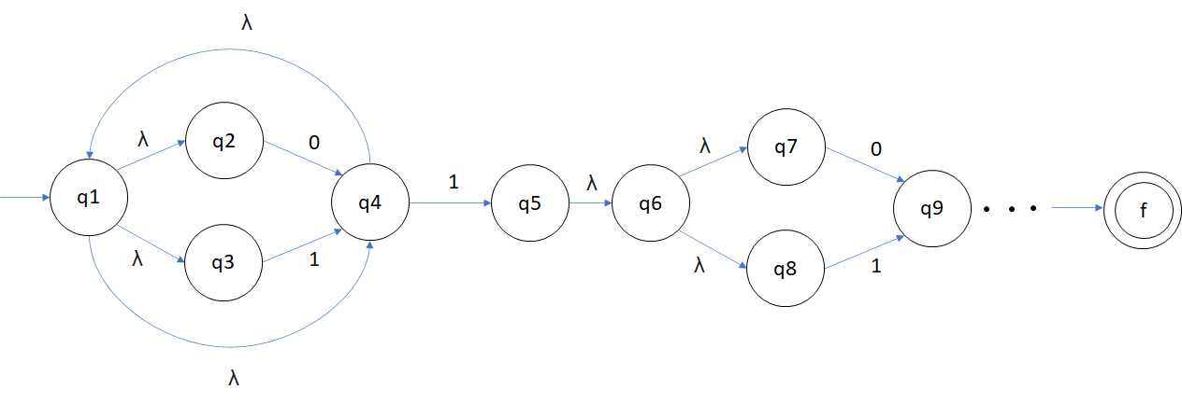
Expanded NFA

Slide 10
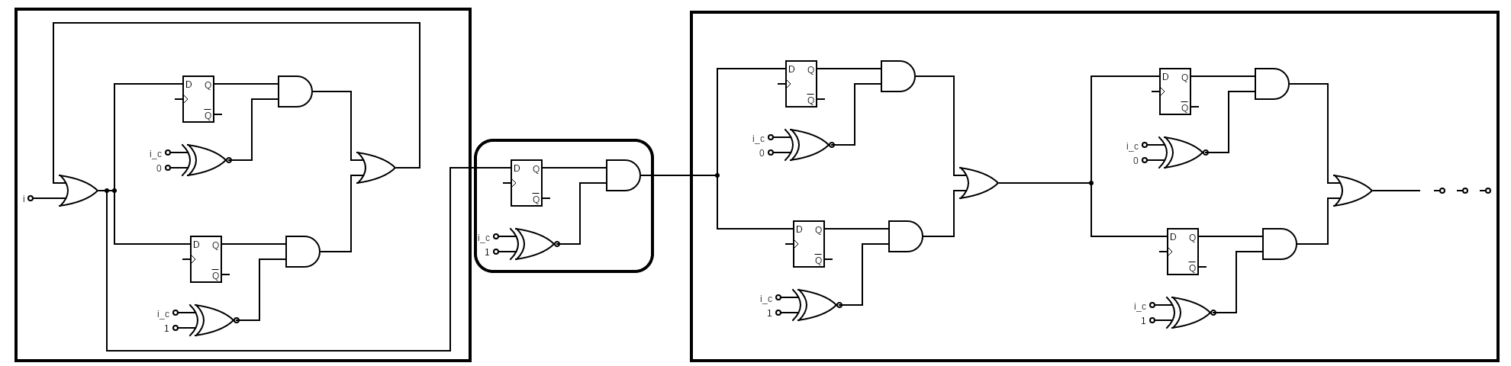
Logic implementation
18
(1|0)*
1
(1|0){20}

Slide 11
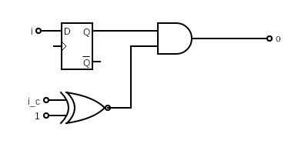
Character one
module char_one (input wire clk, reset, i, input wire ip_c, output wire o);
wire a, b;
xnor2 xnor2_0(ip_c, 1'b1, a);
dfr dfr_1(clk, reset, i, b);
and2 and2_2(a, b, o);
endmodule
b
r
a

Slide 12

Character zero
module char_zero (input wire clk, reset, i, input wire ip_c, output wire o);
wire a, b;
xnor2 xnor2_0(ip_c, 1'b0, a);
dfr dfr_1(clk, reset, i, b);
and2 and2_2(a, b, o);
endmodule
b
r
a

Slide 13
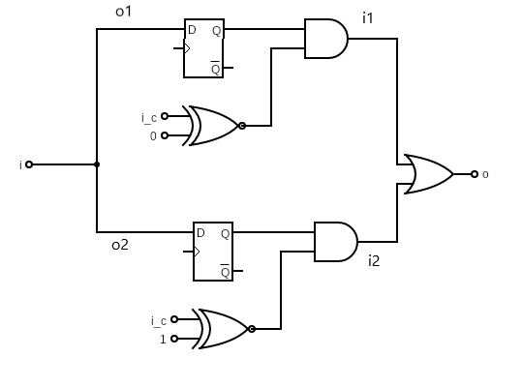
One bar zero (1|0)
module zero_bar_one (input wire clk, reset, i, input wire i_c, output wire o);
wire i1, i2, o1, o2;
bar bar_0 (i, o, i1, i2, o1, o2);
char_zero char_zero_0 (clk, reset, o1, i_c, i1);
char_one char_one_0 (clk, reset, o2, i_c, i2);
endmodule

Slide 14
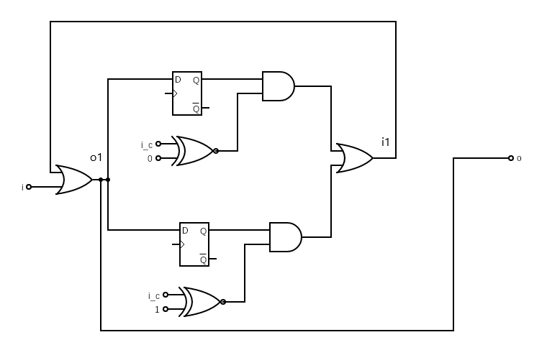
One bar zero star (1|0)*
module one_bar_zero_star(input wire clk,reset,i,input wire i_c,output wire o);
wire i1,o1;
star star_0(i,o,i1,o1);
zero_bar_one bar1(clk,reset,o1,i_c,i1);
endmodule
module star (input wire i, output wire o, input wire i1, output wire o1);
or2 or2_0 (i, i1, o1);
assign o = o1;
endmodule
module zero_bar_one (input wire clk, reset, i, input wire i_c, output wire o);
wire i1, i2, o1, o2;
bar bar_0 (i, o, i1, i2, o1, o2);
char_zero char_zero_0 (clk, reset, o1, i_c, i1);
char_one char_one_0 (clk, reset, o2, i_c, i2);
endmodule

Slide 15
Complete regex.v code
module bar (input wire i, output wire o, input wire i1, i2, output wire o1, o2);
assign o1 = i;
assign o2 = i;
or2 or2_0 (i1, i2, o);
endmodule
module dot (input wire i, output wire o, input wire i1, i2, output wire o1, o2);
assign o1 = i;
assign o2 = i1;
assign o = i2;
endmodule
module star (input wire i, output wire o, input wire i1, output wire o1);
or2 or2_0 (i, i1, o1);
assign o = o1;
endmodule
module zero_bar_one (input wire clk, reset, i, input wire i_c, output wire o);
wire i1, i2, o1, o2;
bar bar_0 (i, o, i1, i2, o1, o2);
char_zero char_zero_0 (clk, reset, o1, i_c, i1);
char_one char_one_0 (clk, reset, o2, i_c, i2);
endmodule

Slide 16
Continued
module zero_bar_one_dot_zero_bar_one(input wire clk, reset, i, input wire i_c, output wire o);
wire i1, i2, o1, o2;
dot dot_0 (i, o, i1, i2, o1, o2);
zero_bar_one zero_bar_one_1(clk, reset, o1, i_c, i1);
zero_bar_one zero_bar_one_2(clk, reset, o2, i_c, i2);
endmodule
module level_three(input wire clk, reset, i, input wire i_c, output wire o);
wire i1, i2, o1, o2;
dot dot_1 (i, o, i1, i2, o1, o2);
zero_bar_one_dot_zero_bar_one level_two_1(clk, reset, o1, i_c, i1);
zero_bar_one_dot_zero_bar_one level_two_2(clk, reset, o2, i_c, i2);
endmodule
module level_four(input wire clk, reset, i, input wire i_c, output wire o);
wire i1, i2, o1, o2;
dot dot_2 (i, o, i1, i2, o1, o2);
level_three level_three_1(clk, reset, o1, i_c, i1);
level_three level_three_2(clk, reset, o2, i_c, i2);
endmodule
module level_five(input wire clk, reset, i, input wire i_c, output wire o);
wire i1, i2, o1, o2;
dot dot_3 (i, o, i1, i2, o1, o2);
level_four level_four_1(clk, reset, o1, i_c, i1);
level_four level_four_2(clk, reset, o2, i_c, i2);
endmodule
module level_six(input wire clk, reset, i, input wire i_c, output wire o);
wire i1, i2, o1, o2;
dot dot_4 (i, o, i1, i2, o1, o2);
level_five level_five_1(clk, reset, o1, i_c, i1);
level_three level_three_3(clk, reset, o2, i_c, i2);
endmodule
module one_one_bar_zero_twenty(input wire clk, reset, i, input wire i_c, output wire o);
wire i1, i2, o1, o2;
dot dot_5 (i, o, i1, i2, o1, o2);
char_one char_one_1 (clk, reset, o1, i_c, i1);
level_six level_six_1(clk, reset, o2, i_c, i2);
endmodule

Slide 17
Continued
module one_bar_zero_star(input wire clk,reset,i,input wire i_c,output wire o);
wire i1,o1;
star star_0(i,o,i1,o1);
zero_bar_one bar1(clk,reset,o1,i_c,i1);
endmodule
module regex (input wire clk, reset, i, input wire i_c, output wire o);
/* Your code here */
wire i1,i2,o1,o2;
dot dot_0(i,o,i1,i2,o1,o2);
one_bar_zero_star mod1(clk,reset,o1,i_c,i1);
one_one_bar_zero_twenty mod2(clk,reset,o2,i_c,i2);
endmodule

Slide 18
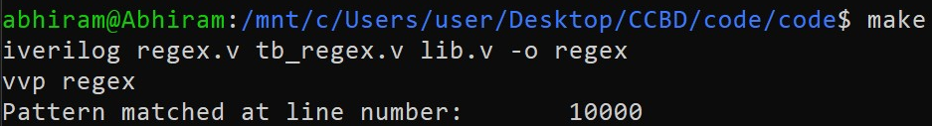
Verilog Execution
iverilog -o aout lib.v regex.v tb_regex.v
vvp aout
The line 10000 contains: 100000010011100001111 which according to the regex (1|0)*1(1|0){20}.
Using make command

Slide 19
THANK YOU!

