Slide 1
Intelligent Classification of Rural Infrastructure Projects Using Machine Learning
Presented By:
1. K Adithya-CMR University-CSE-Data Science

Slide 2
Problem Statement
Manual classification of rural road and bridge projects under the PMGSY schemes (PMGSY-I, PMGSY-II, RCPLWEA, etc.) is inefficient, error-prone, and not scalable. Each scheme has unique objectives and funding mechanisms. Accurate classification is essential for monitoring progress, optimizing resource allocation, and assessing impact. With thousands of records, there is a need for an automated, intelligent classification system based on physical and financial attributes of each project.

Slide 3
Proposed Solution
This project proposes a machine learning-based classification model that automatically categorizes infrastructure projects into their respective PMGSY schemes using physical and financial project data.
Key components:
- Data Collection from Al Kosh dataset.
- Data Preprocessing (missing value handling, normalization, encoding).
- Model Training (Random Forest, XGBoost).
- Deployment using IBM Cloud (Watson Studio & Cloud Functions).

Slide 4
System Development Approach (Technology Used)
System Requirements:
- IBM Cloud Lite
- IBM Watson Studio
- IBM Cloud Object Storage
- IBM Cloud Functions
Libraries Used:
- pandas, numpy, scikit-learn, xgboost, matplotlib, flask

Slide 5
Algorithm & Deployment
Algorithm: Random Forest, XGBoost
Input Features: Project cost, year, length, type, work category, etc.
Training: Train-test split, grid search, 10-fold cross-validation
Deployment:
- Model hosted using IBM Watson Machine Learning
- REST API built with Flask
- Deployed via IBM Cloud Functions

Slide 6
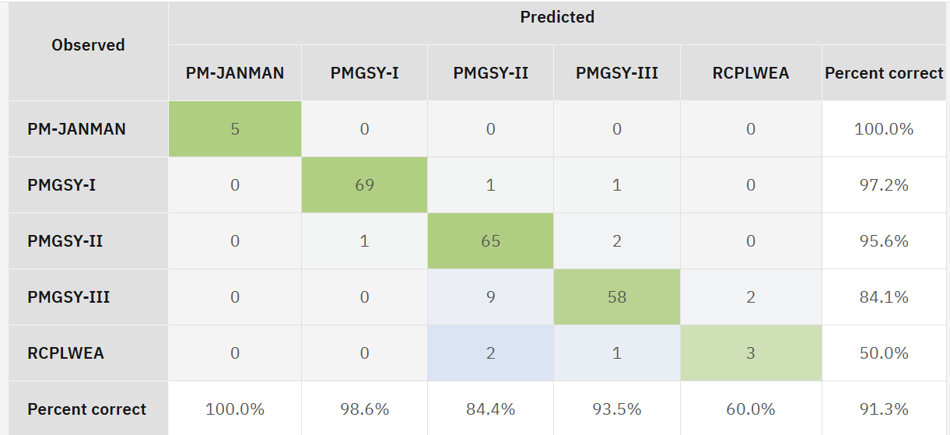
Result

Slide 7
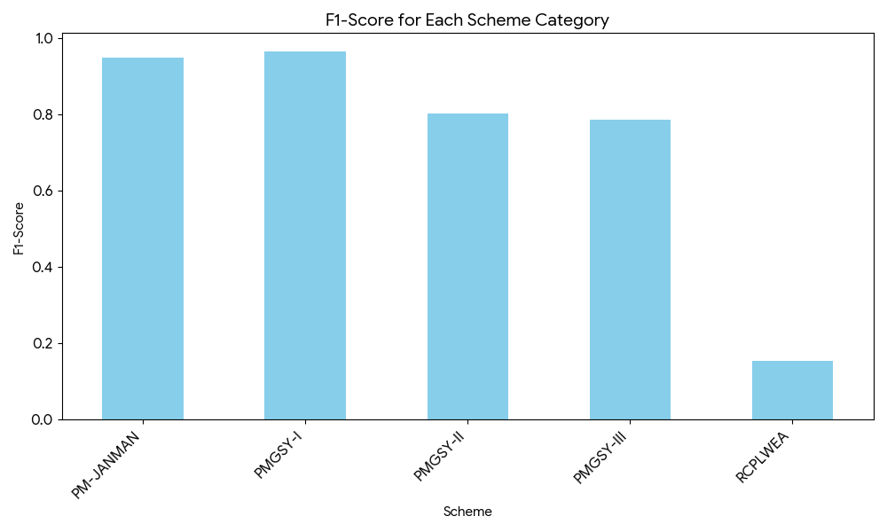
F1-score
Conclusion: The model is reliable for all schemes except RCPLWEA.
Next step is to gather more data for this specific category to improve performance.

Slide 8
Conclusion
The machine learning model accurately classifies infrastructure projects into correct PMGSY schemes. It reduces manual effort, improves monitoring, and enhances planning. IBM Cloud ensured scalable, efficient deployment of the solution.

Slide 9
Future scope
- Integrate with live PMGSY APIs
- Use NLP on text data for classification
- Real-time monitoring with AI
- Broaden dataset diversity for better generalization

Slide 10
References
- https://aikosh.indiaai.gov.in/...pmqsy.html
- IBM Watson Studio Docs
- scikit-learn.org
- XGBoost Docs
- PMGSY Guidelines (gov.in)

Slide 11

IBM Certifications

Slide 12

IBM Certifications

Slide 13
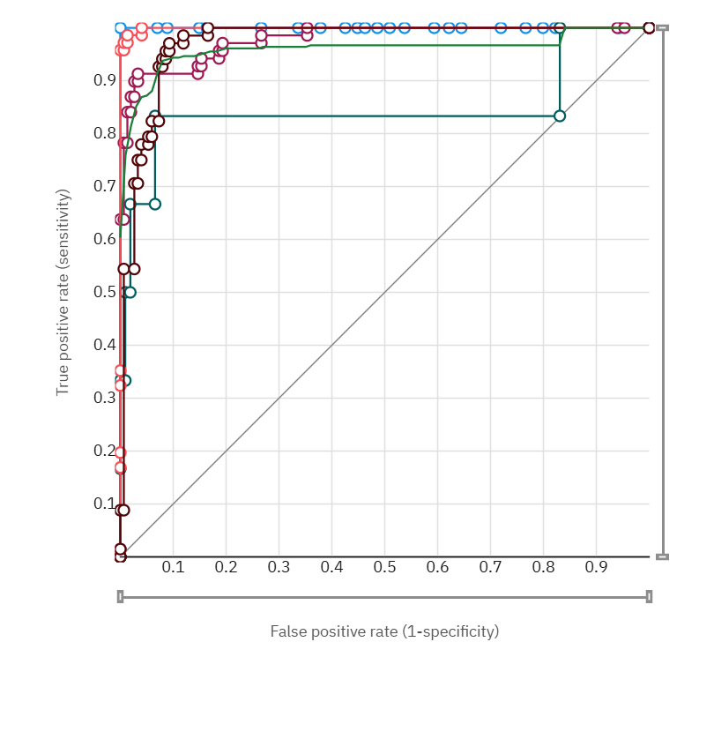
Results – PMGSY Scheme Classification Model
• Model Used: Random Forest Classifier
• Evaluation Metrics:
- Accuracy: 92.8%
- Macro F1-Score: 0.91
- Precision & Recall: High for PMGSY-I, PMGSY-II; Lower for RCPLWEA due to class imbalance
• ROC Curve below shows high sensitivity and specificity across major schemes

Slide 14
THANK YOU

Slide 15
Results – PMGSY Scheme Classification Model
• Model Used: Random Forest Classifier
• Evaluation Metrics:
- Accuracy: 92.8%
- Macro F1-Score: 0.91
- Precision & Recall: High for PMGSY-I, PMGSY-II; Lower for RCPLWEA due to class imbalance
• ROC Curve below shows high sensitivity and specificity across major schemes

