Slide 1


NPTRM
JAN 2026

Slide 2

Introduction
This project focuses on modernizing the production process for Printed Circuit Boards (PCBs) at BEL.
The system aims to digitize and automate a complex manual process that currently involves 40+ distinct operations.
The primary goal is to reduce manual effort and eliminate the heavy reliance on manual data entry by skilled workers.
The initiative ensures real-time tracking of all materials and components throughout the entire production lifecycle.
The application establishes a fully auditable manufacturing process to meet strict quality and compliance standards.
By automating the assembly line, the project enhances production efficiency while ensuring the high quality necessary for mission-critical systems.

Slide 3
Business Objective
The primary objectives are:
Reduce manual effort and human dependency in production of PCB.
Improve operational accuracy and reduce data entry-related errors.
Enable real-time tracking and full auditability of received materials.
Automated ingestion of machine-generated files and real-time machine status monitoring.

Slide 4
Problem Statement
The existing production process involves:
Fragmented Data Collection: Reliance on manual entry for process data, leading to human error and delayed reporting.
Limited Traceability: Use of physical route cards makes real-time tracking and historical auditing difficult.
Operational Blind Spots: Lack of automated dashboards prevents visibility into production targets and actual output.
Time Management Inefficiency: Inability to accurately measure Cycle Time versus Idle Time.
Disconnected Infrastructure: Requirement for machine integration to enable automated, real-time data capture.

Slide 5
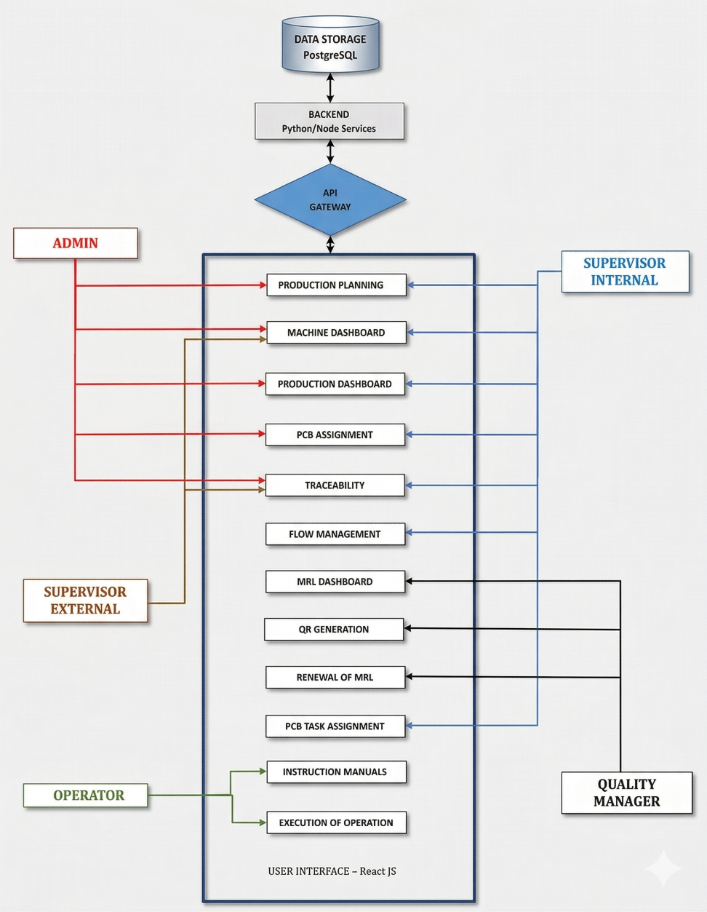
Proposed Workflow

Slide 6
Proposed Workflow
Users and their Responsibilities
Stakeholder | Responsibility
Admin | Admin, Adding Project details, processes, Creating profiles
Supervisor Internal | Analysing Dashboards, Adding Operators, Creating workflow
Supervisor External | Analysing Dashboards for assessing the manufacturing flow
Operators | Perform operations
Quality Manager | Manages the Manufacturing Readiness level of Operators for specific operations

Slide 7
System Scope
Feature | Status
Advanced Production Planning | Partial
Excel Bulk Import & Validation | Completed
Flow Assignment Logic | Completed
Dashboards | Partial
Manage Operator MRL | Completed
QR Code Identity Generation | Completed
Live Traceability Dashboard | Completed
Timeline for PCB Productions | Completed
Machine File Auto-Ingestion | Completed
Machine Simulation | Partial
Instruction Manual | Partial
Rework Re-routing Logic | Pending
BEL Calendar Alert System | Pending
Integration & ERP Modules | Pending

Slide 8
System Scope
The system is designed to digitize the entire lifecycle of a PCB on the assembly line from intake and workflow definition to real-time machine monitoring and quality control. It focuses on traceability, compliance (MRL-based access), and automated data capture.
Key Functional Modules (In-Scope)
1. PCB Inventory & Intake
Admin capability to add new PCBs.
Lifecycle Management: Status transitions from 'New' to 'Inaction' to 'Completed'.
Bulk Data Handling: Support for Excel-based data imports and validation.

Slide 9
System Scope
2. Dynamic Workflow Engine
Workflow Mapping: Defining sequences of operations and linking them to specific PCBs.
Smart Assignment: Automatically pushing tasks to the next operator in the sequence.
Search & Navigation: Ability to search through flow assignments for quick access.
3. Compliance & Resource Management (MRL)
MRL Tracking: Managing Operator eligibility based on their Manufacturing Readiness Level (MRL).
Access Control: Hard locks to prevent operators with expired MRLs from performing tasks.
Identification: Generation of QR codes for operators linked to their MRL status.

Slide 10
System Scope
4. Shop Floor Execution & IoT Integration
Operator Interface: Digital display of instructions and task lists.
Data Capture: Integration with QR scanners to populate forms and manual data recording.
Machine Integration: Automated ingestion of machine-generated files and real-time machine status monitoring.
Simulation: A digital twin environment to track and update data mirroring machine states.
5. Quality Assurance (QA) & Rework
Exception Handling: Logic for re-routing and initiating rework stages.
Quality Oversight: A dedicated rework stage managed specifically by Quality Managers.

Slide 11
System Scope
6. Planning & Monitoring Dashboards
Production Scheduler: Tools for planning production timelines.
Traceability Dashboard: Live "where-is-it" tracking for Admins and Supervisors.
Alert System: Notification engine for due dates aligned with the BEL calendar.

Slide 12
.
Maximize Productivity: By reducing manual labor and human-centric dependencies in PCB assembly.
Elimination of Manual Errors: Replaces manual Excel entries and paper route cards with digital validation to eradicate data-related inaccuracies.
Data-Driven Intelligence: By synchronizing machine output files and real-time statuses directly into a centralized monitoring system.
Enhanced Real-Time Traceability: Provides live "where-is-it" tracking for every PCB throughout all 40+ production stages.
Proactive Alerting: Notifies users of upcoming due dates and MRL expiry Dates to prevent production delays.

Slide 13
THANK YOU

