Slide 1

FraudAI: An Overview
Our AI-powered fraud detection system analyzes financial transactions to identify suspicious patterns. The system flags potential fraud in real-time for human review.
FraudAI integrates with Databricks to process data from a Kaggle Dataset, delivering accurate predictions through a Streamlit interface.
by SDAIC Hackathon Team 29
Adithya Parupudi
Manishanker Kamarapu
Rahul Gundeti
Mani Kanta Gogula
Saisrinivas Ambatipudi

Slide 2
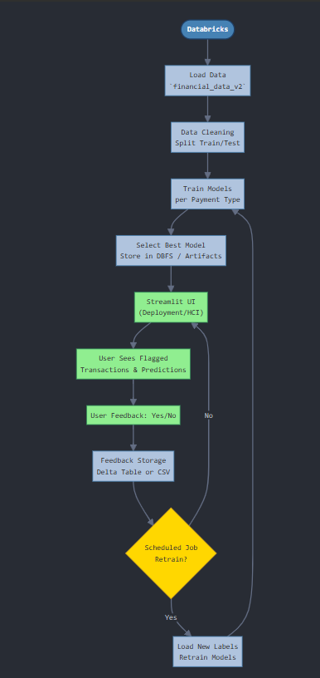




Architecture:
Data Pipeline & Model Training
Data Ingestion
Loads data into Databricks environment
Data Preparation
Clean data and engineer features for model training
Model Training
Trained for each payment type

Slide 3

Model Selection & Deployment
Evaluate Models
Compare performance metrics across different algorithms for each payment type
Select Champions
Choose best-performing models based on precision and recall balance
Deploy with Streamlit
Package models into interactive UI for fraud analysts
Store in DBFS
Save models to Databricks File System for version control

Slide 4








Fraud Detection & Feedback Loop
Transaction Analysis
Flag Suspicious Activity
System analyzes incoming transactions in real-time
Transactions exceeding threshold score are flagged
Feedback Storage
Human Review
User responses stored in Delta table for future learning
Analysts confirm or reject fraud predictions

Slide 5








Project Challenges
Imbalanced Data
Rare fraud examples make training difficult
Real-time Detection
Balancing speed with accuracy requirements
Concept Drift
Fraud patterns evolve, requiring model updates
Model Interpretability
Explaining AI decisions to stakeholders

Slide 6





Learnings & Future Roadmap
Active Learning
Implement feedback loop to improve model training efficiency
Graph Neural Networks
Explore transaction relationships to detect fraud rings
Automated Retraining
Schedule regular model updates to combat concept drift
Enhanced UI
Improve visualization tools for easier pattern recognition

