Slide 1
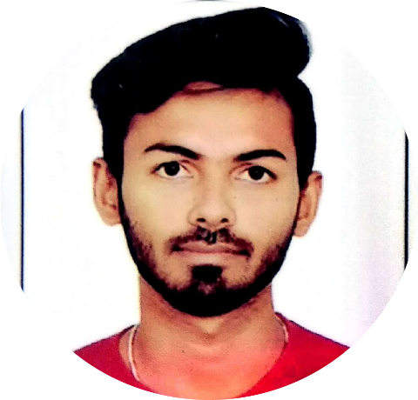
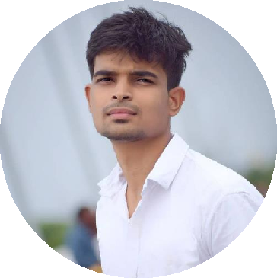




Adithya K
Education and certificates
Master of Computer Application(MCA): 2018 - 2021
Analyst/Software Engineer
Base Location:
Mumbai
Skills RDBMS UNIX/LINUX SQL
Email ID: Mobile No:
Adithya.k@capgemini.com
+918970898249
Grade:
A4
Database Oracle Database MongoDB PostgreSQL
Strengths
Software Engineer who is Strong in design and integration with intuitive problem-solving skills.
Achivement
I won the first prize in PBL at MCA
I won first prize in karate championship at national level
College Project :
Car Rental System
Completed end to end case study of Car rental system along with RDBMS , Data Base Designing Using Oracle SQL
Detector with automatic Recording System
This device notifies users whenever it detects loud noise as well as it automatically records the sounds and saves this recorded sound in a file
Add-ons
Data Science & Machine Learning
Python HTML
Core Java
Ready to learn new technologies and implement them to further improve my knowledge.
Additional Details Excellent Communication Team Player
A team player with good communication skill always
ready to work for the enrichment of knowledge.
Trained on RDBMS, Unix, SQL,core java
Working knowledge of software development and designing
Exposure to Data Science and ML.
Check out my Git Hub Profile and work
Hobbies
Travelling
Games
Listening music
Analysis Trends in Automobile Industry using Machine learning Algorithms
This project is build using ML algorithms. Car sales prediction are desiring more accurate prediction algorithms so that company will not suffer any losses. The huge data is very difficult to process. using ML models easily simplify the work.

