Slide 1
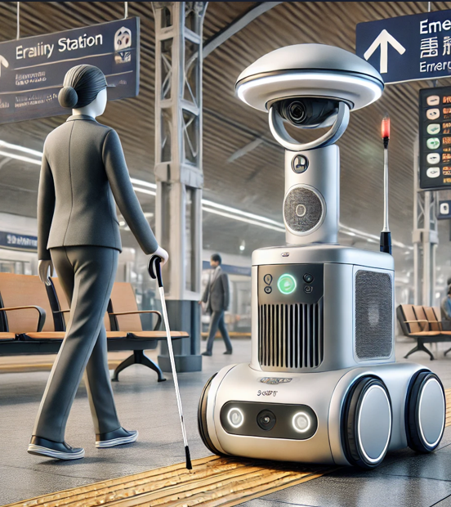
BrailleBot: The Autonomous Guide for the Visually Impaired
Challenges Faced by the Visually Impaired:
  Difficulty navigating complex environments (stations, hospitals, etc.) without consistent assistance.
  Dependence on human help, which may be unreliable or unavailable.
Purpose and Scope of BrailleBot:
  Autonomous, personalized guidance for blind individuals in various public spaces.
  Indoor and outdoor navigation, covering complex areas like metro stations and hospitals.
Core Features of BrailleBot:
  Guided Navigation: Offers precise routing using LiDAR and accurate mapping.
  Elevator Integration: Interfaces with elevators for easy floor-to-floor access.
  Voice Interaction: Communicates with users via voice assistance.
  Safety Indicators: Equipped with an emergency light tower to signal the robot’s presence.
Social Impact:
  BrailleBot fosters independence, promoting accessibility and inclusion in public spaces.

Slide 2
BrailleBot Design: Power and Sensors
Component | Model | Specifications | Power Consumption
Battery Pack | Anker PowerHouse II 400 or Equivalent | 388Wh capacity, Lithium-Ion | —
Additional Battery Pack | Second pack for 440Wh total | Connected in parallel | —
Drive Motors | Maxon DCX 22S High Torque Motor | 12V, 4000 RPM | ~15W each
Motor Controller | Roboclaw 2x7A Motor Controller | Dual-channel, with feedback | 2W
Charger | Nitecore D4 Intelligent Charger | Fast charging, auto shut-off | 10W (during charge)
Estimated Total Power Consumption and Operating Time for 8 Hours
Mixed Active/Idle Usage: Approximately 440Wh capacity required for 8 hours
Active Power Consumption: ~55W, Idle Power Consumption: ~6.3W
Component | Model | Specifications | Power Consumption
LiDAR | RPLIDAR A3 | 360-degree FOV, 25m range | ~8W
Ultrasonic Sensors | MaxBotix MB1040 | Range: 20-765cm | 0.2W each
Camera | Intel RealSense D435i | RGB and depth sensing, IMU | 1.6W
Environmental Sensor | Bosch BME280 | Temperature, humidity, pressure | ~0.003W
Emergency Light Strip | Adafruit NeoPixel RGBW Strip | High brightness, customizable | 10W

Slide 3
BrailleBot Design: Navigation and Software
Navigation System
Software Architecture
Mapping and Localization
  LiDAR (RPLIDAR A3): 360-degree scanning for real-time spatial mapping.
  SLAM: Uses LiDAR and camera data to map environments and localize BrailleBot.
Obstacle Detection and Avoidance
  Ultrasonic Sensors (MaxBotix MB1040): Prevents close-range collisions.
  Depth Camera (Intel RealSense D435i): Assists in obstacle detection and object recognition.
Path Planning
  Navigation Algorithms: Uses A* and Dijkstra algorithms for optimal pathfinding.
  Elevator and Door Access: IoT-enabled systems for multi-level navigation in buildings.
Operating System
  ROS2 for coordinating sensor data, motor control, and path planning.
  Artificial Intelligence
  Meta LLM: Provides user interaction for answering questions and navigation assistance.
  Computer Vision Algorithms: Processes camera data to recognize signs and environmental cues.
Control and Feedback
  Motor Control: Managed by Roboclaw motor controller for smooth and precise movements.
  Safety Protocols: Emergency stop if obstacles detected or off-path deviation occurs.
IoT Connectivity
  Elevator and Door Communication: Interfaces with smart building systems for multi-floor navigation.

Slide 4
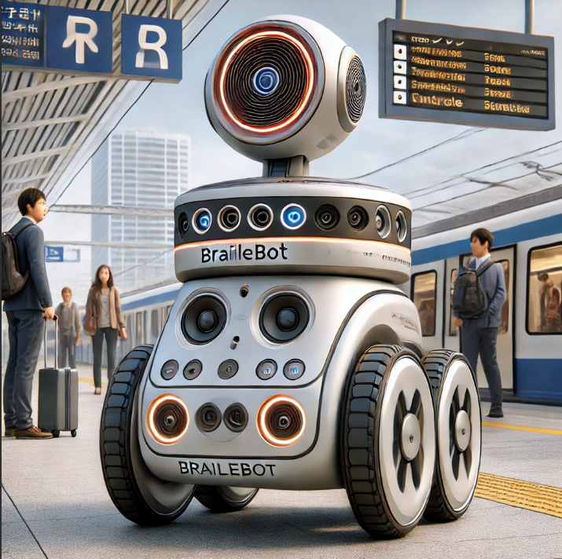
BrailleBot Design: Control and Interaction
System
  ControlMotor Control
    Roboclaw 2x7A Motor Controller: Manages dual closed-loop control with high torque and precision.
    Encoder Feedback: Uses quadrature encoders to monitor speed and position for accurate path correction.
    PID Controller: Ensures smooth acceleration and deceleration for safe navigation.
  Emergency Stop System
    Sensor Fusion for Proximity Detection: Combines ultrasonic and LiDAR to maintain dynamic safety zones.
    Remote Stop Feature: Allows staff to remotely stop BrailleBot via Bluetooth, enhancing safety.
User Interface
  Meta LLM Integration
    Voice Processing: Meta LLM for natural language understanding, enabling complex command handling.
    Multi-Language Support: Interprets commands in multiple languages for broader accessibility.
    Command Parsing: Detects and prioritizes navigation-related keywords for rapid response.
  Auditory Feedback
    Adaptive Sound Levels: Automatically adjusts volume based on ambient noise levels.
    Directional Audio Feedback: Stereo speakers provide spatial awareness for user direction.
    Distinctive Alert Tones: Unique tones signal movements, waypoints, or obstacles.
  Visual and Haptic Signals
    Emergency Light Strip: Customizable RGB LED indicates status (e.g., green for active, red for stop).
    Haptic Feedback Module: Integrated in cane holder, provides vibration feedback for commands and alerts.

Slide 5
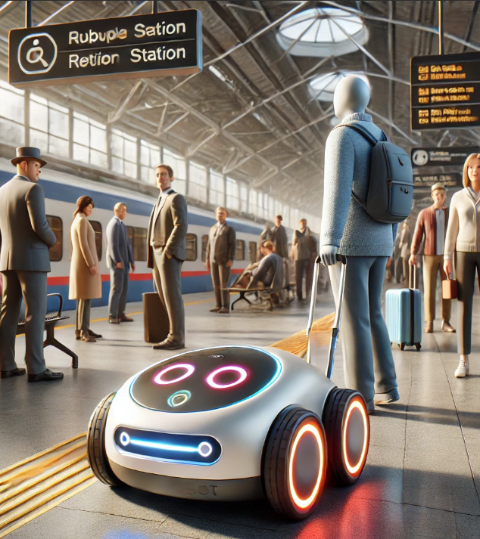
Technical Summary and Social Impact
Technical Summary
  Objective: Autonomous assistive navigation for visually impaired users in complex environments.
Core Components:
  Navigation: High-resolution LiDAR (RPLIDAR A3) with SLAM, multi-sensor fusion (LiDAR, ultrasonic, IMU) for real-time mapping and obstacle detection.
  Control Architecture: Dual closed-loop motor control (Roboclaw 2x7A), PID tuning for precise movement.
  User Interaction Module: Meta LLM for contextual voice command understanding, haptic and auditory feedback with adaptive audio.
  Safety Mechanisms: Proximity-based emergency stop, RGB status signaling, remote stop functionality
Advanced Social Impact
  Enhanced Spatial Accessibility: Assists visually impaired users with sensor fusion and adaptive algorithms for safe, context-aware navigation.
  Promoting Inclusion in Public Infrastructure: IoT integration enables BrailleBot to interact with infrastructure elements, setting a precedent for inclusive design globally.
  Catalyst for Assistive Robotics Research: Scalable framework adaptable to future advancements in perception, HRI, and autonomous navigation, supporting broader inclusivity.

