Slide 1
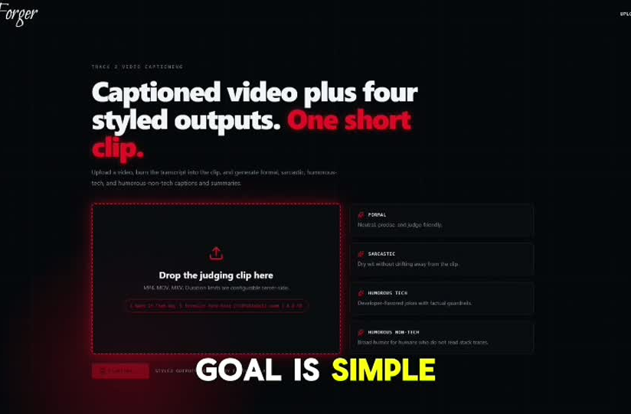
AMD Developer Hackathon Track 2
ClipForger-AMD turns one clip into accurate captions and four styles.
A Fireworks-first, Gemma-ready video captioning pipeline with Groq fallback for reliability, designed for the Track 2 evaluator and packaged as a public linux/amd64 Docker image.
Submission-ready in one sentence: upload, caption, judge, export.
The front end is for the demo. The Docker container is what the judges run.

Slide 2
Why the split matters
Captions stay literal and readable. Summaries carry the humor, but only after the evidence is grounded.
What users get
What the judge sees
• Burned-in captioned MP4
• SRT, VTT, TXT export
• Editable factual base
• Four distinct summary styles
• Submission JSON for the judge
The evaluator gets unseen video clips, not cached answers. Every output has to work on fresh content, so the pipeline must actually understand the clip and the requested style.
That separation is the whole product: accessibility first, creativity second.

Slide 3
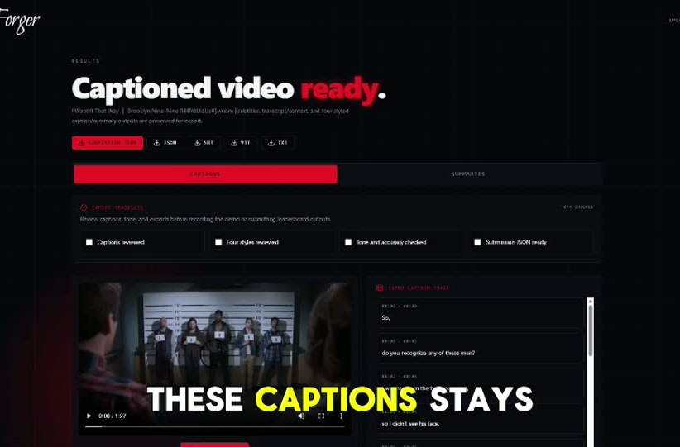
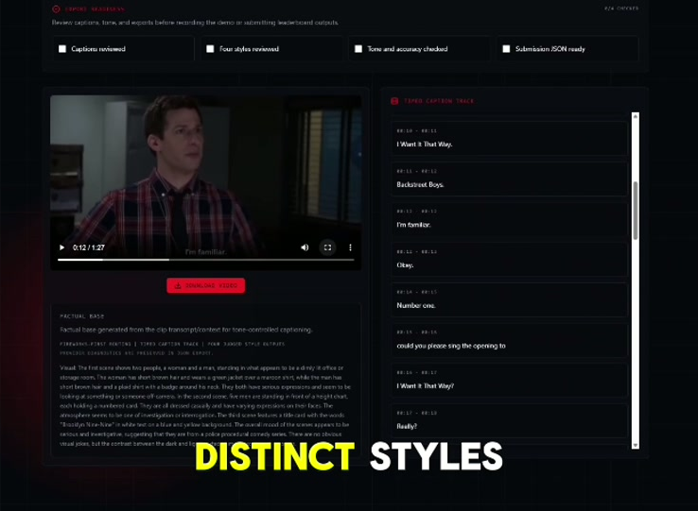
The product flow is simple on purpose
The app starts as a video workspace, then turns into a results page with exports, review controls, and the timed caption track.
Upload and generate
Review captions, summaries, and export readiness

Slide 4
Under the hood, the pipeline stays grounded
1
2
3
4
Upload / input
Timed captions
Visual context
Four styles
Reads a video task and fetches the clip.
Extracts audio, normalizes timestamps, and builds subtitle segments.
Samples keyframes so the captioning model sees the scene.
Generates formal, sarcastic, humorous-tech, and humorous-non-tech.
The web app shows the experience. The Track 2 container runs the same intelligence headlessly.

Slide 5
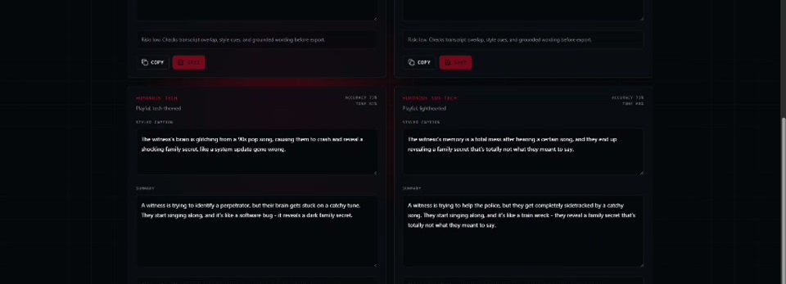
The demo looks polished because the hardest pieces are already solved
Each style is editable and saved back into the job output.
That gives judges a clean review path and a stronger story.

Slide 6
What makes this submission competitive
• Clear separation between captions and summaries
• Track 2 Docker entrypoint that matches the evaluator
• Fireworks-first routing with Groq fallback for reliability
• Grounded outputs that stay tied to transcript and visual context
• Real demo assets, export flow, and review checklist
• Public GitHub repo plus public linux/amd64 Docker image
Submission links
GitHub
Adithya1912/ClipForger-AMD
Docker Hub
adithyaaaaaa/clipforger-amd:latest
By the end, judges should see a reliable captioning agent that is actually ready to score on unseen clips.

