Slide 1
PawFinder
App Screenshots — Full User Flow
17 screens covering login, discovery, adoption, fostering, learning, volunteering & admin

Slide 2

Login
Authentication screen with demo credentials

Slide 3

Create Account
New user registration form

Slide 4

Home / Discover
Hero banner, search, filters, featured dogs, stories & tips

Slide 5

Shelters
Browse 20 shelters across Coimbatore with stats & filters

Slide 6

Shelter Detail
Individual shelter profile with contact info & stats

Slide 7

My Applications
Track adoption application status & process overview

Slide 8

Foster a Dog
Foster program info, dogs needing care & FAQ

Slide 9
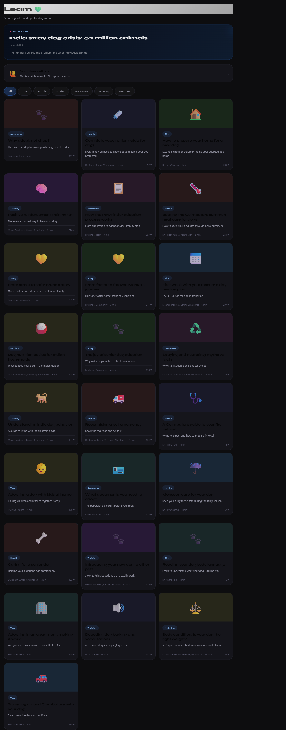
Learn
Articles, stories, health guides & awareness content

Slide 10
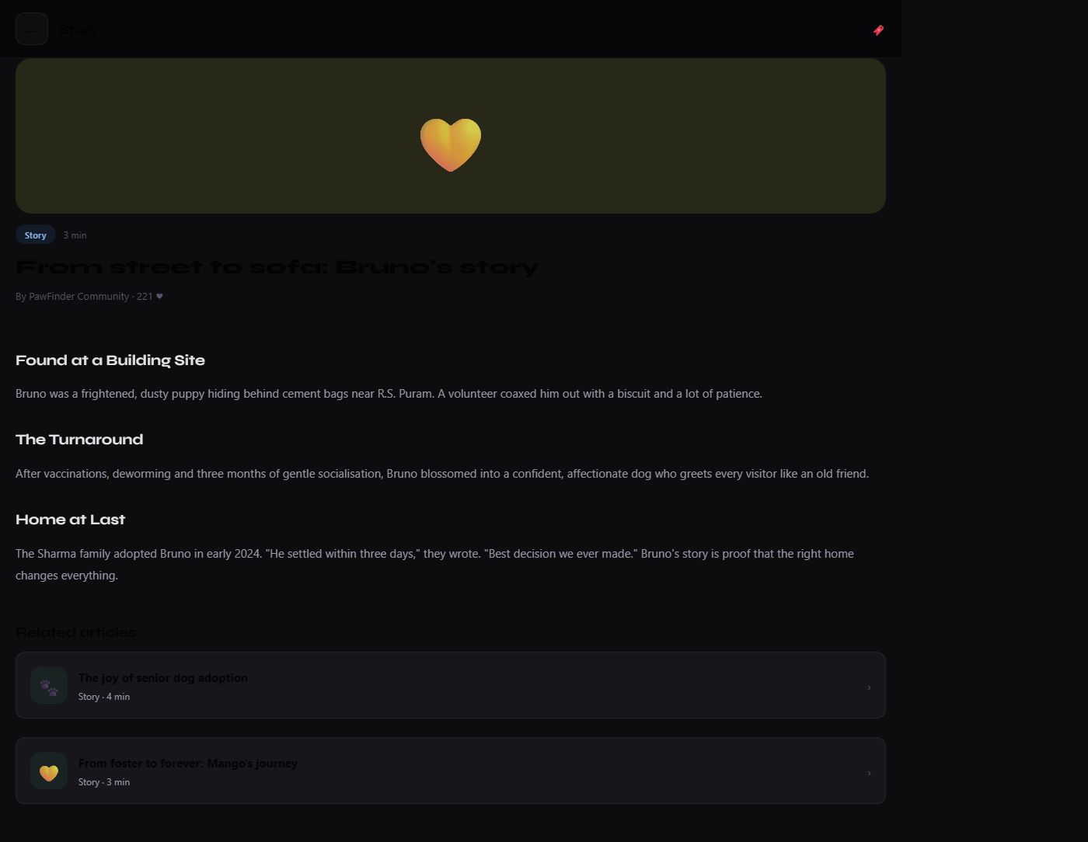
Article Reader
Full article view with bookmarking

Slide 11
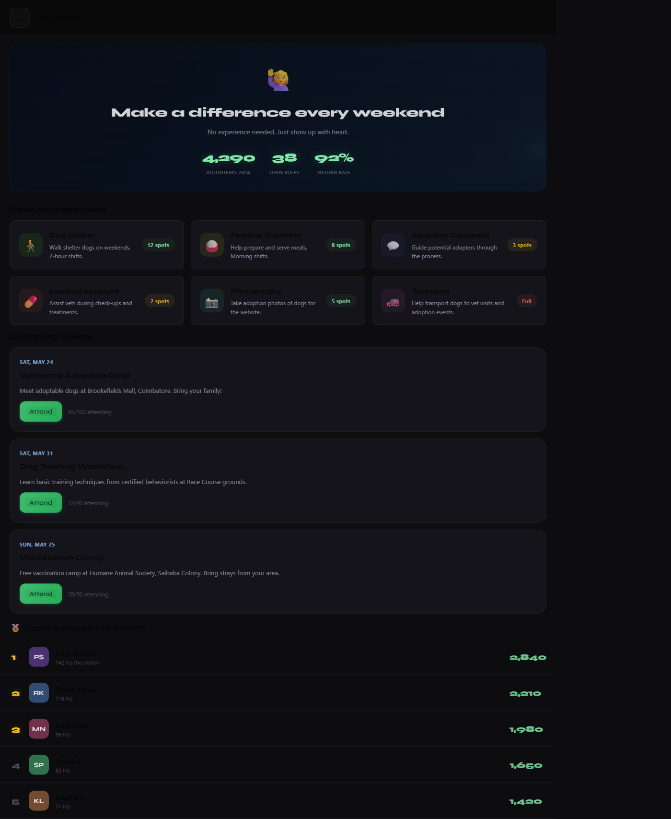
Volunteer
Open roles, upcoming events & volunteer leaderboard

Slide 12
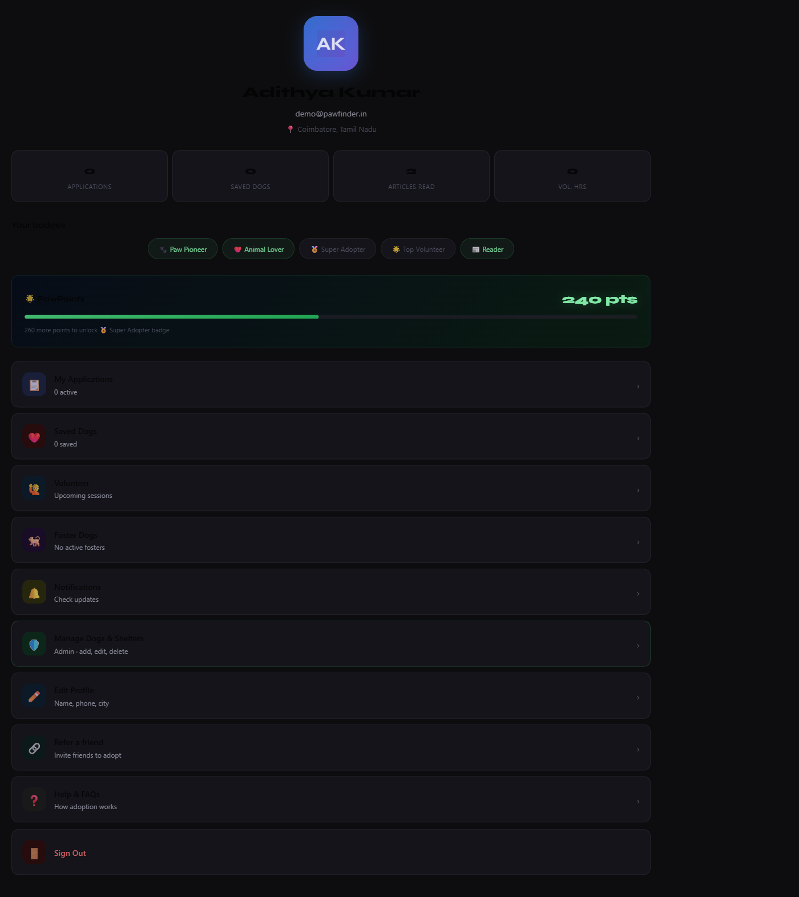
User Profile
Badges, PawPoints, settings & account management

Slide 13
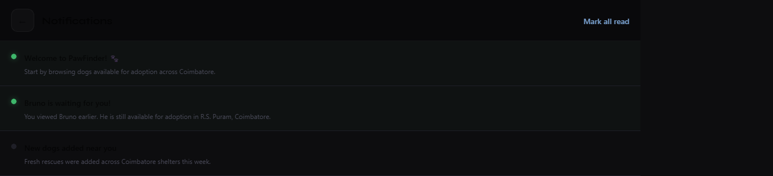
Notifications
Activity alerts and adoption updates

Slide 14
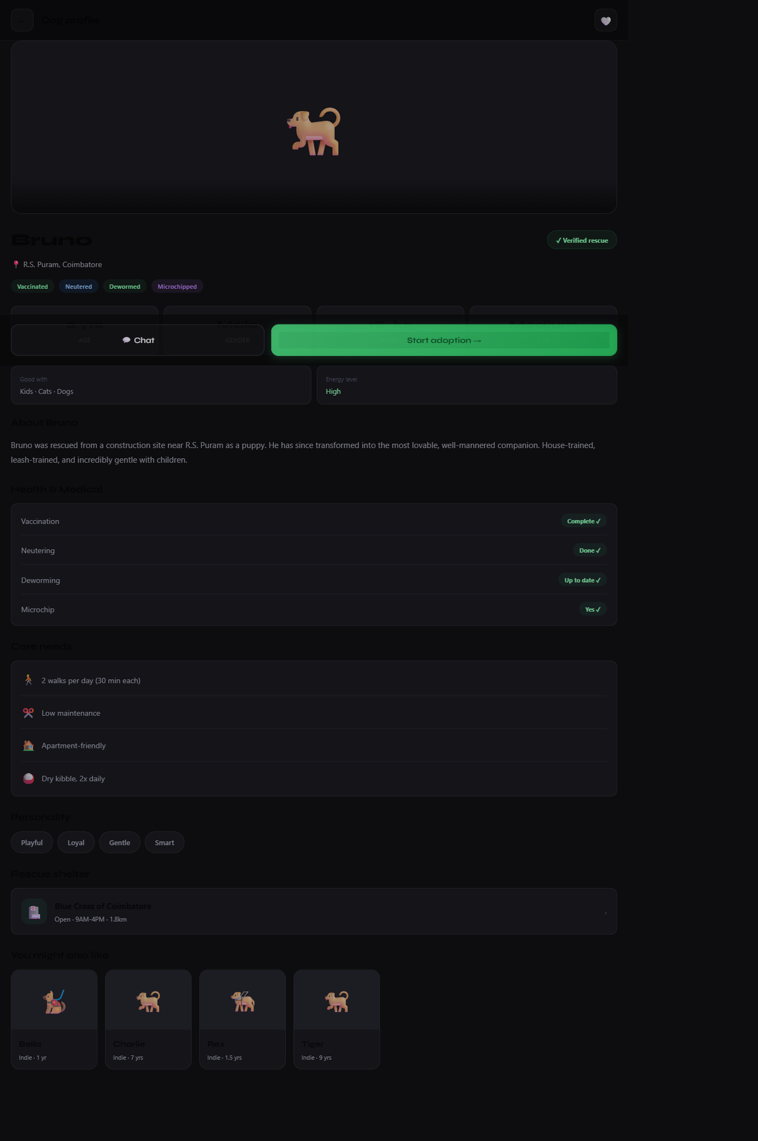
Dog Profile
Individual dog details with chat & adopt actions

Slide 15
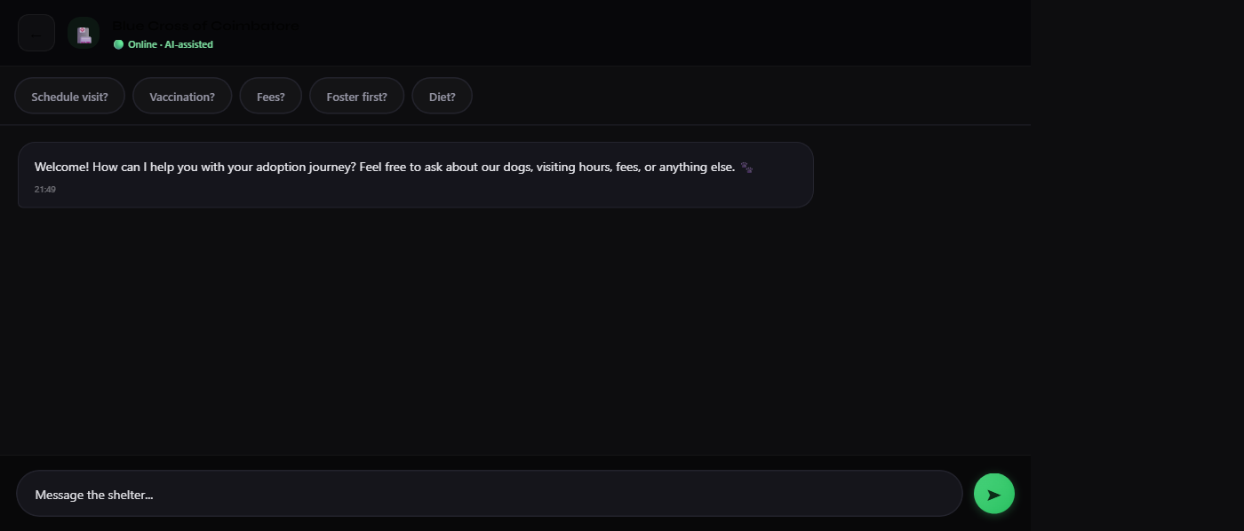
Shelter Chat
AI-assisted messaging with quick reply options

Slide 16
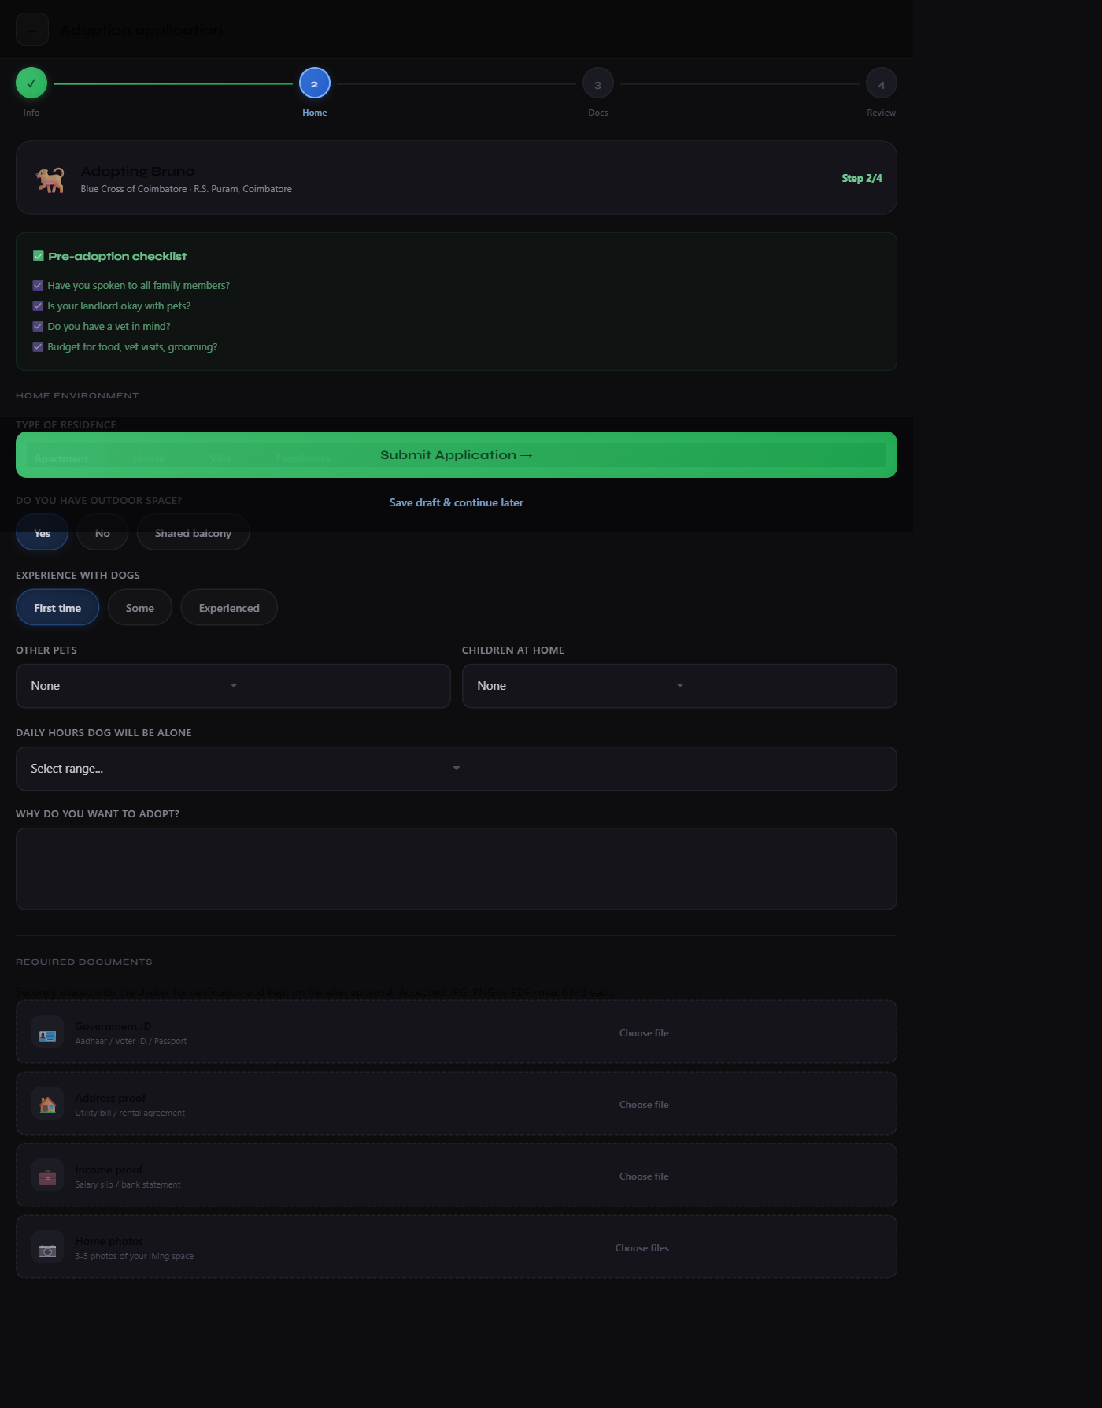
Adoption Application
Multi-step form with checklist & document uploads

Slide 17
Saved Dogs
Bookmarked dogs for later review

Slide 18
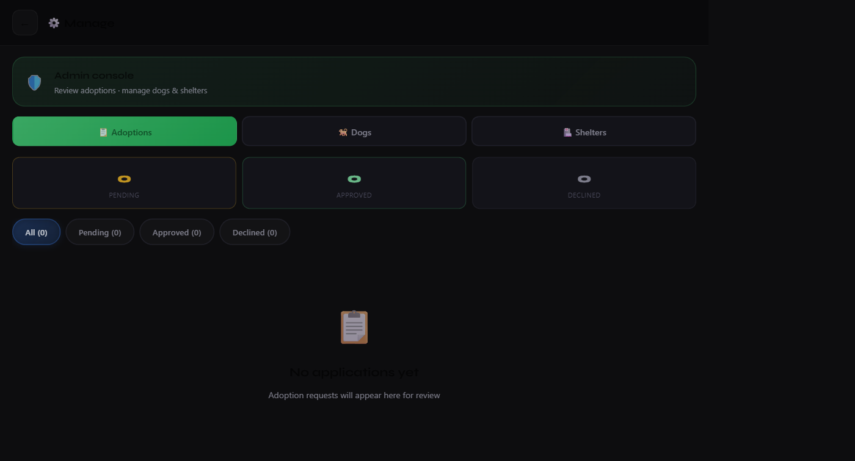
Admin Console
Manage adoptions, dogs & shelters

