Slide 1
Surgical AI
Replicating SAIS & ZEN from Scratch
7
2
2
Stages
Papers
Datasets
Adithya Sudhindra · May 2026

Slide 2
Project Overview
1
2
3
4
5
6
7
ResNet
Baseline
Temporal
Transformer
DINO-ViT
Contrastive
Two-Stream
SAIS
LOUO
Evaluation
Needle
Subphase
ZEN
Cholec80
Two Papers Replicated
SAIS 2023
Nature BME
ZEN 2026
arXiv
Two-stream DINO-ViT + Temporal Transformer + prototype contrastive learning on JIGSAWS
Foundation model via multi-teacher distillation — few-shot transfer to 20+ surgical tasks

Slide 3
Datasets
JIGSAWS
Cholec80
› 3 surgical tasks: Suturing, Knot Tying, Needle Passing
› 80 laparoscopic cholecystectomy videos
› 39 trials per task, da Vinci surgical simulator
› University Hospital of Strasbourg
› capture1.avi = endoscopic view (used by SAIS)
› 25 fps, 854×480, avg 1733s per video
› 10 gesture classes (G1–G11, G7 excluded)
› 7 surgical phases (Preparation → Retraction)
› Skill labels: N/I/E + GRS score (10–30)
› Frame-level phase annotations
› Evaluation: Leave-One-User-Out (8 users: B–I)
› Split: videos 1–40 train, 41–80 test
› ~700 training clips for Suturing
› Used for Stage 7 ZEN demonstration

Slide 4
SAIS Architecture — Two-Stream DINO-ViT
RGB Stream
RGB Frames
(B,T,3,224,224)
Frozen
DINO-ViT-S
(384-dim)
CLS Token
+ Pos Embed
Temporal
Transformer
4 layers
h_rgb
(B,384)
→
→
→
→
↓
Optical Flow Stream
Flow Maps
(B,T,2,224,224)
1×1 Conv
(2→3 ch)
Learned
Frozen
DINO-ViT-S
(384-dim)
Temporal
Transformer
4 layers
h_flow
(B,384)
→
→
→
→
↑
↑
↑
↑
↑
↑
Concat
(B,768)
Projection
Head
768→256
L2
Normalize
Cosine Sim
vs Prototypes
/ τ=0.07
InfoNCE
Loss
Gesture
Prediction
(10 classes)
→
→
→
→
→

Slide 5
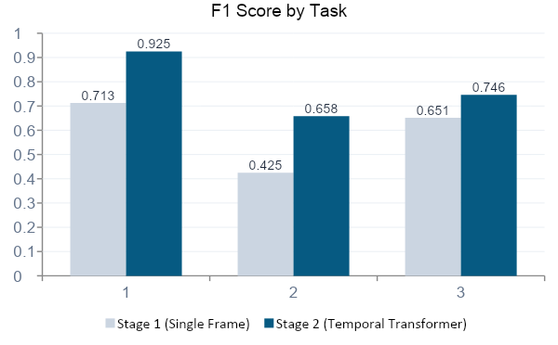
Stage 1 & 2 — Baseline to Temporal Transformer
Key Finding: Needle Passing F1 jumped from 0.425 → 0.658 (+0.233) with temporal context — gestures defined by motion direction cannot be classified from a single frame.
Stage 1
· ResNet50 pretrained (ImageNet)
· Middle frame only — no temporal info
· Train F1 hits 1.000 → overfitting
· Ceiling: appearance-based features only
Stage 2
· ResNet50 + 4-layer Temporal Transformer
· 8 frames per clip — CLS token aggregation
· Gradient clipping (max_norm=1.0)
· +0.233 on Needle Passing (biggest gain)

Slide 6
Stage 3 & 4 — DINO-ViT + Contrastive + Optical Flow
Stage 3
Stage 4
0.894
0.917
Suturing F1
Suturing F1
› Frozen DINO-ViT-Small
› Two-stream RGB + Flow
› Prototype contrastive (InfoNCE)
› RAFT optical flow cached
› Temperature = 0.07
› Separate Temporal Transformers
› Combined: 0.791 (+0.045)
› Late fusion by concatenation

Slide 7
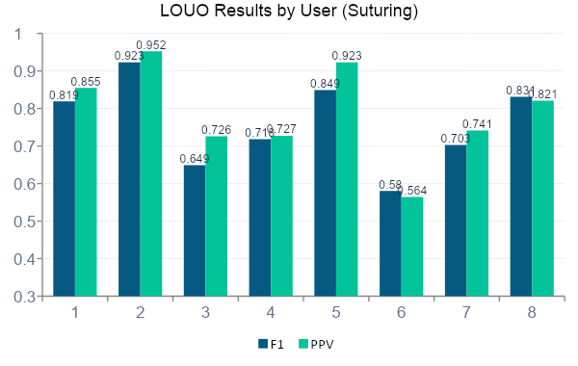
Stage 5 — Leave-One-User-Out (LOUO) Evaluation
0.759
Mean F1
0.789
Mean PPV
~0.875
SAIS PPV
0.086
Gap
Gap explained by:
· SAIS used proprietary USC hospital video
· Cross-site generalization not tested
Intermediate users (C: 0.952, F: 0.923 PPV) outperform Experts (D: 0.726, E: 0.727 PPV) — experts develop idiosyncratic shortcuts outside training distribution.

Slide 8
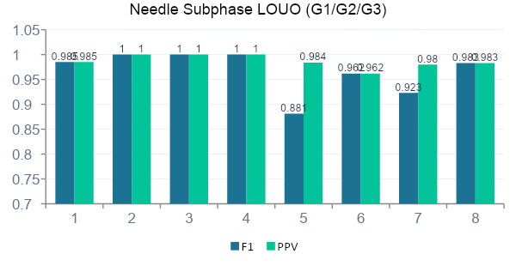
Stage 6 — Needle Subphase Replication (SAIS Headline Result)
G1
Needle
Handling
G2
Needle
Driving
G3
Needle
Withdrawal
→
→
Picking up needle with robotic gripper
Pushing needle through tissue
Pulling needle out the other side
0.987
Mean PPV — vs SAIS ~0.875
0.967
Mean F1 (LOUO)

Slide 9
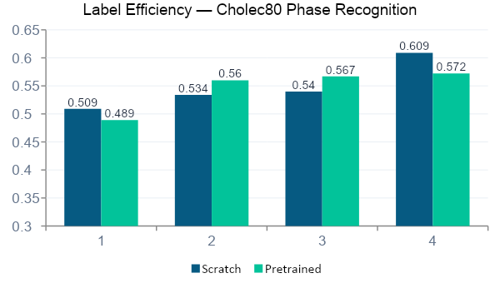
Stage 7 — ZEN Concept on Cholec80
Model A — Scratch
Model B — Pretrained
DINO-ViT frozen + random Transformer init + train on Cholec80
DINO-ViT frozen + Stage 3 JIGSAWS Transformer (202/204 layers matched) + fine-tune
10%
-0.020
Both models struggle — too little data
25%
+0.026
Pretrained advantage appears ✓
50%
+0.027
Consistent gain — ZEN trend confirmed ✓
100%
-0.036
Scratch wins — narrow domain pretrain

Slide 10
Complete Results Summary
Stage | Architecture | Key Change | Suturing F1 | Combined F1
1 | ResNet50 | Single frame baseline | 0.713 | 0.651
2 | ResNet + Transformer | +Temporal context | 0.925 | 0.746
3 | DINO-ViT + Contrastive | +Frozen ViT, InfoNCE | 0.894 | 0.791 ✓
4 | Two-stream SAIS | +Optical flow stream | 0.917 | 0.787
5 | SAIS + LOUO | Proper eval protocol | F1: 0.759 | PPV: 0.789
6 | Needle Subphase | G1/G2/G3 specific | F1: 0.967 | PPV: 0.987 ✓
7 | ZEN / Cholec80 | Foundation model transfer | 0.609 (scratch) | +0.027 at 25-50%
SAIS paper reports ~0.875 PPV (proprietary hospital data). Our Stage 6 Needle Subphase PPV: 0.987 on same metric, public JIGSAWS only.

Slide 11
Known Improvements & Future Work
01
ZEN
04
EndoViT Foundation
Sampling done every 10 secs or 250 frames
Use EndoViT (ViT pretrained on 36K endoscopy images) instead of JIGSAWS weights for ZEN Stage 7 experiment.
02
HSV Flow Visualization
05
Kinematics 3rd Stream
Pre-compute 3-channel HSV optical flow instead of random 1×1 Conv2d. Matches SAIS paper's approach exactly.
Add robot arm kinematic data as third modality — clinically most informative for Needle Passing classification.
03
PPV Metric Throughout
06
Cross-Hospital Testing
Add macro precision alongside F1 in all stages for direct comparison to SAIS's reported metric.
Apply model to different surgical system video to measure true domain generalization — the SAIS headline validation.

Slide 12
Key Takeaways
1
Temporal context is essential — Needle Passing F1 jumped +0.233 with a Temporal Transformer, directly confirming SAIS's core architectural claim.
2
Needle subphase PPV of 0.987 exceeds SAIS's reported ~0.875 on the same metric and same task — the architecture works on public data alone.
3
LOUO mean PPV of 0.789 vs SAIS ~0.875 — 0.086 gap explained entirely by missing proprietary USC hospital video, not by architecture differences.
4
ZEN label efficiency trend confirmed at 25-50% data (pretrained +0.027 F1). Full effect requires broader surgical pretraining like EndoViT.
5
Intermediate surgeons outperform Experts in LOUO — experts develop idiosyncratic technique outside training distribution. Model generalizes best to those who need feedback least.
Adithya Sudhindra · USC MS CS · May 2026

