Slide 1
6-ELEMENT ARRAY
Acoustic Phased-Array System
True Time-Delay Beamforming on the RP2040
OPEN LABORATORY I · REVIEW 1
Methodology with Supporting Literature
Batch 1 · Department of ECE · Amrita Vishwa Vidyapeetham, Coimbatore
TEAM
Beesetty Rohith — CB.EN.U4ECE24106
Indraganti Sri Sarath — CB.EN.U4ECE24122
Lalithadithya Krishna Enukonda — CB.EN.U4ECE24133
Galeti Jaswanth — CB.EN.U4ECE24165
Review 1 · August 3, 2026

Slide 2
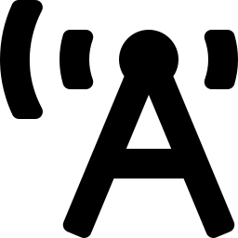
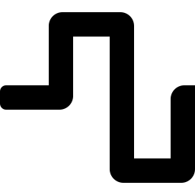
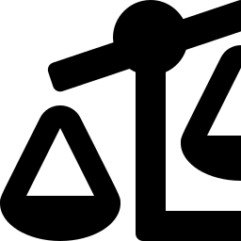



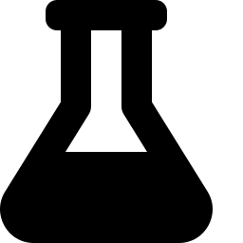
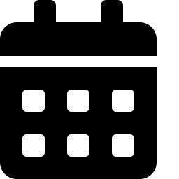
OVERVIEW
Agenda
1. Motivation & Objectives
2. Physics of Beam Steering
Why steerable acoustic beams, and what we set out to build
From diffraction grating to array intensity pattern
3. Key Insight: TTD vs. Phase Steering
4. Literature Review
Why time delay beats phase shift across frequency
Four papers spanning theory, application, and precedent hardware
5. Research Gap & Our Contribution
6. System Architecture
What's missing, and how this project fills it
Hardware and firmware design
7. Methodology
8. Timeline & Future Scope
Simulation-first validation, then hardware-in-the-loop
June–October 2026, and the road to Open Lab II
ACOUSTIC PHASED-ARRAY SYSTEM | OPEN LAB I — REVIEW 1
2

Slide 3
MOTIVATION
Why Steerable Acoustic Beams?
The Problem
Our Approach
Conventional speakers radiate sound broadly — most acoustic energy is wasted where no listener sits
Mechanically steered speakers require motors: slow response, moving parts, high power draw
Fixed installations can't adapt to a moving listener or a changing room layout
Electronic beam steering: redirect acoustic energy using per-channel time delays — no moving parts
A 6-element array driven by an RP2040 lets the beam angle change instantly, set by a simple potentiometer
True time-delay (not just phase) keeps the beam pointed correctly across the whole audio band
Goal: Build a working, steerable acoustic phased array on low-cost embedded hardware, and rigorously validate the physics behind it.
ACOUSTIC PHASED-ARRAY SYSTEM | OPEN LAB I — REVIEW 1
3

Slide 4
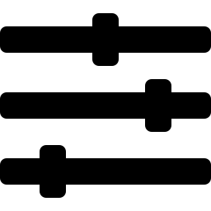
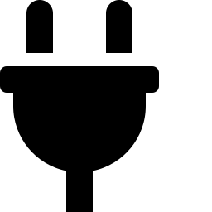

SCOPE
Project Objectives
Design & build a 6-element acoustic phased array with a potentiometer-based steering UI
Implement true time-delay beamforming on the RP2040 — not phase-only steering
Quantify & compare TTD vs. phase-steering performance across the audio frequency band
Validate through simulation in MATLAB/Simulink before committing to hardware measurements
Confirm in hardware using hardware-in-the-loop testing on the physical RP2040 via External Mode
Lay groundwork for ultrasound-modulated audio and productization in Open Laboratory
ACOUSTIC PHASED-ARRAY SYSTEM | OPEN LAB I — REVIEW 1
4

Slide 5
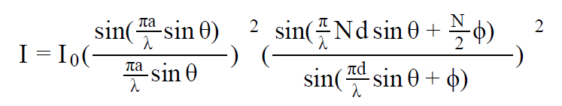
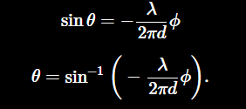
FOUNDATIONS
Physics of Beam Steering
An array of N speakers, spaced d apart, behaves like a diffraction grating for sound
Each speaker's individual radiation pattern is broad — but combining N identical sources creates a sharp interference pattern
Adding a phase term Φ between adjacent elements shifts the direction of that interference peak
Squaring the wave function gives the far-field intensity pattern below
Far-Field Array Intensity Pattern
Design driver: solving for θ shows the steering angle depends on both phase shift AND wavelength — a problem for wideband audio.
Single-slit term
Diffraction envelope of one speaker of width a — a broad central bump.
N-element interference term
Narrow, steerable peaks from combining N sources spaced d apart — this is the part that matters for beam-steering.
ACOUSTIC PHASED-ARRAY SYSTEM | OPEN LAB I — REVIEW 1
5

Slide 6
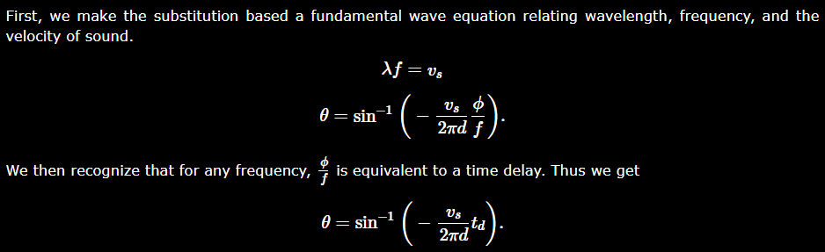
FOUNDATIONS
What is diffraction grating?
In the context of this project, a diffraction grating is a physical model used to describe a system of N signal sources (transmitters) with a specific aperture (a) that are spaced a certain distance (d) apart and transmit at a specific wavelength (λ)
By adding a phase term (ϕ) to the standard diffraction grating equation, we can shift the angle of maximum sound intensity. Mathematically, the angle of maximum amplitude (θ) becomes a function of both the phase shift and the wavelength of the sound
While a standard diffraction grating focuses on a single wavelength, we have to adapt the model for wide-band audio (music), which contains many frequencies
a fixed phase shift would cause different frequencies to steer to different angles. To fix this, they substituted the phase term with a true time delay (td​), which eliminated the dependency on wavelength (λ) and allowed all frequencies in a music file to steer to the same angle simultaneously
Relating wavelength and frequency to velocity of sound
ACOUSTIC PHASED-ARRAY SYSTEM | OPEN LAB I — REVIEW 1
5

Slide 7
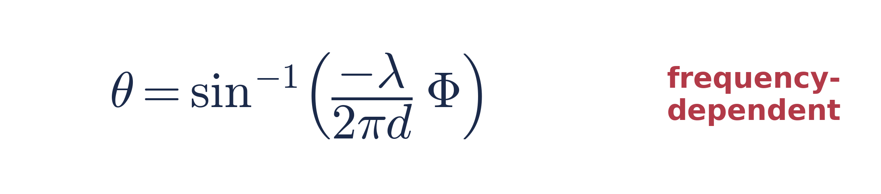
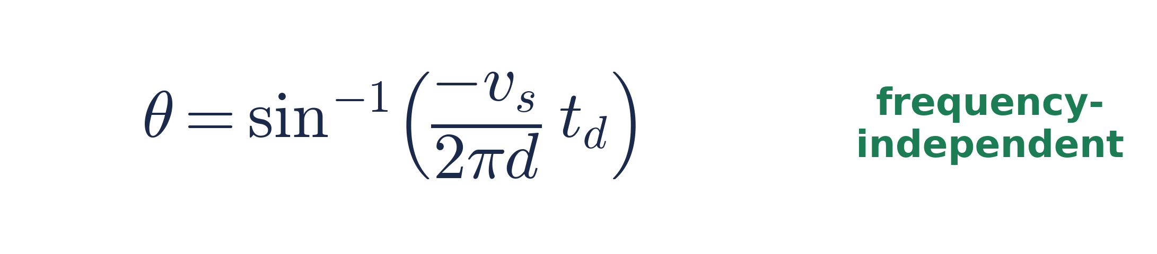
KEY INSIGHT
True Time Delay vs. Phase Steering
PHASE-ONLY STEERING
TRUE TIME DELAY (OURS)
Fixed phase shift per element → the resulting angle depends on wavelength. Correct only at one design frequency.
Fixed time delay per element → angle depends only on element spacing. One delay set steers correctly at every frequency.
Expected Steering-Angle Behavior vs. Frequency (target angle = 30°)
Illustrative — qualitative trend to be confirmed via MATLAB/Simulink simulation and hardware measurement.
ACOUSTIC PHASED-ARRAY SYSTEM | OPEN LAB I — REVIEW 1
6

Slide 8
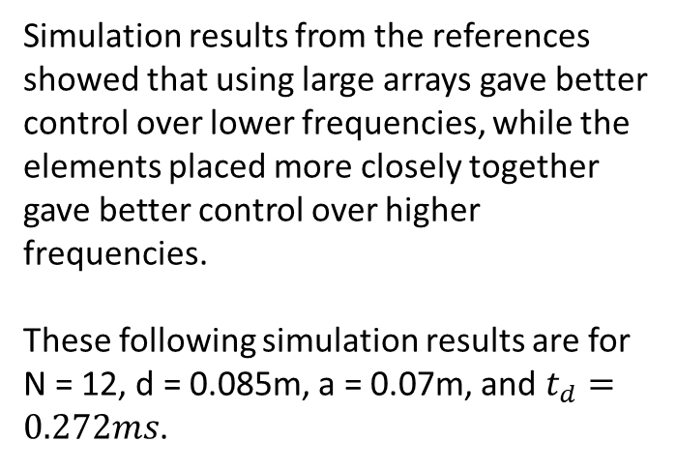
Simulation results from the references showed that using large arrays gave better control over lower frequencies, while the elements placed more closely together gave better control over higher frequencies.
These following simulation results are for N = 12, d = 0.085m, a = 0.07m, and $t_{d}=0.272ms$.
ACOUSTIC PHASED-ARRAY SYSTEM | OPEN LAB I — REVIEW 1

Slide 9
LITERATURE REVIEW
Five References, Two Lenses
Paper | Focus | Key Contribution | Relevance to Our Work
Luo (2024) | Constant-directivity loudspeaker beamforming | Frequency-regularized MECD/MSCD optimization for heterogeneous arrays | Informs future weighting for non-uniform speaker response
Pope et al. (2024) | Phased-array system design & demonstration | Compares analog / digital / hybrid architectures and calibration routines | Justifies our all-digital, MCU-based architecture
Zhang et al. (2024) | Differential loudspeaker line-array beamforming | Steerable frequency-invariant beampatterns (300 Hz–4 kHz) via Jacobi–Anger modal matching | Confirms frequency-invariant design is still unsolved for loudspeaker (not just microphone) arrays
Szoka & Jackson (2012) | Phased-array speaker system, Cornell ECE 4760 | 12-element array steered by 44.1 kHz sample-domain group delay on an ATmega644 — true time delay, not phase shift | Closest direct hardware precedent — validates TTD-on-MCU; rejected FFT-based phase steering as too slow for real time
Grassin (2020) | Open-source beamsteering with a 12-speaker Arduino array | Per-channel phase/amplitude-law steering; measured polar patterns at a single tone (750 Hz) | Shows phase-only steering works well at one frequency — motivates our multi-frequency squint comparison
ACOUSTIC PHASED-ARRAY SYSTEM | OPEN LAB I — REVIEW 1
7

Slide 10
LITERATURE REVIEW
Deep-Dive: Beamforming Theory
Luo, 2024
Zhang et al., 2024
Pope et al., 2024
Constant Directivity Beamforming
Steerable Frequency-Invariant Beamforming
Phased Array Systems — Design & Demo
Proposes MECD / MSCD beamformer designs solved via quadratic programming, optimizing efficiency and sensitivity under a constant generalized-directivity constraint.
Designs a differential loudspeaker line-array beamformer via Jacobi–Anger modal matching, achieving steerable frequency-invariant beampatterns from 300 Hz–4 kHz.
Surveys analog, digital, and hybrid phased-array architectures with measurement-based cascade models and a working calibration routine.
Synthesis: these works establish rigorous beamformer optimization for RF, spherical, and differential loudspeaker arrays — but none target a low-cost, wideband, embedded audio array steered by simple sample-domain TTD.
ACOUSTIC PHASED-ARRAY SYSTEM | OPEN LAB I — REVIEW 1
8

Slide 11
LITERATURE REVIEW
Deep-Dive: Applications & Precedent Hardware
Szoka & Jackson, 2012
Grassin, 2020
True-Time-Delay Speaker Array (Cornell ECE 4760)
Open-Source Phase-Steered Speaker Array
A 12-element array steered by sample-domain group delay on an ATmega644 at 44.1 kHz — true time delay, not phase shift. The team explicitly considered and rejected FFT/IFFT phase steering as too slow for the MCU.
A 12-speaker Arduino array steered by per-channel phase and amplitude law; measured single-tone (750 Hz) polar patterns confirm the physics, published open-source under an MIT license.
Synthesis: both hobbyist/course precedents prove phased-array audio beamsteering works on cheap microcontrollers — one already committed to true time delay, the other to phase-only — but neither quantifies the TTD-vs-phase-only tradeoff across the full audio band.
ACOUSTIC PHASED-ARRAY SYSTEM | OPEN LAB I — REVIEW 1
9

Slide 12
ORIGINALITY
Research Gap & Our Contribution
WHAT THE LITERATURE OFFERS
WHAT'S MISSING
Rigorous beamformer optimization theory — for RF arrays (Pope et al.) and full-size or differential loudspeaker arrays (Luo; Zhang et al.), not resource-constrained embedded audio hardware
Two hobbyist/course-level MCU-driven audio phased arrays — one already true-time-delay (Szoka & Jackson, 2012), the other phase/amplitude-only (Grassin, 2020)
No published low-cost MCU implementation quantitatively compares TTD against phase-only steering across the full audio band
No characterization of the gap between ideal continuous-delay TTD and the sample-quantization-limited TTD actually achievable on embedded hardware
No simulation-first, hardware-validated workflow combining MATLAB/Simulink with a physical RP2040 array
Our contribution: a 6-element RP2040 true-time-delay beamformer benchmarked against an ideal continuous-delay TTD ceiling and a phase-only alternative on the same hardware — quantifying both the TTD-vs-phase-only gap and how much of the ideal advantage survives sample quantization.
ACOUSTIC PHASED-ARRAY SYSTEM | OPEN LAB I — REVIEW 1
10

Slide 13
SYSTEM DESIGN
Hardware Architecture
AUDIO SIGNAL CHAIN
Audio
Source
Input Amp
(bias + gain)
ADC
RP2040
(dual-core)
2× MCP4728
DAC (I2C)
Potentiometer
(steering-angle UI)
Speaker Amp + LPF
(×6 channels)
STEERING CONTROL
Speakers × 6
86 dB · 8Ω
RP2040 computes the per-channel delay for the chosen angle, then drives each speaker's DAC channel accordingly
The low-pass filter removes DAC quantization noise; the buffer stage matches the 8Ω speaker impedance
ACOUSTIC PHASED-ARRAY SYSTEM | OPEN LAB I — REVIEW 1
11

Slide 14
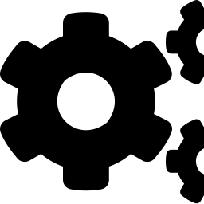
METHODOLOGY
Simulation-First Validation Workflow
MATLAB/Simulink +
Phased Array Toolbox
Simscape Electrical
LTspice
Validates acoustic beam-steering physics and TTD delay logic. All 6 speakers modeled simultaneously at a propagation speed of 343 m/s.
Behavioral modeling of the amplifier and low-pass filter stages — fast to iterate, useful for system-level sanity checks.
Vendor-accurate SPICE-level validation of the same analog stages using real component models — preferred whenever precision matters.
Why simulation-first? Beam-steering logic and analog behavior are validated stage-by-stage in software — using Scope / To Workspace blocks at every node — before any hardware is trusted with the results. LTspice is preferred over Simscape Electrical when a specific analog claim needs vendor SPICE accuracy rather than a generic behavioral model.
ACOUSTIC PHASED-ARRAY SYSTEM | OPEN LAB I — REVIEW 1
14

Slide 15
METHODOLOGY
Hardware-in-the-Loop Validation
Validated Simulink Model
(beam-steering + TTD logic)
Deploy model →
Physical RP2040
(retargeted via Arduino
Support Package v25.2.9)
← External Mode: live signal data over USB
The Simulink Support Package for Arduino Hardware (v25.2.9) confirms RP2040/Pico support as of R2024b — genuine hardware-in-the-loop, not just code generation
External Mode streams live signal data back over USB while the model runs on the board — parameters can be tuned without reflashing
The same model validated in simulation is retargeted directly onto the physical array, closing the loop between theory and hardware
Caveat: the analog stages (input amp, speaker amp, low-pass filters) sit outside the USB/Simulink monitoring loop. Their behavior is confirmed separately with an oscilloscope or DAQ, not through External Mode.
ACOUSTIC PHASED-ARRAY SYSTEM | OPEN LAB I — REVIEW 1
15

Slide 16
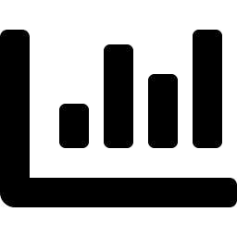
OUTCOMES
Expected Key Deliverable
A direct, quantified comparison of TTD vs. phase-only steering error across the audio band
Metric: angular error = |achieved angle − target angle| at each test frequency
Expect near-zero error for TTD across the full band; growing error for phase-only steering away from its design frequency
Expected Angular Steering Error vs. Frequency
This comparison is expected to be the strongest result in the final report.
Illustrative — actual values pending MATLAB/Simulink simulation and hardware measurement.
ACOUSTIC PHASED-ARRAY SYSTEM | OPEN LAB I — REVIEW 1
16

Slide 17
LOOKING AHEAD
Future Scope
Ultrasound-Modulated Audio
Productization
A parametric array loudspeaker (PAL) modulates audio onto a ~40 kHz carrier for a tight beam from a small aperture
Narrow fractional bandwidth near the carrier means beam squint largely disappears
Self-demodulation relies on air's nonlinearity (Berktay's solution); naive modulation distorts, so real systems predistort
Open Lab II needs new ultrasonic transducers (e.g., MA40S4S) and a matched DAC/amp chain
Convert the working prototype into a finished, enclosed product
Refine industrial design, power delivery, and user interface for real-world use
ACOUSTIC PHASED-ARRAY SYSTEM | OPEN LAB I — REVIEW 1
18

Slide 18
BIBLIOGRAPHY
References
[1]
Y. Luo, “Constant Directivity Loudspeaker Beamforming,” 2024, arXiv:2407.01860v3.
[4]
E. Szoka and T. Jackson, “Phased Array Speaker System,” ECE 4760 Final Project, Cornell University, Spring 2012. [Online]. Available: https://people.ece.cornell.edu/land/courses/ece4760/FinalProjects/s2012/tcj26_ecs227/tcj26_ecs227/index.html
[2]
C. Pope, H. Tang, B. Zheng, and H. Zhang, “Phased Array Systems – Design Considerations & System Demonstration,” in 2024 IEEE Int. Symp. Phased Array Systems and Technology (ARRAY), Boston, MA, USA, 2024, pp. 1–8, doi: 10.1109/ARRAY58370.2024.10880346.
[5]
C. Grassin, “Acoustic Beamsteering with a Speaker Array,” Charles’ Labs, Mar. 2020. [Online]. Available: https://charleslabs.fr/en/project-Acoustic+beamsteering+with+a+speaker+array
[3]
Y. Zhang, Q. Xiang, and Q. Zhu, “Design of Differential Loudspeaker Line Array for Steerable Frequency-Invariant Beamforming,” Sensors, vol. 24, no. 19, art. 6277, 2024, doi: 10.3390/s24196277.
ACOUSTIC PHASED-ARRAY SYSTEM | OPEN LAB I — REVIEW 1
19

Slide 19
Thank You
Questions & Discussion
ACOUSTIC PHASED-ARRAY SYSTEM
Beesetty Rohith · Indraganti Sri Sarath
Lalithadithya Krishna Enukonda · Galeti Jaswanth
Batch 1 · Department of ECE · Amrita Vishwa Vidyapeetham, Coimbatore

