Slide 1
AUTOMATIC HAND GLOVE FOR IMPAIRED PEOPLE
Presented by
D.S.Samanvitha
B.Gayatri D.Niraja Adithya
B.Jahnavi D.Rakesh
Under the guidance of
Dr.K.Krishna Kishore
Associate Professor
ECE Department

Slide 2
Table of contents
Objective
Introduction
Block diagram
Description

Slide 3
Objective
Sign language is mostly used by deaf and dumb people as their mother tongue. Sign language uses the hand gestures. In general, deaf people have problem in communicating with other people, who unable understand sign language. The Smart Glove is a normal glove fitted with flex sensor and accelerometer. They convert the change in bend to electrical resistance, the more the bend, more the resistance value. The output from the sensor is in analog in nature and is converted to digital and compared the output of sensors with prestored values in controller (Arduino UNO) and then using Bluetooth module the message can be transferred to the mobile using Arduino Bluetooth TTS app.

Slide 4
Introduction
Sign language is mostly used by deaf and dumb people as their native languages.
Sign language is an combination of gestures made using hands, fingers, arms, head and facial expressions.
It helps the deaf and dumb people to communicate with people around them and vice versa.
However, for the speaking and hearing impaired people feel difficult to communicate with normal people. More than 13 million people have some degree of hearing loss in high-income countries, with millions more affected worldwide. Those affected can face difficulty in social interaction and communication
Sometimes by using hand gestures, there is a problem that deaf people have a problem in communicating with people ,who are unable to understand the sign language.
So in order to rectify this problem we use smart gloves which is made with flex sensor and accelerometer.

Slide 5
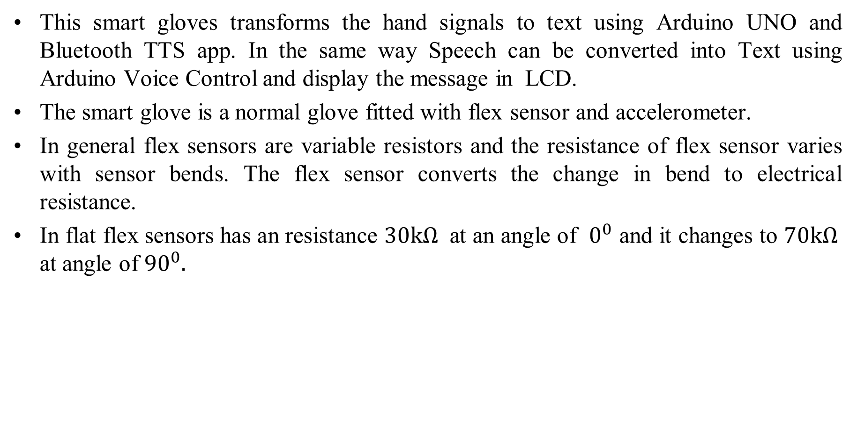

Slide 6
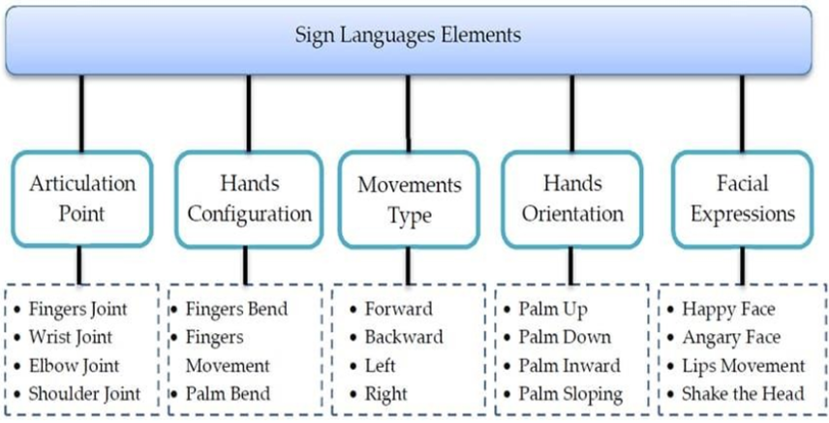

Slide 7
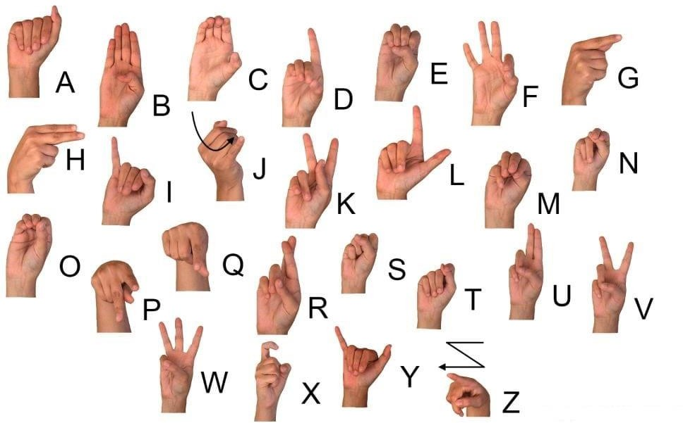
Sign languages

Slide 8
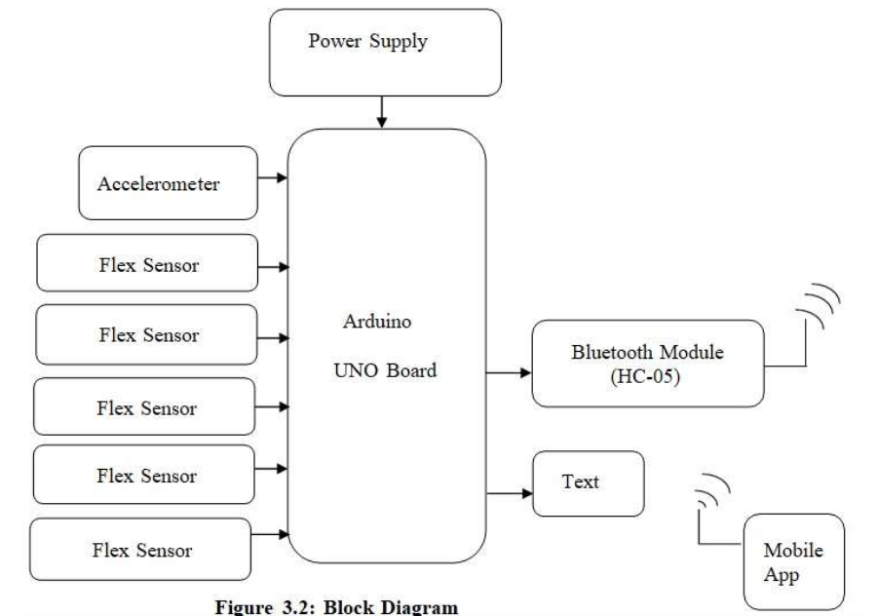
Block Diagram

Slide 9
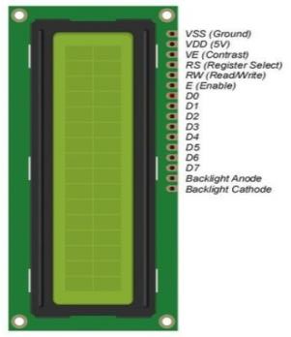
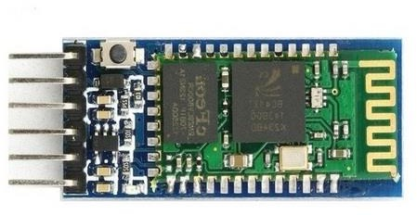
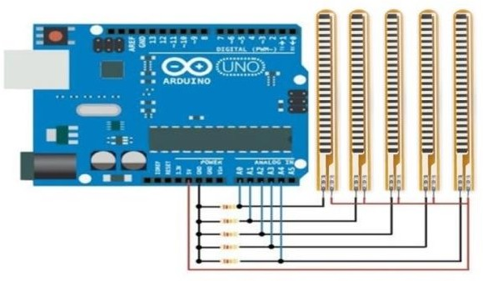
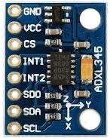
Circuit Diagram :

Slide 10
Description
The glove is internally equipped with flex sensors and accelerometer. Whereas flex sensors work on bending of fingers and Accelerometer works on orientation of palm.
For every particular gesture, the flex sensor produces a proportional modification in resistance and Accelerometer measures the orientation of hand.
Flex Sensor converts change in bend to electrical resistance , the more the bend more resistance value. Flex sensor work on bending of fingers and accelerometer works on orientation of palm.
Impaired people wore that glove and try to communicate through sign language so automatically they try bend their fingers, so glove which are fitted with flex sensors bend then automatically there will be an change voltage when there is an change in be resistance.
When a user makes a letter gesture, the five signals from each flex sensor with combination of static resistance of 1KΩ gives analog resistance value and are sent to a microcontroller.

Slide 11
The output is analog in nature and it is converted into digital output through analog to digital converter which is present in the controller.
If the output from flex sensors are matched with stored data then the data i.e., the string or alphabet are sent to the Bluetooth Module and from Bluetooth module it is transferred to Mobile through Arduino Bluetooth TTS App.
In this transmitter is Bluetooth Module and the receiver is Bluetooth present in android device.

Slide 12
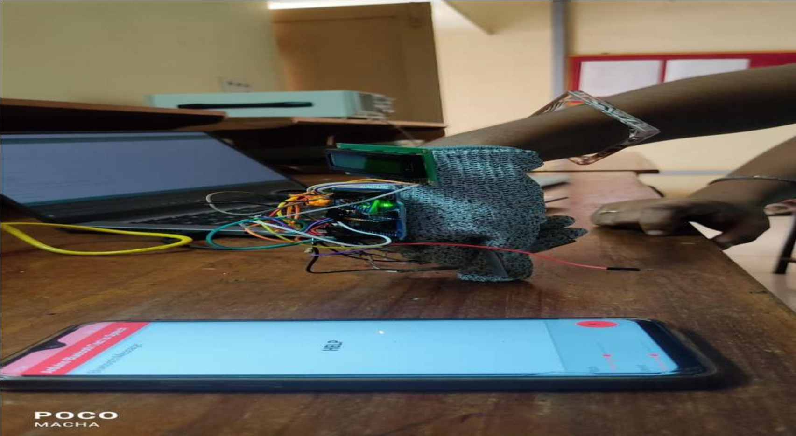
Results
Depending on the angle message will be printed on the android.
(Based on the accelorometer moment (the direction of palm should be facing downwards) and Resistance values of Flex sensors (when all the fingers are bended) then using bluetooth module TTS app HELP message generates on Mobile screen)

Slide 13
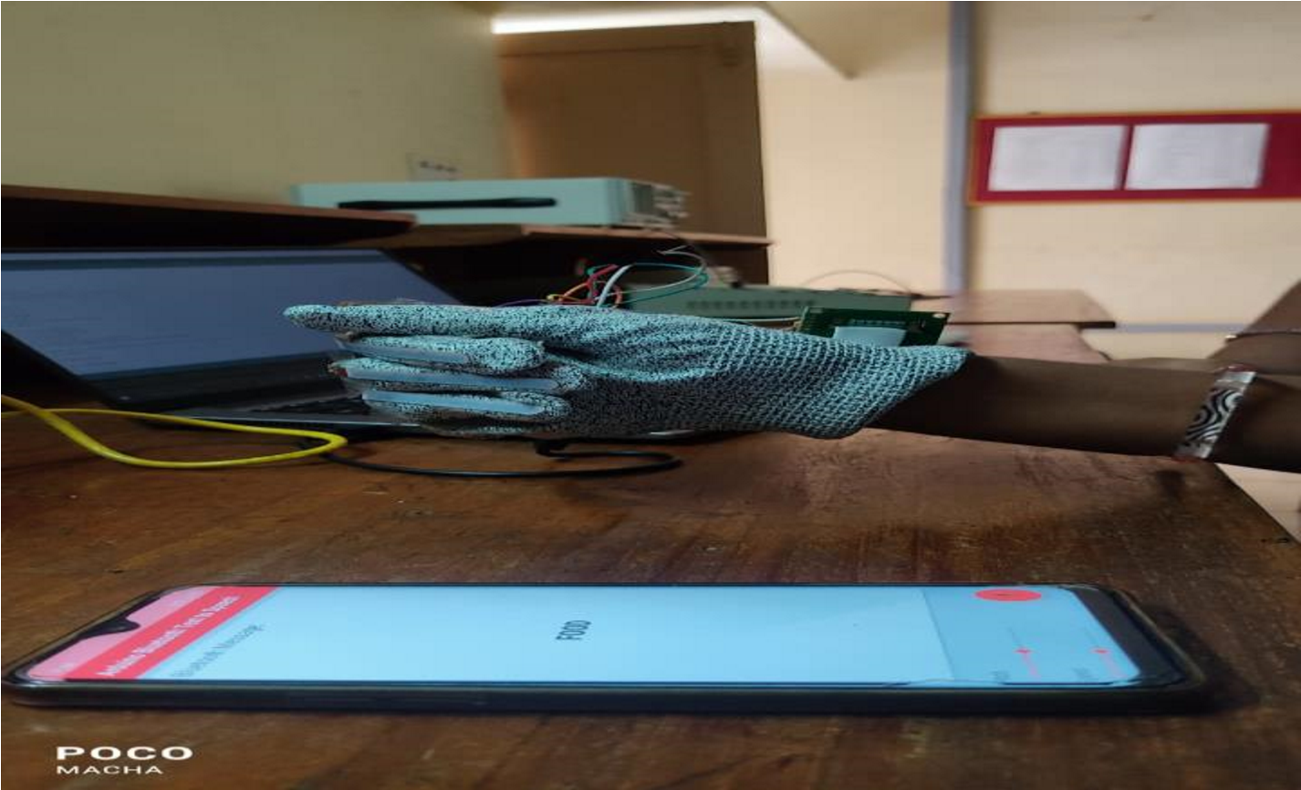
(Based on the accelometer moment (the direction of palm should be facing rightside) and Resistance values of Flex sensors (when all the fingers are bended) then using bluetooth module TTS app FOOD message generates on Mobile screen).

Slide 14
cost
S no | Component | Price
1 | Arduino | 400
2 | Mpu sensor | 200
3 | Flex sensor(4) | 1200
4 | Glove | 50
5 | Jumper wires | 100
6 | Bluetooth Module | 200
 | Total | 2150

Slide 15
Conclusion
The prototype allows speech impaired people to communicate with the rest of the world, allowing them to express themselves without any difficulties.
Flex sensors have a capability to change its resistance while bending.
The flex sensors in connection with the MPU, are capable of successfully and correctly translating Sign language to speech.
Using smart glove fitted with flex sensors is not only efficient but also comfortable to use in our daily lives.
Deaf and dumb people can communicate with Normal people so conveniently.
Impaired people mostly use sign language whereas normal people will use their respective language without effecting their language both can communicate.

