Slide 1

GMR Institute of Technology
An Autonomous Institute Affiliated to JNTUGV
Dept. Of Electronics and Communication Engineering

Slide 2
Designing low-cost and efficient Ventilator with arduino
Presented by
G.Chaitanya
B.Abhiram Naik D.Niraja Adithya
G.Vasu Deva Naidu D.Rakesh
Under the guidance of
Dr.D.Srinivasa Rao
Assistant Professor
ECE Department

Slide 3
TABLE OF CONTENTS
Objective
Introduction
Circuit Diagram
Block Diagram
Working Principle
Advantages
Applications
Cost

Slide 4
OBJECTIVE
This paper describes the design and prototyping of a low-cost portable mechanical ventilator for use in mass casualty cases and resource-poor environments. The ventilator delivers breaths by compressing a conventional ambu bag with a pivoting cam arm, eliminating the need for a human operator for the ambu bag.
Through this prototype, the strategy of automated ambu bag compression is proven to be a viable option to achieve low-cost, low-power portable ventilator technology that provides essential ventilator features at a fraction of the cost of existing technology.

Slide 5
INTRODUCTION
In this Presentation, We will Explain low-cost Ventilators and How We Make Them .We will explain all the things how I connected to the all sensors and LCD.
At the beginning of the covid crisis, most people started looking for open source ventilators. There were several models available but one of the most popular was Low-Cost and efficient Ventilator. This model uses an Ambu, also known as Bag Valve Mask (BVM).
These bags are used by paramedics on emergencies. They press the bag to insufflate air into the patient.
The ventilator was designed and developed using Arduino .
Here We Use a silicon Ventilator bag (We call it as Ambu bag) coupled dc motor With Liner Arm Mechanism To Push the Ventilator Bag.

Slide 6
INTRODUCTION
Apart from this, the ventilator must also monitor the patient’s Heart rate and exhaled lung pressure to avoid over and under-air pressure simultaneously.
And also shows how the switch helps in controlling the system.
Switch, Potentiometer(Variable Resister), MAX30100 And DHT11 Sensor is used as Input Devices.
LCD(16×2 LCD Display) And dc motor is used as Output Devices.
In this presentation ,We will show how inhalation and exhalation takes place for the patient and also how I2C acts as interface between LCD and Arduino .
The Entire system is driven by an Arduino controller to achieve desired results and also assist patients in Emergency situations.
By the end of this presentation, you will have a better understanding of what low-cost ventilator is.

Slide 7
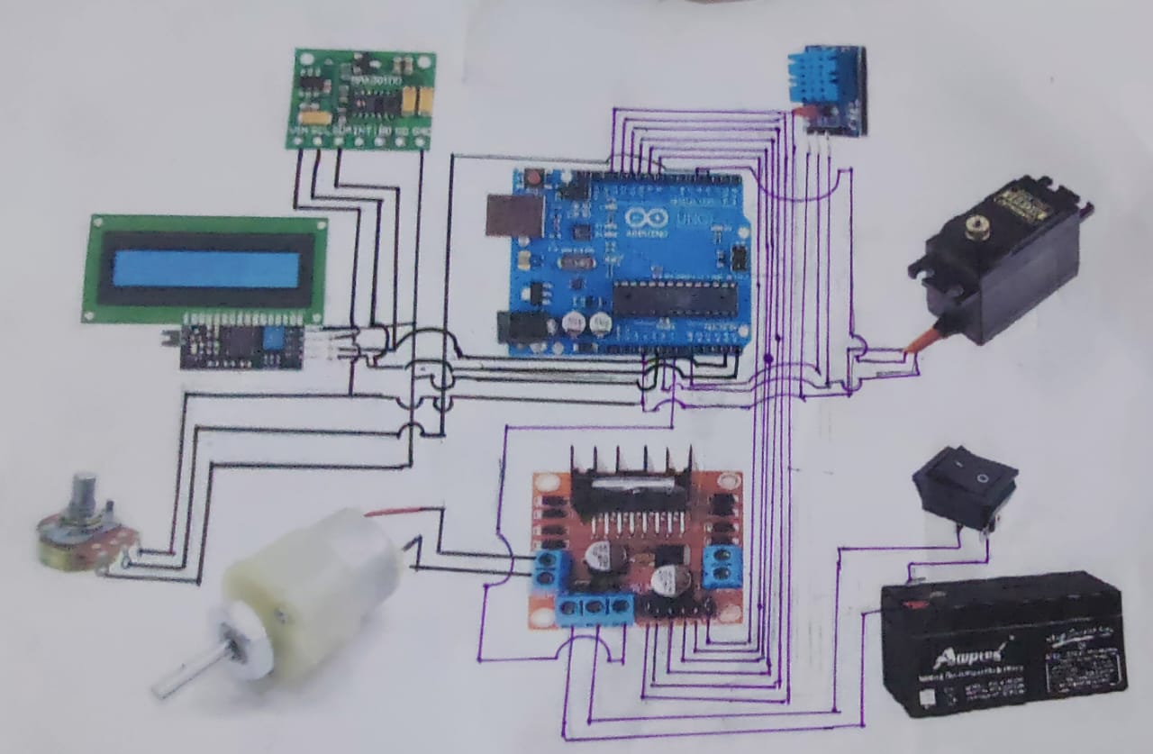
CIRCUIT DIAGRAM

Slide 8
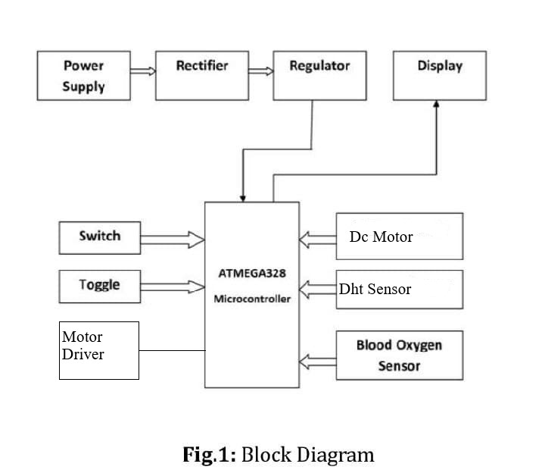
Block Diagram

Slide 9
WORKING PRINCIPLE
A ventilator, also known as a mechanical ventilator or a breathing machine, is a medical device that helps patients who are unable to breathe on their own or have difficulty breathing. Ventilators are commonly used in hospitals and intensive care units (ICUs) to support patients with respiratory failure.
The ventilator delivers oxygen to the patient's through a mask that is inserted into the patient's mouth, nose.
Ventilators are complex machines mean to be operated by trained doctors. They need oxygen and compressed air supplies to operate. Patients are fully dependant on these machines to survive.
The Entire system is driven by an Arduino controller and here we used Arduino UNO and is defined as open source hardware platform readily available to build projects .

Slide 10
WORKING PRINCIPLE
It comes with an ATMEGA microcontroller that processes the data and facilitates the proper working of the system and main purpose of using the this type of Arduino is that it is a low cost, flexible and easy to program.
Here I Used The 16×2 LCD Display .And they will be connected to the Pin Number i.e., GND→GND ,VCC→5V ,SDA→A4 ,SCL→A5 with the help of I2C. And the I2C acts as Interface between Arduino and Display.
In this project , We used the MG-995 servo Motor because is required more Torque and will connected to the Arduino pin Number D4.
MAX30100 is an Heart Beat sensor that is connected to Arduino and is used to measure the Heart Beat of a patient.
And Here We used the Digital Temperature and a Humidity Sensor shortly named as DHT sensor. And it is used to measure the Temperature of the

Slide 11
WORKING PRINCIPLE
surrounding and it doesn’t require any analog data pins .
Here We used Potentiometer to vary the Age of Patient and Motor just Rotate the Potentiometer clockwise or anti-clockwise and used to select the age group.
In open source ventilator there will be a inhalation time i.e., when the Ambu bag will be pressed by motor then this takes place and after few seconds the Ambu bag will come to same position then there will be time for exhalation.
And the LCD shows the temperature of the surrounding and Heart Rate of the patient.

Slide 12
ADVANTAGES
Open source ventilators offer several advantages over traditional, proprietary ventilators, including:
Cost-effectiveness: Open source ventilators are often significantly cheaper than traditional ventilators because they rely on off-the-shelf components that are readily available and affordable.
Customizability: Because open source ventilators are built using open source software and hardware, they can be easily customized to meet specific needs and requirements
Flexibility: Open source ventilators can be quickly and easily modified or upgraded as new information, technologies, and best practices emerge. This allows for rapid iteration and improvement of the technology.
Accessibility: The open source nature of these ventilators also means that they can be built and maintained by individuals or organizations with limited resources. This makes them more accessible to low- and middle-income countries or areas with limited medical infrastructure

Slide 13
APPLICATIONS
Open source ventilators have a wide range of potential applications, including:
Open source ventilators can be used in emergency situations.
Open source ventilators can be used for research and development purposes.
Open source ventilators can be used for education and training purposes, providing medical students and professionals with hands-on experience in a controlled setting.
Open source ventilators can potentially be used in home care settings.

Slide 14
COST
Cost of the project
S NO | Name | Price
1 | Arduino | 650
2 | DC motors | 400
3 | Dht sensor | 150
4 | Max30100 sensor | 250
5 | Ambubag | 600
6 | Jumper wires | 150
7 | Oxygen bottle | 250
8 | Lcd display | 400
 | Total | 2850

