Slide 1
IBM University Engagement Project Submission
Fitness Buddy AI - Your Personal AI Health & Fitness Coach

Slide 2

Project Tile – FITNESS BUDDY AI
Fitness/Health (Agentic AI)
Domain of Project –
Student Name | Recent Passport Photo | Email ID | Mobile number [WhatsApp]
ADITHYA KIRAN GOUD THIGULLA |  | adithyakirangoud@gmail.com | 8885591324

Slide 3
Problem Statement
THE CHALLENGE
THE OBJECTIVE
In today’s fast-paced world, many individuals struggle to maintain a healthy lifestyle due to lack of personalized fitness guidance, busy schedules, inconsistent motivation, expensive fitness subscriptions, and difficulty maintaining healthy habits.
Traditional fitness solutions often provide generic recommendations and fail to adapt to individual goals and lifestyles.
1.
Personalized Fitness Guidance
Provide workout recommendations tailored to user goals
2.
Healthy Lifestyle Support
Suggest nutritious meal ideas and healthy habits
3.
Motivation & Consistency
Keep users engaged through challenges and streak tracking
4.
AI-Powered Assistance
Use IBM Granite to provide intelligent fitness coaching

Slide 4






Technology Used
AI Engine
Backend
Frontend
Cloud
IBM Granite LLM
IBM Watsonx.ai
Node.js & Express.js
REST API & Processing
React.js + Vite
Tailwind CSS
IBM Cloud
IBM Watsonx Runtime
KEY FEATURES
Personalized AI Coaching
Fitness Dashboard
—
—
—
BMI & Calorie Analysis
—
Water & Streak Tracking
—
Daily Challenges

Slide 5
Proposed Solution & Architecture
A personalized, AI-driven fitness tool combining IBM Granite, Node.js, and React — split into three distinct layers to be intelligent, accessible, and scalable.
The Engine
Node.js & Express
The AI Brain
IBM Watsonx.ai
The Command Center
React UI
The backend of the system. It handles user requests, processes fitness data, manages API calls to IBM Granite, and serves personalized responses to the React frontend.
The intelligence of the system. IBM Granite LLM is deployed on IBM’s cloud servers, acting as a virtual fitness coach — analyzing user goals, body metrics, and fitness queries to generate personalized plans.
A modern fitness dashboard featuring BMI calculator, calorie tracker, water intake progress, streak tracking, daily challenges, and an AI coach chat interface.
THE OVERALL FLOW
By leveraging IBM Granite on IBM Cloud and keeping the React interface lightweight, Fitness Buddy delivers intelligent, personalized fitness coaching without heavy local computation. The result is a complete, end-to-end wellness platform that empowers users to build healthier habits every day.

Slide 6
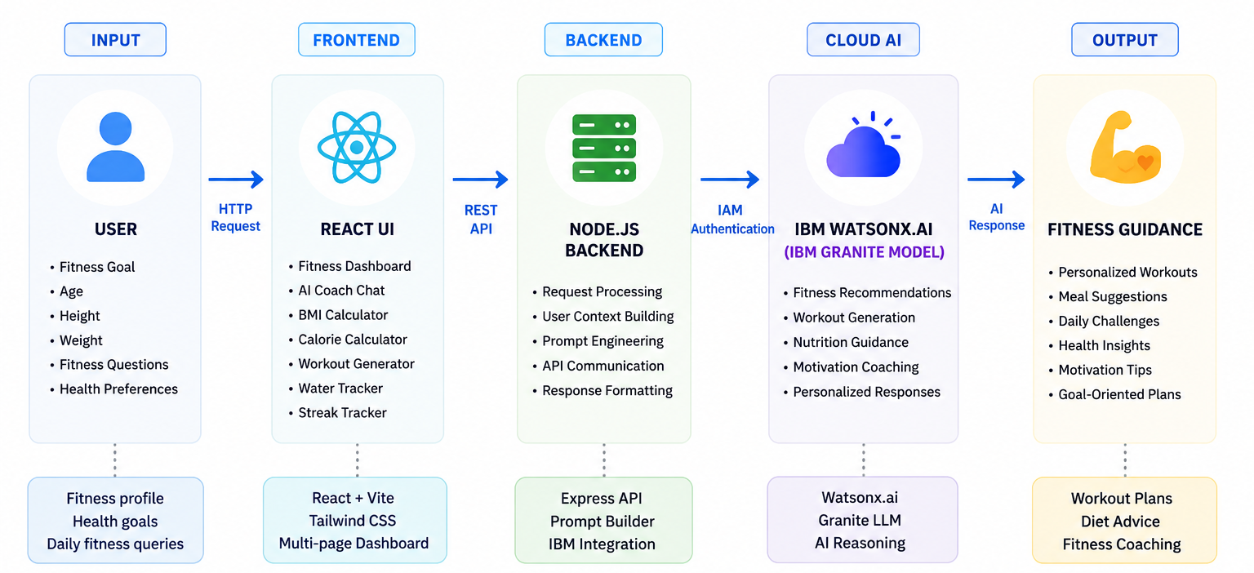
Solution Architecture

Slide 7
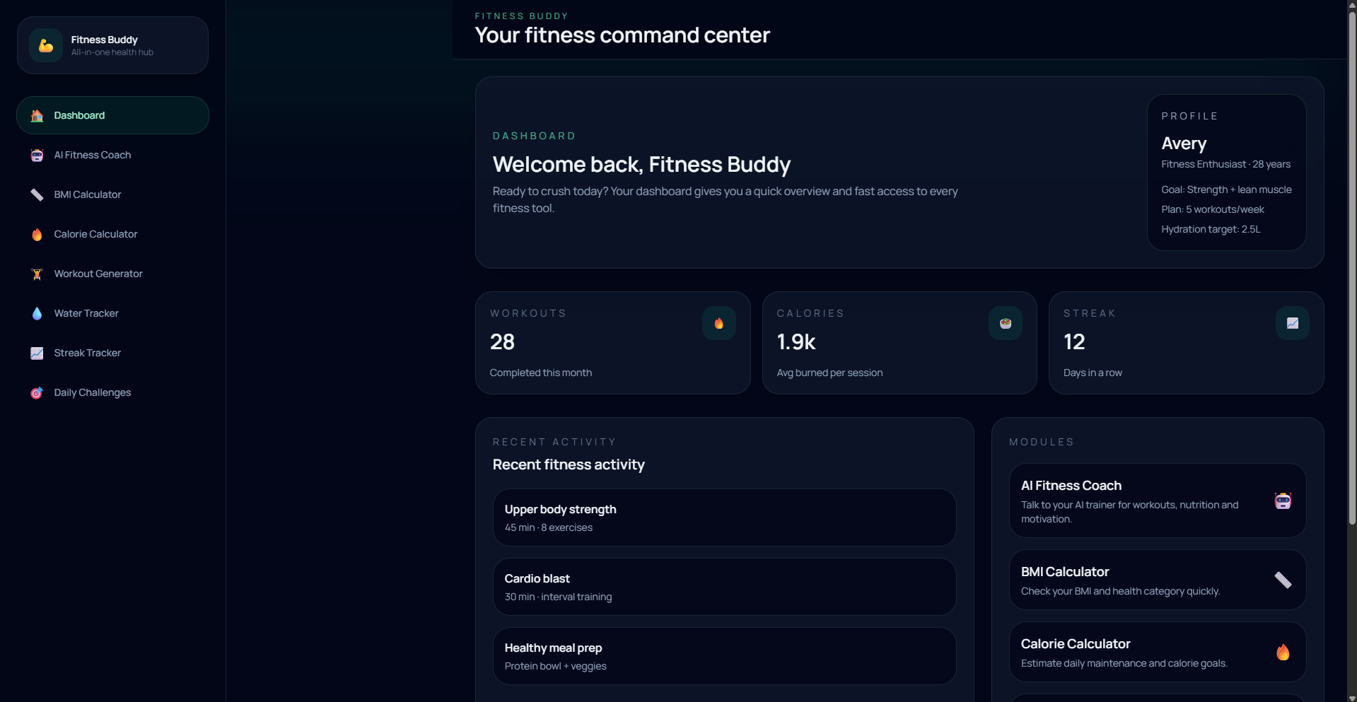
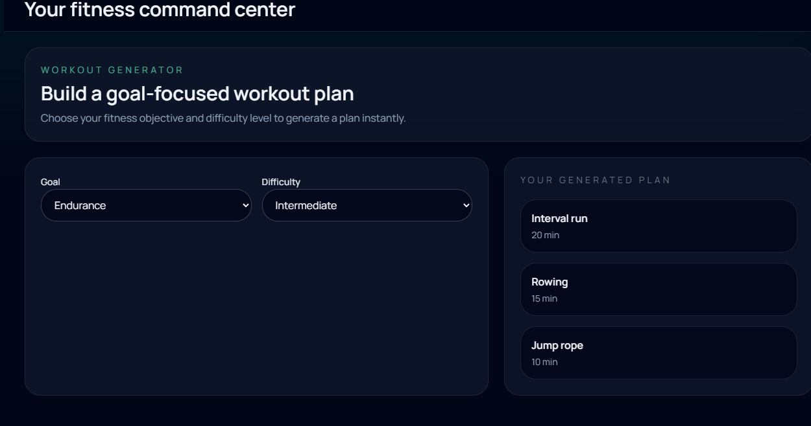
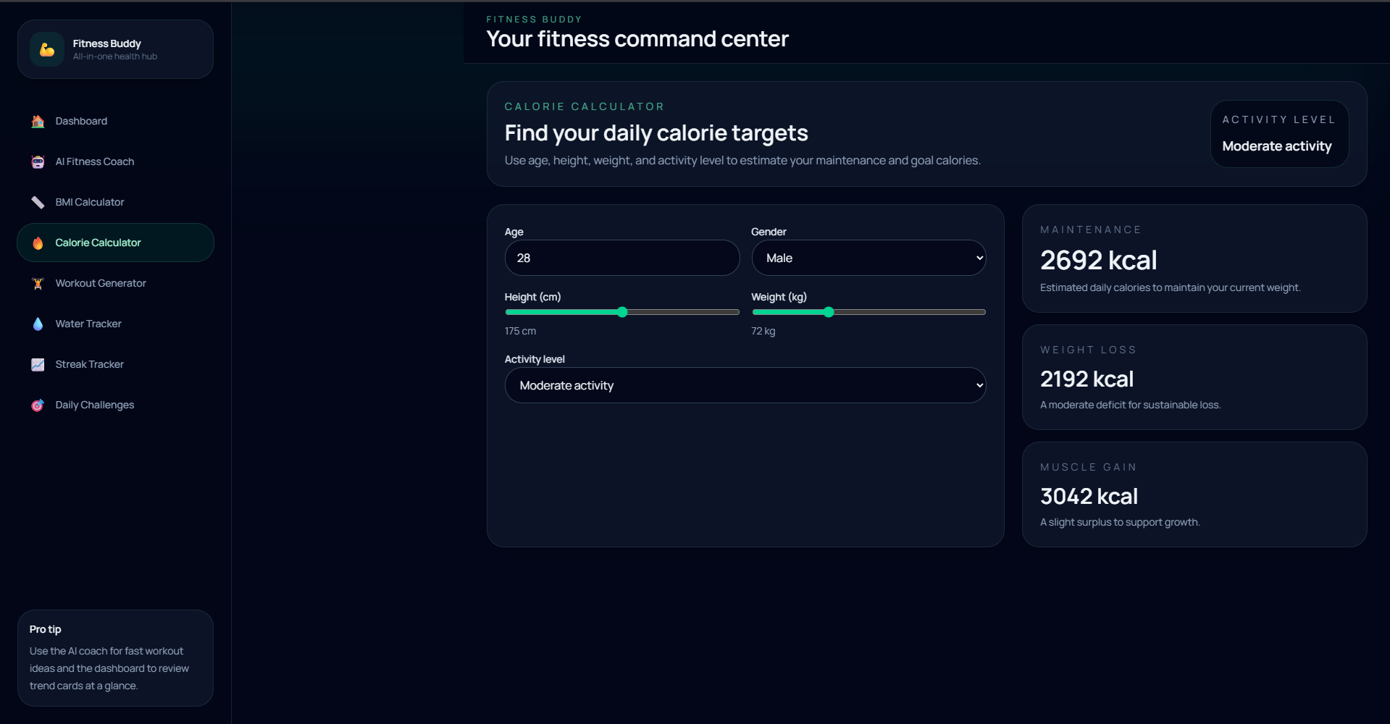
The Fitness Buddy Dashboard
AI Fitness Coach
IBM Granite-powered chat interface for personalized workout plans, meal suggestions, and motivation tips
Health Metrics Tools
BMI Calculator, Calorie Calculator, and AI Workout Generator for beginner, intermediate, and advanced levels
Smart Tracking
Water intake tracker with progress bar and daily targets; streak tracker for habit consistency
Daily Challenges
Random daily fitness challenges with completion tracking to keep users motivated and engaged

Slide 8
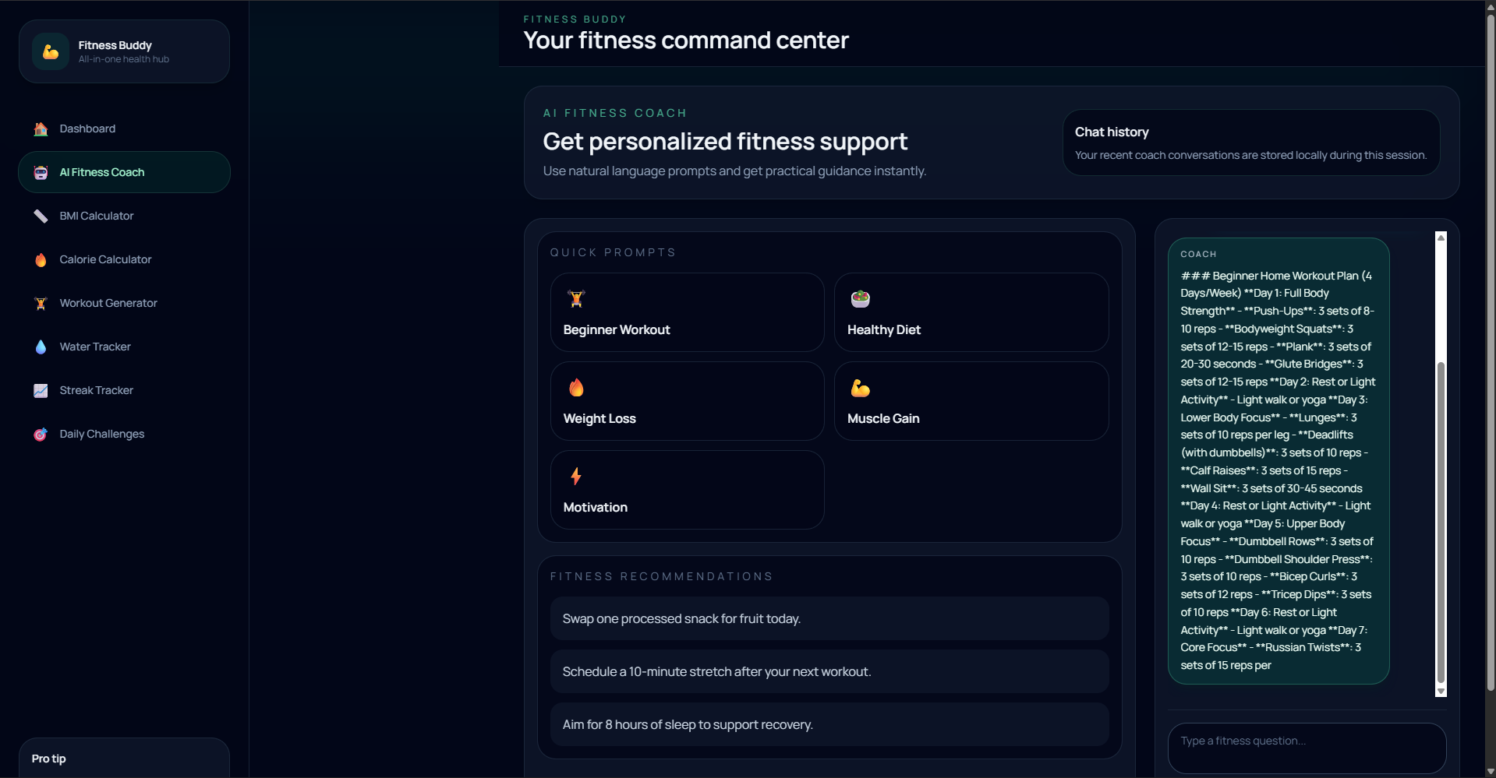
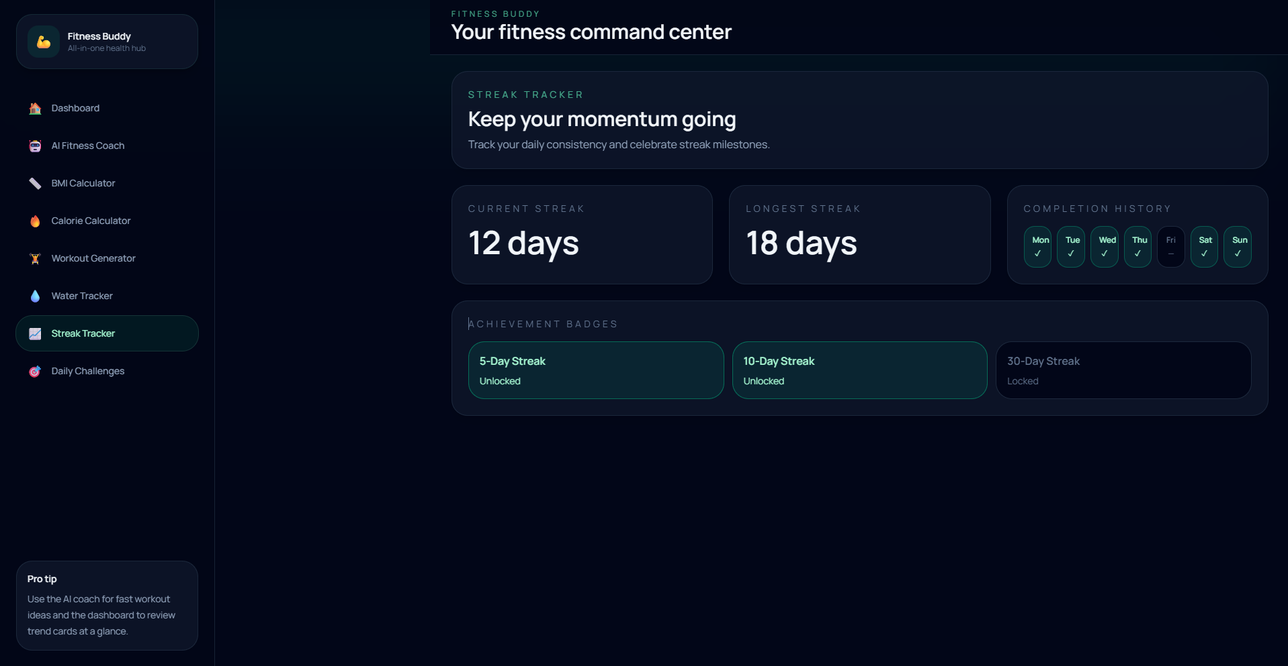
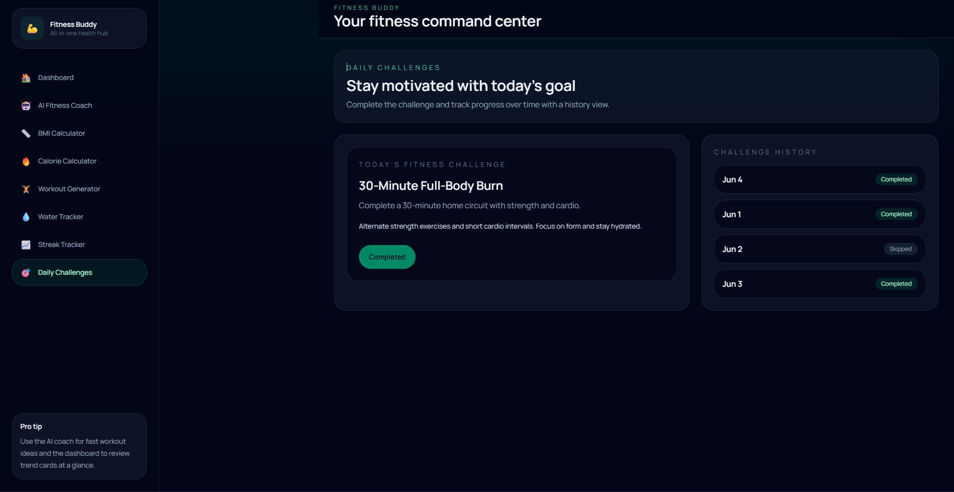
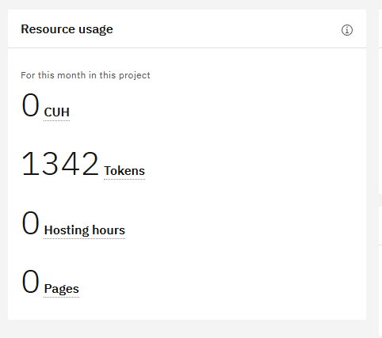
The AI Engine — IBM Granite & Backend
01
User Input
User provides fitness goals, body measurements, and queries through the React dashboard
02
Prompt Engineering
Express backend constructs structured prompts from user data and fitness context for IBM Granite
03
Authentication
Backend authenticates with IBM Watsonx.ai using a Bearer Token via IBM IAM and API Key
04
AI Inference
Prompt is sent to IBM Granite model deployed on IBM Cloud for intelligent fitness guidance generation
05
Response
IBM Granite returns personalized workout plans, diet suggestions, and motivation tips to the dashboard

Slide 9
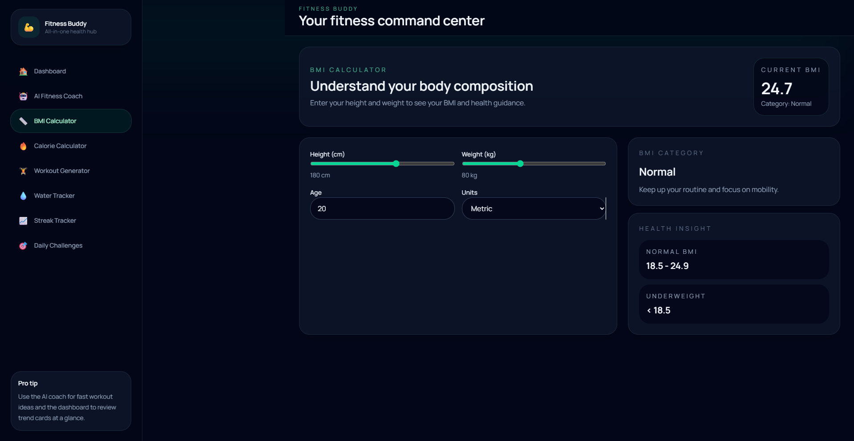
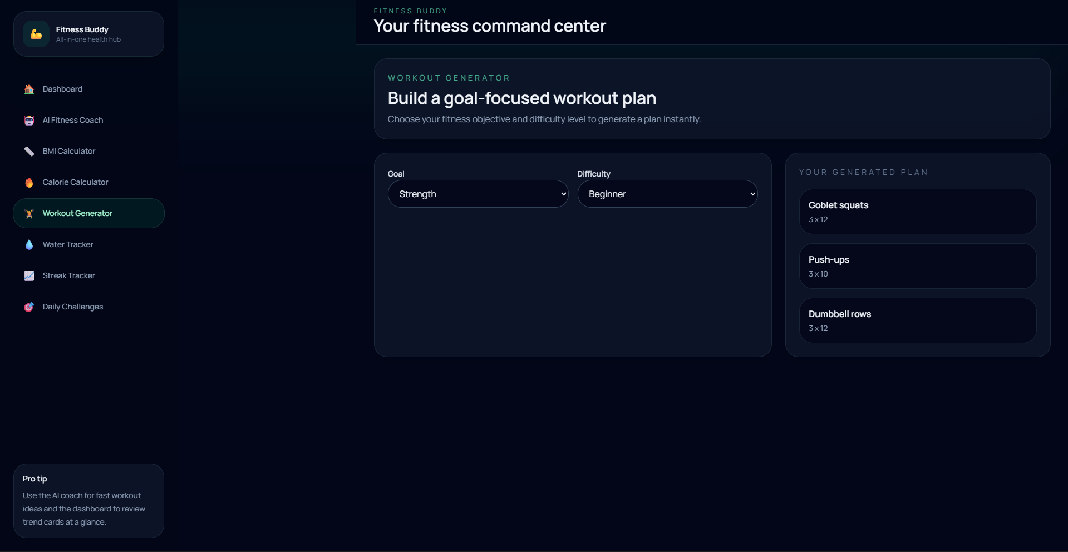
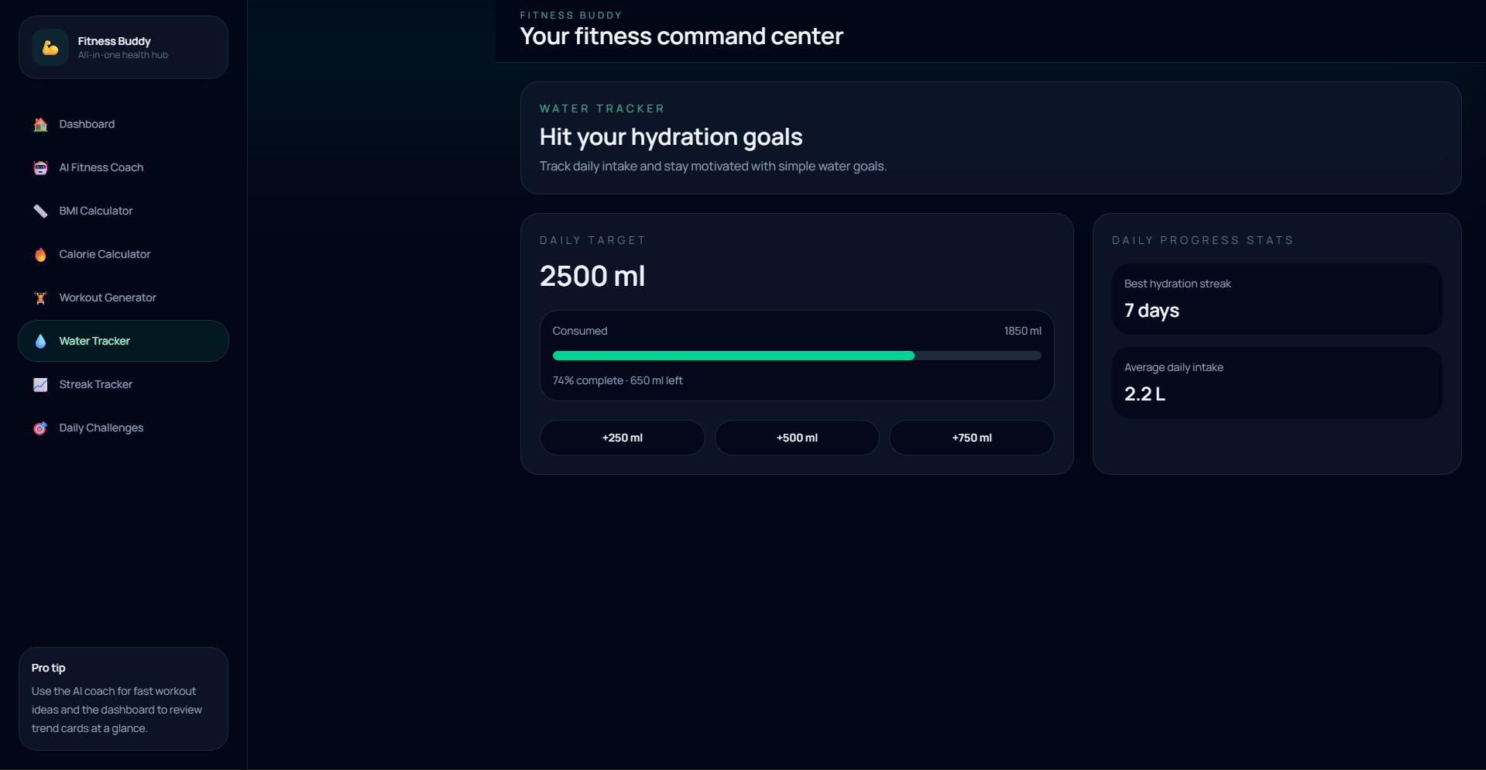
Why This Approach Matters
01
02
03
Personalized Fitness
Accessibility & Scalability
Motivation & Engagement
Every recommendation is tailored to the user’s specific goals, body metrics, and preferences using IBM Granite’s intelligent AI coaching.
Available anytime without expensive personal trainers. The React UI, Express API, and IBM Cloud model run independently, enabling a scalable and robust platform.
Streaks, daily challenges, and an interactive dashboard keep users actively involved in their health journey and encourage long-term consistency.

Slide 10
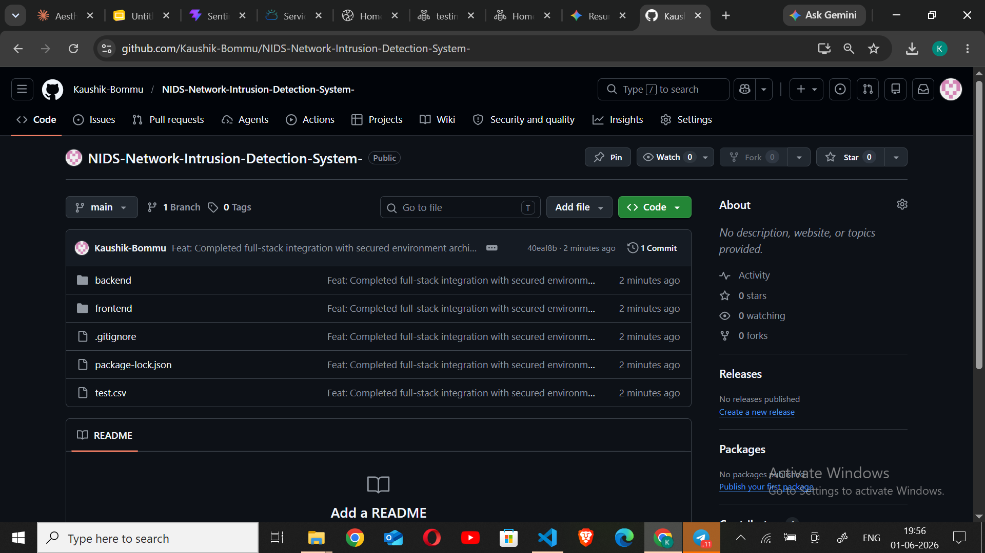
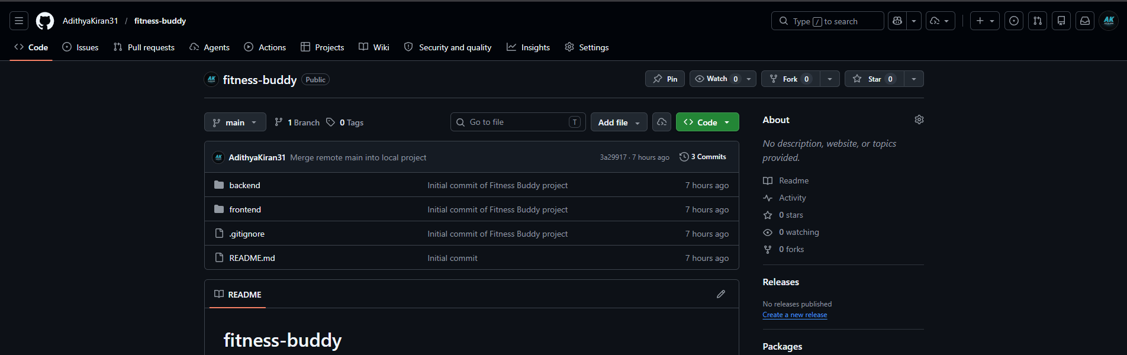
GitHub Repository & Demonstration
Repository URL
https://github.com/AdithyaKiran31/fitness-buddy
GitHub Repository Screenshot
[ Insert Here ]
REPO INCLUDES
✓
Frontend Source Code (React)
✓
Backend Source Code (Node.js)
✓
IBM Granite Integration & Documentation
✓
README.md with setup guide

Slide 11
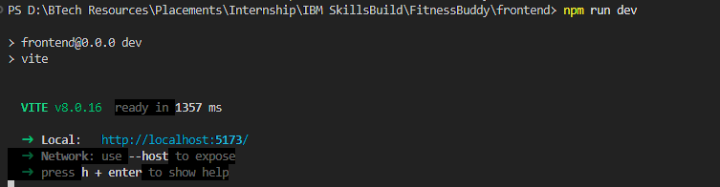
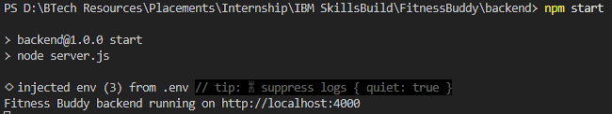
Future Scope
01
02
03
Voice Fitness Coach
AI Diet Planner & Analytics
Wearable & Health Integration
Voice-based interaction with the AI fitness coach, enabling hands-free workout guidance and real-time verbal motivation.
Complete AI-generated meal plans with nutrition breakdown, plus weekly and monthly fitness progress reports for deeper health insights.
Smartwatch and fitness band connectivity for real-time data, plus AI health monitoring for personalized health predictions and recommendations.
IBM University Engagement · Fitness Buddy AI · Building Healthier Habits Through Agentic AI

Slide 12


