Slide 1

The speed of containers, the security of VMs.

Slide 2


Kata Containers is an alternative OCI compatible runtime that enhances the security of container workloads in a lightweight virtual machine.
Notes:
Open Container Initiative (OCI) -- Established in June 2015 by Docker and other leaders in the container industry, the OCI currently contains two specifications: the Runtime Specification (runtime-spec) and the Image Specification (image-spec). The Runtime Specification outlines how to run a “filesystem bundle” that is unpacked on disk. At a high-level an OCI implementation would download an OCI Image then unpack that image into an OCI Runtime filesystem bundle. At this point the OCI Runtime Bundle would be run by an OCI Runtime.

Slide 3
Contents
What is Kata Containers
How does it work
Who benefits from Kata Containers
Features and Roadmap
Kata Containers Technical Details
Kata Containers Governance
Get Involved

Slide 4

Features
OCI-compatible runtime that enhances the security of container workloads in a lightweight virtual machines.
Works seamlessly with Kubernetes and Docker
and is a drop in replacement for runc
Open Source
Open governance project under the Open Infrastructure Foundation umbrella
Multi
Architecture
x86, ARM, IBM Power, IBM s/390x
Multi
Hypervisor QEMU, Cloud Hypervisor,
Firecracker
Notes:
S390 refers to the IBM System z architecture which is a mainframe.
PowerPC is the IBM power architecture

Slide 5
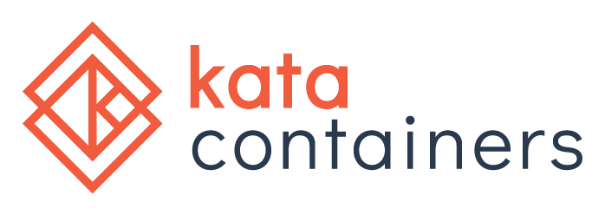
Evolution
The speed of containers,
the security of VMs.
2015 – Intel launches Clear Containers open source project​
​
2017 - Merger of two established projects under Open Infrastructure Foundation; Hyper.SH runV and Intel® Clear Containers.​
​May 2018 – V1.0 released ​
Each container/pod isolated by a quick-to-boot ​ lightweight VM.​
OCI-compatible runtime - Looks just like a ​container in Kubernetes, Docker, or OpenStack.​
​
2019 – Alibaba, Tencent, Baidu, Huawei, Stackpath put Kata Containers ​in production
​
October 2020 – V2.0 released
FAAS
Containers
Cloud
VM (CSP)
Modern
Enterprise
Legacy
Enterprise
Virtualization Continuum

Slide 6
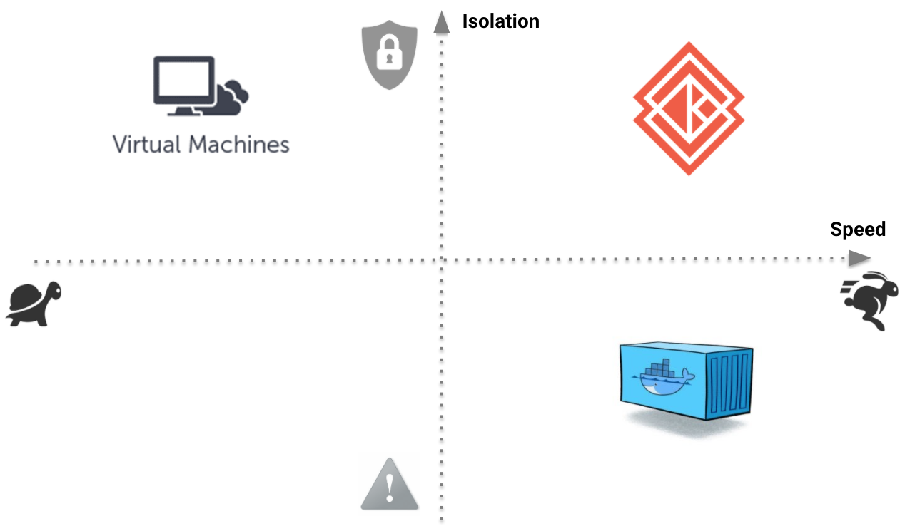
Evolution
The speed of containers,
the security of VMs.

Slide 7
Kata Containers provides additional security
Standard Containers
Virtual Machines
Kata Containers
Cgroups
Namespaces
Capability Filters
Seccomp filtering
Mandatory Access Control (MAC)
Separate Guest Kernel
VMX non-root
Hardware control
CPU Access Memory Access Device Access
+
=
Notes:
S390 refers to the IBM System z architecture which is a mainframe.
PowerPC is the IBM power architecture

Slide 8

Who is involved
Architecture Committee
Ant Group, Apple, Intel, Red Hat
Who’s else is contributing or using?
Adobe, Alibaba, AMD, ARM, Atlassian, Baidu, Canonical, CrayGoogle, eBay, Google, IBM, Microsoft, NVIDIA, Oracle, Orange, Vexxhost, ZTE and other organizations
Who’s interested?
Cloud service providers (IaaS, CaaS, etc.), network equipment makers (NFV workloads), banks and insurance companies, healthcare solution providers

Slide 9
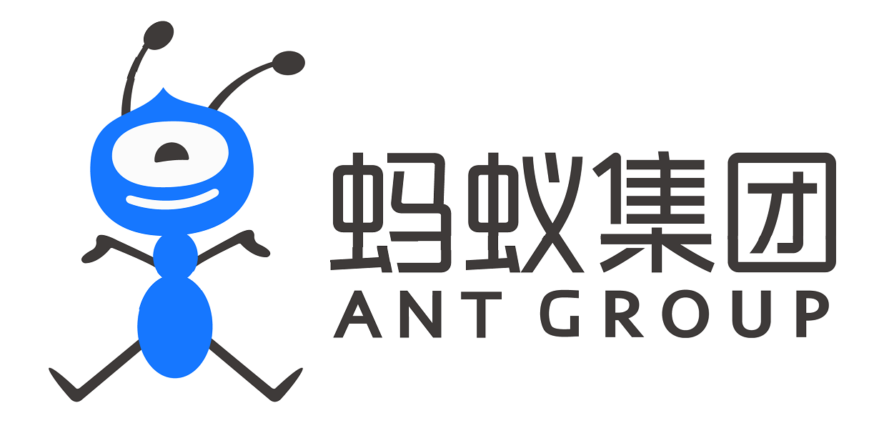
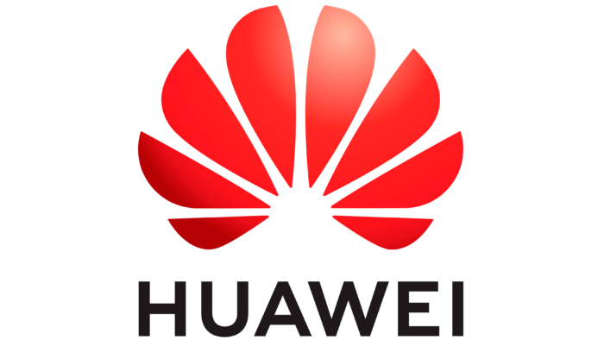
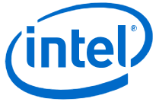
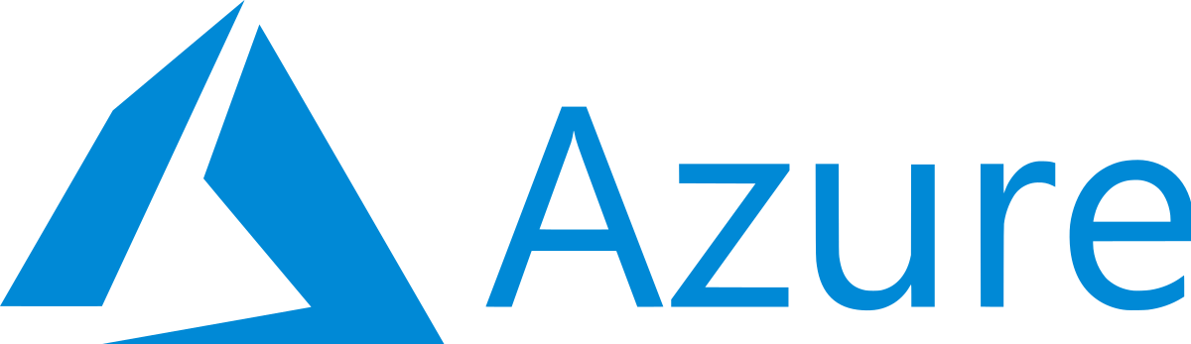


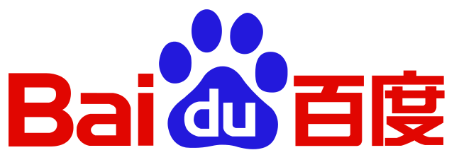





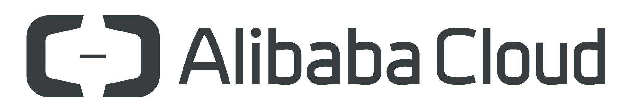




Healthy Growing Community
Notes:
Check out the project’s Infrastructure donors and the companies supporting Kata Containers: https://katacontainers.io/supporters/
Find the Kata Containers community contributor metrics on Kata Bitergia.

Slide 10

How does Kata Containers work?

Slide 11

How it works
Traditional Containers
Isolation by namespaces, cgroups with shared kernel
Kata Containers
Each container or pod is more isolated in its own lightweight VM
Container A
Container B
Container C
Container A
Container B
Container C
PROCESS A
PROCESS B
PROCESS C
VIRTUAL MACHINE
VIRTUAL MACHINE
VIRTUAL MACHINE
Filter:
Seccomp
MAC
CAPS
Filter:
Seccomp
MAC
CAPS
Filter:
Seccomp
MAC
CAPS
PROCESS A
PROCESS B
PROCESS C
namespaces
namespaces
namespaces
GUEST LINUX KERNEL A
GUEST LINUX KERNEL B
GUEST LINUX KERNEL C
namespaces
namespaces
namespaces
HARDWARE VIRTUALIZATION
HARDWARE VIRTUALIZATION
HARDWARE VIRTUALIZATION
HOST LINUX KERNEL
HOST LINUX KERNEL
CPU
Memory
Network
Storage

Slide 12
Seamless integration
Standard container initiation
OPENSTACK
DOCKER
CRI-O or
Containerd
OCI
KUBERNETES
CRI
PROCESS
runc
container
PodMAN (Rootless)
Kata Containers initiation
OPENSTACK
DOCKER
VM
OCI
PROCESS
Looks and acts like a container using K8s, Docker, or OpenStack Zun
KUBERNETES
CRI
CRI-O or
Containerd
Kata-runtime
container
PodMAN (Rootless)
GUEST LINUX KERNEL
Notes:
Container Runtime Interface CRI. From the kubernetes.io website
This is a plugin interface which enables your kubelet to use a wide variety of container runtimes without requiring a recompile
It consists of protocol buffers, grpc api, and libraries.
Kubelet communicates with the container runtime (or a CRI shim for the runtime) over Unix sockets using the gRPC framework, where kubelet acts as a client and the CRI shim as the server. There is an Image service and a RuntimeService.

Slide 13
Multi-tenant Kubernetes example
Standard Containers
Kata Containers
NODE 1
NODE 1
KUBERNETES
KUBERNETES
KERNEL
KERNEL
KATA VM
KATA VM
KATA VM
KATA VM
KATA VM
POD
POD
POD
POD
POD
POD
POD
POD
POD
POD
CONTAINER
CONTAINER
CONTAINER
CONTAINER
CONTAINER
CONTAINER
CONTAINER
CONTAINER
CONTAINER
CONTAINER
CONTAINER
CONTAINER
CONTAINER
CONTAINER
CONTAINER
CONTAINER
CONTAINER
CONTAINER
CONTAINER
CONTAINER
CONTAINER
CONTAINER
CONTAINER
KERNEL
KERNEL
KERNEL
KERNEL
NODE 2
NODE 3
NODE 4
NODE 2
Isolate sensitive workloads by node
Isolate sensitive workloads within a node
Notes:
A node could be a virtual machine or a bare metal machine
Untrusted or sensitive workloads like the ones shaded in red can be run on the same Node with Kata.

Slide 14
Who benefits from Kata Containers?

Slide 15
Kata Containers “Sweet Spots”
Bare metal infrastructure
Mixed workloads production environments
Multi-tenant container clusters
More Security
+
Flexibility
Regulated and sensitive production environments
Legacy and cutting edge workloads with kernel-dependent features

Slide 16

Use Case: Kata Containers in Ant Group
Kata Containers are running on thousands of node and over 10K cores
Part of them have been upgrade to a 2.0-preview version.
Ant Group deployed Kata Containers for
Financial-grade infra architecture, called Trust-Native
Not only Security Isolation, but
Performance Isolation, to help running heterogeneous workload
Failure Isolation, to restrict the explosion radius of any potential software failure
Ant Group believes the isolation provided by Kata Containers will be the cornerstone of our financial-grade infrastructure architecture
Notes:
Check out more Kata use cases:
The practice and landing of Kata containers in Ant Group and Alibaba Group
Kata Containers in Ant Group

Slide 17
Features and Roadmap

Slide 18
Features
Networking
SR-IOV (Lowest Latency)
Data Plane Development Kit (DPDK)/VPP (Fast Software implementation)
Network Plugins - CNI / CNM
Hypervisor
QEMU PCI device passthrough (Direct Device Assignment) Hotplug of memory
DAX / NVDIMM (Direct Access to Memory) Cloud Hypervisor VMM for running modern cloud workloads
Feature parity with QEMU with a smaller attack surface Firecracker Fast and minimal
Storage
SSD’s / HDD Virtio-fs (Shared filesystem) ^{New} Virtio-SCSI/Virtio-blk (Block storage) Intel® Optane™ Memory
DAX (Direct Access to Memory)
Kata Containers VM Minimal kernel and rootfs (Customizable)
VM Templating (Fast Restore)
Memory
Kernel same page merging (Deduplicate Memory)
Virtio-mem (Experimental)
Notes:
SR-IOV- This allows a PCIe device, typically a network adapter, to separate its resources into distinct processing units that can be assigned to a virtual machine. Typically there is a physical interface and multiple virtual functions.
DPDK/VPP - Data plane development Kit is a set of data plane libraries and network interface drivers for faster packet processing. VPP is an extensible framework that provides user space switch/router functionality. In the case of Kata containers it can provide better performance for container to container communication on a host.
Network Plugins – CNI stands for container network interface and includes popular plugins like multus, weave.net, flannel, calico, canal, cilium, kube-router, romana, It is what Kubernetes uses as kubernetes does not manage pod to pod communication and expect the plugin to handle that. CNM which stands for Container Network Model and is what Docker uses. Docker came up with CNM and CoreOS responsible for rkt came up with CNI.
virtio-scsi – is slightly more complex than virtio-blk and is intended for block based storage
virtio-blk – This links PCI and storage devices in a 1:1 relationship and is the driver for the virtual machine to access block storage
9pfs – This is actually a network protocol used to access an underlying filesystem. It does not perform as well but is easy to use with existing filesystems
Virtio-fs – This is a shared filesystem for virtual machiens developed by Red Hat that can access a directory tree on a host. It is new to Kata containers is looks like a promising alternative to 9pfs
Kernel same page merging – This is a kernel feature that makes it possible for a hypervisor system to share identical memory pages amongst different processes or virtualized guests. After some time it will deduplicate memory across multiple copies of Virtual Machines running.
DAX – This was originally introduced in the 4.0 kernel. Before DAX files were first copied from disk to a kernel cache which becomes unnecessary overhead when dealing with a persistent non-volatile memory. DAX removes this extra copy by reading/writing directly to this persistent memory. This helps to remove some of the penalty of using a virtual machine. This will enable guest page cache bypass using Direct Access for files in the VM context

Slide 19
Releases
May 2018
1.0.0
Seamless integration with Docker, Kubernetes (CRI)
Hardware isolation using KVM/QEMU
Direct device assignment (GPU, RDMA, QAT, NIC)
Custom Kernel per workload
Compatible with all major networking (CNI) plugins, including support for Data Plane Development Kit (DPDK), SR-IOV
Support for Intel® Virtualization Technology
July 2018
1.1.0
August 2018
1.2.0
September 2018
1.3.0
November 2018
1.4.0
January 2019
1.5.0
March 2019
1.6.0
May 2019
1.7.0
July 2019
1.8.0
October 2019
1.9.0
January 2020
1.10.0
April 2020
1.11.0
October 2020
1.12.0

Slide 20
Releases
May 2018
1.0.0
July 2018
1.1.0
Kata Containers runtime added support to share PID namespace
Initial support for ppc64le added (multi-architecture)
Initial support for Arm64 added
July 2018
1.1.0
August 2018
1.2.0
September 2018
1.3.0
November 2018
1.4.0
January 2019
1.5.0
March 2019
1.6.0
May 2019
1.7.0
July 2019
1.8.0
October 2019
1.9.0
January 2020
1.10.0
April 2020
1.11.0
October 2020
1.12.0

Slide 21
Releases
May 2018
1.0.0
July 2018
1.1.0
August 2018
1.2.0
VSOCK support: Kata Containers proxy is no longer required
New factory support to allow creating VMs based in a template that will decrease the boot time and memory usage.
Added support for AMD
September 2018
1.3.0
November 2018
1.4.0
January 2019
1.5.0
March 2019
1.6.0
May 2019
1.7.0
July 2019
1.8.0
October 2019
1.9.0
January 2020
1.10.0
April 2020
1.11.0
October 2020
1.12.0

Slide 22
Releases
May 2018
1.0.0
July 2018
1.1.0
August 2018
1.2.0
September 2018
1.3.0
GPU device passthrough is now supported
Hotplugging of VFIO devices
Hotplugging additional memory into the guest is supported
Guest entropy source is configurable and defaults to /dev/urandom
Guest max memory can be configured
New kata-netmon program to monitor netns on the host to inform guest
November 2018
1.4.0
January 2019
1.5.0
March 2019
1.6.0
May 2019
1.7.0
July 2019
1.8.0
October 2019
1.9.0
January 2020
1.10.0
April 2020
1.11.0
October 2020
1.12.0

Slide 23
Releases
May 2018
1.0.0
July 2018
1.1.0
August 2018
1.2.0
September 2018
1.3.0
November 2018
1.4.0
Initial support of NEMU hypervisor (Multi-hypervisor)
Support for macvlan and ipvlan networking
Host cgroups support to restrict QEMU process and vcpu threads
Support for running prestart/poststart/prestop/poststop hook binaries
Allow CNI plugins to directly add tap devices to a sandbox
Allow tc filters to bridge host netns veth and guest tap device
January 2019
1.5.0
March 2019
1.6.0
May 2019
1.7.0
July 2019
1.8.0
October 2019
1.9.0
January 2020
1.10.0
April 2020
1.11.0
October 2020
1.12.0

Slide 24
Releases
May 2018
1.0.0
July 2018
1.1.0
August 2018
1.2.0
September 2018
1.3.0
November 2018
1.4.0
January 2019
1.5.0
Added support for Firecracker hypervisor
Initial shimv2 support
Live upgrade
IBM S/390x support
March 2019
1.6.0
May 2019
1.7.0
July 2019
1.8.0
October 2019
1.9.0
January 2020
1.10.0
April 2020
1.11.0
October 2020
1.12.0

Slide 25
Releases
May 2018
1.0.0
July 2018
1.1.0
August 2018
1.2.0
September 2018
1.3.0
November 2018
1.4.0
January 2019
1.5.0
March 2019
1.6.0
Initial OpenTracing support
virtio-fs mount driver
May 2019
1.7.0
July 2019
1.8.0
October 2019
1.9.0
January 2020
1.10.0
April 2020
1.11.0
October 2020
1.12.0
Notes:
Add OpenTracing support This release includes changes to support OpenTracing, but note that the feature should be considered a preview as it is not yet integrated into the runtime. See TRACING.md and #1369 for full details.
mount: add virtio-fs mount driver Now the agent can mount virtio-fs shared directories.
Agent allow with cpuset that not match with vcpus in the guest.

Slide 26
Releases
May 2018
1.0.0
July 2018
1.1.0
August 2018
1.2.0
September 2018
1.3.0
November 2018
1.4.0
January 2019
1.5.0
March 2019
1.6.0
May 2019
1.7.0
Experimental virtio-fs support
Updated Firecracker VMM support
Initial Persist API changes to support future hot-upgrade
July 2019
1.8.0
October 2019
1.9.0
January 2020
1.10.0
April 2020
1.11.0
October 2020
1.12.0

Slide 27
Releases
May 2018
1.0.0
July 2018
1.1.0
August 2018
1.2.0
September 2018
1.3.0
November 2018
1.4.0
January 2019
1.5.0
March 2019
1.6.0
May 2019
1.7.0
July 2019
1.8.0
Upgrade to Upstream QEMU 4.0
Firecracker Jailer support
October 2019
1.9.0
January 2020
1.10.0
April 2020
1.11.0
October 2020
1.12.0

Slide 28
Releases
May 2018
1.0.0
July 2018
1.1.0
August 2018
1.2.0
September 2018
1.3.0
November 2018
1.4.0
January 2019
1.5.0
March 2019
1.6.0
May 2019
1.7.0
July 2019
1.8.0
October 2019
1.9.0
ACRN Hypervisor support
OCI annotations for per pod Kata Containers configuration
Initial support for rootless on Podman
NEMU Hypervisor deprecated
January 2020
1.10.0
April 2020
1.11.0
October 2020
1.12.0
Notes:
ACRN is an open source Type 1 hypervisor that can run a RTOS in a VM. Kata support means that the RTOS VM can launch containers
that are secured in a different VM on type of the ACRN hypervisor.

Slide 29
Releases
May 2018
1.0.0
July 2018
1.1.0
August 2018
1.2.0
September 2018
1.3.0
November 2018
1.4.0
January 2019
1.5.0
March 2019
1.6.0
May 2019
1.7.0
July 2019
1.8.0
October 2019
1.9.0
January 2020
1.10.0
Initial support for Cloud Hypervisor
Rootless support for QEMU
Deprecated the bridged networking model for tc
April 2020
1.11.0
October 2020
1.12.0
Notes:
Cloud Hypervisor is an open source Virtual Machine Monitor (VMM) that runs on top of KVM. The project focuses on exclusively running modern, cloud workloads, on top of a limited set of hardware architectures and platforms. Cloud workloads refers to those that are usually run by customers inside a cloud provider. For our purposes this means modern Linux distributions with most I/O handled by paravirtualised devices (i.e. virtio), no requirement for legacy devices and recent CPUs and KVM. It is based on Rust
TC is the traffic controller interface.

Slide 30
Releases
May 2018
1.0.0
July 2018
1.1.0
August 2018
1.2.0
September 2018
1.3.0
November 2018
1.4.0
January 2019
1.5.0
March 2019
1.6.0
May 2019
1.7.0
July 2019
1.8.0
October 2019
1.9.0
January 2020
1.10.0
April 2020
1.11.0
Hotplug of CPU and memory for Cloud Hypervisor
Added support for Persistent Memory
Added Storage Performance Development Kit (SPDK) support
Added ipv6 support
Initial newstore feature to support live upgrade
Initial support for virtio-mem
October 2020
1.12.0

Slide 31
Releases
May 2018
1.0.0
July 2018
1.1.0
August 2018
1.2.0
September 2018
1.3.0
November 2018
1.4.0
January 2019
1.5.0
March 2019
1.6.0
May 2019
1.7.0
July 2019
1.8.0
October 2019
1.9.0
January 2020
1.10.0
April 2020
1.11.0
November 2020
1.12.0
SELinux
Intel® QuickAssist Technology Dockerfile to simplify installation

Slide 32
Kata Containers 2.0 (Launched October 2020)
Performance
Transition to Rust Agent for higher container density and better memory overhead. 11MB to 300K
Transition from gRPC communication protocol to ttRPC for lower memory overhead.
Virtio-fs is now the default shared file system type with better POSIX compliance.
Security
Secure Enclave Support with Intel® SGX
Reduced system privileges of Kata components
Separate IO streams for better security isolation
Cloud Hypervisor for smaller surface area of attack.
Stability
New component called Kata-monitor
Better observability and tracing for debug
Live monitoring with Prometheus and Grafana.
Check https://github.com/kata-containers/kata-containers/releases/tag/2.0.0
for more information about Kata 2.0 and its download availability.
Notes:
The Secure Enclave support will include the plumbing for different architecture enclaves to be used with Kata Containers.
Read the Kata Containers 2.0 blog on more information about the new release! https://medium.com/kata-containers/kata-containers-version-2-0-e45df4dd328

Slide 33
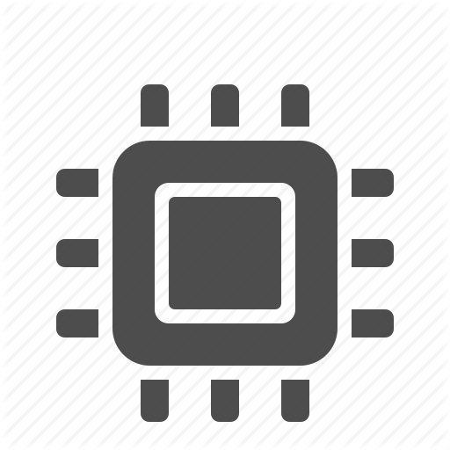


Where to run Kata Containers
Distro packages
Clear Linux CentOS
Debian
Fedora
OpenSUSE
SUSE Linux Enterprise Server
Red Hat Enterprise Linux
Ubuntu
Cloud
Amazon Web Services (AWS)
Microsoft Azure
Google Compute Engine (GCE)
VEXXHOST OpenStack Cloud
Packet.IO
Hardware
Intel® architecture X86
AMD X86
ARM aarch64
IBM Z
IBM pSeries
Notes:
AWS - Kata Containers on Amazon Web Services (AWS) makes use of i3.metal instances. Most of the installation procedure is identical to that for Kata on your preferred distribution, except that you have to run it on bare metal instances since AWS doesn't support nested virtualization yet.
Azure - Kata Containers on Azure use nested virtualization to provide an identical installation experience to Kata on your preferred Linux distribution.
GCE - Kata Containers on Google Compute Engine (GCE) makes use of nested virtualization. Most of the installation procedure is identical to that for Kata on your preferred distribution, but enabling nested virtualization currently requires extra steps on GCE.
VEXXHOST - Kata Containers on VEXXHOST use nested virtualization to provide an identical installation experience to Kata on your preferred Linux distribution.

Slide 34
Installing Kata Containers
Automatic
Simple
kata-manager script
Scripted
Customizable
Kata-doc-to-script
Manual
Step by step instructions Install from tarball Tarball location Build from source
Instructions
Snap
Any distribution that supports snapD
Extra configuration for Docker and Kubernetes
Snap Install instructions
Cloud
Amazon Web Services (AWS)
Microsoft Azure
Google Compute Engine
VEXXHOST OpenStack Cloud
Install from Docker and Kubernetes
Docker - kata-deploy
Kubernetes - Daemonsets and RBAC install
Notes:
Kata-manager script – As the name implies this is a script that installs kata containers packages, installs docker, and configures docker to use kata by default. It works across multiple distributions
Kata-doc-to-script – This can generate custom install scripts that can be tweaked later.
Kata-deploy - provides a Dockerfile, which contains all of the binaries and artifacts required to run Kata Containers, as well as reference daemonsets, which can be utilized to install Kata Containers for both Docker and on a running Kubernetes cluster.
Kubernetes – This allows the install of kata through daemonsets on a node only if it uses either containerd or CRIO CRI shims
kubectl apply -f kata-rbac.yaml
kubectl apply -f kata-deploy.yaml

Slide 35
Kata Containers Technical Details

Slide 36

Speed of a container
$ kubectl apply -f nginx.yml
Create
Start
VM boot
Kernel
Agent
Start pod
Prepare container image
Prepare volumes
hotplug

Slide 37
Kata Containers integration with Docker, Kubernetes, and OpenStack
VIRTUAL MACHINE
Creates VM
Starts shim
DOCKER
OCI cmd/spec
gRPC
Container
Command
Container
Exec
Kata-runtime
Facilitates lifecycle of container
Creates cgroups inside VM
KUBERNETES
container
Kata-Shim
namespaces
PodMAN
I/O
gRPC
Kata-Shim
KATA AGENT
OPENSTACK
KATA KERNEL
Maps container process to Docker or Kubernetes
HYPERVISOR
HYPERVISOR VSOCK socket

Slide 38
Kubernetes ContainerD v2 shim integration Kata Containers v1.5 and later
VIRTUAL MACHINE
OCI cmd/spec
gRPC
Container
Command
Container
Exec
KUBERNETES
Containerd-kata-shim-v2
container
I/O
gRPC
namespaces
AGENT
KERNEL
HYPERVISOR
HYPERVISOR VSOCK socket

Slide 39
Networking
Kubernetes
Overlay
Network
or
Docker Bridge
VIRTUAL MACHINE
Traffic
Controller
Pod
veth pair
Tap
Container A
Container B
Container Namespace

Slide 40
Networking
VIRTUAL MACHINE
Traffic
Controller
Network Interface
Pod
Macvlan or IPvlan
Tap
Container A
Container B
Container Namespace
Notes:
Network interface could be
Virtual interface
Physical interface

Slide 41
Storage
CONTAINER 1
Rootfs
9pfs or virtio-fs
9pfs or virtio-fs
VOLUME
-v /etc:/etc
Aufs/Overlay2
Or
Kata Containers VM
Or
CONTAINER 2
Rootfs
virtio-blk
virtio-blk
VOLUME
-v /dev/sdb
Block (Devicemapper)
Notes:
Aufs - (short for advanced multi-layered unification filesystem) implements a union mount for Linux file systems. The name originally stood for AnotherUnionFSuntil version 2.
Docker
overlay2 is the preferred storage driver, for all currently supported Linux distributions, and requires no extra configuration.
aufs is the preferred storage driver for Docker 18.06 and older, when running on Ubuntu 14.04 on kernel 3.13 which has no support for overlay2.
devicemapper is supported, but requires direct-lvm for production environments

Slide 42
Storage
CONTAINER 1
Rootfs
virtio-fs
virtio-fs
VOLUME
-v /etc:/etc
Aufs/Overlay2
Or
DAX
Or
Kata Containers VM
VOLUME
-v /pmem:/pmem
Or
CONTAINER 2
Rootfs
virtio-blk
VOLUME
-v /dev/sdb
virtio-blk
Block (Devicemapper)
Notes:
Aufs - (short for advanced multi-layered unification filesystem) implements a union mount for Linux file systems. The name originally stood for AnotherUnionFSuntil version 2.
Docker
overlay2 is the preferred storage driver, for all currently supported Linux distributions, and requires no extra configuration.
aufs is the preferred storage driver for Docker 18.06 and older, when running on Ubuntu 14.04 on kernel 3.13 which has no support for overlay2.
devicemapper is supported, but requires direct-lvm for production environments

Slide 43

Kata Containers and Vector Packet Processing (VPP) Faster throughput between containers on a host
$ docker network create –d vpp --subnet=192.168.1.0/24 --gateway=192.168.1.1 vpp_net $ docker run --net=vpp_net --ip=192.168.0.1
--name containerA --itd debian sh
$ docker run --net=vpp_net --ip=192.168.0.2 --name containerB --it debian bash –c “ping 192.168.1.1”
qemu
qemu
1
VM 1
VM 2
Container A
Container B
2
virtio-net
virtio-net
3
vhost-user
vhost-user
HYPERVISOR
VPP L2-XC
Host userspace
1. Create Docker Network with VPP driver
2. Start Container A and attach to Docker network
3. Start Container B, attach to Docker network, ping network
HOST Kernel
Software optimized, low latency, faster throughput
Notes:
DPDK/VPP - Data plane development Kit is a set of data plane libraries and network interface drivers for faster packet processing. VPP is an extensible framework that provides user space switch/router functionality. In the case of Kata containers it can provide better performance for container to container communication on a host.
VPP overview
Built on a packet processing graph.
All user space - makes use of DPDK.
Modular: It is a framework to which you can add your own graph nodes.
Takes in a vector of packets at a time to amortize the cost of a D-cache miss and mitigates read latency. Nodes optimized to keep I-cache hot.
Vhost-user
-mem-path to allocate guest RAM as memory that can be shared with another process.
Unix domain socket to communicate between QEMU and the user space vhost implementation
user space application will receive file descriptors for the pre-allocated shared guest RAM. It will directly access the related vrings in the guest's memory space.

Slide 44
Kata Containers and SR-IOV for network cards Hardware optimized networking performance
$ docker network create –d sriov --opt pf_iface=eno3
--subnet=192.168.0.0/24 vfnet
$ docker run --net=vfnet --ip=192.168.0.10
--name containerA -itd alpine sh
qemu
qemu
1
VM 1
VM 2
2
Container A
Container B
ixgbe
ixgbe
$ docker network create –d sriov --opt pf_iface=eno3
--subnet=192.168.0.0/24 vfnet
$ docker run --net=vfnet --ip=192.168.0.11
--name containerB -it alpine sh -c “ping 192.168.0.10”
1
VFIO-PCI
VFIO-PCI
3
HYPERVISOR
HYPERVISOR
HOST KERNEL
HOST KERNEL
1. Create Docker Network on both hosts with SR-IOV driver
2. Start Container A and attach to Docker network
3. Start Container B, attach to Docker network, ping network
SRIOV NIC
SRIOV NIC
VF
VF
Hardware offload, lowest latency, fastest throughput
Notes:
The VFIO-PCI is a kernel module that allows PCIe devices to be dedicated to a virtual machine so the VM can control it directly. It could be for a USB port, SATA controller, network card, sound card , or even graphics card.

Slide 45
Kata Containers and SR-IOV with Intel® QuickAssist Technology Accelerated cryptography and compression
qemu
$ docker run -it --runtime=kata-runtime --device=/dev/vfio/90 -v /dev:/dev -v etc:/etc openssl-qat-engine bash
# openssl engine -c -t qat
# openssl speed -engine qat -elapsed -async_jobs 72 rsa2048
VM 1
1
Container A
2
3
intel_qat.ko
VFIO-PCI
Note:
A custom Kata kernel and rootfs with QAT support is required for crypto and compression acceleration. A provided Dockerfile makes building this easier.
HYPERVISOR
HOST KERNEL
1. Start container passing in QAT vf device bound to vfio-pci driver
2. Verify Intel® QuickAssist Technology card is in container
3. Execute OpenSSL performance test using QAT engine.
Intel® QAT
VF
VF
VF
VF
VF
VF
VF
VF
VF
VF
VF
VF
VF
VF
VF
VF
Hardware offload with more secure isolation
Notes:
C32x chipset has 16 vf’s per pf and 2 processing units per vf.

Slide 46
Kata Containers and Intel® GVT-d for Accelerated GPU passthrough Secure containerized HW transcoding
qemu
$ docker run -it --runtime=kata-runtime
--device /dev/vfio/1
-v /dev:/dev debian bash
# lspci | grep VGA
01:01.0 VGA compatible controller: Intel Corporation Iris Pro Graphics 580 (rev 09)
VM 1
1
Container A
2
i915
VFIO-PCI
HYPERVISOR
HOST KERNEL
1. Start container passing in GPU bound to vfio-pci driver
2. Verify GPU available in container
GPU

Slide 47
Kata Containers and Intel® GVT-g for Accelerated GPU virtualization Secure containerized HW transcoding sharing
qemu
qemu
$ docker run -it --runtime=kata-runtime
--device /dev/vfio/0
-v /dev:/dev debian bash
# lspci | grep VGA
01:01.0 VGA compatible controller: Intel Corporation Iris Pro Graphics 580 (rev 09)
VM 1
VM 2
1
Container A
Container B
2
i915
i915
HYPERVISOR
HOST KERNEL
i915
1. Start container passing in vGPU bound to IOMMU group 0
2. Verify GPU available in container
GPU

Slide 48

The Kata Containers community welcomes contributions from anyone.

Slide 49
Resources
Source code Kata Containers source
Documentation
Kata Containers Getting Started Kata Containers Architecture Kata Containers Developer Guide
More coming soon from katacontainers.io

Slide 50
Kata Containers Governance

Slide 51
Governance
The Kata Containers project is governed according to the “four opens,”
open source
open design
open development
open community
Technical decisions will be made by technical contributors and a representative Architecture Committee. The community is committed to diversity, openness, encouraging new contributors and leaders to rise up.

Slide 52
Governance
Contributors
At least one github contribution for the past 12 months
Maintainers
Active contributor, nominated by fellow maintainers
Can merge code
Architecture Committee
Take high level architecture and roadmap decisions
5 seats, elected by contributors

Slide 53
Governance
Architecture Committee
The Architecture Committee is responsible for architectural decisions, including standardization, and making final decisions if Maintainers disagree.
It will be comprised of 5 members, who are appointed by the Maintainers at launch but fully elected by Contributors within the first year.
The Current Architecture committee members are Samuel Ortiz (Intel), Xu Wang (Ant Group), Eric Ernst (Apple), Archana Shinde (Intel), Fabiano Fidêncio (Red Hat)

Slide 54
Get Involved

Slide 55
Get Involved
Apache 2 license
Architecture Committee meetings: every Tuesday. Agenda and dial in info can be found here
Code and documentation hosted on https://github.com/kata-containers/
Developer Mailing List: lists.katacontainers.io
Freenode IRC: #kata-dev
Kata Containers User Survey: surveymonkey.com/r/KataContainers
Major releases managed through Github Project
Project Teams Gathering: Twice a year. Find more details here
Slack bit.ly/katacontainersslack
Twitter: @KataContainers
WeChat: Kata Containers

Slide 56
Thank you!

