Slide 1
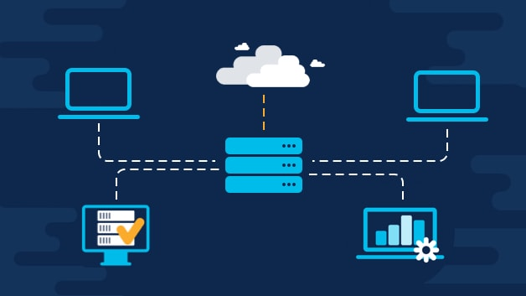
NETWORK DESIGN PROPOSAL FOR AIRPORT
COMPUTER NETWORKING PROJECT

Slide 2
TEAM MEMBERS-
Saswata Lahiri (RA1911027010001)
P.Adithya (RA1911027010003)
Avinash reddy Vasipalli (RA1911027010007)
Aagam Shah (RA1911027010015)

Slide 3
Project Scope
The project calls for the design and implementation of a secure network for a modern airport in which we maintain the security ,quality and safety of systems. Airports are sensitive areas we need a proper design to prevent any unauthorized access from any users. This project helps us build a design that deny access.

Slide 4
OBJECTIVES
The project goals and objectives include:
To Build a highly resilient Network used in large airports and used by large uses per year.
To Build a high throughput network
To Provide a high security level for the airport’s network
To Provide a high quality of service for the airport’s network
To Prevent accidental damage to the network's private data, its users, or their devices
To Maintain users’ details in a secure way
To Support the FMS (flight management system)

Slide 5
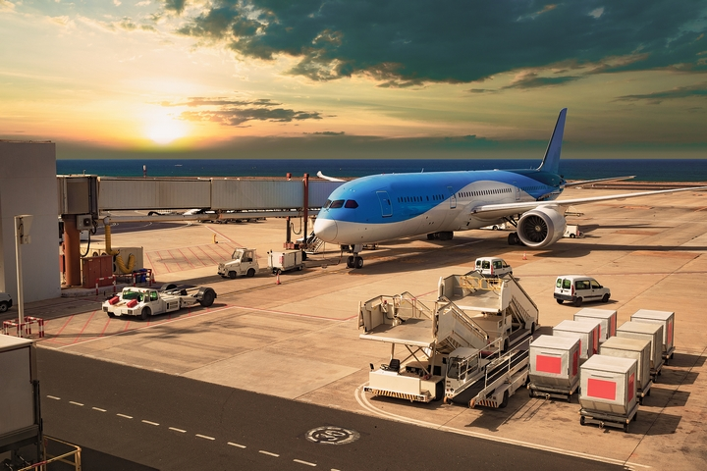
INTRODUCTION : -
Airports are the sensitive places around the world. Network Security plays a major role on computer network, especially in where high quality of services are required. Modern technology takes edge over the primitive ones where lot of energy, resources and time were wasted.

Slide 6
PROBLEM STATEMENT
The project will be used by 3 groups:-
Airport Authority
Flight Service Providers
Guests

Slide 7

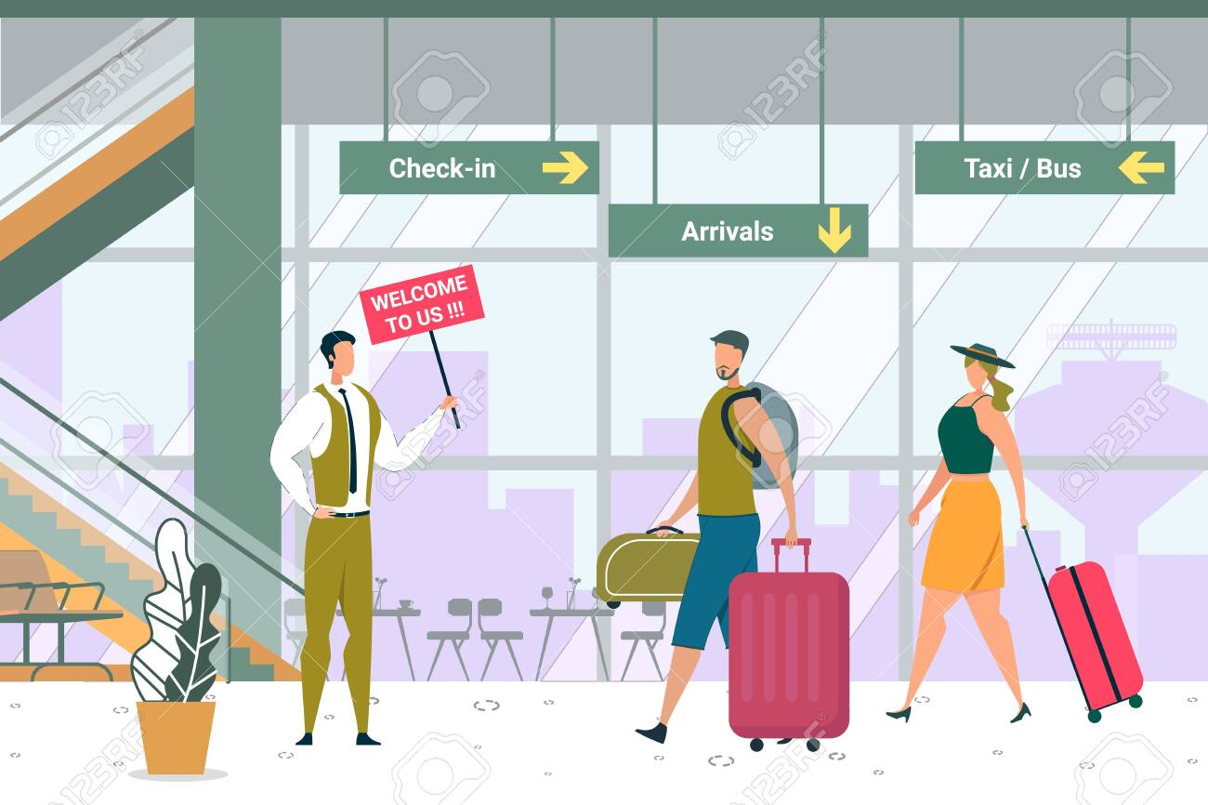
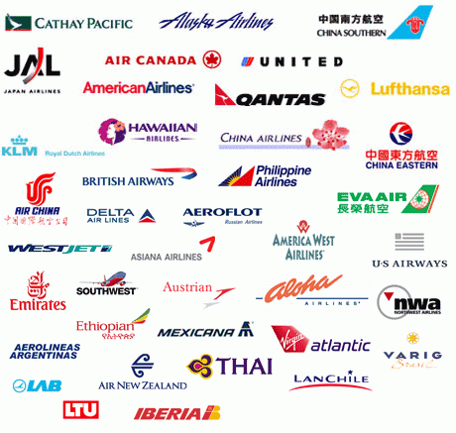
a. Airport Authority The airport authority maintains a server which handles the flight management controls.
b. Flight Service Providers They will have access only to the specific server in the airport authority network and not to any other systems.
c. Guests
The guest users have wireless access to a high speed internet connection.

Slide 8

The project is design to secure the network from the following threats:
Unauthorized access devices.
Unencrypted or plaintext information.
DHCP Snooping.
Internal Access.

Slide 9
Network design method

Slide 10
VLAN technology
VLAN (virtual local area network) is also known as a virtual LAN. This technology can logically partition and isolate one or more physical LANs into multiple broadcast domains.
VLANs allow network administrators to automatically limit access to a specified group of users by dividing workstations into different isolated LAN segments.

Slide 11
Why VLAN?
A Virtual LAN can prioritise data, separate private and public networks, or secure specific devices.
Administrators can keep data from merging over into the voice traffic lane. Prioritising using VLANs helps maintain the quality of service users expect.
Another common use of VLANs is separating private and public networks.

Slide 12
Advantages of VLAN
help with network efficiency by reducing extraneous traffic
enhance security by creating a virtual boundary around that business unit
improve bandwidth performance by limiting node-to-node and broadcast traffic
save workplace disruption, as there is no need to physically match up ports and switches on a network.

Slide 13
Design Analysis
DHCP servers established for each switch to provide IP address automatically
A Firewall introduced such that security level for accessing the router and other components is hard
Airport authority are given access to all other devices that are connected in the design.
Guest users are denied of accessing other users or servers only internet is provided.
Flight management can access guest bur not airport authorities

Slide 14
Functionalities
Provides connections to the airport authority of 20 users; the flight service providers of 40 users and the maximum numbers of guests are estimated to be 100.
DHCP server is assigning dynamic IP addresses to users on the network. The DHCP server service on and provide IP automatically.
Firewall protection for the design so no unauthorized connections are made within or outside of the confined switches

Slide 15
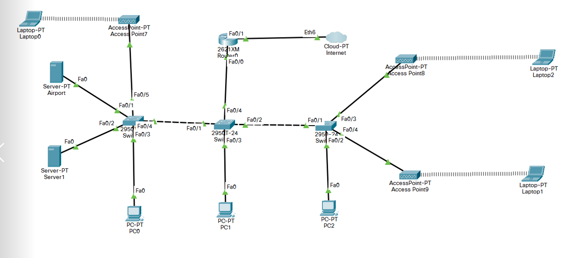
Sample Topology

Slide 16
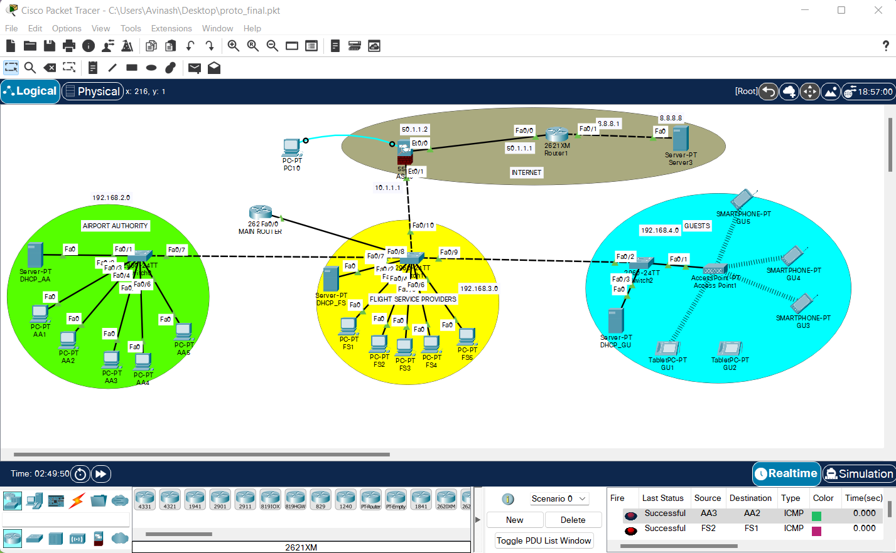
Final Topology

Slide 17
Result and Conclusion In this report, we present the design and deployment of a secure network for airport. In this project we configured VLAN’s, Access and trunk ports and routing protocol and DHCP on switches and provide screenshots and test connectivity in depth. The proposed system will provide enhanced security, stability and high speed internet to the users at any part. As a result of these techniques, the airport’s network is ready to provide a secure environment with a high quality of service and safety for the airport’s system and passengers.

