Slide 1
ProtectWare – File and Malware Scanner
PNB Hackathon 2025
Adithya Rajagopalan

Slide 2
Team Firewall
Adithya Rajagopalan
me24b002@smail.iitm.ac.in
First year student at Indian Institute of Technology, Madras.

Slide 3
Problem Statement
Objective:
To develop a user-friendly tool to detect malware in files and folders, ensuring system security and data integrity.
Challenges Dealt with:
- Increasing malware threats.
- Need for user-centric scanning solutions.

Slide 4
Tech Stack
- Languages: C++, Python
- Libraries:
- C++: Windows API
- Python: pefile, joblib, logging, os, math
- Tools:
- Compiler: Visual Studio
- Python Interpreter
- Machine Learning Model for Malware Detection

Slide 5
Architecture
Overview:
- A Windows desktop GUI application using the Windows API.
- Integration with a Python script for malware analysis.
- Logging and visualization of scan results.
Flow:
1. User selects file/folder through GUI.
2. GUI calls Python script.
3. Script analyzes the file(s) using the machine learning model.
4. Results are displayed in the GUI.

Slide 6
Project Brief
Key Features:
- GUI: Intuitive interface for scanning and updating.
- Backend: Python script processes files and provides analysis.
- Machine Learning Model: Predicts whether a file is malware.
Logging: Detailed logs saved for system administrators.

Slide 7
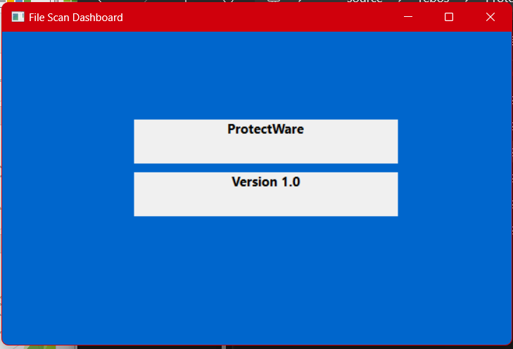

Slide 8
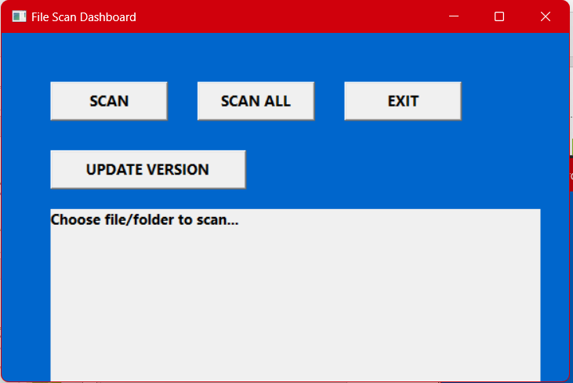

Slide 9
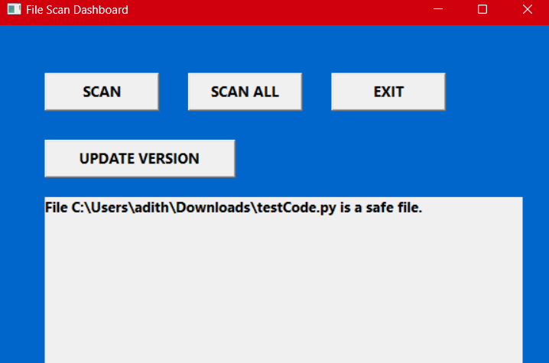

Slide 10
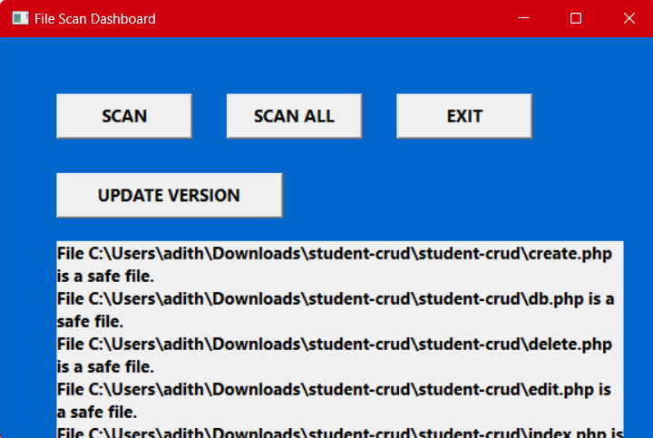

Slide 11
Thank You

