Slide 1
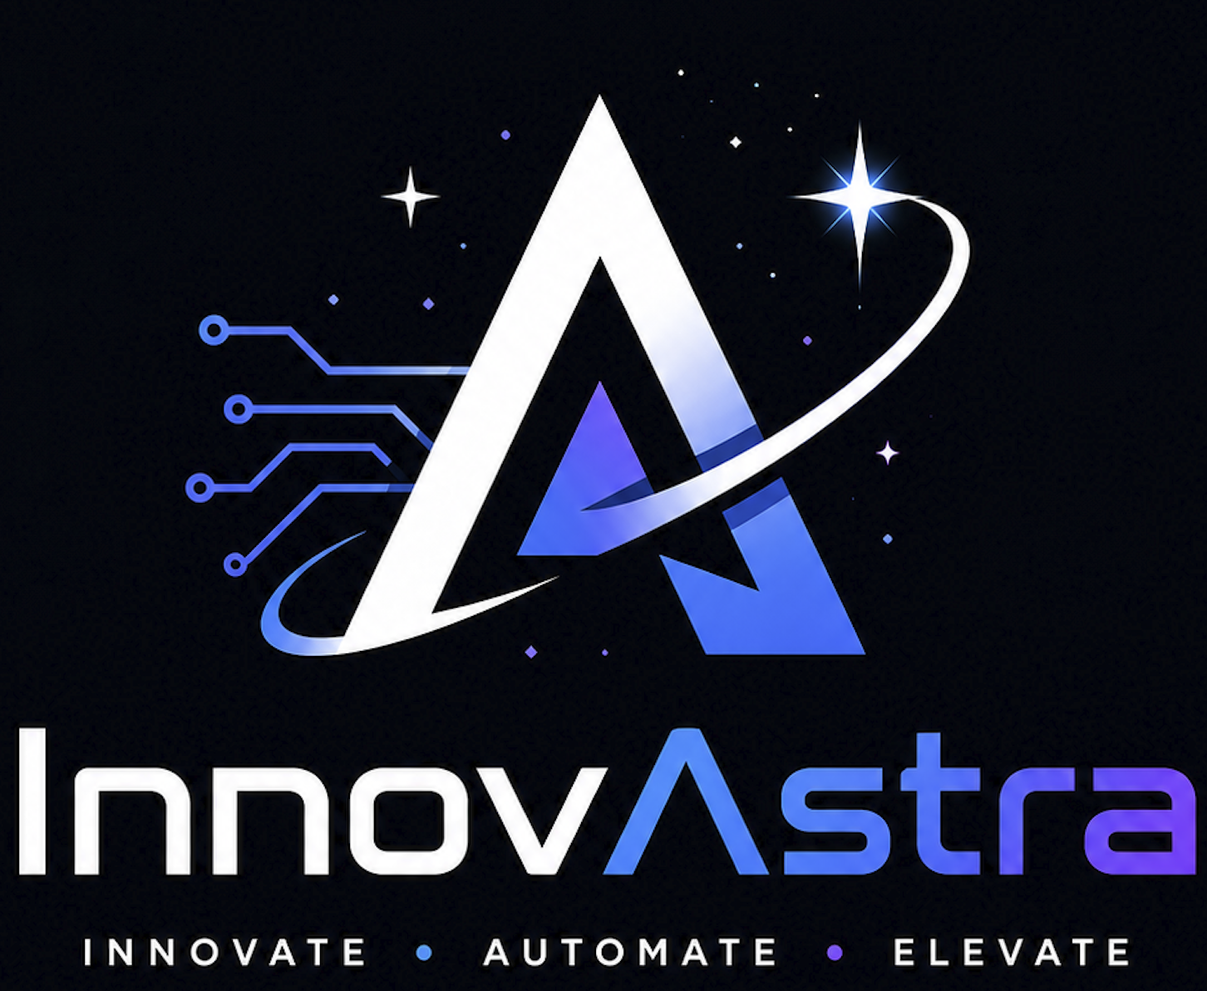
TwinLine
Strategic Growth Proposal
Accelerating Operational Excellence
Team InnovAstra

Slide 2
Executive Summary
Bridges the gap between siloed plant systems uniting into a single, real-time shared digital twin.
Transitions manufacturing operations from reactive firefighting to proactive prevention
Eliminates late detection and manual investigations by predicting bottlenecks and WIP buildup
Prevents quality escapes and costly line stoppages through early defect prediction
Delivers proven economic impact, including a 5-12% increase in line availability, 15-25% lower unplanned downtime, and typical savings of ₹15–30 Crore/year with a 6–12 month payback

Slide 3
Core Strategic Pillars
Unified Real-Time Visibility
Proactive Congestion & Bottleneck Mitigation
Quality Assurance & Defect Prevention
Material Flow & Inventory Optimization
Automated Diagnostics & Root-Cause Analysis (RCA)
  Breaks down historical data silos by integrating MES, SCADA, ERP, and QMS platforms into a single, cohesive digital twin.
  Continuously ingests live shopfloor signals via GCP Pub/Sub and Dataflow to maintain an up-to-date station topology model.
  Predicts line congestion and WIP buildup before cycle times exceed takt targets, moving beyond late time-series forecasting.
  Gives production planners critical lead time to clear bottlenecks and prevent downstream delays, scrap, or line stoppages.
  Eliminates quality escapes usually caught only at final inspection by analyzing live machine and process parameters.
  Flags high-risk vehicles and anomalies early to prevent defects from cascading downstream and reducing rework rates.
  Cross-references live component consumption against inventory levels and supplier schedules to anticipate material shortages.
  Optimizes stock levels to prevent production halts while minimizing excess inventory carrying costs.
  Replaces slow manual investigations with automated correlation engines that link process, machine, maintenance, quality, and material data.
  Generates ranked, explained contributing factors and actionable recommendations to help teams resolve operational risks swiftly.

Slide 4
Graph aware reasoning
Technical Novelty
Reactive + proactive intelligence
Multi-source fusion
Explainable decision support
Human-in-the-loop design

Slide 5
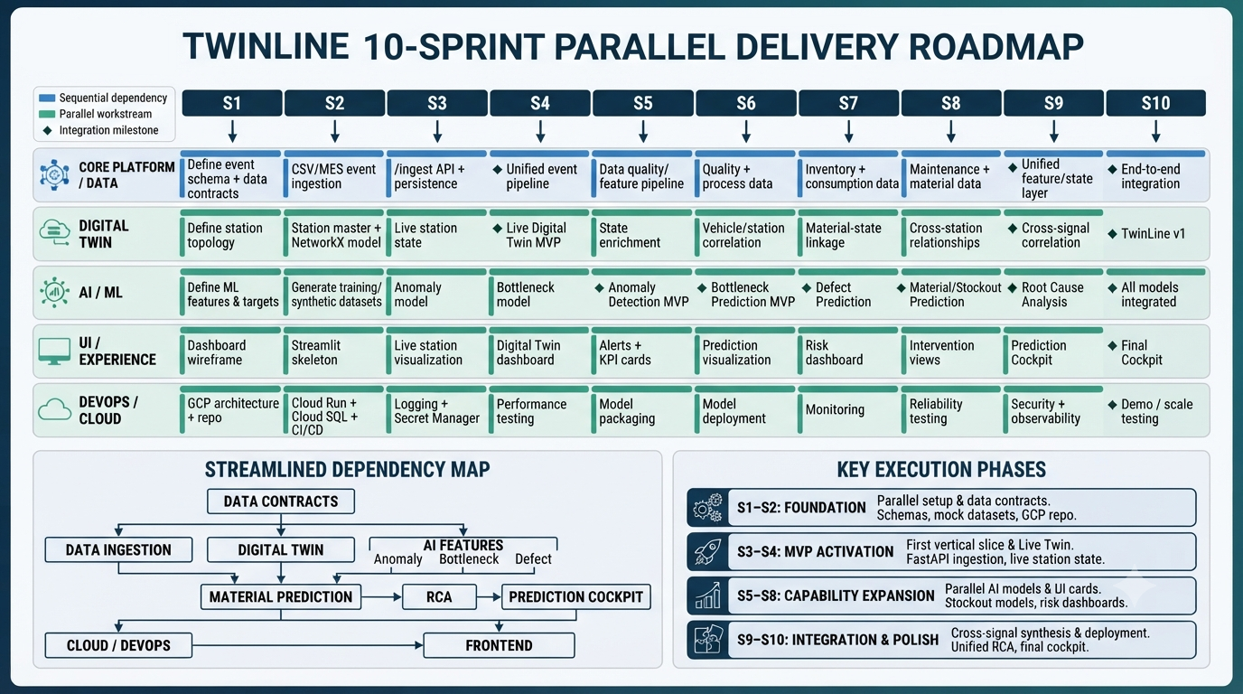

Slide 6
POC Scope Alignment
MVP Element | TwinLine Proposal Alignment
Data sources | Shopfloor systems + MES-style events + reference/master data
Digital Twin | Live graph of stations, vehicles, WIP and process dependencies
AI | Anomaly detection + proactive bottleneck prediction
Users | Plant Operator, Maintenance Engineer, Production Planner
Dashboards | Live Line Dashboard + Prediction Cockpit
Business outcomes | Downtime ↓ Throughput ↑ WIP ↓

Slide 7
Key risks and Mitigation
  Inconsistent timestamps, missing events and unreliable sensors can degrade predictions.
  Mitigation: validation, completeness monitoring, interpretable fallback logic.
Data Quality
  Excessive false positives can reduce trust.
  Mitigation: severity prioritization, configurable thresholds and operator feedback.
Alert Fatigue
  Operating conditions and product mix change.
  Mitigation: performance monitoring, retraining and model governance.
Model Drift
Legacy Integration
  Industrial environments contain heterogeneous systems.
  Mitigation: modular adapters and phased pilots.
Cybersecurity/ Safety
  Operational technology environments are critical.
  Mitigation: segmented architecture, least-privilege access and initially read-only decision support.
  A technically capable tool can still fail if it disrupts workflows.
  Mitigation: role-specific dashboards and human-in-the-loop recommendations.
Adoption
Business credibility
  Synthetic POC results are not automatically real-plant savings.
  Mitigation: explicitly separate simulated evidence from plant-specific ROI validation.

