Slide 1
News Buddy
Autonomous Daily News Summarizer and Social Media Generator
Team Middle Earth

Slide 2
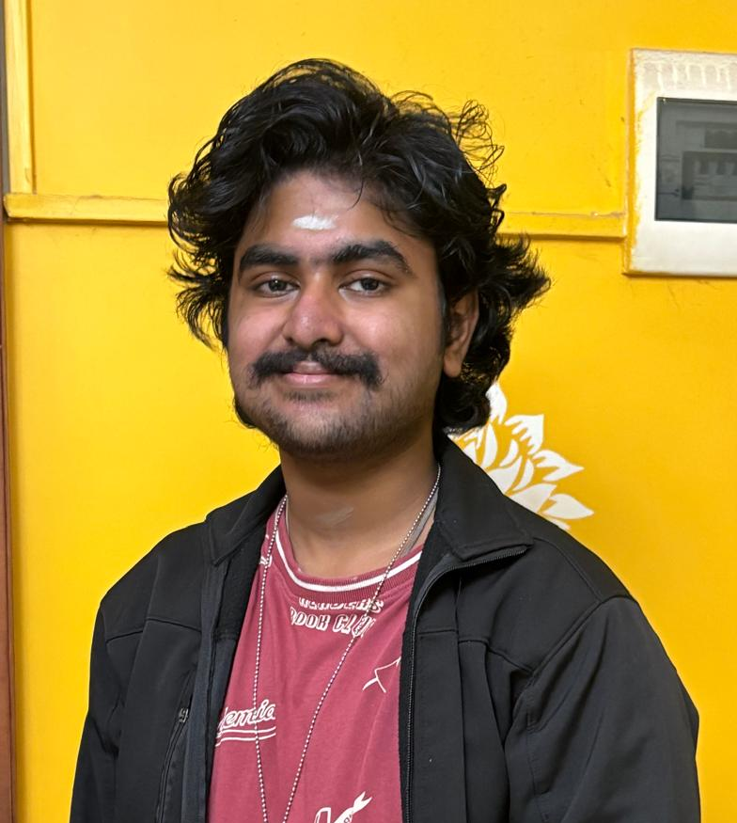
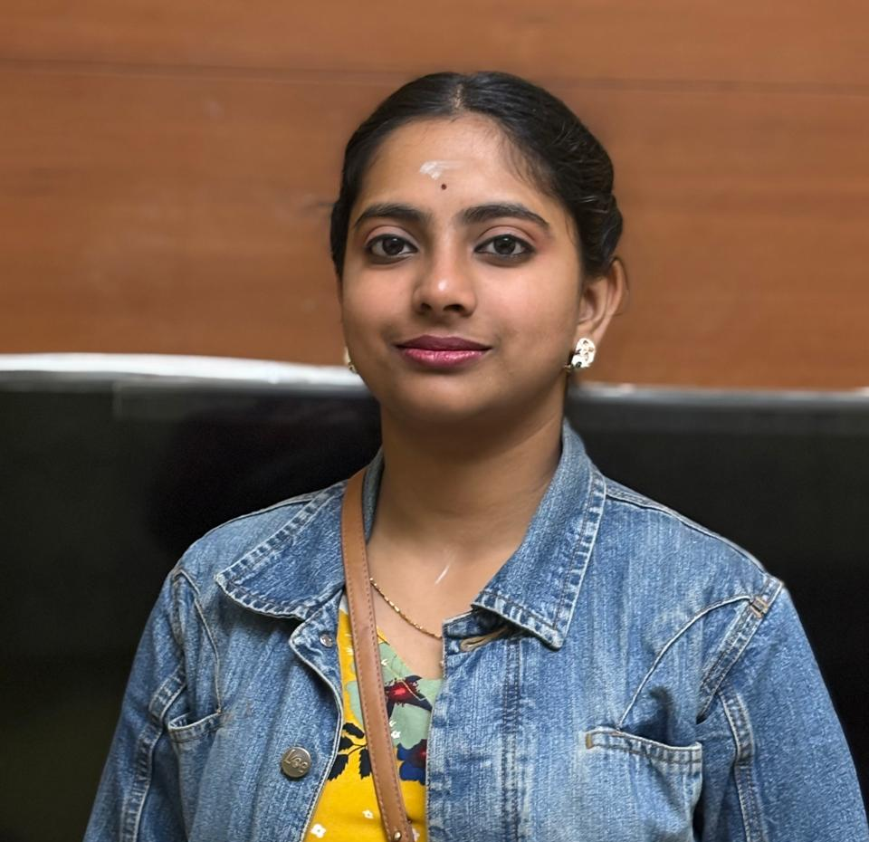
Team members
Adithya
First year student. Interested to learn and work with AI.
Shwethaa
Working professional, has knowledge in various aspects of AI.
https://github.com/AdithyaRajagopalan24/genAIhackathon
https://github.com/shwethaar/NewsBuddy

Slide 3
Problem Statement
Build an AI agent capable of autonomously retrieving the most relevant daily news articles, summarizing them, and generating engaging social media posts in multiple formats, including text, images, videos, and memes, based on user-defined inputs.

Slide 4
Commercial Viability

Slide 5
Target Market
Main target audience are the Millenials. The project also aims to help GenZ adapt by providing a fast way to obtain information on latest news.
The target audience size is approximately 800 million, in India alone.

Slide 6
Use Case
Use Case 1 : Deliver personalised news details to the user in various formats, like text, image and video.
Use Case 2 : Deliver personalised memes to the user based on the meme topic requested.

Slide 7
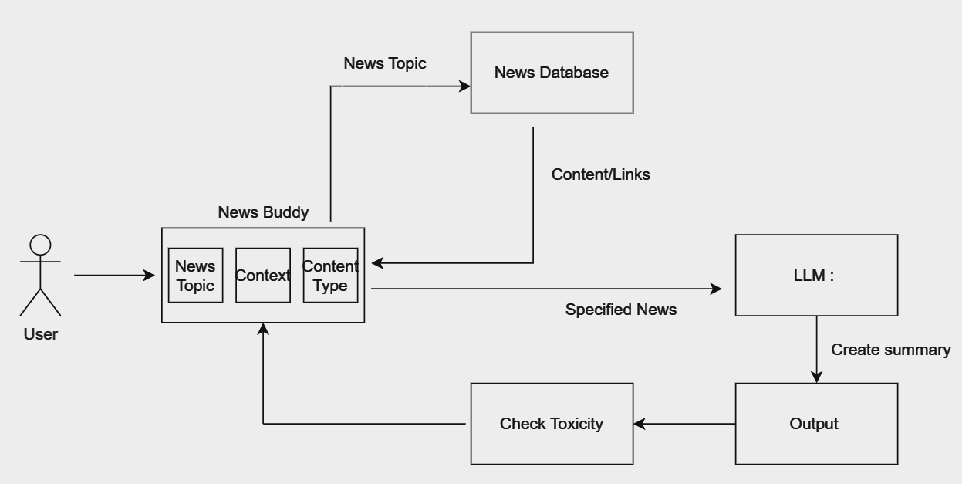
Solution Overview

Slide 8
Technical Details
The system integrates GROQ for efficient processing, a Retrieval-Augmented Generation (RAG) model for summarization and content generation, and APIs for fetching news and creating multimedia content.
Key technologies/tools used:
GROQ for computation, RAG model for generating tailored summaries and posts, and external APIs for multimedia generation and news retrieval.
TO BE IMPROVED.

Slide 9
Hosting the solution.
The solution can be hosted on Kubernetes in Google Cloud.

Slide 10
Next Steps
Introduce subscription plans.
Subscription based output. E.g. Text generation for basic plan, text and image for advanced, and so on.
Enable users to export past chat history.
Parameterise storage of past history, which is also linked with user subscription.

Slide 11
Thank You!
https://github.com/AdithyaRajagopalan24/genAIhackathon
https://github.com/shwethaar/NewsBuddy
adithyarajagopalancollege24@gmail.com
shwethaarajagopalan@gmail.com

