Slide 1
AI News Agent
Autonomous Daily News Summarizer and Social Media Generator
Team Middle Earth

Slide 2
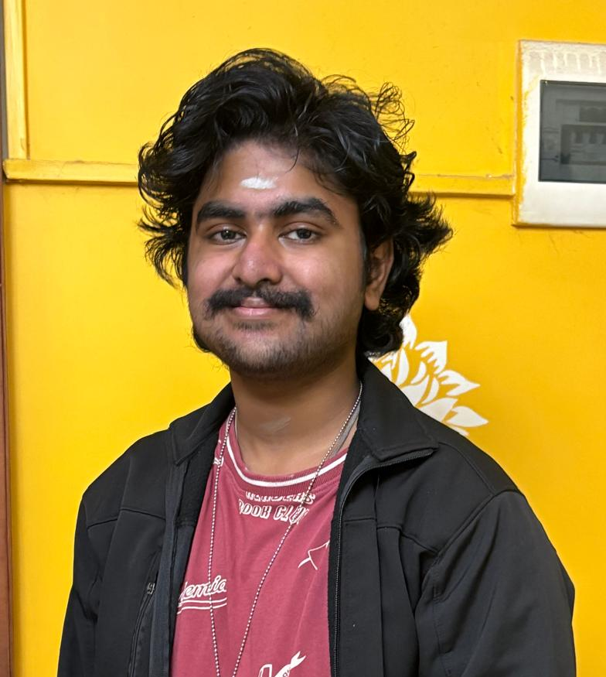
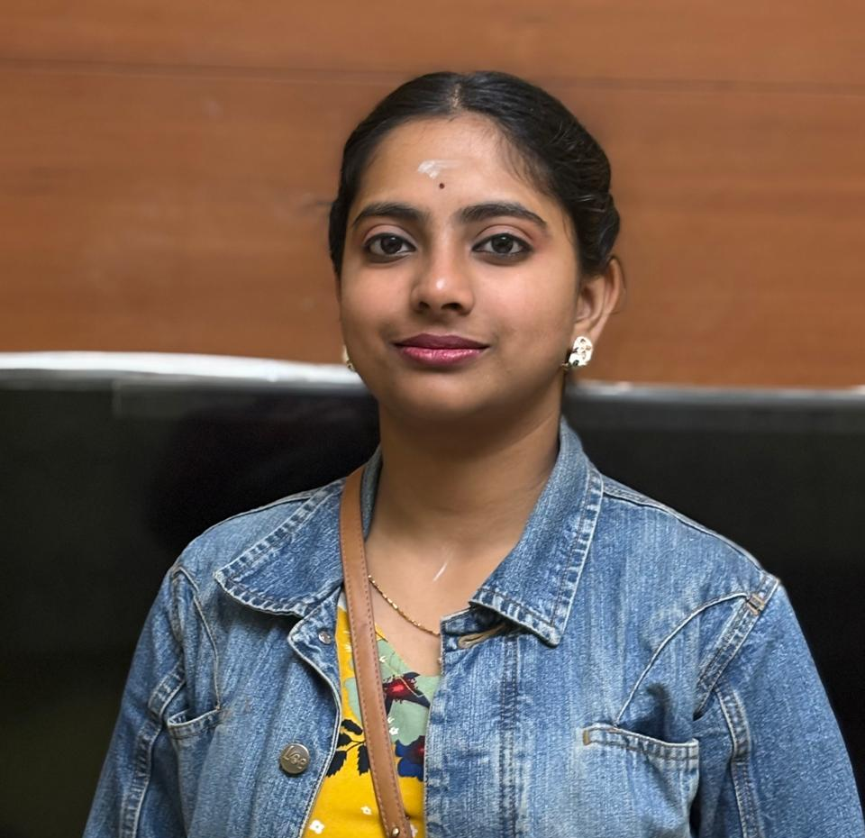
Team members
Adithya
First year student. Interested to learn and work with AI.
Shwethaa
Working professional, has knowledge in various aspects of AI.

Slide 3
Problem Statement
Build an AI agent capable of autonomously retrieving the most relevant daily news articles, summarizing them, and generating engaging social media posts in multiple formats, including text, images, videos, and memes, based on user-defined inputs.

Slide 4
Use Case
Use Case 1 : Deliver personalised news details to the user in various formats, like text, image and video.
Use Case 2 : Deliver personalised memes to the user based on the meme topic requested.

Slide 5
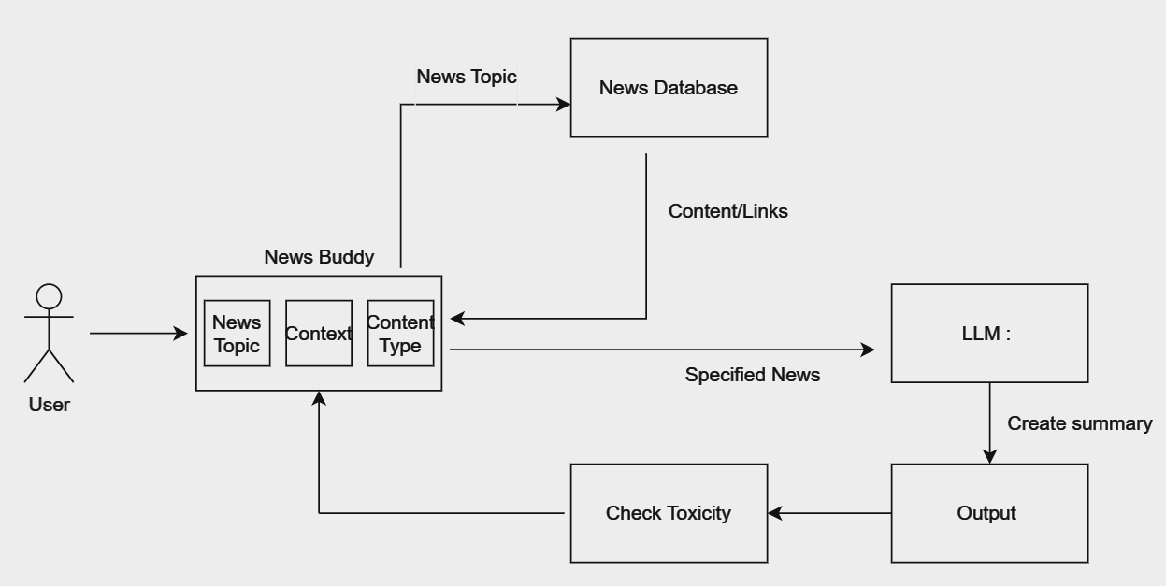
Solution Overview

Slide 6
Technical Details
The system integrates GROQ for efficient processing, a Retrieval-Augmented Generation (RAG) model for summarization and content generation, and APIs for fetching news and creating multimedia content.
Key technologies/tools used:
GROQ for computation, RAG model for generating tailored summaries and posts, and external APIs for multimedia generation and news retrieval.
TO BE IMPROVED.

Slide 7
Next Steps
Future plans:
Create an option to save past requests of a user, and an authentication system.

Slide 8
Thank You!

