Slide 1

CNN Based Deep Fake Detection CS-SCI 5530-002 Principles of Data Science Prof. Syed Jawad Shah
Team Members
Adithya Reddy Palakshareddy – 16353883
Vaishnavi Tatineni – 16354451
Sai Harshith Nimmalagottu – 16352577
Jayanth Rapaka - 16354833

Slide 2
Introduction
Deep fakes are AI-generated synthetic media where a person in an existing image or video is replaced with someone else's likeness.
Detecting deep fakes is critical due to their misuse in misinformation, fraud, and defamation.
Our project leverages Convolutional Neural Networks (CNNs) for detecting deep fakes with high accuracy.

Slide 3

Problem Statement & Objective
With the rise of deep fake technologies, distinguishing between real and fake media is increasingly challenging.
Need for an automated and accurate detection mechanism.
The goal is to classify video frames or images as real or fake using deep learning.
Build a CNN-based model to detect deep fake images.
Use preprocessed datasets for training and testing.
Evaluate model performance using appropriate metrics (accuracy, loss).

Slide 4

Dataset Description
Used a dataset consisting of labeled real and fake images.
Dataset was split into:
Training set
Validation set
Testing set
Images were resized and normalized for CNN input.

Slide 5
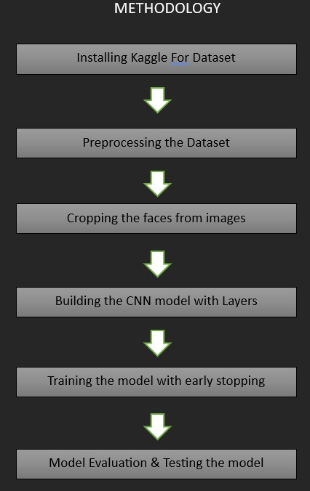
Methodology

Slide 6
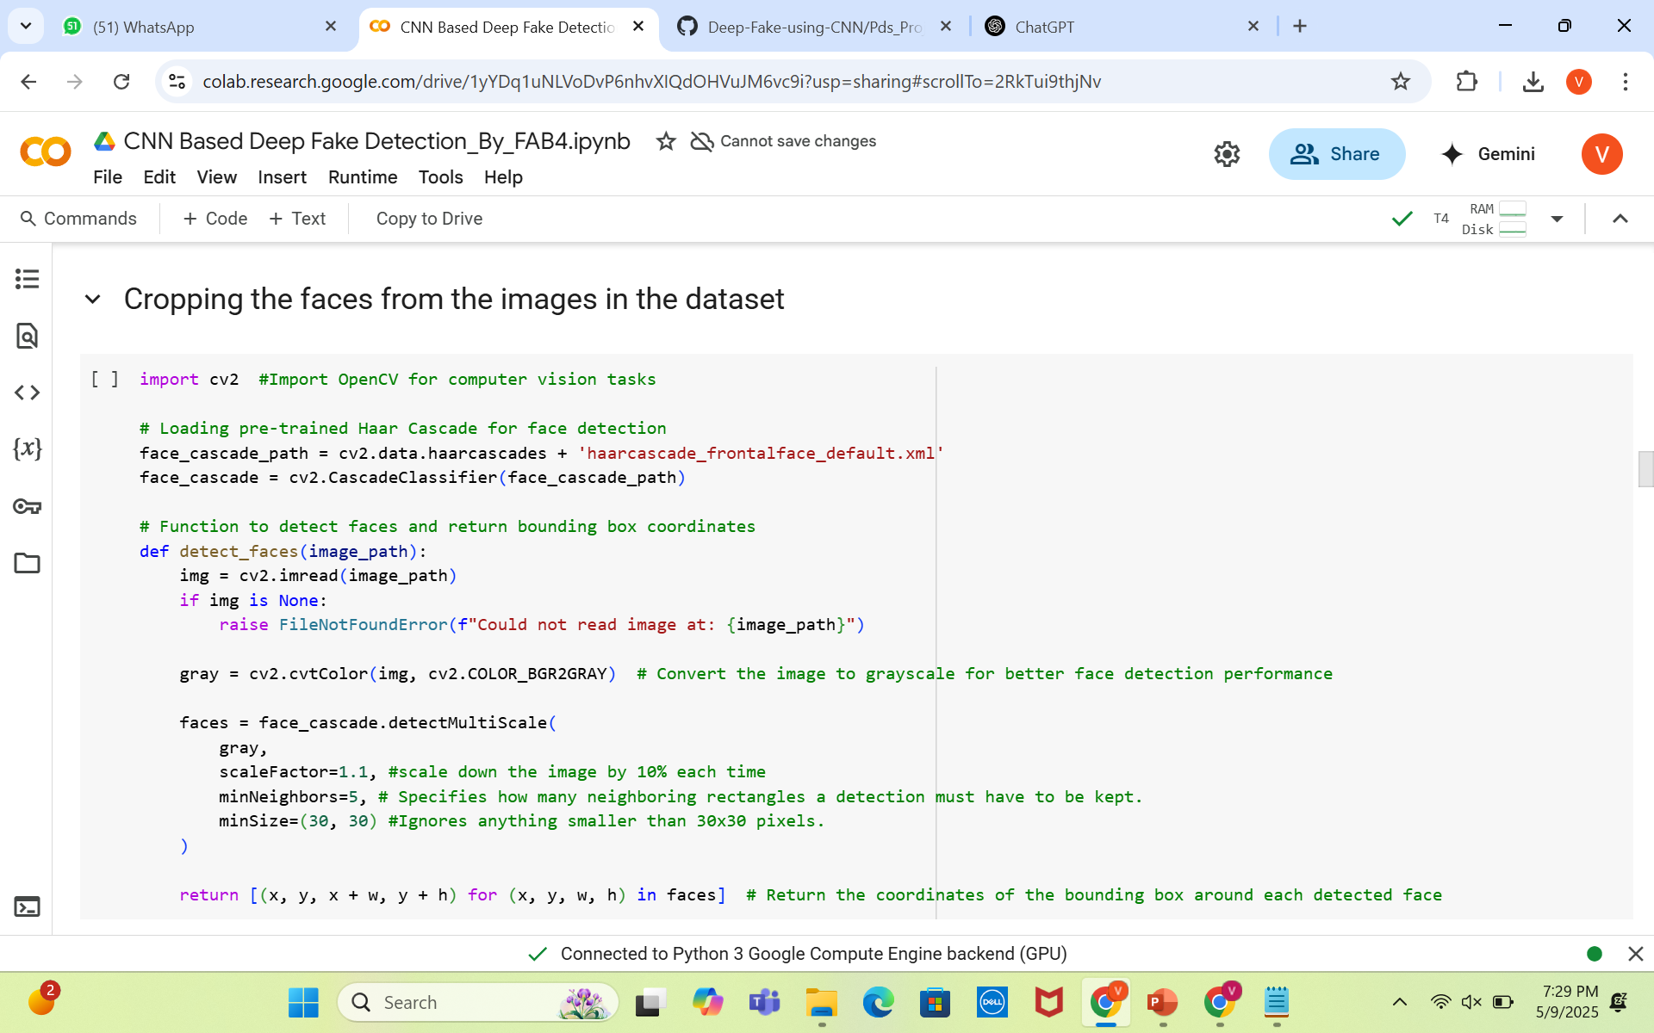
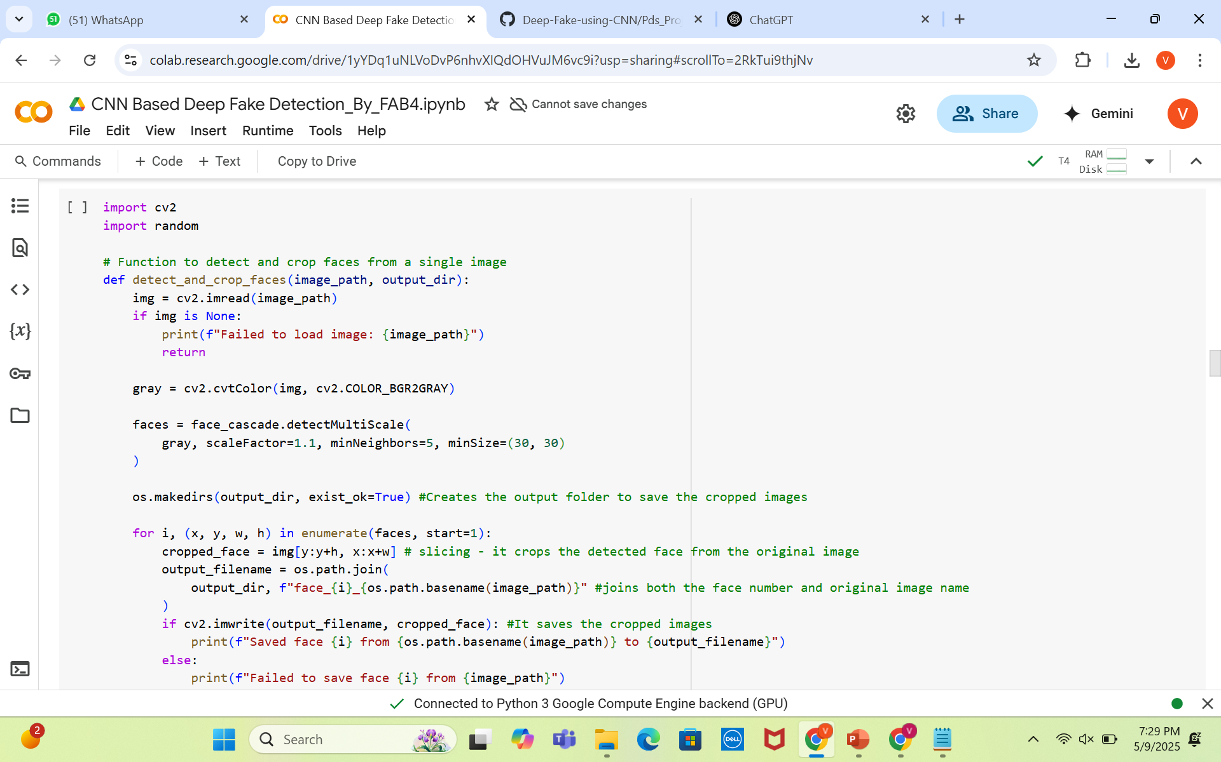
Image Cropping

Slide 7
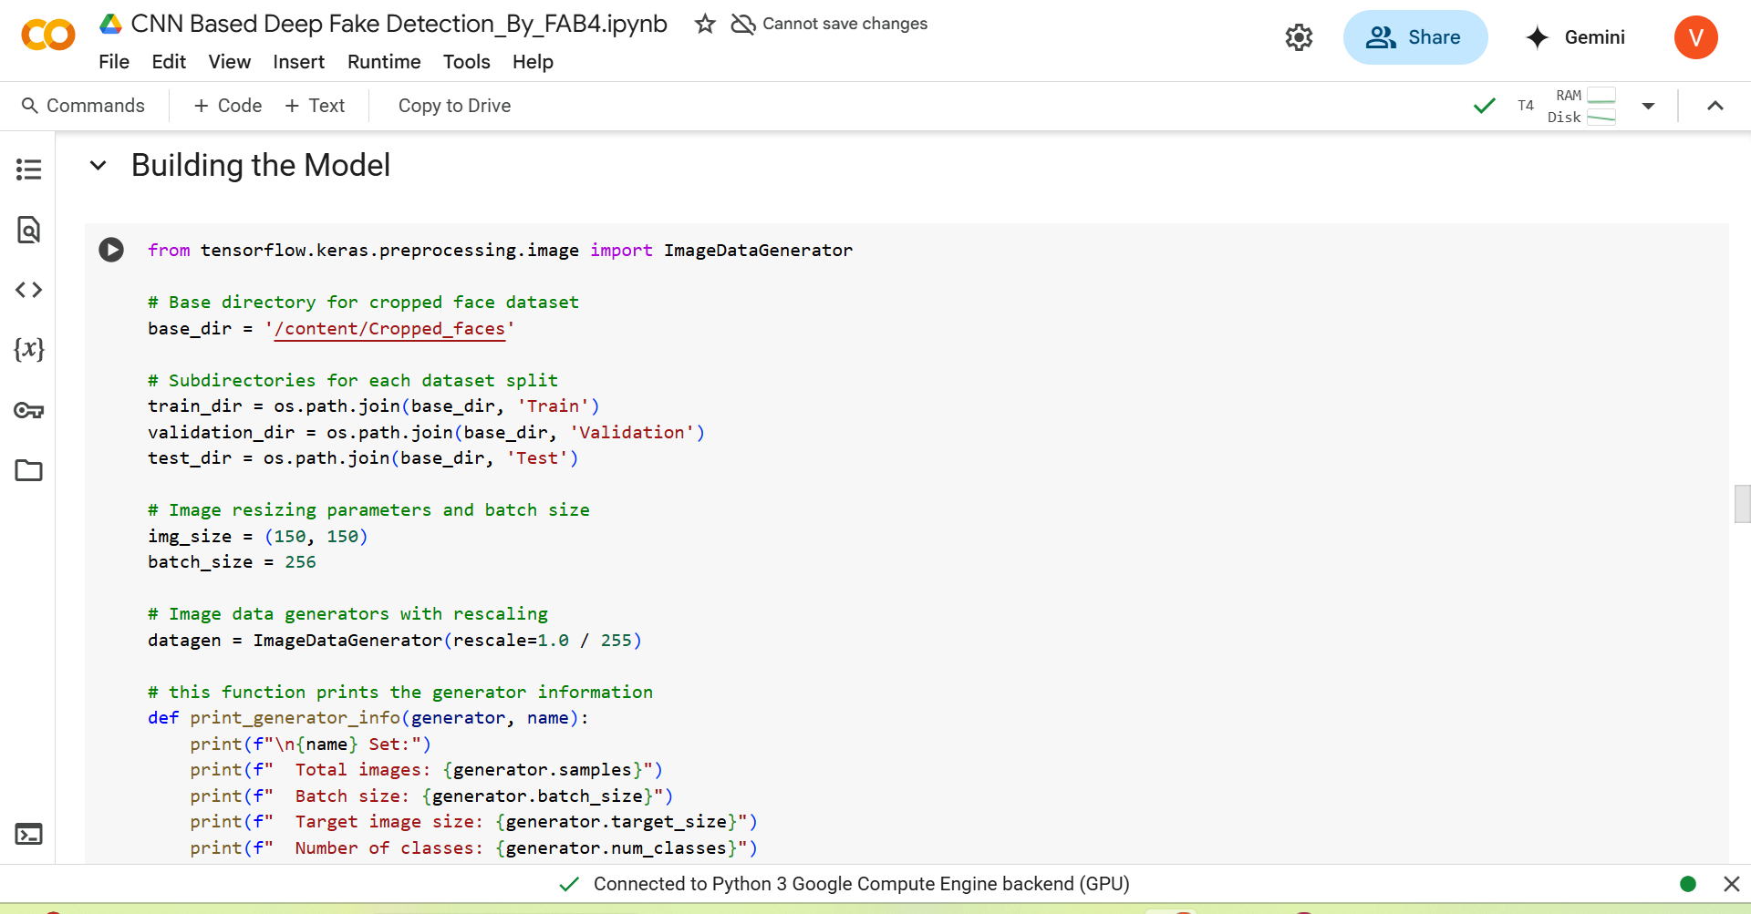
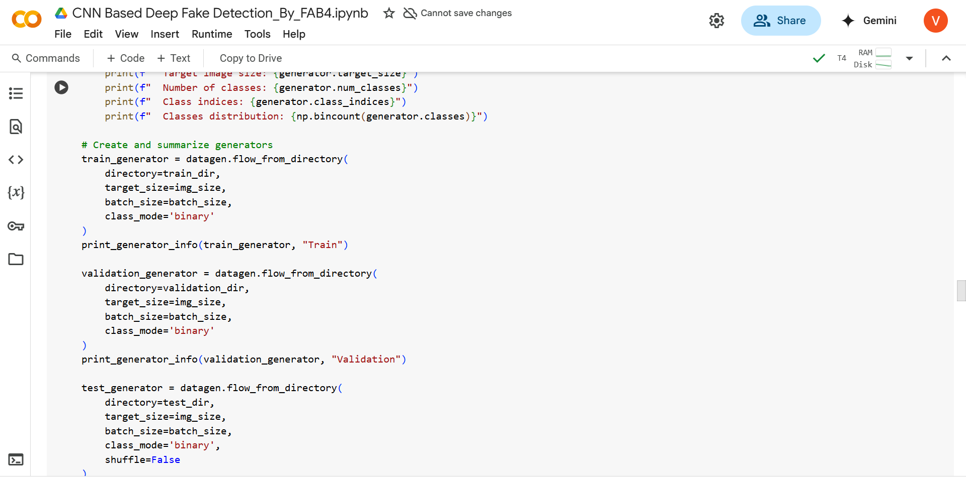
Model Building

Slide 8
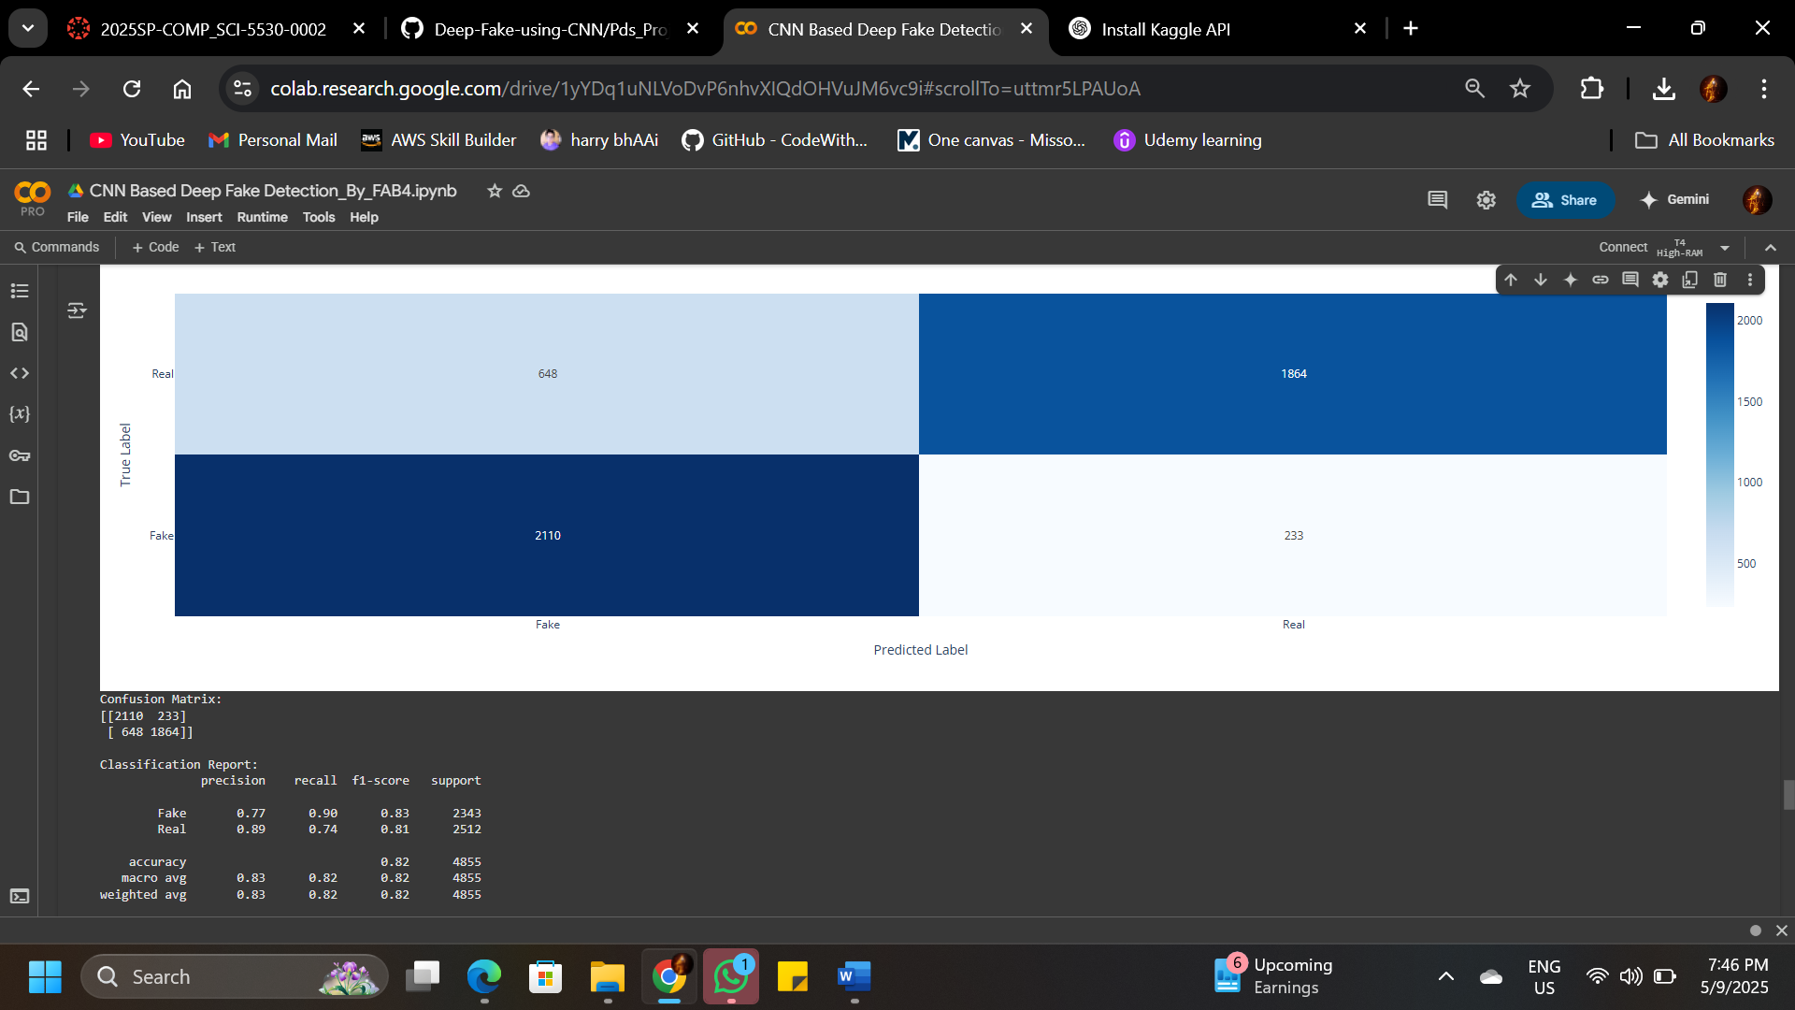
RESULTS

Slide 9
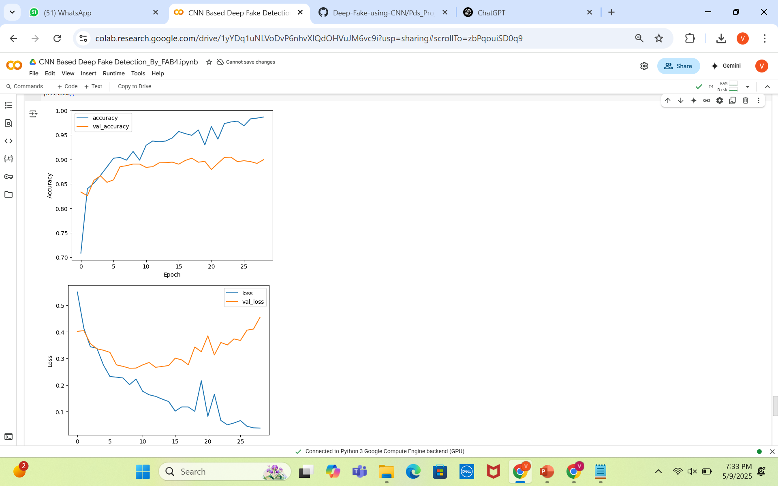
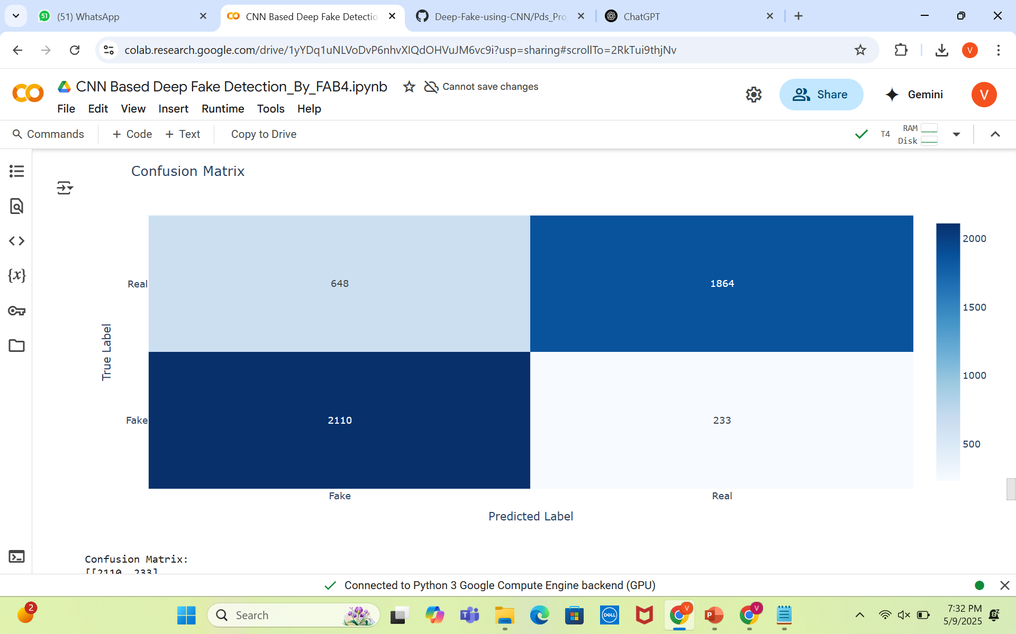
Results & Discussions

Slide 10
Conclusion
This project successfully implemented a Convolutional Neural Network (CNN) to detect deepfake images with a high level of accuracy and reliability. By preprocessing the dataset, focusing on facial regions, and training the model with early stopping, we achieved robust performance, as reflected in the evaluation metrics. The system effectively distinguishes between real and fake faces, demonstrating its potential as a practical tool for addressing the growing threat of deepfakes in digital media. Future enhancements can include expanding the dataset, applying transfer learning, and adapting the model for video-based detection.

