Slide 1
TITLE PAGE
Problem Statement ID – 1
Problem Statement Title - Eco-Loop Building Agents
Theme - Smart Automation
PS Category - Software
Student Name – Adithya Sankar Menon
Student ID – 23BRS1079
Candidate ID - 20509261

Slide 2
Proposed Solution: Eco-Loop - Autonomous Physical AI for Smart Buildings
Detailed explanation of the proposed solution
Eco-Loop transforms static, rule-based Building Management Systems (BMS) into dynamic, self-correcting autonomous agents.
It integrates the EnergyPlus physics engine with a local open-source LLM, reading live sensor data (temp, energy) to dynamically inject optimal HVAC setpoints.
How it addresses the problem
Legacy BMS systems waste energy due to rigid schedules and inability to adapt to real-time weather or occupancy. Eco-Loop actively relaxes cooling setpoints during peak loads to minimize compressor duty cycles.
Innovation and uniqueness of the solution
True Closed-Loop AI: The LLM doesn't just suggest actions; it directly overwrites the C++ physics engine memory at runtime.
Sliding Window Memory: Retains historical state context to prevent setpoint oscillation.

Slide 3
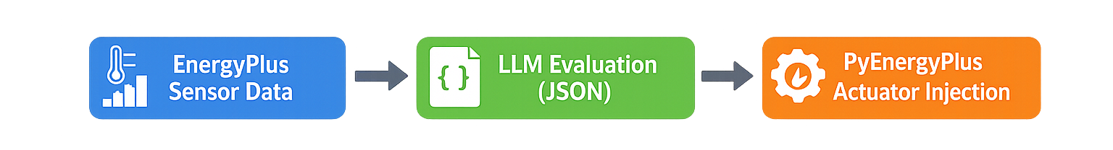
TECHNICAL APPROACH
Technologies to be used
Simulation Engine: EnergyPlus (via the PyEnergyPlus native Python API).
Cognitive Engine: Local Open-Source LLM (e.g., Llama 3 via Ollama REST API).
Dashboarding: Streamlit, Pandas, Plotly (for real-time PMV and kWh telemetry).
Methodology and process for implementation
Step 1 (Telemetry): PyEnergyPlus pauses at regular timesteps, extracting Zone Temperature, PMV (thermal comfort), and Energy usage.
Step 2 (Cognitive Evaluation): The LLM parses the telemetry array using a strict JSON-enforced tool-calling structure.
Step 3 (Actuation): The JSON response is parsed and injected directly into the EnergyPlus actuator API as a supervisory override.
Step 4 (Validation): Real-time energy savings (kWh) are visualized against a legacy baseline on the Streamlit dashboard.

Slide 4
FEASIBILITY AND VIABILITY
Analysis of the feasibility of the idea
Highly feasible, The solution uses open-source, industry-standard protocols (REST APIs) and existing building simulation software (EnergyPlus), requiring no proprietary hardware changes to deploy in modern digital twin setups.
Potential challenges and risks
AI Hallucinations: LLMs occasionally output malformed markdown instead of strict JSON, crashing the C++ simulation loop.
Setpoint Oscillation: The AI reacting too aggressively to minor temperature fluctuations, causing wear-and-tear on real-world HVAC equipment.
Strategies for overcoming these challenges
Robust JSON Parsing: We implemented a regex-based extraction layer that safely strips out conversational text and isolates the JSON payload.
Macro-Throttling & Memory: We implemented a "Sliding Window" state memory and throttled the LLM to only make macro-decisions (e.g., once every 24 hours), guaranteeing system stability.

Slide 5
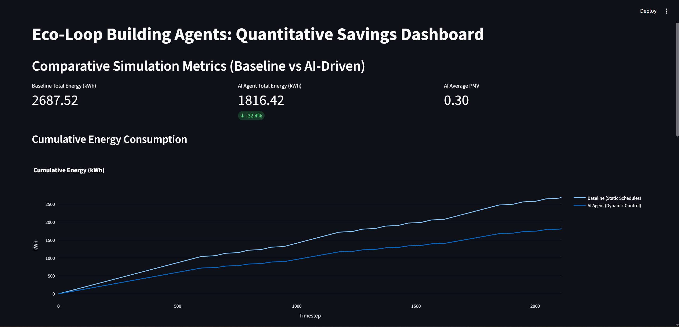
ARTIFACTS
evaluate_and_act function inside backend/agent.py
Dashboard
def evaluate_and_act(self, temp, pmv, energy):
system_prompt = """
user_prompt = f"Current State - Temp: {temp}C, PMV: {pmv}, Energy: {energy}kWh. What are the optimal setpoints?"
messages = [{"role": "system", "content": system_prompt}]
messages.extend(self.history)
messages.append({"role": "user", "content": user_prompt})
try:
response = self.client.chat.completions.create(
model=self.model,
messages=messages,
response_format={ "type": "json_object" },
temperature=0.1
)
result = response.choices[0].message.content
parsed_decision = self._safe_json(result)
self.history.append({"role": "user", "content": user_prompt})
self.history.append({"role": "assistant", "content": json.dumps(parsed_decision)})
if len(self.history) > self.max_history * 2: # maintain at most `max_history` turn pairs
self.history = self.history[-(self.max_history * 2):]
return parsed_decision
except Exception as e:
print(f"Agent Error: {e}")
# Fallback safe setpoints
return {"heating_setpoint": 20.0, "cooling_setpoint": 24.0, "reasoning": "Fallback due to error"}
Terminal Output
Performing Zone Sizing Simulation
...for Sizing Period: #2 IND_CHENNAI ANNUAL COOLING 1% DESIGN CONDITIONS DB/MCWB
Calculating System sizing
...for Sizing Period: #1 IND_CHENNAI ANNUAL HEATING 99% DESIGN CONDITIONS DB
Calculating System sizing
...for Sizing Period: #2 IND_CHENNAI ANNUAL COOLING 1% DESIGN CONDITIONS DB/MCWB
Adjusting Air System Sizing
Adjusting Standard 62.1 Ventilation Sizing
Initializing Simulation
Reporting Surfaces
Beginning Primary Simulation
Initializing New Environment Parameters

Slide 6
RESEARCH AND REFERENCES
Physics Engine (NREL EnergyPlus):
Utilized the U.S. Department of Energy's open-source whole-building energy simulation engine for high-fidelity thermodynamic validation.
Reference: https://energyplus.net/
Native API Integration (PyEnergyPlus):
Leveraged the C++ memory-injection API to bypass slow file I/O and achieve real-time, closed-loop actuation.
Reference: https://energyplus.readthedocs.io/en/latest/api.html
Cognitive Engine & Tool Calling (OSS LLMs):
Implemented via the open-source Llama 3 / Ollama architecture using standardized REST protocols to parse telemetry and inject optimal setpoints.
Reference: https://ollama.com/
Thermal Comfort Bounds (ASHRAE Standard 55):
The LLM was strictly constrained to operate within the globally recognized Predicted Mean Vote (PMV) range of -0.5 to +0.5 to guarantee human comfort.
Reference: https://www.ashrae.org/

