Slide 1

SAMSUNG PRISM
Generative AI
Hackathon
3rd Edition 2026 – 27
Theme ID - Theme 05: Interruptible Real-Time Agents
Team Name - [TEAM NAME]
College Name - [COLLEGE NAME]
Member - [Member 1 name & email]
Member - [Member 2 name & email]
Submission Github link - [public GitHub URL]

Slide 2
Problem: an agent that acts is unsafe to interrupt
People change their mind mid-sentence: “book Thursday … no wait, Friday”.
An LLM in a loop books twice, books the old value, or announces success it did not achieve.
Full-Duplex-Bench v3 tests exactly this over real audio: disfluent speech, self-corrections, multi-step tasks, and it scores strict Pass@1. The best published system passes 60%.
Our aim: interruption-safe by construction, not by prompting.

Slide 3
Solution: models propose, one kernel decides
Janus kernel
one synchronous step,
sole writer of state
read-set invalidation
same-step cancel
Async workers
Interpret · Plan
Compose · Vision
Workers only return proposals; the kernel never awaits.
Every proposal records the facts it read. A changed fact cancels dependent work in the same step; a reverted value costs nothing.
A write passes one gate and is ledgered before it is emitted: no double booking.
Audio in
Silero VAD + Whisper
Gemini
(hosted)
CommitGate + EmissionGate
settle · intent · no duplicate
Tools
FDB mock APIs /
device care
Audio out
Kokoro TTS

Slide 4
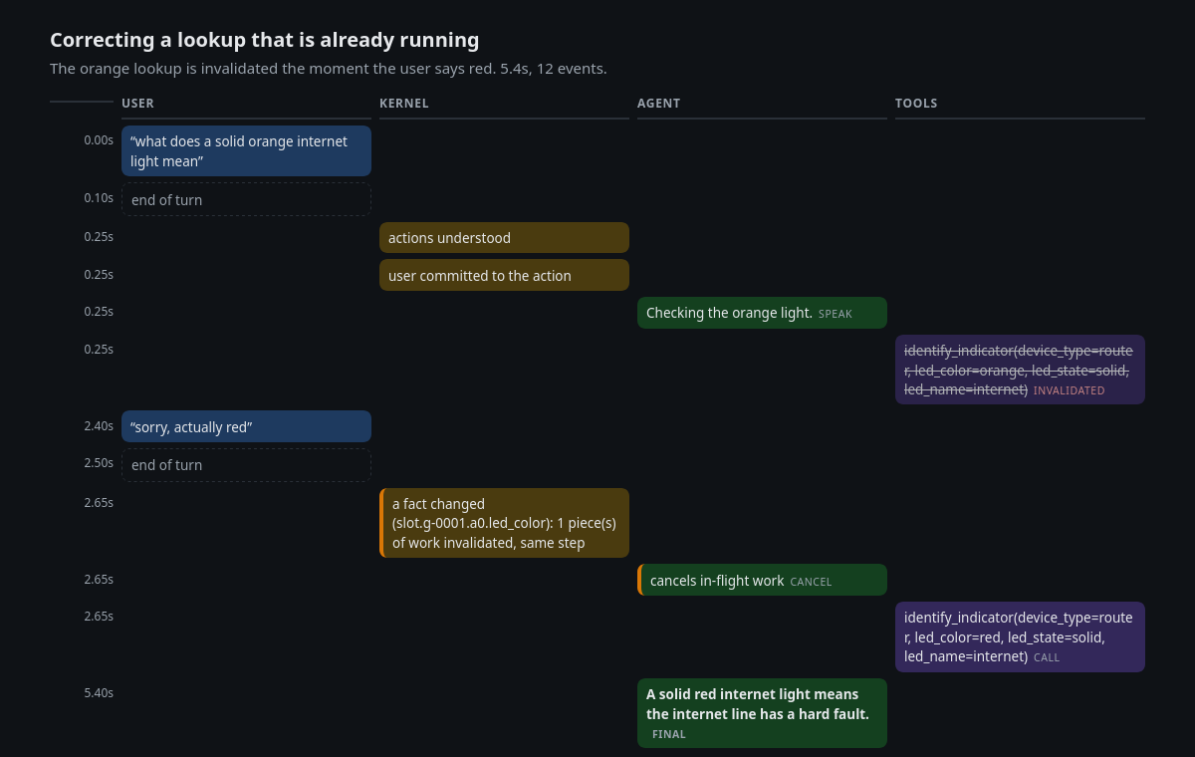
An interruption, handled (kernel X-ray)
User asks about an orange light; 2.4 s later: “sorry, actually red”.
The orange lookup is struck through: invalidated and cancelled in the same step the correction arrives.
Re-run with red; one final answer grounded in the red result.

Slide 5
Results on Full-Duplex-Bench v3
System (FDB-v3, gpt-4o judge) | Pass@1 | Tool sel. | Arg acc. | Resp. qual.
Janus, text replay, 100 scenarios | 77.0% | 0.959 | 0.807 | 0.840
Janus, voice over LiveKit, 100 (30 Sep) | 42.0% | 0.844 | 0.611 | 0.597
GPT-Realtime (paper) | 60.0% | 0.876 | 0.680 | 0.792
Gemini Live 3.1 (paper) | 54.0% | 0.817 | 0.588 | 0.718
Cascaded Whisper→GPT-4o→TTS (paper) | 45.0% | 0.803 | 0.562 | 0.600
Text replay feeds ground-truth transcripts: it measures the reasoning and safety core, not speech or latency. Voice row: all 100 recordings on 30 Sep, before the turn-ending fixes (26 re-run on 2 Oct: 16 pass, was 12).
Housing is weakest (35% text), as for every published system. The organizers' re-run of ./reproduce.sh is what scores.

Slide 6
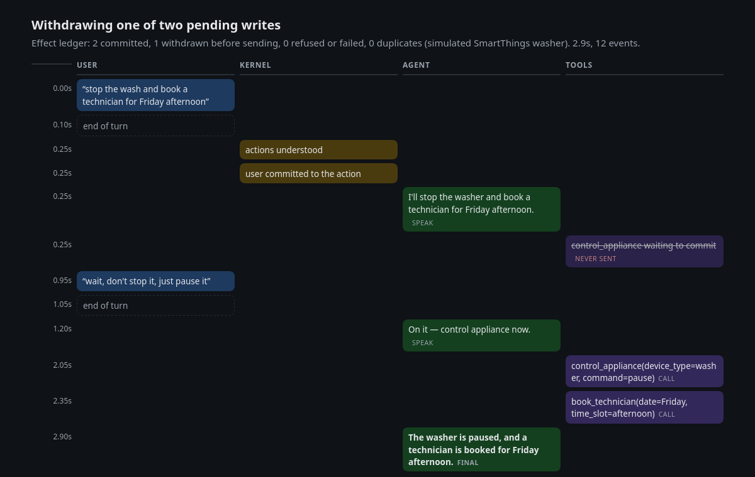
Extension: Samsung-style home care
Router read from the camera; a Samsung washer (codes 4C, 5C, UB, dC) through a SmartThings-shaped status.
“Stop the wash … wait, just pause it”: the pending stop is never sent; pause and the booking go through once.
“Resume” while 4C shows: the washer refuses, and the agent says so.
Effect ledger per session: committed, withdrawn, refused, duplicates (0).
Real: speech, camera, Gemini, the kernel. Simulated: the device and Samsung Care services.

Slide 7
Stack, rigour and honest limits
Stack: LiveKit Agents · Silero VAD · faster-whisper large-v3-turbo · Kokoro-82M · Gemini 3.6 Flash (hosted) · Python 3.11, Docker.
587 deterministic tests (stepped clock, scripted model), TraceChecker on every run, adversarial explorer over 19 race scenarios.
One-command reproduction: pinned FDB commit, sha256-checked data, weights baked into the image.
Limits: the full voice run predates the turn-ending fixes; housing 35%; the hosted model is not bit-reproducible; the extension's device backend is simulated.

Slide 8
What's next
A live SmartThings adapter behind the same tool manifest (the demo's device backend is simulated).
Measure the full 100-recording voice path on organizer-class hardware and close the housing gap.
Samsung worklet: one safe action layer for any device manifest, so a phone, TV or appliance gets interruption-safe voice control from its tool list alone.
On-device speech and a small local decision model behind the same kernel.

