Slide 1
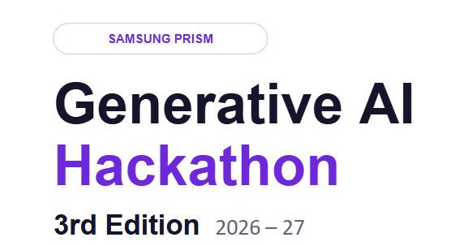

Theme ID - Theme 05: Interruptible Real-Time Agents
Project Name - Janus
Tagline - The voice agent you can interrupt, correct and trust: models propose, a deterministic kernel decides.
Team Name - AICA
College Name - Vellore Institute Of Technology, Vellore
Member Name & Email 1 - Adithya Santhosh P (adithyasanthosh.p2024@vitstudent.ac.in)
Member Name & Email 2 - Eldo John Giby (eldo.johngiby2024@vitstudent.ac.in)
Member Name & Email 3 - V V Ramarathinam Iyer (ramarathinamiyer.vv2024@vitstudent.ac.in)
Member Name & Email 4 - Aryaman Tripathi (aryaman.tripathi2024@vitstudent.ac.in)
Submission GitHub link - https://github.com/AdithyaSanthosh-P/Janus/
Demo video link - [paste demo video URL here]

Slide 2
The Problem with Voice Agents Today
The Challenge
Today's AI voice assistants work in half-duplex mode: they listen, think, then speak. Real conversation is never that clean. Users interrupt mid-sentence, revise parameters on the fly and switch tasks while tools are still running. Existing systems freeze, fail or hallucinate.
The Goal
Build a full-duplex voice agent that stays responsive: reasoning while listening, cancelling stale work atomically and delivering accurate actions without ever confusing the user.
Existing Solutions and Where They Fail
System | ChatGPT Voice / GPT-4o | Google Duplex / Assistant | Amazon Alexa | LangGraph / AutoGen
Approach | Turn-based with barge-in detection | Pre-scripted dialog flows | Single-turn intent classification | Streaming STT + LLM pipeline
Critical gap | Drops context on interruption; no atomic tool cancellation | Brittle outside narrow domains; cannot handle mid-task repairs | No multi-turn tool state; restarts from scratch on interruption | No real-time audio management or floor control; sequential, not concurrent
The gap: no system safely handles continuous audio, in-flight actions and changing intent at the same time. The result is stale actions, false confirmations and double bookings.

Slide 3
Our Solution
Janus: A Single-Writer Coordination Kernel for Full-Duplex Voice
Janus solves the three-way concurrency problem with a deterministic 7-phase synchronous step engine (under 5 ms per step) paired with isolated async workers. All state changes happen inside a single-threaded kernel step, eliminating race conditions by design, not by luck.
Every event, whether a speech chunk, a tool result or a user interruption, passes through the same deterministic pipeline:
DRAIN → ORDER → APPLY → INVALIDATE → DECIDE → EMIT → LOG
What Makes Janus Unique
Capability | Interruption without data loss | Zero duplicate actions | Faster first action | Never talks over the user | Handles "wait, change that" | Chained tool dependencies
How Janus does it | Chunk-anchored cancellation: stale calls are killed mid-utterance, not at end of turn. | Fingerprinted, exactly-once writes: a duplicate (tool, args) is blocked. | Compiles the plan directly from the interpretation, with no separate planning call. | Floor rule: never acts or speaks while the user holds the floor. | Read-set checks plus a short settle window catch hesitation before a write commits. | Late binding: arguments are resolved from live upstream results.

Slide 4
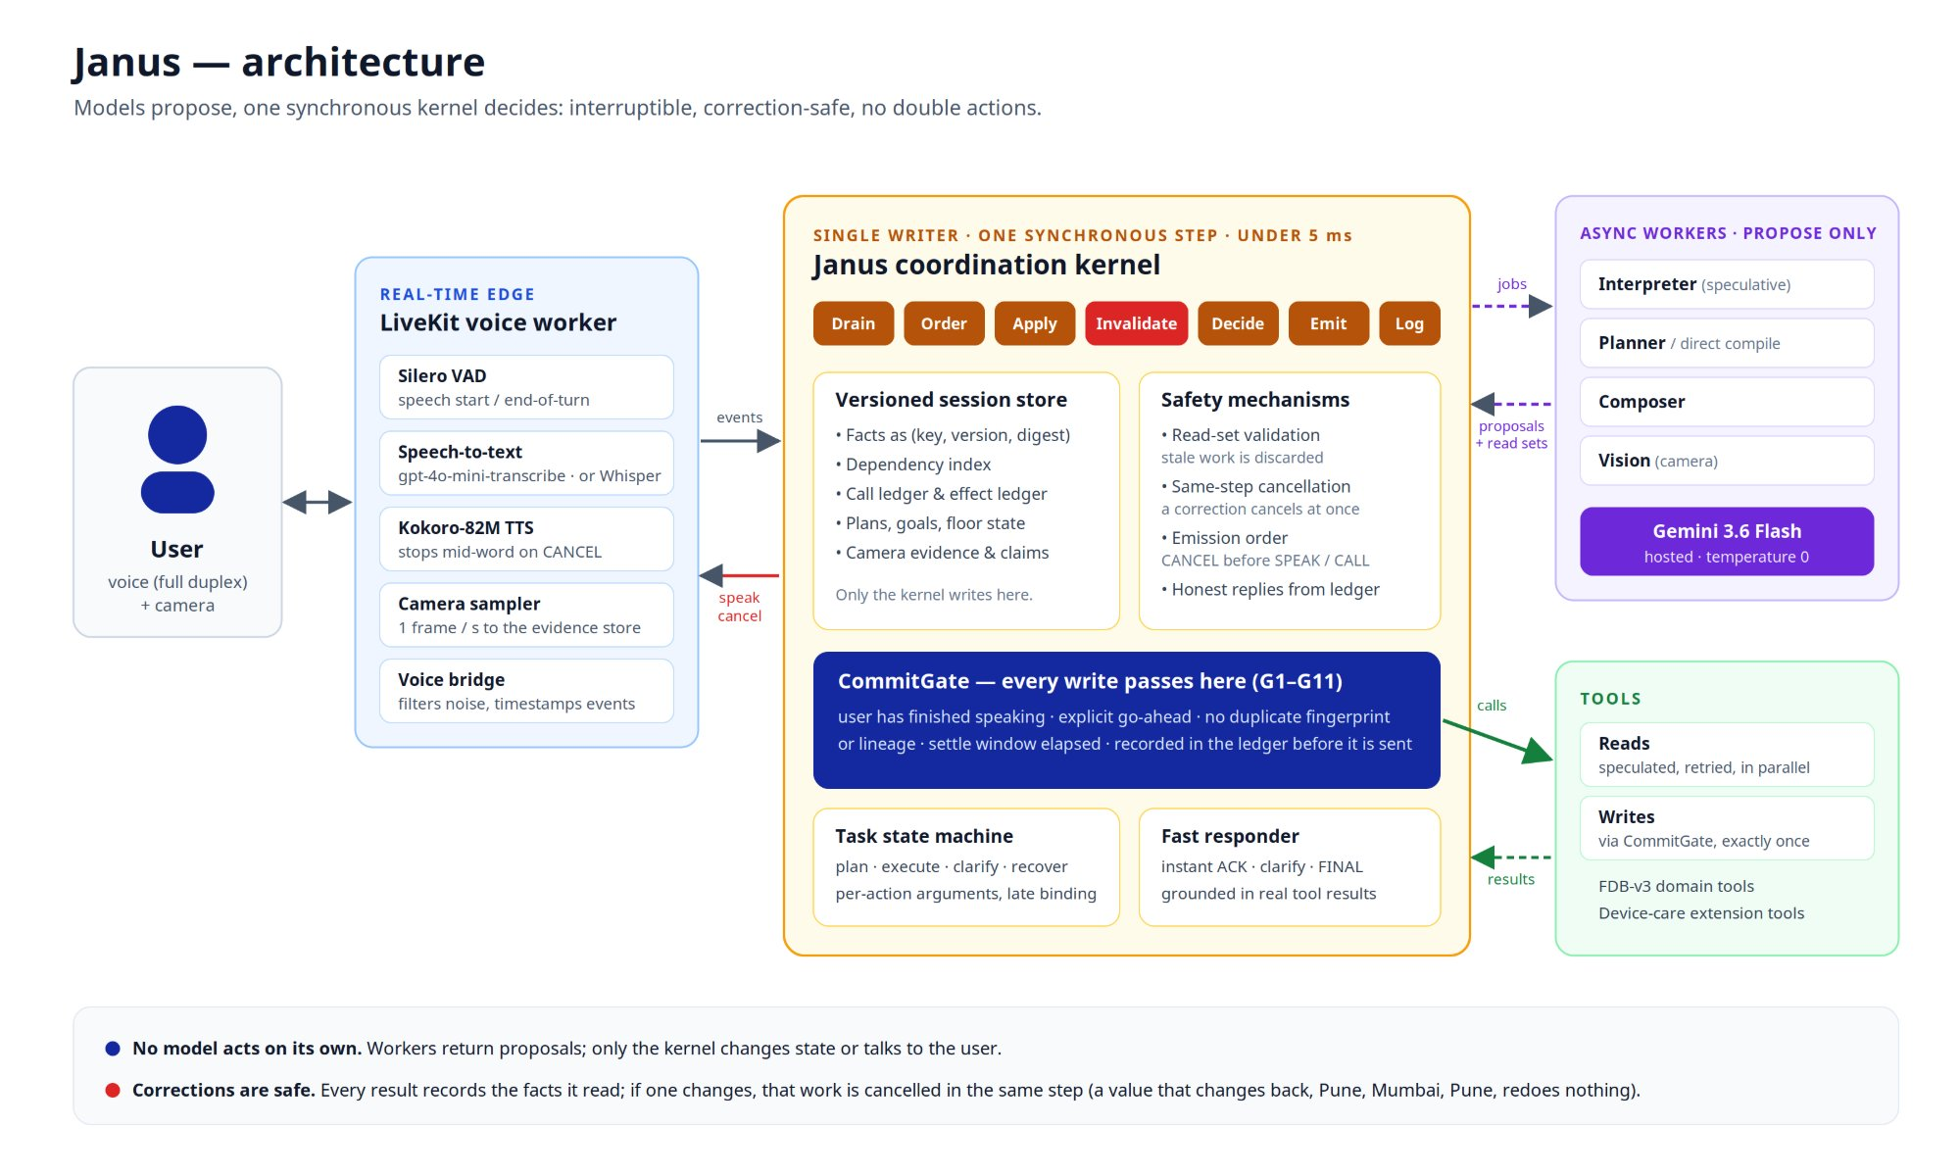
Architecture: Models Propose, the Kernel Decides

Slide 5
Extension: Camera-Grounded Device Care, Built for the Samsung Ecosystem
Delivered
Point-and-Ask Diagnostics: the user points a phone camera at an appliance (blinking router LED, washer error code) and speaks naturally, without technical jargon.
Looks before it asks: with the camera on, it reads the device before asking the user a question.
Camera-Grounded Reasoning: the vision worker extracts visual telemetry from video frames to look up diagnostic fixes in real time.
Interruption-Safe Action: mid-utterance date changes ("Book Thursday morning... actually make it Friday") guarantee exactly one technician visit via CommitGate.
Roadmap: Samsung Integration
Galaxy AI & Bixby: direct integration into the Galaxy Camera viewfinder for hands-free, real-time visual troubleshooting.
SmartThings Ecosystem: correlates live camera feeds with IoT diagnostics across Bespoke Refrigerators, Washers, ACs and Smart TVs.
Samsung Care+ Automation: safe, automated service booking and ticket dispatch with fingerprinted, exactly-once bookings.
On-Device NPU Ready: the lightweight kernel and local audio stack can run on Samsung Exynos / Snapdragon NPUs alongside Samsung Gauss models.

Slide 6
Innovation & Results
Key Innovations: Why Janus Is Different
Single-writer safety kernel (under 5 ms per step). Models only propose; a synchronous kernel arbitrates every state change and tool call.
Same-step cancellation with read sets. Every result records the (fact, version, digest) it read; if one changes, that work is cancelled in the same step.
CommitGate (G1–G11) and settle window. Separates speculative reads from irreversible writes, so each write happens exactly once.
Speculative interpretation and floor rule. Pre-interprets speech while the user talks, with zero added latency when the prediction holds.
Deterministic replay and automated invariant checks. A stepped virtual clock gives byte-identical replays, audited by the trace checker.
Camera-grounded multimodal safety. 1 fps video plus voice for hands-free, interruption-safe troubleshooting.
0.412
self-correction Pass@1 on voice vs 0.176 for the published cascaded pipeline
Self-correction (Table 3) | Pass@1
Janus reasoning core (text replay) | 0.824
Janus full voice path | 0.412
GPT-Realtime (published) | 0.588
Gemini Live 3.1 (published) | 0.353
Cascaded pipeline (published) | 0.176
Full-Duplex-Bench v3, all 100 scenarios
Setting | Strict pass@1 | Tool selection | Argument accuracy | Response quality
Reasoning core (text replay, Gemini 3.6 Flash, judged) | 77.0% | 0.959 | 0.807 | 0.840
Full voice path (LiveKit, 100 recordings, judged) | 42.0% (41% exact) | 0.844 | 0.611 | 0.597
Published: GPT-Realtime / Gemini Live 3.1 / Cascaded | 60 / 54 / 45% | 0.876 / 0.817 / 0.803 | 0.680 / 0.588 / 0.562 | 0.792 / 0.718 / 0.600
By domain (text replay): Finance 100%, Travel 95%, E-commerce 83%, Housing 35%.
Latency (voice): 7.8 s mean time to first word (6.7 s median) vs 8.78 s for the cascaded pipeline; part of it is deliberate (a turn closes after 1.5 s of silence, and writes wait a short settle window so late corrections land).
Engineering: 499 deterministic tests pass with the trace checker run over every decision log; replays are byte-identical; the adversarial explorer covers 19 race scenarios.
Known Limits
Voice trails text replay (42.0% vs 77.0%), largely from misheard proper nouns; Housing (35%) is the hardest domain for every published system too.
The hosted Gemini API adds network latency, and the camera is sampled at about 1 fps, so fast LED blinking needs a spoken cue.
Notes:
Improvement since the full voice run (hardest recordings only): rerun of the 32 hardest recordings after the speech-to-text GPU fix: 11/32 exact match (was 8/32), turn-taking 32/32 (was 72%). Current code with hosted speech-to-text on the recordings the full run failed: 13/31 judged (same recordings: 4/30 in the full run). Turn-taking in that run: 64/64 (100%).

Slide 7
Technology Stack
Core Kernel & Coordination
• Runtime & Language: Python 3.11 (compatible with 3.10–3.12)
• Data & Schema Integrity: Pydantic v2.6+ (immutable state records, read-set validation), PyYAML
• Coordination Engine: Custom Single-Writer Synchronous Kernel (7-phase deterministic step, under 5 ms per step)
• Deterministic Clock: Stepped ClockPort (zero wall-clock dependencies; 100% byte-identical replayability)
Real-Time Audio & Vision Edge
• WebRTC & Streaming: LiveKit Agents SDK v1.8.3 (livekit-agents)
• Voice Activity Detection (VAD): Silero VAD v5 (turn boundary and barge-in detection)
• Speech-to-Text (STT): OpenAI gpt-4o-mini-transcribe (default, pinned snapshot); faster-whisper large-v3-turbo on the GPU as a local option
• Text-to-Speech (TTS): Kokoro-82M v0.9.4 + Misaki + spaCy (instant low-latency neural synthesis)
• Vision Ingestion: WebRTC Video Sampler (1 fps JPEG extraction for multimodal grounding)
Reasoning & Foundation Models
• Decision & Worker LLMs: Google Gemini 3.6 Flash / 3.5 Flash (hosted API, temperature=0, thinking budget 0)
• Async workers: Interpreter (intent), Planner / Rebinder (DAGs), Composer (grounded speech)
• Visual Reasoning: Gemini Multimodal Vision Worker (MediaPart / blob_resolver)
• Domain Tools & Extensions: FDB-v3 Domain APIs (Finance, Travel, E-Commerce, Housing) + Device Care Diagnostic Tools
Benchmark, Testing & Infrastructure
• Primary Benchmark: Full-Duplex-Bench v3 (FDB-v3) + NVIDIA Parakeet-TDT 0.6B (NeMo ASR scorer)
• Evaluation Judge: OpenAI GPT-4o (semantic argument & response quality evaluation)
• Verification & Testing: pytest (499 deterministic tests) + TraceChecker (commit gate & floor rule audits)
• Deployment & Containerization: Docker (nvidia/cuda:12.4.1, PyTorch v2.14 / CUDA 12.6) + ./reproduce.sh (one-command SHA-256 verified build & run)

Slide 8
What’s Next
Streaming ASR & Entity Recognition
Speech-to-text is already hosted (gpt-4o-mini-transcribe). Next: a streaming ASR (NVIDIA Parakeet) for better proper nouns and lower latency.
→ Fewer misheard cities and model numbers
Proactive Dialogue & Multi-Slot Reasoning
Move from passive settle-time barriers to clarification dialogues ("I found two options, shall I book the 6 PM one?") and better handling of complex multi-constraint queries (Housing).
→ Fewer wrong bookings on hard requests
Temporal Video Diagnostics
Upgrade from 1 fps still frames to multi-frame analysis to detect high-frequency blinking LED patterns and dynamic appliance states.
→ Reads blinking-LED codes without a spoken cue
On-Device NPU Porting (Galaxy AI)
Port the lightweight synchronous kernel and local speech stack to Samsung Exynos / Snapdragon NPUs for offline, ultra-low-latency execution.
→ Galaxy devices, offline
Production Samsung Ecosystem Bridge
Plug Samsung Gauss / Bixby in as the reasoning engine via the existing ModelGateway, plus direct SmartThings and Samsung Care+ APIs for live appliance telemetry, error-code lookup and automated technician dispatch.
→ Real Samsung devices, real service tickets

