Slide 1
Samsung PRISM GenAI Hackathon 3rd Edition | Theme 05: Real-Time Voice Agents
Team AICA | VIT Vellore
DETERMINISTIC CONCURRENCY KERNEL FOR FULL-DUPLEX VOICE
Built for the Samsung Language AI team
Janus
Models propose. One deterministic synchronous kernel decides.
Zero double-bookings, zero phantom completions, and sub-millisecond preemption under live user interruptions.
FDB-V3 VOICE PASS@1
KERNEL STEP LATENCY
DETERMINISTIC VERIFICATION
82.0%
vs 60.0% GPT-Realtime SOTA
< 0.4 ms
0 async awaits in hot loop
779 Tests
Stepped-clock replayable

Slide 2
1. UNDERSTANDING OF PROBLEM & CAVEATS
Why Loop-Based Voice Agents Fail Under Interruption
Root Cause: Conflating Language Generation with State Mutation
Industry voice agents (GPT-Realtime, Gemini Live) let the LLM directly invoke tools and speak in a single loop. When users interrupt, network I/O, state changes, and speech synthesis race uncontrollably.
FAILURE MODE 01
FAILURE MODE 02
FAILURE MODE 03
In-Flight State Races
Phantom Completions
Duplicate Side Effects
The Flaw:
User corrects a value mid-sentence ("Actually, Chicago"). The stale in-flight search returns and speaks obsolete data over the user.
The Flaw:
Streaming TTS declares "Booked!" before backend APIs settle. If the network drops or API aborts, the user gets false confirmation.
The Flaw:
Hesitation pauses or mid-sentence retries trigger models to re-execute tool calls, causing duplicate charges and bookings.

Slide 3
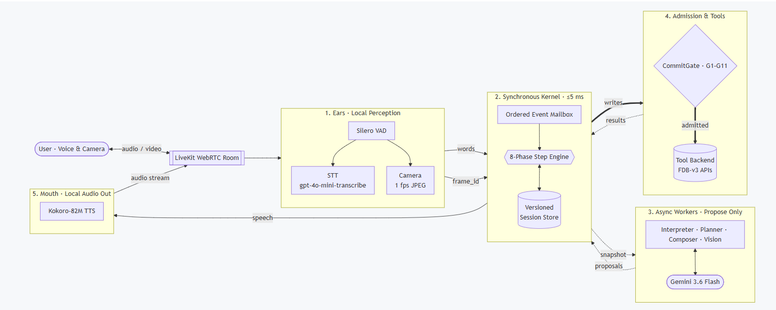
2. CORE ARCHITECTURE & TECHNOLOGY MODULES
Five-Stage System Architecture: The Single-Writer Principle

Slide 4
2. CORE ARCHITECTURE & TECHNOLOGY MODULES
Five-Stage System Architecture: The Single-Writer Principle
1. EARS
2. KERNEL (<= 0.4 ms)
3. ASYNC WORKERS
4. SAFETY
5. MOUTH
Perception & Audio
Single Writer
Propose Only
Admission & Tools
Local Speech Out
• Silero VAD (1.5s floor)
• Fast STT (OpenAI / Whisper)
• 1 fps camera frame buffer
• Streamed transcript events
• 8-phase synchronous step
• 0 async awaits in hot loop
• Versioned Fact Store
• Single session state mutator
• Gemini Flash / GPT-4o
• Interpreter, Binder, Vision
• Return proposals + read sets
• Never touch state directly
• CommitGate G1–G12 checks
• Pre-emission effect ledger
• G5 idempotency deduplication
• G12 spoken confirmation gate
• Kokoro-82M TTS (<300ms)
• Speaks ONLY admitted facts
• Instant barge-in preemption
• Zero false completion claims
Core Invariant: Models propose. One deterministic synchronous kernel decides.
Clean Architectural Decoupling

Slide 5
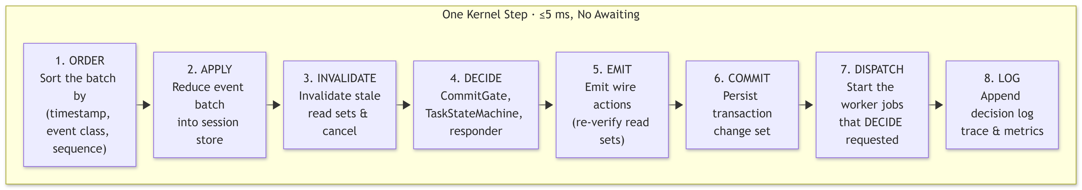
2. CORE ARCHITECTURE & STEP EXECUTION
< 0.4 ms measured execution | 0 async awaits in hot loop
Anatomy of One Synchronous Kernel Step
1. ORDER
Sort batch deterministically by (timestamp, event_class, seq).
2. APPLY
Reduce speech chunks, tool returns, worker proposals, and camera frames.
3. INVALIDATE
Walk dependency index; invalidate stale read sets in same 0.4ms step.
4. DECIDE
Run fixed-order sub-phases, update task FSM, check CommitGate G1–G12.
5. EMIT
Re-verify G9; emit wire CANCEL actions before SPEAK or TOOL_CALL.
6. COMMIT
Automatically save the state changes
7. DISPATCH
Start non-blocking async worker jobs requested by Decide.
8. LOG
Append immutable execution trace for live X-ray and offline replay.
Decide Resolution Order: Cancellations ➔ Deadlines ➔ Late Binding ➔ Task FSM ➔ Perception ➔ CommitGate ➔ FastResponder

Slide 6
2. CORE ARCHITECTURE & CONCURRENCY
Deterministic How?
Dependency Tracking: Every proposal, tool call, and speech action records its read set:
Tuple: (fact_key, fact_version, sha256_digest) — Validated before any wire action emits
System calls to find current time are completely forbidden.
Every event is sorted by a strict composite key
We hash SHA-256 hashing instead of Python’s hashing, so replays do not occur.

Slide 7
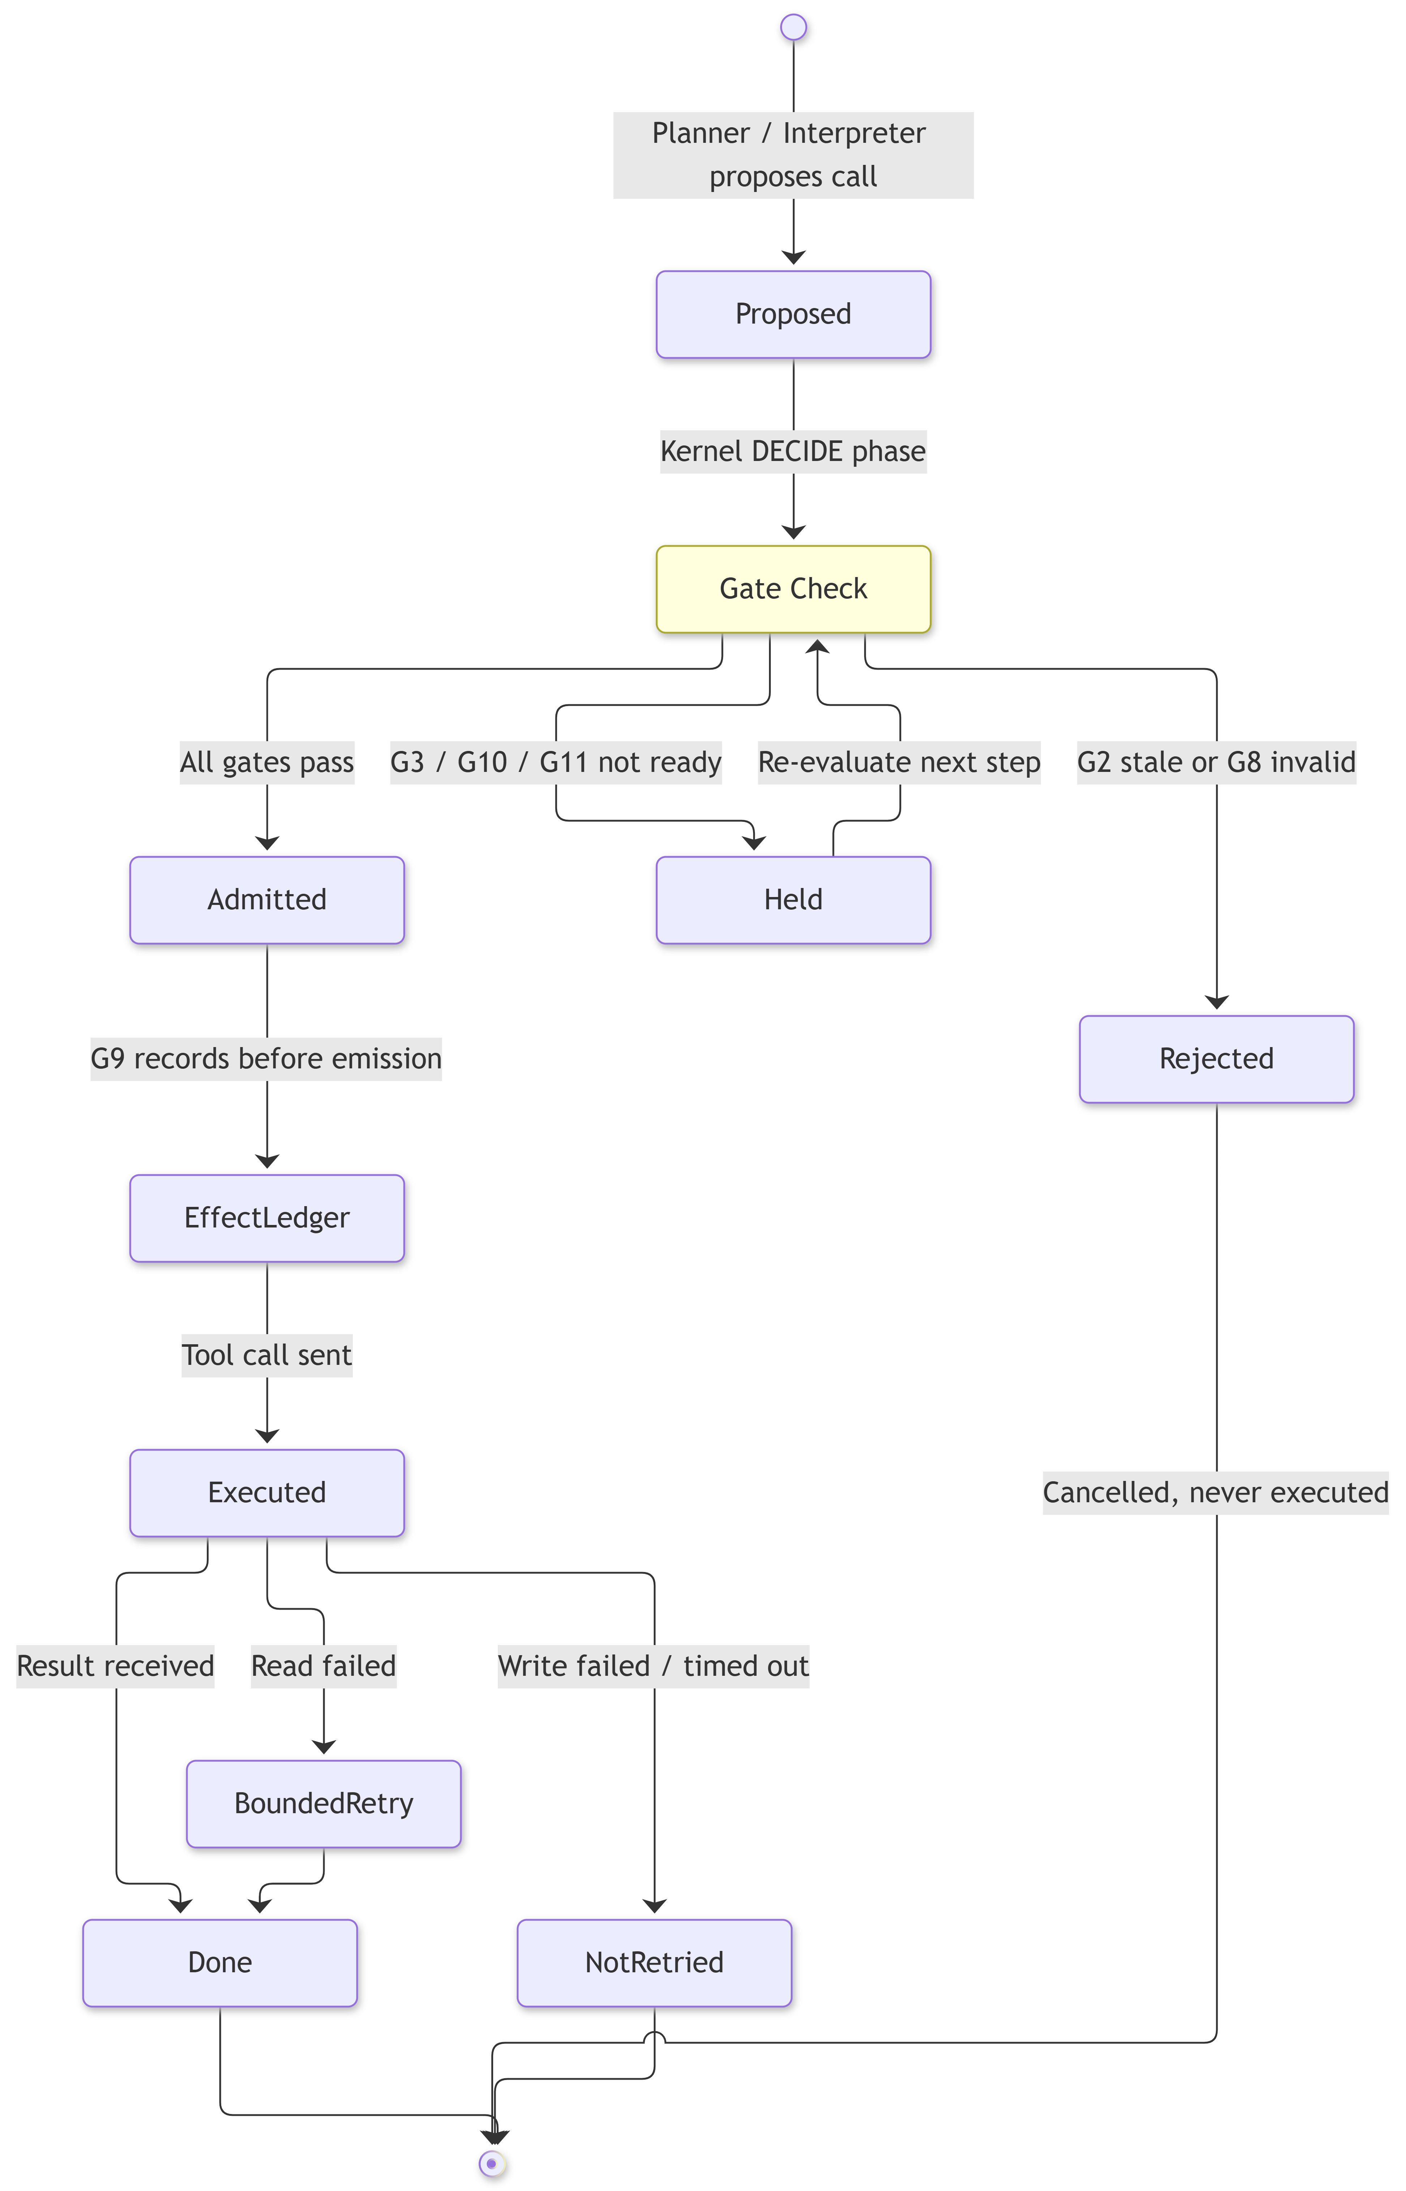
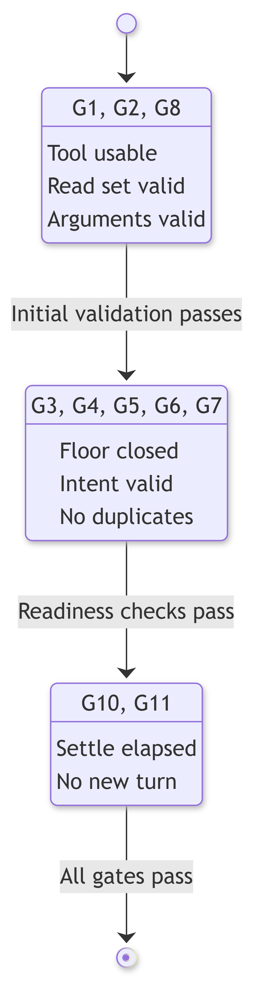
2. CORE ARCHITECTURE & ADMISSION SAFETY
CommitGate (G1-G12) & Pre-Emission Effect Ledger

Slide 8
2. CORE ARCHITECTURE & ADMISSION RULES
CommitGate (G1-G12) Rule Enforcement Matrix
Gate | Admission Rule Enforced | Action on Failure
G1 – G2 | Tool exists/usable (G1) and read set is still valid (G2) | Fail goal honestly or cancel stale call
G3 – G4 | Floor closed/user quiet (G3) & explicit user go-ahead (G4) | Hold call or ask "Shall I go ahead...?"
G5 – G6 | No duplicate fingerprint (G5) or plan-step lineage effect (G6) | Block write; report what already ran
G7 – G8 | No unknown-outcome write (G7) & valid schema args (G8) | Ask user before retry; refuse blank args
G9 – G12 | Valid at emission (G9), settle window (G10), no open turn (G11), explicit user confirmation for security actions (G12) | Withdraw before wire or hold for correction
Append-Only Effect Ledger: Admitted writes are recorded before wire emission; failed writes are never blindly retried.

Slide 9
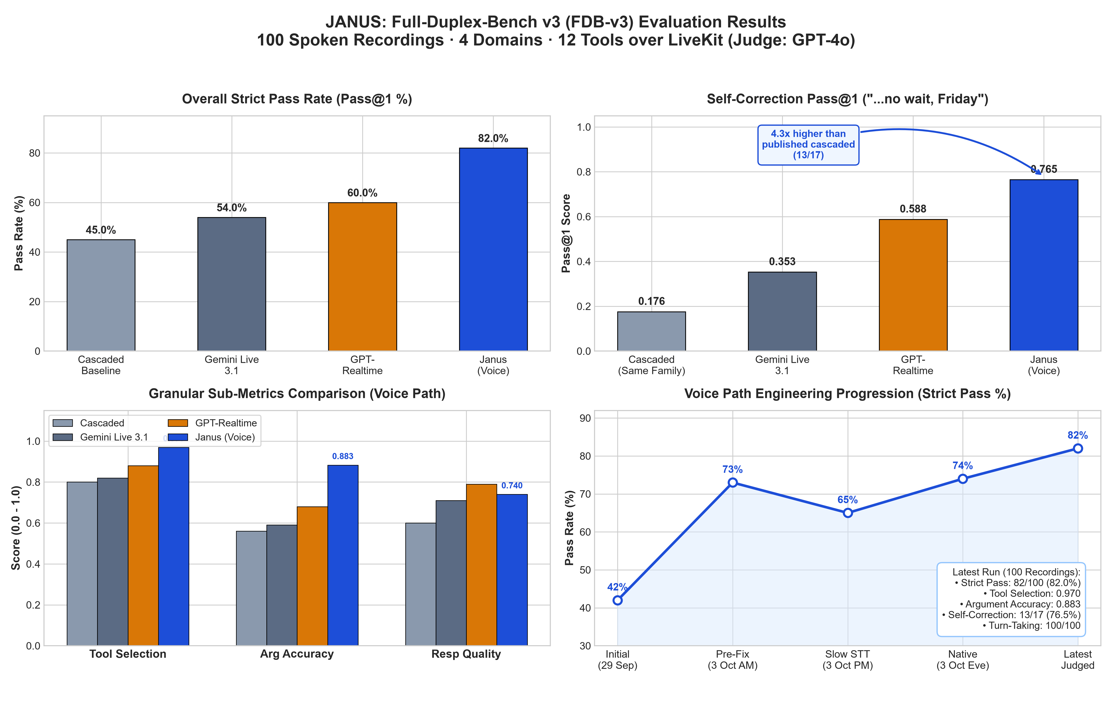
2. CORE ARCHITECTURE - VERIFICATION & FDB-V3 BENCHMARKS
Full-Duplex-Bench v3 Results (100 Recordings, Official Judge)

Slide 10
4. SCALABILITY: COVERING NEW USE CASE SCENARIOS
Zero-Code Kernel Domain Expansion
Adding new Samsung domains (Smart TVs, Galaxy Watch, Samsung Health, B2B Care) requires zero modifications to the core kernel.
Every voice call runs as an independent, fully isolated session with its own Kernel and FactStore instance.
A single standard 32-core cloud node can coordinate over 5,000 concurrent active calls without CPU thread starvation.
Ready for hybrid deployment: run VAD, wake-word, and safety gating directly on Galaxy NPU hardware while offloading complex reasoning to cloud backends.

Slide 11
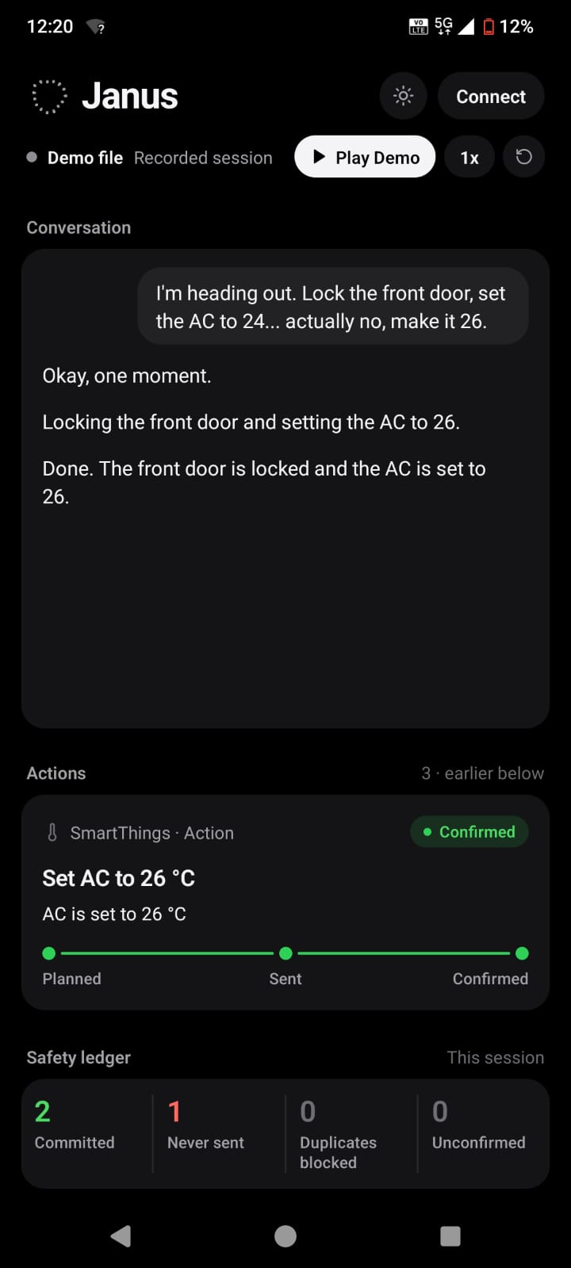
3. Samsung Extension — Multimodal Device Care
See the washer error. Hear the user's correction. Book one appointment. Never two.
What we built
A camera-grounded Samsung appliance care agent that can see a washer error code, diagnose it, and schedule a technician — all by voice, all live.
Camera reads the washer display
Mid-speech corrections are safe
Dangerous commands need a spoken yes
What you say beats what the camera sees

Slide 12
3. Samsung Extension — SmartThings Cloud Control
Real devices. Real confirmation. Honest failures.
Live SmartThings Cloud
Built directly against official Samsung SmartThings Developer REST APIs with zero mocks or synthetic shims.
Unifies real multi-category Samsung devices, including smart locks, garage doors, thermostats, wall switches, and washers.
"Sent" is not "Done"
Standard smart home clouds return success the moment a command is received, even if a lock has dead batteries or a jammed bolt.
Janus enforces a mandatory physical state read-back after every write to verify that the hardware actually moved.
If the physical device does not confirm movement, Janus honestly reports that the command was sent but unverified.
Proactive, Self-Withdrawing & Zero Duplicates
Janus monitors background device telemetry to proactively offer assistance, such as asking to close an open garage or lock an unlocked door.
High-risk security operations like unlocking doors strictly require an explicit spoken "Yes" to an exact confirmation prompt.
Semantic fingerprinting and plan lineage tracking mathematically guarantee that no command is ever sent twice over the radio network.
Android Companion App & Live Fault Drawer
The companion app acts as a real-time visual X-ray, displaying verified device states alongside live action cards.
An interactive failure drawer lets the jury inject real-world IoT chaos live, including hub drops, dropped confirmations, and concurrent commands.
It directly mirrors the kernel's append-only Effect Ledger to give evaluators visual proof of zero duplicate actions.

Slide 13
5. LIVE SYSTEM DEMO & VERIFICATION (< 2 MINS)
End-to-End Live Demonstration: SmartThings & Multimodal Care
DEMO WALKTHROUGH TIMELINE (< 2 MINS)
0:00 – 0:10 | Companion App Joins Room
Live device tiles appear (Lock, Garage, AC, Switch, Washer) over WebRTC.
0:10 – 0:40 | Washer Error (4C) Diagnostics
Camera reads 7-segment display. Agent diagnoses water supply error and speaks fix.
0:40 – 1:10 | Mid-Speech Correction & G12 Security Gate
"Set AC to 24... no, 26" — 24 is cancelled before emit. "Lock door" triggers spoken confirmation.
1:10 – 1:35 | Live Failure Drill ("Sent is Not Done")
Jury injects stuck lock. State never confirms. Agent speaks: "Sent, but couldn't confirm."
1:35 – 1:50 | Effect Ledger Summary
App displays: 2 committed, 1 cancelled before send, 1 unconfirmed, 0 duplicates.
[ CLICK TO PLAY DEMO VIDEO ]
Duration: 1 min 50 s
Voice: Gemini 3.6 Flash + Silero VAD + Kokoro TTS
SmartThings: Real Cloud API — live virtual devices
App: Android 14 companion (Hermes, physical device)

Slide 14
FROM PROTOTYPE TO SAMSUNG ECOSYSTEM
The coordination kernel moves onto Galaxy; the guarantees move with it
Today the brain coordinates between local GPU and cloud. The architecture was designed from day one to live on-device.
Today
Next: On Galaxy Device
With Samsung
GPU edge host: Silero VAD, single-writer kernel, Kokoro TTS. Phone: LiveKit audio & companion display. Cloud: Gemini 3.6 Flash / GPT-4.1 for reasoning depth.
Kernel ported 1:1 to Rust/C++ (same stepped-clock tests); local SLM (Samsung Gauss or Gemma 2B via LiteRT/ONNX); on-device acoustic VAD; cloud invoked only for deep multi-step planning.
Native Bixby agent routing; Samsung Knox hardware-backed confirmation for security writes (biometric unlock); SmartThings Hub Core integration; Galaxy AI side-button trigger.
What it is not, yet
•
The kernel runs on a host machine today (the phone acts as ears, mouth, and X-ray display).
•
Any agent interacting with physical hardware (SmartThings, Bixby, Samsung Care+) requires these non-negotiables: never act on stale data, never book twice, never lie about device state.
•
Appliance camera reading is evaluated on 7-segment displays (4C error codes). English only.
•
No live financial billing; no OS-level cross-app injection (respects Android sandboxing).
•
Foundation models are interchangeable commodities. The deterministic coordination kernel is the product.
Thank you.

