Slide 1
JÖNKÖPING UNIVERSITY
PHASE 8.6.20 V6a: TENSILE TO FAILURE — 100 % INFILL (PILOT)
Test setup
Test timeline
Parameter | Value
Specimen | S7 — fresh PLA, 100 % infill, LED on
Geometry | 10 × 8 mm gauge (80 mm², CAD-verified)
Markers | Spray paint — DIC 99.9 % to fracture
Preload | +470 N (anchor 475 N post-fracture)
Rate | 0.1 mm/s (rate-matched to V5)
Load cell | ANYLOAD 3 t — peak used 13 %
Reference | Chacón et al. (2017), Materials & Design
Mount S7 + spray markers; LED on
Preload +470 N → Tare δ / load / DIC
LED pre-flight: ε_c≈0, 2 blobs tracked
Pull 0.1 mm/s → UTS 3826 N @ 0.020
47.8 MPa
UTS (nominal)
3 826 N
peak force
2.41 GPa
E (nominal)
Plastic plateau → 7 % softening
47.8 MPa
σ_y (0.2 %)
2.98 %
failure strain
≈ 1
offset k
Fracture ε_f = 0.030 @ 7.33 mm travel
V6a (S7) = the PILOT (first) 100 % specimen, shown here in detail. It is the batch's strength / modulus EDGE point — representative n = 5 result on pp. 157–160; the V5 comparison uses V6d (≈ mean).
141

Slide 2
JÖNKÖPING UNIVERSITY
PHASE 8.6.20 V6a: PREDICTED RESULTS (pre-test)
Hypotheses before pulling the 100 % specimen
Quantity | Predicted | Actual | Verdict
Peak force | ≤ ~4.8 kN (≈2× V5) | 3.83 kN | ✓ in range
UTS (nominal 80 mm²) | lands in Chacón 32–50 MPa | 47.8 MPa | ✓ in range
Offset factor k | ≈ 1 (no knock-down) | 0.67–1.25 | ✓ ≈ 1
σ_y | ≈ 2× V5 (rate-matched) | 47.8 MPa (2.5×) | ✓
Failure mode | stiffer, higher force, slight soften | 7 % soften, ε_f 0.030 | ✓
DIC under LED | ≥ 95 % tracking, clean floor | 99.9 % | ✓
Core hypothesis (G2/G3): if the 50 % offset (k≈1.45) is purely an infill knock-down, then 100 % infill at the same nominal area should reach literature directly with k ≈ 1. Confirmed below.
Predictions set from the 50 % V5 baseline + Chacón (2017) ranges and the infill-knock-down argument.
142

Slide 3
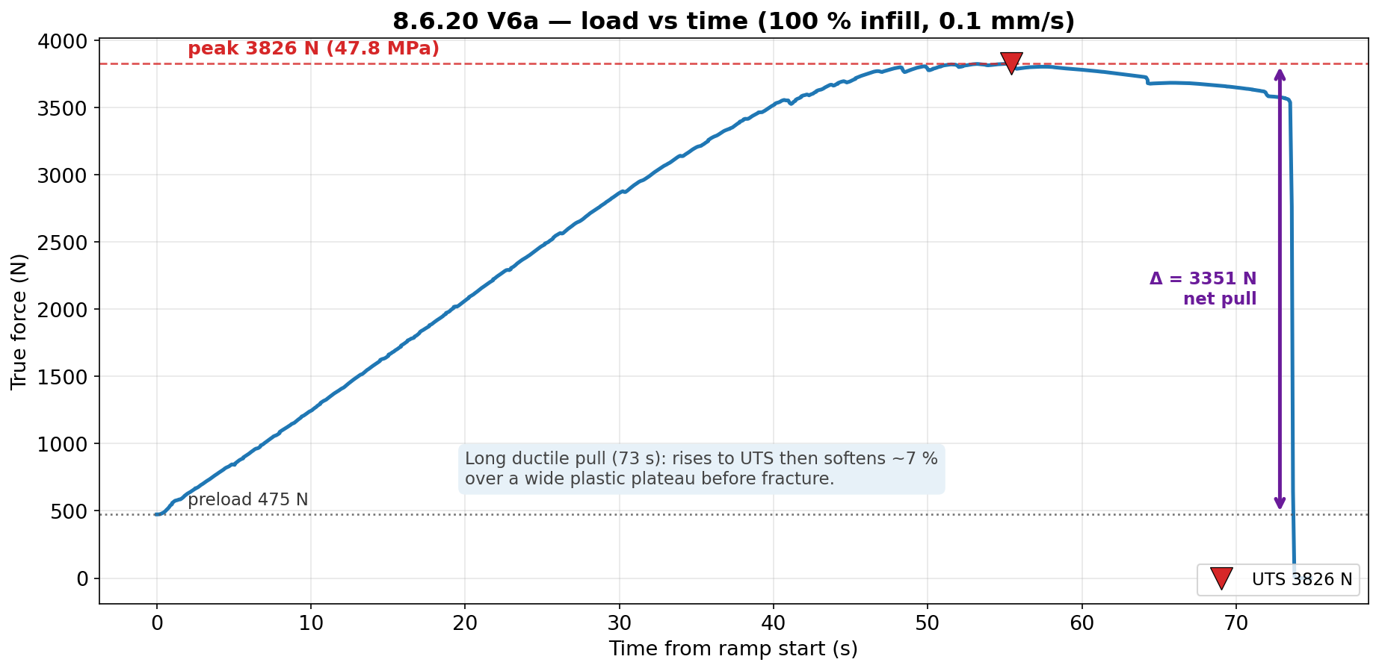
JÖNKÖPING UNIVERSITY
PHASE 8.6.20 V6a: LOAD vs TIME
Long ductile pull (73 s) at 0.1 mm/s: rises to UTS 3826 N then softens ~7 % over a wide plastic plateau before fracture. Net pull Δ ≈ 3351 N above the 475 N preload.
143

Slide 4
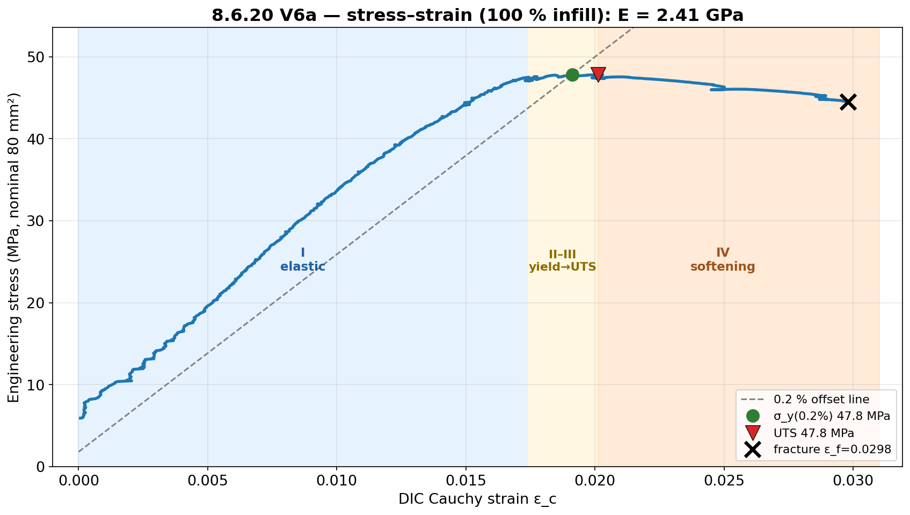
JÖNKÖPING UNIVERSITY
PHASE 8.6.20 V6a: STRESS vs STRAIN
E = 2.41 GPa; σ_y(0.2 %) 47.8 MPa ≈ UTS 47.8 MPa (near-linear to peak), then region IV softening to ε_f = 0.030. Strength is the robust DIC-independent result (load cell + fixed area).
144

Slide 5
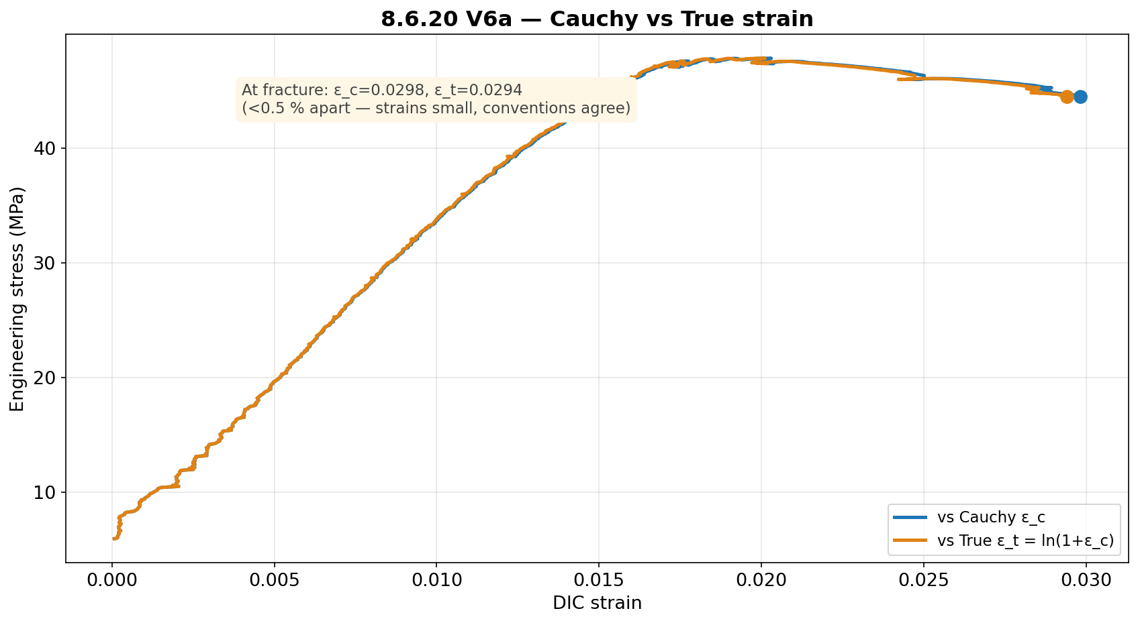
JÖNKÖPING UNIVERSITY
PHASE 8.6.20 V6a: CAUCHY vs TRUE STRAIN
Cauchy and True strain agree to <0.5 % (strains are small): ε_c = 0.0298 vs ε_t = 0.0294 at fracture.
145

Slide 6
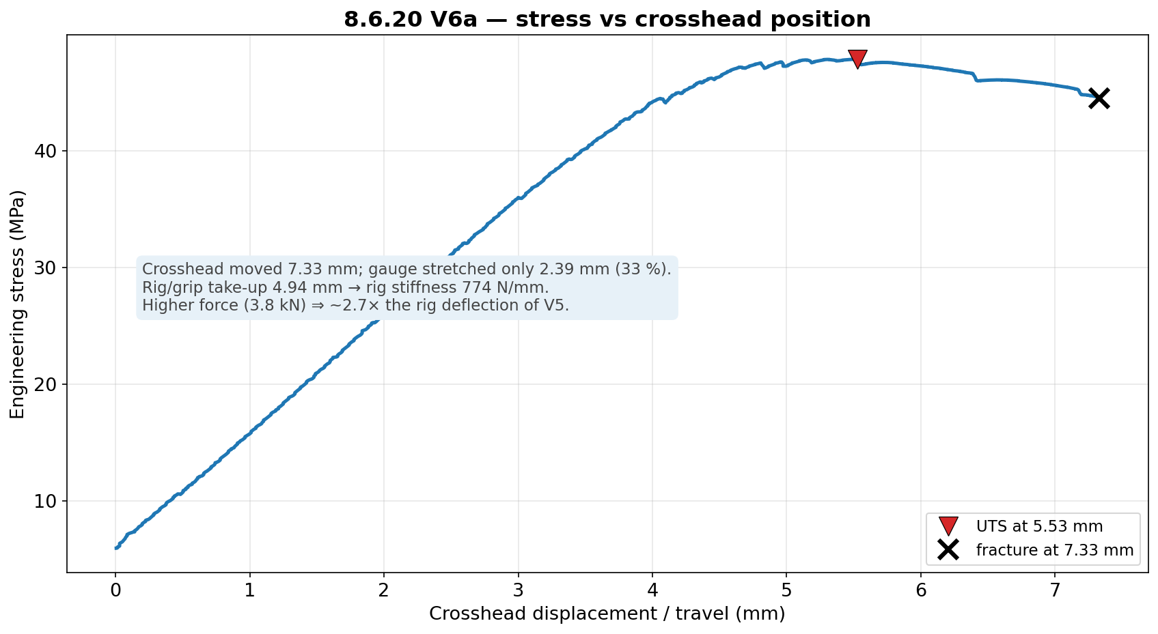
JÖNKÖPING UNIVERSITY
PHASE 8.6.20 V6a: STRESS vs CROSSHEAD POSITION
Of 7.33 mm crosshead travel, only 2.39 mm (33 %) stretched the gauge; rig/grip took up 4.94 mm. Higher force (3.8 kN) ⇒ ~2.7× the rig deflection of V5 → strain MUST come from DIC.
146

Slide 7
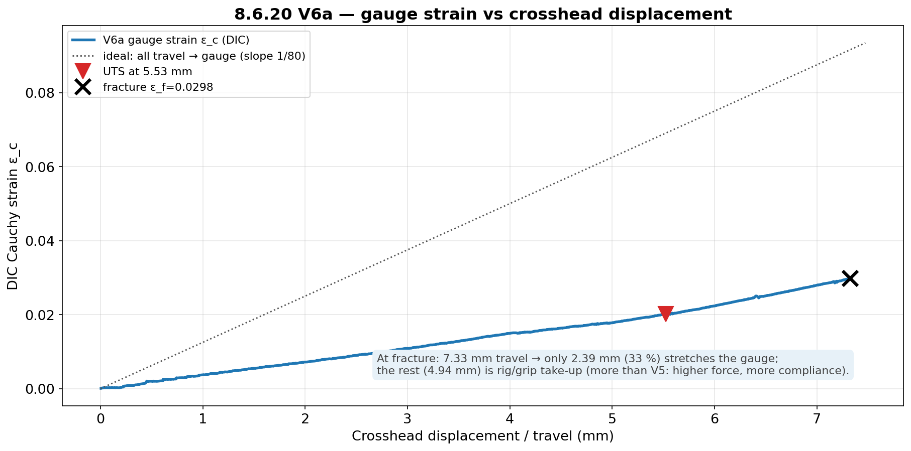
JÖNKÖPING UNIVERSITY
PHASE 8.6.20 V6a: GAUGE STRAIN vs DISPLACEMENT
Gauge strain rises ~linearly with travel but well below the ‘all-travel-to-gauge’ line — confirming ~two-thirds of the crosshead motion is machine compliance at this force level.
147

Slide 8
JÖNKÖPING UNIVERSITY
PHASE 8.6.20 V6 (n = 5): VALIDATION — JOURNAL REFERENCE
Chacón (2017) journal — n = 5 mean vs range, offset k = Chacón_min / measured
Property | V5 k | V6 k | V6 mean (n=5) | Chacón range
E | ×1.95 | ×1.15 | 2.60 GPa | 3.0–5.5 GPa
σ_y | ×1.58 | ×0.67 | 45.0 MPa | 30–50 MPa
UTS | ×1.45 | ×0.69 | 46.2 MPa | 32–60 MPa
2.09×
UTS vs 50 %
5.0×
toughness vs 50 %
≥99 %
DIC tracking (LED)
13 %
peak / load-cell
Green = measured value lands INSIDE the Chacón range; yellow = just below. At 100 % infill the strength values land in literature directly: UTS 46.2 MPa and σ_y 45.0 MPa sit mid-range (k = 0.67–0.69 < 1 ⇒ no knock-down needed). E (2.60 GPa, ×1.15) is ~13 % below the 3.0 GPa floor — held down by the rig-compliance-limited apparent modulus. Strength common-factor window ≈ [0.69, 1.11] → k ≈ 1 (p. 155).
G2 ✓ 100 % infill reaches literature (k≈1). G3 ✓ the 50 % offset (×1.45) was purely the infill knock-down.
DIC validated under LED lighting (clean ≥99 % tracking across all 5, stable baseline) — lighting is precision-only, as predicted.
n = 5 mean vs Chacón (2017); per-specimen repeatability on p. 157, add:north datasheet on p. 156. Strength inside range (k ≈ 1); E ~13 % below the journal floor.
148

Slide 9
JÖNKÖPING UNIVERSITY
PHASE 8.6.20 V6a: RECOMMENDATIONS / NEXT
1
Run V6b, V6c (100 % repeats, LED on) to confirm offset-≈1 repeatability — as the 50 % set established for k≈1.45.
2
For material claims at 100 % infill, report nominal values directly (no infill correction); apply the ×1.45 knock-down only for 50 % infill parts.
3
LED neutrality: V6a tracked 99.9 % under LED, so lighting works for DIC. The formal 50 % LED on/off gate (V5d/e) was skipped — backfill it only if a 50 % LED-on dataset is needed.
4
Keep the rate at 0.1 mm/s for all remaining runs (the V5c2 0.2 mm/s rate-confound lesson).
5
Post-fracture DIC fully drops out at 100 % (energetic fracture) — the load-collapse anchor handles it; the strength result is unaffected.
Next bench step: V6b/V6c (100 % repeats). Campaign goals G1 (50 % repeatable), G2/G3 (100 %≈literature) met.
149

Slide 10
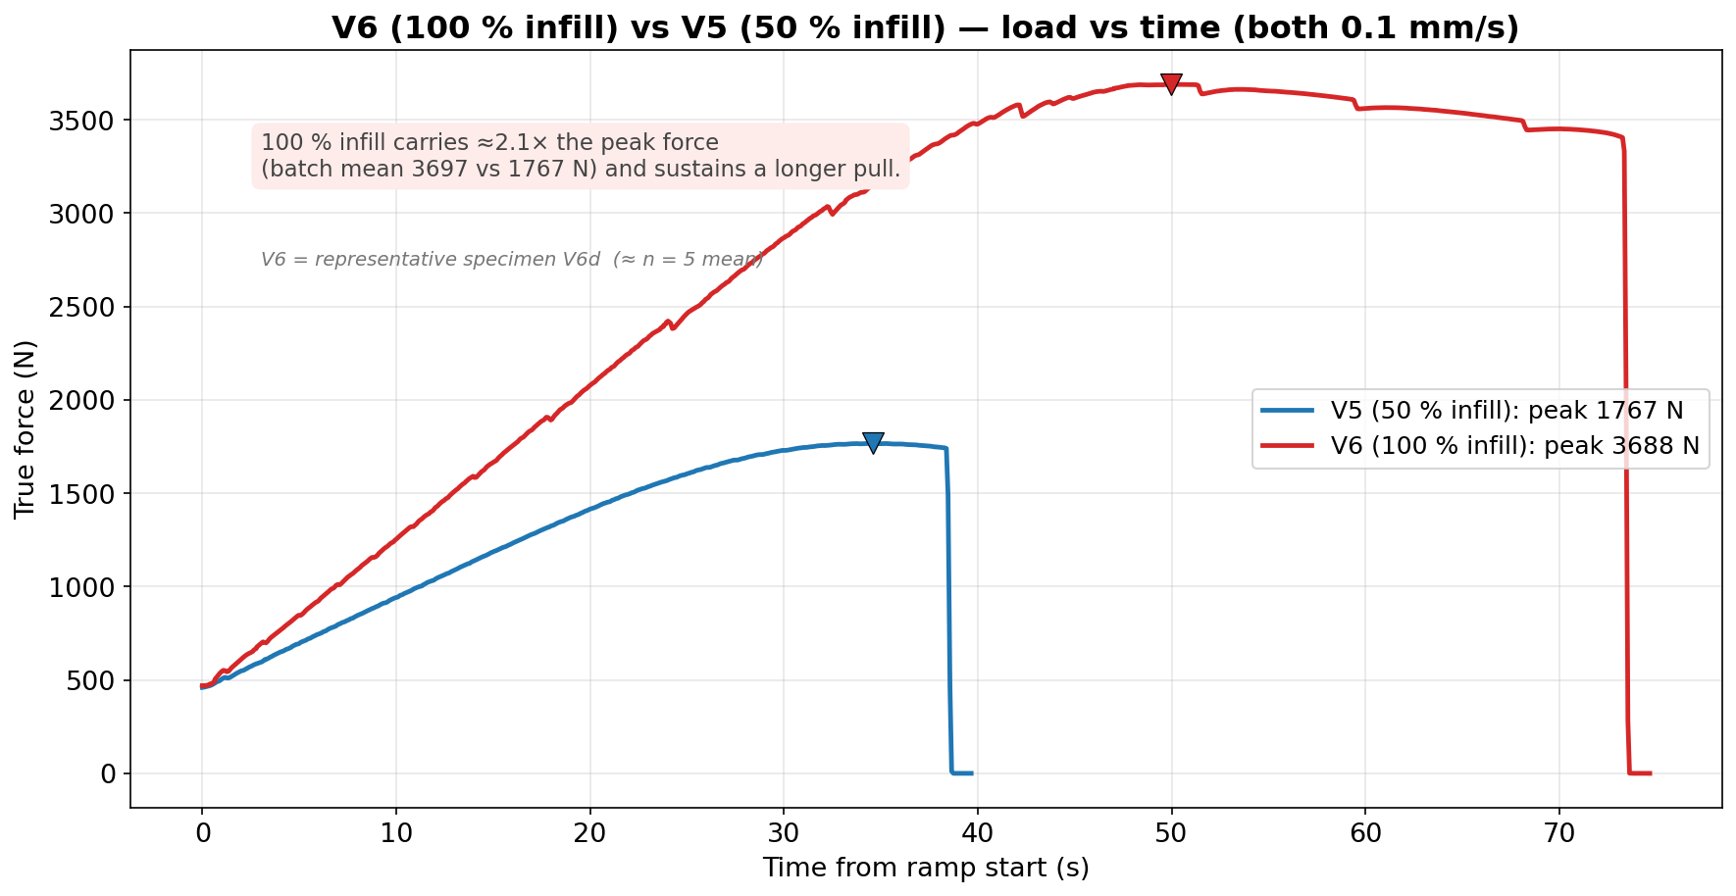
JÖNKÖPING UNIVERSITY
V6 (100 % INFILL) vs V5 (50 % INFILL): LOAD vs TIME
Both at 0.1 mm/s (rate-matched). 100 % infill carries ≈2.1× the peak force (batch mean 3697 vs 1767 N) and sustains a longer pull. Uses representative specimen V6d (≈ n = 5 mean), not the pilot V6a.
150

Slide 11
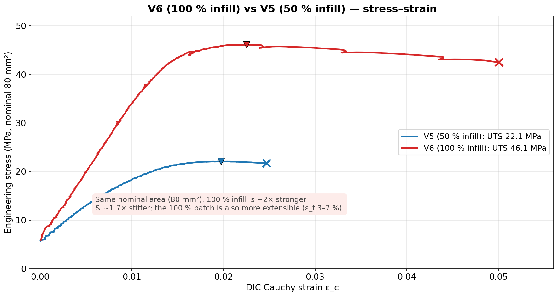
JÖNKÖPING UNIVERSITY
V6 (100 % INFILL) vs V5 (50 % INFILL): STRESS vs STRAIN
Same nominal 80 mm². 100 % infill is ~2× stronger (UTS 46.1 vs 22.1 MPa) and ~1.7× stiffer; the 100 % batch is also more extensible (ε_f 3–7 % vs ~2.5 %) — the difference is the infill load-bearing knock-down.
151

Slide 12
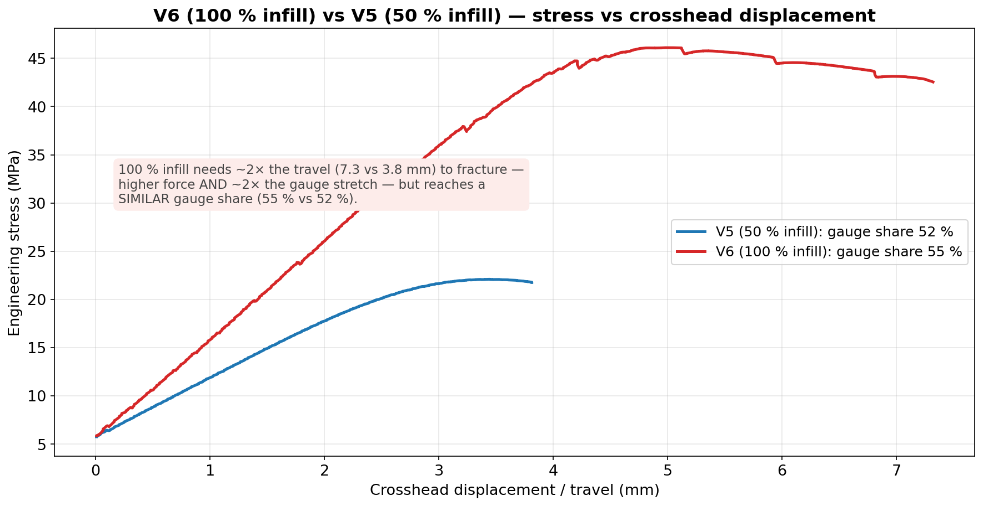
JÖNKÖPING UNIVERSITY
V6 (100 % INFILL) vs V5 (50 % INFILL): STRESS vs DISPLACEMENT
100 % infill needs ~2× the travel (7.3 vs 3.8 mm) to fracture — higher force and ~2× the gauge stretch — but reaches a SIMILAR gauge share (55 % vs 52 %). (The pilot V6a's low 33 % was its own outlier.)
152

Slide 13
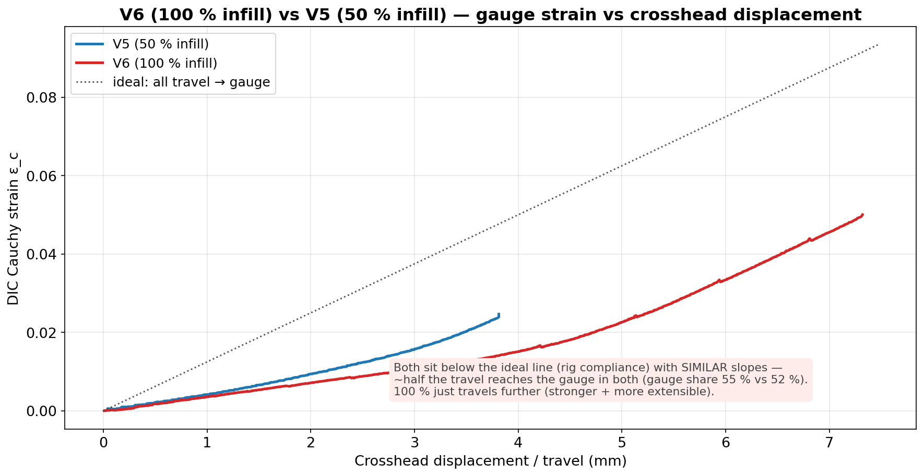
JÖNKÖPING UNIVERSITY
V6 (100 % INFILL) vs V5 (50 % INFILL): GAUGE STRAIN vs DISPLACEMENT
Both curves sit below the ideal ‘all-travel-to-gauge’ line (rig compliance) with SIMILAR slopes — about half the travel reaches the gauge in both; 100 % just travels further (stronger and more extensible).
153

Slide 14
JÖNKÖPING UNIVERSITY
50 % vs 100 % INFILL — FULL COMPARISON
All measured values — V6 = representative V6d (≈ n=5 mean); ratio (100 %/50 %), % change
What it means
Parameter | V5 50 % infill | V6 100 % infill | ratio | Δ %
Peak force (N) | 1767 | 3688 | 2.09× | +109
UTS (MPa) | 22.09 | 46.10 | 2.09× | +109
Yield σ_y 0.2 % (MPa) | 19.04 | 44.73 | 2.35× | +135
Elastic modulus E (GPa) | 1.54 | 2.63 | 1.71× | +71
Fracture stress (MPa) | 21.75 | 42.55 | 1.96× | +96
Failure strain ε_f | 0.0247 | 0.0500 | 2.02× | +102
Toughness (kJ/m³) | 462 | 2131 | 4.61× | +361
Post-UTS softening (%) | 1.5 | 7.7 | 5.1× | +413
Crosshead travel (mm) | 3.81 | 7.32 | 1.92× | +92
Gauge stretch DIC (mm) | 1.97 | 4.00 | 2.03× | +103
Rig take-up (mm) | 1.84 | 3.32 | 1.80× | +80
Gauge share of travel (%) | 51.8 | 54.7 | 1.06× | +6
Rig stiffness (N/mm) | 961 | 1111 | 1.16× | +16
Pull duration (s) | 38.4 | 73.3 | 1.91× | +91
DIC tracking (%) | 99.8 | 99 | 0.99× | ≈0
Strength scales ~2.1× — MORE than 2× for a 2× infill jump. The 50 % knock-down is NONLINEAR: 50 % infill bears < 50 % of the solid load path. • σ_y rises the most (2.35×) — 100 % yields near its UTS. • 100 % is also ~2× MORE extensible (ε_f 0.050 vs 0.025) — tougher (4.6×), not only stronger. • Gauge share ≈ the same (55 % vs 52 %) — 100 % just travels ~2× further (more force + more stretch). • Rate, area, markers, preload all matched — the only variable is infill.
≈ 2.1× strength, k: 1.45 → 1.0 (V6 = representative V6d)
154

Slide 15
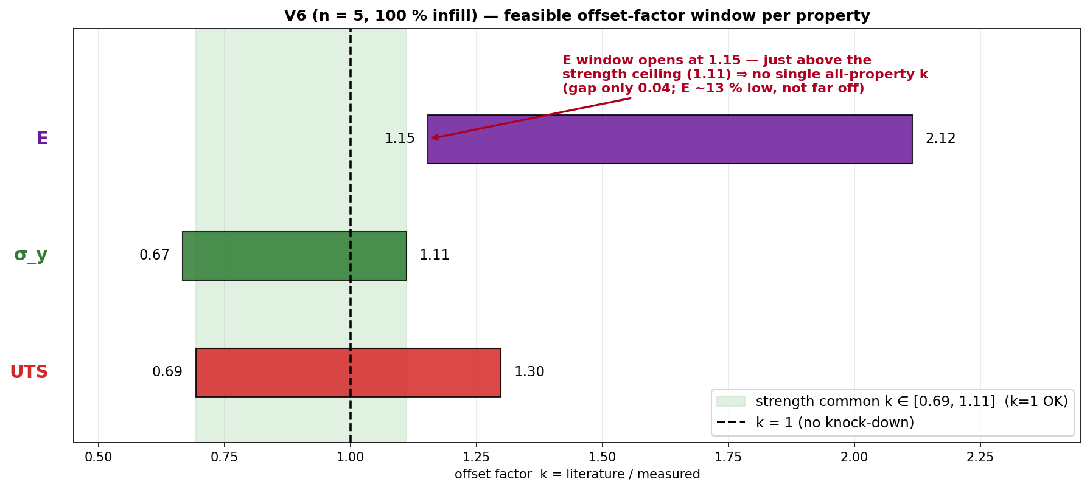
JÖNKÖPING UNIVERSITY
V6 (n = 5): A SINGLE COMMON OFFSET FACTOR?
Same interval method as V5 · from n = 5 mean
Property | feasible k window
E | [1.15, 2.12]
σ_y | [0.67, 1.11]
UTS | [0.69, 1.30]
ALL three | ∅ empty
Strength σ_y + UTS | [0.69, 1.11]
k window per property = [Chacón_lo / measured, Chacón_hi / measured]; a single uniform k must lie in the intersection of all three.
STRENGTH: a single uniform factor works — k ∈ [0.69, 1.11] and k = 1 sits inside it ⇒ apply k = 1.0 (no knock-down) to σ_y and UTS at 100 % infill.
No single ALL-property k: E reads ~13 % low (needs k ≥ 1.15) while in-range σ_y caps k ≤ 1.11 → they pull opposite ways, but only by 0.04. Treat E separately. (Contrast V5: a common k ≈ 2.4 existed.)
155

Slide 16
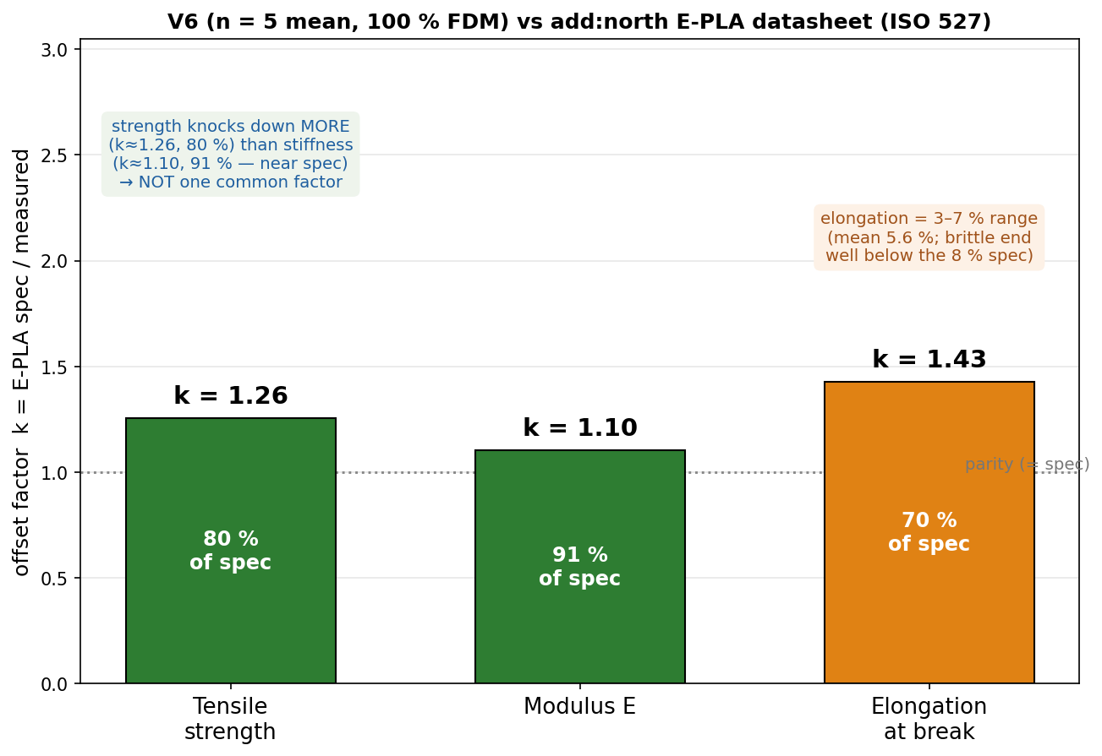
JÖNKÖPING UNIVERSITY
PHASE 8.6.20 V6 (n = 5): VALIDATION — add:north PLA REFERENCE
add:north E-PLA datasheet (ISO 527 / 178) vs measured n = 5 mean — k = spec / measured
Property | ISO | E-PLA spec | V6 (n=5) | k | retain
Yield strength σ_y | 527 | 58 MPa † | 45.0 MPa | 1.29 | 78 %
Tensile strength (UTS) | 527 | 58 MPa | 46.2 MPa | 1.26 | 80 %
Tensile modulus E | 527 | 2.87 GPa | 2.60 GPa | 1.10 | 91 %
Elongation @ break | 527 | 8 % | 3–7 % | 1.1–2.7 | 37–93 %
Flexural strength | 178 | 120 MPa | not tested | — | —
Density / HDT | 527/75 | 1.24 / 55 °C | — | — | —
Validated against TWO references: • Journal (Chacón 2017): σ_y & UTS land INSIDE the range (pass); modulus just below floor. • add:north E-PLA datasheet: strength ≈ 80 % of rated (k ≈ 1.26); stiffness ≈ 91 % (k ≈ 1.10, near spec) — E is CLOSER to spec than strength, so NOT one common factor. Repeatable at CV 2.5 % (n = 5).
Spec sheet — add:north E-PLA TDS (PDF, ISO 527 / 178)
add:north PLA Economy — product page
Closest match = add:north E-PLA datasheet: strength k ≈ 1.26 (80 % of rated), stiffness k ≈ 1.10 (91 %, near spec). Predict printed strength ≈ spec ÷ 1.25.
† E-PLA reports one tensile strength (at break), PLA σ_y ≈ UTS → both vs 58 MPa. E-PLA = closest add:north PLA (no PLA Economy TDS); ISO 527 moulded vs printed 80 mm² bar; values = n = 5 mean.
156

Slide 17
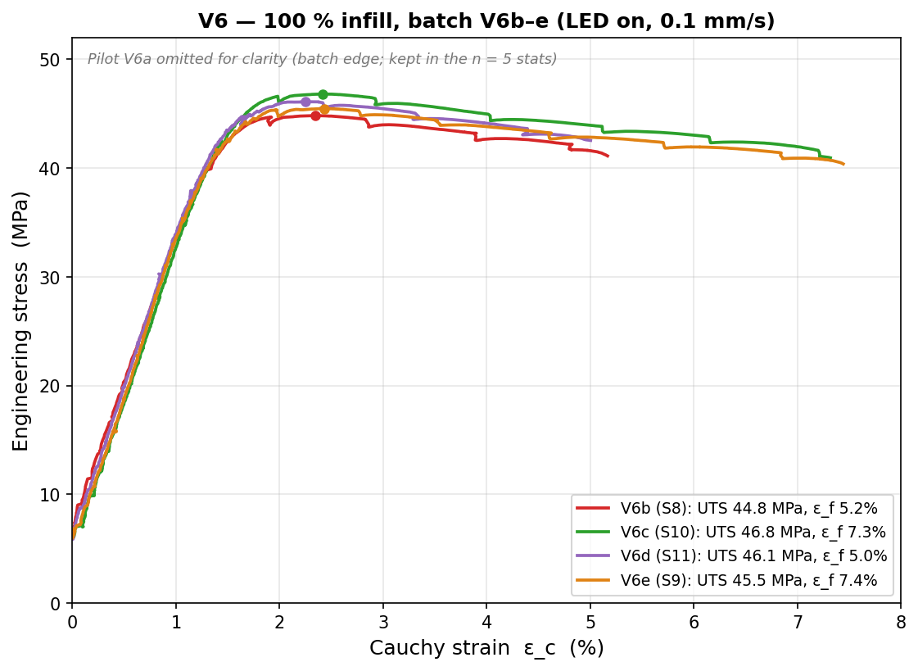
JÖNKÖPING UNIVERSITY
PHASE 8.6.20 V6: REPEATABILITY STUDY (n = 5, 100 % INFILL)
Per-specimen values (UTS/σ_y MPa · E GPa · ε_f –)
Specimen | UTS | σ_y | E | ε_f
V6a · S7 | 47.82 | 47.80 | 2.41 | 0.030
V6b · S8 | 44.83 | 43.24 | 2.63 | 0.052
V6c · S10 | 46.82 | 45.09 | 2.72 | 0.073
V6d · S11 | 46.10 | 44.73 | 2.63 | 0.050
V6e · S9 | 45.47 | 44.03 | 2.59 | 0.074
mean | 46.2 | 45.0 | 2.60 | 0.056
CV % | 2.5 | 3.8 | 4.4 | 33
2.5 %
UTS CV
3.8 %
σ_y CV
4.4 %
E CV
33 %
ε_f CV
⚠ V6a (S7) = pilot, run 8 days before the b–e batch → the strength/modulus EDGE point (σ_y +4.3σ, E −4.2σ, most brittle). Matched b–e batch alone: UTS 1.9 % · σ_y 1.8 % · E 2.1 % CV. Kept in n = 5 (conservative) — verdict unchanged.
Strength REPEATABLE — UTS/σ_y/E all CV ≤ 4.4 % (n = 5; matched b–e batch < 2.1 %). Ductility ε_f scatters 33 % → report as a range.
157

Slide 18
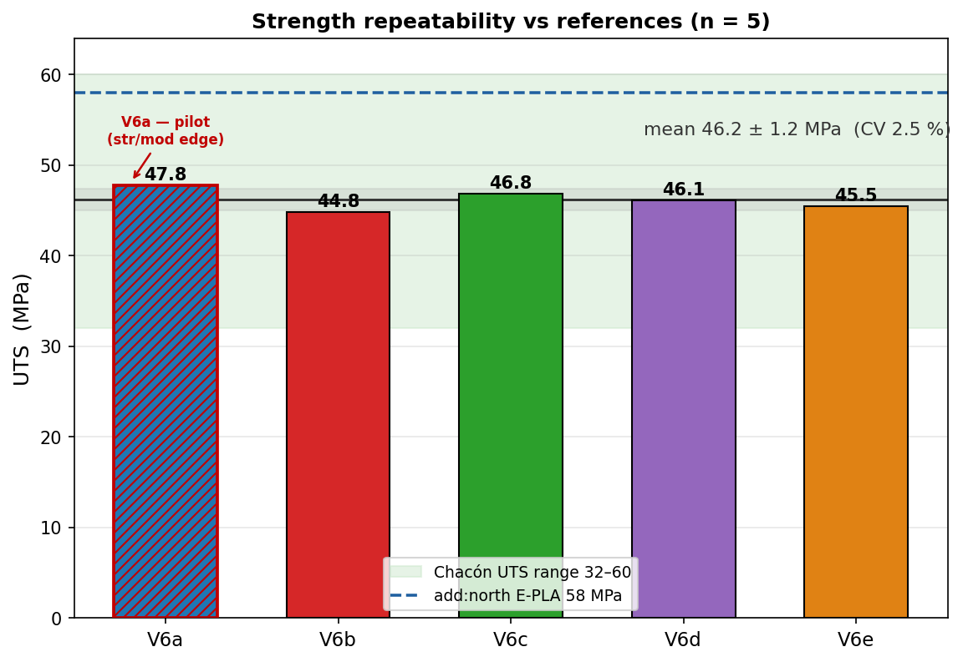
JÖNKÖPING UNIVERSITY
PHASE 8.6.20 V6: STRENGTH — REPEATABLE & IN LITERATURE
Strength vs both references
Quantity | V6 (n=5) | vs Chacón | vs E-PLA
UTS | 46.2 ± 1.2 MPa | inside 32–60 ✓ | 80 % (k 1.26)
σ_y (0.2 %) | 45.0 MPa | inside 30–50 ✓ | 78 %
E | 2.60 GPa | 13 % below 3.0 ⚠ | 91 % (k 1.11)
• UTS = 46.2 ± 1.2 MPa (CV 2.5 %, 95 % CI ±1.4) — converged as n grew. • All 5 land INSIDE the Chacón range → k ≈ 1 (no knock-down), confirming the 50 % offset (k≈2.4) was purely the infill effect. • vs add:north E-PLA datasheet: 80 % of rated strength, 91 % of stiffness — coherent FFF knock-down.
STRENGTH PASS — repeatable (CV 2.5 %), inside the journal range, and a sensible ~80–90 % of the manufacturer's rated solid material.
158

Slide 19
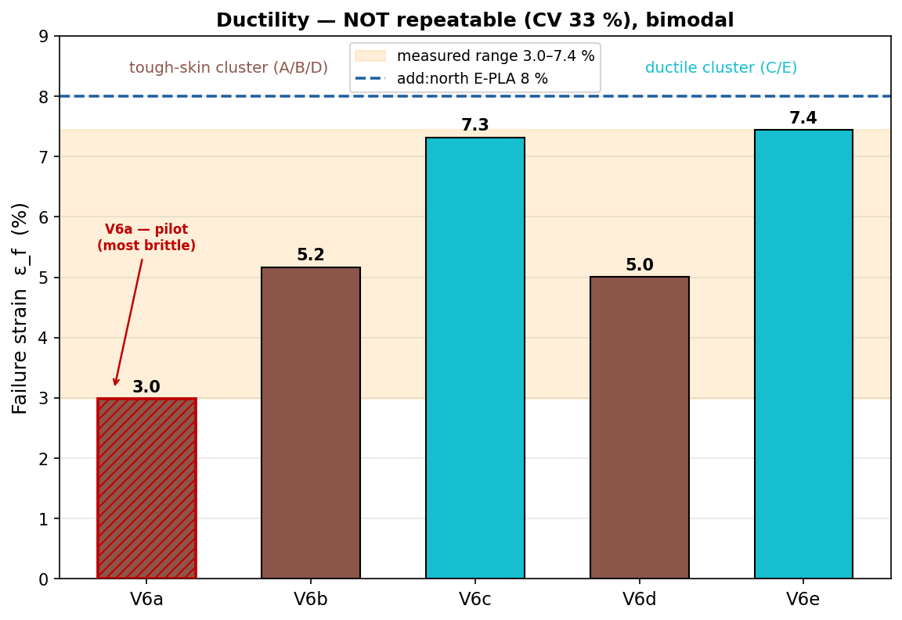
JÖNKÖPING UNIVERSITY
PHASE 8.6.20 V6: DUCTILITY — REPORT AS A RANGE
Failure strain & toughness
3.0–7.4 %
ε_f range
33 %
ε_f CV
2315 kJ/m³
toughness
Failure strain is NOT reproducible (CV 33 %) and looks bimodal: • tough-skin cluster A/B/D ≈ 3.0–5.2 % • ductile cluster C/E ≈ 7.3–7.4 % (nearly the 8 % datasheet value) FDM crack-initiation lottery — a void / weak layer decides where the crack starts, so elongation varies far more than strength. Toughness follows ε_f (1310–3053 kJ/m³).
Quote ductility as a RANGE (ε_f = 3–7 %), never a single number. Strength is the reproducible engineering value; ductility is specimen-dependent.
159

Slide 20
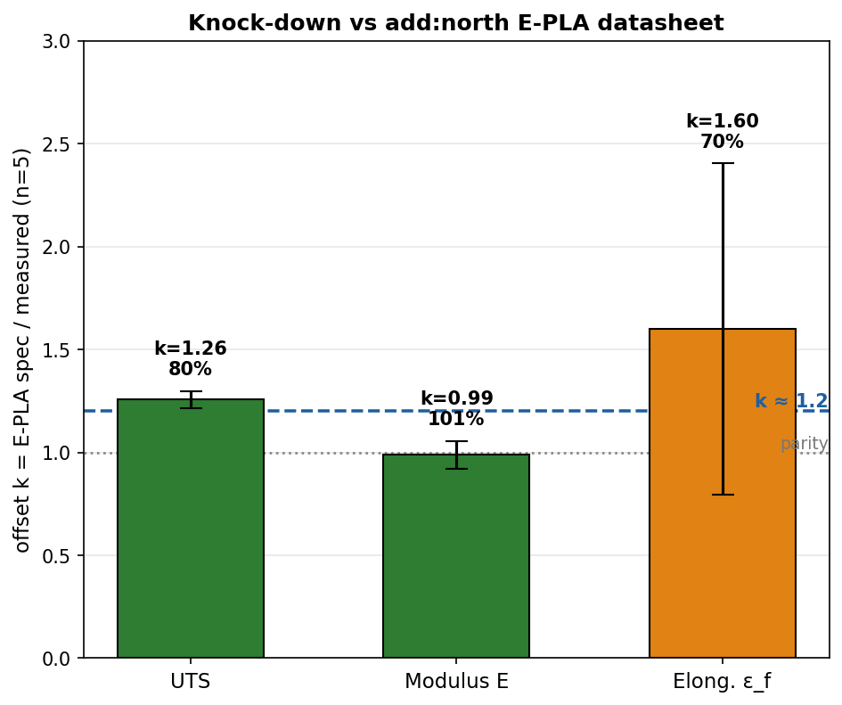
JÖNKÖPING UNIVERSITY
PHASE 8.6.20 V6: VALIDATION SUMMARY — JOURNAL & MANUFACTURER
Pass / fail vs both references (n = 5, 100 % infill)
Property | V6 mean | Chacón range | vs journal | E-PLA spec | vs datasheet
UTS | 46.2 MPa | 32–60 MPa | ✓ PASS | 58 MPa | 80 % (k1.26)
σ_y | 45.0 MPa | 30–50 MPa | ✓ PASS | 58 MPa † | 78 %
E | 2.60 GPa | 3.0–5.5 GPa | ⚠ 13 % low | 2.87 GPa | 91 % (k1.11)
ε_f | 3.0–7.4 % | — | — | 8 % | 37–93 % range
PASS — strength lands inside the journal (k ≈ 1) AND sits at a coherent k ≈ 1.2 vs the add:north E-PLA datasheet (80 % strength / 91 % stiffness), repeatable at CV 2.5 % across 5 specimens.
Caveat: elastic modulus is ~13 % below the journal floor (but meets the datasheet at 91 %); ε_f is reported as a 3–7 % range, not a single value.
add:north E-PLA TDS (ISO 527 / 178)
Writeup: 100 % PLA validated vs literature for strength (k≈1 vs Chacón); characterised at k≈1.2 vs add:north E-PLA datasheet; modulus meets datasheet, marginally below journal; ε_f = 3–7 % range.
160

Slide 21
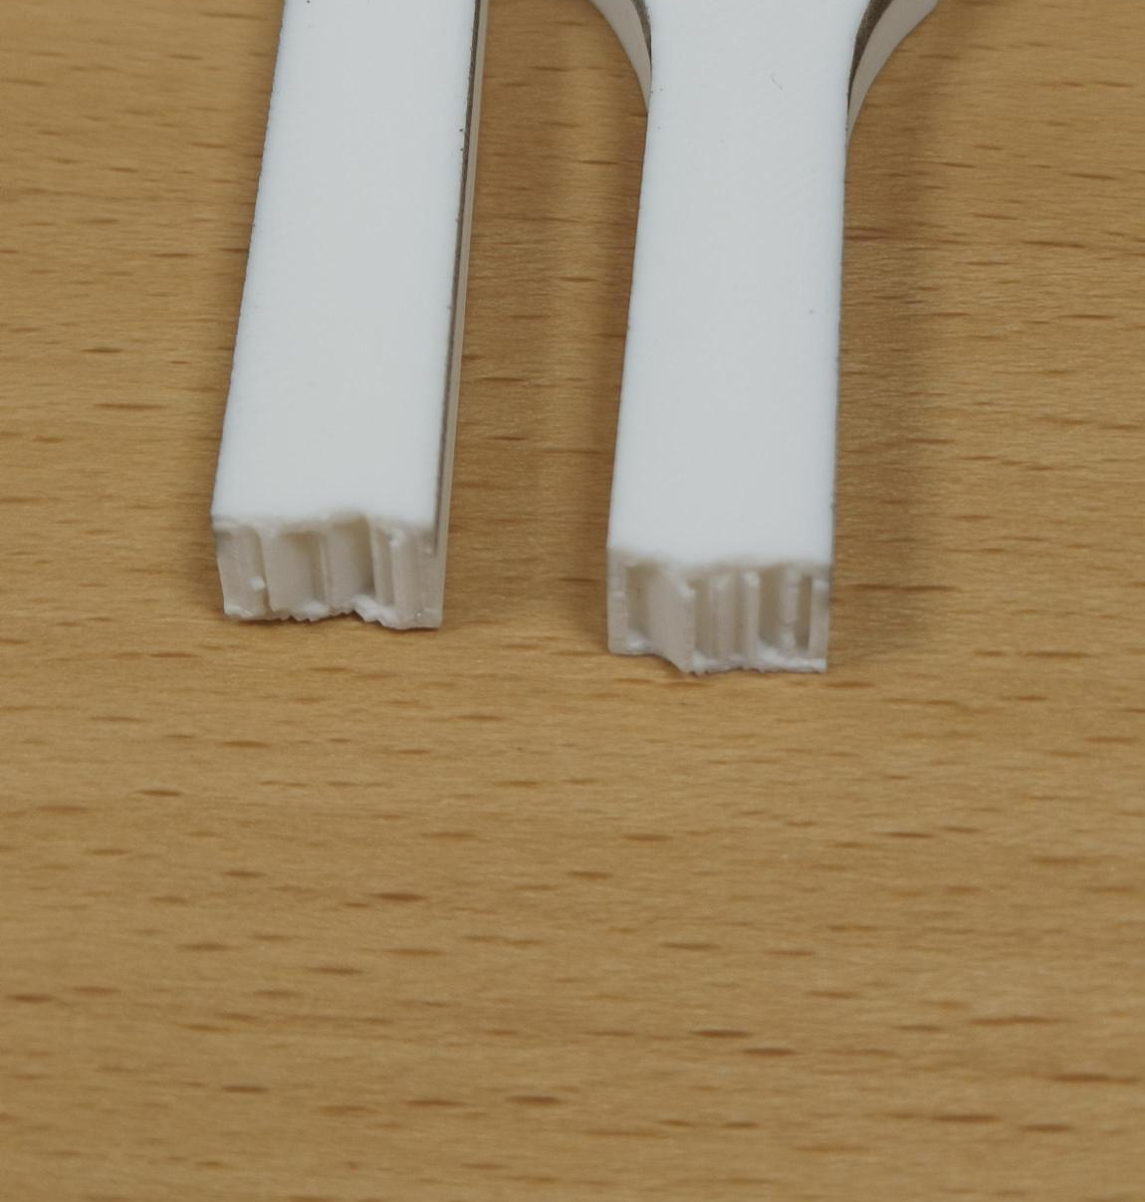
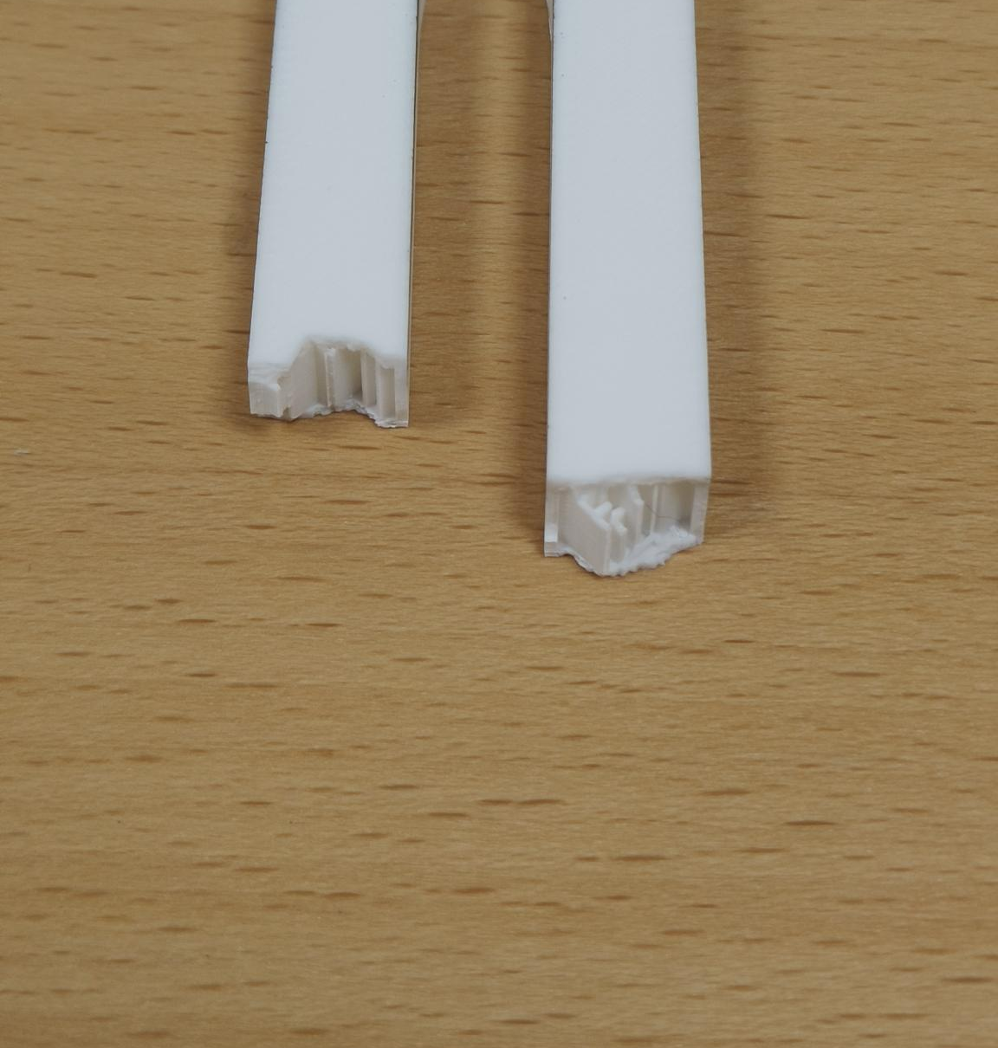
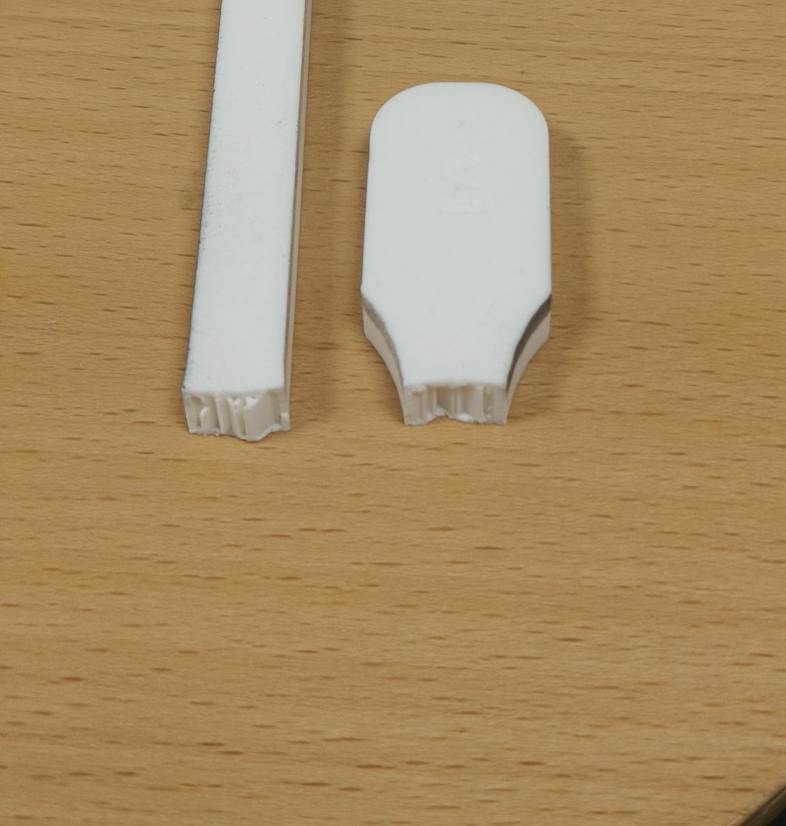
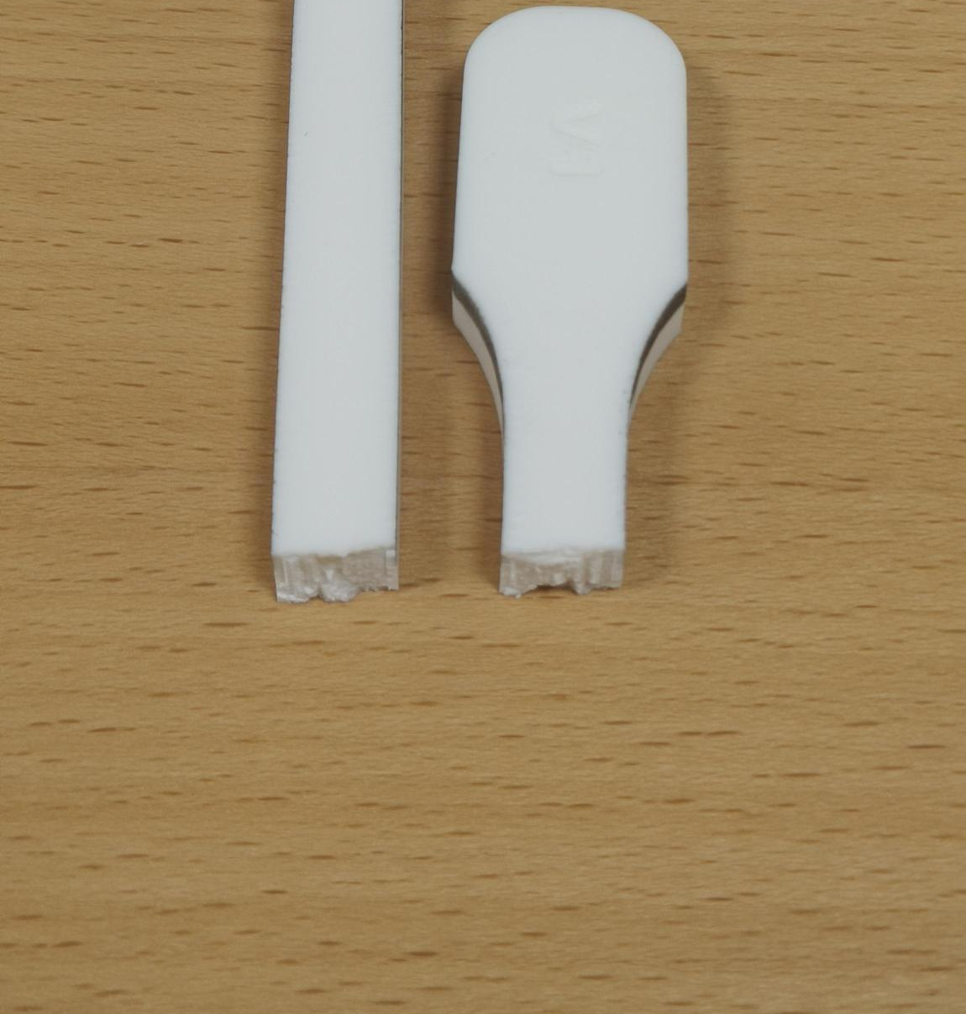
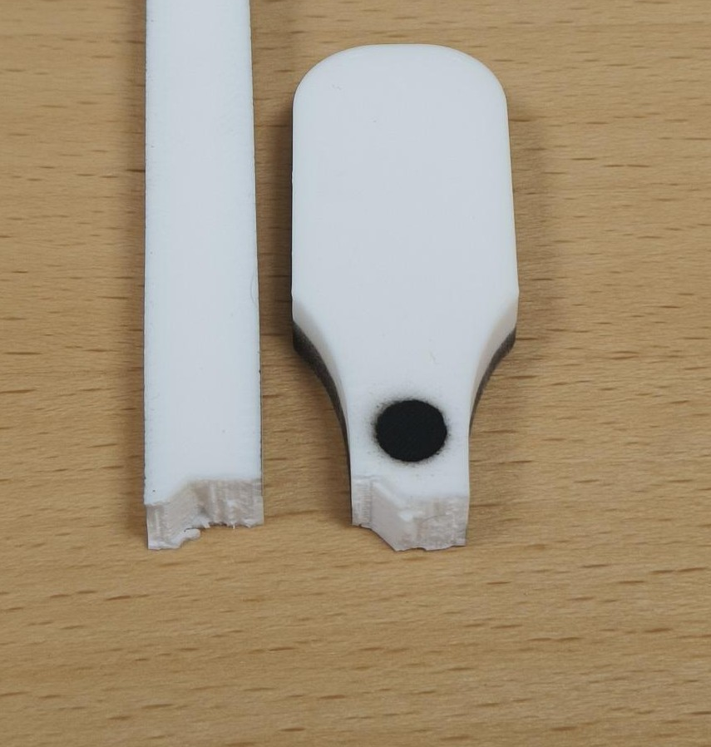
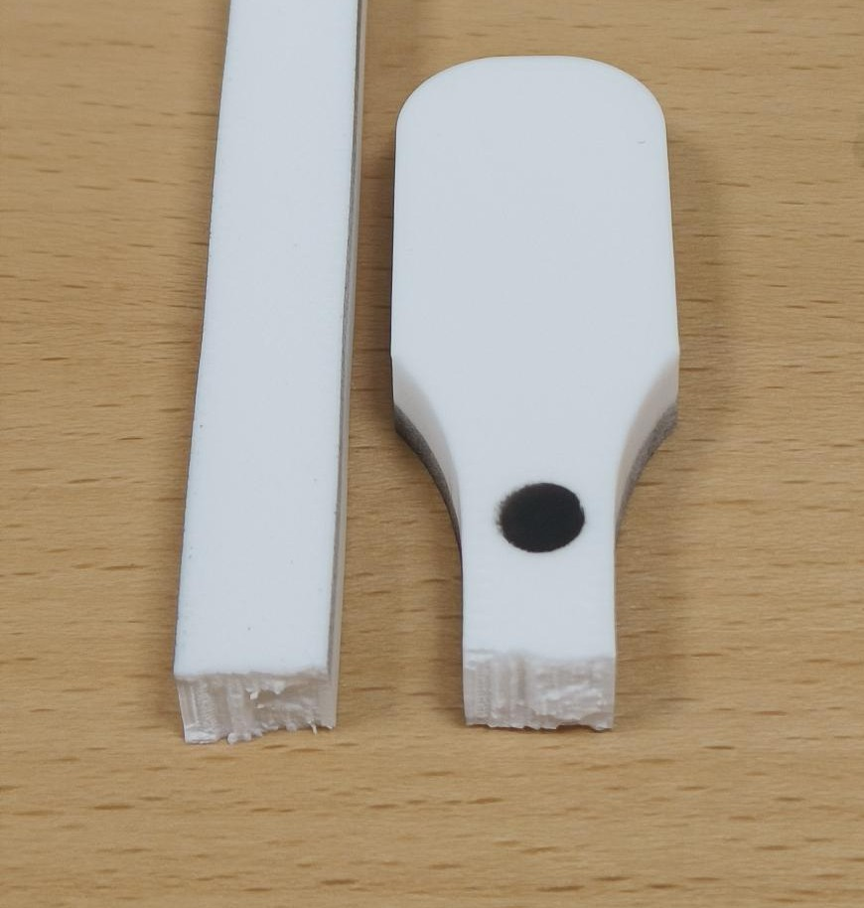
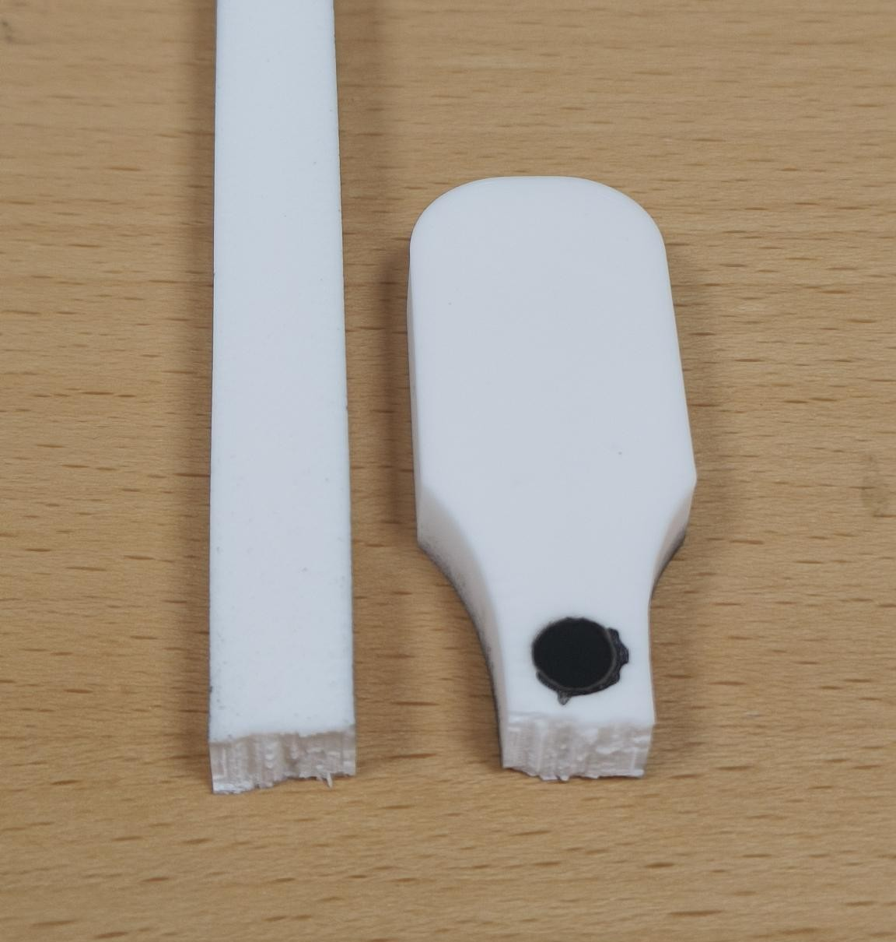
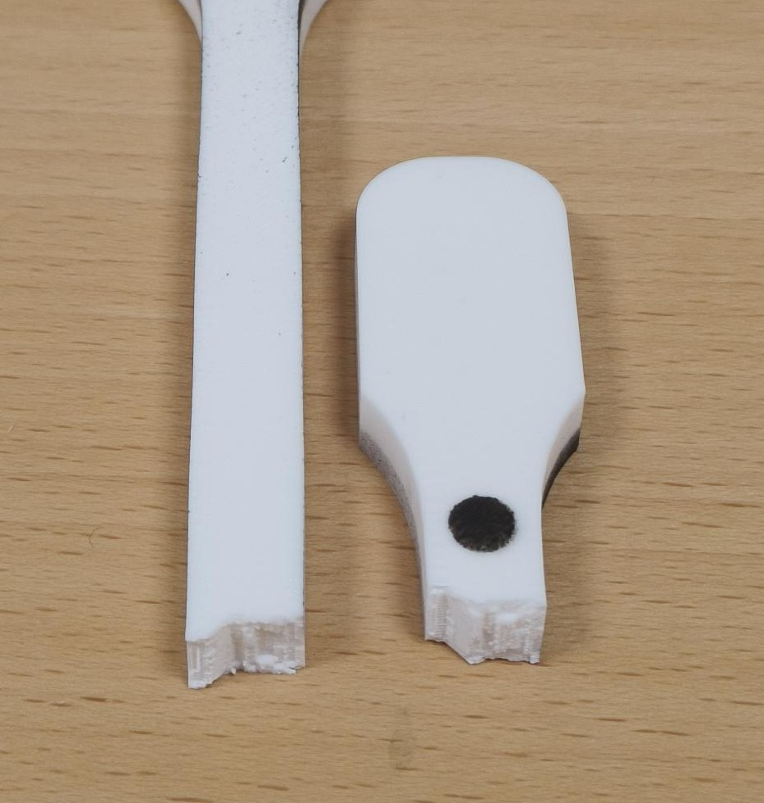
JÖNKÖPING UNIVERSITY
PHASE 8.6.20: FRACTURE PATTERNS — 50 % vs 100 % INFILL (V5 & V6)
FRACTURE — KEY FINDING
50 % INFILL — V5 group (LED off)
HOW TO READ
All 8 specimens failed the SAME way — a flat, transverse break at the lower gauge–fillet (a stress concentration), with no necking = brittle FDM failure. Infill sets STRENGTH & stiffness, NOT the failure mode.
• 50 % faces expose the sparse infill ribs; 100 % faces are fully dense. • V6a = pilot (batch edge). V6c / V6e = ductile cluster (ε_f ≈ 7 %); the others ≈ 3–5 %.
V5 · S4
V5b · S3
V5c · S2
22.1 MPa · ε_f 2.5 %
22.0 MPa · ε_f 2.6 %
22.0 MPa · ε_f 3.1 %
100 % INFILL — V6 quintet (LED on)
V6a · S7 (pilot)
V6b · S8
V6c · S10 (ductile)
V6d · S11
V6e · S9 (ductile)
47.8 MPa · ε_f 3.0 %
44.8 MPa · ε_f 5.2 %
46.8 MPa · ε_f 7.3 %
46.1 MPa · ε_f 5.0 %
45.5 MPa · ε_f 7.4 %
Each specimen photo is an individually placed, croppable picture (…/8.6.20 - Tensile test to Failure/Specimen_S*/). Labels = measured UTS · ε_f. Reset crop in PowerPoint to see the full specimen.
161

Slide 22
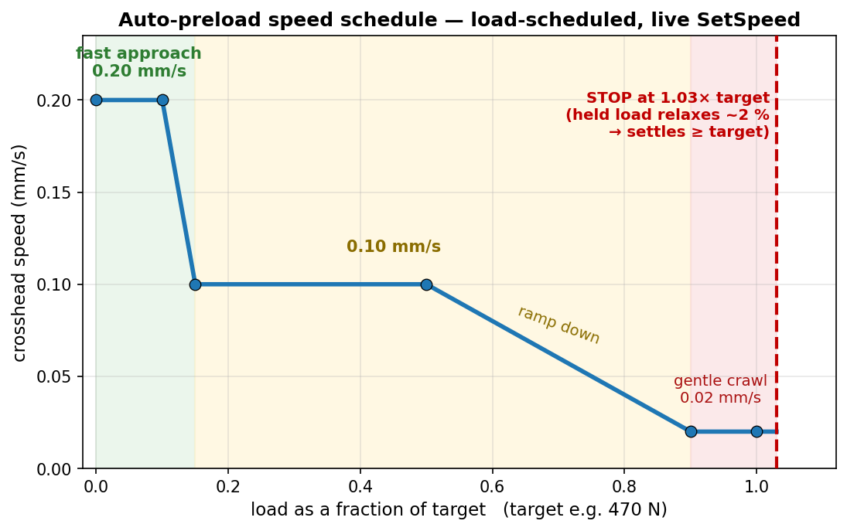
JÖNKÖPING UNIVERSITY
UTM SOFTWARE: AUTOMATIC PRELOAD (‘PRELOAD TENSION’)
Preload to:
470 N
▴ ▾
Preload tension
The operator control (screen recreation): type a target load, click once — the crosshead auto-tensions to it, hands-off.
How it works — one click, hands-off
1. Enter the target preload (e.g. 470 N) and press Preload tension. 2. The crosshead tensions at a LOAD-scheduled speed: 0.20 mm/s up to ~15 % of target, 0.10 mm/s to 50 %, then ramps to a gentle 0.02 mm/s as it nears the target. 3. It stops at 1.03× the target — a deliberate ~3 % overshoot. 4. PLA stress-relaxes ~2 % while held → the load settles AT / just above the target.
Why: manual jogging is slow and overshoots, and PLA relaxes after you stop (you would undershoot). Auto-preload lands consistently at target (+3 % set − ~2 % relaxation ≈ target). Safety: hard cap 1.25× target, 180 s timeout, live speed-only control (no Stop→restart re-latch).
Feature in Software/UTM_PyQt6/main.py — PRELOAD_SPEED_KNOTS · TARGET_FACTOR 1.03 · OVERSHOOT_CAP 1.25 · TIMEOUT 180 s. Used to set the ~470 N preload before every V5 / V6 pull.
162

Slide 23
JÖNKÖPING UNIVERSITY
SOFTWARE ROADMAP — ADVANCED FEATURES & EASE OF USE: STATUS
The rig automated only ONE thing (auto-preload). A phased roadmap adds automated test modes, smart DIC and one-click analysis — each piece shippable on its own. After the full rig-test campaign:
Phase | Focus | Status
0 · Foundations | shared analysis library · control engine · recipes | DONE
A · One-click workflow | per-test report · test registry · prepare-specimen · auto-stop | DONE — VALIDATED
B · Closed-loop modes | strain-rate + cyclic / staircase / relaxation / creep | strain-rate DONE · 4 to wire
C · Smart DIC | live health HUD + measured Poisson / true Cauchy | HUD DONE · Poisson next
D · UX layer | guided wizard · live overlay · dashboard | PLANNED
7
MODULES (in git)
9
APP FEATURES
9 / 9
SIM CHECKS PASSED
6 / 6
RIG TESTS PASSED
LEGEND — DONE + rig-validated (green) · partial, more to wire (amber) · PLANNED (grey). Foundations, the one-click workflow and the strain-rate fracture test are validated on the rig; the remaining modes, measured Poisson and the UX layer are next.
All analysis logic is unit-tested / sim-validated offline; the app feature set is now snapshot-committed (main.py a3b187f) after the full rig-test campaign — see ROADMAP.md / TESTING_TODO.md.
163

Slide 24
JÖNKÖPING UNIVERSITY
DONE — BUILT, VERIFIED & COMMITTED
Analysis & workflow tooling (offline-verified, in git)
In the UI (main.py — RIG-VALIDATED · snapshot a3b187f)
Module | What it gives you
utm_analysis.py | ONE fracture detector + E / σy / UTS / εf / anchor
utm_report.py | one-click per-test PDF + PNG report
utm_registry.py | one table of EVERY test (props + anchor)
utm_recipes.py | save / load a full test setup
control_policies + _sim | closed-loop test-mode engine — 9/9 sim
utm_dic.py | live DIC health + Poisson / Cauchy maths
• Generate report — one button → PDF + images • Settings — Load / Save a setup (+ Default) • Prepare specimen — 1-click tare (position + force + DIC) • Fracture test / Auto-stop — halts on load collapse • Strain-rate fracture test — closed-loop dε/dt • DIC health HUD — live OK / WARN / BAD badge • Safety net — 4.5 kN / 30 mm / stall guard / dead-DIC
Kills the copy-paste-per-specimen analysis burden (the cause of the V6c / V5-S4 detector bugs): one tested analyser, reused everywhere. Reproduces the known V5 / V6 numbers exactly.
Modules committed & regression-checked against the deck numbers; the UI feature set is now snapshot-committed (main.py a3b187f) after full rig validation.
164

Slide 25
JÖNKÖPING UNIVERSITY
VALIDATED ON THE PPD-UTM Mk I (2026-07-28 / 29)
Feature checks — ALL PASSED
Rig facts — ALL RESOLVED
Feature | Result
DIC health HUD | green 2/2 live; red BAD on dot cover ✓
Prepare specimen | 1 click → position + force + DIC tared ✓
Auto-stop at fracture | caught S16 collapse 2992 → −417 N ✓
Settings | Default + Load / Save round-trip ✓
Generate report | S16 report = CSV, every KPI ✓
Strain-rate fracture | held 0.0005/s → fracture, auto-stop ✓
These unblock the other 4 test modes: 1. Stop HOLDS position ✓ (zero drift over 5 / 10 / 15 s) 2. Direct reversal auto-decels ~1 s ✓ (no manual Stop needed) 3. Travel cap set to 30 mm ✓ → cyclic / staircase / relaxation / creep are now UNBLOCKED to wire.
RESULT — every built feature passed on the rig; S16 = first 100% infill fracture (UTS 47.4 MPa, anchor-corrected). Strain-rate 6.2 held the target rate by adapting crosshead speed 0.10 → 0.05 mm/s. ONE hardware limit found — motor torque ceiling ~2.6 kN (next slide).
PPD-UTM — the Department of Product Development, Production and Design's universal testing machine; Mk I and Mk II are defined on p184. · Full step-by-step results: Software/UTM_PyQt6/docs/TESTING_TODO.md; thresholds confirmed (fracture arm 30% / collapse 50%, travel cap 30 mm, stall guard 0.05 mm / 6 s).
165

Slide 26
JÖNKÖPING UNIVERSITY
PLANNED NEXT — MEASURED POISSON (EDGE-WIDTH) + REMAINING AUTOMATION
Measured Poisson / true Cauchy — edge-width tracking (next build, reuses THIS camera)
Matte-black MDF backdrop (behind gauge)
Camera detects L & R specimen edges
Average width over the gauge (100s of rows)
εw → ν and true area → Cauchy stress
MEASURED (no assumed ν), reusing the current camera + specimen — matte finish avoids LED glare, a few-cm gap softens shadows. FIRST STEP: mount the board, grab ONE still frame → prototype the edge-detection to confirm contrast BEFORE building the live feature. (Transverse dots stay ruled out — see slide 164.)
Remaining automation & ease-of-use
• Cyclic / staircase / relaxation / creep modes (engine ready — rig facts RESOLVED, ready to wire) • Measured Poisson — 4-marker / edge-width + auto specimen metadata + folder from recipe • One-click per-specimen report deck
• Guided wizard / checklist (Connect → … → Prepare → Run → Save) • Live stress-strain + elastic-modulus overlay • Glanceable dashboard + fracture beep / banner
HARDWARE LIMIT — motor torque ceiling ~2.6 kN (variable; driver Vref / thermal / PSU) blocks 100% full-area fracture; use 50% / smaller specimens until resolved. ORDER — wire remaining modes → edge-width Poisson → UX layer.
166

Slide 27
JÖNKÖPING UNIVERSITY
SMART-UTM FEATURE SET — SF1 to SF19
17 built and RIG-VALIDATED (green) · 2 built, offline-verified only (blue). Numeric order, so a card can be found by its SF number.
SF1 DIC health HUD live 2/2 · jitter
SF2 Prepare specimen 1-click tare all
SF3 Settings / recipes reuse a whole setup
SF4 Generate report 1-click PDF + PNG
SF5 Auto-stop at fracture halts on collapse
SF6 Strain-rate fracture constant dε/dt
SF7 Stall guard halts a frozen motor
SF8 Release load safe return to true 0
SF9 6 closed-loop protocols cyclic…prog-cyclic→fracture
SF10 Auto-preload 0.2→0.1→0.02 mm/s
SF11 Auto-metadata link capture ↔ CSV, by overlap
SF12 DIC auto-calibrate sweeps exposure × threshold
SF13 Guided wizard 12 steps, optional, off by default
SF14 Test registry every run + force anchor
SF15 Dead-DIC guard + backstops 0.2 s freeze / 1.0 s halt
SF16 Live Px₀ overlay frozen vs live pair, on the feed
SF17 Video + image capture PNG + 3 AVI styles, 0 dropped
SF18 DIC post-processing measure any recorded video
SF19 Noise capture the instrument at rest
Renumbered 2026-09-02 to a contiguous SF1–SF19 — two entries were dropped, a developer-only sim harness and optics-blocked Poisson (now FW1). Four safety layers on every driven test: load-collapse · stall guard · 4.5 kN / 30 mm · dead-DIC freeze.
167

Slide 28

JÖNKÖPING UNIVERSITY
DIC HEALTH HUD — LIVE TRACKING QUALITY
A live badge on both test tabs: markers found / expected · % frames tracked · pixel jitter.
What each state means
State | Colour | Condition | Meaning
OK | green | all markers · ≥ 95% tracked · jitter ≤ 1.5 px | trust the strain
WARN | amber | 70–95% tracked OR jitter > 1.5 px | degraded — re-light / watch
BAD | red | a marker missing OR < 70% tracked | unreliable — fix before pulling
NO DATA | grey | camera off / no frames | —
Recorded per-frame in the CSV (DIC_Blobs column) — so you know DIC was reliable, and can PROVE it after the test.
168

Slide 29
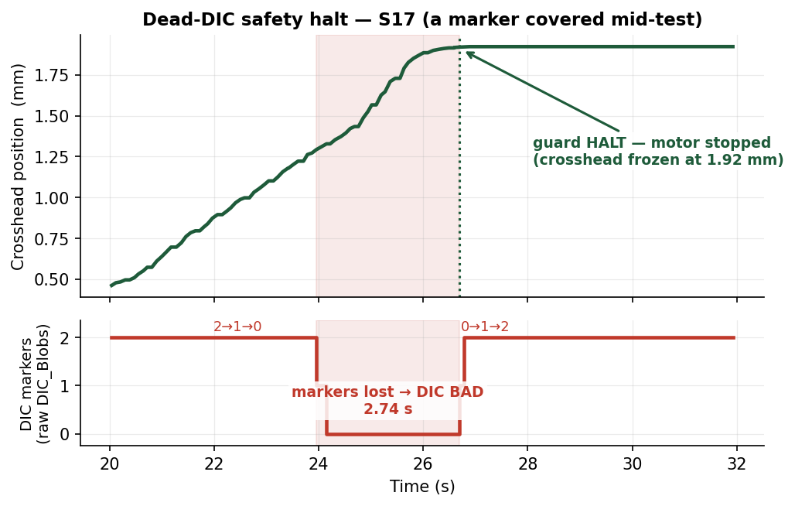
JÖNKÖPING UNIVERSITY
DIC-DRIVEN SAFETY — HALT IF TRACKING GOES BAD (proof, S17)
CONDITION
During a strain-rate test, if DIC strain FREEZES (markers lost): • FREEZE speed at 0.2 s • HALT at 1.0 s
Why
The loop STEERS on DIC strain. If tracking dies it is blind — so it stops instead of pulling on stale / frozen data.
S17 — covered a marker mid-test → DIC went BAD → motor auto-halted. No runaway on blind data.
169

Slide 30
JÖNKÖPING UNIVERSITY
SF 2 — PREPARE SPECIMEN (one-click tare)
One click zeroes everything
Tare position (δ = 0)
Tare force (N = 0)
Tare DIC (set L0)
Clear plots + consoles
• Replaces the old 3-click tare with ONE button • DIC tares only at green 2/2 — otherwise 'DIC skipped' (honest, no false L0) • Leaves a clean, ready-to-pull baseline
Rig-validated — position + force + DIC all zeroed, consoles + stress-strain plot cleared, from one press.
Feature in Software/UTM_PyQt6/main.py (Prepare specimen button). Validated 2026-07-28.
170

Slide 31
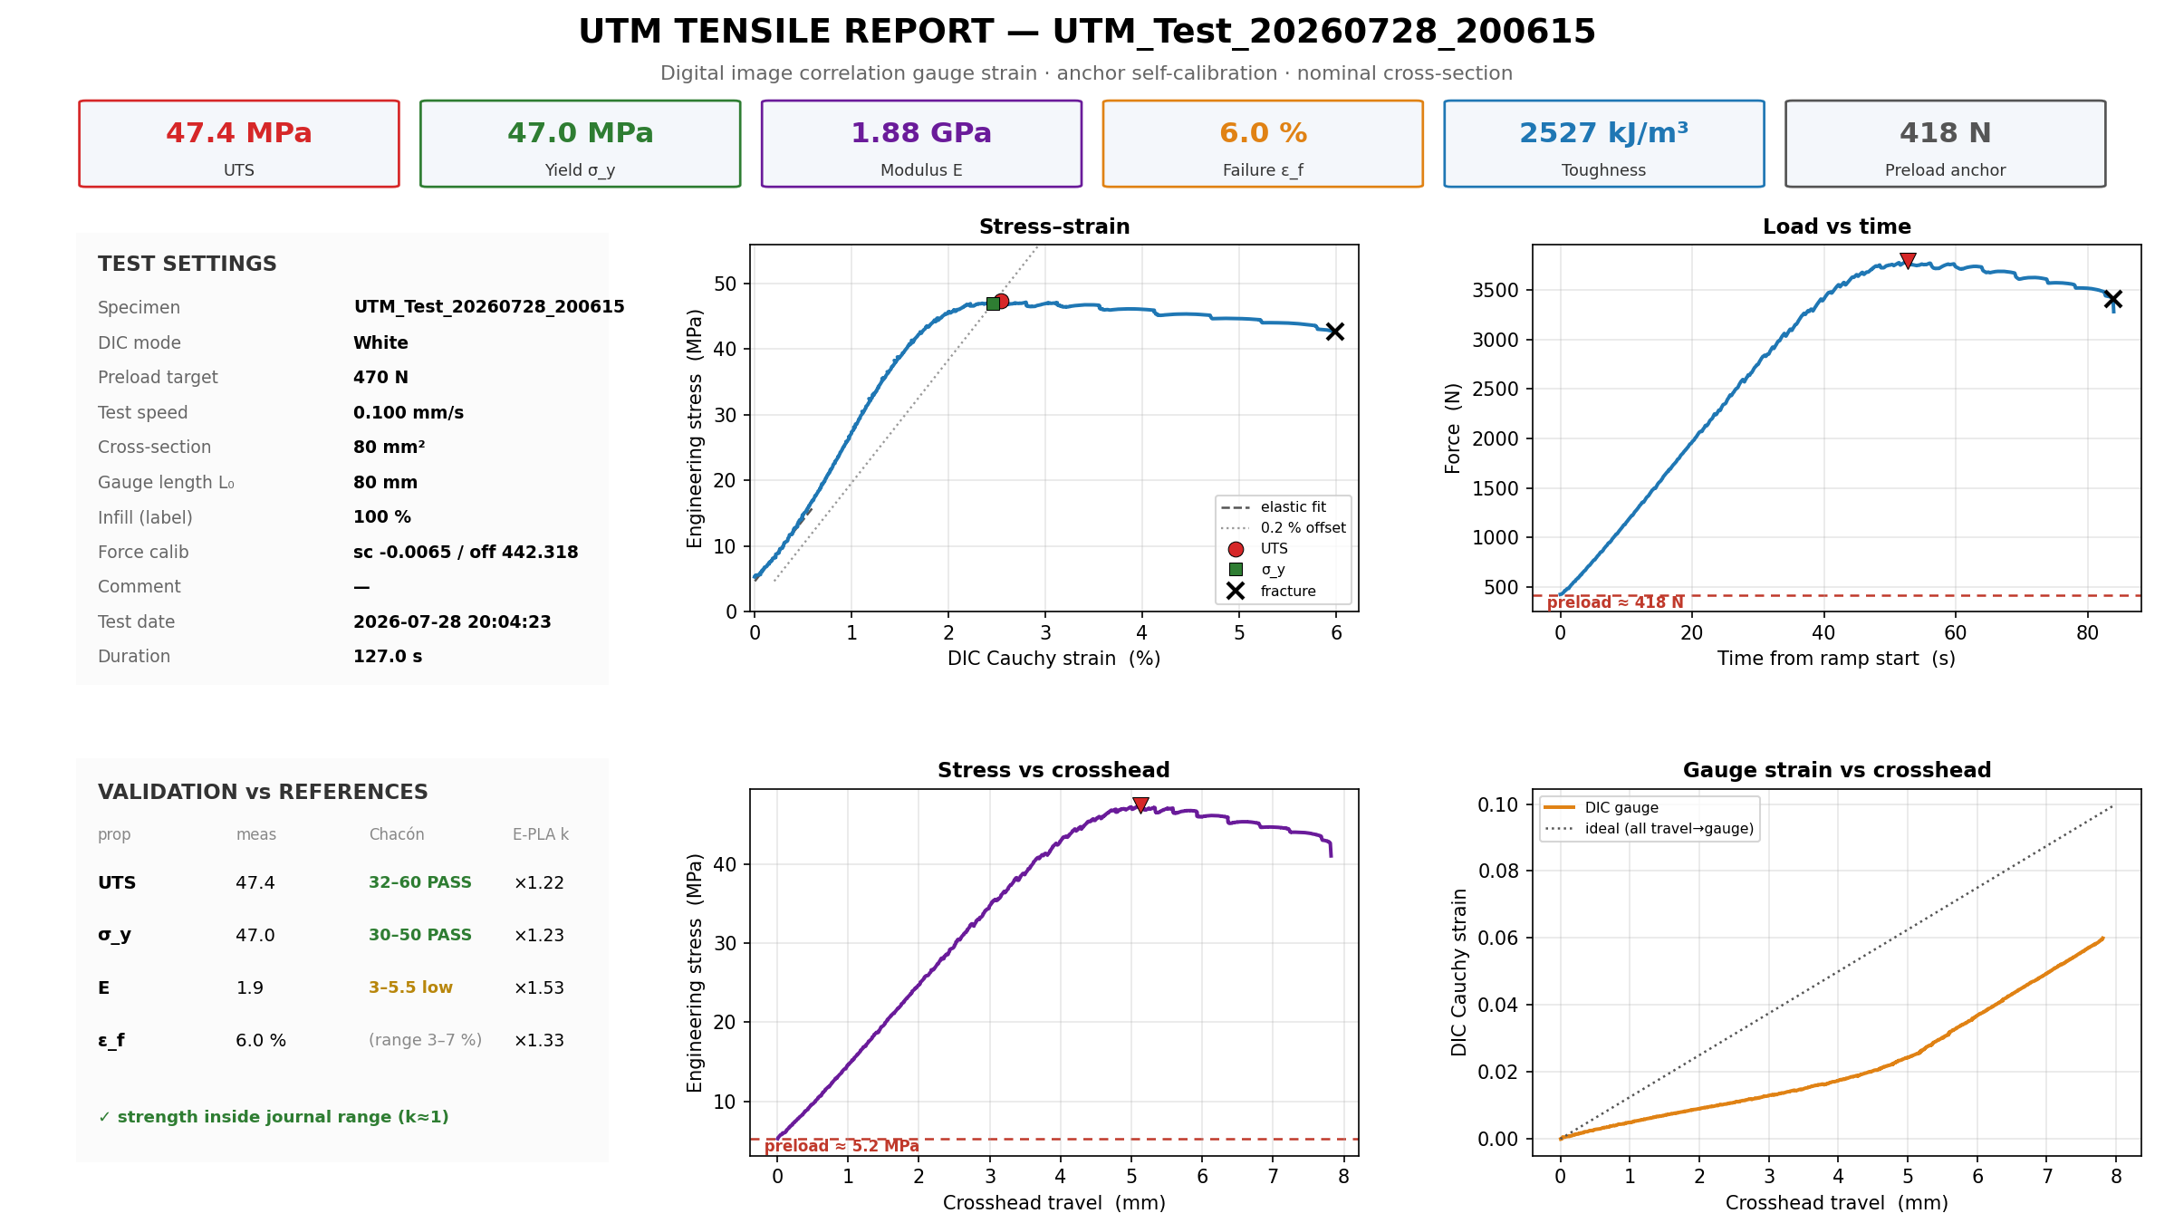
JÖNKÖPING UNIVERSITY
IN THE APP — ONE-CLICK REPORT & SAVED SETTINGS
Generate report → one-page PDF + PNGs
Settings — save a setup, reload in 1 click
• Saves area · gauge · preload · speed · mode + params • 'Default' always present (auto-stop ON) • Reload a full test setup with ONE click • Infill % = recorded label only (does NOT change data) • Report reads the CSV header → KPIs + 4 plots + validation
Report shown is the REAL S16 one-pager (auto-generated). Settings image = the live Motor-Control controls.
171

Slide 32
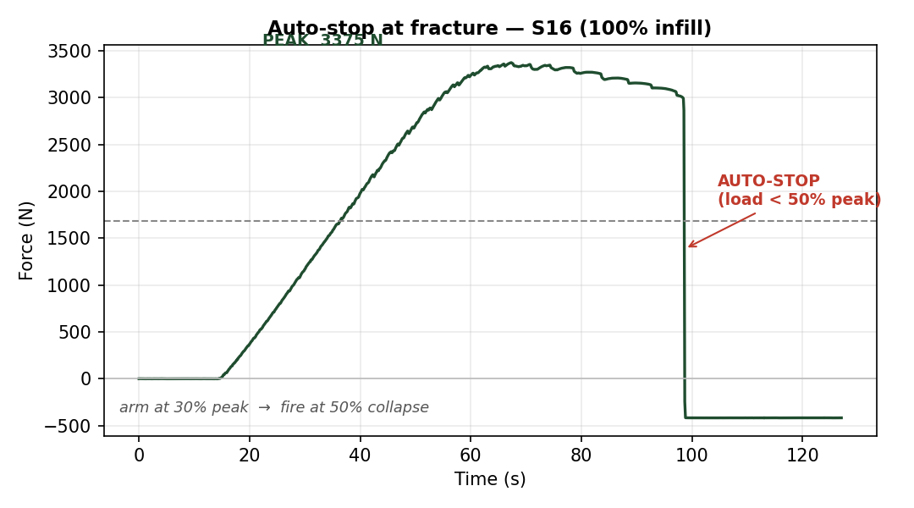
JÖNKÖPING UNIVERSITY
PROOF — AUTO-STOP AT FRACTURE (S16, 100% infill)
ACTIVATION CONDITION
ARM when load ≥ 30% of peak FIRE when load < 50% of peak (collapse) → Stop + E-Stop
2992 N
PEAK
47.4 MPa
UTS (true)
Fires in ONE sample after the load collapses — no hand on the button.
The rig detects its OWN fracture and halts — arm at 30% of peak, fire at 50% collapse.
172

Slide 33
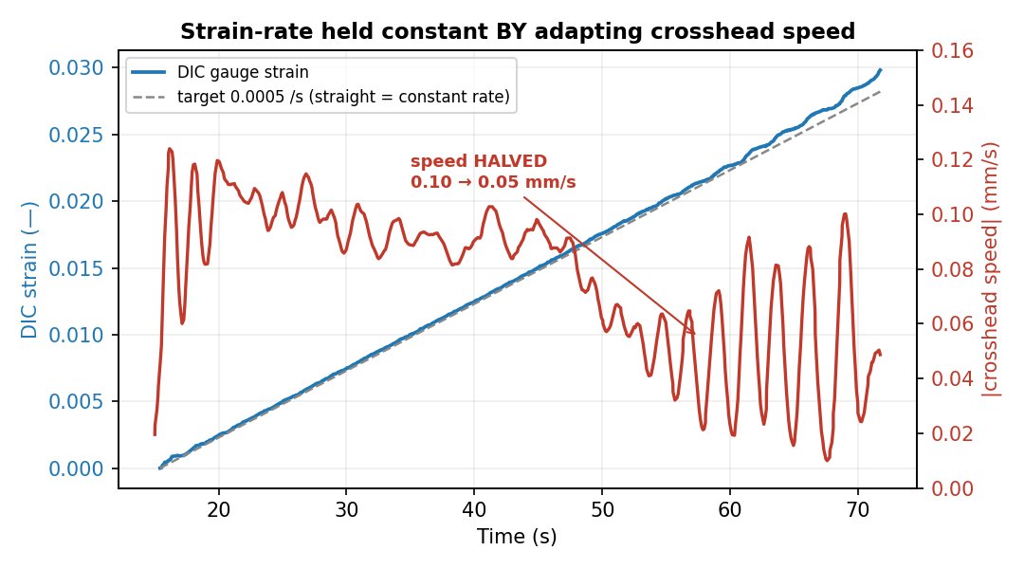
JÖNKÖPING UNIVERSITY
STRAIN-RATE FRACTURE TEST — RESULTS & WHY IT WORKS
Rate held BY adapting speed
Regime | speed | dε/dt
elastic | 0.10 | 0.00049
yield | 0.09 | 0.00050
necking | 0.06 | 0.00048
draw | 0.05 | 0.00054
Why it matters
• Constant MATERIAL strain rate (test standards) • Compliance-free — measures the gauge, not the machine • Comparable E / σy across specimens & rigs
Held 0.00051 /s (target 0.0005) while HALVING crosshead speed 0.10 → 0.05 mm/s — a fixed-speed pull cannot.
173

Slide 34
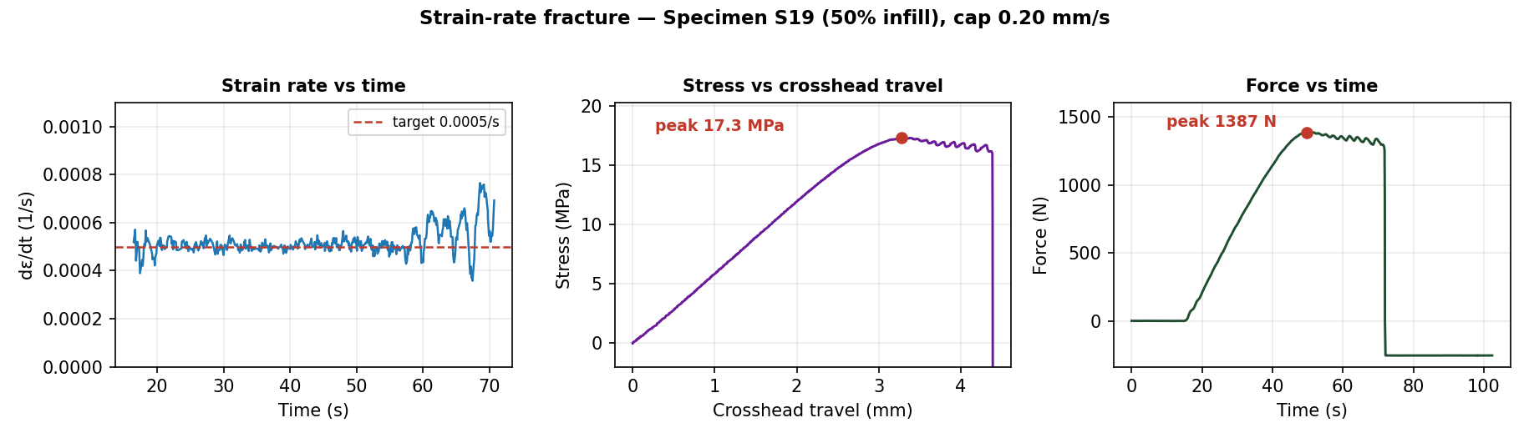
JÖNKÖPING UNIVERSITY
STRAIN-RATE FRACTURE — REPORT PLOTS (S19, 50% infill)
Closed-loop speed limits
0.0005 /s
TARGET RATE
0.005 mm/s
MIN SPEED
0.20 mm/s
MAX SPEED (cap)
S19 (50%) fractures ~1.4 kN — under the motor ceiling. The loop varied crosshead speed 0.005–0.20 mm/s to hold 0.0005 /s to fracture.
174

Slide 35
JÖNKÖPING UNIVERSITY
SAFETY GUARDS & LIMITS — WHAT STOPS THE TEST
Guards that halt a driven test
Guard | Trips when | Action
Fracture auto-stop | load < 50% of peak (armed at 30%) | Stop
Stall guard | crosshead < 0.05 mm in 6 s under load > 200 N | Stop + E-Stop
Dead-DIC guard | DIC strain frozen (markers lost) | freeze speed 0.2 s → HALT 1.0 s
Force backstop | load ≥ 4.5 kN | Stop + E-Stop
Travel backstop | crosshead travel ≥ 30 mm | Stop + E-Stop
Timeout | runtime ≥ 900 s | Stop
HARD LIMITS — force 4.5 kN · travel 30 mm · stall 0.05 mm in 6 s (>200 N) · dead-DIC halt 1.0 s · timeout 900 s. Any breach → Stop + E-Stop.
Layered so a driven test (preload · fracture · strain-rate) can't run away — protects the motor, the printed grips and the 3 t load cell.
175

Slide 36
JÖNKÖPING UNIVERSITY
SF 8 — RELEASE PRELOAD (safe return to 0)
Controlled unload after a preload
Preloaded specimen
Reverse at 0.30 mm/s
Stop at ~5 N
Limits
0.30 mm/s
RELEASE SPEED
5 N
TARGET
50 N
RISE CAP
180 s
TIMEOUT
Rig-validated — eases tension off the specimen + grips; live-SetSpeed only (no re-latch runaway); stops on target / rise-cap / timeout.
Feature in Software/UTM_PyQt6/main.py (Release preload button). Validated 2026-07-28.
176

Slide 37
JÖNKÖPING UNIVERSITY
TWO WAYS TO FRACTURE — WHEN TO USE WHICH
 | Direct motor speed | Strain-rate fracture
How | constant crosshead mm/s | closed-loop on DIC dε/dt
Rate | varies (fast neck, slow elastic) | CONSTANT gauge rate
Needs DIC? | no | YES (green 2/2)
Motor force | full — higher speed OK | capped speed → less force
Best for | quick UTS · strong specimens | standards-grade · rate-sensitive
Suggestion
MAX pulling force or a quick UTS? → DIRECT motor speed
Controlled material strain rate (comparable)? → STRAIN-RATE fracture
Both auto-stop on fracture (same detector) + stall guard. On THIS rig (torque ~2.6 kN today) use 50% / smaller specimens for strain-rate to reach break.
177

Slide 38
JÖNKÖPING UNIVERSITY
INNOVATION ROADMAP — AT A GLANCE
0 · Foundations analysis · engine · recipes
A · One-click report · prepare · auto-stop
B · Test modes strain-rate ✓ · 4 more
C · Smart DIC health HUD ✓ · Poisson
D · UX layer wizard · overlay · dash
DONE
DONE
1 / 5
partial
next
Next up (in order)
1 · Wire the 4 remaining modes (engine ready)
2 · Measured Poisson (4-marker + backdrop)
3 · UX wizard + live overlay
Hardware gate — motor torque ~2.6 kN today; fix driver Vref / cooling to fracture 100% infill.
178

Slide 39
JÖNKÖPING UNIVERSITY
SPECIMEN REGISTER (S1 – S26)
Spec | Infill | Colour | Test / result
S1
S2 | 50% |  | V5c · 22.0 MPa
S3 | 50% |  | V5b · 22.0 MPa
S4 | 50% |  | V5 · 22.1 MPa
S5
S6
S7 | 100% |  | V6a · 47.8 MPa
S8 | 100% |  | V6b · 44.8 MPa
S9 | 100% |  | V6e · 45.5 MPa
S10 | 100% |  | V6c · 46.8 MPa
S11 | 100% |  | V6d · 46.1 MPa
S12
S13
Spec | Infill | Colour | Test / result
S14
S15 | 100% |  | stall (no fracture)
S16 | 100% |  | first 100% fracture · 47.4
S17 | 100% |  | halt tests (DIC / stall)
S18 | 50% |  | T7.2 staircase→frac · 21.2 MPa
S19 | 50% |  | strain-rate frac · 17.3 MPa
S20 | 100% |  | T1–T7 modes · T7 stalled 2355 N
S21 | 50% |  | T8 prog. cyclic→frac · 21.4 MPa
S22 | 50% |  | T6.4/6.5 cyclic · T7.3 → 19.7 MPa
S23 | 50% |  | T9 creep 600 N / 900 s
S24 | 100% |  | VC1 capture · 46.5 MPa
S25 | 100% |  | VC2 capture · 46.2 MPa
S26 | 100% |  | VC3 capture · 47.2 MPa
All spray markers (black dots on PLA). V1_Spray batch = 50% · V2_Spray = 100%. VC1-3 = the frame-capture fracture runs (p221-224). Colour column to be filled by operator.
179

Slide 40
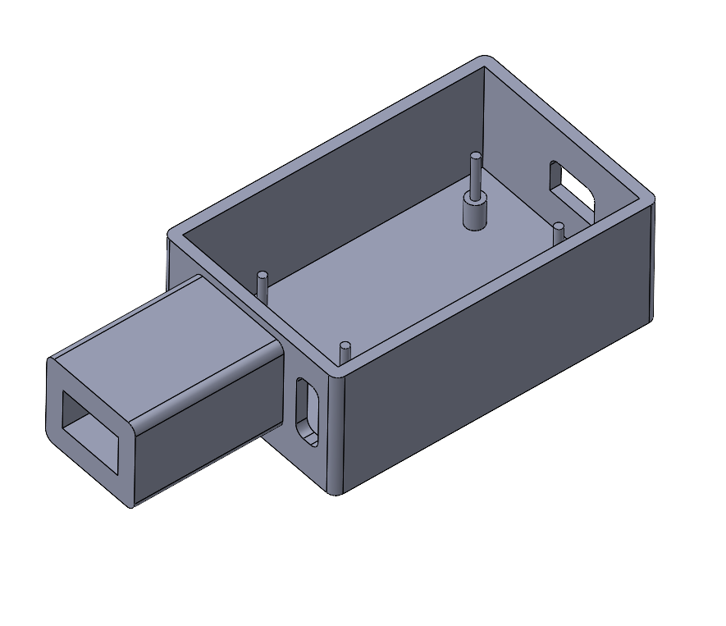
JÖNKÖPING UNIVERSITY
BUCK-CONVERTER ENCLOSURE — CAD (PLA)
Purpose
PLA-printed enclosure that houses the buck converter powering the LED ring lights.
1 · PCB locating pins
2 · LED-switch extrusion
• Pins align + hold the buck-converter PCB • Side extrusion = housing for the LED on/off switch • Open top + side slots for wiring / mounting
CAD for a PLA-printed part. Callout arrows mark the PCB locating pins (floor posts) and the LED-switch extrusion (side tube).
180

Slide 41
JÖNKÖPING UNIVERSITY
MOTOR TORQUE CEILING — THE 100% FRACTURE LIMIT
Same crosshead speed (0.10 mm/s), different MAX force
~2.6 kN
WEAK DAY (S15 · today)
3.2–3.8 kN
STRONG DAY (V6 · S16)
~3.7 kN
100% FULL-AREA NEEDS
What we suspected at the time — torque capacity, NOT speed or software
• Driver current (Vref) set low • PSU voltage sag under load
• Driver THERMAL derating (the chip, not motor) • Mechanical binding (screw / rails) ← this one
SUPERSEDED — see p183. It was the fourth cause: the load holders had worked loose and the crossheads sat out of alignment. Fixed; the rig now pulls 3.5 kN.
At the SAME 0.10 mm/s and on the SAME DAY: S15 stalled 2.6 kN but S16 fractured 3.8 kN. Read as day-to-day drift at the time — it was specimen-to-specimen, i.e. the remount.
181

Slide 42
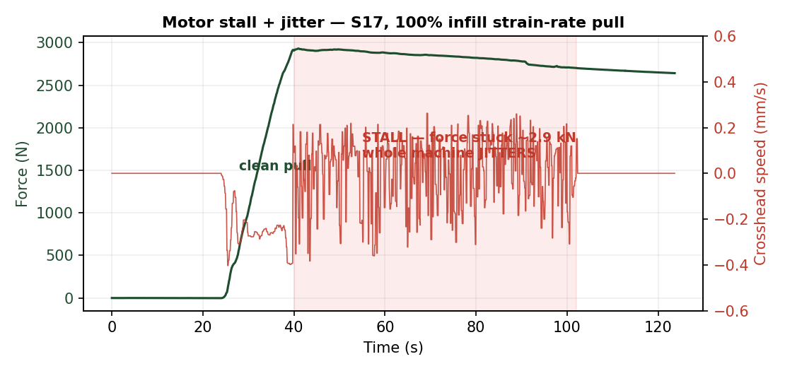
JÖNKÖPING UNIVERSITY
MOTOR JITTER = STALL WARNING (a failed test)
What happened
At the force ceiling the crosshead FROZE and the whole machine SHOOK — a stalled stepper skipping steps. S15: had to Stop by hand.
Why
• Motor at / beyond its torque limit • Strain-rate loop then oscillated, chasing a motor that can't move
SUPERSEDED (next slide) — the jitter was BINDING, not a torque limit. The stall guard still auto-halts (< 0.05 mm in 6 s under load).
182

Slide 43
JÖNKÖPING UNIVERSITY
RESOLVED — THE “TORQUE CEILING” WAS A CROSSHEAD MISALIGNMENT
The load holders had worked loose, letting the crossheads sit out of alignment. The motor was spending its torque on binding instead of on the specimen. Re-aligned and re-tightened, the rig pulls 3.5 kN with no stutter.
Loose load holders
ROOT CAUSE
3.5 kN, no stutter
AFTER THE FIX
~3.7 kN
100 % FULL-AREA NEEDS
2.6 kN
SUPPOSED CEILING
The data already said “mechanical” — before the fault was found
What that retires — the four ranked causes (p201)
• The same machine has fractured 100 % infill at 177–3826 N on 16 separate specimens over three months (mean 3009 ± 1408 N, CV 46.8 %). • That is 13 of 16 runs straight THROUGH a 2.6 kN “ceiling”. A ceiling ten runs walk past is not a ceiling. • Decisive: S15 stalled at 2.6 kN and S16 fractured at 3792 N on the SAME DAY (2026-07-28) — +46 %, same rig, same 0.10 mm/s.
Ranked cause | Verdict
1 Driver current (Vref) too low | exonerated
2 Driver thermal derating | exonerated
3 PSU voltage sag under load | exonerated
4 Mechanical binding (ranked LAST) | CONFIRMED
Why only the mechanical cause fits
Vref is a setting — it does not change between two specimens. Thermal derating gets WORSE through a session, not 46 % better on the next pull. PSU sag scales with load, so it cannot let a HIGHER load through. Binding is the only candidate that is intermittent, and it changes exactly when the specimen is remounted — which is when alignment changes.
SUPERSEDES p181 and p182 — the 50 %-specimen workaround is no longer needed. 100 % full-area specimens fracture normally at ~3.0 kN.
Not a hardware purchase and not a software change — a fastener. The stall guard and the force and travel backstops were never the problem, and were not touched to fix it.
183

Slide 44
JÖNKÖPING UNIVERSITY
TESTS AFTER THE REALIGNMENT — PPD-UTM Mk II, THE RELIABLE SET
“Mk” is MARK — the engineering convention for successive configurations of ONE machine, not for two different machines. PPD-UTM Mk I is this rig up to 2026-08-12; PPD-UTM Mk II is the SAME rig after its crossheads were realigned and its load holders re-tightened. No other part of it changed, and no recalibration of the load cell or the optics was involved. Every run below is Mk II. Both stalls on record fall BEFORE that line; none after.
Specimen | Date | Material | What it was for | Peak | UTS | E | Outcome
S24 | 2026-08-14 | 100 % white PLA | Frame capture VC1 | 3718 N | 46.5 MPa | 3.00 GPa | fractured
S12 | 2026-08-17 | 100 % BLACK PLA | Black attempt VC6 — capture not filed | 3822 N | 47.8 MPa | 3.29 GPa | fractured
S25 | 2026-08-17 | 100 % white PLA | Frame capture VC2 — extensometer basis | 3693 N | 46.2 MPa | 3.17 GPa | fractured
S26 | 2026-08-17 | 100 % white PLA | Frame capture VC3 — extensometer basis | 3774 N | 47.2 MPa | 3.55 GPa | fractured
S27 | 2026-08-17 | 50 % white PLA | 50 % video pair VC4 | 1588 N | 19.9 MPa | 1.40 GPa | fractured
S28 | 2026-08-17 | 50 % white PLA | 50 % video pair VC5 | 1594 N | 19.9 MPa | 1.28 GPa | fractured
S13 | 2026-08-18 | 100 % BLACK PLA | Black preset VALIDATED VC7 | 3706 N | 46.3 MPa | 3.03 GPa | fractured
S30 | 2026-08-22 | 100 % PETG | PETG 1 of 3 VC9 — the representative run | 3340 N | 41.8 MPa | 1.81 GPa | fractured
S31 | 2026-08-22 | 100 % PETG | PETG 2 of 3 VC10 — strength only, 57 % tracked | 3244 N | 40.5 MPa | 2.12 GPa | fractured
S33 | 2026-08-24 | white PLA | Marker spacing 45 mm VC12 — against S25 | 3767 N | 47.1 MPa | 3.17 GPa | fractured
S34 | 2026-08-24 | white PLA | Marker spacing 45 mm VC13 — against S26 | 3867 N | 48.3 MPa | 3.45 GPa | fractured
S35 | 2026-08-24 | TPU 95A | TPU pair VC14 — marker lost at ~15 mm travel | 180 N | 2.2 MPa | 0.03 GPa | fractured
S36 | 2026-08-24 | TPU 95A | TPU pair — marker lost at ~15 mm travel | 177 N | 2.2 MPa | 0.03 GPa | fractured
S37 | 2026-08-26 | TPU 95A | TPU at 45 mm markers VC15 — the fix | 208 N | 2.6 MPa | 0.02 GPa | fractured
14
RUNS SINCE THE FIX
0
STALLS SINCE THE FIX
3693–3822 N
100 % PLA RUNS, PEAK RANGE
2
STALLS BEFORE IT
All 14 ran to fracture with no stutter, and the 5 at 100 % infill PLA peaked 3693–3822 N — every one ABOVE the 2.6 kN carried as a hardware ceiling. Earlier results are not wrong (S15 and T7 were caught by the stall guard and excluded, never silently averaged in), but only this set is free of a load path that could bind.
S12 is listed because the PULL was sound (47.8 MPa) — what failed was the frame capture. Peaks are UTS × the CAD 80 mm² nominal area.
184

Slide 45
JÖNKÖPING UNIVERSITY
MEASURING CAUCHY (TRUE) STRESS
Getting the DEFORMING cross-section for TRUE / Cauchy stress + Poisson ratio - a separate future work-stream: edge-width tracking on a matte-black backdrop.
185

Slide 46
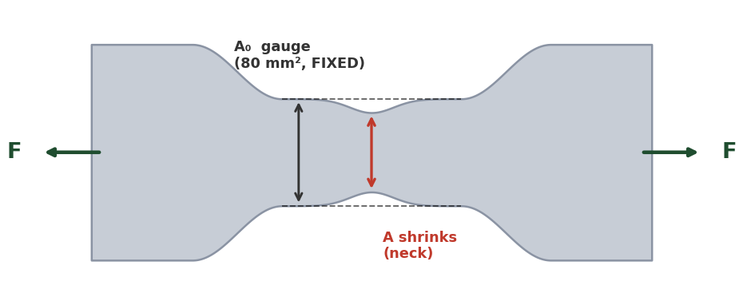
JÖNKÖPING UNIVERSITY
ENGINEERING vs TRUE (CAUCHY) STRESS — & MEASURING THE AREA
Why we REPORT engineering stress
Measuring the CURRENT area → true stress (future)
Method | How | Note
Poisson estimate | A = A₀(1−ν·ε)², ν ≈ 0.35 (no hardware) | cheap; ν drifts in yield
Transverse markers | +2 dots across width → ε_w; A ≈ A₀(1+ε_w)² | reuses blob-DIC; gives Poisson
+ edge camera | 2nd view → thickness strain; A = w·t | rigorous; FDM is orthotropic
Full-field speckle | fine random speckle + subset DIC | strain field + necking; new pipeline
σ_eng = F / A₀ (REPORTED) σ_true = F / A (not tracked, ~2–5% higher) Basis: ISO 527 · Chacón · datasheet all use ENGINEERING → apples-to-apples for our k-factors. E & σ_y ~unchanged.
Same speckle style (spray dots): just add a transverse dot pair — the current 2-marker tracker extends naturally (2 axial + 2 transverse). A finer random speckle enables full-field DIC (transverse field + necking) but needs a new analysis pipeline.
TRANSVERSE markers = ideal, but the gauge is too NARROW → EDGE-WIDTH detection (next slide) is the practical route. Keep ENGINEERING stress as the validated basis.
Current V6 report & plots = engineering stress (nominal 80 mm²). True/Cauchy needs the deforming area; post-necking needs full-field DIC or markers at the neck.
186

Slide 47
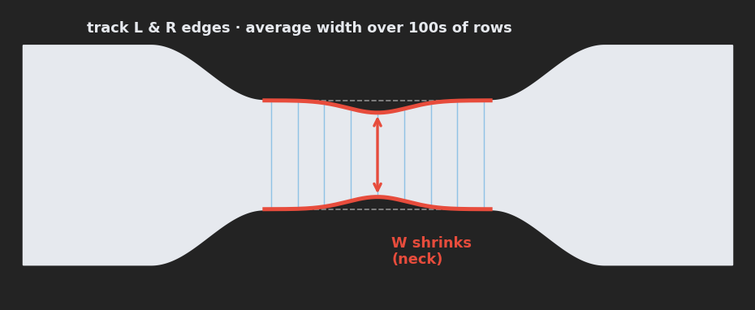
JÖNKÖPING UNIVERSITY
MEASURING POISSON'S RATIO & TRUE STRESS — WITHOUT TRANSVERSE DOTS
The fix — track the specimen's OWN edges
Three ways to MEASURE it (no transverse dots)
Route | How it works | Needs
1 Edge / silhouette width tracking | find the specimen's L & R edges across the gauge; MEAN width while it is uniform (for ν), MINIMUM band once necking starts (for area) -> ε_w each frame | matte-black backdrop; reuses THIS camera
2 Full-field speckle DIC | fine random speckle + subset correlation (Ncorr / muDIC, offline) -> full axial + transverse strain field | speckle + new analysis pipeline
3 Hardware probe | 2nd side camera (thickness), laser micrometer, or clip-on transverse extensometer | extra hardware; lab-grade
Gauge too NARROW for transverse dots (sub-pixel at 20 px/mm) → track the L & R edges instead. ε_w = (W₀−W)/W₀ ν = −ε_w/ε_axial A = W·t → MEASURED (no assumed ν), written to the CSV.
Why #1 works at 20 px/mm: one edge is sub-pixel, but averaging the width along the whole gauge (100s of rows) cuts the noise ~10x to ~0.01 px — the ~0.5 px elastic width change is then well resolved. It only needs CRISP edges = a dark background behind the specimen. WHICH statistic depends on the regime, and this is not interchangeable. Before necking the width is uniform, so the MEAN over the whole gauge is right and buys that noise reduction — that is the ν measurement. Once a neck forms the deformation is LOCAL and the load is carried by the smallest section, so the area must come from the MINIMUM, averaged over a short band at the neck. A mean over the whole gauge would under-correct exactly where the correction matters most.
EDGE-WIDTH TRACKING + a matte-black backdrop = the only route that MEASURES Poisson & true Cauchy, reusing THIS camera & specimen. Keep ENGINEERING stress as the validated basis.
Supersedes the transverse-marker idea on the previous slide: the narrow gauge + camera resolution rule out a transverse dot pair. Measure the specimen's own edges (or full-field speckle) instead.
187

Slide 48
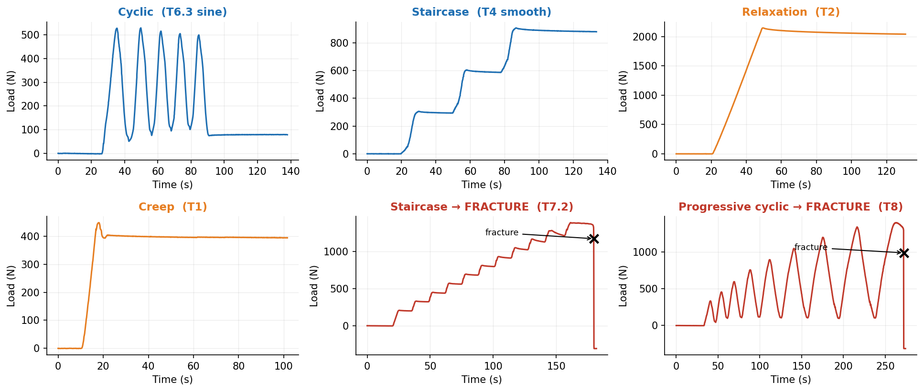
JÖNKÖPING UNIVERSITY
SF9 — ADVANCED TEST MODES: SIX CLOSED-LOOP PROTOCOLS, ONE ENGINE
All six share one control loop (`_policy_step`) and one safety net. Every trace below is real rig data, not a schematic. Two of them drive the specimen to destruction.
Why it matters: a conventional pull gives ONE modulus, ONE yield, ONE UTS. These modes interrogate the specimen on the way to failure — so a single specimen yields a CURVE (stiffness vs damage, relaxation vs level) instead of a point.
Rig-validated 2026-08-08/09 on S18, S20, S21. Engine: control_policies.py · app wiring: main.py `_policy_step` · schematics: ui_help/.
188

Slide 49
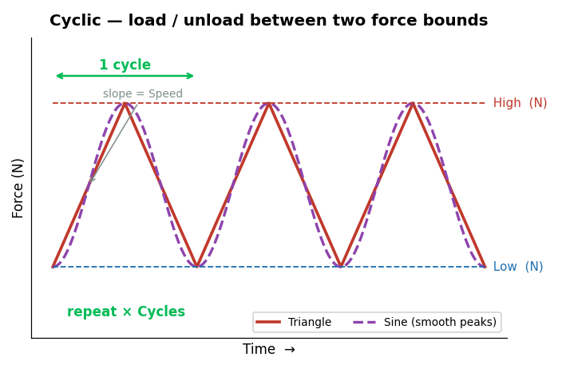
JÖNKÖPING UNIVERSITY
SF9 · CYCLIC [T5 · T6.3] — HOW IT WORKS
What this mode tells you
Repeatedly loads and unloads between a Low and a High force for N cycles. • Hysteresis loop area = energy dissipated per cycle • Change in loop shape = early damage, before any visible yield • Waveform choice: Triangle (constant-speed ramps) or Sine (eases at each peak) • Stays elastic — the specimen is REUSABLE afterwards
Settings used for our test
Parameter | Value
Low / High force | 100 / 500 N
Cycles | 5
Speed | 0.100 mm/s
Waveform | Triangle (T5) · Sine (T6.3)
Specimen | S20 · 100 % infill
SOFTWARE LIMITS — Low 0–5000 N · High 0–5000 N · Cycles 1–1000 · Speed 0.005–0.500 mm/s
Guidance: keep High below yield, or the run becomes a fatigue test and the specimen breaks.
Always-on, every mode: 4.5 kN force · 30 mm travel · 900 s timeout · stall guard (6 s window, min(0.05 mm, 35 % of commanded travel), armed above 200 N) · dead-DIC freeze 0.2 s / halt 1.0 s · E-Stop.
189

Slide 50
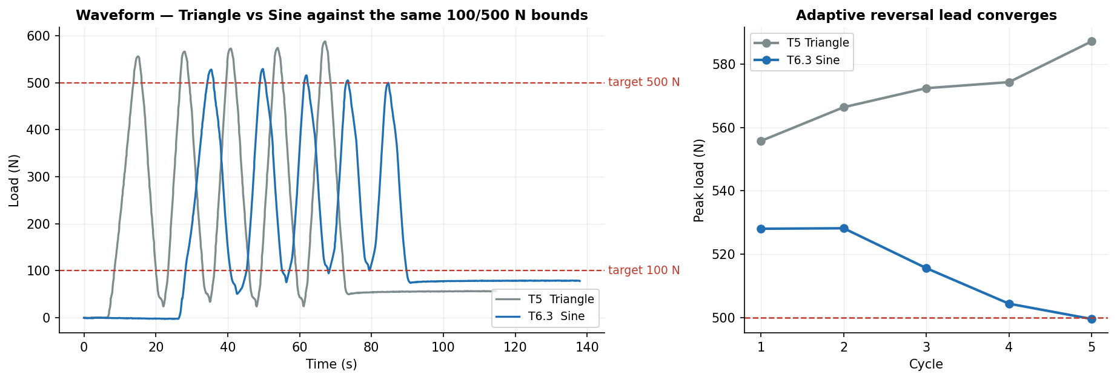
JÖNKÖPING UNIVERSITY
SF9 · CYCLIC [T5 · T6.3] — OUR RESULTS
71 N
Peak error — Triangle
15 N
Peak error — Sine
500 N
Sine, final cycle
5 + 5
Cycles completed
Cycle | 1 | 2 | 3 | 4 | 5 | mean |err|
T5 Triangle — peak (N) | 556 | 566 | 572 | 574 | 587 | 71
T6.3 Sine — peak (N) | 528 | 528 | 516 | 504 | 500 | 15
Sine cuts peak error 71 N → 15 N (78 % better) and CONVERGES: 528 → 500 N across the 5 cycles, landing on the 500 N target.
The convergence is the adaptive reversal lead learning the true coast distance in the FORCE domain. Seeded at zero so it approaches from below — seeding it at the measured 1.3 s decel over-led and rang (T6, T6.2).
190

Slide 51
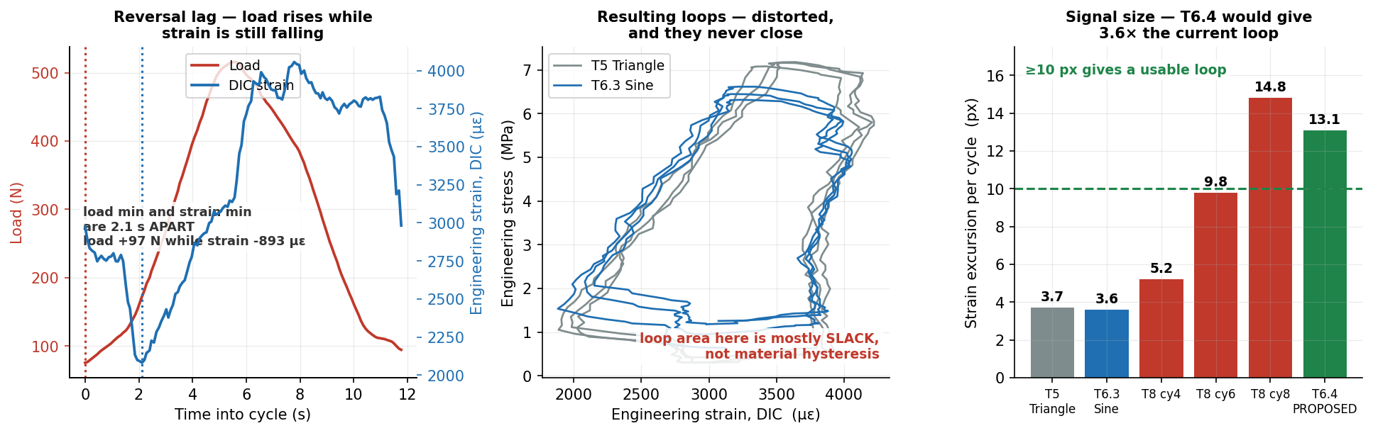
JÖNKÖPING UNIVERSITY
SF9 · CYCLIC [T5 · T6.3] — HYSTERESIS: A NEGATIVE RESULT
The mode promises loop area = energy dissipated and loop-shape change = early damage. Neither is measurable from THIS run. It is NOT a DIC resolution problem — the fault is mechanical slack.
14 % of fracture load
Cycled at
2.1 s
Reversal lag
load +97 N, strain −893 µε
…during which
+25 µm / cycle
Crosshead ratchet
0.1 px steps, ±0.02 px
DIC is NOT the limit
Root cause: at every reversal the load climbs 97 N while the strain still FALLS 893 µε — the load train is re-taking backlash, not straining the specimen. That fabricated area is most of the loop. Cycling at only 14 % of fracture load leaves little real hysteresis to compete with it.
✅ RESOLVED — T6.4 / T6.5 ran 2026-08-11 on S22 at 400→1100 N and the loops closed: 12.3 px measured against the 13.1 px predicted here. See p215-214.
The 400 N floor is the key: never unload through the slack band, so backlash is crossed once at the start instead of twice per cycle. Arm auto-stop — 1100 N is above the 694 N yield knee, which is the point, but T8 fractured at 1397 N.
191

Slide 52
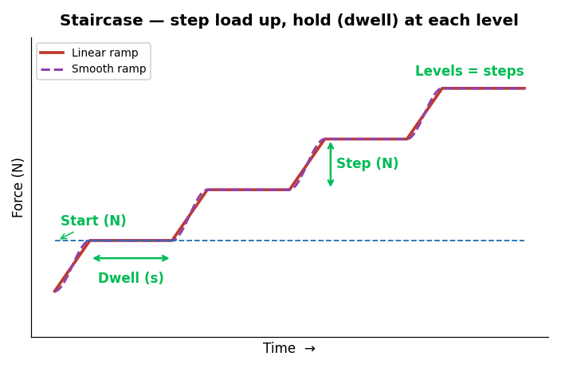
JÖNKÖPING UNIVERSITY
SF9 · STAIRCASE [T3 · T4] — HOW IT WORKS
What this mode tells you
Steps the load up — Start, Start+Step, Start+2·Step … — and DWELLS at every level. • Each dwell is a mini stress-relaxation test • Modulus can be re-measured at every level • Ramp shape: Linear (constant speed) or Smooth (eases into each level) • Non-destructive if the top level stays below yield
Settings used for our test
Parameter | Value
Start / Step | 300 / 300 N
Levels | 3
Dwell | 20 s
Speed | 0.100 mm/s
Ramp | Linear (T3) · Smooth (T4)
Specimen | S20 · 100 % infill
SOFTWARE LIMITS — Start 0–5000 N · Step 10–2000 N · Levels 1–20 · Dwell 1–600 s · Speed 0.005–0.500 mm/s
Guidance: keep the top level, Start+(Levels−1)·Step, below yield.
Always-on, every mode: 4.5 kN force · 30 mm travel · 900 s timeout · stall guard (6 s window, min(0.05 mm, 35 % of commanded travel), armed above 200 N) · dead-DIC freeze 0.2 s / halt 1.0 s · E-Stop.
192

Slide 53
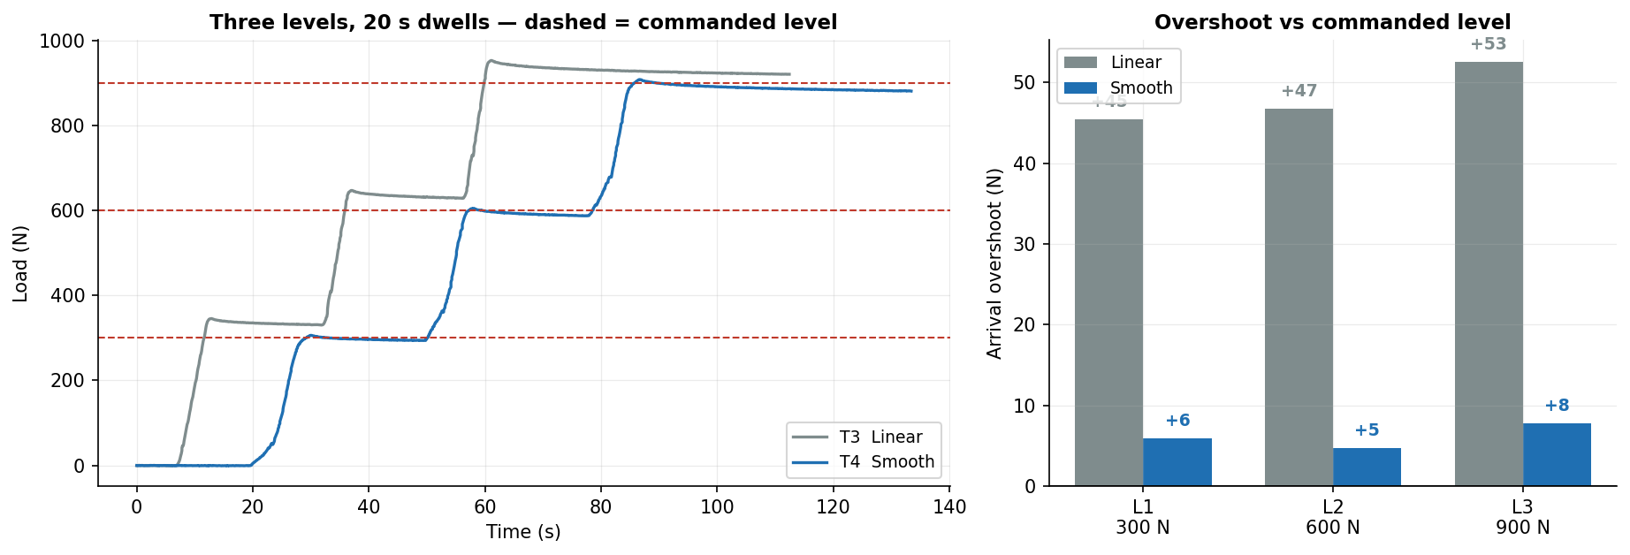
JÖNKÖPING UNIVERSITY
SF9 · STAIRCASE [T3 · T4] — OUR RESULTS
48 N
Linear — mean overshoot
6 N
Smooth — mean overshoot
8×
Improvement
0 of 6 dwells
Stall guard false trips
Level (commanded) | L1 · 300 N | L2 · 600 N | L3 · 900 N
T3 Linear — arrival overshoot | +45.5 N | +46.8 N | +52.6 N
T4 Smooth — arrival overshoot | +6.0 N | +4.8 N | +7.8 N
Dwell force drop (Smooth) | 7.7 N | 16.1 N | 6.0 N
Smooth ramp cuts arrival overshoot from ~48 N to ~6 N — a 8× improvement — by tapering the last 25 % of every approach.
Overshoot is measured against the COMMANDED level, not the settled value — the settled value already contains the dwell relaxation, which would mask the control error.
193

Slide 54
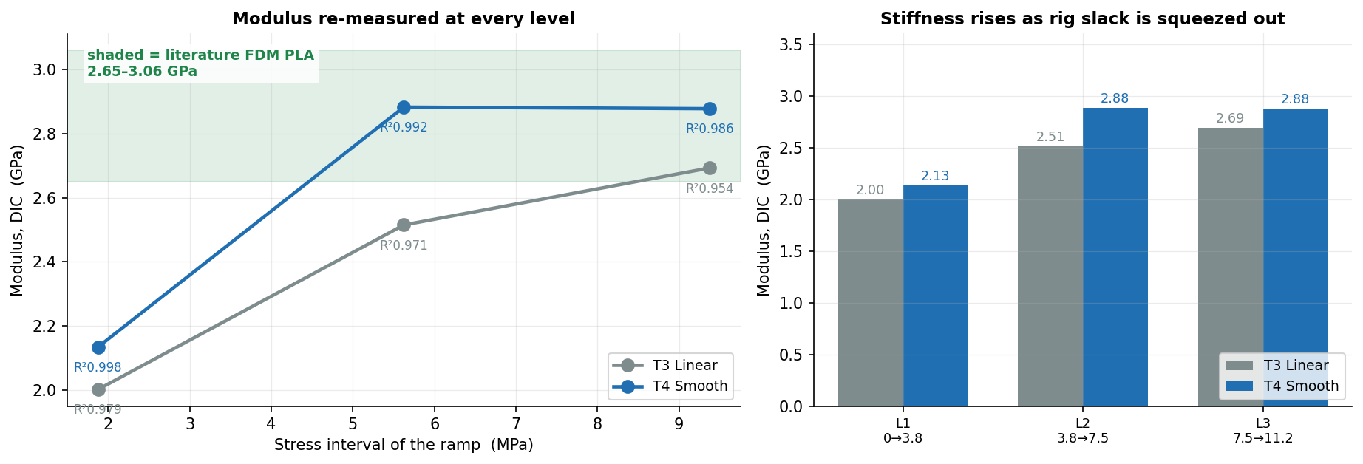
JÖNKÖPING UNIVERSITY
SF9 · STAIRCASE [T3 · T4] — MODULUS AT EVERY LEVEL
The mode's claim is that stiffness can be re-measured at every level. Here it is: a modulus fitted to the ramp into each level, so E as a function of stress.
Ramp into level | L1 · 0 → 3.8 MPa | L2 · 3.8 → 7.5 MPa | L3 · 7.5 → 11.2 MPa
T3 Linear — E (GPa) | 2.00 (R² 0.979) | 2.51 (R² 0.971) | 2.69 (R² 0.954)
T4 Smooth — E (GPa) | 2.13 (R² 0.998) | 2.88 (R² 0.992) | 2.88 (R² 0.986)
Literature, FDM PLA | 2.65 – 3.06 GPa | (solid / high infill) | Chacón · Chen et al.
E climbs 2.13 → 2.88 GPa across the three levels and settles INSIDE the literature band — the rise is rig slack being squeezed out at low load, the same artefact that fools the crosshead stiffness in T8.
Fit quality improves with the Smooth ramp (R² ≥ 0.986 vs 0.954) because a tapered approach spends more samples in steady loading and fewer in the overshoot transient.
194

Slide 55
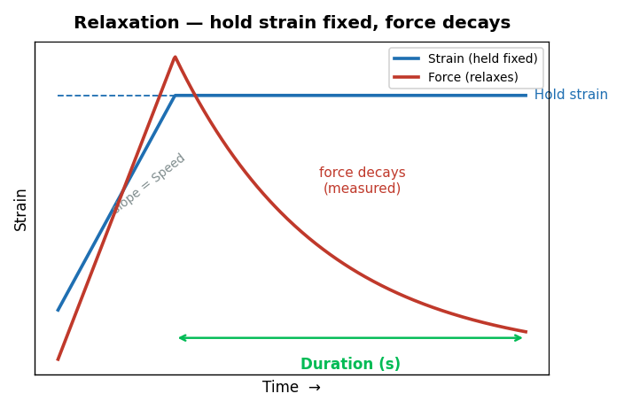
JÖNKÖPING UNIVERSITY
SF9 · RELAXATION [T2] — HOW IT WORKS
What this mode tells you
Ramps to a target STRAIN, then holds the crosshead still and watches the force decay. • Measures the viscoelastic stress-relaxation of the polymer • Decay rate and magnitude are material fingerprints • Requires live DIC (green 2/2) — strain is the controlled variable • Non-destructive below yield
Settings used for our test
Parameter | Value
Hold strain | 0.010
Hold duration (measured) | 81 s
Speed | 0.100 mm/s
Specimen | S20 · 100 % infill
SOFTWARE LIMITS — Hold strain 0.001–0.200 · Duration 1–3600 s · Speed 0.005–0.500 mm/s · needs DIC green 2/2
Guidance: keep the hold strain below yield (≈0.015 for PLA) for a purely elastic hold.
Always-on, every mode: 4.5 kN force · 30 mm travel · 900 s timeout · stall guard (6 s window, min(0.05 mm, 35 % of commanded travel), armed above 200 N) · dead-DIC freeze 0.2 s / halt 1.0 s · E-Stop.
195

Slide 56
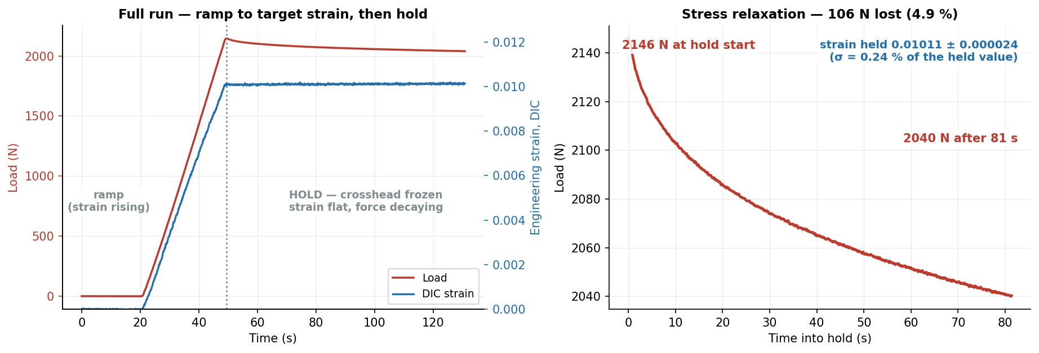
JÖNKÖPING UNIVERSITY
SF9 · RELAXATION [T2] — OUR RESULTS
2146 N
Peak load
2040 N
After hold
106 N (4.9 %)
Stress relaxed
0.01011
Strain held
Quantity | Value | Interpretation
Force decay over 81 s | 2146 → 2040 N | 4.9 % of the initial stress relaxed away
Strain held | 0.01011 ± 0.000024 | ±0.24 % of the held value — the crosshead really did stand still
Textbook viscoelastic relaxation: 106 N (4.9 %) shed at a strain held to ±0.24 %. The control did its job — the decay is the MATERIAL, not drift.
Relaxation is the one mode whose dwell is not a zero-speed hold: it keeps nudging the crosshead to pin the strain, so the dwell is found from crosshead POSITION going flat.
196

Slide 57
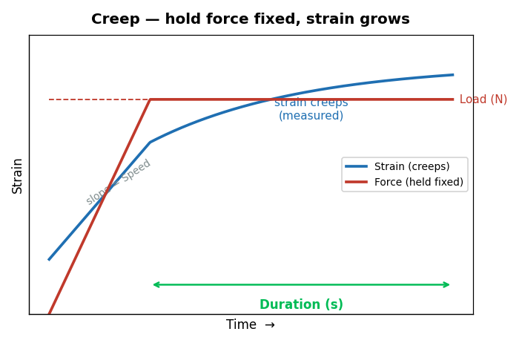
JÖNKÖPING UNIVERSITY
SF9 · CREEP [T1] — HOW IT WORKS
What this mode tells you
Ramps to a target LOAD, then holds that force constant and watches the strain grow. • The dual of relaxation: fix stress, measure strain(t) • Reveals time-dependent deformation under sustained service load • Primary-creep slope indicates how the part behaves under a permanent load • Non-destructive well below UTS
Settings used for our test
Parameter | Value
Hold load | 400 N
Hold duration (measured) | 40 s
Speed | 0.100 mm/s
Specimen | S20 · 100 % infill
SOFTWARE LIMITS — Load 10–5000 N · Duration 1–3600 s · Speed 0.005–0.500 mm/s
Guidance: use ≤60–70 % of UTS — above that, creep runs away and the specimen fails during the hold.
Always-on, every mode: 4.5 kN force · 30 mm travel · 900 s timeout · stall guard (6 s window, min(0.05 mm, 35 % of commanded travel), armed above 200 N) · dead-DIC freeze 0.2 s / halt 1.0 s · E-Stop.
197

Slide 58
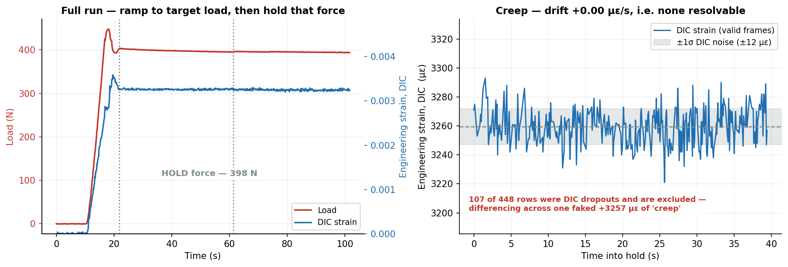
JÖNKÖPING UNIVERSITY
SF9 · CREEP [T1] — OUR RESULTS
398 N
Force held
± 2.2 N
Hold stability
-14 µε (none)
Creep measured
± 12 µε
DIC noise band
Quantity | Value | Interpretation
Force held | 398 ± 2.2 N | ±0.55 % of target — the load is genuinely constant
DIC strain over the hold | 0.00326 ± 0.000012 | drift +0.00 µε/s → +0 µε in 40 s: BELOW the ±12 µε noise band
DIC dropouts skipped | 107 of 448 rows | a dropout writes ec=0.0; differencing across one faked +3257 µε of 'creep'
Force pinned to ±2.2 N (0.55 %) — the CONTROL works. But creep was NOT resolvable: 5.0 MPa is only 11 % of UTS and PLA is glassy at room temperature. Negative result, correctly reported.
✅ RESOLVED — T9 ran 2026-08-11 on S23 at 600 N tared for 877 s and creep IS resolved: +1080 µε drift-corrected = 41× the noise floor, decelerating (Findley n = 0.48). See p217-217.
T1 could not have detected creep at all: fitted rate +0.002 ± 0.060 µε/s, so the 95 % bound is <0.12 µε/s — under 5 µε across the whole 40 s hold. The hold was ~20× too short and the stress ~2× too low. Run a 900 s ZERO-LOAD baseline first to separate thermal drift from creep.
198

Slide 59
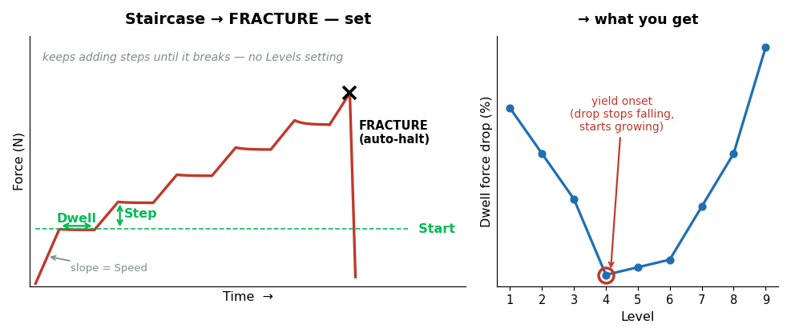
JÖNKÖPING UNIVERSITY
SF9 · STAIRCASE → FRACTURE [T7.2] — HOW IT WORKS
What this mode tells you
DESTRUCTIVE. Like Staircase, but it keeps adding levels until the specimen breaks. • A mini stress-relaxation at EVERY level, right up to failure • Yield onset appears as the dwell drop stops shrinking and starts growing • Modulus re-measured at every level = stiffness vs stress • Ends in fracture → UTS and ε_f from the SAME specimen
Settings used for our test
Parameter | Value
Start / Step | 200 / 120 N
Dwell | 10 s
Speed | 0.100 mm/s
Ramp | Smooth
Specimen | S18 · 50 % infill
Destructive modes are behind a confirmation dialog that echoes area, gauge and infill before arming.
SOFTWARE LIMITS — Start 0–5000 N · Step 10–2000 N · Dwell 1–600 s · Speed 0.005–0.500 mm/s · max 60 levels (policy cap)
Guidance: size Step so ~8–12 levels reach fracture. Too fine and the run drags; too coarse and you lose resolution exactly where yield happens.
Always-on, every mode: 4.5 kN force · 30 mm travel · 900 s timeout · stall guard (6 s window, min(0.05 mm, 35 % of commanded travel), armed above 200 N) · dead-DIC freeze 0.2 s / halt 1.0 s · E-Stop.
199

Slide 60
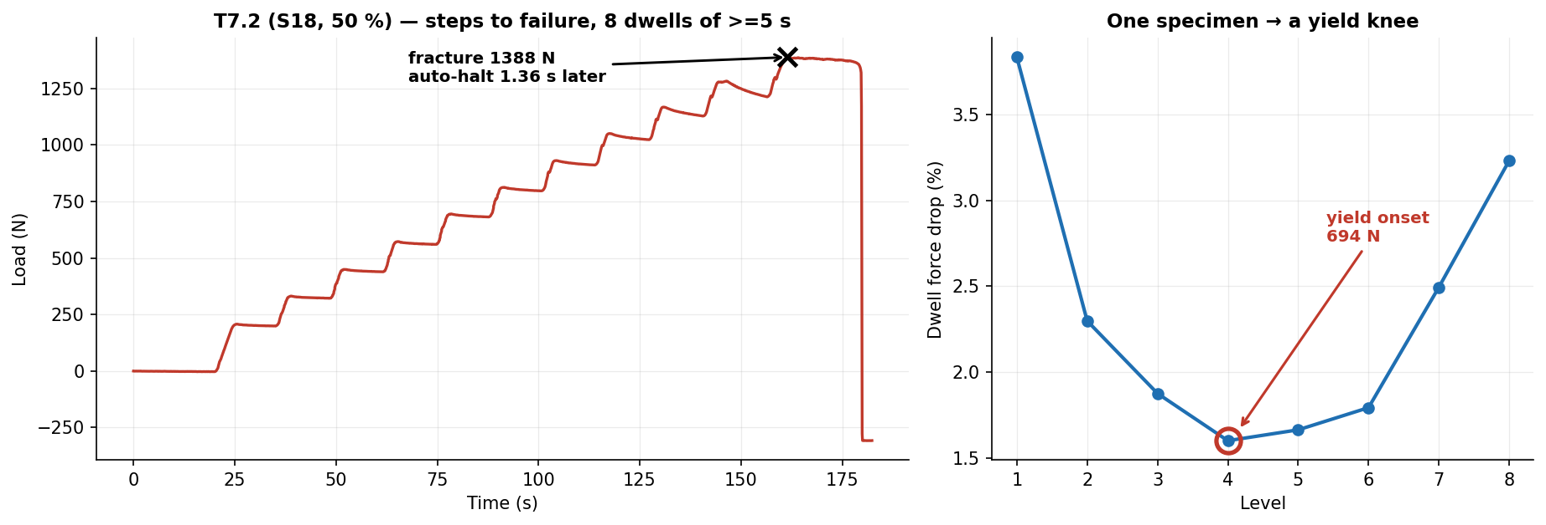
JÖNKÖPING UNIVERSITY
SF9 · STAIRCASE → FRACTURE [T7.2] — OUR RESULTS
1388 N
Peak load
307.4 N
Force anchor
21.19 MPa
TRUE UTS
1.36 s
Auto-halt after collapse
Quantity | Value | Note
Levels resolved | 8 dwells | each one a mini relaxation test
Yield onset | 694 N tared | the dwell drop stops falling and starts growing
Nominal vs TRUE UTS | 17.35 → 21.19 MPa | anchor 307.4 N recovered from the post-fracture tail
One specimen delivered a yield knee AND a fracture: 8 relaxation points, yield located at 694 N, TRUE UTS 21.19 MPa, auto-halt 1.36 s after collapse.
The anchor is the preload the tare removed; recovering it from the settled post-fracture tail converts nominal stress to true stress without a second measurement.
200

Slide 61
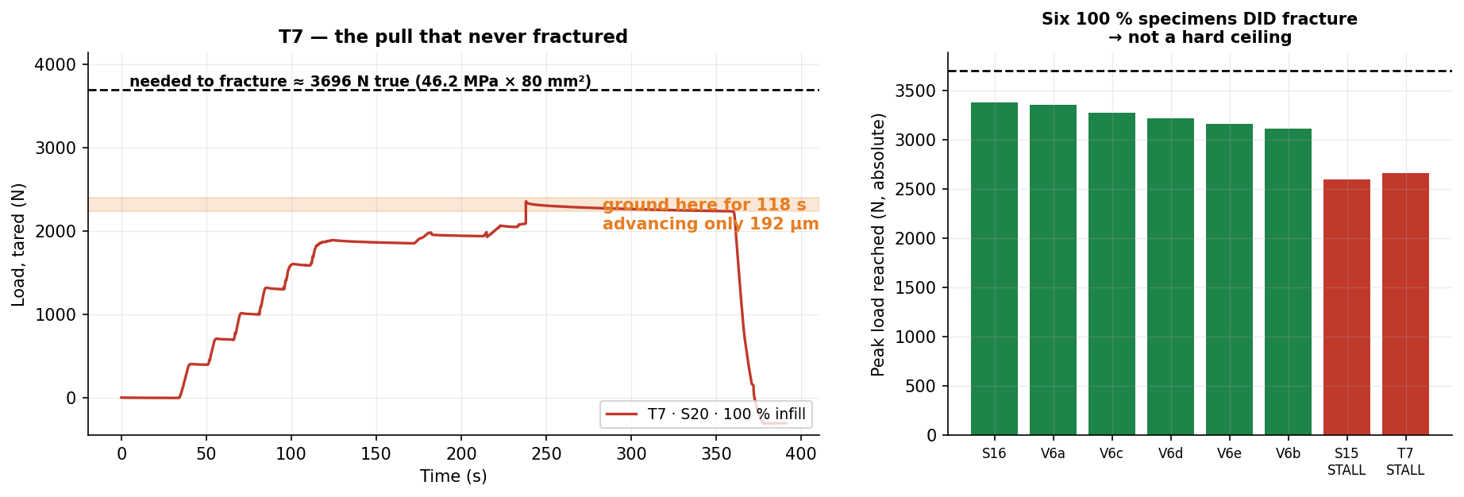
JÖNKÖPING UNIVERSITY
SF9 · THE ONE THAT FAILED [T7] — AND WHY
T7 ran Staircase → FRACTURE on S20 (100 % infill) and never broke the specimen. Worth a slide: the failure is a HARDWARE limit, and the software behaved exactly as designed.
2355 N
Peak reached
3696 N
Needed to fracture
72 % of it
Got to
192 µm in 118 s
Crosshead at the top
1.6 %
…of commanded rate
Why it stalled — ranked at the time (ANSWER: no. 4)
Mitigation
1 Stepper DRIVER CURRENT (Vref) set too low — most likely, and cheapest to check 2 Driver THERMAL DERATING — T7 was the 7th test of a 2 h 15 min session 3 PSU voltage SAG under peak load 4 ✔ MECHANICAL BINDING — crossheads misaligned, load holders loose. See p183.
1 Raise driver current (Vref) — ⚠ HARDWARE today, NOT a software change · see next slide 2 Cool between destructive runs — T7.2 and T8 both PASSED after a pause 3 Scope the rail under load; fit a stiffer PSU 4 On a weak day use 50 % specimens (fracture ≈1.4 kN) — both later runs did
NOT a hard ceiling: six 100 % specimens fractured at 3.1–3.4 kN. Software response was correct — nothing ran away, and the specimen was released intact and reusable.
201

Slide 62
JÖNKÖPING UNIVERSITY
SF9 · T7 — CAN THE Vref FIX BE DONE IN SOFTWARE?
NO — not as the rig stands today. But the driver hardware would allow it, and that is the single highest-value change available.
TODAY — a screwdriver job, not a code change
POSSIBLE — the driver is an SPI Trinamic part
Firmware drives the motors with STEP / DIR / ENABLE only. • No SPI, no UART to the driver • No TMCStepper (or equivalent) library • MoToStepper in STEPDIR mode; 200 × 8 microsteps ⇒ Nothing in main.py or the firmware can change motor current. Vref is set physically on the driver board and verified with a multimeter.
MKS TMC2160_57 boards (README + PROJECT_REQUIREMENTS). Wire CS / SCK / MOSI / MISO to the ESP32 and you can: • SET run current in code — GLOBALSCALER + IRUN • READ DRV_STATUS — otpw / ot over-temperature flags • READ StallGuard — a true stall signal, not an inference ⇒ The thermal-derating theory stops being a theory and becomes a LOGGED CHANNEL.
Is the drivetrain even big enough? 2 × 1.85 Nm · 20:1 gearbox · 5 mm lead
Lead-screw efficiency assumed | 15 % (pessimistic ACME) | 20 % | 30 % | 90 % (ball screw)
Force the drivetrain should reach | 12,554 N | 16,738 N | 25,108 N | 75,323 N
Headroom over the 3696 N needed | 3.4× | 4.5× | 6.8× | 20.4×
Even at a pessimistic 15 % screw efficiency the drivetrain should deliver ~3.4× what is needed, yet T7 stopped at 72 %. A mechanical-sizing explanation does not survive that arithmetic — an electrical one does, which is why driver current is suspect #1.
RECOMMENDED ORDER — (1) measure Vref and compare against the motor's rated current; (2) fit a heatsink/fan; (3) wire the SPI pins and log DRV_STATUS so derating is measured, not guessed.
Motor AMP57TH76-4280 (1.85 Nm), gearbox EPL64/2 20:1, 5 mm lead — from README.md and the MM_PER_S_PER_RPM constant in main.py. Torque figures are holding torque at rated current; if the driver runs the motor below rating, available force scales down roughly with current.
202

Slide 63
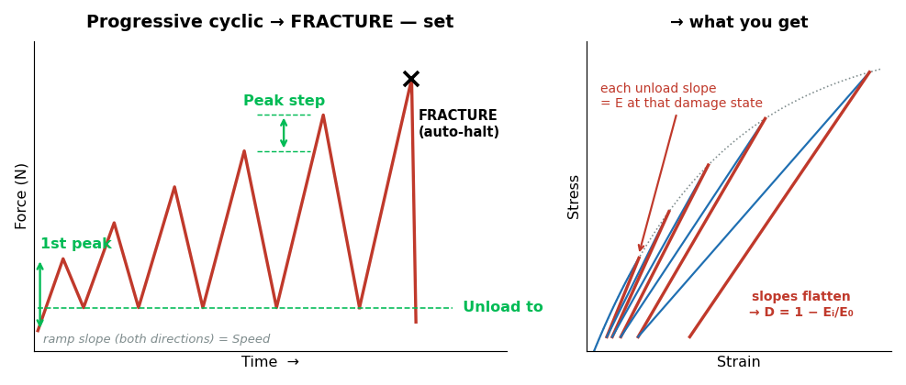
JÖNKÖPING UNIVERSITY
SF9 · PROGRESSIVE CYCLIC → FRACTURE [T8] — HOW IT WORKS
What this mode tells you
DESTRUCTIVE. Load–unload–reload with the peak rising every cycle, until fracture. • EVERY unload measures the modulus at that damage state • Gives the stiffness-degradation curve D = 1 − Eᵢ/E₀ vs stress • Hysteresis area per cycle tracks energy going into damage • Permanent set per cycle shows plasticity accumulating
Settings used for our test
Parameter | Value
1st peak | 300 N
Peak step | 150 N
Unload to | 100 N
Speed | 0.100 mm/s
Specimen | S21 · 50 % infill
The collapse watch here is PER RISING STROKE and armed only past halfway to target — a single always-on detector would trip on every intentional unload.
SOFTWARE LIMITS — 1st peak 0–5000 N · Peak step 10–2000 N · Unload to 20–2000 N · Speed 0.005–0.500 mm/s · max 40 cycles (policy cap)
Guidance: keep the unload floor ≥20 N so the specimen never goes slack and the grips stay seated.
Always-on, every mode: 4.5 kN force · 30 mm travel · 900 s timeout · stall guard (6 s window, min(0.05 mm, 35 % of commanded travel), armed above 200 N) · dead-DIC freeze 0.2 s / halt 1.0 s · E-Stop.
203

Slide 64
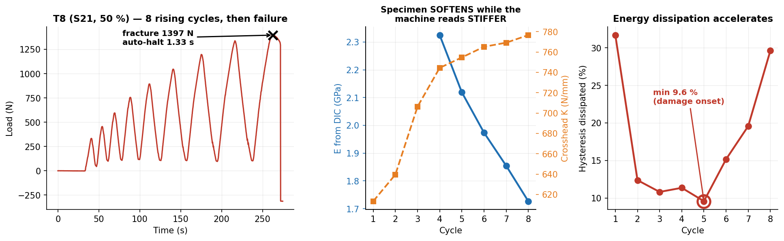
JÖNKÖPING UNIVERSITY
SF9 · PROGRESSIVE CYCLIC → FRACTURE [T8] — OUR RESULTS
Cycle | 1 | 2 | 3 | 4 | 5 | 6 | 7 | 8 | trend
Peak load (N) | 333 | 455 | 595 | 756 | 893 | 1046 | 1198 | 1338 | target ±12 N
Peak error vs target (N) | +33 | +5 | -5 | +6 | -7 | -4 | -2 | -12 | ±6 mean
DIC unload E (GPa) | — | — | — | 2.32 | 2.12 | 1.97 | 1.85 | 1.73 | 2.32 → 1.73
Crosshead K (N/mm) | 613 | 640 | 706 | 744 | 755 | 765 | 769 | 777 | 613 → 777 ↑
Hysteresis dissipated (%) | 31.7 | 12.4 | 10.8 | 11.4 | 9.6 | 15.2 | 19.6 | 29.6 | min 9.6 → 29.6
Specimen SOFTENED 2.32 → 1.73 GPa (25 % stiffness lost) while the crosshead read 613 → 777 N/mm — STIFFER. Without DIC this test concludes the opposite of the truth.
Cycles 1–3 carry no modulus: the DIC strain CHANGE in those small unloads is below the noise floor (R² 0.17–0.82). Dissipation is an energy integral over a large position range and has no such floor — on this rig it is the better damage metric.
204

Slide 65
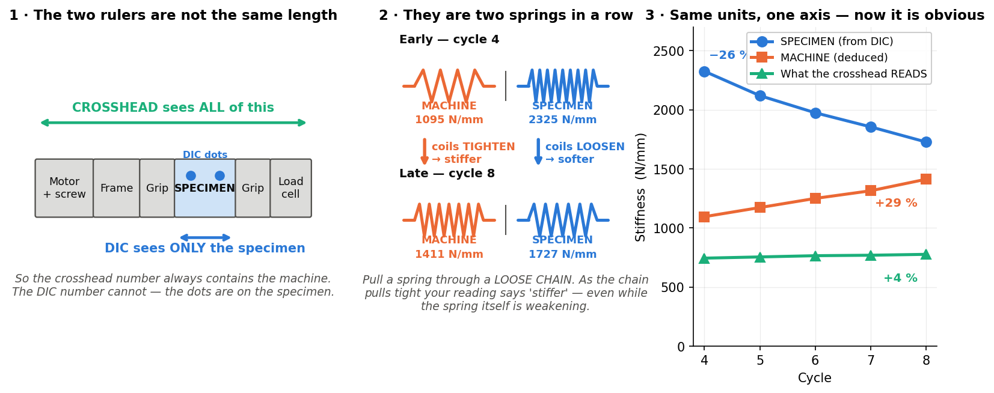
JÖNKÖPING UNIVERSITY
EXPLAINER — “the specimen softens but the machine reads stiffer”
This is the single most important idea on the T8 slide, so here it is slowly. Nothing here is new data — it is the same numbers, explained.
What you are measuring
Two DIFFERENT things. DIC watches two dots ON the specimen. The crosshead measures how far the whole machine moved.
Why that matters
The crosshead reading contains the grips, screw, frame and every bit of slack — the specimen is only ONE part of what it sees.
What actually happened
The specimen got 26 % SOFTER (real damage). The machine got 29 % STIFFER as slack was squeezed out. The machine change is bigger, so the total went UP 4 %.
The one-line version
The rig is the SOFTER spring (1095 vs 2325 N/mm), so it dominates the crosshead number. Only DIC can see the specimen by itself.
Springs in series: 1/K_measured = 1/K_specimen + 1/K_machine. K_specimen = E·A/L; with A = 80 mm² and L = 80 mm that is numerically E in MPa, which is why all three fit on one axis.
205

Slide 66

JÖNKÖPING UNIVERSITY
EXPLAINER — why the energy loss DIPS, then CLIMBS
The U shape looks odd until you see that TWO separate things are being added together — one dying away, one waking up.
Cycle | 3 | 4 | 5 ← lowest | 6 | 8 | what it tells you
Energy lost per cycle | 10.8 % | 11.4 % | 9.6 % | 15.2 % | 29.6 % | dips, then climbs
Permanent stretch added | +106 µm | +102 µm | +22 µm | +65 µm | +271 µm | dips, then climbs
Left-over strain added (DIC) | +385 µε | +254 µε | +212 µε | +264 µε | +1669 µε | dips, then climbs
Three completely separate measurements all bottom out at CYCLE 5. That is why it is believed — one dipping curve could be noise; three agreeing is a real change of regime.
Careful: cycle 5 is where MATERIAL damage overtakes the still-fading MACHINE settling — it is not a pure yield point. T7.2's relaxation knee says 694 N, this says 893 N, so the deck quotes yield onset as a BRACKET of 700–900 N rather than one number.
206

Slide 67
JÖNKÖPING UNIVERSITY
SF3 · SETTINGS (RECIPES) — WHAT ONE CLICK RESTORES
A recipe is the WHOLE test setup, not just a couple of boxes. Pick a profile, press Load, and every field below is restored — including the advanced test mode and its parameters.
Specimen & rig
Test programme ← the part people miss
Field | Stored as | Example
Material | material | PLA
Infill % | infill_pct | 50
DIC specimen preset | specimen_mode | White / Black
Cross-section area | area_mm2 | 80.0 mm²
Gauge length | gauge_mm | 80.0 mm
Preload target | preload_N | 300 N
Test speed | test_speed_mm_s | 0.100 mm/s
Field | Stored as | Example
Which advanced mode | mode | Progressive cyclic → FRACTURE
ALL SIX modes' parameters | mode_params | see below
Strain-rate target | strain_rate | 0.0005 /s
Auto-stop at fracture | auto_stop_fracture | ON
Free-text notes | notes | why these settings
— Cyclic | low/high/cycles/speed/waveform | 100 / 500 N · 5 · Sine
— Progressive cyclic | first_peak/peak_step/unload_to/speed | 300 / 150 / 100 N
Every mode's parameters are stored, not just the selected one — so switching Test type AFTER a Load gives sane values instead of leftovers from whatever was loaded before. Verified by round-trip: save → reload returns byte-identical params for all six modes.
Why it matters
The profile that ships
• A destructive test is ONE specimen — there is no second chance to get the settings right. • Repeat runs are identical by construction, not by memory or a lab notebook. • A student can run a validated protocol without knowing how it was tuned. • One shared source of truth: `_mode_widget_map()` drives BOTH save and load, so the two can never drift apart. Adding a mode means one entry there and nothing else.
Profile | Infill | Preload | Fracture protocols sized for
Default | 100 % | 300 N | ~3.2 kN in ~10 levels
Recreated automatically if missing, so a fresh clone always has it. A profile you have saved under your own name is never overwritten. Was two profiles (100 % / 50 % infill) until 2026-08-12 — one is enough, since infill is a label that enters no calculation and every force here is a starting point the operator adjusts per specimen anyway.
Stored as plain JSON in Software/UTM_PyQt6/recipes/ — readable, diffable, and easy to hand to someone else. The folder is gitignored as user-local; the two defaults regenerate on launch.
207

Slide 68

JÖNKÖPING UNIVERSITY
SF9 — STRESS vs STRAIN, ALL SIX MODES
The same six protocols in MATERIAL space. Strain is DIC gauge strain, ENGINEERING (ΔL/L₀); stress is engineering (F/A₀). True stress needs the current cross-section, which needs Poisson from edge tracking — not measured yet, so nothing here is labelled 'true'.
Each protocol has a signature: cyclic = a tight loop bundle · staircase = one straight line with dwell steps · relaxation = a VERTICAL drop at fixed strain · creep = a single POINT · both fracture modes = the full curve to failure.
ε_f 3.10 % (T7.2) and 3.32 % (T8). A marker-separation plausibility bound is applied: at fracture L_px jumps 1668→1825 px ONE SAMPLE before the load collapses, which would otherwise stretch both fracture panels to a fictitious 10 % strain.
208

Slide 69

JÖNKÖPING UNIVERSITY
SF9 — DO THE NUMBERS MAKE SENSE? vs add:north E-PLA TDS
SAME reference as the V6 slides (p156 / p163): add:north E-PLA TDS rev 2.1, ISO 527 / 178, so k = spec ÷ measured is directly comparable across the deck. The datasheet has NO creep or relaxation data — those two rows use journals and are marked ‡.
Property | ISO | E-PLA spec | SF9 measured | k | retain
Tensile modulus E — T4 staircase, top level (100 %) | 527 | 2.87 GPa | 2.88 GPa | 1.00 | 100 %
Tensile modulus E — T8 cycle 4 (50 % infill) | 527 | 2.87 GPa | 2.32 GPa | 1.23 | 81 %
Tensile strength — T7.2 / T8 (50 % infill) | 527 | 58 MPa | 21.2 / 21.4 MPa | 2.74 / 2.71 | 37 %
Elongation at break — T7.2 / T8 (50 % infill) | 527 | 8 % | 3.10 / 3.32 % | 2.58 / 2.41 | 39–42 %
Stress relaxation ‡ — T2, 81 s at ε=0.010 | — | not on TDS | 4.9 % | — | see ‡
Creep ‡ — T1, 40 s at 5.0 MPa | — | not on TDS | none resolvable | — | see ‡
Headline: the staircase modulus measured on a HIGH-STRESS increment lands on the datasheet (k = 1.00) where the conventional broad-range fit gives k = 1.10 — the low-stress slack is what drags the usual number down.
Spec sheet — add:north E-PLA TDS (PDF, ISO 527 / 178)
‡ TDS carries no viscoelastic data. Relaxation/creep compared against Materials 15(10) 3509 and J. Appl. Polym. Sci. e54463 (~11–13 % relaxation, far longer holds). Tg 55–60 °C is from the TDS.
209

Slide 70
JÖNKÖPING UNIVERSITY
SF9 — TEST CAMPAIGN REGISTER (T1–T8)
Every advanced-mode run, in order. Use the Test ID to tie a slide back to its CSV, and the Slides column to go the other way. Dates are the CSV's own 'Test Date' header — the filename timestamp is a session id and does NOT match (all three T6 attempts share one).
Test | Mode / variant | Spec. | When (2026) | Headline result | Slides
T1 | Creep | S20 100 % | 08-08 18:28 | held 398 ± 2.2 N for 40 s; creep NOT resolvable (-14 µε vs ±12 µε noise) | 195-196 · 206 · 207
T2 | Relaxation | S20 100 % | 08-08 18:34 | ε pinned at 0.01011; force decayed 2146 → 2040 N (4.9 %) | 193-194 · 206 · 207
T3 | Staircase · Linear ramp | S20 100 % | 08-08 19:37 | 3 levels / 20 s dwells — arrival overshoot +45/+47/+53 N | 190-192 · 206
T4 | Staircase · Smooth ramp | S20 100 % | 08-08 19:42 | same levels — overshoot +6/+5/+8 N ▸ the taper fix | 190-192 · 206
T5 | Cyclic · Triangle | S20 100 % | 08-09 13:10 | 5 cycles 100/500 N in 115 s; peak error 71 N (no lead yet) | 187-189 · 204
T6 | Cyclic · Sine — 1st try | S20 100 % | 08-09 13:16 | accurate (8 N) but took 222 s — ~2× too slow, flat bottoms ▸ velocity-law bug found | —
T6.2 | Cyclic · Sine — 2nd try | S20 100 % | 08-09 14:03 | speed fixed (117 s) but peaks flat at +15 N — no convergence ▸ 2 structural fixes | —
T6.3 | Cyclic · Sine — final | S20 100 % | 08-09 14:25 | 138 s, peak error 15 N, and peaks CONVERGE 528 → 500 N | 187-189 · 204
T7 | Staircase → FRACTURE | S20 100 % | 08-09 15:20 | STALLED at 2355 N (72 % of what was needed) — no fracture, specimen intact | 199-200
T7.2 | Staircase → FRACTURE | S18 50 % | 08-09 15:37 | yield knee 694 N, TRUE UTS 21.19 MPa, auto-halt 1.36 s | 197-199 · 206
T8 | Progressive cyclic → FRACTURE | S21 50 % | 08-09 17:34 | 8 clean cycles, 25 % stiffness lost, TRUE UTS 21.38 MPa | 201-206
11 runs, 6 modes, 3 specimens. T6 → T6.2 → T6.3 are three attempts at ONE test, not three tests — each failure diagnosed a real bug. T7 is the only outright failure, and it is hardware.
Specimen economy: S20 (100 %) survived all eight NON-destructive runs (T1–T6.3) AND the failed T7 — a destructive protocol it was never broken by. The two destructive runs that DID succeed each consumed a fresh specimen (S18, S21). T7 came after 2 h 15 min of continuous testing that day, which is the thermal-derating argument on p201.
Raw CSVs: Software/UTM_PyQt6/8.7/<specimen folder>/. Metrics recomputed by documentation/scripts/sf9_data.py — this table is generated, not typed.
210

Slide 71

JÖNKÖPING UNIVERSITY
REFERENCE — ENGINEERING vs TRUE vs “CAUCHY” STRAIN
Three names, only TWO quantities. This page exists because the CSV column is called DIC_Cauchy while it holds ENGINEERING strain — the single most confusing thing in this project.
THE TRAP: “Cauchy STRESS” means TRUE stress — but “Cauchy STRAIN” is a synonym for ENGINEERING strain. Putting the two words side by side invites exactly the wrong reading, which is why every axis now says “Engineering strain, DIC”.
Why engineering — and it is about STRESS, not strain
So the choice is forced
Quantity | Needs | Can we?
Engineering strain ΔL/L₀ | length only | YES
True strain ln(L/L₀) | length only | YES
Engineering stress F/A₀ | original area | YES
True stress F/A_current | CURRENT area | NO — not yet
• A stress–strain curve must be INTERNALLY CONSISTENT — engineering with engineering, or true with true. Mixing them is simply wrong. • True stress needs the current cross-section ⇒ Poisson, which the narrow gauge blocks (p187). • So engineering + engineering is the only defensible pairing available today. • ISO 527 and the add:north TDS also report engineering — which is what keeps our k-factors comparable (p208).
In code: cauchy = (L−L₀)/L₀ and true_strain = ln(L/L₀), both written to every CSV. Verified on real data: DIC_True always equals ln(1 + DIC_Cauchy), so the maths was right — only the NAME was misleading. The column name is kept for backward compatibility with every past test.
211

Slide 72

JÖNKÖPING UNIVERSITY
REFERENCE — WOULD TRUE STRESS CHANGE OUR ANSWERS?
Worth asking before building the edge-tracking rig on p187. Short answer: it is a ~3 % refinement on the numbers — but it buys two things nothing else can.
Engineering strain | 1 % | 3.3 % (T8 ε_f) | 7 % (V6 worst) | 20 % (a ductile metal)
True stress higher by — elastic, ν = 0.35 | +0.7 % | +2.4 % | +5.1 % | +15.6 %
True stress higher by — volume conserved | +1.0 % | +3.3 % | +7.0 % | +20.0 %
Our 21.38 MPa would become | 21.6 | 21.9 – 22.1 | 22.5 – 22.9 | —
Engineering vs TRUE STRAIN differ by | 0.5 % | 1.6 % | 3.3 % | 10.7 %
So DO IT — but not for the 3 %. Do it for (1) POISSON'S RATIO, a material property we cannot measure at all today, and (2) telling whether the post-peak drop is real softening or just thinning: S16 falls 47.4 → 42 MPa, and volume-conserved true stress is still only 44.5.
✅ DESIGN FIX APPLIED on p187 (2026-09-01): the spec said “average width over 100s of rows”. Necking is LOCAL, so the mean under-corrects exactly where it matters. It now reads MEAN while the width is uniform (ν), MINIMUM band once necking starts (area). Fixed before building, which is the cheap end.
212

Slide 73

JÖNKÖPING UNIVERSITY
SF9 · CYCLIC — RE-RUN [T6.4 · T6.5] — OUR RESULTS
± 3.4 N
Peak error
12.3 px (was 3.6)
Strain excursion
14.2 → 10.9 kJ/m³
Loop area
1.49 → 1.43 GPa
Unload modulus
0.99 (was 0.12)
Unload-fit R²
Quantity | T6.4 (1st run) | T6.5 (2nd run) | What it means
Closed loops recovered | 3 of 8 · 45 % frames | 6 of 8 · 97 % frames | T6.4 lost the camera at t ≈ 145 s
Loop area, first → last | 15.3 → 10.2 kJ/m³ | 14.2 → 10.9 kJ/m³ | falls monotonically — real energy, not noise
Unload modulus (R²), 1st → last | 1.51 → 2.19 GPa (0.65) | 1.49 → 1.43 GPa (≥ 0.99) | resolvable every cycle — impossible on T6.3
T6.5 IS THE SLIDE-READY CYCLIC RESULT: 8 cycles at 400→1100 N, peak held to ± 3.4 N, 6 closed loops, and BOTH damage metrics (loop area, unload E) fall monotonically. The negative result on p191 is closed.
STILL MISSING — a DAMAGE CURVE. T6.4 lost DIC mid-run and T6.5 ran on the already-cycled specimen, and E RECOVERED over the 40 min between them (cycle 3 = 1.52 → cycle 8 = 1.54 GPa), so recoverable softening cannot be separated from permanent damage. D = 1 − Eᵢ/E₀ is NOT computable here.
Both runs are S22, 50 % infill. Cycle 1 is never a baseline — rig slack inflates it (ratchet +185 µm on T6.4 cycle 1 vs +37 µm on cycle 2). The loop extraction needs a trough-peak-trough triplet, so the first and last half-cycles are correctly not counted.
213

Slide 74

JÖNKÖPING UNIVERSITY
T6.3 → T6.5 — WHY THE RE-RUN WORKED
One parameter, not a new machine. Same mode, same engine, same camera, same code — the ONLY change is where the cycle bottoms out and tops out. p191 predicted a 13.1 px loop from that change alone; here is the measurement.
What was wrong on T6.3 | Why it was wrong | What T6.5 changed | Result
Loop area was mostly BACKLASH | unloading to 100 N re-crosses the slack band every cycle | floor raised to 400 N — crossed ONCE, at the start | loops close; ratchet +34 µm/cycle
Strain excursion only 3.6 px | that swing is near the centroid quantisation limit | peak raised to 1100 N — 1.8× the load swing | 12.3 px, vs 13.1 px predicted
Unload modulus unfittable (R² 0.12) | the strain change in a small unload is under the noise floor | the unload now spans 6169 µε, not ~243 | R² 0.99–1.00 every cycle
The lesson generalises: on a machine with slack, WHERE you cycle matters more than HOW accurately you cycle. T6.3 already held its peaks to 15 N — the control was never the problem, the operating window was.
Kept honest: T6.3's loop area was 7.6 kJ/m³, not zero — it was never 'no signal', it was signal you cannot attribute, and the R² column is what separates those two cases. Different specimens (S20 100 % vs S22 50 %), so absolute stress is not comparable; resolvability is.
214

Slide 75

JÖNKÖPING UNIVERSITY
SF9 · CREEP [T9] — HOW IT WAS DESIGNED: TWO RUNS
T1 failed because a creep signal below the noise floor is indistinguishable from the instrument drifting. T9 therefore MEASURES the drift first — same specimen, same mounting, nothing commanded — then subtracts its SLOPE from the real hold.
The protocol — order matters
Settings, and how the target was sized
Step | What runs | Why
1 Preload + tare | 300 N, tare force & DIC | one mounting state for both runs
2 RUN 1 — baseline | 928 s, nothing commanded | drift, with zero load applied
3 RUN 2 — creep | 600 N tared, 877 s hold | the actual experiment
4 Subtract the SLOPE | +0.2893 µε/s | a rate survives a re-tare; an offset does not
Parameter | Value | Reasoning
Hold load | 600 N tared | 11.3 MPa true = 53 % of the 21.2 MPa UTS
Hold duration | 900 s commanded | 877 s of settled hold measured
Specimen | S23 · 50 % infill | 50 % infill ⇒ ~2× the stress at the same load
Ramp speed | 0.100 mm/s | same as every other SF9 mode
THE DISCRIMINATOR WAS FIXED BEFORE THE RUN: material creep DECELERATES (log-shaped), instrument drift is LINEAR. The baseline's half-slopes are 0.345 / 0.277 µε/s (ratio 0.80) — linear, exactly as a drift should be. Anything curved in run 2 is therefore the specimen.
The baseline also RE-MEASURED the DIC noise floor as ± 26 µε over a full 900 s window (p198's ± 12 µε is a 40 s window). 9971 of 10854 rows DIC-valid at 20.6 ± 0.23 N, crosshead frozen.
215

Slide 76

JÖNKÖPING UNIVERSITY
SF9 · CREEP — RE-RUN [T9] — OUR RESULTS
596.5 ± 1.3 N
Force held
+1080 µε
Creep strain
41 ×
vs noise floor
n = 0.48
Findley exponent
100 %
DIC frames tracked
Quantity | Value | Interpretation
Load held over the 877 s window | 596.55 ± 1.30 N (594.1–610.9 N) | ± 0.22 % — the strain rise is not a load artefact
Raw strain rise → drift-corrected | +1334 µε → +1080 µε | drift only 19 % of raw; subtraction costs ± 2 µε
Shape — the pre-set discriminator | Findley n = 0.48 · half-slopes 1.48 → 0.59 µε/s | n < 1 and the rate halves: primary creep, not drift
Crosshead travel to hold the load | +172 µm (DIC gauge only +107 µm) | only 62 % of that motion is specimen — rest is rig
CREEP RESOLVED: +1080 µε drift-corrected = 41× the 26 µε noise floor, decelerating (n = 0.48), while the load sat at 597 ± 1.3 N. The negative result on p198 is closed.
Also measured: creep compliance J = 0.863 → 1.008 GPa⁻¹ (+16.7 %), plus a free fixed-grip relaxation tail, 598 → 582 N over 300 s (−2.8 %). ⚠ The CSV header reads 'Infill: 100 %' while S23 is 50 % — a label that enters no calculation, so no number here is affected.
216

Slide 77

JÖNKÖPING UNIVERSITY
T1 → T9 — WHY CREEP IS NOW RESOLVED
T1 was not a broken test — it was an UNDER-SIZED one, and it never could have succeeded. Three things were too small at once, and each was fixed by a number, not by new hardware.
What was wrong on T1 | Why it was fatal | What T9 changed | Result
Stress only 11 % of UTS | creep scales with stress — at 11 % there is nothing to see | 600 N on a 50 %-infill specimen = 53 % of UTS | signal ×77
Hold only 40 s | primary creep is log-shaped — it plays out over minutes | 877 s of settled hold | 22× longer
No drift baseline existed | any slow rise could equally be the instrument, so nothing could be attributed | a 928 s zero-load run FIRST, same mounting | drift measured: +0.2893 µε/s
WHAT THE BASELINE BOUGHT: the drift was +268 µε over 928 s — 19 % of the whole raw signal, and about 60 % of what a textbook 6 % creep would have been. Without run 1 the answer would have been arguable; with it, the subtraction is good to ± 2 µε.
⚠ NOISE FLOOR DEPENDS ON THE WINDOW: ± 12 µε on p198 is T1's own 40 s scatter; over a full 900 s window it is ± 26 µε. Any LONG-hold claim must be judged against 26, not 12.
Honest limits: the creep/instantaneous ratio of 16.8 % is an UPPER bound (ε_inst is tared at preload), and n=1 — one specimen, one stress level. A compliance CURVE needs 3-4 levels.
217

Slide 78
JÖNKÖPING UNIVERSITY
SF9 — FOLLOW-UP CAMPAIGN REGISTER (T6.4 – T9, 2026-08-11)
Continues the T1–T8 register on p210. One session, two specimens, five runs — aimed squarely at the two negative results (cyclic hysteresis, creep) and at the first fatigue-damage number.
Test | Mode / variant | Spec. | When (2026) | Headline result | Slides
T6.4 | Cyclic · Sine 400/1100 N | S22 50 % | 08-11 14:06 | peak error 3.0 N and the loop opens up — but the CAMERA stopped at t ≈ 145 s, so cycles 4-8 have no strain (45 % frames) | 211-212
T6.5 | Cyclic · Sine 400/1100 N | S22 50 % | 08-11 14:45 | 6 closed loops · area 14.2 → 10.9 kJ/m³ · unload E 1.49 → 1.43 GPa — the slide-ready cyclic result | 211-212
T7.3 | Staircase → FRACTURE (fatigued) | S22 50 % | 08-11 15:12 | residual strength after 16 cycles at 1100 N: 1272 N tared, TRUE UTS 19.74 MPa = -6.8 % vs S18 (same protocol); yield knee moved UP (load memory) | 208 · 216
T9-a | Creep · zero-load BASELINE | S23 50 % | 08-11 15:50 | 928 s at 20.6 N, crosshead frozen: drift +0.2893 µε/s (R² 0.90), noise floor ± 26 µε | 213
T9-b | Creep · 600 N tared | S23 50 % | 08-11 16:26 | held 596.5 ± 1.3 N for 877 s → +1080 µε drift-corrected (41× noise), Findley n = 0.48; +172 µm crosshead needed to hold it | 213-215
Two negative results turned positive in ONE session, by changing NUMBERS only — no new hardware, no code change to the control engine. Cyclic needed a higher window (400→1100 N instead of 100→500 N); creep needed more stress, more time, and a baseline.
What is now CLOSED
What is still OPEN
• Cyclic hysteresis is measurable — loop area AND unload modulus both trend (p213-214). • Creep is measurable — +1080 µε at 41× the noise floor, decelerating (p216-217). • The DIC noise floor is now MEASURED over a full 900 s window: ± 26 µε. • Fatigue damage has a first number: -6.8 % TRUE UTS after 16 cycles at 79 % of fracture, measured against S18 — the run that used the SAME protocol (T7.3). • A fixed-grip relaxation tail comes free at the end of every creep run.
• No damage curve D = 1 − Eᵢ/E₀ — T6.4 lost DIC, T6.5 started already damaged, and E RECOVERED over the 40 min between them, so there is no valid E₀. ▸ T6.6: fresh specimen, 12 cycles, ONE continuous run, baseline E on cycle 2. • Creep at ONE stress level only — a compliance curve needs 3-4 levels. • The `Infill` CSV header still writes 100 % after an app restart (label only).
Raw CSVs: Software/UTM_PyQt6/Test data/Smart Features - Advanced Test Modes/<specimen folder>/. Every number on this page is recomputed by documentation/scripts/sf9_data.py — the table is generated, not typed.
218

Slide 79
JÖNKÖPING UNIVERSITY
S25 · S26 — FRAME CAPTURE, CHECKED AGAINST THE TEST DATA
Two 100 % infill runs pulled to fracture on 2026-08-17 with capture armed. These videos are going to an extensometer package, so the question is not “did it record” but “is every frame real, distinct, and matched to a load sample”.
Check | S25 · VC2 | S26 · VC3 | Verdict
PNG stills written | 1445 | 1682 | —
video.avi (raw) | 1445 | 1682 | —
video_boost.avi | 1445 | 1682 | —
video_speckle.avi | 1445 | 1682 | —
All four sinks hold the same count | yes | yes | PASS
Dropped frames (implied by timestamps) | 0 | 0 | PASS
Capture rate (median interval) | 19.9 fps (50.2 ms) | 19.9 fps (50.2 ms) | PASS
Worst interval (p95) | 52.3 ms | 52.4 ms | PASS
SF11 run.json points at this CSV | yes | yes | PASS
DIC coverage (CSV header) | 100% | 100% | PASS
DIC health (CSV header) | 100% frames tracked 2/2 | 100% frames tracked 2/2 | PASS
Replay: frames byte-distinct | 100.0 % | 100.0 % | PASS
Replay: 2 markers found by the app's detector | 99.8 % | 99.9 % | PASS
Does the video cover the pull?
The whole point is a video that spans the loaded history — a capture that opens late has no elastic region to give the extensometer. S25 ramp 33.5 s · capture 33.0 → 106.0 s · fracture 101.4 s S26 ramp 10.6 s · capture 10.0 → 95.0 s · fracture 90.4 s Both open ≈ 0.6 s BEFORE the crosshead moves and run 4.6 s past fracture.
The one that did not do this
S24 (the first capture run, before these two) logged only 27 % DIC coverage — the frames were all there and all distinct, so the loss was in the load↔DIC matching step. It has not recurred: both runs here are at 100 %.
PASS — 3 127 stills and 3 × 3 127 AVI frames, zero dropped, all four sinks in step, 100 % DIC coverage on both runs. The videos are usable as extensometer input.
Raw: Software/UTM_PyQt6/Test data/8.6.20 - Tensile test to Failure/Specimen_S25… and …S26…/. Frame counts, rates and coverage recomputed at build time by documentation/scripts/s25_s26_data.py.
219

Slide 80

JÖNKÖPING UNIVERSITY
S25 vs S26 — STRESS vs STRAIN, OVERLAID
Same material, same 80 mm² nominal section, same protocol, 37 minutes apart. Engineering stress, anchor-corrected; DIC gauge strain over 80 mm.
 | S25 · VC2 | S26 · VC3 | Δ
UTS (MPa) | 46.16 | 47.17 | +1.01
at strain (%) | 2.19 | 2.44 | +0.25
σ_y 0.2 % (MPa) | 39.82 | 41.75 | +1.93
E (GPa) | 3.167 | 3.549 | +0.382
ε_f (%) | 4.18 | 5.74 | +1.57
Toughness (kJ/m³) | 1564 | 2309 | +745
Force anchor (N) | 280 | 308 | +27
Gauge share (%) | 49.5 | 57.8 | +8.4
What agrees, and what does not
UTS agrees to 2.2 % — it needs no curve fit, so it is the number to carry into the extensometer comparison. E and σ_y do NOT agree, and the next page shows they are the same disagreement counted twice. ε_f differs by 1.6 points. Across the eight 100 % runs on record ε_f spans 3.0–7.4 %, so this is ordinary specimen scatter in a brittle-ish failure, not an instrument effect.
Both curves come from utm_analysis.analyze() — the same function behind the app's Generate-report button. Plot: documentation/scripts/s25_s26_plots.py.
220

Slide 81

JÖNKÖPING UNIVERSITY
WHY E AND σ_y DISAGREE — AND WHY UTS DOES NOT
Read on its own, “2.98 vs 2.51 GPa” looks like two specimens with different stiffness. It is not. analyze() fits E over a FIXED 0.05–0.40 % strain window, and the two specimens do not have their toe in the same place — so for one of them that window is sitting on curved data.
 | fixed window | straightest run (its own)
S25 | 3.167 GPa | 3.123 GPa (0.13–0.65 %)
S26 | 3.549 GPa | 3.464 GPa (0.33–0.85 %)
σ_y then follows E, mechanically
The 0.2 % offset line has slope E. A softer E tilts it down, so it meets the curve later and higher: S25 E 3.17 → σ_y is 86.3 % of its UTS S26 E 3.55 → σ_y is 88.5 % of its UTS So the σ_y spread (39.8 vs 41.7 MPa) is largely the E spread re-expressed — one disagreement, counted twice.
TAKE-AWAY — quote UTS (no fit, agrees to 2.2 %) and treat σ_y / E from these two runs as fit-window artefacts until the E window is made adaptive. Fixing it is a change to utm_analysis.analyze(), not to the rig: search each curve for its own straightest run instead of assuming every specimen seats identically.
Shaded bands are the two candidate fit windows on each specimen's own curve. Recomputed by s25_s26_data.best_elastic_fit().
221

Slide 82
JÖNKÖPING UNIVERSITY
S25 vs S26 — STRESS-STRAIN DATA TABLE (1/3)
Both runs on ONE strain axis at 0.10 % steps, so every row is a like-for-like comparison — this is the form to hold beside extensometer output. ε 0.00 % → 1.90 %, read down the left block then the right. Δ = S26 − S25 at the same strain; “—” means that strain is past that specimen's fracture, so it genuinely has no stress there.
ε (%) | S25 σ | S26 σ | Δ | Landmark
0.00 | — | — | —
0.10 | 6.20 | 5.84 | -0.37
0.20 | 8.86 | 8.28 | -0.58
0.30 | 12.05 | 10.64 | -1.41
0.40 | 15.11 | 13.64 | -1.48
0.50 | 18.34 | 17.12 | -1.22
0.60 | 21.31 | 20.59 | -0.71
0.70 | 24.14 | 24.27 | +0.14
0.80 | 26.90 | 27.56 | +0.66
0.90 | 29.45 | 30.60 | +1.15
1.00 | 31.81 | 33.47 | +1.67
ε (%) | S25 σ | S26 σ | Δ | Landmark
1.10 | 34.11 | 35.89 | +1.79
1.20 | 36.23 | 38.12 | +1.89
1.30 | 38.25 | 40.16 | +1.92
1.38 | 39.82 | 41.55 | +1.73 | S25 yield
1.40 | 40.07 | 41.75 | +1.67 | S26 yield
1.40 | 40.10 | 41.78 | +1.68
1.50 | 41.67 | 43.13 | +1.47
1.60 | 43.05 | 44.27 | +1.22
1.70 | 44.13 | 45.18 | +1.05
1.80 | 44.97 | 45.88 | +0.92
1.90 | 45.57 | 46.39 | +0.82
Yield — 0.2 % offset
UTS — peak stress
Fracture — load collapse
Highlighted rows carry MEASURED values at each run's true landmark strain, not grid-interpolated ones. FULL RESOLUTION (all 768 + 903 raw samples): documentation/decks/S25_S26_stress_strain_reference.pdf
222

Slide 83
JÖNKÖPING UNIVERSITY
S25 vs S26 — STRESS-STRAIN DATA TABLE (2/3)
Both runs on ONE strain axis at 0.10 % steps, so every row is a like-for-like comparison — this is the form to hold beside extensometer output. ε 2.00 % → 3.90 %, read down the left block then the right. Δ = S26 − S25 at the same strain; “—” means that strain is past that specimen's fracture, so it genuinely has no stress there.
ε (%) | S25 σ | S26 σ | Δ | Landmark
2.00 | 45.94 | 46.73 | +0.79
2.10 | 46.11 | 46.95 | +0.84
2.19 | 46.16 | 47.06 | +0.91 | S25 UTS
2.20 | 46.16 | 47.08 | +0.92
2.30 | 46.07 | 47.13 | +1.06
2.40 | 45.94 | 47.16 | +1.22
2.44 | 45.87 | 47.17 | +1.30 | S26 UTS
2.50 | 45.75 | 47.15 | +1.39
2.60 | 45.54 | 47.11 | +1.57
2.70 | 45.31 | 47.04 | +1.73
2.80 | 45.10 | 46.96 | +1.86
ε (%) | S25 σ | S26 σ | Δ | Landmark
2.90 | 44.87 | 46.86 | +1.99
3.00 | 44.66 | 46.74 | +2.08
3.10 | 44.45 | 46.61 | +2.17
3.20 | 44.23 | 46.47 | +2.24
3.30 | 44.05 | 46.32 | +2.28
3.40 | 43.85 | 46.17 | +2.32
3.50 | 43.67 | 46.03 | +2.36
3.60 | 43.47 | 45.89 | +2.42
3.70 | 43.27 | 45.74 | +2.47
3.80 | 43.06 | 45.60 | +2.54
3.90 | 42.83 | 45.46 | +2.63
Yield — 0.2 % offset
UTS — peak stress
Fracture — load collapse
Highlighted rows carry MEASURED values at each run's true landmark strain, not grid-interpolated ones. FULL RESOLUTION (all 768 + 903 raw samples): documentation/decks/S25_S26_stress_strain_reference.pdf
223

Slide 84
JÖNKÖPING UNIVERSITY
S25 vs S26 — STRESS-STRAIN DATA TABLE (3/3)
Both runs on ONE strain axis at 0.10 % steps, so every row is a like-for-like comparison — this is the form to hold beside extensometer output. ε 4.00 % → 5.75 %, read down the left block then the right. Δ = S26 − S25 at the same strain; “—” means that strain is past that specimen's fracture, so it genuinely has no stress there.
ε (%) | S25 σ | S26 σ | Δ | Landmark
4.00 | 42.54 | 45.32 | +2.77
4.10 | 42.17 | 45.17 | +3.00
4.18 | 41.59 | 45.07 | +3.48 | S25 fracture
4.20 | — | 45.03 | —
4.30 | — | 44.90 | —
4.40 | — | 44.79 | —
4.50 | — | 44.66 | —
4.60 | — | 44.54 | —
4.70 | — | 44.41 | —
4.80 | — | 44.29 | —
4.90 | — | 44.17 | —
ε (%) | S25 σ | S26 σ | Δ | Landmark
5.00 | — | 44.02 | —
5.10 | — | 43.89 | —
5.20 | — | 43.76 | —
5.30 | — | 43.62 | —
5.40 | — | 43.47 | —
5.50 | — | 43.28 | —
5.60 | — | 43.08 | —
5.70 | — | 42.76 | —
5.75 | — | 42.54 | — | S26 fracture
Yield — 0.2 % offset
UTS — peak stress
Fracture — load collapse
Highlighted rows carry MEASURED values at each run's true landmark strain, not grid-interpolated ones. FULL RESOLUTION (all 768 + 903 raw samples): documentation/decks/S25_S26_stress_strain_reference.pdf
224

Slide 85

JÖNKÖPING UNIVERSITY
E — WHERE THE FIT WINDOW LANDS, AND WHY IT MATTERS
E is the slope of the straight part of the stress-strain curve, so measuring it means choosing WHICH part to fit — the “fit window”. analyze() uses a fixed 0.05-0.40 % strain window for every specimen. That is a normal convention (ISO 527 fixes a window too) and it assumes every curve is straight in the same place. Ours are not.
What the picture shows
Each line is the slope measured over a short rolling window, so it answers a question a single fitted number cannot: is the curve even straight where we are looking? Every specimen STIFFENS through the first half-percent, peaks, then softens as yielding starts. The fixed windows (shaded) sit on the RISING part — so what gets reported is whatever that specimen happened to have reached by 0.40 %. S24 has almost finished rising by then. S26 and S16 have not, so their E reads low. Same material, same settings — a difference in how the specimen seated.
This is NOT new. The E explainer deck already recorded it on S16 (reported 1.88 GPa where the straight part of its own curve reads 2.6). S26 is the second clear instance, which is why it is now being settled with evidence instead of noted again.
Rolling fit: 0.20 %-wide window stepped in 0.02 % increments. Markers = centre of each specimen's steepest straight run. Generated by documentation/scripts/e_fit_plots.py.
225

Slide 86

JÖNKÖPING UNIVERSITY
E — THREE WAYS TO PICK THE WINDOW, ON OUR NINE 100 % RUNS
Same nine specimens, same curves, three rules for choosing the window. Judged on the two things that matter: how much they scatter across nominally identical specimens, and where they sit against the material datasheet.
Rule for the window | mean E | CV | vs TDS
ISO fixed 0.05-0.25 % | 2.45 GPa | 20.3 % | -15 %
fixed 0.05-0.40 % (was ours) | 2.55 GPa | 17.1 % | -11 %
Steepest straight run ✔ | 2.85 GPa | 16.3 % | -1 %
What the numbers say
The steepest straight run wins on BOTH counts at once: least scatter (CV 16.3 % against 17.1 and 20.3) and closest to the datasheet (-1 % against -11 and -15). Lower scatter is the load-bearing result — a rule that merely chased noise would make repeatability WORSE. So the fixed windows are partly measuring how each specimen seated. Note ISO is the WORST of the three here: adopting it for comparability would cost repeatability.
DECISION TAKEN 2026-08-18 — utm_analysis.analyze() now reports the steepest straight run as E, and the 0.05–0.40 % value alongside it as E_fixed so nothing is lost. Every test in the deck and the registry was re-analysed on the new basis. UTS, ε_f, toughness and the anchor are untouched and were verified bit-identical on all 20 runs; σ_y moves because the 0.2 % offset line has slope E. See p239.
“Steepest straight run” = the steepest stretch below 2 % strain, at least 0.25 % wide, whose R² is within 0.0005 of the straightest the record can offer (capped at 0.999). Steepest, not straightest: the toe and the yield knee are smooth too. Standard clauses to be checked against the source documents before publication.
226

Slide 87
JÖNKÖPING UNIVERSITY
S13 — THE FIRST BLACK SPECIMEN PULLED TO FRACTURE
Every specimen up to here was white PLA with BLACK spray dots. S13 inverts that — black PLA with WHITE dots — which flips the threshold polarity through the entire DIC chain: the blob detector, the live overlay and the speckle video all have to look for the opposite thing. The Black preset had never been run on a real specimen before this.
46.33 MPa
UTS
42.07 MPa
σ_y (0.2 %)
3.030 GPa
E
5.15 %
ε_f
11.9 µε
DIC noise
47 %
DIC coverage
What had to be proved
What came back
1. The detector finds the markers at all — opposite polarity, Otsu instead of a fixed cut. 2. The strain it produces is no noisier than on a white specimen. 3. The mechanical numbers are unchanged — marker colour is a property of the MEASUREMENT, and force comes from the load cell, so it must not move UTS at all. 4. The capture pipeline records the right thing: the speckle view has to invert with the preset or the video comes out a negative.
Check | Result
Markers found (2/2) | 99.9 % of frames | PASS
DIC noise vs white mean | 11.9 vs 14.3 µε | PASS
UTS vs white mean | -0.7 % | PASS
Camera rate | 19.9 fps · 0 dropped | PASS
PNG stills written | 1539 | PASS
DIC coverage | 47 % of load rows | LOW
HEADLINE — black markers work, and work slightly BETTER than white on the one thing that could have gone wrong (noise). The 47 % coverage is real but is NOT a marker-colour effect; p232 separates the two.
S13 · 100 % infill · black PLA, white spray dots · 2026-08-18 · Software/UTM_PyQt6/Test data/8.6.20 - Tensile test to Failure/Specimen_S13_V2_Spray_Video7/
227

Slide 88

JÖNKÖPING UNIVERSITY
S13 ALONE — THE RUN AS IT HAPPENED
Four views of the same 123 s. Read them together: the load cell and the DIC are independent instruments, and only one of them had a bad day.
Reading the four panels
TOP LEFT — a textbook curve. Yield, a rounded peak, then a long softening tail to fracture at 5.15 %. Nothing about it says the specimen was a different colour. TOP RIGHT — the load cell. Clean ramp, sharp collapse at 90 s. This channel never touches the DIC, so UTS is safe whatever the strain column does. BOTTOM LEFT — DIC strain against crosshead strain. The DIC reads LOWER throughout, as it should: the crosshead includes machine and grip compliance, the DIC sees only the gauge. The vertical jump at 90 s is the markers flying apart at fracture, not a measurement. BOTTOM RIGHT — the noise floor, specimen stationary. ±11.9 µε against a fracture strain of 51 500 µε: 0.02 % of full scale.
Generated by documentation/scripts/s13_plots.py from the test CSV. Strain is DIC gauge strain over 80 mm; stress is engineering stress on 80 mm², anchor-corrected.
228

Slide 89

JÖNKÖPING UNIVERSITY
S13 (BLACK) vs S26 (WHITE) — HEAD TO HEAD
Same material (100 % infill), same protocol, same rig, 24 hours apart. If marker colour mattered to the mechanics, it would show here. The right-hand panel is the important one: it sets the black-vs-white difference against how much the two WHITE runs already disagree with each other.
On every property, black-vs-white is SMALLER than white-vs-white: UTS 0.7 % against 2.2 %, E 9.8 % against 11.4 %, ε_f 3.8 % against 31.6 %. The marker colour is not detectable above specimen scatter.
Circles mark UTS. Right panel: |black − white mean| against |S25 − S26|, both as a percentage of the white mean.
229

Slide 90
JÖNKÖPING UNIVERSITY
BLACK vs WHITE — THE NUMBERS, 100 % INFILL ONLY
S28 is deliberately absent: it is 50 % infill, so putting it in this table would mix a marker-colour question with a material one. The only honest white comparators for S13 are S25 and S26.
 | S13 · BLACK | S25 · white | S26 · white | white mean | black vs mean | white vs white
UTS (MPa) | 46.33 | 46.16 | 47.17 | 46.66 | -0.7 % | 2.2 %
σ_y 0.2 % (MPa) | 42.07 | 39.82 | 41.75 | 40.78 | +3.2 % | 4.7 %
E (GPa) | 3.030 | 3.167 | 3.549 | 3.358 | -9.8 % | 11.4 %
ε_f (%) | 5.15 | 4.18 | 5.74 | 4.96 | +3.8 % | 31.6 %
Toughness (kJ/m³) | 2015 | 1564 | 2309 | 1936 | +4.0 % | 38.5 %
Force anchor (N) | 307 | 280 | 308 | 294 | +4.5 % | 9.3 %
DIC noise, 10 s (µε) | 11.9 | 15.4 | 13.3 | 14.3 | -17.3 % | —
Markers found (%) | 99.9 | 99.9 | 99.9 | — | — | —
DIC coverage (%) | 47 | 100 | 100 | — | — | —
How to read the last two columns
“black vs mean” is S13 against the average of the two white runs. “white vs white” is how far apart those two white runs are FROM EACH OTHER — the honest yardstick, because it is pure specimen-to-specimen scatter with no variable changed at all. Black beats that yardstick on every mechanical property, so the marker colour cannot be resolved above it.
Recomputed at build time by documentation/scripts/s13_data.py via utm_analysis.analyze(). Noise measured over a COMMON 10 s window — see p231 for why that matters.
230

Slide 91

JÖNKÖPING UNIVERSITY
DIC NOISE — THE BLACK SPECIMEN IS THE QUIETEST
The one place marker colour COULD legitimately hurt is precision: centroid noise scales with edge contrast, and white dots on black PLA are a different contrast problem to black dots on white. Measured on the pre-ramp hold, where the specimen is not moving and every non-zero reading is instrument noise by definition.
 | marker | RMS | peak-peak
S13 | BLACK | 11.9 µε | 52 µε
S25 | white | 15.4 µε | 86 µε
S26 | white | 13.3 µε | 61 µε
Why the window is fixed at 10 s
The DIC noise floor on this rig GROWS with observation time — already on record as ±12 µε over 40 s against ±26 µε over 900 s. So a short hold flatters itself. S13's hold was the shortest of the three, and comparing it raw would have handed it an unearned win. Every run is therefore cut to the LAST 10 s, the shortest available. The right-hand panel shows what that choice was worth.
S13 11.9 µε against 14.3 µε for the white pair — 17 % QUIETER. Against a fracture strain of 51500 µε this is 0.02 % of full scale either way, so the practical answer is that marker colour does not matter for precision.
Noise = standard deviation of DIC gauge strain with the specimen stationary and the crosshead stopped. Drift over the window: S13 1.6, S25 0.7, S26 1.0 µε/s.
231

Slide 92

JÖNKÖPING UNIVERSITY
S13's 47 % DIC COVERAGE — WHAT IT IS, AND WHAT IT IS NOT
Less than half the load samples came back with a strain value. Three explanations were tested; the data killed two of them outright.
Suspect | Evidence
Camera slowed down | 19.9 fps, 0 dropped — identical to S25 | NO
Black markers harder to see | detector found 2 markers on 99.9 % of frames | NO
Otsu + bigger ROI too slow | benchmarked 1.37 ms/frame ≈ 730 Hz ceiling | NO
Readings arriving too far apart | median gap 147 ms vs a 100 ms match window | YES
The mechanism
main.py sets DIC_STALE_THRESHOLD_MS = 100: a load sample only receives a strain value if a DIC reading exists within 100 ms of it. S13's readings arrived 147 ms apart; S25's and S26's arrived 100 ms apart. At 147 ms roughly half the load rows have nothing inside the window — and 47 % is what came out.
STILL OPEN — WHY the readings slowed. The camera grabbed at 19.9 fps with zero dropped frames and the detector succeeded on every frame it saw, so the loss is between detection and the matching queue. That needs the live DIC-Hz badge watched during a pull, not more analysis of this CSV. It has now happened twice (S24 at 27 %, S13 at 47 %) on specimens of BOTH colours, so it is a pipeline issue, not a marker one. Raising the 100 ms window would hide it by pairing load samples with staler strain — not a fix.
Left: distribution of the gap between consecutive DIC readings, against the matching window. Right: markers FOUND vs load rows that received a value.
232

Slide 93
JÖNKÖPING UNIVERSITY
WHAT THE MISSING COVERAGE COST — AND THE VERDICT
Half the strain rows missing sounds fatal. It is not, and it is worth being precise about which numbers it can and cannot touch.
 | loaded readings | in the E fit window | gap median | worst gap
S13 · BLACK | 378 | 54 | 143 ms | 664 ms
S25 · white | 769 | 146 | 90 ms | 210 ms
S26 · white | 904 | 102 | 88 ms | 187 ms
Which numbers are affected
Quantity | Source | Affected?
UTS | load cell only | NO
Force / time curve | load cell only | NO
Force anchor | load cell only | NO
E, σ_y | strain column | slightly
ε_f | strain column | watch it
Why E survived
E is fitted over 0.05–0.40 % strain, and S13 still put 54 readings inside that window. Fewer than S25's 146, but a straight-line fit does not need many — which is why S13's E lands at 3.030 GPa, between S25's 3.167 and S26's 3.549. ε_f is the one to treat with care: it depends on catching the LAST valid reading before fracture, and a 664 ms worst-case gap is a real risk of missing it.
Open / next
• Watch the live DIC-Hz badge through the next pull — 19.9 at rest, what during the ramp? • A second black specimen would turn n = 1 into a repeat. • Black is now cleared for use; nothing about it needs changing.
VERDICT — the Black preset is validated. Markers found on 99.9 % of frames, noise BELOW the white pair, and every mechanical property closer to the white mean than the two white runs are to each other. The roadmap's black-specimen DIC check is answered.
One blemish worth recording: S13's AVI sinks came out 1539 / 1540 / 1540 frames — the writers stopped one frame apart. Harmless here, but the other runs matched exactly.
233

Slide 94
JÖNKÖPING UNIVERSITY
S27 · S28 — THE 50 % INFILL VIDEO PAIR
Two 50 % infill specimens pulled to fracture on 2026-08-17 with capture armed, 14 minutes apart. With these, FIVE specimens now have a frame-by-frame video and a matching load/DIC record — three at 100 % infill, two at 50 % — which is what the extensometer comparison needs on both sides.
19.85 / 19.93
UTS S27 / S28
0.4 %
pair agrees to
1.395 / 1.282
E (GPa)
3.97 / 4.20
ε_f (%)
1227 / 1280
frames captured
0
dropped
Capture integrity
Which CSV is canonical
Check | S27 · VC4 | S28 · VC5
PNG stills | 1227 | 1280 | —
AVI sinks (raw/boost/speckle) | 1227 / 1227 / 1227 | 1280 / 1280 / 1280 | —
All sinks equal | yes | yes | PASS
Dropped frames | 0 | 0 | PASS
Rate | 19.9 fps | 19.9 fps | PASS
DIC coverage | 100 % | 98 % | PASS
Both folders hold several CSVs — S27 has two, S28 three. They are not separate tests: the plot buffer keeps growing while the rig idles, so each later save is the SAME run with a longer tail. analyze() trims to the test window and returns identical numbers from any of them. The capture link is not identical, though. run.json names ONE csv, and that is the one taken as canonical here — S27 → …155639.csv, S28 → …161046.csv. The descriptively-named saves are earlier snapshots of the same data. The duplicates were also auto-registered, so the registry carried the same specimen two and three times; that is cleaned up as part of this analysis.
PASS — 2507 stills and 3 × that in AVI frames across both runs, zero dropped, all sinks in step, DIC coverage 100 % and 98 %. Both videos are usable as extensometer input.
Software/UTM_PyQt6/Test data/8.6.20 - Tensile test to Failure/Specimen_S27_V1_Spray_Video4/ and …_S28_…_Video5/. Frame counts and rates recomputed at build time.
234

Slide 95

JÖNKÖPING UNIVERSITY
S27 vs S28 — HOW REPEATABLE IS A 50 % SPECIMEN?
The left panel is two curves, not one — they overlay almost exactly. The right panel puts that beside the 100 % pair measured under the identical protocol, which is the only fair way to say whether 0.4 % is good.
The 50 % pair agrees to 0.4 % on UTS and 8.4 % on E, against 2.2 % and 11.4 % for the 100 % pair — better on all four properties. With n = 2 in each group this is an observation about these four specimens, not a demonstrated property of infill; p238 explains what does follow from it.
Circles mark UTS. Right panel: |S27 − S28| and |S25 − S26|, each as a percentage of its own pair mean.
235

Slide 96

JÖNKÖPING UNIVERSITY
THE INFILL KNOCK-DOWN FACTOR — 50 % vs 100 %
k = datasheet ÷ measured. It answers the question that has followed this campaign since V5: when our PLA reads below literature, is that the RIG or the SPECIMEN? A 100 % specimen is close to solid material, so if the rig were the problem it would read low there too.
100 % infill lands at k = 1.24 on UTS and 0.85 on E — essentially solid material. 50 % needs k = 2.92. The rig is not the reason the 50 % numbers are low; the specimens are half air.
Reference: add:north E-PLA TDS — 58 MPa, 2.87 GPa. Earlier campaign figures quoted k ≈ 2.4 for 50 % against Chacón (2017); the difference is which reference, not which specimens.
236

Slide 97
JÖNKÖPING UNIVERSITY
50 % vs 100 % — THE NUMBERS, AND EVERY RUN ON RECORD
Left: the four capture runs. Right: every fracture test in the registry at each infill, as context for whether this pair is typical.
 | S27 · 50 % | S28 · 50 % | 50 % mean | 100 % mean | ratio
UTS (MPa) | 19.85 | 19.93 | 19.89 | 46.66 | 2.35×
σ_y 0.2 % (MPa) | 18.83 | 18.33 | 18.58 | 40.78 | 2.19×
E (GPa) | 1.395 | 1.282 | 1.339 | 3.358 | 2.51×
ε_f (%) | 3.97 | 4.20 | 4.09 | 4.96 | 1.21×
Toughness (kJ/m³) | 676 | 745 | 710 | 1936 | 2.73×
knock-down k (vs TDS) | — | — | 2.92 | 1.24 | —
infill | runs | UTS mean ± sd | this pair | verdict
50 % | 12 | 16.52 ± 8.60 | 19.89 | slightly low
100 % | 15 | 46.01 ± 2.19 | 46.66 | typical
Is this pair typical?
At 100 % the answer is yes — 46.66 against a registry mean of 46.01 over 15 runs. At 50 % this pair reads a little LOW: 19.89 against 16.52 over 12 runs, about one standard deviation below. The earlier 50 % specimens (V5, V5b, V5c) came in around 22 MPa. Not enough to reject the pair — a 1 σ excursion in a group of nine is unremarkable — but worth carrying into any k quoted from these two alone.
Doubling infill multiplies UTS by 2.35× and E by 2.51× — both MORE than the 2× that 'twice the material' would give. ε_f barely moves (1.21×). Strength and stiffness scale super-linearly with infill; ductility does not scale with it at all.
Registry rows read live and de-duplicated; infill classified by PEAK FORCE rather than the header label, which is known to write 100 % after an app restart.
237

Slide 98
JÖNKÖPING UNIVERSITY
WHAT S27 / S28 CLOSE — AND WHAT THEY FEED
Two things are settled by this pair, and one previously-open question gets its evidence.
✅ Closed
▶ Feeds the E fit-window decision
MOT EXTENSOMETER PREREQUISITE. Five specimens now carry a frame-by-frame video with a matching load/DIC record — S24/S25/S26 at 100 %, S27/S28 at 50 % — so the extensometer package can be compared against DIC on BOTH materials rather than one. THE INFILL KNOCK-DOWN. 100 % lands at k ≈ 1, so the rig and the analysis are not why our 50 % numbers sit below literature. That was the open question from the V5 campaign, and it is now answered with both infills measured under one protocol in one week.
The 50 % pair agrees on E to 8.4 % where the 100 % pair disagrees by 11.4 %. Looking at the local slope explains why: across 0.05–0.60 % strain it moves about 5 % on S28 but 42 % on S26. A fixed fit window is only as repeatable as the curve is straight inside it. That is the same mechanism p225 argues, now visible in a second material — which is the evidence the decision was waiting for. It does NOT settle whether the low-strain compliance is seating or real PLA non-linearity: with n = 2 per group these four specimens cannot carry that.
HOUSEKEEPING — the registry carried S27 twice and S28 three times, from repeated saves of one run, which would have double- and triple-weighted them in any average. It also recorded both as 100 % infill: the known label defect, contradicted by a 1290 N peak where a 100 % specimen reaches 3400 N. Both corrected as part of this analysis.
STILL OPEN — why DIC delivery slowed on S24 and S13. Unrelated to infill: both 50 % runs here came back at 98–100 % coverage. The grab loop is now instrumented, so the next low run will name its own bottleneck in the CSV header.
Deck: 50 % pair p236-237 · 100 % pair p221-224 · E fit window p227-226 · black specimen p229-233.
238

Slide 99
JÖNKÖPING UNIVERSITY
THE E FIT WINDOW — DECISION TAKEN, AND WHAT IT MOVED
p225–224 laid out the evidence; the gate was S27/S28 running on the old code, which they have. utm_analysis.analyze() now reports the STEEPEST STRAIGHT RUN as E, with the old fixed-window value kept alongside as E_fixed so no historical number is lost. Every test in the registry was re-analysed.
 | n | E before | E after | CV before | CV after
50 % infill | 9 | 1.191 GPa | 1.294 GPa | 23.6 % | 12.6 %
100 % infill | 16 | 2.079 GPa | 2.326 GPa | 52.5 % | 52.2 %
The runs it changed most
spec | infill | E old | E new | window %
S21 | 50 % | 0.609 | 1.382 | 0.70–1.00
S26 | 100 % | 2.508 | 3.549 | 0.42–0.68
S16 | 100 % | 1.876 | 2.638 | 0.71–1.11
S7 | 100 % | 2.409 | 3.003 | 0.44–0.77
S9 | 100 % | 2.594 | 3.075 | 0.50–0.85
S27 | 50 % | 1.216 | 1.395 | 0.31–0.61
What moved, and what did not
SCATTER FELL IN BOTH MATERIALS — 23.6 → 12.6 % at 50 % infill and 13.2 → 8.5 % at 100 %. That is the whole case: a rule that merely chased noise would have raised it. UTS, ε_f, TOUGHNESS AND THE ANCHOR ARE UNTOUCHED. Verified bit-identical on all 20 runs rather than assumed — a silent change to UTS would have invalidated the campaign. σ_y MOVES, because the 0.2 % offset line has slope E. A steeper E meets the curve earlier and lower, so σ_y falls: −1.7 % typical, −10.2 % worst (S26). Its own scatter improves at 100 % (5.1 → 4.3 %) and is flat at 50 % (7.7 → 8.0 %) — call σ_y unchanged in quality, not improved.
S21's fixed-window E of 0.609 GPa was half the next lowest 50 % specimen — the fixed window had landed squarely on its toe. At 1.382 it now sits inside the family (0.95–1.50). The biggest movers are the runs the old rule was getting most wrong.
The fixed window is not deleted — analyze() returns E_fixed and E_fixed_R2 next to E, so any run can still be stated on the old basis without re-deriving it, and this slide is computed from both.
Rule: steepest stretch below 2 % strain, ≥ 0.25 % wide, ≥ 25 points, R² within 0.0005 of the straightest the record can offer (capped 0.999). The relative floor matters — an absolute one alone fell back to the fixed window on the noisier 50 % runs, which would have meant two rules over one dataset.
239

Slide 100

JÖNKÖPING UNIVERSITY
S27 vs S28 — HOW FAR APART DO THE TWO CURVES ACTUALLY RUN?
Two curves that “look identical” is not a measurement. Putting them on a common strain axis and subtracting is: agreement becomes a number at every strain, which is what a repeatability claim rests on.
0.200 MPa
mean |Δσ|
0.273 MPa
RMS
0.806 MPa
worst |Δσ|
3.98 %
worst at ε
1.32 %
mean |Δ|
44
matched points
Shared strain range ε 0.10–3.98 %. Δσ = σ(S28) − σ(S27) at matched strain; the worst case sits at the very end, where one specimen has begun to fracture and the other has not.
240

Slide 101
JÖNKÖPING UNIVERSITY
S27 vs S28 — DEVIATION TABLE (1/3)
Both 50 % runs on ONE strain axis at 0.10 % steps, with the difference at every row. ε 0.00 % → 1.90 %, read down the left block then the right. Δσ = S28 − S27; “—” means that strain is past one specimen's fracture.
ε (%) | S27 σ | S28 σ | Δσ | Δ % | Landmark
0.00 | — | — | — | —
0.10 | 4.88 | 4.98 | +0.10 | +2.0
0.20 | 5.96 | 6.30 | +0.34 | +5.6
0.30 | 7.30 | 7.55 | +0.26 | +3.5
0.40 | 8.58 | 8.80 | +0.22 | +2.5
0.50 | 10.01 | 10.04 | +0.03 | +0.3
0.60 | 11.31 | 11.24 | -0.07 | -0.6
0.70 | 12.62 | 12.43 | -0.19 | -1.5
0.80 | 13.88 | 13.58 | -0.30 | -2.1
0.90 | 15.05 | 14.66 | -0.38 | -2.5
1.00 | 16.14 | 15.70 | -0.44 | -2.7
ε (%) | S27 σ | S28 σ | Δσ | Δ % | Landmark
1.10 | 17.12 | 16.61 | -0.51 | -3.0
1.20 | 17.96 | 17.47 | -0.50 | -2.8
1.30 | 18.65 | 18.14 | -0.51 | -2.7
1.34 | 18.83 | 18.41 | -0.42 | -2.3 | S27 yield
1.34 | 18.85 | 18.33 | -0.52 | -2.8 | S28 yield
1.40 | 19.14 | 18.68 | -0.46 | -2.4
1.50 | 19.48 | 19.07 | -0.40 | -2.1
1.60 | 19.67 | 19.51 | -0.17 | -0.9
1.70 | 19.78 | 19.59 | -0.19 | -1.0
1.80 | 19.82 | 19.78 | -0.04 | -0.2
1.90 | 19.85 | 19.86 | +0.02 | +0.1
Yield — 0.2 % offset
UTS — peak stress
Fracture — load collapse
Highlighted rows carry MEASURED values at each run's true landmark strain. Across the whole shared range the two agree to 1.32 % on average.
241

Slide 102
JÖNKÖPING UNIVERSITY
S27 vs S28 — DEVIATION TABLE (2/3)
Both 50 % runs on ONE strain axis at 0.10 % steps, with the difference at every row. ε 1.98 % → 3.90 %, read down the left block then the right. Δσ = S28 − S27; “—” means that strain is past one specimen's fracture.
ε (%) | S27 σ | S28 σ | Δσ | Δ % | Landmark
1.98 | 19.85 | 19.93 | +0.08 | +0.4 | S28 UTS
1.99 | 19.85 | 19.91 | +0.06 | +0.3 | S27 UTS
2.00 | 19.85 | 19.83 | -0.02 | -0.1
2.10 | 19.84 | 19.87 | +0.03 | +0.2
2.20 | 19.82 | 19.85 | +0.04 | +0.2
2.30 | 19.78 | 19.69 | -0.09 | -0.4
2.40 | 19.75 | 19.78 | +0.03 | +0.1
2.50 | 19.71 | 19.79 | +0.07 | +0.4
2.60 | 19.66 | 19.74 | +0.08 | +0.4
2.70 | 19.63 | 19.73 | +0.10 | +0.5
2.80 | 19.58 | 19.68 | +0.10 | +0.5
ε (%) | S27 σ | S28 σ | Δσ | Δ % | Landmark
2.90 | 19.54 | 19.64 | +0.10 | +0.5
3.00 | 19.50 | 19.59 | +0.09 | +0.5
3.10 | 19.46 | 19.53 | +0.07 | +0.4
3.20 | 19.41 | 19.49 | +0.07 | +0.4
3.30 | 19.37 | 19.43 | +0.06 | +0.3
3.40 | 19.32 | 19.38 | +0.06 | +0.3
3.50 | 19.26 | 19.34 | +0.08 | +0.4
3.60 | 19.19 | 19.28 | +0.09 | +0.4
3.70 | 19.12 | 19.22 | +0.10 | +0.5
3.80 | 19.03 | 19.16 | +0.13 | +0.7
3.90 | 18.71 | 19.09 | +0.38 | +2.0
Yield — 0.2 % offset
UTS — peak stress
Fracture — load collapse
Highlighted rows carry MEASURED values at each run's true landmark strain. Across the whole shared range the two agree to 1.32 % on average.
242

Slide 103
JÖNKÖPING UNIVERSITY
S27 vs S28 — DEVIATION TABLE (3/3)
Both 50 % runs on ONE strain axis at 0.10 % steps, with the difference at every row. ε 3.98 % → 4.20 %, read down the left block then the right. Δσ = S28 − S27; “—” means that strain is past one specimen's fracture.
ε (%) | S27 σ | S28 σ | Δσ | Δ % | Landmark
3.98 | 18.24 | 19.04 | +0.81 | +4.4 | S27 fracture
4.00 | — | 19.03 | — | —
4.10 | — | 18.88 | — | —
4.20 | — | 18.38 | — | —
4.20 | — | 18.35 | — | — | S28 fracture
Yield — 0.2 % offset
UTS — peak stress
Fracture — load collapse
Highlighted rows carry MEASURED values at each run's true landmark strain. Across the whole shared range the two agree to 1.32 % on average.
243

Slide 104

JÖNKÖPING UNIVERSITY
50 % vs 100 % INFILL — S27 AND S28 AGAINST S26
The middle panel is the one to look at. Divide each curve by its own UTS and the three nearly collapse onto one another — so the two infills differ mostly by a SCALE FACTOR, not by a change in how the material behaves.
Strength and stiffness scale super-linearly with infill — UTS ×2.35, E ×2.51 for a 2× change in material — while ε_f moves only ×1.21. The normalised shapes explain why: the material yields and softens the same way at both infills; there is simply less of it.
S26 chosen as the 100 % comparator because it is the closest run in protocol and date. Ratios use both-run means at each infill, not S26 alone.
244

Slide 105

JÖNKÖPING UNIVERSITY
MOT VIDEO EXTENSOMETER — SETUP, AND THE RECORD ON ITS OWN
An independent optical measurement of the same quantity our DIC measures. It carries STRAIN ONLY — no load channel — and stops at 0.401 % strain, far short of fracture, so this can test our STRAIN and nothing else.
Parameter | MOT XT-205 | PPD-UTM
Instrument | XT-205 video ext. | Basler acA2440-35um, 2 spray dots
Gauge length | 80.0033 mm | 80.0 mm
Sampling | 20.0 Hz | 19.9 Hz
Preload | 300 N | 300 N
Crosshead | 0.10 mm/s | 0.10 mm/s
Specimen | same batch as S25/S26 | S25, S26
Channels | strain only | load + position + strain
Ends at | 0.401 % strain | fracture, 4–6 %
What the file actually contains
• 585 rows, of which 221 read “Invalid” — the tracker had not locked on • Then ~13 s at zero strain: the crosshead has not started moving • 364 usable rows, t = 2.00 → 20.70 s • strain %% = 100 × extension ÷ gauge to within 1×10⁻⁶ — a plain ratio, no hidden compensation
TWO CONFOUNDS REMOVED FOR FREE: their gauge is 80.0033 mm, so both instruments measure over the SAME length; and their preload and speed match ours, so the strain zero and the rate need no correction.
Left: everything delivered, including the parts that are not data. Right: the loading ramp used for every comparison that follows, with its residual inset.
245

Slide 106

JÖNKÖPING UNIVERSITY
MOT vs S25 / S26 — STRAIN RATE
Compared over a MATCHED STRAIN INTERVAL (0.05–0.35 %), not matched time — and the 2.2× gap that results is a COMPLIANCE measurement, not a calibration one.
 | dε/dt (10⁻⁴/s) | % of ceiling | R² | n
MOT | 7.42 | 53 % | 0.9973 | 80
S25 | 2.67 | 19 % | 0.9993 | 129
S26 | 4.06 | 29 % | 0.9993 | 86
Reading the 2.2× gap
Only 19–29 % of OUR crosshead motion reaches the gauge; the rest goes into machine compliance, grips and shoulders. That fraction belongs to the MACHINE, so a stiffer frame delivering more of it looks exactly like this. The ratio is a COMPLIANCE measurement, not a scale one.
Both records sit below the 14.0×10⁻⁴/s ceiling, so neither is physically impossible. Our calibration is not contradicted — confirming it needs their load or displacement channel.
Right-hand panel: our local slope CLIMBS as seating slack is used up, theirs is flat from the moment it engages — which is why S25 and S26 differ by 52 % here but agree to 1.4 % in a force-matched window.
246

Slide 107

JÖNKÖPING UNIVERSITY
MOT vs S25 / S26 — NOISE, THE COMPARISON THAT SURVIVES
Residual scatter about the straight fit does NOT depend on how much crosshead motion reached the gauge, so unlike the rate it puts both instruments on the same footing.
 | median |r| | 95th pct |r| | max |r| | RMS | pt-to-pt
MOT | 12 µε | 116 µε | 210 µε | 44.9 µε | 38 µε
S25 | 13 µε | 45 µε | 81 µε | 23.5 µε | 24 µε
S26 | 17 µε | 45 µε | 63 µε | 23.6 µε | 32 µε
The honest reading
The XT-205 holds the QUIETEST baseline of the three (median 12 µε vs our 13 and 17). It loses on RMS only because of a handful of large excursions — 95ᵗʰ percentile 116 µε against our 45. The PPD-UTM is not finer; it is more CONSISTENT.
Two spray dots hold 1.9× lower RMS strain noise than the commercial extensometer, and our two runs agree with each other to 0.2 %. The DIC strain measurement is sound.
Same 0.05–0.35 % strain interval for all three. |r| = absolute residual about each record's own straight fit; pt-to-pt is the median sample-to-sample step, immune to slow drift.
247

Slide 108

JÖNKÖPING UNIVERSITY
WHAT THE RMS NUMBER MEANS, AND WHERE IT COMES FROM
The previous slide gives one number per instrument. This says exactly what was measured, over which stretch of the test, and what the number does NOT claim.
What RMS is — and is not
Why a straight line is the right reference here
Fit a straight line to strain-against-TIME over the window, subtract it, and take the standard deviation of what is left. That is the RMS, in microstrain (1 µε = 0.0001 % strain), so our 23.5 µε is ± 0.0024 % strain. It measures STEADINESS, not correctness. It says nothing about whether the strain value is right — px_per_mm calibration is what decides that.
The window is 0.05–0.35 % strain: the elastic toe, 8 % of the way to PLA's 4.2 % fracture and well before yield. Pulled at constant crosshead speed, strain there rises linearly in time — R² = 0.99928 on S25 over 11 s and 129 samples. So anything off the line is the instrument, not the material. Past yield that stops being true, which is why the window ends at 0.35 %.
THE WINDOW IS NOT OURS TO CHOOSE: THE XT-205's WHOLE RECORD ENDS AT 0.40 % STRAIN, SO 0.05–0.35 % IS 80 OF ITS 364 SAMPLES — NEARLY ALL IT DELIVERED, AND ONLY 13 % OF OURS.
Left panel: S25's full pull to fracture with the window shaded. Middle and right: that window on S25, the straight fit, and the residual the RMS summarises.
248

Slide 109
JÖNKÖPING UNIVERSITY
SMART FEATURES 1–10 — RUNNING THE TEST
Everything the operator touches between mounting a specimen and having its data. All ten are built and rig-validated.
DIC health HUD
Prepare specimen
SF1
A live OK / WARN / BAD badge on both test tabs: markers found, tracking %, pixel jitter. Grey when the camera is off, so “no data” never reads as “good”.
SF2
One button tares the DIC readouts, the position and the force, and clears the plots. It does NOT touch Px₀ — that belongs to Calibrate Px₀ alone.
Settings / recipes
Generate report
SF3
Save and reload a whole test setup: dimensions, DIC preset, preload, speed, mode and its parameters. A Default profile is always present.
SF4
One click turns the saved CSV into a one-page PDF plus every graph as PDF and PNG, written beside the data rather than into a folder you have to find.
Auto-stop at fracture
Strain-rate fracture test
SF5
Feeds every load sample to a load-collapse detector during a manual pull and sends Stop the moment the specimen breaks.
SF6
Closed loop on the DIC: varies crosshead speed to hold a constant GAUGE strain rate — measured 0.00051/s against a 0.0005 target while the crosshead moved 0.10 → 0.05 mm/s.
Stall guard
Release load — two depths
SF7
Halts if the crosshead advances < 0.05 mm in 6 s while carrying > 200 N. Stays silent through a ductile draw, where force falls while the crosshead still advances.
SF8
To preload (specimen stays mounted and tensioned) or fully to true zero (so it can be unclamped). Named on the button, because the depth decides how far a motor travels.
Six closed-loop protocols
Auto-preload
SF9
Cyclic · staircase · relaxation · creep · staircase→fracture · progressive-cyclic→fracture, all on ONE control engine with one shared safety net.
SF10
Creeps in tension on a 0.2 → 0.1 → 0.02 mm/s schedule and stops at 1.03× target, offsetting the ~2 % PLA relaxation that follows.
Green = built and rig-validated. The dense index of all 20 is on p167; SF11–SF17 continue on the next slide.
249

Slide 110
JÖNKÖPING UNIVERSITY
SMART FEATURES 11–19 — SETUP, EVIDENCE AND SAFETY
The features that make a run trustworthy rather than merely possible. Green = built AND rig-validated · blue = built and verified offline, not yet used on a real pull.
Auto-metadata link
DIC auto-calibration
SF11
Saving writes “# Capture:” into the CSV header and run.json into the capture folder, so either half finds the other. Matched by time-window OVERLAP, never by recency.
SF12
Sweeps exposure × threshold and scores each on trackability — contrast margin dominates, because it predicts whether tracking SURVIVES a flicker. Proposes; Cancel restores exactly. Shown running on the rig on the next slides.
Guided wizard
Test registry
SF13
Twelve steps in the order they must be done, read from flags the app already had. Optional and off by default — a checklist that cannot be dismissed is just a wider warning.
SF14
One queryable index of every run with its computed E, σ_y, UTS, ε_f, toughness and force anchor. Killed the hard-coded CSV paths that caused two detector bugs.
Dead-DIC guard + backstops
Live Px₀ overlay
SF15
Freezes commanded speed if strain goes stale for 0.2 s and halts at 1.0 s, behind an always-on 4.5 kN / 30 mm / 900 s backstop.
SF16
Draws the frozen reference pair and the live pair straight on the camera feed, with a caption whose Δ agrees with the strain readout. Screenshot on the rig: 1745 px frozen, 1745 px live, Δ 0 — overlay and caption agree.
Video + image capture
DIC post-processing
SF17
PNG stills plus three AVI views — raw, contrast-boosted and adaptive speckle — recorded together. S25/S26: 3 127 stills and 3 × 3 127 frames, 0 dropped, 19.9 fps.
SF18
A tab that measures strain from ANY recorded video with the rig's own pixel-to-strain rule, so our runs can be re-checked and another machine's footage measured on the same footing.
Noise capture
SF19
Records the instrument AT REST for a chosen window and separates what a later run can be corrected for — offset and drift — from what it cannot: the residual sd, which is the measurement uncertainty.
Renumbered 2026-09-02 to a contiguous SF1–SF19: two entries were dropped because a card has to be something the OPERATOR invokes — measured Poisson (optics-blocked, now future work FW1) and a developer-only simulation harness. SF19 is built and verified offline but has not yet recorded a real pull.
250

Slide 111
JÖNKÖPING UNIVERSITY
WHERE THE PROOF FOR EACH SMART FEATURE LIVES
The two cards above say what each feature IS. This says where in this deck it was shown working, so a claim and its evidence are never more than a page reference apart.
SF | Feature | Where it is shown working | Kind of evidence
1 | DIC health HUD | p168 | screenshot on the rig
2 | Prepare specimen | p170 | before / after readouts
3 | Settings / recipes | p207 | one click restores 6 fields
4 | Generate report | p171 | the report itself, from S16
5 | Auto-stop at fracture | p172 | the halt on the load trace
6 | Strain-rate fracture test | p173 · p174 | 0.00051/s held vs 0.0005 target
7 | Stall guard | p175 | silent through a ductile draw
8 | Release preload | p176 | both depths on the trace
9 | Six closed-loop protocols | p188–p204 · p213–p218 | one How + one Results slide each
10 | Auto-preload | p162 | the 0.2→0.1→0.02 schedule
SF | Feature | Where it is shown working | Kind of evidence
11 | Auto-metadata link | p268 | both halves round-trip, 14/14
12 | DIC auto-calibration | NEXT SLIDE | the sweep dialog, real numbers
13 | Guided wizard | NEXT SLIDE + 1 | 9 of 9 done, on the rig
14 | Test registry | p269 | the CLI listing, 34 runs
15 | Dead-DIC guard | p175 | the halt at 1.0 s stale
16 | Live Px₀ overlay | LAST OF THIS BLOCK | overlay 1745 px = caption 1745 px
17 | Video + image capture | LAST TWO OF THIS BLOCK | S26 frames and all 3 videos
18 | DIC post-processing | p312–p316 | three independent checks + the guide
19 | Noise capture | p322 | offset / drift / sd, separated
— | Capture formats & disk | p272 · p273 | TIFF/PNG, FFV1/Y800, cost
THE FOUR FEATURES WITH NO SCREENSHOT UNTIL NOW — AUTO-CALIBRATION, THE WIZARD, CAPTURE AND THE Px₀ OVERLAY — ARE PROVEN ON THE NEXT FIVE SLIDES.
The list runs SF1–SF19 with no gaps (renumbered 2026-09-02). Page numbers are this deck's own, and were read back off the built deck rather than written by hand.
251

Slide 112

JÖNKÖPING UNIVERSITY
SF12 · DIC AUTO-CALIBRATION — THE SWEEP, ON THE PPD-UTM
What the dialog is showing
Seven exposures swept at the working threshold, each scored on how well the markers would survive a disturbance — not on whether they happen to be found right now. It picked 35 ms / threshold 120 over the 50 ms / 150 that was loaded: detect 100 %, contrast 0.96, only 0.1 % of pixels clipped, score 0.82. The two settings that also detect 100 % lose on clipping (0.8 % and 2.0 %) — at 140 ms the frame is so bright that detection collapses to 0 %. It PROPOSES. Cancel puts the camera back exactly as it was, which is why it is safe to run with a specimen already mounted.
Why contrast margin, not detection rate
Detection rate answers “does it work now”. Contrast margin answers “will it still work when the light flickers or the specimen necks” — how far the markers sit from the threshold. Three settings here detect 100 % and only one of them has room to spare.
STATUS CHANGED: SF12 WAS “BUILT, WAITING ON RIG TIME”. THIS IS IT RUNNING ON THE RIG — THE CARD IS NOW GREEN.
Operator screenshot, 2026-08-22. Settings ▸ DIC camera setup ▸ Auto-calibrate DIC.
252

Slide 113

JÖNKÖPING UNIVERSITY
OTSU'S METHOD — WHAT IT DOES, AND WHAT IT ASSUMES
What it does — in one sentence
• THE JOB: decide which pixels are “marker” and which are “background”. That needs one brightness number — above it is a marker, below it is not. • Otsu picks that number by itself, from the picture alone. No setting to turn, nothing to train, no guess about what the specimen looks like. • HOW: it tries all 254 possible numbers and keeps the one that leaves the two groups as tidy as possible — dark pixels alike, bright pixels alike. • Written out, it maximises σ²b(t) = ω₀ω₁ (μ₀ − μ₁)² (ω = group sizes, μ = group means), which is the same thing as making each group internally consistent.
Why that is a respectable choice
• It is Fisher's linear discriminant applied to the intensity histogram — a real statistical criterion, not a heuristic. • Non-parametric: it assumes no distribution, only that there are two classes. • Cheap — one pass over 256 bins, O(L). It can run on every frame.
Read on the histogram above
• The dark mass at 25–100 is the specimen body. • The bright mass above 170 is the spray dots AND the grips. • Between them sits a broad valley — that is where any threshold has to go. • Otsu puts it at 131; the rig's Black preset uses 149. 18 grey levels apart, both inside the valley.
…and what it quietly assumes
• A BIMODAL histogram with a deep, sharp valley. • Two classes of comparable SIZE and comparable VARIANCE — the derivation models them as two equal normals. • Even illumination and low noise.
Otsu 1979 — “A Threshold Selection Method from Gray-Level Histograms”, IEEE Trans. SMC 9(1):62–66 · ieeexplore.ieee.org/document/4310076
253

Slide 114

JÖNKÖPING UNIVERSITY
READING THAT GRAPH — GREY LEVELS AND WHAT OTSU IS DOING
“Grey level” — the number on a pixel
“Share of pixels” — a headcount
What Otsu does with it — plainly
• The camera records no colour. Each pixel is ONE number: 0 is black, 255 is white, and everything between is a shade of grey. • The left panel is a real 8 × 6 corner of a frame with those numbers printed on it. Read across the top row and the marker's edge is visible as the numbers fall from 234 to 104. • Nothing is interpreted yet. This is just what the sensor wrote down.
• Go through every pixel in the picture and tally how many have each of the 256 numbers. That tally is the graph on the right. • The height is the SHARE: “this percentage of the picture is exactly this bright”. • The scale is logarithmic because the two markers are a fraction of one per cent of the pixels. On an ordinary scale the specimen body would be a spike and the markers would be an invisible flat line.
• It tries EVERY possible cut, 1 to 254, and for each one splits the pixels into a dark pile and a bright pile. • It keeps the cut where each pile is most alike INSIDE itself — where the two piles are most cleanly separated. • Like sorting a room of people into “short” and “tall”: you put the line where you get two tidy groups, not one where half the tall people end up with the short ones. • On this picture that lands at 131 — down in the valley, where few pixels live.
The valley is the whole point: a threshold put where hardly any pixels sit can drift a little without changing which side anything falls on.
254

Slide 115

JÖNKÖPING UNIVERSITY
WHAT THE VALLEY ACTUALLY IS — READ OFF THE SPECIMEN
The three bands, as things you can point at
A correction worth making here
So what IS in the valley?
• 25–100, the big peak — the specimen and the field behind it. Plain body reads 79, a dark print line 68, the background 61. • Above 150 — the two spray dots (234 at centre) and the grips (229). • 101–150, the valley — 2.73 % of the frame. Every ring in amber above is one of these, and none of them is an object.
• Calling the big peak “the specimen body” is a simplification. It is the specimen AND the dark field behind it. • Measured in the columns where both are visible: the body averages grey 79.3, the surround 66.4, and 99.6 % of BOTH fall in 25–100. • They are one peak because brightness cannot tell them apart — only position can. It does not matter here, because neither is anywhere near the cut.
• Edges. A pixel lying across a boundary averages the bright side and the dark side, and the lens is not perfectly sharp — so a marker's rim reads 115 two pixels out, on its way from 234 to 79. • Glare. The grip is still at 150 some 98 px away from its own face. • One real oddity: a glint off a raised print artefact out on the gauge, peaking at 145. Next slide.
Nothing in this scene IS mid-grey. The valley is what you get at the boundaries between the things that are — which is exactly why a threshold is safe there.
255

Slide 116

JÖNKÖPING UNIVERSITY
THE VALLEY IS AN EDGE — AND MOSTLY THE GRIPS' EDGE
Where every valley pixel sits
Why the grips own it — two factors, both measured
Nearest bright object | share of the valley | what those pixels are
a GRIP | 80.3 % | glare along a long, bright edge
a SPRAY DOT | 10.1 % | the marker's own thin rim
neither | 9.6 % | glints on the print, sensor noise
• MORE EDGE. The grips have 2,370 px of outline against the two dots' 1,053 — 2.25×. Four big shapes cut by the frame beat two circles 125 px across. • A SOFTER EDGE. Out from a spray dot the grey is back under 100 within 2 px; out from a grip it takes 6 — 3.00×. Matte paint on matte plastic gives a crisp step; a bright specular face throws a skirt of glare. • Together 6.8×, against the 8.0× observed. The two factors are the bulk of it; the residual is glare reaching past where the width metric stops counting — not the same number, and not claimed as one.
The markers contribute a tenth of it. If the valley looks mushy, that is the GRIPS being mushy — and the grips are exactly what the blob detector has to reject.
This is the mechanism behind “six qualifying blobs, not two”: the grips are bright, large, and soft-edged, so they pass any threshold the markers pass.
256

Slide 117

JÖNKÖPING UNIVERSITY
OTSU IS NOT A BLACK-SPECIMEN METHOD — IT WORKS ON WHITE TOO
The polarity and the rule are separate settings
• The rig has a WHITE preset — THRESH_BINARY_INV, dark dots on a light body — beside the BLACK one. • Every Otsu call in the app does the same two steps: strip the flag, then re-apply it — base = type & ~THRESH_OTSU, then base | THRESH_OTSU. • So Otsu supplies the LEVEL; BINARY vs BINARY_INV decides which side counts as “marker”. The two never interfere.
Measured on four runs — and white has MORE room
Run | marker | body | Otsu | margin either side
S24 · white | 110 | 255 | 157 | 47 / 98
S25 · white | 99 | 255 | 156 | 57 / 99
S26 · white | 112 | 255 | 158 | 46 / 97
S13 · black | 227 | 65 | 131 | 66 / 96
• Otsu lands at 156–158 on all three white runs — as stable as the 131 it picks on black. • The white specimens give it MORE clearance, not less: the nearest margin is 46 grey levels against 66 on black. • So nothing about Otsu prefers a dark specimen. What differs is the SCENE, and that is the next slide.
Why every earlier example here was black
• Because that is where the measured evidence was — S13 and the abandoned PETG run. It was an accident of which specimens had saved frames, not a property of the method. • S24–S26 are light-bodied: mean grey ~172 against S13's 79. They have now been measured, and the claim is no longer resting on one polarity.
257

Slide 118

JÖNKÖPING UNIVERSITY
BUT OTSU NEVER LOOKS AT THE MARKERS — ON EITHER POLARITY
What Otsu is actually separating
• The two DOMINANT populations — and on this rig neither of them is a marker. • On a WHITE specimen: the bright body against the dark background. • On a BLACK specimen: the dark body against the bright grips. • The markers survive because they happen to land on the far side of a boundary that was chosen without reference to them.
Why this is the real reason not to default to it
• The deck has said “Otsu follows the SCENE, not the markers”. This is the proof, and it is sharper than the PETG story alone. • Otsu was never optimising for the quantity that matters. Marker separation is a BY-PRODUCT of a specimen/background split. • On PETG the dominant populations shifted, the by-product went with them, and one marker fell under the cut on half the frames. Nothing warned anyone, because nothing in the algorithm was watching the markers.
The test
• Paint the two markers out of the frame — fill them with the body's own grey — and recompute Otsu on the doctored picture. • If Otsu were choosing a marker/specimen boundary, deleting the markers would move it a long way. It moves by at most 3 grey levels, on all four runs. • The markers are 0.42–0.69 % of the frame. They cannot shift an optimum computed over the whole picture.
What the rig does instead
• A FIXED threshold does not follow the scene at all — it stays put and is wrong in a way you can predict. • Auto-calibrate sweeps fixed values AND Otsu, scores them on contrast margin — the thing Otsu ignores — and applies the winner.
The margin is what protects the markers, and nothing inside Otsu is defending it.
258

Slide 119

JÖNKÖPING UNIVERSITY
OTSU ON THIS RIG — EVALUATED EVERY TIME, DEFAULTED TO NEVER
Where the rig DOES use it
• It is a per-frame option in DIC camera setup — “Threshold automatically (Otsu)”. • Auto-calibrate scores it as a NAMED candidate against every swept fixed value, so the operator is told when Otsu wins rather than it being assumed either way.
Why it is not the default for black specimens
Frames holding 2/2 markers | Otsu | fixed 149
S29 · PETG — run abandoned | 48.5 % | 99.5 %
S13 · black PLA | 99.8 % | 99.8 %
• Otsu recomputes from the WHOLE picture, so it follows the SCENE, not the markers. • The markers are a fraction of a per cent of the pixels — the very case Otsu's own literature flags, where the within-class variance swamps the between-class variance. • On black PLA it lands at 131 and works. On PETG — glossier, more translucent, brighter body — the histogram shifts and it lands at 127, three grey levels BELOW that specimen's 130–160 working band. One marker fell under the cut on half the frames. • Nothing was wrong with the markers, the ROI or the lighting. The RULE chose a value just outside the band that works.
What the three strips show
• Both cuts find both markers on THIS specimen — the replay record is 99.8 % either way. • The grips are as bright as the dots and pass the same gates, so the frame yields six qualifying blobs, not two. • Otsu's lower cut blooms them wider, which is why the detector has to choose the pair rather than trust the count.
A fixed threshold is not better than Otsu — it is only STABLE. When the LEDs or the material change, re-run auto-calibrate: it sweeps both and applies the winner.
Otsu's threshold measured on 120 S13 frames (documentation/scripts/otsu_data.py); the 48.5 / 99.5 / 99.8 rates are quoted from the project's replay validation over two full runs. Limitations per Otsu 1979 and its review literature.
259

Slide 120

JÖNKÖPING UNIVERSITY
THRESHOLD, BINARY, INTENSITY — WHAT EACH ONE IS ACTUALLY FOR
Three different levels, often confused for three options
 | What it decides | What comes out | Used here?
THRESHOLDING RULE fixed value · Otsu · auto-calibrate | ONE number: the grey level that splits bright from dark | a single threshold, per run or per frame | YES — fixed by default, Otsu offered and scored
BINARY / blob method | which shapes past that cut are markers — by area, circularity, pairing | two centroids → one axial strain | YES — this is what the PPD-UTM measures with
INTENSITY methods weighted centroid · full correlation | position from the grey levels themselves — no cut at all | sub-pixel centres, or a whole displacement FIELD | NO — measured below, and the reason
So Otsu is not an alternative to “the binary method” — it is a rule INSIDE it. Its only alternatives are a fixed number or the swept value auto-calibrate picks.
What keeping the grey levels would buy
• The rig throws the grey levels away at the threshold: every pixel inside the blob counts 1, every pixel outside 0, and the centroid is the contour's moments. • Weighting each pixel by its contrast instead cuts frame-to-frame jitter by 1.09× on black and 1.31–2.06× on white. Real, and not transformative. • Jitter about a 9-frame local trend — NOT the noise floor, which also carries drift.
Why full correlation DIC is a different animal
• It never thresholds. It matches the grey-level pattern of small subsets between frames, so it needs a random speckle over the whole gauge — not two dots — and returns a strain FIELD that shows necking and localisation. • On this rig it would have nothing to match: 38.6–40.8 % of every white frame sits at exactly 255. The body is CLIPPED, so it carries no pattern to correlate. Exposure would have to come down first.
Jitter measured over 250 consecutive frames per run at 1/5 through the pull, on the frame as the camera delivers it (documentation/scripts/otsu_modes.py). Detection rates are quoted, never re-derived.
260

Slide 121
JÖNKÖPING UNIVERSITY
FROM “START CAMERA” TO A STRAIN NUMBER — THE WHOLE LOOP
ONCE — when the button is pressed
Start Camera pressed
set_specimen_mode(preset) ROI · exposure · THRESHOLD · polarity
connect_camera() apply ROI to the sensor
start_acquisition() grab thread starts
The preset is applied BEFORE connecting — the specimen dropdown decides the ROI, the threshold value and the polarity, and every one of those is wrong to change later.
THEN — every frame, ~35 times a second, on the grab thread
RetrieveResult() one frame from the camera
rotate 90° CW sensor → rig orientation
detect_blobs(img) the THRESHOLD lives in here → NEXT SLIDE
calculate_dic_strain() only if EXACTLY 2 found
frame_ready.emit() feed · overlay · badge
frame_sink(img) video capture, ~47 µs
Recording branches off the RAW frame, before any threshold — so a recorded video can be re-measured later at a different setting.
What the strain number actually is
What happens when it is NOT exactly 2
• Two centroids, one separation: L_px = |y₂ − y₁|. Strain is (L_px − Px₀) / Px₀ — a pure PIXEL RATIO. • No gauge length, no px/mm, no calibration constant enters it. They cancel. • Px₀ is frozen once, by the Calibrate Px₀ button — the same detect_blobs runs, and its separation is stored as initial_distance. • The identical conversion is shared with the offline post-processor (utm_dic.dic_strain), so a live pull and its own recording cannot disagree.
• No strain row is written. A dropout is always preferable to a confident wrong number. • The health badge says which — “DIC BAD 1/2” — and the near-miss reporter names the gate that rejected the blob, throttled to once every 3 s. • If the loop itself falls below 12 Hz, load samples would start going out with no strain beside them, and that is reported too.
grey level still there (0–255)
the cut itself
0 or 255 only — grey gone
261

Slide 122
JÖNKÖPING UNIVERSITY
INSIDE detect_blobs — HOW A MARKER IS IDENTIFIED
① the frame arrives 2348 × 419, grey 0–255
⑤ findContours(binary, RETR_EXTERNAL)
⑨ more than 2 survived? the grips qualify too
② mask_x — blank the columns outside the specimen (Black mode)
⑥ per contour, measure area · perimeter → circularity moments → centroid
⑩ _choose_marker_pair Px₀ known → the pair closest to it else → the two nearest the centre-line
③ cv2.threshold(frame, THRESHOLD, 255, THRESHOLD_TYPE)
⑦ THE GATE MIN_AREA < area < MAX_AREA and circularity > MIN_CIRC
⑪ plausibility check separation ≥ 0.85 × Px₀ (asymmetric — tension only pulls apart)
④ binary image every pixel now 0 or 255
⑧ sort the survivors by Y top marker first
⑫ two centroids → calculate_dic_strain
THE GREY LEVELS END HERE. Nothing after step ③ ever reads the frame again — only the binary and the contours taken from it.
a REJECTED blob over 200 px is kept as a NEAR MISS and reported with the reason
Step ⑪ exists because one S13 frame passed with the markers 112 px apart against a 1668 px Px₀ — post-fracture, one marker gone.
THE ANSWER TO “WHAT METHOD IDENTIFIES A MARKER”: not the threshold, and not Otsu. Steps ⑦ and ⑩ do it — AREA, CIRCULARITY, and separation against Px₀. The threshold only decides which pixels are candidates.
This is why the grips are not a problem even though they pass the cut: they are the wrong SHAPE (aspect 2.45–4.24 against the dots' 0.95–1.04), the wrong SIZE, and no pairing of them sits near Px₀. Brightness alone never separates them — geometry does.
grey level still there (0–255)
the cut itself
0 or 255 only — grey gone
262

Slide 123
JÖNKÖPING UNIVERSITY
WHERE THE GREY LEVELS COME BACK — TWO PATHS, NOT ONE
PATH 1 — measurement. One way, and lossy.
the raw frame grey 0–255
THRESHOLD
binary 0 or 255
shapes + gates area · circularity
two centroids
strain
Nothing flows right-to-left. Once the threshold has run, the grey level of a pixel is gone and no later step can recover it.
PATH 2 — calibration and monitoring. Here the loop CLOSES.
the raw frame grey 0–255
THRESHOLD
binary 0 or 255
frame_score() utm_autocal.py
The binary says WHICH pixels. The frame says WHAT VALUE. Neither could compute the margin alone — that is the intersection.
cv2.mean(FRAME, mask=BINARY) · cv2.mean(FRAME, mask=NOT binary)
…and reads the ORIGINAL frame again. THAT is where the two halves meet.
What frame_score weighs — 70 % grey, 30 % shape
Where that closed loop runs, and why it matters
Term | Weight | Comes from
contrast margin | 0.45 | GREY — how far the markers sit from the cut
headroom (clipping) | 0.25 | GREY — share of pixels at 0 or 255
area fit + circularity | 0.30 | BINARY — the shapes that survived
• AUTO-CALIBRATE sweeps thresholds and scores each by what the blob stage made of it — so here the binary result CHOOSES the threshold. Full feedback. • THE LIVE BADGE runs the same function on the current setting, throttled. It is what turns “DIC OK” into “DIC FRAGILE”: still tracking, but only N grey levels from the cut. • Path 1 cannot warn you it is about to fail — it threw away the evidence. Path 2 is the thing that goes back and looks. • And it is the correction to Otsu: Otsu scores a cut on the HISTOGRAM, which is blind to the markers. frame_score scores it on where the markers actually landed.
grey level still there (0–255)
the cut itself
0 or 255 only — grey gone
263

Slide 124

JÖNKÖPING UNIVERSITY
SF13 · GUIDED WIZARD — NINE OF NINE, ON A REAL RUN
What it is reading
Why the ORDER is the feature
Nothing new is measured. Every line is a flag the app already had, put in the order the steps must happen: • serial link open • motors enabled • camera running, 2/2 markers • data streams on • specimen mode chosen • auto-calibrate run for THIS specimen • preload applied — 311 N now • Px₀ frozen — 1648.2 px @ 305 N • Prepare test done • frame capture armed (optional) • the run itself — 2 522 samples • data saved, with the path The grey dots are the two OPTIONAL steps. They never block, and they never turn green.
Three of these steps are order-dependent and each has already cost a run somewhere in this deck: • Auto-calibrate BEFORE arming capture — the speckle video follows the camera settings. • Px₀ AFTER preload — freeze it unloaded and every strain in the test is measured from the wrong zero. • Prepare test AFTER Px₀ — it tares the FORCE, so the load the freeze happened at can no longer be read back. The panel shows Px₀ frozen at 305 N with the preload reading 311 N: the right order, self-evidently, without the operator having to remember it.
Operator screenshot, 2026-08-22 — the wizard at the end of a completed run (UTM_Test_20260822_180547.csv). Optional and off by default.
264

Slide 125

JÖNKÖPING UNIVERSITY
SF17 · VIDEO + IMAGE CAPTURE — WHAT THE OPERATOR CHOOSES
Three decisions, all costed live
STILLS — TIFF uncompressed by default, PNG as the option. Both are lossless; TIFF is faster to write, PNG is smaller. VIDEO — FFV1 (.mkv) or raw Y800 (.avi), both lossless, so the video can be MEASURED from rather than merely watched. MJPG was dropped: it is lossy and it drops the last column of an odd-width frame. VIEWS — raw, speckle-only, boosted contrast; any combination, recorded together from the same pull. The disk cost updates as the boxes change, in GB per minute AND per hour, against a 3-minute fracture pull and the free space on the drive. 237 GB/hour is the kind of number that has to be seen BEFORE a run, not discovered after it.
Operator screenshot, 2026-08-22. Every option carries a ? help button explaining the trade-off — added after the formats went in.
265

Slide 126


JÖNKÖPING UNIVERSITY
SF17 · WHAT IT ACTUALLY RECORDED — S26, START TO FRACTURE
Why this is evidence and not an illustration
1682 stills at 19.9 fps and 1682 video frames per view, all read back off disk to build this slide. The last still is the fracture — the one frame that cannot be recaptured. Each still carries the load and strain from the LOAD file at the same instant, matched on the clock: the capture ran t = 10.8–95.2 s of a 125 s test, so the two recordings do NOT start together and frame % cannot stand in for test %. Frame 1049 landing exactly on the 47.17 MPa peak is the check that the link is right.
Specimen S26, run 20260817_111525 — 1.7 GB of stills beside 62 + 144 + 60 MB of lossless video.
266

Slide 127

JÖNKÖPING UNIVERSITY
SF16 · LIVE Px₀ OVERLAY — FROZEN PAIR vs LIVE PAIR
What is drawn, and what it is for
Why agreement is the evidence
Two rings and a dashed line: the marker pair as it is RIGHT NOW, over the separation frozen at Calibrate Px₀. The caption carries both numbers and their difference. It answers the question an operator actually has before starting a pull — “is the strain reference the one I think it is?” Before this, Px₀ was a number in a status bar with nothing tying it to what the camera could see.
The overlay reads Px₀ 1745 px → now 1745 px (−0). The status bar, computed separately, reads Px₀ 1745.3 px @ 0 N with Eng ε −0.000029. Those come from DIFFERENT code paths — one draws the blob centroids, the other divides the live separation by the frozen one. Agreement to a fraction of a pixel is what says the strain readout is measuring the pair the overlay is drawing, and not some other pair. Badge alongside: DIC OK, 2/2 markers, track 100 %, jitter 0.0 px, margin 82.
STATUS CHANGED: SF16 WAS THE LAST CARD WAITING ON A SCREENSHOT. WITH THIS, EVERY CARDED SMART FEATURE HAS BEEN SHOWN WORKING — SF19 OFFLINE, THE REST ON THE RIG.
Operator screenshot on the rig, unloaded at 0 N (ε −2.9×10⁻⁵ — the noise floor). White specimen mode, exposure 50 ms, threshold 150, 20 fps.
267

Slide 128
JÖNKÖPING UNIVERSITY
SF11 · AUTO-METADATA LINK — AND THAT BOTH HALVES STILL AGREE
Saving writes each half of the link into the other's folder, so a capture and its load file can always find each other. The test is whether they still round-trip.
The two halves, on one run (S37)
Matched by OVERLAP, never by recency
Written into | Field | Value
the CSV header | # Capture: | Software/UTM_PyQt6/Test data/8.6.20 - Tensile test to Failure/Specimen_S37_V5_TPU_Spray_Video15/20260826_123049
the capture folder | csv | Software/UTM_PyQt6/Test data/8.6.20 - Tensile test to Failure/Specimen_S37_V5_TPU_Spray_Video15/UTM_Test_20260826_123524.csv
(run.json) | csv_name | UTM_Test_20260826_123524.csv
 | captured_from / to | 12:30:49 → 12:35:16
Run | Test window | Capture window | Folder
S30 | 18:02:30 – 18:05:51 | 18:02:52 – 18:04:48 | 180252 | inside
S31 | 18:18:04 – 18:20:05 | 18:18:08 – 18:19:56 | 181808 | inside
S33 | 11:17:56 – 11:19:35 | 11:18:20 – 11:19:28 | 111820 | inside
S34 | 11:32:07 – 11:33:51 | 11:32:21 – 11:33:38 | 113221 | inside
Do they still point at each other?
Two same-session pairs. Each capture window sits INSIDE its own test window — the link is made from the largest overlap between the two intervals, not from whichever capture happened last. These four were saved promptly, so recency would have agreed. It stops agreeing the moment two runs are saved after the fact, or a specimen folder holds more than one capture — S12's holds two. A mislabelled link is worse than none, because it looks authoritative.
Check | Result
run.json → its CSV | 14 / 14 resolve
CSV header → its capture folder | 19 / 20 resolve
full round-trip, CSV → folder → back to the SAME CSV | 14 / 14
THE LINK WAS ALWAYS CORRECT; THE STORED POINTER WAS NOT. BOTH HALVES RECORDED ABSOLUTE PATHS, WHICH DIED WHEN A CAPTURE FOLDER WAS FILED INTO ITS SPECIMEN FOLDER — 0/14 AND 1/20 RESOLVED. NOW STORED REPO-RELATIVE, AND EVERY EXISTING FILE REPAIRED FROM THE csv_name THAT DID SURVIVE.
One capture is honestly unrecoverable: S29's folder was not kept, so its header is left pointing where it pointed rather than at an invented path.
268

Slide 129
JÖNKÖPING UNIVERSITY
SF14 · TEST REGISTRY — ONE QUERYABLE INDEX OF EVERY RUN
34 runs, each with its computed properties and its force anchor, addressable by specimen, material or test label instead of by a path typed into a script.
The CLI, run for this slide
What it holds
python Software/UTM_PyQt6/utm_registry.py list --contains TPU
 | Runs
PLA | 26
PETG | 5
TPU | 3
with a full property set | 27 of 34
test spec infill UTS sy E ef tough anchor date --------------------------------------------------------------------------------------------- S35 100.0 2.25 0.98 0.025 0.1262 178 20 2026-08-24 15:15:56 S36 100.0 2.21 1.12 0.025 0.1168 165 20 2026-08-24 18:42:25 S37 100.0 2.6 0.96 0.024 0.1849 601 19 2026-08-26 12:30:26 3 test(s).
The rest are runs analyze() cannot complete — an abandoned pull, or one that never fractured. The row is KEPT rather than dropped: a blank property is a fact about the run, and deleting it would quietly shrink the denominator.
Captured by RUNNING the command at build time, not re-rendered from the JSON — so this slide cannot show a table the tool would not.
What it is actually worth — two bugs it caught
• THE FRACTURE CUT THAT NEVER RAN. Two deck scripts asked analyze() for "fracture_i"; the key is "fr_i", so .get() returned None every time and the PLA and PETG curves carried post-fracture data. Found by enumerating every run through the registry and re-analysing — with paths hard-coded into each script, there was nothing to enumerate. • A RENAME, CAUGHT IN ONE LINE. S37's folder gained a “_Video15” suffix after its run. The registry reported one unresolved row immediately; the alternative was a deck build failing later with no clue why.
34 ROWS, 0 UNRESOLVED PATHS. THE REGISTRY IS WHAT MAKES “EVERY RUN ON RECORD” A QUERY RATHER THAN A CLAIM.
Auto-populated on save (SF11) and by utm_registry.py scan. Properties are re-analysed from the CSVs, never copied from a previous result.
269

Slide 130
JÖNKÖPING UNIVERSITY
SF15 · DEAD-DIC GUARD — WHEN THE CAMERA STOPS, NOT THE RIG
The stall guard watches the MOTOR and the backstops watch force, travel and time. None of them can see a dead camera: the crosshead is advancing, the load is rising, and every mechanical signal looks healthy. Only the strain has stopped changing — and in a strain-steered test, that is the signal doing the steering.
Why it fires in TWO stages, not one
What it does NOT do
A strain-rate loop holds dε/dt by comparing measured strain against the target. If strain stops updating, the loop reads it as “not deforming fast enough” and ramps the speed UP — blind, and at exactly the moment it has no idea what the specimen is doing. So the first stage does not halt; it FREEZES the commanded speed at the last good value after 0.2 s, about two DIC frames. The run continues at a speed that was correct when strain was last real, and it cannot accelerate into the dark. Only if strain is still frozen at 1.0 s does it hard-halt: by then the camera is gone, not merely late.
It does not run on force-steered modes. Cyclic, staircase, creep and relaxation steer on the LOAD CELL, which never goes stale — a frozen camera there costs the DIC column in the CSV and nothing else, so halting the test would be an over-reaction. It does not fire on a dropped frame either. A single miss is normal; 0.2 s is two frames, and the freeze is harmless if strain resumes. And it is not the same guard as the DIC↔load matching window (100 ms), which decides whether a strain reading is fresh enough to PAIR with a load sample. That one drops a row; this one stops the machine.
The layers, and which failure each one catches
Guard | Threshold | The failure it is the only one to catch
Dead-DIC freeze | 0.2 s of frozen strain | the controller ramping up blind because its feedback stopped
Dead-DIC halt | 1.0 s of frozen strain | a camera that has stopped while the motor keeps pulling normally
Force backstop | 4.5 kN | a runaway that the specimen cannot stop
Travel backstop | 30 mm | a post-fracture runaway driving into the end-stop
Timeout backstop | 900 s | a long hold that never reaches its exit condition
THE POINT IN ONE LINE: every other guard watches the machine, and the machine is fine. This is the only one watching the MEASUREMENT — which in a strain-steered test is the one thing that must not be trusted blindly.
Thresholds read from main.py: POLICY_STALE_FREEZE_S 0.2 s, POLICY_DEAD_DIC_S 1.0 s, POLICY_MAX_FORCE_N 4.5 kN, POLICY_MAX_TRAVEL_MM 30 mm, POLICY_TIMEOUT_S 900 s.
270

Slide 131
JÖNKÖPING UNIVERSITY
SF7 vs SF15 — THE MOTOR GUARD AND THE MEASUREMENT GUARD
Both halt a running test, so they read as one feature. They are not. They watch different signals, they fire in OPPOSITE directions, and during the failure each one catches, the other sees a perfectly healthy machine.
Side by side
 | SF7 · stall guard | SF15 · dead-DIC guard
What it watches | the MOTOR — is the crosshead advancing? | the MEASUREMENT — is the strain still changing?
Which sensor | the position encoder | the camera, through DIC strain
Fires when there is | TOO LITTLE motion | no new strain — which would cause TOO MUCH motion
Threshold | less than min(0.05 mm, 35 % of commanded) in 6 s, armed above 200 N | strain unchanged for 0.2 s (freeze) then 1.0 s (halt)
What it does | Stop + E-Stop | first FREEZES the speed, only then halts
Runs on | any commanded tension pull | DIC-steered modes only
The failure only SF7 catches
The failure only SF15 catches
The crosshead stops advancing while the motor is told to pull — binding, a jam, a stall. This is what happened on T7: the pull ground to 192 µm in 118 s, 1.6 % of the commanded rate. SF15 is blind to it. The camera is fine, so strain keeps updating — it simply reports a specimen that has stopped stretching, which is exactly what a specimen at its yield plateau also looks like.
The camera dies mid-pull. The crosshead is advancing, the load is rising, the encoder is healthy — every signal SF7 can see says the test is going perfectly. And it is worse than merely unmeasured: a strain-rate loop steers ON strain, so frozen strain reads as “not deforming fast enough” and the controller ramps the speed UP, blind. That is why SF15's first stage freezes the speed rather than halting — the danger is acceleration, not the stop.
WHY NEITHER CAN COVER THE OTHER: SF7 asks whether the MACHINE is doing what it was told. SF15 asks whether the MEASUREMENT still means anything. A test can fail either way, and the failure that is invisible to one is the one the other exists for.
SF7 from STALL_WINDOW_S / STALL_MIN_ADVANCE_MM / STALL_SHORTFALL_FRAC / STALL_MIN_LOAD_N; SF15 from POLICY_STALE_FREEZE_S and POLICY_DEAD_DIC_S.
271

Slide 132

JÖNKÖPING UNIVERSITY
WHAT THE CAPTURE WRITES — STILL IMAGES
Three formats, and EVERY ONE OF THEM IS LOSSLESS — none changes a pixel. The choice is bytes against CPU, never image quality. PNG in particular was never lossy; that is the misconception this slide exists to kill.
Format | Size / frame | CPU to write | Lossless | When to pick it
TIFF, uncompressed ← default | 0.94 MB | 1.5 ms | yes | Default. The file IS the sensor bytes, and it is the cheapest to write by far.
TIFF, LZW | 0.35 MB | 7.6 ms | yes | Long runs, or when a session has to fit on a stick — same pixels, a third of the disk.
PNG | 0.95 MB | 7.3 ms | yes | What the rig wrote until 2026-08-21. Kept for tools that will not read TIFF.
Switching the default from PNG to uncompressed TIFF cost nothing and saved four fifths of the CPU: same pixels, same size on disk, 1.5 ms instead of 7.3.
Measured on a real 419×2348 frame from S26. A binary speckle view is written compressed whichever format is chosen — uncompressed TIFF on a two-tone frame would waste the same 23× that PNG level 1 was introduced to capture.
272

Slide 133

JÖNKÖPING UNIVERSITY
WHAT THE CAPTURE WRITES — VIDEO
Here the choice DOES change the pixels. The video was MJPG until 2026-08-21, and MJPG is lossy — the panel below shows exactly where it loses the image, and it is not a subtle place.
Codec | Pixels kept | Size / frame | CPU | File | When to pick it
FFV1 ← default | 100.0 % | 0.22 MB | 9.7 ms | .mkv | Default. The only codec that is both lossless AND small — use it if the video will be re-analysed.
Raw Y800 | 100.0 % | 0.94 MB | 0.8 ms | .avi | No encoding at all. Pixel-perfect and cheapest on CPU, but 4× the size.
MJPG | 51.8 % | 0.04 MB | 2.6 ms | .avi | Tiny and seeks well, so it is fine to WATCH — but never measure from it.
ALSO FIXED: every codec works in even-width blocks, so the rig's 419 px ROI came back 418 and the outermost column was gone for good. Frames are now PADDED to even and run.json records the true width, so a reader can crop it back exactly.
HuffYUV, FFVHuff and both Ut Video variants claim lossless and returned only 72 % identical on this build; lossless JPEG silently fell back to MJPG. Only the two verified at 100.0 % are offered as lossless.
273

Slide 134

JÖNKÖPING UNIVERSITY
PETG — THREE RUNS ON ONE MATERIAL
S29 is excluded outright: it was loaded repeatedly before it finally fractured, so its curve is not a single monotonic pull and nothing from it describes virgin material. Three runs remain, all 100 % infill at 0.10 mm/s.
Run | Tracked | Peak load N | UTS MPa | E GPa | ε_f % | What it can carry
S30 | 89 % | 3340 | 41.75 | 1.81 | 7.81 | everything
S31 | 57 % | 3244 | 40.55 | — | — | strength only
S32 | 65 % | 3417 | 42.72 * | 1.78 | 8.01 | force and slopes, not absolute stress
PEAK LOAD IS THE ONE NUMBER ALL THREE CAN CARRY — 3340, 3244 and 3417 N, a spread of 5.4 %. It comes straight off the load cell and touches neither the DIC nor the anchor.
* S32's UTS is re-derived with the rig's usual 300 N preload because its own anchor recovery failed — see the next slide. Same protocol as the PLA pair throughout.
274

Slide 135

JÖNKÖPING UNIVERSITY
PETG — WHAT LIMITS EACH RUN, AND WHAT SURVIVES IT
Two different faults, neither of them the material — and in both cases some of the run is still perfectly good. Discarding a whole specimen because part of it is compromised throws away evidence.
S31 — 57 % tracked
S32 — the force anchor failed
The sprayed dots carry a crescent of overspray FUSED to the rim, which puts circularity at 0.49–0.51 against a 0.50 gate; noise then flipped markers in and out frame by frame. UTS and σ_y come from the LOAD CELL and never touch the DIC, so they stand — and agree with S30 to 2.9 %. E, ε_f and toughness are strain quantities and do not.
The anchor is recovered from the settled post-fracture tail, which should read −(the tared-away preload) ≈ −300 N. S30's tail settles at −311 N; S32's settled at +936 N — the specimen never fully released — so the anchor came out −1044 N and shifted every stress down by 13 MPa. Its peak LOAD, 3117 N off the load cell, is untouched.
A CONSTANT OFFSET CANCELS IN ANY SLOPE, which is why S32's E (1.78 GPa) already matches S30's (1.81) and why it can still be compared on the plastic slope two slides on.
min_circularity was loosened 0.50 → 0.40 after S31 ran; the roadmap carries the revert. S32 should be redone, or re-derived with an explicit anchor.
275

Slide 136

JÖNKÖPING UNIVERSITY
PETG vs PLA — S30 AGAINST S25
The first time this rig has compared two materials. Same protocol, same gauge, same DIC — so any difference is the polymer, not the machine.
 | UTS MPa | σ_y MPa | E GPa | ε_f % | toughness kJ/m³ | peak load N
PLA S25 | 46.16 | 39.82 | 3.17 | 4.18 | 1564 | 3692
PETG S30 | 41.75 | 31.51 | 1.81 | 7.81 | 2715 | 3340
PETG vs PLA | -9.6 % | -20.9 % | -42.9 % | +87.1 % | +73.6 %
PETG trades STRENGTH AND STIFFNESS for TOUGHNESS: 90 % of PLA's UTS and 57 % of its modulus, but 87 % more strain before fracture and 74 % more energy absorbed. That is the classic PLA-vs-PETG trade, and the rig reproduced it unaided.
S25 chosen as the PLA comparator: same frame-capture protocol, 100 % DIC coverage, and the closest run in date. S26 is drawn on the curve for context.
276

Slide 137

JÖNKÖPING UNIVERSITY
IS IT WHAT LITERATURE PREDICTS?
The ORDERING is the prediction worth testing — absolute values move with spool, printer and settings, but which material wins each property does not.
Property | Literature says | We measured | PLA | PETG | Verdict
UTS | PLA higher | PLA higher | 46.16 MPa | 41.75 MPa | ✔ as expected
Stiffness E | PLA higher | PLA higher | 3.17 GPa | 1.81 GPa | ✔ as expected
Ductility ε_f | PETG higher | PETG higher | 4.18 % | 7.81 % | ✔ as expected
Toughness | PETG higher | PETG higher | 1564.11 kJ/m³ | 2714.82 kJ/m³ | ✔ as expected
ALL FOUR PREDICTIONS HOLD. And the one MISS is shared: both materials sit ~7-8 % below the published UTS band while E and ε_f land inside it. A strength knock-down that is the SAME SIZE on two different polymers is the print process, not the instrument — the measurement is exonerated by the very thing that looked like a shortfall.
⚠ Bands are typical published values for 100 % infill printed parts. The PETG spool's OWN datasheet has not been obtained — until it is, this is a sanity check on the ordering, not the like-for-like validation PLA has against add:north E-PLA.
277

Slide 138

JÖNKÖPING UNIVERSITY
PETG — THE PLASTIC SLOPE, SPECIMEN TO SPECIMEN
After the peak, PETG draws: stress falls while strain keeps climbing. The RATE it falls at is a material response the toe and the grips cannot reach, which makes it a cleaner specimen-to-specimen comparison than UTS.
Run | Tracked | dσ/dε (MPa per % strain) | R² | Fitted over
S30 | 89 % | -2.361 | 0.9837 | 4.03 – 7.14 %
S32 | 65 % | -2.017 | 0.9928 | 4.31 – 7.35 %
S31 | 57 % | cannot be fitted | — | curve ends 1.08 % past the peak
Why this comparison survives S32's anchor
The failed anchor enters the stress axis as a CONSTANT OFFSET, and a constant cancels in any derivative. So S32's absolute UTS cannot be trusted while its SLOPES can — its E (1.78 GPa) already matches S30's (1.81), which is the same fact showing up twice.
The two runs that can be fitted agree to 15 % on the softening rate (-2.36 vs -2.02 MPa per % strain, both R² > 0.98), and their curves lie almost on top of one another. For a first pass at a new material on this rig, that is a good result.
Fitted between 15 % and 85 % of the way from the UTS strain to fracture, so neither the turnover at the peak nor the last dying samples enter the fit.
278

Slide 139

JÖNKÖPING UNIVERSITY
PETG — THE ELASTIC SLOPE, SPECIMEN TO SPECIMEN
The straight run at the very start of the curve. Compared over the SAME 0.05–0.35 % strain interval the MOT extensometer analysis used on p245–247, so the two sit on one basis instead of each inventing its own region.
Run | Tracked in E window | E — own steepest run | E — 0.05–0.35 % | R²
S30 | 100 % | 1.808 GPa (0.18–0.43 %) | 1.697 GPa | 0.9975
S31 | 100 % | 2.122 GPa (0.06–0.34 %) | 2.119 GPa | 0.9990
S32 | 100 % | 1.778 GPa (0.48–0.76 %) | 1.673 GPa | 0.9988
Two things this settles
S31's STIFFNESS IS SOUND even though its run is not — all three tracked 100 % of the samples inside their elastic window, because its dropouts came later. It carries E as well as strength; only ε_f and toughness are lost. And the fit WINDOW is not what separates them: S31 reads the same 2.12 either way.
S30 AND S32 AGREE TO 1.4 % (1.697 vs 1.673 GPa) AND LIE ON TOP OF ONE ANOTHER. S31 sits 26 % stiffer than both — a real specimen difference, not a fit artefact. Quoting a single 19 % spread would have hidden a clean pair and one outlier.
Left: each run fitted over its OWN steepest straight run (shaded) — S32's sits later because its toe is longer. Right: the same three refitted over one common window, which removes the fit rule from the comparison.
279

Slide 140
JÖNKÖPING UNIVERSITY
TPU 95A — WHY AN ELASTOMER IS A DIFFERENT TEST ON THE SAME RIG
What had to change, and why
Held identical, so the comparison stays valid
Setting | PLA / PETG | TPU | Reason
Preload | 300 N | 20 N | 300 N is ~0.15 % strain on PLA but a large part of TPU's elastic range — it would be tared away
Auto-stop | armed | OFF | watches for a load COLLAPSE; a drawing elastomer never produces one, so armed it can only misfire
Strain cap | 25 % | 60 % | the DIC calls a bigger separation a lost marker; TPU reaches the rig's travel limit as REAL strain
Marker gate | 0.40 | 0.25 | sprayed dots on TPU score 0.50-0.65 roundness against 0.76 for a clean dot
Ends at | fracture | 28 mm travel | TPU does not break: the run has to end on a travel target instead
Held constant | Value
Gauge length | 80 mm
Cross-section | 80 mm² (CAD-verified)
Crosshead rate | 0.1 mm/s
Marker method | spray dots, same batch of paint
Everything in the left table is a property of the MATERIAL. Everything here is a property of the TEST. Keeping the second column fixed is what makes PLA, PETG and TPU comparable at all — a different gauge or rate would confound the modulus we are about to compare. All five left-hand settings ride with a saved 'TPU' profile, so they move together in one click and revert together. None of them is a constant edited before a run.
S35 – S37
Specimens
24.6 MPa
E (mean)
2.4 % spread
Run-to-run
2.35 MPa
Peak stress
14.3 %
Strain reached
TPU 95A, 100 % infill, same 80 mm gauge and 80 mm² section as every PLA and PETG specimen in this deck.
280

Slide 141

JÖNKÖPING UNIVERSITY
WHY THE TPU RUNS STOP AT ~15 mm — THE FRAME, NOT THE SPECIMEN
The chain of hard limits
So the honest statement is
Limit | Value | Can it be relaxed?
Sensor width along the specimen | 2448 px | No — acA2440 is 2448 × 2048
ROI width in use | 2448 px | No — already the FULL sensor
ROI offset on the tight side | OffsetX = 0 | No — the sensor's own edge
Room ahead of the moving marker | 228 px | Only by moving the CAMERA
The frame is long enough for a 28 mm pull — it supports ~37 mm with the pair aimed correctly. It is AIMED wrong: the marker that travels sits 283 px from the edge it moves toward, and needs 541 px. The 305 px of spare frame is at the end that never moves. Correcting it needs the camera shifted ~12 mm along the specimen. On this rig the camera mount is fixed, so 15 mm of travel is the ceiling for these two specimens — an INSTRUMENT limit, recorded as such, not a material result.
THE SPECIMEN WAS INTACT AND STILL CARRYING RISING LOAD WHEN TRACKING ENDED. ELONGATION AT BREAK AND TOUGHNESS ARE THEREFORE LOWER BOUNDS, NOT MEASUREMENTS.
Drawn to scale from the measured marker positions of S36 (Px₀ 1690 px, 21.12 px/mm). RESOLVED LATER BY S37 — not by moving the camera, which this rig cannot do, but by shortening the marker pair to 45 mm so it travels fewer pixels per mm.
281

Slide 142

JÖNKÖPING UNIVERSITY
TPU REPEATABILITY — S35 AND S36 OVER THE SAME TRAVEL
At matched crosshead travel
What the pair establishes
Travel | S35 strain | S36 strain | S35 σ | S36 σ
4 mm | 3.24 % | 3.06 % | 0.997 | 0.984
10 mm | 8.10 % | 7.80 % | 1.726 | 1.754
15 mm | 12.29 % | 11.64 % | 2.181 | 2.203
E agrees to 1.1 % (24.9 vs 24.6 MPa, R² 0.999 on both) and stress agrees within ±4 % at every matched strain. That is repeatability of the same order as the PLA set. Only ~65 % of crosshead travel reaches the gauge — the rest goes into the shoulders and grips — so 15 mm of travel is ~12 % gauge strain, not 19 %.
Both runs truncated at the common 15.09 mm so neither is credited with travel the other could not track.
282

Slide 143

JÖNKÖPING UNIVERSITY
PLA vs PETG vs TPU — THE CURVES
LEFT, log stress: all three are legible at once and the ordering is plain — PLA stiffest and strongest, PETG close behind, TPU two decades below both. RIGHT, the same data linearly: TPU is a flat line on the floor. This is the reason the comparison is made on MODULUS and on matched-strain stress rather than on one shared stress axis, and the reason a single 'PLA is 20× stronger than TPU' number would mislead — that ratio is taken at matched strain, and TPU has not finished stretching.
One representative run per material: PLA S25, PETG S30, TPU S36. Curves end at fracture (PLA, PETG) or at the frame limit (TPU).
283

Slide 144

JÖNKÖPING UNIVERSITY
MODULUS AGAINST THE PUBLISHED BANDS — ALL THREE LAND INSIDE
Measured vs literature
Material | Measured E | Literature | Verdict
PLA (n=6) | 3.09 GPa | 2.0-3.5 GPa | in band
PETG (n=2) | 1.96 GPa | 1.5-2.1 GPa | in band
TPU (n=3) | 24.6 MPa | 12-30 MPa | in band
The modulus is the claim this campaign can actually make, and it is the strongest one: • three materials, two decades apart, every one inside its published range • n=6 / 2 / 3, with run-to-run spread well inside the band width • E is a SLOPE, so the force anchor cancels out of it entirely — the 20 N that was missing from TPU's stress never touched its modulus Stiffness ratio PLA : PETG : TPU = 126 : 80 : 1.
PLA 3.09 GPa · PETG 1.96 GPa · TPU 25 MPa — THE EXPECTED ORDER, AND EVERY VALUE INSIDE ITS PUBLISHED BAND.
Bands: PLA Chacón 2017 + filament TDS; PETG Durgashyam 2019 + TDS; TPU 95A TDS (Ultimaker / SainSmart) + Hohimer 2020. Shaded = published range, dots = our runs.
284

Slide 145

JÖNKÖPING UNIVERSITY
EXPECTED SLOPE vs MEASURED SLOPE — MATERIAL BY MATERIAL
Each panel draws the SLOPE the published modulus predicts (shaded wedge), the slope we measured (dashed) and the run itself (black). Wedge and dashed line are anchored to the run's OWN intercept: Px₀ is frozen at the preloaded state, so every curve starts at the preload stress rather than at the origin, and what is being compared here is slope, not offset. All three runs lie inside their own wedge. The wedges are two decades apart in height — the same statement the modulus chart makes, drawn a different way: PLA > PETG ≫ TPU is not a subtle effect needing careful statistics, it is the dominant feature of the data.
Shaded vertical band = the strain window each run's E was actually fitted over. The INTERCEPT is taken over 0.05-0.4 %. Expected bands are literature — sources on the chart.
285

Slide 146

JÖNKÖPING UNIVERSITY
IS THAT DASHED LINE CHOSEN FAIRLY? — AUDITING THE MODULUS RULE
The dashed line decides whether each material passes, so the rule that produced it is worth more than an assertion. Here it is, and here is the rule it beat.
What the dashed line actually is
How each E is found
The verdict, including the cost
Its SLOPE is the group-mean measured E. Its INTERCEPT alone is fitted to the run drawn beside it. It is therefore a prediction laid over one run, not a regression of that run — which is why it leaves the black curve once the material leaves its elastic region.
Every candidate window is scored, the straightness gate (R² ≈ 0.999) is applied FIRST, and the STEEPEST survivor wins. Not a fixed window — our runs are not straight in the same place: S25 is straight over 0.22–0.47 %, S16 not until 0.71–1.11 %.
A rule chasing noise RAISES scatter. This one lowers it on all three: PLA 16.0→9.6 %, PETG 13.8→11.3 %, TPU 5.3→1.2 %. The cost is a slight upward bias — for PLA the fixed window sits nearer the band centre. Both rules stay in band.
DEFENSIBLE, NOT PERFECT: THE RULE WINS ON REPEATABILITY IN EVERY MATERIAL AND COSTS A SMALL UPWARD BIAS — AND BOTH RULES LAND INSIDE EVERY PUBLISHED BAND.
Fixed-window comparison from the same CSVs (analyze() reports both). S26 and S16 are the cases that decide it: their straight stretch starts late, so the fixed window averages the compliant toe into the slope and reads ~41 % low.
286

Slide 147
JÖNKÖPING UNIVERSITY
PLA vs PETG vs TPU — WHAT EACH NUMBER IS WORTH
Property | PLA (n=6) | PETG (n=2) | TPU (n=3) | Status
Elastic modulus | 3.09 ± 0.27 GPa | 1.96 ± 0.16 GPa | 24.6 ± 0.2 MPa | MEASURED — all in band
Max stress reached | 46.8 MPa | 41.1 MPa | 2.35 MPa | PLA/PETG = UTS; TPU = lower bound
Strain at end | 5.2 % | 5.8 % | 14.3 % | PLA/PETG = at fracture; TPU = frame limit
Ended by | fracture | fracture | frame ran out at 15 mm | —
What we can claim
What we must NOT claim
• STIFFNESS, fully. Three materials, correct order, every value inside its published band, with repeatability on all three. • PLA vs PETG, fully. Both fractured, so strength and ductility are real measurements: 46.8 vs 41.1 MPa and 5.2 vs 5.8 % strain. PETG less strong, more ductile — as expected. • The DUCTILITY ORDERING including TPU. TPU passed 14.3 % without failing, which already exceeds both fractured values.
• TPU's STRENGTH. Its curve was still rising when the frame ran out. Published TPU 95A breaks at 25-40 MPa — comparable to PETG — but at 400-700 % elongation. • Any 'PLA is 20× stronger than TPU' figure. That ratio is taken at MATCHED STRAIN and would misrepresent the material. • TPU's ε_f or toughness. Both are lower bounds set by the instrument. • A TPU fracture on this rig at all: 30 mm of travel is 24 % gauge strain, and TPU needs 400 %. It would take a gauge of ~5 mm, which breaks the comparison.
287

Slide 148
JÖNKÖPING UNIVERSITY
IS THE TREND AS EXPECTED? — YES, AND FOR THE RIGHT REASONS
Prediction, result, and the physical reason
Expectation from the literature | What the rig measured | Why the material does this
PLA stiffest and strongest, least ductile | E 3.09 GPa · σ 46.8 MPa · fractures at 5.2 % strain — highest E, highest σ, least ductile | Glassy, high-crystallinity polyester well below Tg; chains cannot slide, so it fails by brittle crazing soon after yield
PETG slightly less stiff and strong, more ductile | E 1.96 GPa (−36 % vs PLA) · σ 41.1 MPa (−12 %) · fractures at 5.8 % strain (+11 %) | The glycol modification suppresses crystallisation, leaving an amorphous copolyester that yields and draws instead of crazing
TPU two decades softer, effectively unbreakable at this scale | E 25 MPa — 126× below PLA. Still rising at 14.3 % strain with no yield point | Block copolymer: rubbery soft segments carry the strain while hard segments act as physical crosslinks — hyperelastic, so there is no yield to find
The one number that carries it
Three materials chosen to span the useful range of FDM polymers, and the rig separates them by a factor of 126 without ambiguity — every value inside its published band, every material repeatable run to run. That is the result. TPU's strength and elongation at break sit outside what this rig can reach and are quoted from the datasheet, clearly marked as such.
3.09 GPa
PLA
1.96 GPa
PETG
25 MPa
TPU
STIFFNESS RATIO PLA : PETG : TPU = 126 : 80 : 1 — THE EXPECTED ORDER, THE EXPECTED MAGNITUDES, ON ONE RIG WITH ONE PROTOCOL.
288

Slide 149

JÖNKÖPING UNIVERSITY
DOES MARKER SPACING CHANGE THE STRAIN? — S33 / S34 AT 45 mm
The one deliberate change
A recording error found on the way in
Held constant | Changed
PLA, 100 % infill, white specimen | marker spacing 80 mm → 45 mm
80 mm² section, 0.10 mm/s, ~300 N preload | Px₀ 1675 px → 939 px
same rig, same optics at 20.9 px/mm | (a 44 % shorter pixel baseline)
Both CSVs were written with “Gauge Length: 80.0 mm” — the app was left on the old setting. Corrected in the files, with the original preserved in a note. It changed NO result, and that was checked rather than assumed: DIC strain is (L_px − Px₀)/Px₀, a ratio of PIXELS, and the gauge length never enters it. Only px_per_mm was wrong (11.75 → 20.89). Re-analysing both files at 45 mm and at 80 mm gives identical E, σ_y, UTS, ε_f and toughness.
Px₀ / 45 mm = 20.89 px/mm and Px₀ / 80 mm = 20.94 px/mm — THE SAME OPTICS, so the data itself confirms the two spacings.
S33 and S34, 2026-08-24, on the PPD-UTM Mk II (see p183). Reference pair S25 / S26 from the same material and protocol at 80 mm.
289

Slide 150

JÖNKÖPING UNIVERSITY
S33 vs S34 — REPEATABILITY AT THE NEW 45 mm SPACING
The pair
Read this before the comparison
 | S33 | S34
E (GPa) | 3.174 | 3.451
UTS (MPa) | 47.09 | 48.34
ε_f (%) | 2.95 | 5.25
The two agree on UTS to 2.6 % but differ by up to 20 % in measured strain at low stress, closing to a few % by 40 MPa. That shape — large early, converging late — is GRIP SEATING in the toe region, not the material and not the markers. It is also the yardstick for the next slide: this is what two specimens of the SAME spacing do.
Curves end at fracture. Stress includes the recovered preload anchor (310 and 318 N).
290

Slide 151

JÖNKÖPING UNIVERSITY
45 mm vs 80 mm — THE CURVES DO NOT SEPARATE BY GAUGE
LEFT: all four runs on one axis, coloured by spacing. They interleave — the 45 mm runs do not sit above or below the 80 mm runs. RIGHT: the difference in measured strain at matched stress, one line per pairing. S33 against S25 holds within ±1.3 % from 10 to 40 MPa despite a pixel baseline 44 % shorter. The other pairing, S34 against S26, starts at −30 % and closes to −1 % by 40 MPa — the same toe-region signature seen WITHIN the 45 mm pair on the previous slide.
Matched STRESS, not matched strain: force is what the machine applies, strain is what the DIC measures, and the measurement is what is under test.
291

Slide 152

JÖNKÖPING UNIVERSITY
THE TEST THAT SETTLES IT — SCATTER WITHIN vs BETWEEN GAUGES
The argument
A gauge-length effect would show up as a green bar taller than the red and blue ones — a difference between the two spacings that exceeds what two specimens of the SAME spacing do. It does not. At NO stress level is the green bar the tallest of the three, and by 40 MPa it is 0.3 % against 10.1 % and 7.9 % of within-pair scatter. It does exceed the BLUE bar at 15 and 20 MPa — but that is the toe region, where the 80 mm pair happens to agree closely with itself while the 45 mm pair does not. So the honest conclusion is a NEGATIVE result, and a useful one: moving the markers from 80 mm to 45 mm does not measurably change the strain the DIC reports.
THE DIFFERENCE BETWEEN GAUGES IS SMALLER THAN THE DIFFERENCE BETWEEN TWO SPECIMENS OF THE SAME GAUGE. THERE IS NO SPACING EFFECT TO FIND AT n=2.
Bars are |difference| in measured strain at matched stress, per specimen pair.
292

Slide 153
JÖNKÖPING UNIVERSITY
WHAT THE MARKER-SPACING TEST VALIDATES — AND WHAT IT CANNOT
Property | 45 mm (S33, S34) | 80 mm (S25, S26) | difference | verdict
Elastic modulus | 3.31 ± 0.14 GPa | 3.36 ± 0.19 GPa | -1.3 % | inside scatter
UTS | 47.71 ± 0.63 MPa | 46.66 ± 0.50 MPa | +2.3 % | cannot depend on gauge — it is F/A
σ_y (0.2 %) | 39.37 ± 0.06 MPa | 40.78 ± 0.96 MPa | -3.5 % | inside scatter
ε_f | 4.10 ± 1.15 % | 4.96 ± 0.78 % | -17 % | UNRESOLVED — see right
What it establishes
What it does NOT establish
• The DIC strain is scale-free, which it must be — strain is a pixel ratio — but this is the first time the rig has been asked to prove it on two different baselines. • The strain field between the markers is uniform. If the 80 mm span reached into the shoulders it would read a different average strain than the 45 mm span. It does not. • A bound on a fixed centroid bias. Such a bias shifts strain by δ/Px₀, which differs between a 939 px and a 1675 px baseline. The agreement puts δ below 0.10 px — an upper bound, since it credits the whole discrepancy to that one cause. • Either spacing may be used, so a shorter gauge is available when the frame is the constraint — which is exactly the TPU problem on p281.
• ε_f. This is the one property that SHOULD depend on gauge length, because fracture localises and a shorter gauge weights the necking region more heavily. But within the 45 mm pair ε_f is 2.95 % and 5.25 % — a 78 % spread from where the specimen happened to break. n=2 cannot separate a real effect from that. • Anything below ~15 MPa. The toe region is dominated by grip seating and varies more between specimens than between gauges. • Spacings outside 45–80 mm. Nothing here says a 10 mm gauge would behave; it would sit far closer to the fracture and sample a different strain field.
293

Slide 154
JÖNKÖPING UNIVERSITY
S37 · TPU WITH A 45 mm MARKER GAUGE — THE TEST SETUP
One change, made for one reason: S35 and S36 both lost the travelling marker at ~15 mm of crosshead travel. A shorter marker pair needs less frame per mm of travel.
What changed from S35 / S36 — and why
Held identical, so the comparison stays valid
Setting | S35 · S36 | S37 | Reason
Marker gauge | 80 mm | 45 mm | the binding constraint — a shorter pair travels fewer pixels per mm, so it stays in frame further
Specimen mode | White | Black | this specimen is BRIGHT dots on dark speckle: THRESH_BINARY, the opposite polarity to the earlier TPU
Roundness gate | 0.25 | 0.16 | these sprayed dots score 0.18–0.24 where the earlier TPU dots scored 0.50–0.65. A one-off, not a new default
Cross-section | 80 mm² | 80 mm² | unchanged — only the marker SPACING differs, so the stress axis stays directly comparable
Held constant | Value
Crosshead rate | 0.1 mm/s
Preload | 20 N (Px₀ frozen at 19 N)
Auto-stop at fracture | OFF — TPU does not break
Strain cap | 60 %
Why the gauge can change without invalidating anything: DIC strain is a PIXEL ratio, (L_px − Px₀)/Px₀. The gauge length does not appear in it at all — only px_per_mm depends on the gauge, and that scales millimetres, not strain. So if the initial slope moves when the gauge moves, something other than the material is being measured. That is exactly what the next slide tests.
45 mm
Gauge
20.47
px per mm
0.16
Roundness gate
3499
Samples
309 s
Duration
THE 0.16 ROUNDNESS GATE IS A ONE-OFF FOR THIS SPECIMEN, RECORDED IN THE CSV HEADER. THE STANDING DEFAULT IS 0.40 — THE PROPER FIX IS BETTER MARKER PREPARATION, NOT A LOOSER GATE.
Specimen S37, TPU 95A, 100 % infill, 80 mm² section. UTM_Test_20260826_123524.csv
294

Slide 155
JÖNKÖPING UNIVERSITY
S37 · WHAT THE 45 mm GAUGE BOUGHT — THE RESULT
The run tracked 95 % of its samples and reached 18.9 % strain, against 21–33 % coverage and ~12 % strain on the two 80 mm runs.
95 %
DIC coverage
18.9 %
Max DIC strain
24.3 MPa
Elastic modulus
2.60 MPa
Peak stress
26.0 mm
Travel
The record itself
Two things to read carefully
Quantity | S37 (45 mm) | S36 (80 mm)
DIC coverage | 95 % of samples | 21 %
Frames tracked 2/2 | 90 % (3154 / 3499) | —
Max DIC strain | 18.94 % | 11.68 %
Crosshead travel | 26.0 mm | 15.1 mm
Gauge share of travel | 33 % | 62 %
GAUGE SHARE FELL TO 33 %, from ~62 % on the 80 mm runs. Expected, not a fault: the marked span is a smaller fraction of the specimen, so it receives a smaller share of the crosshead. 45/80 of 62 % is 35 % — the measured 33 % sits right there. THIS RUN'S HEADER SAYS “Max Strain: 0.5788”, AND THAT IS NOT DIC STRAIN. It was motor strain — travel over gauge, 26.0 mm / 45 mm = 57.9 % — while the DIC strain maxes at 18.94 %. On the 80 mm specimens the two sat close enough that it never stood out; at 45 mm the header read three times the real strain. FIXED SINCE: the app now writes “Max DIC Strain” and “Max Motor Strain” as two labelled lines. S37 is the last run recorded under the old single label.
NO FRACTURE: TPU DID NOT BREAK, SO PEAK STRESS AND STRAIN ARE LOWER BOUNDS SET BY WHERE THE TEST WAS STOPPED — NOT MEASUREMENTS OF STRENGTH OR ELONGATION AT BREAK.
Anchor 19 N, added back so the 20 N preload is present in the stress. UTM_Test_20260826_123524.csv
295

Slide 156

JÖNKÖPING UNIVERSITY
S36 vs S37 — DOES THE 45 mm GAUGE CHANGE THE ANSWER?
The initial slope, on a matched window
What that settles
Fitted over the SAME 0.05–1.20 % strain window for all three, so no run is credited with a window that flatters it: S35 24.82 MPa · S36 24.55 MPa · S37 24.75 MPa S37 differs from S36 by +0.8 % — and the two 80 mm runs differ from EACH OTHER by +1.1 %.
The gauge change moves the modulus by LESS than the run-to-run scatter of the original pair — the answer the pixel-ratio argument predicts. S37 lands between S35 and S36. Stress at matched strain runs 2–8 % below S36: ordinary specimen scatter for an elastomer, and it does not touch E, which is a slope and so is offset-independent.
S35 is the better-instrumented of the two 80 mm runs (33 % DIC coverage against S36's 21 %); both are plotted so the comparison does not rest on picking one.
296

Slide 157

JÖNKÖPING UNIVERSITY
PLA vs PETG vs TPU — MATCHED STRAIN, THEN EACH TO ITS OWN END
Stress at matched DIC strain
Why the comparison is drawn twice
Strain | PLA (S25) | PETG (S30) | TPU (S37)
0.5 % | 18.10 MPa | 12.43 MPa | 0.36 MPa
1.0 % | 31.67 MPa | 20.73 MPa | 0.48 MPa
2.0 % | 45.92 MPa | 34.39 MPa | 0.71 MPa
4.0 % | 42.57 MPa | 41.19 MPa | 1.10 MPa
LEFT is the only region where all three are still intact — PLA fractures first, at 4.2 %. Comparing beyond it would set a broken specimen against an unbroken one. RIGHT lets each run to its own end, which is the honest picture of how differently the three fail: PLA and PETG fracture; TPU never does, and the test is stopped by hand.
Log stress on both panels — the three span two decades, and TPU is a flat line on a linear axis. TPU is S37 here, the only TPU run that tracked most of its pull.
297

Slide 158

JÖNKÖPING UNIVERSITY
WHAT A DIC POSITION ESTIMATOR DOES, AND WHY IT IS NEEDED
Where it sits in the chain
Why a whole pixel is nowhere near good enough
frame → find the two markers → ESTIMATE EACH CENTRE → L_px → ε = (L_px − Px₀) / Px₀ Everything else in that chain is bookkeeping. The estimator is the only step that decides a NUMBER, and it decides it for both markers on every frame. DIC strain is a ratio of PIXELS (p289), so its precision is set entirely by how well those two centres are known.
Quantity | Value
Marker separation Px₀ | 1676 px
Strain per WHOLE pixel | 597 µε — the red staircase
Rig's measured noise floor | 29 µε
…so a centre must be known to | 0.048 px
Without sub-pixel estimation the elastic region — the part that gives E — would be a 597 µε staircase, about 21× coarser than the noise floor the rig actually achieves.
Left: S26's own elastic region, the same marker pair read with and without sub-pixel estimation. Measurements cached 2026-08-27 14:55.
298

Slide 159

JÖNKÖPING UNIVERSITY
FOUR WAYS TO FIND A MARKER CENTRE — AND WHAT EACH COSTS
Method | How it decides where the centre is | Advantage | Disadvantage
(a) Correlation + parabola peak-fit | Slides the reference patch over the search area; the best-matching offset, refined by a parabola through the peak and its neighbours. | Needs no threshold at all, and works on any texture — so it is what FINDS a moved patch. | On a large flat disc the correlation peak is broad, so the parabola is ill-conditioned. Erratic: 25.8 µε on S25, 11.0 on S26.
(b) Binary contour centroid (the live rig) | Thresholds the patch, takes the blob nearest the centre, and averages the coordinates of every pixel inside it — each pixel counting once. | Simple, fast and robust. Runs at frame rate on the rig today. | Where the threshold cuts the soft edge DECIDES the answer. Worst of the three on the harder specimen (20.5 µε, S26).
(c) Contour + intensity weighting ← CHOSEN | The same contour still selects the blob, but each pixel then votes in proportion to how dark it is, using the graded edge instead of cutting it. | Best or tied-best on BOTH specimens (18.4 / 11.3 µε) and ~2.5× less sensitive to the threshold. | Assumes a symmetric marker — which is why the detector requires circularity ≥ 0.40 before it accepts a blob.
(d) Full-field subset DIC (Ncorr / DICe style) | Correlates thousands of small subsets across a sprayed speckle pattern and solves for a whole displacement field, not two points. | Gives strain FIELDS, Poisson's ratio and localisation. The research standard. | Needs a speckle pattern rather than two dots, and is minutes of offline compute — so it cannot drive a live control loop.
Panels drawn from a real S26 marker at the reference frame. All four answer the SAME question and differ only in which pixels vote, and how loudly — except (d), which is a different instrument. Noise over the fixed window; see p301.
299

Slide 160
JÖNKÖPING UNIVERSITY
WHY THE INTENSITY-WEIGHTED CENTROID — THE REASONING
1 · Position information lives in the GRADIENT, nowhere else
2 · A binary threshold throws that gradient away
For a feature in an image carrying noise σ_n, the best achievable position variance is bounded var(x̂) ≥ σ_n² ⁄ Σ (∂I/∂x)² summed over pixels. A flat region contributes EXACTLY ZERO: the interior of the dot and the background say nothing about where the dot is. All of it sits in the brightness ramp at the rim — measured on our markers at 12 px wide.
Thresholding replaces the 12 px ramp with a step, and the centroid then depends on WHERE the step landed. Move the level — or the illumination, or the exposure — and the boundary slides along the ramp, taking the centre with it. Weighting by darkness uses the ramp's shape instead, averaging over the whole transition rather than over one arbitrary contour of it.
3 · Two jobs, deliberately kept separate
4 · Why not simply correlate, as the tracker already does
Job | Done by | Why that one
Which blob is the marker? | the contour (binary) | A yes/no question — robustness matters, precision does not.
Where exactly is its centre? | intensity weighting | A continuous question — needs the gradient, so no hard cut is used.
Correlation is the right tool for FINDING a patch that has moved, and it is still what the post-processor uses for that. But its peak on a near-uniform disc is broad — low curvature — so the sub-pixel parabola through it is poorly conditioned and prone to peak-locking toward whole pixels. Correlation locates the marker; the centroid then measures it.
5 · What that reasoning PREDICTS — which is what the next two slides test
If the reasoning is right, then… | Testable consequence | Result
information is in the edge, not the interior | a patch too small to reach the rim tracks badly however good the estimator | confirmed — 13× worse
weighting uses the ramp; thresholding cuts it | sweeping the threshold moves a binary centre much further than a weighted one | confirmed — 2.4× and 2.5× further
the estimator sets precision, not the value | all three agree on Px₀ and on peak strain, and differ only in scatter | confirmed — Px₀ within 0.05 %
The bound in (1) is the Cramér–Rao limit for feature localisation; it is quoted to say WHERE the information is, not to claim the estimator attains it. Proof on p301 and p302.
300

Slide 161


JÖNKÖPING UNIVERSITY
DATA PROOF (1 OF 2) — PATCH SIZE FIRST, THEN THE ESTIMATOR
184 µε
PATCH TOO SMALL (< 1× r)
14 µε
PATCH CLEAR OF THE EDGE
25.2 µε
BINARY CENTROID, WORST CASE
18.4 µε
WEIGHTED, WORST CASE
Order of operations matters: patch size buys 13×, the estimator a further 1.4× — so a wrong patch cannot be repaired by a better estimator. Every configuration is scored over the same fixed FRAME window taken from the rig's own strain.
301

Slide 162


JÖNKÖPING UNIVERSITY
DATA PROOF (2 OF 2) — ROBUSTNESS AND ACCURACY
Precision bought without buying error
Tested, and WITHDRAWN — artefacts of a moving window
 | S25 | S26
ε_f measured by the rig (%) | 4.18 | 5.74
peak ε re-measured here (%) | 4.17 | 5.72
scatter against the live rig (µε) | 330 | 363
Claim previously made here | Re-measured | Verdict
a centroid anchored to its own last position beats one re-centred on correlation | 18.51 vs 18.52 µε (S25) 11.52 vs 11.49 µε (S26) | no effect — withdrawn
a fixed grey level beats per-frame Otsu, by about six times | 18.5 vs 18.2 µε (S25) 11.5 vs 11.2 µε (S26) | equal within 2 % — withdrawn
The fixed level is KEPT — for reproducibility, since it depends only on the reference frame — but it is not what makes the centroid quiet; the weighting is, which is why the level stopped mattering. The −473 / −526 µε offset against the live rig is the same in every mode, so it is not the estimator.
302

Slide 163

JÖNKÖPING UNIVERSITY
HOW THE NOISE IS MEASURED — AND WHAT A MICROSTRAIN IS
The unit: microstrain (µε)
The measurement, in three steps
What it is NOT
Strain is a length divided by a length, so it carries NO unit. That makes the raw numbers inconveniently small — a good measurement here is 0.000011 — so they are quoted in millionths. 1 µε = 10⁻⁶ strain = 0.0001 % On this rig's 80 mm gauge, 1 µε is 0.08 µm of extension. Across the 1676 px pixel baseline it is 0.0017 px of marker movement — which is why sub-pixel estimation is not optional.
 | Step | Why
1 | Take a SHORT window where the true response is nearly straight | 0.02 – 0.32 % strain, 50 points
2 | Fit a straight line to the marker separation L over that window | the material is still elastic there, so a line IS the model
3 | Take the standard deviation of what is left, ÷ Px₀, × 10⁶ | 0.019 px → 11.3 µε
Noise is the SCATTER, not the error in the answer. A measurement can be quiet and still be offset — which is why accuracy is checked separately, against the live rig (p302). It is not a fixed property of the rig either. It depends on the estimator, the patch size and the marker, so a microstrain figure only means something alongside the settings that produced it.
The window must be SHORT and nearly straight, and fixed the same way for anything being compared. Detrending a whole fracture curve with a polynomial measures how badly the polynomial fits — a mistake already made once in this project, and the reason every figure here is scored over one window pinned in frame numbers.
Worked on S26 with the chosen estimator, over the same window every other estimator figure uses — so this walkthrough lands on 11.3 µε, the same number quoted on p301.
303

Slide 164

JÖNKÖPING UNIVERSITY
MOT TEST 1 — WHAT WAS TESTED, AND HOW
The design: three legs, so a disagreement can be attributed
The two records
Comparison | What differs | What it isolates
XT-205 extensometer vs PPD-UTM DIC on the same footage | only the analysis — same footage, specimen and instant | the CALCULATION
PPD-UTM DIC on XT-205 footage vs PPD-UTM DIC on S25 / S26 | the machine and the mounting, not the analysis | the RIG
(previously) XT-205 vs PPD-UTM | instrument AND specimen at once | nothing, on its own
 | MOT XT-205 | PPD-UTM (S25/S26)
configuration | — | Mk II, after the 2026-08-12 realignment
marker span Px₀ | 2234 px | 1676 px
scale | 27.9 px/mm | 21.0 px/mm
specimen width | 9.60 mm | 10.12 mm
frame rate | 19.405 fps, from its own per-frame acquisition log | 19.93 fps, from the capture's index.csv
strain range usable | to 0.40 %, then its marks are lost | to fracture
Both machines were set to the SAME 0.1 mm/s crosshead speed, and both measure an 80 mm marker span — so anything left over after the calculation is checked belongs to the machine, the grips or the specimen.
MOT record: test2.chan 0.avi + strain.csv + test2.daq, XT-205, gauge 80.0033 mm. Ours: S25 and S26, PLA 100 % infill, the same pair used throughout this deck.
304

Slide 165

JÖNKÖPING UNIVERSITY
MOT TEST 1 — SAME 80 mm GAUGE, DIFFERENT PIXEL COUNTS
On the previous slide the XT-205's gauge spans 2234 px and the PPD-UTM's spans 1676 px, yet both are 80 mm of the same kind of specimen. Nothing is wrong: the two cameras magnify differently.
Why the counts differ
Why it does not affect the strain
Where it DOES matter
The XT-205 lays 27.9 pixels across a millimetre; we lay 21.0. Over an 80 mm gauge that is 2234 px against 1676 px — a 33 % difference that belongs entirely to the optics and says nothing about the specimen, the grips or the test.
Because strain is a RATIO of pixels: ε = (L_px − Px₀) / Px₀ px/mm appears in the numerator and the denominator and cancels exactly. Neither machine needs the other's optics, or even a correct gauge length, for the two strains to be comparable — which is what makes the comparison on p306 possible at all.
Resolution. One whole pixel is 448 µε on their longer baseline and 597 µε on ours — their pixel is worth 25 % less strain. It also matters for px/mm if an EXTENSION in millimetres is wanted; for strain alone it is not used.
Read the right-hand plot carefully: our pipeline reaches 5.7 µε on their footage and 23.5 µε on S25, a 4× gap where the magnification alone accounts for only 1.3×. The rest is the specimen, the lighting and the marker quality — not the camera.
305

Slide 166

JÖNKÖPING UNIVERSITY
MOT TEST 1 — THE TWO CALCULATIONS AGREE
Read at matched instants — no fitting at all
…and the PPD-UTM is the quieter of the two
Test | Result
strain ratio, PPD-UTM DIC ÷ XT-205 (83 points) | median 1.0017
PPD-UTM DIC as a straight fit of the XT-205 | 1.0256 × XT-205 -32 µε
independent scale check (p309) | k = 0.99991
fitted strain-rate ratio | 1.0235
Record | d(ε)/dt | noise
XT-205 footage, PPD-UTM DIC | 7.598e-04 /s | 5.7 µε
XT-205 footage, XT-205 extensometer | 7.424e-04 /s | 44.9 µε
S25, PPD-UTM | 2.666e-04 /s | 23.5 µε
S26, PPD-UTM | 4.063e-04 /s | 23.6 µε
Same footage, same specimen, same instant — so the only thing that differs is the arithmetic, and it agrees. That the two strains are also the same SIZE, and not merely the same shape, is established separately and to 0.01 % (p309); what is left over here is each instrument's own noise.
On the XT-205's own footage the PPD-UTM reads 7.9× quieter (5.7 vs 44.9 µε) — a larger pixel baseline and a sub-pixel centroid against the extensometer's 20 Hz output.
Fitted over 0.05–0.35 % strain, inside the XT-205's valid range — it loses its marks at 0.4015 %. See p303 for what a microstrain is.
306

Slide 167

JÖNKÖPING UNIVERSITY
MOT TEST 1 — WHY THE SLOPES DIFFER
Ranked by how much of the gap each accounts for — the MOT's crosshead is commanded, not measured
# | Cause | The evidence | Size
1 | Motor speed is not specimen speed. The rig's Position_mm is a MOTOR-shaft encoder read through 20:1 gearing and a 5 mm screw. It proves the motor turned; it proves nothing about the grips, and no sensor measures them directly. | motor 0.1001 mm/s — exactly commanded — while the gauge sees 0.0213 mm/s (S25) and 0.0325 mm/s (S26). Everything between the motor and the specimen is assumed rigid, and is not. | the bulk of it
2 | Grip seating varies from mounting to mounting. The XT-205 clamps with jaws; matching PRELOAD in newtons does not match how the specimen is seated. | S25 21 % against S26 33 % — 11 points apart on two runs of the same protocol. A fixed frame compliance would repeat. Something that varies per mounting does not. | explains the SPREAD
3 | The PPD-UTM markers sit on the fillet shoulders. Wider material carries the same load at lower stress, so it strains less and dilutes the average over the span. | only 85 % of the PPD-UTM marker span is parallel; at its two ends the specimen is 64 % and 69 % wider. The XT-205's span is parallel across 100 %. | 6.5 % — real but minor
4 | Strain-rate dependence then compounds it. PLA is viscoelastic, so its elastic slope rises with strain rate. | the PPD-UTM gauge is strained at a third of the XT-205's, so a lower modulus follows even from a perfect instrument. A CONSEQUENCE of 1–2, not an independent cause. | multiplies 1 and 2
Not every loss is a fault — the shoulders and grip sections strain too, so 100 % is not the target on any machine; the XT-205 loses 41 % itself. Shares are d(ε)/dt × 80 mm ÷ crosshead speed over one window.
307

Slide 168
JÖNKÖPING UNIVERSITY
WHAT HAD TO BE FIXED BEFORE THESE NUMBERS MEANT ANYTHING
Four traps, every one of which produced a confident wrong answer first
Trap | What it did | How it was caught, and fixed
The video declares 1000 fps and 117 497 frames | It holds 2281 frames at 19.4 fps. Every time-based figure in the first run was out by 52× — 'duration 0.77 s', 'mean rate 2.5e-02 /s'. | test2.daq carries EXACTLY 2281 rows for those 2281 frames, each timestamped. The time base is now read from it rather than from the container.
Recovering the frame rate by matching strain curves | Circular. If the PPD-UTM strain were k× the XT-205's the fit returns fps ÷ k, and the two rates then agree BY CONSTRUCTION. That version reported 0.6 % agreement. | Replaced by the acquisition log's per-frame timestamps; the honest figure is 2.4 %. The fit is kept, demoted to the scale check it is genuinely good for.
cv2 seeking returns a STALE frame on this file | Correct for the first ~40 frames, wrong past ~80, while reporting its position honestly. Sampling by seek showed markers that never moved — and I reported the video held no deformation. It holds a pull to 4 % and a fracture. | read_frame now probes each file and decodes in order when the seek cannot be trusted. Two cheaper probes were tried and rejected: the position property is honest here, and the stale seeks are not identical.
Box half-size 105 px, marker 121 px from the frame edge | Box.clamp() pinned the box at 2357 px once the marker travelled far enough; 184 rows sit at exactly that value, after which the centroid flip-flops several px a frame. | The run is trimmed at the first jump the specimen could not physically make (0.085 px/frame is real, the cut fires at 0.52). It lands at 0.52 % strain — above the fitted window, so nothing fitted is lost.
What to do differently next time
What this run can and cannot settle
• Keep both markers well clear of the frame edge — at least the box half-size plus the travel expected, or the box runs out of room before the specimen does. • Set the frame rate from the acquisition log, never from the container. • Place the markers inside the PARALLEL section, not on the fillets.
It settles the CALCULATION: same pixels in, same strain out, to 0.17 %. It does not settle the modulus. The XT-205 record carries no force, so E, σ_y, UTS and ε_f cannot be compared at all — only d(ε)/dt and noise. One specimen on each machine is also not a repeatability claim.
Sources: mot_postproc_compare.py and motpp_plots.py, both reading the raw records at build time. Measured 2026-08-27.
308

Slide 169

JÖNKÖPING UNIVERSITY
THE SCALE CHECK — WHY IT IS NEEDED, AND WHAT IT RULES OUT
1 · The problem: a strain RATE needs a clock
2 · Two ways to get the real one
Comparing d(ε)/dt between two machines means knowing when each video frame happened. test2.chan 0.avi declares 1000 fps and 117 497 frames; it holds 2281 frames at about 19.4 fps. Believe the file and every rate on these slides is out by a factor of 52.
Route | Where it comes from | Result
INFERRED | when each record reaches the same strain levels | 19.407 fps
RECORDED | the XT-205's own log, one timestamped row per frame | 19.405 fps
3 · Why not just use the recorded one and move on?
4 · And the check is calibrated, not asserted
Because then nothing would test whether the two strains agree in SIZE. The INFERRED route depends on size — stretch our strain by k and it returns fps ÷ k. The RECORDED route cannot move, because it never looks at strain. So the gap between them IS the size error.
Feeding it a deliberate 10 % error makes it report 10 % (right-hand plot), so agreement is informative rather than inevitable. On the real data it reports k = 0.9999: the two strain scales match to 0.01 %.
What it does NOT rule out: if the recorded frame rate were wrong by a factor m AND our strain were stretched by the same m, the test would still pass. That needs two independent errors to coincide exactly — the log comes from the other instrument — but it is not logically excluded.
309

Slide 170
JÖNKÖPING UNIVERSITY
RAW DATA (1 OF 2) — 0.050 TO 0.205 % STRAIN
All 83 matched samples across both slides, 15.80–19.90 s, unaveraged and unsmoothed. The PPD-UTM column is RAW: the post-processor applies no filtering of any kind, and its source value is exactly (L_px − Px₀) / Px₀. The XT-205 column is that instrument's own output interpolated onto our sample times — what it does internally cannot be seen from the file, so the two columns are NOT equally traceable and are not presented as if they were.
t (s) | PPD-UTM | XT-205 | Δ µε | Δ %
15.80 | 0.0505 | 0.0502 | +3 | +0.61
15.85 | 0.0534 | 0.0541 | -8 | -1.43
15.90 | 0.0571 | 0.0580 | -9 | -1.50
15.95 | 0.0620 | 0.0614 | +5 | +0.88
16.00 | 0.0644 | 0.0655 | -10 | -1.58
16.05 | 0.0684 | 0.0690 | -6 | -0.89
16.10 | 0.0730 | 0.0731 | -1 | -0.10
16.15 | 0.0766 | 0.0767 | -1 | -0.16
16.20 | 0.0807 | 0.0811 | -4 | -0.51
16.25 | 0.0846 | 0.0848 | -2 | -0.24
16.30 | 0.0876 | 0.0883 | -7 | -0.84
16.35 | 0.0905 | 0.0921 | -16 | -1.69
16.40 | 0.0963 | 0.0963 | -1 | -0.08
16.45 | 0.0994 | 0.0999 | -6 | -0.59
16.50 | 0.1037 | 0.1035 | +2 | +0.21
16.55 | 0.1068 | 0.1074 | -6 | -0.57
16.60 | 0.1099 | 0.1109 | -10 | -0.88
16.65 | 0.1140 | 0.1150 | -10 | -0.89
16.70 | 0.1186 | 0.1189 | -3 | -0.23
16.75 | 0.1216 | 0.1226 | -10 | -0.84
16.80 | 0.1253 | 0.1265 | -13 | -1.00
t (s) | PPD-UTM | XT-205 | Δ µε | Δ %
16.85 | 0.1294 | 0.1303 | -8 | -0.65
16.90 | 0.1334 | 0.1338 | -5 | -0.35
16.95 | 0.1380 | 0.1393 | -13 | -0.92
17.00 | 0.1414 | 0.1417 | -4 | -0.28
17.05 | 0.1444 | 0.1451 | -7 | -0.49
17.10 | 0.1487 | 0.1481 | +6 | +0.40
17.15 | 0.1523 | 0.1530 | -7 | -0.43
17.20 | 0.1564 | 0.1557 | +7 | +0.45
17.25 | 0.1599 | 0.1469 | +131 | +8.90
17.30 | 0.1635 | 0.1634 | +1 | +0.07
17.35 | 0.1691 | 0.1670 | +21 | +1.27
17.40 | 0.1721 | 0.1581 | +140 | +8.88
17.45 | 0.1762 | 0.1751 | +11 | +0.63
17.50 | 0.1778 | 0.1784 | -6 | -0.31
17.55 | 0.1824 | 0.1820 | +4 | +0.20
17.60 | 0.1864 | 0.1859 | +5 | +0.29
17.65 | 0.1906 | 0.1896 | +10 | +0.55
17.70 | 0.1939 | 0.1936 | +2 | +0.13
17.75 | 0.1984 | 0.1971 | +14 | +0.69
17.80 | 0.2012 | 0.2008 | +4 | +0.20
17.85 | 0.2054 | 0.2048 | +6 | +0.27
Read Δ µε before Δ % : at 0.05 % strain a 10 µε difference is 2 % of the reading, and at 0.35 % the same 10 µε is 0.3 % — so the percentage column exaggerates the early points and flatters the late ones. Full list to six decimals: documentation/mot_matched_points.csv
310

Slide 171
JÖNKÖPING UNIVERSITY
RAW DATA (2 OF 2) — 0.209 TO 0.362 % STRAIN
Continued — points 43 to 83 of 83. Same two columns, same raw values; see p310 for what each one is.
t (s) | PPD-UTM | XT-205 | Δ µε | Δ %
17.90 | 0.2089 | 0.2088 | +1 | +0.06
17.95 | 0.2124 | 0.2123 | +1 | +0.04
18.00 | 0.2161 | 0.2161 | -0 | -0.02
18.05 | 0.2201 | 0.2198 | +2 | +0.11
18.10 | 0.2236 | 0.2238 | -2 | -0.09
18.15 | 0.2277 | 0.2274 | +3 | +0.11
18.20 | 0.2320 | 0.2318 | +2 | +0.09
18.25 | 0.2362 | 0.2351 | +11 | +0.46
18.30 | 0.2400 | 0.2391 | +9 | +0.39
18.35 | 0.2439 | 0.2429 | +10 | +0.39
18.40 | 0.2462 | 0.2462 | -1 | -0.03
18.45 | 0.2506 | 0.2503 | +3 | +0.12
18.50 | 0.2546 | 0.2541 | +5 | +0.20
18.55 | 0.2591 | 0.2581 | +10 | +0.39
18.60 | 0.2631 | 0.2624 | +7 | +0.27
18.65 | 0.2669 | 0.2659 | +10 | +0.36
18.70 | 0.2701 | 0.2694 | +7 | +0.27
18.75 | 0.2737 | 0.2735 | +2 | +0.07
18.80 | 0.2780 | 0.2773 | +7 | +0.25
18.85 | 0.2814 | 0.2806 | +8 | +0.29
18.90 | 0.2857 | 0.2846 | +11 | +0.39
t (s) | PPD-UTM | XT-205 | Δ µε | Δ %
18.95 | 0.2898 | 0.2888 | +10 | +0.35
19.00 | 0.2929 | 0.2927 | +2 | +0.06
19.05 | 0.2967 | 0.2962 | +5 | +0.17
19.10 | 0.3009 | 0.2999 | +10 | +0.34
19.15 | 0.3051 | 0.3039 | +12 | +0.39
19.20 | 0.3084 | 0.3076 | +8 | +0.27
19.25 | 0.3117 | 0.3113 | +4 | +0.13
19.30 | 0.3160 | 0.3155 | +5 | +0.17
19.35 | 0.3192 | 0.3192 | -0 | -0.01
19.40 | 0.3234 | 0.3227 | +7 | +0.22
19.45 | 0.3283 | 0.3020 | +263 | +8.70
19.50 | 0.3311 | 0.3210 | +100 | +3.12
19.55 | 0.3354 | 0.3408 | -54 | -1.58
19.60 | 0.3390 | 0.3186 | +204 | +6.40
19.65 | 0.3429 | 0.3371 | +58 | +1.72
19.70 | 0.3473 | 0.3355 | +119 | +3.53
19.75 | 0.3502 | 0.3335 | +167 | +5.02
19.80 | 0.3542 | 0.3383 | +159 | +4.69
19.85 | 0.3570 | 0.3441 | +129 | +3.74
19.90 | 0.3621 | 0.3499 | +122 | +3.48
+3 µε
MEDIAN OFFSET
71 of 83
WITHIN ± 50 µε
-54 to +263 µε
RANGE
+0.17 %
MEDIAN, AS A %
Read Δ µε before Δ % : at 0.05 % strain a 10 µε difference is 2 % of the reading, and at 0.35 % the same 10 µε is 0.3 % — so the percentage column exaggerates the early points and flatters the late ones. Full list to six decimals: documentation/mot_matched_points.csv
311

Slide 172

JÖNKÖPING UNIVERSITY
SF18 · DIC POST-PROCESSING — MEASURE ANY RECORDED VIDEO
What it is for
The rig measures strain live and throws the frames away. This tab measures strain from a video AFTERWARDS, with the same pixel-to-strain rule — utm_dic.dic_strain, the function the live camera path calls. Nothing about the maths is re-implemented. That buys two things a live-only rig cannot have.
1 · Re-check our own runs
Same pull, same frames, an independent path. A live number that cannot be reproduced offline is a number with no second opinion.
2 · Measure ANOTHER machine
Point it at a commercial extensometer's own footage and our rule produces a strain from it — which is the only way to compare two instruments without also changing the specimen.
Multi-video: each keeps its own boxes, frame rate and settings, and every finished run is plotted together — so two specimens, or two machines, land on one set of axes.
Software/UTM_PyQt6/utm_postproc.py (engine, no Qt) + utm_postdlg.py (the tab). The engine is importable on its own, which is what let every figure in this section be built from a script rather than by hand.
312

Slide 173
JÖNKÖPING UNIVERSITY
SF18 · DOES IT ACTUALLY MEASURE? — THREE INDEPENDENT CHECKS
1 · Against our own live DIC
2 · Against a commercial instrument
3 · Its estimator was chosen on data
Re-measuring S25 and S26 from their recordings reproduces the rig's live strain to 330 and 363 µε RMS, with Px₀ agreeing to 0.005 %. The residual is a reproducible −0.05 % offset on BOTH specimens, not scatter — see p302.
Run on the MOT XT-205's own footage it agrees with that machine's extensometer to a median ratio of 1.0017 over 83 matched points, and the strain SCALES match to 0.01 % (p309).
The sub-pixel method is not a default that happened to work: four candidates were measured on real video and the winner picked on its WORST case, not its best (p299).
The numbers, and where each comes from
Check | Result | Why it is the right test
Noise on the XT-205's footage | 5.7 µε, against 44.9 µε for the XT-205's own extensometer on the same frames | Same footage and same window, so the comparison is of the MEASUREMENT and not of two different pulls.
Noise on our own footage | 18.4 µε (S25) and 11.3 µε (S26), against 28.9 µε for the rig measuring live | Quieter than the live path because it is not racing the control loop and can use a larger patch.
Patch size, the biggest lever | 13× worse with a patch narrower than the marker | Found by sweeping it, which is also how the tab learned to SUGGEST a size from the detected marker.
What it refuses to do, which is the part that makes it usable
Guard | Why
Stops when the markers are lost, and marks the point on the plot | A curve that simply ends looks identical to one that reached the end of its video.
Verifies the frame rate against a sidecar, and warns when the file's claim is implausible | One of our own files declares 35 fps and ran at 19.93; an extensometer's declares 1000.
Verifies that seeking works, and decodes in order when it does not | On one real file cv2 returns stale frames past ~80, silently — it cost a wrong conclusion.
Every figure in p309, p301 and the estimator slides was produced by this engine, driven from a script. Measured 2026-08-27 14:55.
313

Slide 174

JÖNKÖPING UNIVERSITY
SF18 · THE BUILT-IN GUIDE — THE PROCEDURE, IN THE TOOL
Why the tool carries its own instructions
Post-processing has an order that matters and one step — the frame rate — that silently distorts everything if it is skipped. A procedure that lives in a document is a procedure nobody reads at the machine, so it lives in the tab: the Guide button beside Add video(s), or View ▸ Guided wizard ▸ DIC post-processing.
It follows what you have actually done
Each step is ticked when the state it produces EXISTS — a video loaded, both boxes placed, a run finished — not when the reader was told to do it. So it doubles as a “what is left” indicator, and it cannot claim a step is done when it is not. It is modeless, so it stays open while you work, and “Follow my progress” switches itself off the moment you turn a page by hand.
Ticked · current · pending, at a glance. The window is a real screenshot, rendered by driving the widget — so it cannot go stale unnoticed.
The seven steps
1 Add the video or videos → 2 Check the frame rate → 3 Fix the reference frame → 4 Place the two boxes → 5 Confirm the gauge → 6 Run it → 7 Take the results away
The step list on these slides is read from PostProcTab.GUIDE_STEPS when the deck is built, not retyped — so the deck and the tool cannot say different things.
314

Slide 175
JÖNKÖPING UNIVERSITY
SF18 · THE PROCEDURE — SETTING IT UP
Steps 1–4 of 7, as the tool states them. The right-hand column is the part that is easy to get wrong.
# | Step | What to do | The part that catches people out
1 | Add the video or videos | Press Add video(s)… at the top left and pick one file, or several at once. Any format OpenCV can read works — .avi, .mp4, .mkv, .mov and more. | Every video keeps its OWN boxes, frame rate and settings, so a rig recording and an extensometer recording can sit in the same list without one spoiling the other.
2 | Check the frame rate | Look at Timebase ▸ Frame rate and make sure it is the rate the camera actually ran at. This is the one setting that silently distorts a result, because it scales the whole time axis. | A container's fps field is what the writer claimed, not what the camera did. One of our own recordings declares 35 fps and actually ran at 19.93 — believing it would stretch time by 1.76×.
3 | Fix the reference frame | Drag the Reference frame slider, or play the video with ▶ ⏸ ⏹, to the frame where strain should read zero — normally just after preload, before the pull starts — then press Set this frame as the reference. | If the recording holds no clean frame of the specimen at rest — it starts after the pull began, or the early frames are mid-adjustment — press Use an image… and pick a still instead. It must be the SAME size as the video, and the boxes are then placed on it, because that is where Px₀ is measured.
4 | Place the two boxes | Press Auto-detect markers, or click near each marker and the box snaps to that marker's centre. Drag a box to move it, or select one and nudge it with the arrow keys. | Make the box wider than the marker's radius. This is the single biggest lever on precision: a patch that sits inside the dot has only flat black to lock onto and is about 13× noisier than one that reaches past the edge.
Read from the tool at build time. Every step's remaining notes are in the guide window itself — Guide, or Ctrl+Shift+P.
315

Slide 176
JÖNKÖPING UNIVERSITY
SF18 · THE PROCEDURE — MEASURING, AND TAKING THE RESULTS
Steps 5–7 of 7, as the tool states them. The right-hand column is the part that is easy to get wrong.
# | Step | What to do | The part that catches people out
5 | Confirm the gauge | Type the real distance between the two markers into Gauge (A→B) — or, if what you actually know is the calibrated scale, type that into …or px per mm and the gauge follows. | The two are the SAME NUMBER once the boxes are placed: px/mm = Px₀ ÷ gauge. Enter whichever one you measured and let the dialog do the arithmetic.
6 | Run it | Press Run this video, or Run all pending to work through every video that has its boxes placed, one after another, plotting each as it finishes. | Watch the Px₀ / L / ε readout directly above the video. Seeing L climb while the specimen stretches is what makes the tracking believable — a strain curve alone gives no way to tell a real 2 % from a marker that has quietly slipped.
7 | Take the results away | The plot and the results table are both live. When you are happy with them, save what you need. | The toolbar above the plot pans and zooms it, the same one the Load and Stress/Strain plots carry. A zoom set during a run is kept as the curve grows; Home returns to the whole curve, and a new run starts fresh.
Read from the tool at build time. Every step's remaining notes are in the guide window itself — Guide, or Ctrl+Shift+P.
316

Slide 177

JÖNKÖPING UNIVERSITY
WHY 20.9 px/mm — NOT A SETTING, BUT WHAT THE FRAME LEAVES
px/mm is not a number anyone typed in. It is fixed by the lens, the working distance and the sensor crop, and it is what the FIELD OF VIEW leaves behind. The field of view is the thing that was actually chosen, and this is the constraint that chose it.
The binding constraint
How much margin that actually is
Where it is NOT enough
A fracture test is only useful if the markers stay in frame until the specimen breaks. On a 2348 px crop with a 75 px box, a marker reaches the edge at 31 % strain. The rig's own travel backstop is 37.5 % on an 80 mm gauge, so the frame very nearly outlasts the machine — and the full 2448 px sensor takes it to 37 %, past the backstop.
 | strain
S25 fractured at | 4.18 %
S26 fractured at | 5.74 %
a marker leaves the frame at | 31 %
margin on PLA | 5×
TPU. An elastomer runs to hundreds of per cent, so the markers leave the frame long before anything stops the test and the trace simply ends mid-pull. That is a known limit of the shipped crop, recorded in camera_manager.set_roi, and the reason a wider ROI exists as an override rather than the ROI being treated as fixed.
Basler acA2440-35um, shipped ROI [0, 988, 2348, 419]. The 80 mm gauge lands on 1676 px, so px/mm = 20.95 — an OUTPUT of the optics, not an input.
317

Slide 178
JÖNKÖPING UNIVERSITY
WOULD MORE PIXELS PER mm BE BETTER? — THE XT-205 ANSWERS IT
The XT-205 sits at the other end of the same trade: 33 % more pixels per millimetre, and a field of view that holds almost nothing but the gauge. It is the experiment we did not have to run ourselves.
What the extra magnification bought, and what it cost
 | PPD-UTM | MOT XT-205 | What it means
pixels per millimetre | 21.0 | 27.9 | the XT-205 magnifies 33 % more
one whole pixel, in strain | 597 µε | 448 µε | so its quantisation floor is 25 % finer — a real gain
field of view | 112.1 mm | 88.2 mm | and it holds only 8.2 mm beyond an 80 mm gauge
a marker leaves the frame at | 31 % strain | 0.70 % strain | which is the whole cost, in one number
what actually happened | ran to fracture | degraded at 0.52 % | its box hit the frame edge; 184 rows pinned there (p308)
And the finer pixel did NOT set the precision
The honest answer
 | PPD-UTM | XT-205 footage
one whole pixel | 597 µε | 448 µε
achieved by our pipeline | 11.3 µε | 5.7 µε
sub-pixel factor | 53× | 79×
More px/mm IS better — but only while the frame still outlasts the test. Both machines achieve 53–79× better than one pixel, so the magnification sets the floor and the ESTIMATOR sets the result. Buying resolution with field of view is a bad trade for a fracture test, and a good one for a machine that only measures the elastic region.
What we could NOT establish: no standard or literature basis for a px/mm target is recorded anywhere in this project. The choice is an engineering one — field of view against the machine's own travel limit — and it should be described that way rather than as a specification.
The 0.52 % figure is where the XT-205 run's own tracking degraded, measured independently; the 0.70 % is where its box geometry says it must. They agree.
318

Slide 179

JÖNKÖPING UNIVERSITY
IS IT A CAMERA PROPERTY? — YES, AND A TAPE MEASURE CAN CHECK IT
px/mm is the optical magnification divided by the pixel pitch — nothing else goes into it. Two constants of the hardware and one distance produce the number, and the last of those is the only thing anyone chose.
The chain, end to end
What that buys us — and what changing it would cost
 | value | where it comes from
pixel pitch | 3.45 µm | acA2440 datasheet
lens | 25 mm | Azure-2514M f/1.4 — TODO.md, README.md
measured px/mm | 20.95 | 1676 px of gauge over 80 mm, on S26
so the magnification is | 0.0723× | pitch × px/mm — one pixel covers 47.7 µm
so the lens must stand | 371 mm away | f(1 + 1/M) — a PREDICTION
Run a tape from the lens to the specimen. If it reads about 371 mm, the chain on the left is the entire explanation for 21.0 px/mm and nothing else is involved. Move the camera 86 mm closer and the same camera and the same lens give the XT-205's 27.9 px/mm — no new hardware. It would also cut the field of view to 88 mm and take the frame limit from 31 % strain to nothing. Placement matters at this scale: 8 mm of error is worth 0.5 px/mm, which is why the scale is measured on the image and never assumed.
Two caveats. The pixel pitch is a datasheet figure rather than one measured here, and the thin-lens relation ignores the real lens's principal-plane separation — so treat the 371 mm as a prediction good to a few per cent, not a specification. Neither touches the measured 20.95 px/mm, which is read off the gauge in the image.
Sensitivity: near our operating point, one millimetre of camera movement is worth 0.06 px/mm.
319

Slide 180

JÖNKÖPING UNIVERSITY
TWO FRACTURE PROTOCOLS, ONE STRENGTH — T7.2 AGAINST T8
The rig can break a specimen two ways: a staircase that climbs to failure, and a progressive cyclic schedule that fatigues then breaks it. If the machine is measuring the MATERIAL, the route it took should not change the answer.
The two runs, side by side
Why this is worth a slide
 | T7.2 staircase | T8 prog. cyclic
specimen | S18 | S21
UTS, as recorded | 17.35 MPa | 17.46 MPa
preload anchor | 307 N (sd 0.21) | 313 N (sd 0.22)
UTS, anchor-corrected | 21.19 MPa | 21.38 MPa
halted within | 1.36 s | 1.33 s
It is the only cross-check the rig can run on ITSELF. Every other agreement in this deck is the same protocol repeated, or our DIC against our own crosshead. Here two different control loops, two different load histories and two different specimens land 0.19 MPa apart — 0.9 % — and both auto-stopped on load collapse inside 1.36 s. The anchor correction is worth 3.9 MPa, twenty times the difference being discussed, which is why the figure shows it: a 0.9 % agreement means nothing unless the correction behind it was applied the same way to both, and it was, to within 6 N.
THE CAVEAT, AND IT IS NOT A SMALL ONE: these are DIFFERENT SPECIMENS, n = 1 each. The 0.9 % contains specimen-to-specimen scatter as well as any protocol effect, and nothing here can separate the two. It bounds the protocol effect; it does not measure it.
Both values are anchor-corrected true UTS from sf9_data, computed from the CSVs rather than restated. Nominal (uncorrected) values are on the figure.
320

Slide 181
JÖNKÖPING UNIVERSITY
TWO GUARDS BETWEEN THE OPERATOR AND A WASTED SPECIMEN
Recipes are covered on p207. These are the other two workflow features, and both share a property that makes them easy to overlook: when they are working correctly, nothing happens.
The destructive-test confirmation
Why it exists — a real cost, already paid
A fracture test destroys the specimen and cannot be repeated, so it is the one place where a stale setting is unrecoverable. The dialog therefore does not just ask “are you sure” — it reads the specimen back: area, gauge, material and INFILL, in the same order and wording the CSV header will carry, so what is confirmed and what is recorded cannot drift apart. Underneath it lists the preparation steps, ordered by the CURRENT strain-zero convention — under the after-preload rule the preload comes first, so the checklist changes with the setting rather than describing the opposite procedure. Cancel is the DEFAULT button. A returned keypress does not start a destructive test.
T6.4, T6.5 and both T9 runs recorded “Infill: 100 %” on 50 % specimens. T7.3 — the same mistake waiting to happen — came out right, and the reason is exactly this dialog: it was a fracture test, so the label was echoed back and caught. The four that went wrong were NON-destructive and had no such gate. That asymmetry is what prompted the 2026-09-01 change putting the same read-back into Prepare test, which every test type performs.
The stall guard, and why a flat threshold could not work
 | Value | Why this and not something simpler
window | 6 s | long enough that one slow load-cell sample cannot trip it
must advance by | min(0.05 mm, 35 % of commanded) | a FLAT 0.05 mm assumed every mode runs near 0.1 mm/s, where 0.6 mm is expected and the bar is 8 %
at a tapered crawl | 0.01–0.02 mm/s → 0.06–0.12 mm expected | a flat 0.05 mm would demand 42–83 % of commanded travel, and a HEALTHY motor trips on rounding alone
only guards above | 200 N | below that the crosshead may legitimately be taking up slack, not pulling
nothing commanded | threshold 0 — cannot fire | a hold is not a stall, and the guard must not invent one
BOTH ARE JUDGED BY WHAT THEY DID NOT DO. The stall guard stayed silent through every ductile 100 % draw — the case that looks most like a stall and is not — and fired on T7, which really had stopped advancing. A guard that cries wolf gets switched off.
Constants read from main.py: STALL_WINDOW_S, STALL_MIN_ADVANCE_MM, STALL_SHORTFALL_FRAC, STALL_MIN_LOAD_N.
321

Slide 182
JÖNKÖPING UNIVERSITY
SF19 · NOISE CAPTURE — MEASURING THE INSTRUMENT ALONE
Every number this rig reports is specimen plus instrument. This records the instrument ALONE — preloaded, mounted, and completely still — so the two can be told apart. The button sits beside Prepare test and Fracture test, and it is the only one there that does not move the motor.
Three numbers per channel — and only two of them are subtractable
 | What it is | Can it be removed from a later run?
OFFSET | the mean while at rest | YES — it is a constant, so it subtracts exactly
DRIFT | the slope while at rest (N/s, µε/s) | YES — it is systematic, so the fitted line subtracts
RESIDUAL SD | what is left once that line is removed | NO. This is the measurement uncertainty — quote it, do not subtract it
Why the SD cannot be subtracted
Two things it insists on
Because it is RANDOM, and two random records do not cancel. Subtracting one independent recording from another gives √2 times the variance, not zero — so a “noise-corrected” curve built that way would be noisier than the raw one, while looking cleaner on the slide. What the sd is FOR is the uncertainty band on a result, and the threshold below which a reported change is not a measurement. That is the honest use, and it is the one this feature supports. The straight line is removed BEFORE the sd is computed. A raw sd over a drifting window folds the drift in and reports a removable trend as irreducible noise.
PRELOAD FIRST, judged from the live load rather than from history — a preload that relaxed, or one applied to a different specimen, should not count. Without it the operator gets the warning and an explicit “Measure anyway”, because a bare-machine baseline is a legitimate thing to want; the override is written into the file. It matters because unseated grips settle, and that settling is recorded as a drift that will not be there during the run. THE WINDOW TRAVELS WITH THE NUMBER. This rig's DIC noise floor GROWS with observation time — about 12 µε over 40 s against 26 µε over 900 s (p231). A 30 s figure applied to a 900 s creep test understates the noise by roughly half, so the duration is chosen per capture and written into the header.
STATUS: BUILT AND VERIFIED OFFLINE — NOT YET RUN ON THE RIG. The statistics are checked against a synthetic signal with a known 0.25 N/s drift and 2.0 N sd, and recover 0.249 and 2.015. What has not happened yet is a capture on the real machine, so no measured noise floor is claimed here.
Saves every sample and the summary where the operator chooses. No DIC gives a load-only capture with the strain columns EMPTY, never zero.
322

Slide 183

JÖNKÖPING UNIVERSITY
MOT TEST 2 — A 45 mm GAUGE PULL, AS THE XT-205 RECORDED IT
The test as run
Condition | As recorded
crosshead speed | 2 mm/min = 0.0333 mm/s
preload | 300 N — reached at t = 8.85 s, inside the record
gauge, as their software reports it | 45.0034 mm
sampling | 19.86 Hz — 3300 load rows, 3257 strain rows
duration to fracture | 166.1 s
Two files, one clock — and no column headers
The strain lives in a CSV and the load in a .daq that names none of its 52 columns. Column 4 is identified by SHAPE: it is the only channel that climbs from zero to 3.57 kN, holds, and collapses in one sample — and 3.57 kN on 80 mm² is 44.6 MPa, where PLA belongs. No other column is even the right order of magnitude.
Why fracture is read at the peak, not at the last sample
A trap in the CSV that does not announce itself
When the specimen parts, the two halves spring back and the extensometer's marks go with them. Strain reads 5.33 % at 165.2 s and 2.81 % barely a second later — a 2.5 % collapse that is the specimen coming apart, not deforming. The last sample in the file would report that recoil as the failure strain and understate it by half, so the failure strain is taken at the MAXIMUM inside the pull and the fracture stress at that same instant.
Before the marks are found the instrument writes "Invalid" across a WHOLE row. Reading the time and strain columns independently leaves 3351 times against 3308 strains — arrays that still zip, still plot, and are wrong by 43 samples of lag. Rows are kept or dropped whole.
Everything above is the MOT XT-205's own instrument, maths and machine — no part of the PPD-UTM pipeline touches it. That is what makes it usable as an independent check.
Source: Validation docs\MOT Test 2\Videoextesometer MOT\strain-sample3.csv + sample3.daq. Parsed by documentation/scripts/mot2_data.py; nothing is retyped.
323

Slide 184

JÖNKÖPING UNIVERSITY
MOT TEST 2 — STRESS–STRAIN, AND WHAT THE ZERO COSTS
The landmarks, on both ways of zeroing the strain
 | as recorded (zero at 0 N) | re-zeroed at 300 N (our convention)
E, 0.05–0.40 % window | 3.277 GPa (R² 0.9974) | 3.210 GPa (R² 0.9982)
σ_y, 0.2 % offset | 38.86 MPa at 1.38 % | 39.45 MPa at 1.31 %
UTS | 44.62 MPa at 2.03 % | 44.62 MPa at 1.92 %
fracture strain | 5.33 % | 5.21 %
The question we said had to be settled first
Their strain zero is at ZERO LOAD: the 300 N preload is applied inside the record, at t = 8.85 s, by which point they already read 0.116 %. Our Px₀ is frozen AFTER preload, so their curve carries a toe ours does not. The validation pack called this the largest single risk to the comparison. Re-zeroing at 300 N moves E by 2 % — there is almost no toe to remove.
MOT pulls a third as fast — and that is not a defect
MOT pulled at 2 mm/min; the PPD-UTM pulls at 6.0 — 3× faster. PLA is rate-sensitive and a slower pull gives a LOWER strength, so their 44.62 MPa sitting below our 47.09 / 48.34 MPa is the direction the physics predicts. It is carried into every comparison rather than averaged away, because it is the one condition the two machines did not share.
Where the XT-205 modulus lands
Both values fall INSIDE our own 45 mm bracket, 3.174–3.451 GPa (S33 / S34). The full like-for-like comparison — and MOT footage through the PPD-UTM pipeline, as in p306 — follows.
The strain-zero difference we most feared costs 2 % on E — well under the 9 % scatter between our own two runs. UTS and σ_y come from the load cell and never depended on it at all.
Stress is load ÷ 80 mm² CAD nominal, the same basis as every other number in this deck. The curve is drawn to the strain peak only.
324

Slide 185
JÖNKÖPING UNIVERSITY
MOT TEST 2 vs PPD-UTM 45 mm RUNS — MAKING IT FAIR
MOT Test 1 could compare only strain RATE: that export carried no load and stopped at 0.40 % strain. MOT Test 2 has a load channel and runs to fracture, so every landmark is now comparable — provided three things are held fixed first.
The three things held fixed, and why each one matters
The three records
Held fixed | Left alone, it would show up as…
THE STRAIN ZERO — theirs re-zeroed at their 300 N preload, onto our convention | a toe inside their strain only, moving E and the 0.2 % offset yield with it
THE MODULUS METHOD — both methods run on both machines, by the app's own search | a METHOD gap of 12 % reported as a MACHINE gap of 6 %
THE NOISE WINDOW — reported over matched STRAIN and matched DURATION, both | our floor grows with observation time, and they dwell longer at any given strain
 | XT205-S2 · MOT | S34 · PPD-UTM | S33 · PPD-UTM
crosshead | 2 mm/min | 6.0 mm/min | 6.0 mm/min
preload | 300 N | 318 N | 310 N
marker span Px₀ | not yet known | 938 px | 940 px
sampling | 19.9 Hz | 11.0 Hz | 10.0 Hz
samples in the pull | 3124 | 824 | 570
Why S34 is the reference — and it is not because it agrees
What is NOT held fixed, and cannot be
The validation pack warned that NEITHER of our 45 mm runs could be trusted on failure strain, because S34 tracked 83 % of its samples and S33 only 78 %, against 100 % for the 80 mm pair. Splitting those losses by WHERE they fall changes the answer for one of them: • S34 — all 202 dropouts fall AFTER its fracture sample. Inside the pull it tracks 99.9 %, so its ε_f is sound. • S33 — 145 of its losses fall INSIDE the pull, leaving 79.7 % tracked. Its ε_f of 2.96 % is the artefact that warning was about. So S34 is the reference on data quality, decided before any agreement was looked at. S33 is carried through every table anyway.
THE SPEED. They pulled at 2 mm/min and we pull at 6.0 — 3× faster. PLA is rate-sensitive, so this is a real difference and it has a known DIRECTION: a slower pull gives a lower strength. THE SPECIMEN. Three different printed bars, n = 1 each. Our own two differ by 2.7 % on UTS, which is the floor on what any disagreement here can mean. Both are carried into the reading of every number rather than averaged away.
Held fixed: the strain zero, the modulus method, the noise window. Not fixed, and stated every time: the pull speed and the specimen.
Built by documentation/scripts/mot2_compare.py from the raw records on both sides — the XT-205's CSV and .daq, and our own test CSVs through utm_analysis.analyze().
325

Slide 186

JÖNKÖPING UNIVERSITY
MOT TEST 2 — YIELD AND ε_f AGREE, UTS DOES NOT
Every landmark, and the offset from S34
 | XT205-S2 | S34 | offset | S33
σ_y (0.2 % offset) | 39.61 | 39.23 | +1.0 % | 39.36
strain at yield (%) | 1.30 | 1.24 | +5.5 % | 1.36
UTS (MPa) | 44.62 | 48.34 | -7.7 % | 47.09
strain at UTS (%) | 1.92 | 2.27 | -15.5 % | 2.23
failure strain (%) | 5.21 | 5.25 | -0.8 % | 2.96
fracture stress (MPa) | 39.07 | 43.57 | -10.3 % | 44.47
toughness (MJ/m³) | 1.96 | 2.13 | -7.9 % | 1.03
Read the two halves of that table differently
THE TOP HALF IS A PASS. Yield lands within 1.0 % and failure strain within 0.8 % — and S33 puts yield at 39.36 MPa too, so three specimens on two machines agree on yield to under 1 %. Neither number was tuned to make that happen. THE BOTTOM HALF IS NOT A FAILURE, IT IS THE SPEED. Every quantity that disagrees is one that depends on what happens AFTER yield, and all of them move the way a 3× slower pull moves them: a lower peak, reached earlier in strain, with less area under the curve. But the DIRECTION is all the speed buys: the two gauges see only 1.19× of strain rate between them, not the 3× of crosshead, so rate is worth well under 1 % here (p330). Our own 2.7 % specimen-to-specimen scatter covers more of the 7.7 % than the speed does; the rest is a batch and machine difference that n = 1 a side cannot separate.
Both curves start at the preload stress, not at the origin — 3.75 MPa for them and 3.97 MPa for us. That is what the two strain zeros being put on ONE convention looks like on the page, and it is the single correction that makes the rest of this slide legitimate (p324).
Yield +1.0 % · failure strain -0.8 % · UTS -7.7 % — the two that agree are the two the pull speed does not touch.
σ_y is computed on each record's OWN steepest-straight-run modulus, so the same construction is used on both machines. On the fixed window it reads 39.45 vs 42.68 MPa — see the next slide but one.
326

Slide 187

JÖNKÖPING UNIVERSITY
MOT TEST 2 — XT205-S2 AGAINST S34, HEAD TO HEAD
Every landmark, with the offset graded by size
 | XT205-S2 | S34 | offset | S33
σ_y (0.2 % offset, MPa) | 39.61 | 39.23 | +1.0 % | 39.36
strain at yield (%) | 1.30 | 1.24 | +5.5 % | 1.36
UTS (MPa) | 44.62 | 48.34 | -7.7 % | 47.09
strain at UTS (%) | 1.92 | 2.27 | -15.5 % | 2.23
failure strain (%) | 5.21 | 5.25 | -0.8 % | 2.96
fracture stress (MPa) | 39.07 | 43.57 | -10.3 % | 44.47
toughness (MJ/m³) | 1.96 | 2.13 | -7.9 % | 1.03
How to read the colour
Band | What it means
≤ 1 % | instrument-level agreement
1 – 3 % | inside our own S33/S34 specimen scatter
3 – 8 % | larger than that scatter — needs a reason
> 8 % | the largest gaps in this comparison
Two specimens, two machines, one material. UTS and fracture are called out on both curves because they are the two landmarks that behave differently: they sit 7.7 % apart on stress and 0.8 % apart on strain. The curves are indistinguishable up to about 1.5 % strain and separate only after yield.
Read down the offset column and the split is not random: the two GREEN rows are the ones the pull speed cannot touch, and every amber or red row is post-yield.
Yield and failure strain agree at instrument level; everything after yield does not. Which of those two groups a number falls into is the whole result.
Offsets are XT205-S2 relative to S34. σ_y is on each record's own steepest-straight-run modulus, so the same construction is used on both. S33 is shown for scale and is not part of the offset.
327

Slide 188

JÖNKÖPING UNIVERSITY
MOT TEST 2 — TEST 1'S OPEN QUESTION, CLOSED
What Test 1 was left saying
MOT Test 2 supplies it
The honest caveat on that number
MOT Test 1 found the XT-205 reading strain 2.21× faster than the PPD-UTM at the same commanded speed, and could not say why. The verdict then was explicit: a stiffer frame delivers a larger share of its crosshead travel to the gauge, so this is what a stiffer frame LOOKS like — "but our calibration is not contradicted, nor is it confirmed. That needs their load or crosshead-displacement channel."
With load on both sides the share can be measured instead of hypothesised, and it is 45 % for them against 33 % for S34 and 21 % for S33. Their frame IS the stiffer one, by about the factor the rate gap needed. The hypothesis Test 1 could only state is now the measured answer, and our scale is not implicated.
Ours is measured — the rig records crosshead position. Theirs is NOMINAL, speed × time, because the .daq carries no crosshead channel. If their crosshead ever lagged its command the true share is HIGHER than 45 %, not lower, so the conclusion is safe in the direction it matters.
Two-thirds of our crosshead travel never reaches the gauge — and on a commercial machine it is still over half. This is a property of load trains, not a defect of ours.
Share = DIC gauge stretch ÷ crosshead travel, both taken from the preload instant to fracture. The rest goes into frame flex, grip take-up and the specimen's shoulders.
328

Slide 189

JÖNKÖPING UNIVERSITY
MOT TEST 2 — WHERE YOU FIT CHANGES WHAT YOU GET
The same two methods on all three records
The XT-205 curve has no toe
The PPD-UTM curve does
 | fixed 0.05–0.40 % | steepest straight run | window | spread
XT205-S2 · MOT | 3.210 GPa | 3.229 GPa | 0.00–0.41 % | 0.6 %
S34 · ours | 3.075 GPa | 3.451 GPa | 0.26–0.58 % | 12.2 %
S33 · ours | 2.932 GPa | 3.174 GPa | 0.23–0.59 % | 8.2 %
MOT vs S34 | +4.4 % | -6.4 % | — | —
Their steepest straight run is 0.00–0.41 % — the fixed window, near enough. Their two methods differ by 0.6 %. Their record is simply straight from the origin.
Ours dips to 2.7 GPa near 0.15 % and is steepest only at 0.26–0.58 %. That is grip seating still working through the load train after the preload — the FW grip-seating experiment, visible.
Both of their numbers (3.210 and 3.229 GPa) fall INSIDE our own 45 mm bracket of 3.174–3.451 GPa. Quote a modulus with the method attached or it means nothing.
The steepest-straight-run search is utm_analysis._steepest_straight_run — the app's own function, run here on the XT-205's record as well as on ours, so the comparison is of machines and not of arithmetic.
329

Slide 190
JÖNKÖPING UNIVERSITY
MOT TEST 2 — WHAT THE SPEED DIFFERENCE PREDICTS
S34 was pulled 3.0× faster than XT205-S2 at the crosshead. PLA is rate-sensitive, so that is the first thing to suspect for the slope gap on the previous slide. It is worth doing the arithmetic before believing it.
The crosshead ratio is not the ratio that matters
So how much modulus should that buy?
 | XT205-S2 | S34 | ratio
crosshead | 2.00 mm/min | 5.98 mm/min | 2.99×
share reaching the gauge | 45 % | 33 % | 1.38×
GAUGE STRAIN RATE | 2.596e-04 /s | 3.095e-04 /s | 1.193×
If PLA's E rises… | …then S34 − XT205-S2 should be
3 % per decade of strain rate | +0.23 %
5 % per decade | +0.38 %
8 % per decade | +0.61 %
10 % per decade (a generous ceiling) | +0.76 %
Why the two ratios are so different
The prediction, stated before looking
A specimen does not feel the crosshead; it feels the strain rate in its own gauge. The XT-205 delivers 45 % of its travel there and the PPD-UTM 33 %, so the stiffer frame hands over a larger share and claws back most of the 3.0× speed handicap. What is left is 1.193× — a factor of 2.5 smaller than the speeds suggest, and only 0.076 of a DECADE.
DIRECTION: XT205-S2 is the slower specimen, so it should have the LOWER slope. A polymer pulled slowly gives its chains more time to rearrange, and reads softer. MAGNITUDE: under 1 % on E, whichever rate-sensitivity is assumed. That is the useful part — anything much larger than 1 % is NOT the speed, whatever direction it points in.
The per-decade figures are literature-typical for PLA, not measured on this rig — which is why the DIRECTION test below carries the argument and the magnitude only bounds it.
Note what this already says about the planned experiment. Running the PPD-UTM at 2 mm/min matches XT205-S2's COMMANDED speed but not its strain rate: our gauge would see 1.035e-04 /s, which is 0.40× theirs — an overshoot in the other direction. To match the RATE the PPD-UTM would run 5.02 mm/min.
Gauge strain rate is fitted over the same 0.05–0.35 % window used everywhere in this block, on the preload-zeroed axis. Share of travel reaching the gauge is from p328.
330

Slide 191
JÖNKÖPING UNIVERSITY
MOT TEST 2 — DID THE SLOPES DIFFER AS PREDICTED?
Prediction: S34 stiffer than XT205-S2, by under 1 %. Two fitting methods, two answers — and they do not even agree on the SIGN.
Predicted against measured
So what IS driving it
 | XT205-S2 | S34 | S34 − XT205-S2 | as predicted?
predicted from the strain rate | — | — | +0.38 % (±) | —
MEASURED, fixed 0.05–0.40 % | 3.210 GPa | 3.075 GPa | -4.2 % | NO — wrong sign
MEASURED, steepest straight run | 3.229 GPa | 3.451 GPa | +6.9 % | right sign, 9× too big
The toe in the PPD-UTM load train, which p329 shows directly: XT205-S2's slope is flat from the origin, while S34's dips to 2.7 GPa near 0.15 % and only reaches its steepest at 0.26–0.58 %. A fixed window that straddles that dip reads S34 LOW; a steepest-run search that skips past it reads S34 HIGH. Same specimen, same pull — the sign of the gap is set by which part of our own seating curve the fit lands on.
The sign test, and why it is the one that decides
A rate effect has a direction that does not depend on how the line is fitted: the slower specimen reads softer, always. Here the slower specimen reads SOFTER on the steepest-run fit and STIFFER on the fixed window. One of those contradicts rate outright, so rate is not what is driving either. The magnitude says the same thing from the other side. Rate can buy under 1 %; the two measurements are 4.2 % and 6.9 % apart. And S34's OWN two methods differ by 12.2 % on one specimen with no speed difference at all — the method spread is larger than the machine gap it is being used to explain.
What would test rate properly
Match the GAUGE STRAIN RATE, not the crosshead: 5.02 mm/min on the PPD-UTM. Pair it with a 2 mm/min run and the two bracket XT205-S2 from both sides.
ANSWERED: XT205-S2 was predicted to have the lower slope, and it does on one fitting method and not the other. Because the sign is not stable, the 6.9 % gap cannot be credited to the speed — the speed is worth under 1 %, and where the line is fitted is worth 12.2 %.
Both moduli are computed by the same two methods on both records, so nothing here is a method difference dressed as a machine difference. Percentages are relative to XT205-S2.
331

Slide 192

JÖNKÖPING UNIVERSITY
MOT TEST 2 — NOISE, AND WHY THE LEAD CHANGED HANDS
Both windows, because each one flatters a different side
A reversal, stated plainly
Because the gauge got shorter
window | record | rms | median | p95 | dwell | spans
STRAIN 0.05–0.40 % | XT205-S2 | 26.7 µε | 7.5 | 69 | 13.8 s | 0.35 %
 | S34 · ours | 43.5 µε | 29.8 | 74 | 11.9 s | 0.35 %
DURATION 4.5 s | XT205-S2 | 19.9 µε | 5.0 | 46 | 4.5 s | 0.116 %
 | S34 · ours | 27.5 µε | 19.1 | 53 | 4.5 s | 0.130 %
MOT Test 1 reported the PPD-UTM floor as the quieter, at 45 µε for the XT-205 against ~24 µε for us. MOT Test 2 reverses it: 27 against 43 µε. Both windows agree on the reversal, so it is not a windowing artefact.
Strain is a pixel ratio with Px₀ underneath it, so the floor should scale as 1/Px₀. 1676 px → 939 px predicts 1.78×. Measured: 1.78×. The prediction had nothing fitted to it.
Our floor rose 1.78× where 1/Px₀ predicted 1.78× — 0.3 % apart. It is set by the PIXEL SPAN, not the specimen or the lighting. Theirs moved the other way (0.64×), so theirs is limited by something else.
All six records on one window (0.05–0.35 %), which is the window MOT Test 1 used. Residual scatter about a straight fit, in microstrain.
332

Slide 193
JÖNKÖPING UNIVERSITY
MOT TEST 2 — WHAT THE COMPARISON SETTLES
An independent commercial extensometer, on its own machine, with its own optics and its own software, measuring a different specimen of the same material. Three verdicts, kept apart.
CONFIRMED
EXPLAINED, NOT DISMISSED
STILL OPEN
 | offset
0.2 % offset yield | +1.0 %
failure strain | -0.8 %
E, fixed window | +4.4 %
E, steepest run | -6.4 %
UTS is 7.7 % low, the strain at UTS 15.5 % low, toughness 7.9 % low. Every quantity that disagrees is post-yield, and every one moves the way a 3× slower pull moves it. That is a DIRECTION the physics predicts, and NOT a magnitude — the correction on p330 is that the two gauges differ by 1.19× of strain rate rather than the 3× of crosshead, so the speed is worth under 1 %. Our own 2.7 % specimen scatter carries more of it, and the remainder belongs to a different machine and a different batch, which n = 1 a side cannot split. Also explained: the 1.78× rise in our noise floor, which is 1/Px₀ and nothing else, and the strain-rate gap MOT Test 1 could not account for, which is the load train.
1. IS THE UTS GAP RATE OR SPECIMEN? One pull of ours at 2 mm/min separates them. It is a single test on a specimen we already print, and it is the cheapest open question in this deck. 2. WHY DID THE XT-205'S NOISE IMPROVE between the two tests? Its Test 2 optics are unknown, so its pixel span cannot be computed. Running MOT footage through the PPD-UTM pipeline gives that px/mm directly (p306 did it for MOT Test 1). 3. THEIR GAUGE SHARE IS NOMINAL. A crosshead channel from them would turn 45 % from a bound into a measurement.
Every one of these is inside the 2.7–9 % scatter between our own two runs. The yield agreement is the strongest single result here: three specimens, two machines, two instruments, under 1 % apart.
THE HEADLINE: an instrument we do not own, on a machine we do not control, put yield within 1.0 %, failure strain within 0.8 % and modulus inside our own run-to-run bracket. Nothing was tuned to make that happen, and the one correction applied — putting their strain zero on our convention — was decided before the numbers were compared.
WHAT WOULD HAVE FALSIFIED THIS: a modulus outside our bracket, a failure strain off by more than our own two runs differ, or a yield gap larger than the specimen scatter. None of those happened. What did happen — the post-yield gap — has a named cause with a testable direction, and the test costs one specimen. That is the difference between a result that survived a check and a result that was never at risk.
Reference run S34 (100 % infill PLA, 45 mm marker spacing, 99.9 % DIC coverage inside the pull); S33 carried alongside. MOT XT-205, gauge 45.0034 mm.
333

Slide 194
JÖNKÖPING UNIVERSITY
MOT TEST 2 — MOT FOOTAGE THROUGH THE PPD-UTM PIPELINE
MOT Test 2 has now been measured three ways, and each pair differs in exactly ONE thing. The XT-205's extensometer and the PPD-UTM pipeline read the SAME footage, so the only difference between them is the CALCULATION. The PPD-UTM pipeline on MOT footage and on S34 differs only in the MACHINE. That is what makes a disagreement attributable instead of merely observed.
The frame-to-load mapping is exact, not interpolated
Neither one touches the strain
The .daq carries 3351 rows and the video carries 3351 frames. They were written by one acquisition, so frame i IS row i — no nearest-time search and no assumption that either stream is evenly sampled. Neither is: both carry a few doubled intervals. Their strain file is 43 rows shorter because it drops what it could not measure, so the pairing is made on TIME and lands 3253 matched instants.
Because strain is a pixel ratio: ε = (L − Px₀) / Px₀. The frame rate is not in it and the gauge is not in it. So this run is an accidental controlled experiment in the deck's own claim about px/mm (p319): two wrong inputs, and exactly the outputs that depend on them came out wrong while the measurement itself did not move at all.
Two inputs were wrong — and that turned out to be useful
And it answers a question we left open
Input | Entered | True | What it corrupts
frame rate | 1000 fps | 19.864 fps | every time output, by 50.3×
gauge | 80 mm | 45.0034 mm | px/mm and the extension in mm
px/mm (derived) | 15.6866 | 27.8852 | nothing further
The previous slide-set said the XT-205's Test 2 optics were unknown, so its pixel span could not be computed and its noise could not be explained. It can now: Px₀ = 1254.9 px over 45.0034 mm is 27.885 px/mm — the SAME 27.9 px/mm they used in MOT Test 1. The XT-205's optics did not change between the two tests; only the gauge did.
The clock was corrected from the acquisition, not re-run: the .daq already carries the true time base, so the fix is exact rather than approximate.
Source: Validation docs\MOT Test 2\DIC post processing data\sample3_chan 0_dic_postproc.csv (3351 frames, 100 % tracked, 0 re-seeds), read by documentation/scripts/mot2_pp.py.
334

Slide 195


JÖNKÖPING UNIVERSITY
MOT TEST 2 — TWO STRAIN RECORDS FROM ONE VIDEO
Read them apart first
The same trap, one sample apart
Why the trim rule is safe
Two instruments, one video, one specimen, one clock. On their own zero-load zeros the peaks are 5.325 % (ours) and 5.327 % (theirs) — 0.03 % apart, before any correction or alignment is applied to either.
Both records run past the specimen parting, and both then follow the halves rather than the gauge. Theirs collapses 5.33 → 2.78 % and the peak is read before it. Ours holds on longer and then jumps +3.42 px in one 50 ms frame; 4 trailing frames are dropped. Untrimmed it would report 5.402 %, and a 1.6 % disagreement where there is none.
It is relative, not absolute: a trailing sample is dropped only if the marker span moves more than 10× the median step of the preceding 40 frames. A fast but genuine plastic ramp cannot trip it, and it is applied to both records even though only one needs it.
A specimen cannot stretch further in 50 ms than it did in the previous second while the load is FALLING. That is the whole test, and it is what separates the tear from the pull.
Both plots are the FULL records on each instrument's own zero-load zero, so they can be read against each other directly. Every landmark table in this block re-zeroes both at the 300 N preload instead.
335

Slide 196

JÖNKÖPING UNIVERSITY
MOT TEST 2 — SAME PIXELS, TWO CALCULATIONS, ONE ANSWER
Scale and offset, separated — they are different faults
Why not just a ratio
MOT Test 1 said the same
Quantity | Value | What it means
scale | 0.999283 | the two calculations differ by 0.072 % of scale
offset | -54.8 µε | -0.0688 px on a 1255 px span — a reference-frame difference
R² | 0.9999964 | residual sd 30.3 µε over 3153 points
A ratio cannot tell a scale error from a constant offset: a fixed 55 µε is 1.5 % of the reading at 0.3 % strain and 0.1 % of it at 5 %, which looks exactly like a drifting scale. Regressing separates them.
On the 80 mm footage the two calculations agreed to a median ratio of 1.0017 and k = 0.99991 (p306). Different gauge, different specimen, same answer — which is what makes it a repeat rather than a coincidence.
Same footage, two independent calculations: they agree on SCALE to 0.072 % and differ by a constant of 0.069 px — less than a tenth of one pixel on the marker span. Our maths is not the thing that could be wrong.
3253 instants matched on the shared clock; the 3153 above 0.05 % strain are used, because below that a ratio measures the noise floor rather than the strain.
336

Slide 197

JÖNKÖPING UNIVERSITY
MOT TEST 2 — ONE LOAD CHANNEL, THREE STRAIN READINGS
Every landmark, and the offset from the XT-205
 | XT205-S2 · PPD-UTM DIC | XT205-S2 · XT-205 | offset | S34 · PPD-UTM
σ_y (0.2 % offset, MPa) | 39.61 | 39.61 | +0.00 % | 39.23
UTS (MPa) | 44.62 | 44.62 | +0.00 % | 48.34
strain at UTS (%) | 1.91 | 1.92 | -0.22 % | 2.27
failure strain (%) | 5.22 | 5.21 | +0.08 % | 5.25
fracture stress (MPa) | 39.05 | 39.07 | -0.04 % | 43.57
toughness (MJ/m³) | 1.93 | 1.96 | -1.44 % | 2.13
noise, 0.05–0.35 % (µε) | 24.1 | 28.6 | -15.8 % | 44.0
Two of these columns are the same specimen
UTS is identical to two decimals because both read the SAME load cell — that column is a check on the plumbing, not on the DIC. Everything that depends on STRAIN is where the test actually is, and σ_y lands within 0.00 %, failure strain within 0.08 % and fracture stress within 0.04 %. The gap to S34 is the one that is real: a different machine and a different specimen. It stays at 7.7 % on UTS, exactly where the previous slide-set left it, and this leg does not move it. That is the point — the calculation was never a candidate for it, and now that is shown rather than assumed.
Toughness differs by 1.44 % for a mechanical reason rather than a numerical one: it is the AREA under the curve, so it accumulates every small strain difference along the whole record instead of sampling one instant. It is the most sensitive line in the table and still under 1.5 %.
The blue dashed curve is the PPD-UTM DIC and the red is the XT-205, on one specimen — they are drawn on top of each other because they are the same measurement.
All three re-zeroed at the 300 N preload so they share our convention. Stress is the XT-205's load ÷ 80 mm² nominal for the two red/blue curves, and our own load cell for S34.
337

Slide 198


JÖNKÖPING UNIVERSITY
MOT TEST 2 — THE ELASTIC SLOPE, MEASURED TWICE
The modulus, both methods, all three records
The shapes match too
And it isolates the toe
 | fixed 0.05–0.40 % | steepest run | window | spread
XT205-S2 · PPD-UTM DIC | 3.214 GPa | 3.238 GPa | 0.00–0.38 % | 0.7 %
XT205-S2 · XT-205 | 3.210 GPa | 3.229 GPa | 0.00–0.41 % | 0.6 %
S34 · PPD-UTM | 3.075 GPa | 3.451 GPa | 0.26–0.58 % | 12.2 %
PPD-UTM vs XT-205, same footage | +0.13 % | +0.29 % | — | —
Both traces sit flat from the origin and roll over at the same place. That is a stronger statement than two moduli agreeing: a fitted number can match by accident, a whole curve cannot.
S34's trace dips to 2.7 GPa near 0.15 % and only reaches its steepest at 0.26–0.58 %. Neither of these two does. So the toe is in the PPD-UTM LOAD TRAIN, not in its maths — the grip-seating item, narrowed.
Same footage, two calculations: E agrees to 0.13 % on the fixed window and 0.29 % on the steepest run — an order of magnitude tighter than the 6.4 % between the two machines.
Both panels are the local dσ/dε over a sliding 0.12 % strain window, against the same load channel. The two records differ only in how the strain was computed from the pixels.
338

Slide 199
JÖNKÖPING UNIVERSITY
MOT TEST 2 — WHAT THE THIRD LEG SETTLES
Three records, one specimen for two of them, one load channel for all three. Each pair differs in exactly one thing, so each disagreement has exactly one candidate cause.
SETTLED — the calculation
A CORRECTION TO WHAT WE SAID LAST
AND ONE THING IT REVEALS
XT205-S2, PPD-UTM vs XT-205 | offset
scale | 0.072 %
σ_y | +0.00 %
failure strain | +0.08 %
E, steepest run | +0.29 %
The previous slide-set reported that we had LOST the noise lead — 28.6 µε for them against 44.0 µε for S34. That comparison stands, but it is between two RIGS, not two estimators, and it was read too broadly. On identical footage our estimator is the quieter one: 24.1 µε against their 28.6 µε, the same direction MOT Test 1 found. The rig comparison and the estimator comparison are different questions and this leg is what separates them. The honest reading: their IMAGES are better than ours, our MATHS is not worse than theirs.
1/Px₀ predicted our floor exactly across our own two gauges. Applied here it predicts 32.9 µε on their 1255 px span; we actually reach 24.1 µε — 1.37× BETTER than the pixel count alone allows. So MOT footage carries roughly 1.4× less measurement noise per pixel than ours does. That is lighting, focus and marker quality, not optics and not software — and it is the first quantified target for improving our own noise floor without touching the camera.
Two independent calculations on identical pixels, agreeing to better than a tenth of a pixel. Whatever else is uncertain in this project, the pixel-to-strain step is not — and MOT Test 1 said the same on a different gauge and a different specimen.
THE THREE-WAY RESULT: the calculation is confirmed to 0.072 % of scale, the instrument agrees on every strain landmark to under 0.1 %, and the only differences left standing belong to the MACHINE and the SPECIMEN — which is exactly where the previous slide-set had already put them.
STILL OPEN, AND NARROWED: the 7.7 % UTS gap to S34 is now definitively not the DIC — the PPD-UTM maths on MOT footage reproduces the XT-205 to 0.00 %. It is the pull speed or the specimen, and one run of ours at 2 mm/min separates those two. What this leg removed is the third candidate.
Noise is the residual about a straight fit over 0.05–0.35 % strain, on the preload-zeroed convention for all three — scale-invariant in time, so the 1000 fps entry does not reach it.
339

Slide 200
JÖNKÖPING UNIVERSITY
MOT TEST 1 — STRAIN RATE ON ONE SHARED WINDOW
What the two panels do
And what it could NOT settle
LEFT — one video, two calculations. The XT-205's own extensometer and the PPD-UTM DIC pipeline read the SAME 80 mm footage, so anything between them is arithmetic and nothing else. They lie on each other. RIGHT — the same fitted window applied to four records, so the rates are commensurable. The top two are that one video; the bottom two are PPD-UTM pulls of our own specimens.
The XT-205 reads strain about 2.2× faster than PPD-UTM at the same commanded speed. That is not a calibration error and Test 1 said so: only 19–29 % of our crosshead motion reaches the gauge, the rest going into frame flex, grips and shoulders, and a stiffer frame delivers a larger share. MOT reading faster is what a stiffer frame LOOKS like — but with no load or crosshead channel from them, Test 1 could not prove it. p328 closes it.
Two calculations on one video agree; two MACHINES on the same commanded speed do not — and only the second of those is a question about the rig.
80 mm marker spacing, 0.05–0.35 % strain window on each record's own axis. Built by documentation/scripts/mot_postproc_compare.py.
340

Slide 201

JÖNKÖPING UNIVERSITY
MOT TEST 2 — STRAIN RATE ON ONE SHARED WINDOW
The same layout, the 45 mm test
The row that changed, and why
 | XT205-S1 · 80 mm | XT205-S2 · 45 mm
the MOT bar · PPD-UTM DIC | 7.60e-04 /s | 2.59e-04 /s
the MOT bar · XT-205 | 7.42e-04 /s | 2.60e-04 /s
the two calculations, apart | 2.4 % | 0.4 %
XT-205 ÷ PPD-UTM specimens | 2.21x | 0.85x
The two CALCULATIONS agree in both tests, and more tightly here: 0.4 % against Test 1's 2.4 %. The two MACHINES have swapped places. In Test 1 the XT-205 read 2.2× faster than our specimens; here it reads 0.85× — slightly SLOWER. Nothing about either instrument changed. The XT-205 pulled at 2 mm/min against our 6.0, a 3× handicap, and it delivers 45 % of that travel to the gauge against our 33 %. The two effects very nearly cancel, which is exactly what a compliance explanation predicts and a calibration error could not.
Same figure, same window, one test apart: the CALCULATION agreement holds and the MACHINE gap moves with the pull speed — which is the difference between a method and a machine.
WHAT "FITTED WINDOW" MEANS: the shaded band is a slice of RAW samples — nothing is smoothed, filtered or resampled. The only fitting is one least-squares straight line through the strain-against-time points inside that band, and its SLOPE is the rate reported in the bars. The band is narrow and nearly straight on purpose, so what the fit leaves behind is instrument noise rather than the curvature of the pull (p342).
45 mm marker spacing. The window is 0.05–0.35 % of the PRELOAD-ZEROED strain: Test 2's preload lands inside the recording, so a raw window would sit on the seating ramp.
341

Slide 202

JÖNKÖPING UNIVERSITY
THE WHOLE PULL, BOTH CALCULATIONS — XT205-S2 TO FRACTURE
Why this had to be shown at full scale
And it does
What the lower panel is NOT
Every other view of these two records either stops at 0.9 % strain — the fitted window and a little either side — or puts them on separate axes. Neither answers the question a reader should be asking: does the agreement SURVIVE past the elastic ramp, out to 5.21 % where the specimen is drawing and then tearing? The window is 6 % of the record. This is the other 94 %.
The two traces are indistinguishable at this scale for the whole 156 s. The lower panel is the difference on the same time axis: it sits on a constant −55 µε — which is 0.069 px on a 1255 px marker span, a reference-frame difference and not a calibration one — with no drift, no divergence at large strain, and no step at yield. Fracture strain lands 0.08 % apart.
It is a DIFFERENCE, and a difference cannot say whose noise is larger — subtracting two records ADDS their scatter. That answer comes from fitting each record separately over one window: PPD-UTM 24.1 µε against the XT-205's 28.6 µε, so ours is the quieter by 1.19×.
The difference scatters by 36.7 µε, within 2 % of the 37.3 µε those two noises give added in quadrature — so they are INDEPENDENT. Neither instrument is picking up a common flicker from the footage they share; each is limited by its own marker-locating.
Raw samples throughout; the lower panel is a plain difference, not a fit. Both records are re-zeroed at the 300 N preload so they share one convention.
342

Slide 203
JÖNKÖPING UNIVERSITY
THE SIX RECORDS, NAMED — AND THE SPEED EACH WAS PULLED AT
Two tests on the MOT XT-205 and four pulls on the PPD-UTM. The MOT specimens had no names of their own, which made "the XT-205" mean the instrument and the bar it was holding at the same time. They have names now.
The naming
Name | What it is | Which test
XT205-S1 | the specimen the MOT XT-205 pulled in its first session, 80 mm marker spacing | MOT Test 1
XT205-S2 | the specimen it pulled in its second, 45 mm marker spacing | MOT Test 2
XT-205 | the INSTRUMENT — the video extensometer and its software, not a specimen | both
PPD-UTM | our rig, and the DIC pipeline that runs on it | both
S25 · S26 · S33 · S34 | our own printed bars, named as they are in the specimen registry | —
…and the speed each one was pulled at — the two MOT tests do NOT match
Record | Test | Gauge | Crosshead speed | Source of that speed | Gauge strain rate
XT205-S1 | MOT Test 1 | 80 mm | 6.00 mm/min (0.100 mm/s) | commanded — no position channel | 7.42e-04 /s
S25 · PPD-UTM | MOT Test 1 | 80 mm | 5.98 mm/min | MEASURED from the rig's own channel | 2.67e-04 /s
S26 · PPD-UTM | MOT Test 1 | 80 mm | 5.98 mm/min | MEASURED from the rig's own channel | 4.06e-04 /s
XT205-S2 | MOT Test 2 | 45 mm | 2.00 mm/min (0.0333 mm/s) | operator-reported — no position channel | 2.60e-04 /s
S33 · PPD-UTM | MOT Test 2 | 45 mm | 5.98 mm/min | MEASURED from the rig's own channel | 3.00e-04 /s
S34 · PPD-UTM | MOT Test 2 | 45 mm | 5.98 mm/min | MEASURED from the rig's own channel | 3.10e-04 /s
Test 1 was speed-matched. Test 2 was not.
Which is where a slope difference comes from
Both machines ran 6 mm/min in Test 1, so a difference between them could not be the speed. In Test 2 the XT-205 ran 2 mm/min against the PPD-UTM's 5.98 — a 3× mismatch that was introduced between the two MOT sessions and not by us.
PLA is rate-sensitive: pull it faster and it reads stiffer and stronger. On the like-for-like steepest-run modulus S34 reads 3.451 GPa against XT205-S2's 3.229 — the FASTER specimen is the stiffer one, by 6.4 %, which is the direction rate predicts. It is a candidate, not a proof: one PPD-UTM pull at 2 mm/min would separate it from specimen scatter.
Our speeds are read back from each run's own position channel by utm_analysis, not restated from the recipe. The MOT tests log no position, so theirs are the commanded values and are marked as such.
343

Slide 204
JÖNKÖPING UNIVERSITY
THE PPD-UTM AT A GLANCE — ALL 19 SMART FEATURES
Everything the rig does beyond pulling a specimen and logging force. GREEN = built and rig-validated · BLUE = built, offline-verified, awaiting rig time. Each has a slide of its own earlier in this deck.
SF1 · DIC health HUD
Live badge on both test tabs: markers found, % frames tracked, pixel jitter.
SF2 · Prepare specimen
One click tares load, position and strain together before a pull.
SF3 · Settings / recipes
Save and reload a whole setup — camera, protocol, limits — as one recipe.
SF4 · Generate report
One click turns a finished run into a PDF report with the plots embedded.
SF5 · Auto-stop at fracture
Watches for load collapse and halts the motor at fracture on its own.
SF6 · Strain-rate fracture
Closes the loop on strain rate, not crosshead speed — constant dε/dt.
SF7 · Stall guard
Detects a motor commanded to move that is not moving, and halts.
SF8 · Release load
Unloads to a true zero instead of leaving the specimen held in tension.
SF9 · 6 closed-loop protocols
Six closed-loop protocols: monotonic, cyclic, programmable-cyclic, to fracture.
SF10 · Auto-preload
Finds first contact in three slowing stages, 0.2 → 0.1 → 0.02 mm/s.
SF11 · Auto-metadata link
Pairs each video with its CSV automatically, by timestamp overlap.
SF12 · DIC auto-calibrate
Sweeps exposure × threshold and reports the setting that tracks best.
SF13 · Guided wizard
Twelve-step guided setup for a new operator — optional, off by default.
SF14 · Test registry
Every run recorded with its own force anchor, so a number can be traced back.
SF15 · Dead-DIC guard + backstops
Freezes the plot at 0.2 s without DIC, halts the test at 1.0 s.
SF16 · Live Px₀ overlay
Draws the frozen Px₀ pair against the live pair, on the camera feed.
SF17 · Video + image capture
PNG stills plus three AVI styles, with zero dropped frames on record.
SF18 · DIC post-processing
Re-measures any recorded video — ours or a foreign rig's — after the fact.
SF19 · Noise capture
Records the instrument at rest, so the noise floor is measured, not assumed.
ALWAYS ON — the safety net
Four safety layers on every driven test: load collapse · stall guard · 4.5 kN / 30 mm · dead-DIC freeze.
17 of 19 done and validated on the rig · 2 built and waiting on rig time · every one of them reachable from the two test tabs, no scripting required.
344

