Slide 1
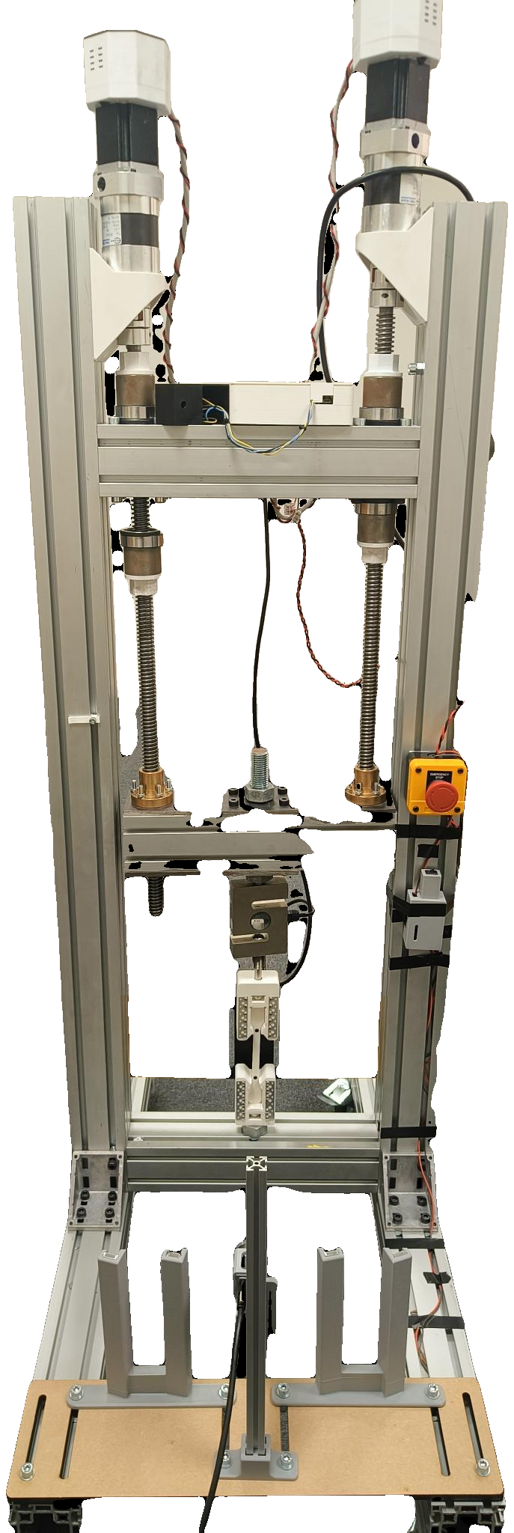
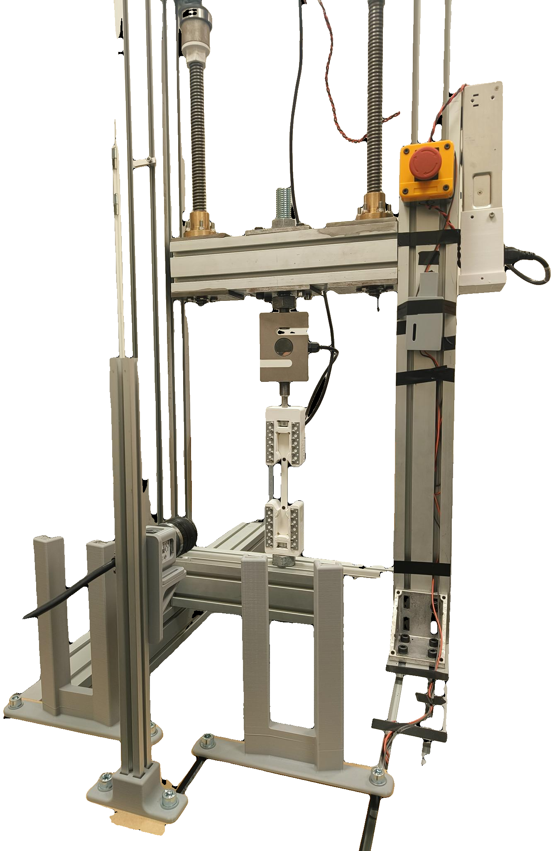
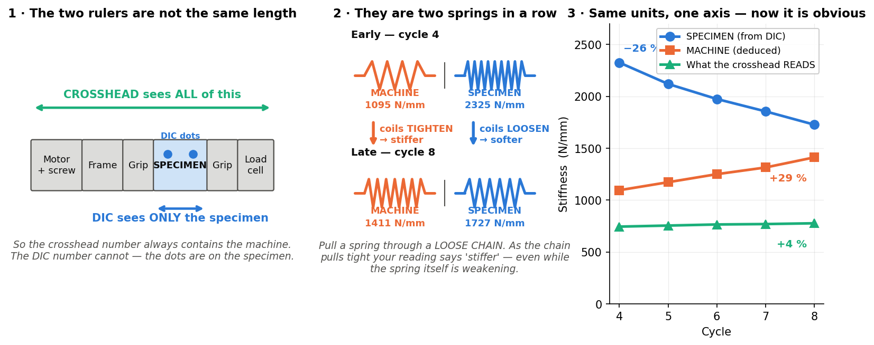
SMART UTM — PROGRESS REPORT
Jönköping University · School of Engineering — status to 12 August 2026 · automated tensile testing with camera-based strain
12 of 16 planned features are built AND validated on the rig.
All six closed-loop test protocols work. The material results are publication-grade. What remains is two rig runs, three convenience features, and two hardware decisions that are not mine to make.
12 / 16
6 / 6
29
2.5 %
2
features built
and rig-validated
test protocols
validated
specimens tested,
34 indexed runs
strength scatter,
n = 5 at 100 % infill
hardware decisions
needed from you
WHERE THE PROJECT STANDS
RESULTS WORTH REPORTING
NEXT
The rig is no longer a manual machine. A test is now: pick a recipe, press Prepare, press Start — the software runs the protocol, watches the specimen through a camera, stops itself at fracture and writes an indexed report. Six protocols beyond a plain pull are validated, so a single specimen can return a curve rather than a single number. The two results that were negative in July, cyclic hysteresis and creep, were both re-sized and are now positive.
Strength repeatability is publication-grade
Now
T6.6 — the fatigue damage curve
100 % infill, n = 5: UTS 46.2 ± 1.2 MPa — 2.5 % scatter, and the only n > 2 result we own. Two fracture protocols landed 0.9 % apart, but on DIFFERENT specimens (n = 1 each), so that bounds protocol and specimen scatter together, not the protocol alone.
One fresh specimen, 12 cycles, one uninterrupted run. The only missing piece of the damage story; about 40 minutes of rig time.
The camera is not a nicety — it changes the answer
Now
Black-specimen DIC check
Over the same cycles the crosshead reads 4 % STIFFER while the specimen's true modulus falls 26 %. Without strain measured on the specimen itself, this test reports the opposite of what actually happened.
Every specimen so far is white. The black preset has never been exercised — needed before anyone else uses the rig.
The rig — built in-house, every control loop closed in software
Next
SF11 — auto-metadata and per-specimen reports
First fatigue-damage number
Removes the last manual bookkeeping step from a test.
After 16 cycles at 79 % of fracture load, residual strength is −6.8 % against the same-protocol virgin run (−7.2 % against the two-protocol mean). The virgin baseline spans only 0.9 %, so the loss is far larger than the scatter.
Next
Student operating manual
So the rig can be run by someone who did not build it.
Creep measured, with the instrument subtracted
A zero-load baseline measured the rig's own drift first; the corrected creep is +1080 µε at 41× the noise floor, and decelerates as real creep must.
Two steppers (1.85 Nm, 20:1) drive 5 mm lead screws against a fixed base. An ANYLOAD 3 t cell measures force; a Basler camera measures strain optically at 20.8 px/mm from two markers on the 80 mm gauge. The ESP32 runs STEP/DIR/ENABLE only and knows nothing of test protocols — every protocol, guard and measurement here lives in the PyQt6 app, closing the loop at ~11 Hz.
The machine reads STIFFER while the specimen SOFTENS
WHAT HAS BEEN DELIVERED
June
DIC validation closed
41/41 software checks; tension, compression and staircase linearity all sign-verified.
June
First run to fracture
Progressive cyclic to fracture. Crosshead stiffness ROSE 744 → 777 N/mm as rig slack squeezed out, while the DIC-measured specimen modulus FELL 2.32 → 1.73 GPa, a 26 % loss. Read from the crosshead alone this test says the material is getting stiffer — the strongest argument for putting the camera in the loop.
Rig and camera both hold all the way to failure — the precondition for every destructive protocol since.
June
100 % infill quintet, n = 5
July
UTS 46.2 ± 1.2 MPa, scatter 2.5 % — publication-grade repeatability.
DECISIONS I NEED FROM YOU
Smart features SF1–SF10
One-click workflow, a four-layer safety net, and constant-strain-rate control demonstrated to fracture.
Motor torque ceiling — needs a hardware decision
August
All six protocols validated
Fracture loads reach 3.2–3.4 kN normally, but fell to ~2.6 kN on one session and stalled a 100 % infill test. The drivetrain is rated above 12 kN, so the cause is electrical: driver current, thermal derating or supply sag. Two routes — set the driver current (Vref) on the board, or wire the TMC2160's SPI pins to the ESP32 so current and thermal status can be set and logged in software. I need bench time with the driver board, and a decision on which route.
Including both destructive protocols; two landed 0.9 % apart on ultimate strength, though on different specimens.
August
Fatigue and creep resolved
Residual strength after cycling is −6.8 % against the same-protocol virgin run; creep resolved at 41× the noise floor.
Poisson's ratio — needs optics, not code
The four-marker maths is written and self-tested, but the gauge is too narrow to resolve a transverse pair at the present 20.8 px/mm. A gauge-zoomed lens (or a second camera) plus a matte backdrop unblocks true stress and Poisson's ratio. Until then every stress reported is engineering stress, which is stated on every figure.
More specimens before publication
Creep and fatigue are each n = 1 at one condition. The measurement is proven; the material constants are not. 3–4 stress levels for creep and 3 repeats for fatigue would make both publishable.
Every number on this page is recomputed from the rig CSVs by documentation/scripts/sf9_data.py and the test registry — nothing is transcribed by hand. Full detail: the 76-slide technical deck in documentation/, and ROADMAP.md for the complete task list.

