Slide 1

1-D DIC IMPLEMENTATION ON UNIVERSAL TESTING MACHINE
A camera-instrumented desktop tensile tester — built, validated against a commercial lab, and documented.
SEPTEMBER 2026
Adithya Sivakumar
adithya.sivakumar@ju.se
Supervisors: Johan Jansson · Mirza Cenanovic
01

Slide 2
AGENDA
Today, in six parts
01
DIC, in one picture
02
What was built
what the rig measures, and why no sensor touches the part
hardware, software — and 19 things it does on its own
PPD-UTM · FINAL PRESENTATION
03
Live demo
04
Validation
a specimen pulled to fracture, live on the rig
the same material through a commercial lab — and how close we land
05
AI in the loop
06
What comes next
how this was built by one engineer and a coding agent
future work, and one number for fun
Appendix afterwards: Otsu thresholding · PLA vs PETG vs TPU · rig-to-rig noise.
02

Slide 3
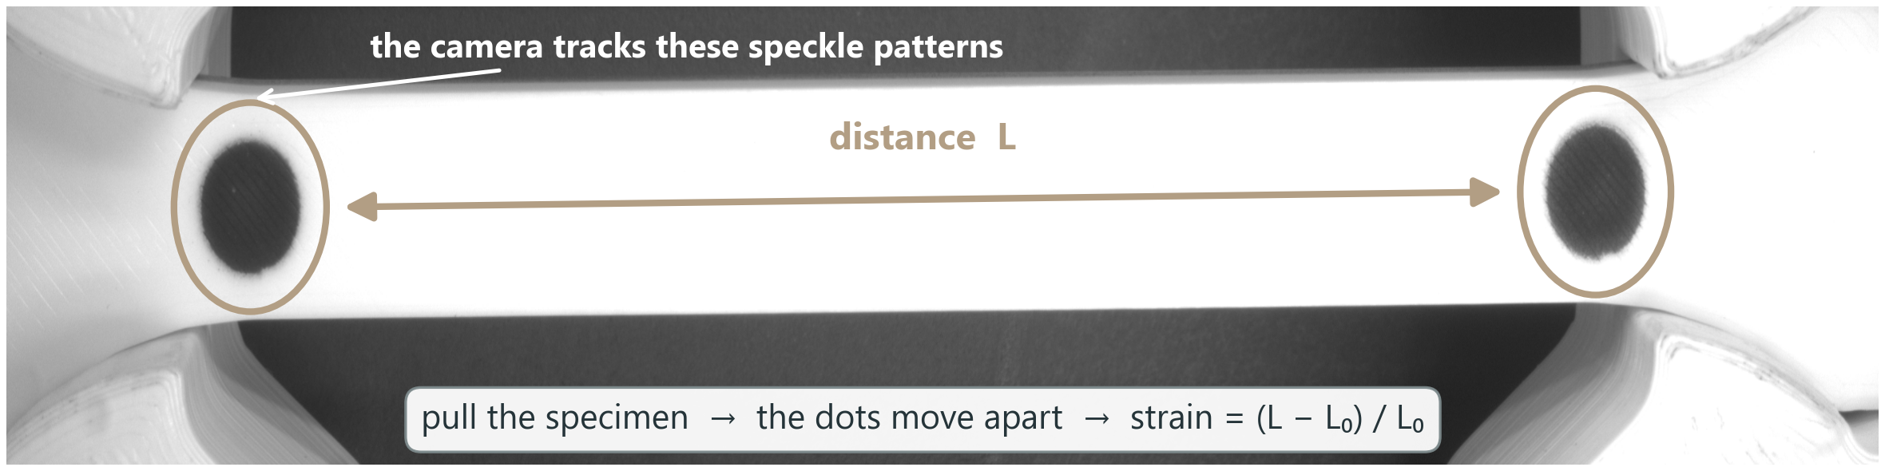
01 · BACKGROUND
DIC — the camera is the strain gauge
DIC — Digital Image Correlation — measures how a part deforms by comparing photographs of its surface while it is loaded; here in its simplest two-dot form.
BACKGROUND
No contact
Live stress–strain
Every frame captured
no strain gauge glued on, no clip-on extensometer — nothing touches the specimen
the load cell gives force, the camera gives strain — the stress–strain curve draws itself live during the pull
35 frames per second (FPS), live on screen while the test runs
03
Notes:
glued = strain gauge, clipped = extensometer, camera = video extensometer (XT-205, and our rig)

Slide 4
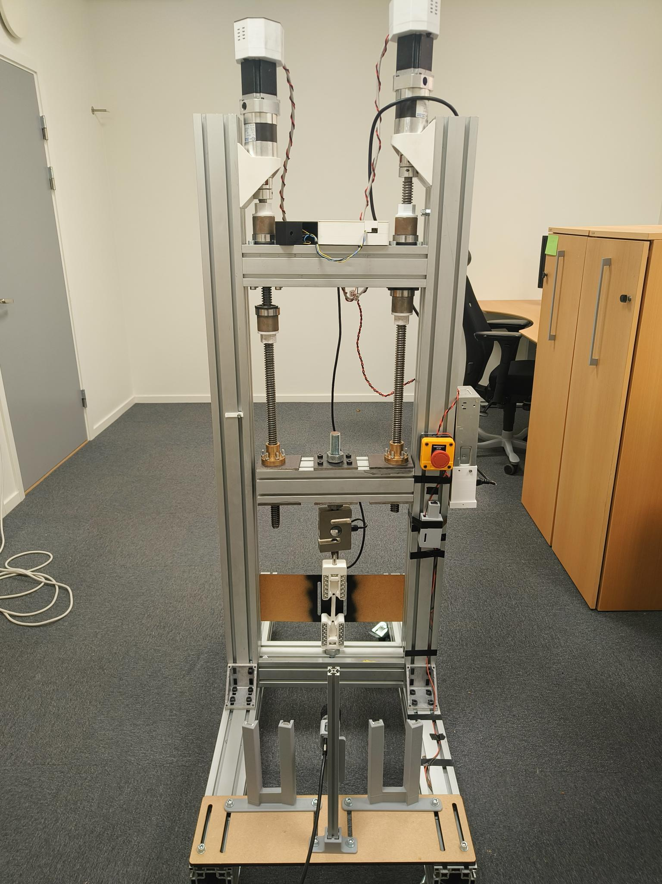
02 · THE BUILD
One rig, one application — built together
HARDWARE
28
▪ twin ball-screw frame, 4.5 kN load cell
▪ industrial camera + LED panel — the DIC eye
▪ printed grips, emergency stop, enclosure
specimens pulled
3
materials
THE BUILD
SOFTWARE
19
smart features
▪ one PyQt6 application runs the whole test
▪ live DIC strain at 35 fps, six closed-loop protocols
▪ every run leaves a CSV + video + PDF report
▪ post-processor re-measures any recorded video
~44 k
lines of Python
204
evidence pages
the PPD-UTM
numbers as of Sep 2026
04

Slide 5
02 · THE BUILD
Nineteen things the rig does on its own
SF1
SF2
SF3
SF4
DIC health HUD
Prepare specimen
Settings / recipes
1-click PDF report
SF5
SF6
SF7
SF8
Auto-stop at fracture
Strain-rate control
Stall guard
Release load
THE BUILD
SF9
SF10
SF11
SF12
6 test protocols
Auto-preload
Auto-metadata link
DIC auto-calibrate
SF13
SF14
SF15
SF16
Guided wizard
Test registry
Dead-DIC guard
Live Px₀ overlay
SF17
SF18
SF19
Video + stills capture
DIC post-processing
Noise capture
each of these has its own evidence page in the project deck
05

Slide 6
02 · THE BUILD
…and the three worth two minutes each
SF1
SF2
SF3
SF4
DIC health HUD
Prepare specimen
Settings / recipes
1-click PDF report
SF5
SF6
SF7
SF8
Auto-stop at fracture
Strain-rate control
Stall guard
Release load
sees the load collapse and halts the motor itself — no hand on the stop button
closes the loop on measured strain rate, not motor speed — constant dε/dt
THE BUILD
SF9
SF10
SF11
SF12
6 test protocols
Auto-preload
Auto-metadata link
DIC auto-calibrate
SF13
SF14
SF15
SF16
Guided wizard
Test registry
Dead-DIC guard
Live Px₀ overlay
SF17
SF18
SF19
DIC post-processing
Video + stills capture
re-measures ANY recorded video — it is how the commercial lab's test got audited
Noise capture
SF5 protects the specimen · SF6 makes tests comparable · SF18 made the validation possible
06

Slide 7
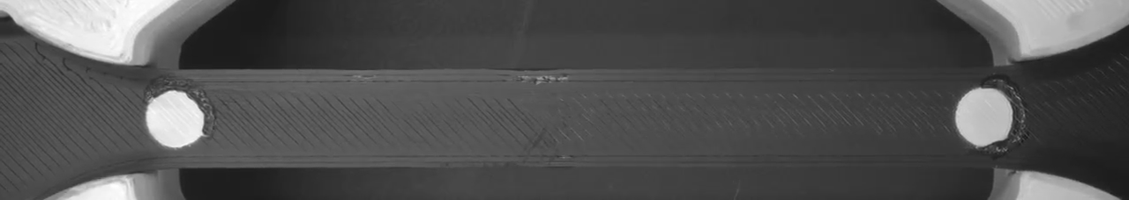
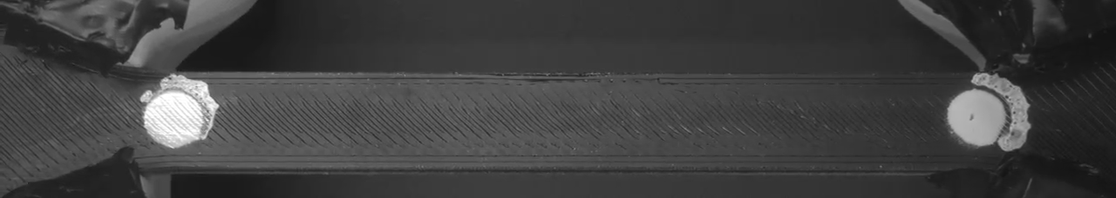
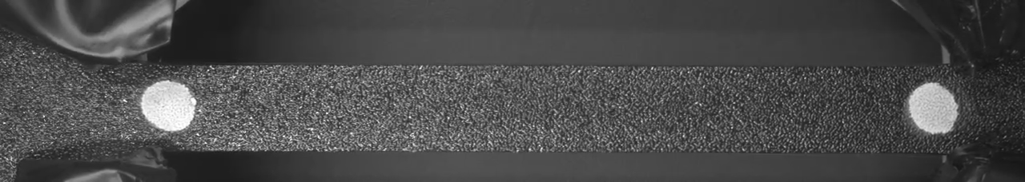
03 · LIVE DEMO
Three materials, three behaviours — then the real thing
PLA — S13
PLA
black PLA · fractures at ~4 % strain
PETG — S30
LIVE DEMO
PETG
glossier, more ductile · ~8 % at fracture
TPU — S35
TPU
rubber-like · leaves the frame before it fractures
15-second timelapses of real pulls on this rig (click to play) — then we switch to the live software and break one for real.
07

Slide 8
04 · VALIDATION
The same material, through a commercial lab
THE REFERENCE
▪ MOT materials lab — commercial tensile frame
▪ XT-205 video extensometer: a camera that tracks two painted marks — the same principle as our DIC, in certified form
▪ two specimens from our own print batch: XT205-S1 and XT205-S2
VALIDATION
MOT LAB PHOTO
drops in here — machine + XT-205 in view
TEST CONDITIONS · XT205-S2
45 mm gauge
2 mm/min
300 N preload
▪ same stress-strain quantities, computed two independent ways
▪ and their raw video, re-measured by OUR post-processor (SF18)
08

Slide 9
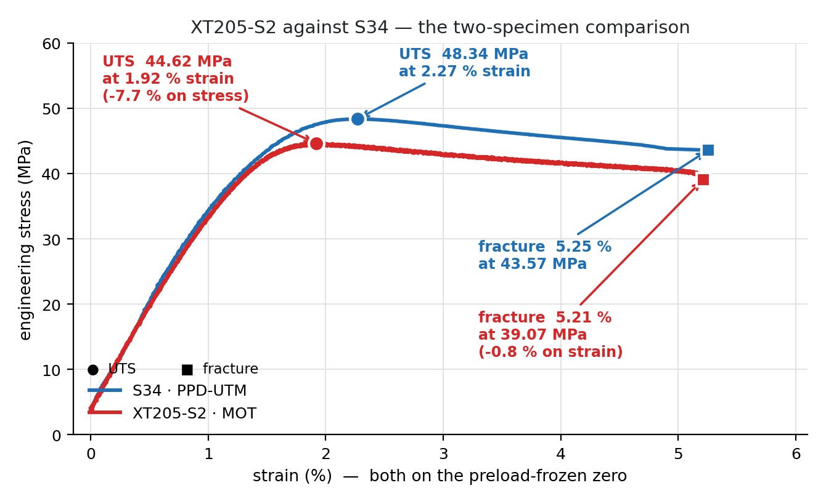
04 · VALIDATION
Two rigs, one material — the curves land together
S34 (PPD-UTM) / XT205-S2 (MOT)
UTS
48.34 / 44.62 MPa
−7.7 %
Yield σy
39.23 / 39.61 MPa
+1.0 %
VALIDATION
Modulus E
3.45 / 3.23 GPa
−6.4 %
Fracture εf
5.25 / 5.21 %
−0.8 %
▪ strain agrees to 1 % — the DIC is doing its job
▪ stress gap is real but small — different specimens, different day, 3× pull speed
▪ shape of the whole curve matches to fracture
09

Slide 10
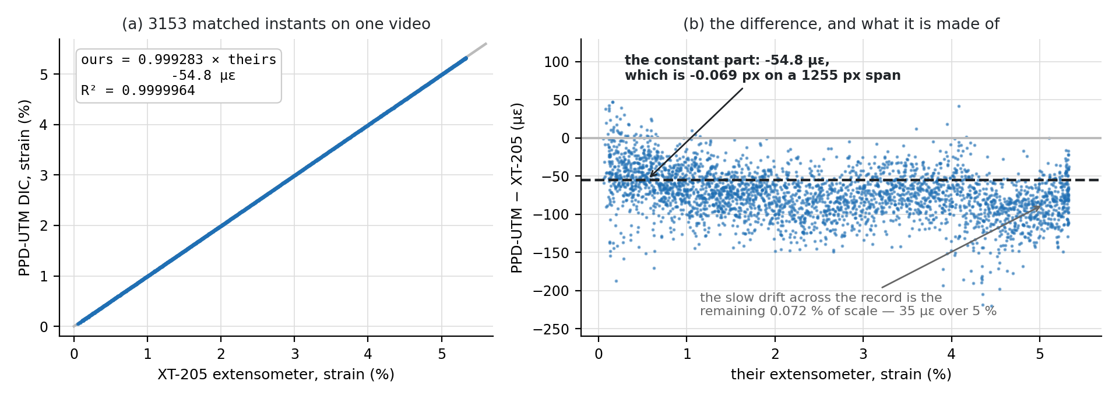
04 · VALIDATION
Same video, two calculations — one line
0.99928
scale — ours vs theirs
0.072 % from perfect
VALIDATION
−55 µε
constant offset
= 0.07 px on a 1255 px gauge
0.9999964
R², 3 153 matched instants
one video, two independent codes
The MOT lab's own fracture video, fed through our post-processor: the two strain calculations are the same measurement.
10

Slide 11
04 · VALIDATION
Where the remaining gap comes from
Pull speed
Grips & seating
Specimen & moisture
measured
measured
study pending
▪ their pull: 2 mm/min · ours: ≈3× faster
▪ but at the GAUGE the strain-rate ratio is only 1.19×
▪ → predicts under 1 % of the stress gap — a real effect, not the story
▪ only 21–45 % of crosshead travel reaches the gauge
▪ our four runs cluster at 21 % and 33 % — a joint that either seats or doesn't
▪ → affects travel-based numbers, never the DIC strain
▪ different print batches, weeks apart, unconditioned storage
▪ PLA is hygroscopic — literature review queued
▪ → explanation lands here once the study is done
VALIDATION
The honest ranking: seating and specimen dominate; speed is measured and small.
11

Slide 12
05 · PROCESS
Built by one engineer and a coding agent
intent
“the rig must stop itself at fracture”
348
commits · 94 % co-authored with the agent
↓
prompt
precise ask + constraints + how to verify
9 weeks
from first DIC frame to a validated rig — 314 commits
PROCESS
↓
Claude Code
writes app code, tests, analysis
~44 k
lines of Python: app, analysis, this deck's generator
↓
verify on rig
real pulls; failures go straight back in
204
evidence pages, regenerated from raw data on every build
↓
evidence
every claim becomes a measured deck page
▪ the prompt is the engineering: what to build, what would falsify it, how to prove it ran
▪ the agent measures instead of assuming — it renders every page and looks at it
12

Slide 13
06 · OUTLOOK
Future work — named, sized, and how
2D-DIC strain field
Correlation, not binary
Feed simulation models
full-field strain over the speckled gauge, not just two dots
sub-pixel tracking that keeps the grey levels
measured strain fields calibrating FE material cards
HOW
HOW
HOW
offline first, in the existing post-processor; needs lower exposure — the white body currently saturates the sensor
measured gain: 1.1–2.1× less jitter; add as a post-processing option before touching the live loop
export the field per frame; compare predicted vs measured maps on the same geometry
OUTLOOK
Poisson & true stress (FW1)
Grip-seating experiment (FW2)
Rate-matched MOT rerun
four markers → lateral strain, ν, Cauchy stress
why gauge share clusters at 21 % vs 33 %
close the last confound in the lab comparison
HOW
HOW
HOW
maths written and self-tested; blocked on optics — needs a gauge-zoomed second camera or a wider specimen
one specimen, re-mounted several times, elastic pulls only — spread survives → seating
pull at 5.01 mm/min (rate-matched) and 2.00 mm/min (speed-matched) and re-compare
13

Slide 14
06 · OUTLOOK
One number for fun — the carbon footprint
OUTLOOK
CARBON-FOOTPRINT NUMBERS LAND HERE
the calculation is queued: filament + rig power + compute for the AI collaboration
spoiler: the printed specimens are not the biggest line item.
14

Slide 15
Thank you.
Questions — or come break a specimen with me.
Adithya Sivakumar
adithya.sivakumar@ju.se
15

Slide 16
APPENDIX
For the curious
A1
Otsu thresholding
how the camera decides what is a marker
APPENDIX
A2
PLA vs PETG vs TPU
our curves against what literature expects
A3
Noise, rig against rig
how quiet each instrument is, measured at rest
16

Slide 17
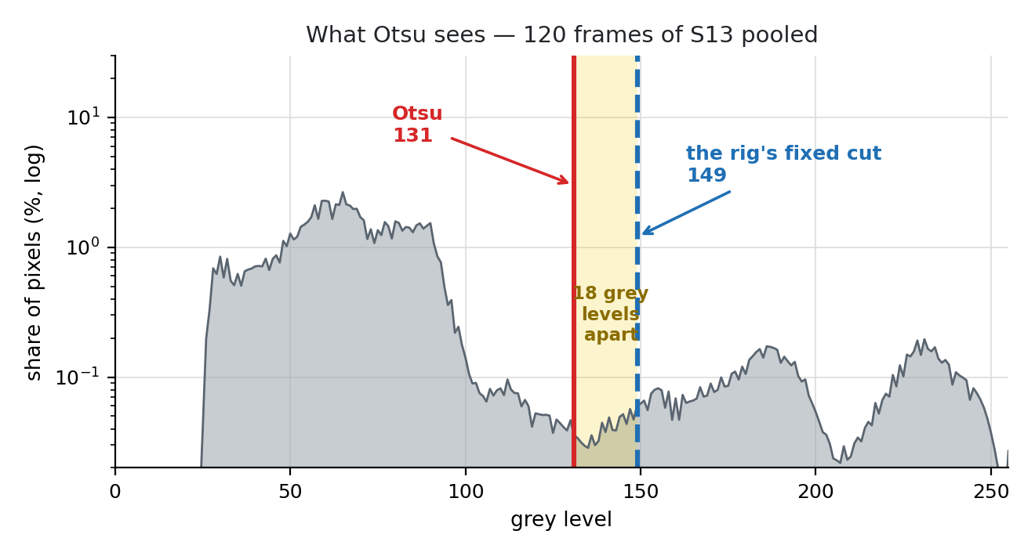
APPENDIX · A1
Otsu — how the camera picks its threshold
▪ WHY it exists
▪ every frame must be split into “marker” and “not marker” — that takes one brightness number
▪ WHAT it does
▪ tries all 254 cuts, keeps the one giving the two tidiest groups — lands in the histogram's empty valley
▪ THE CATCH
▪ it follows the SCENE, not the markers — so the rig scores it against fixed values (auto-calibrate) instead of trusting it blindly
APPENDIX
Otsu (1979), IEEE Trans. SMC 9(1):62–66 · measured here on 120 frames of specimen S13.
17

Slide 18
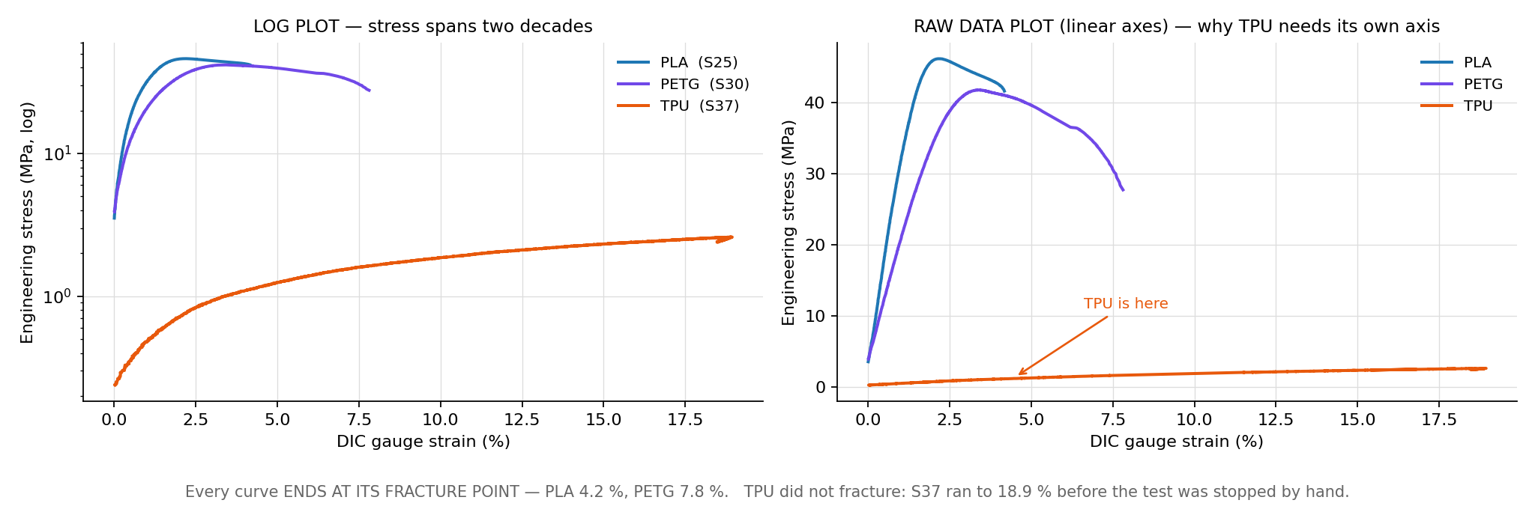
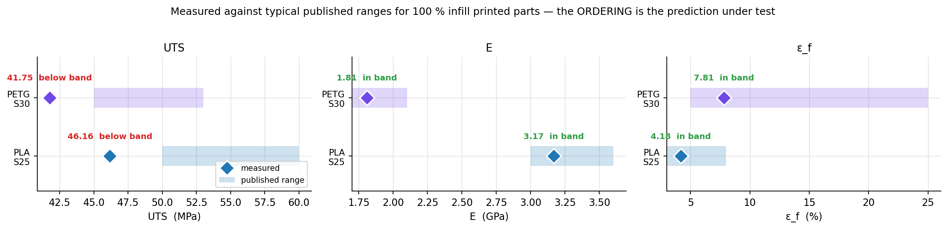
APPENDIX · A2
Three materials — measured, against expectations
APPENDIX
▪ ordering exactly as published
▪ TPU never fractured — it left the frame at 19 % strain
published ranges: filament TDS + printed-part literature, as compiled in the project's material notes.
18

Slide 19
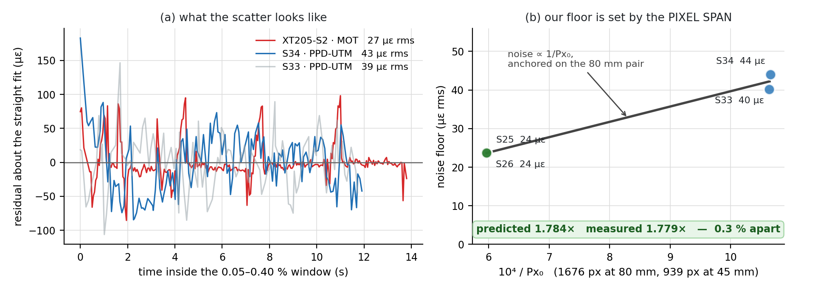
APPENDIX · A3
How quiet is each instrument?
▪ both rigs sit in the tens of microstrain
▪ our floor is set by pixel quantisation: noise ∝ 1/Px₀
▪ predicted 1.78× between our two gauge lengths — measured 1.78×
▪ so the noise is understood, not just small
APPENDIX
19

