Slide 1

1-D DIC IMPLEMENTATION ON UNIVERSAL TESTING MACHINE
A camera-instrumented desktop tensile tester — built, tested, validated, and documented.
SEPTEMBER 2026
Adithya Sivakumar
adithya.sivakumar@ju.se
Supervisors: Johan Jansson · Mirza Cenanovic
01

Slide 2
AGENDA
Content, in six parts
01
DIC, in one picture
02
What was built
what the rig measures, and why no sensor touches the part
hardware, software — and 20 things it does on its own
03
Live demo
04
Validation
a specimen pulled to fracture, live on the rig
the same material through a MOT lab test — and how close we land
05
AI in the loop
06
Future work
how this was built by one engineer and a coding agent
What comes next and interesting numbers
Appendix: Thresholding · PLA vs PETG vs TPU · rig-to-rig noise.
02

Slide 3
01 · BACKGROUND
Where DIC is used — and where this project sits
DIC — Digital Image Correlation — measures how a surface deforms by comparing photographs of it under load: no contact, no wires, just pixels tracked frame to frame.
THIS PROJECT
Material testing & characterization
Manufacturing quality control
Aerospace structural monitoring
Material testing & characterization
stress–strain curves, E, σy, UTS, εf — strain measured without touching the specimen.
warpage, springback and assembly distortion checked on the line — parts against CAD, contactless and in minutes
wing bend and fuselage-skin strain in full-scale tests — thousands of virtual gauges from a pair of cameras
stress–strain curves, E, σy, UTS, εf — strain measured without touching the specimen. THIS PROJECT: a desktop tensile rig whose only extensometer is a camera.
BACKGROUND
Fracture mechanics & crack propagation
Biomechanics & medical devices
Thermal stress analysis
strain concentration at the crack tip, crack speed and direction — our future-work item 4 builds exactly this on the same rig
tissue, implants and prostheses under load — contactless is the only option when the specimen must stay untouched
expansion and warpage under heating — where a glued strain gauge would cook, the camera just watches
…and more: FEA model validation, civil-structure monitoring, electronics reliability, high-speed impact. One method, many arenas — the next slides are our corner: the tensile test.
03

Slide 4
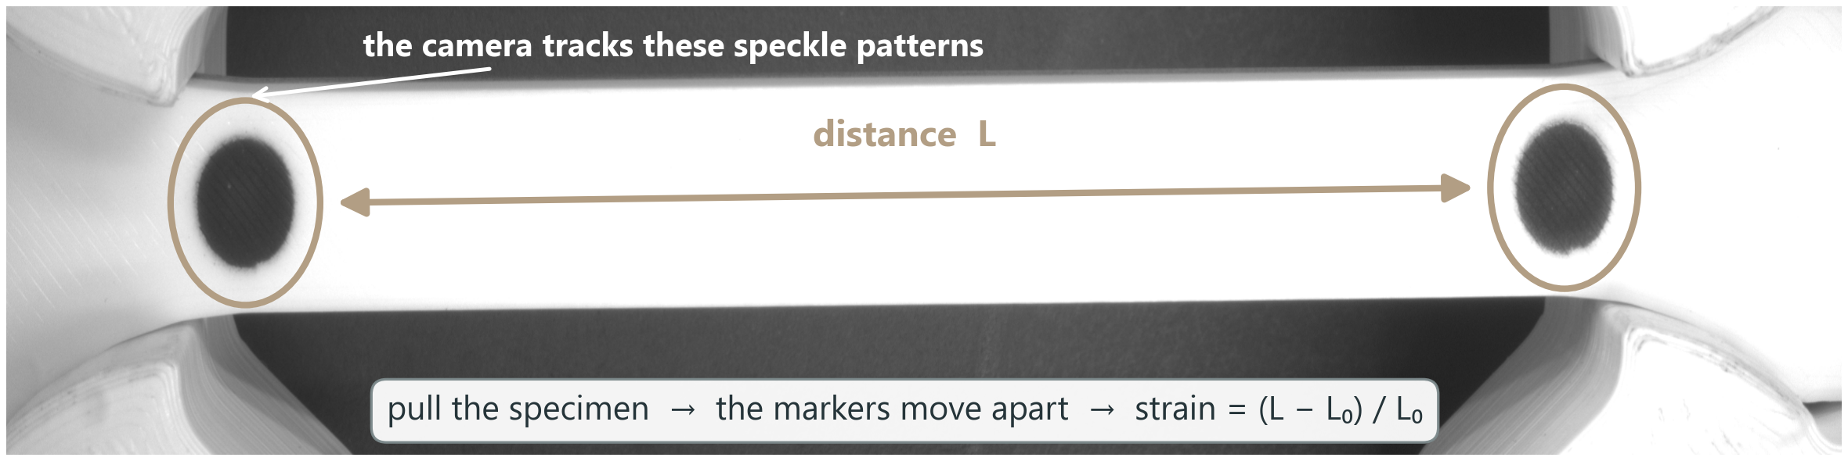
01 · BACKGROUND
DIC — the camera is the strain gauge
How WE use DIC — the simplest form there is: two painted dots on the gauge; the camera tracks their separation L every frame, and strain is just (L − L₀) / L₀.
BACKGROUND
Contactless
Pixels become strain
Live stress–strain
No strain gauge glued on, no clip-on extensometer — nothing touches the specimen
Each frame, the marker spacing L is measured in pixels and compared with the frozen L₀ — strain = (L − L₀) / L₀, no millimetres needed
Load cell gives force, the camera gives strain — the stress–strain curve draws itself live during the pull
04
Notes:
glued = strain gauge, clipped = extensometer, camera = video extensometer (XT-205, and our rig)

Slide 5
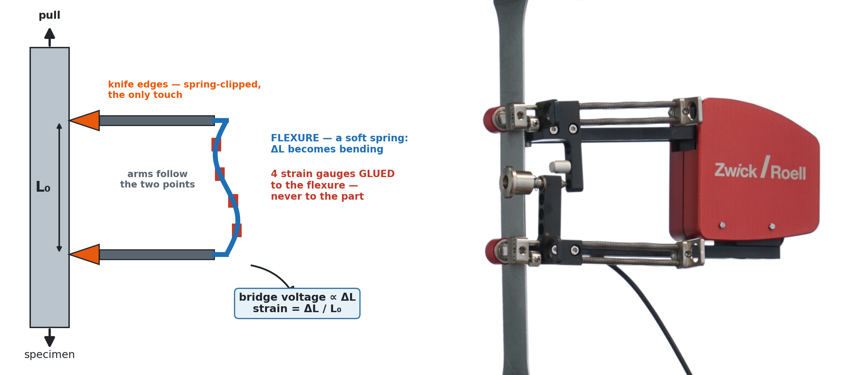
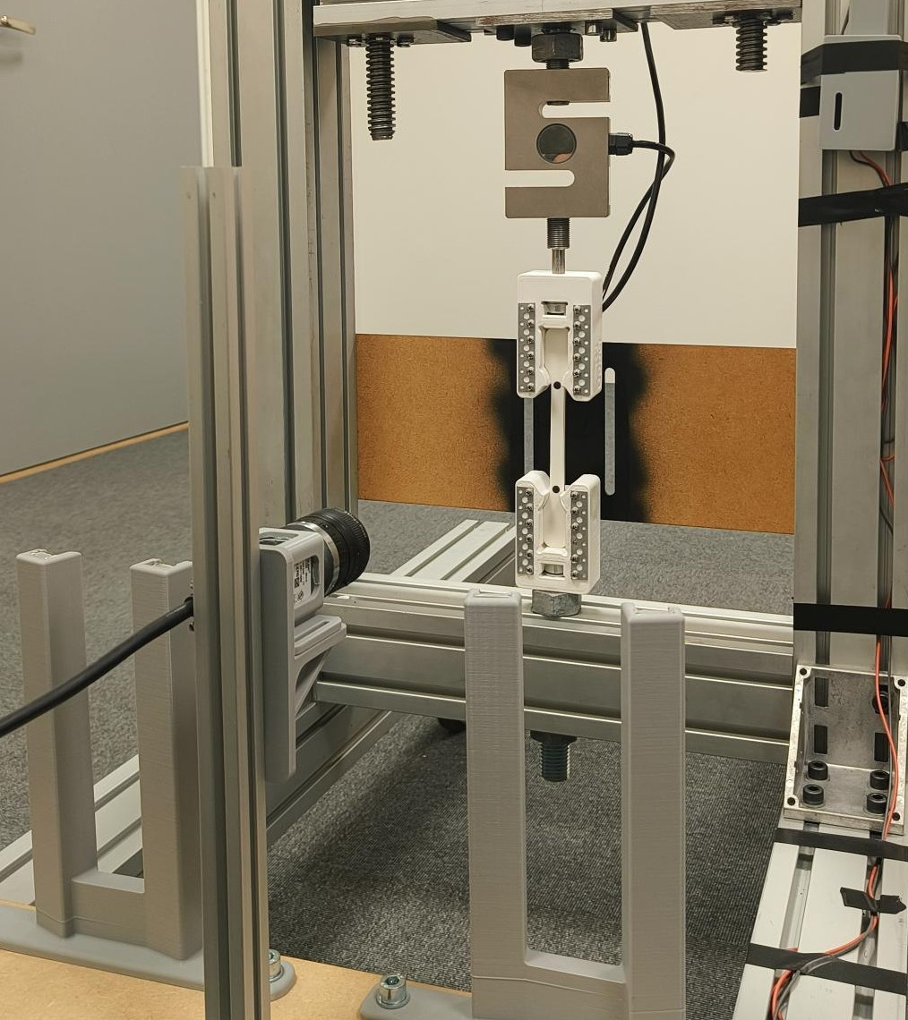
01 · BACKGROUND
DIC — the camera is the strain gauge
DIC — Digital Image Correlation — measures how a part deforms by comparing photographs of its surface while it is loaded; here in its simplest two-dot form.
BACKGROUND
the clip-on extensometer — the principle, and a commercial one (Zwick/Roell): knife edges TOUCH the specimen
our rig — the camera, touching nothing
Contactless
Pixels become strain
Live stress–strain
No strain gauge glued on, no clip-on extensometer — nothing touches the specimen
Each frame, the marker spacing L is measured in pixels and compared with the frozen L₀ — strain = (L − L₀) / L₀, no millimetres needed
Load cell gives force, the camera gives strain — the stress–strain curve draws itself live during the pull
05

Slide 6
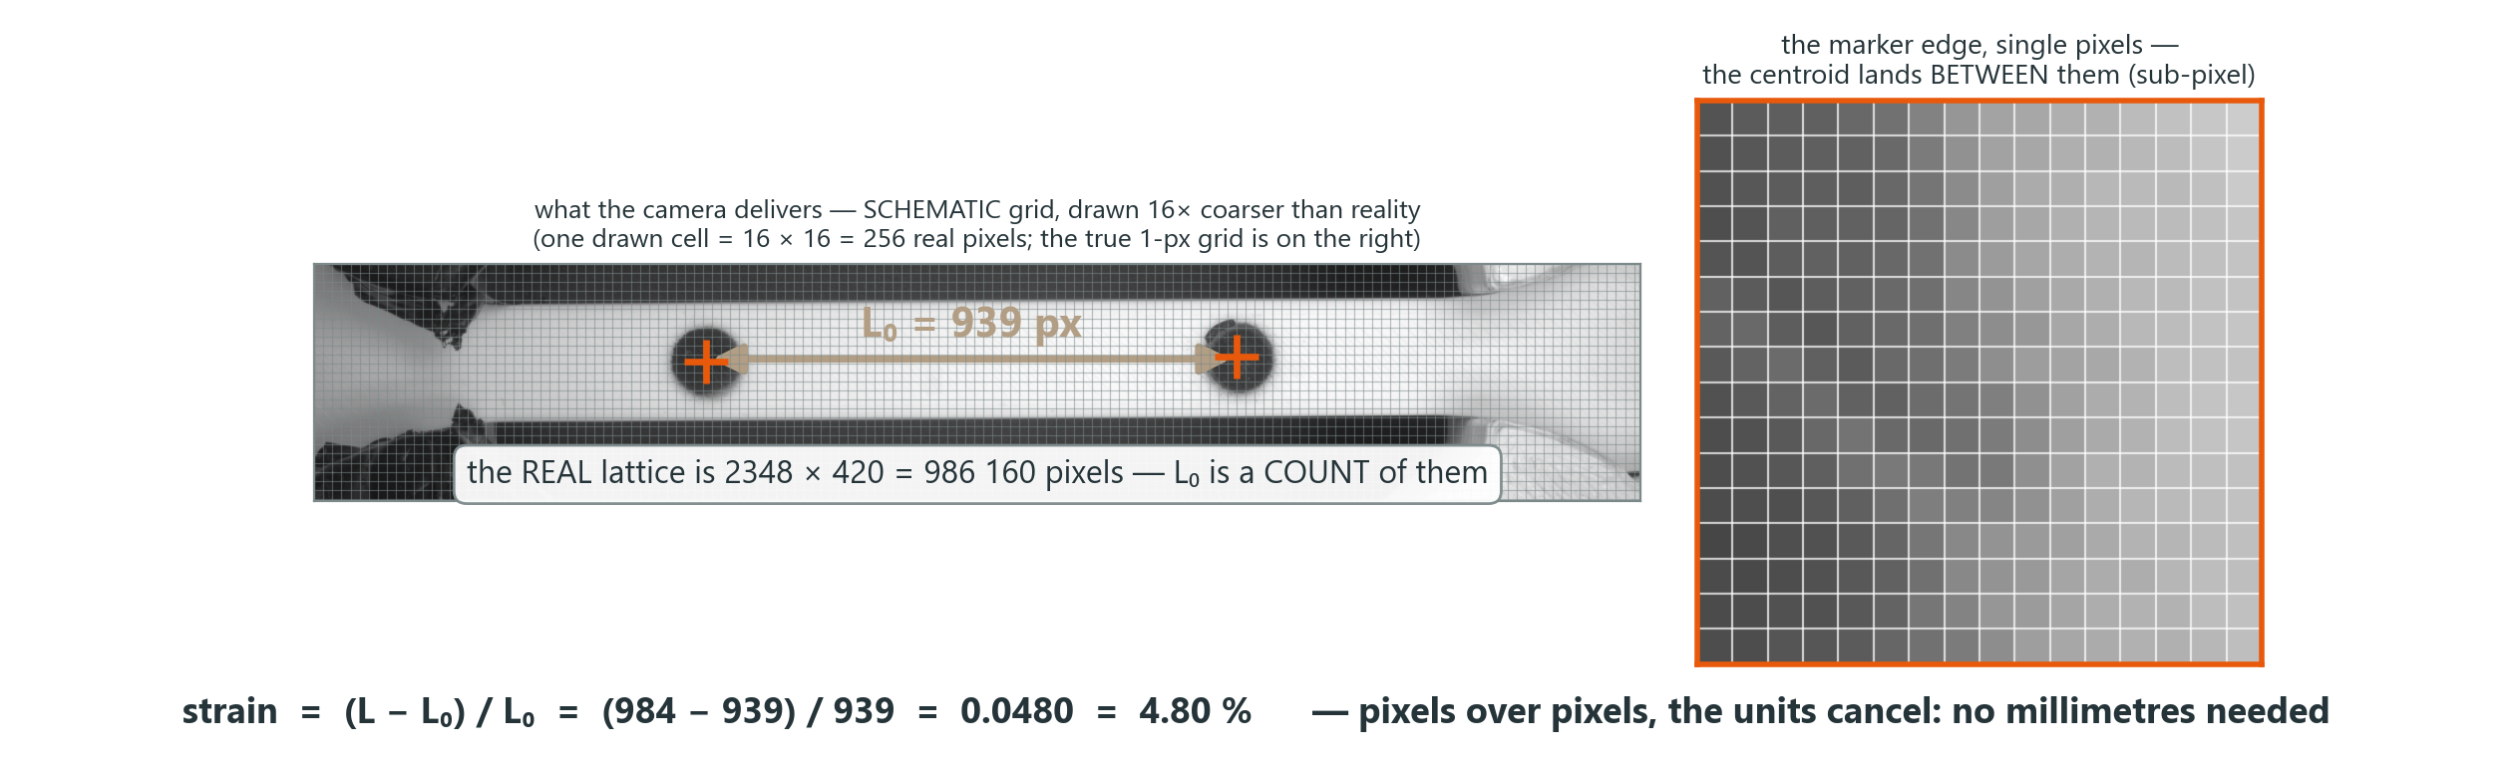
01 · BACKGROUND
DIC — the camera is the strain gauge
DIC — Digital Image Correlation — measures how a part deforms by comparing photographs of its surface while it is loaded; here in its simplest two-dot form.
BACKGROUND
Contactless
Pixels become strain
Live stress–strain
No strain gauge glued on, no clip-on extensometer — nothing touches the specimen
Each frame, the marker spacing L is measured in pixels and compared with the frozen L₀ — strain = (L − L₀) / L₀, no millimetres needed
Load cell gives force, the camera gives strain — the stress–strain curve draws itself live during the pull
06

Slide 7
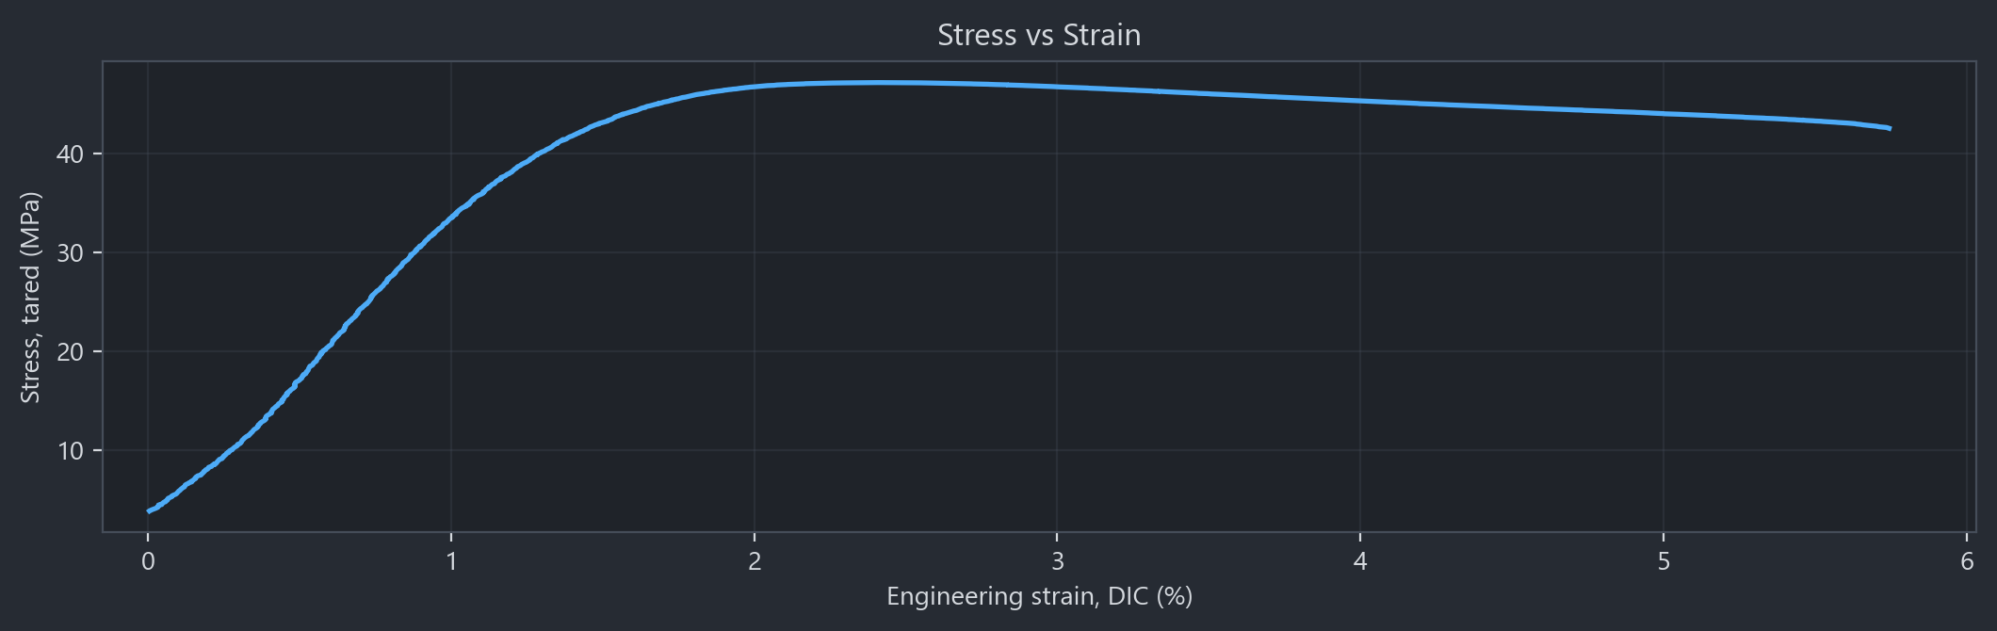
01 · BACKGROUND
DIC — the camera is the strain gauge
DIC — Digital Image Correlation — measures how a part deforms by comparing photographs of its surface while it is loaded; here in its simplest two-dot form.
BACKGROUND
S26 · PLA — the curve exactly as the rig draws it live, one point per frame
Contactless
Pixels become strain
Live stress–strain
No strain gauge glued on, no clip-on extensometer — nothing touches the specimen
Each frame, the marker spacing L is measured in pixels and compared with the frozen L₀ — strain = (L − L₀) / L₀, no millimetres needed
Load cell gives force, the camera gives strain — the stress–strain curve draws itself live during the pull
07

Slide 8
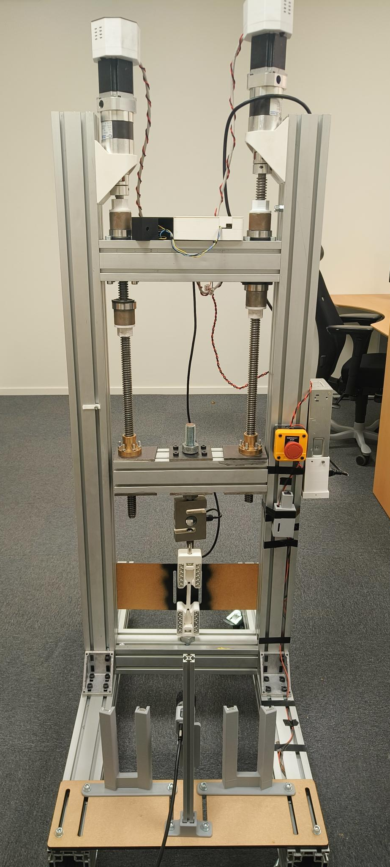
02 · THE BUILD
DIC rig and Application built together
HARDWARE
SOFTWARE — BUILT IN-HOUSE
▪ Aluminium-profile frame — twin ball screws, brackets, load holders
▪ 4.5 kN load cell, 3D-printed grips
▪ Drive motors + their control electronics, emergency stops
▪ One PyQt6 application runs the whole test — written line by line in this project
▪ OpenCV does the seeing: thresholding, blob detection, sub-pixel centroids
▪ Live DIC strain at ≈20 fps (measured — the exposure sets it), six closed-loop protocols
▪ 20 smart features, each automated behind a single click
▪ Basler camera · LED panels · light enclosure — the DIC eye, and the hardware I worked on most
THE BUILD
the PPD-UTM DIC
08

Slide 9
02 · THE BUILD
20 Smart Features - rig does on its own
SF1
SF2
SF3
SF4
DIC health HUD
Prepare specimen
Settings / recipes
1-click PDF report
SF5
SF6
SF7
SF8
Auto-stop at fracture
Strain-rate control
Stall guard
Release load
THE BUILD
SF9
SF10
SF11
SF12
Advanced test modes
Auto-preload
Auto-metadata link
DIC auto-calibrate
SF13
SF14
SF15
SF16
Guided wizard
Test registry
Dead-DIC guard
Live Px₀ overlay
SF17
SF18
SF19
SF20
Video + stills capture
DIC post-processing
Noise capture
Manual blob selection
each of these has its own evidence page in the final project deck
09

Slide 10
02 · THE BUILD
3 of my best picks for the smart features
SF1
SF2
SF3
SF4
DIC health HUD
Prepare specimen
Settings / recipes
1-click PDF report
SF5
SF6
SF7
SF8
Auto-stop at fracture
Strain-rate control
Stall guard
Release load
sees the load collapse and halts the motor itself — no hand on the stop button
THE BUILD
SF9
SF10
SF11
SF12
Advanced test modes
6 closed-loop protocols in one tab — the tests beyond a plain pull to fracture
Auto-preload
Auto-metadata link
DIC auto-calibrate
SF13
SF14
SF15
SF16
Guided wizard
Test registry
Dead-DIC guard
Live Px₀ overlay
SF17
SF18
SF19
SF20
DIC post-processing
Video + stills capture
re-measures ANY recorded video — it is how the commercial lab's test got audited
Noise capture
Manual blob selection
SF5 protects the specimen · SF9 runs the six closed-loop protocols · SF18 made the validation possible
10

Slide 11
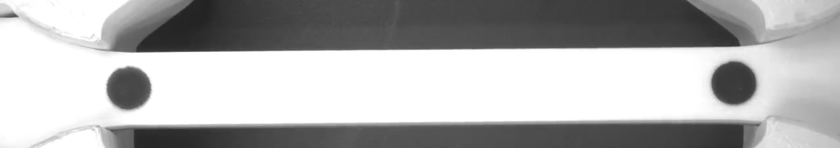
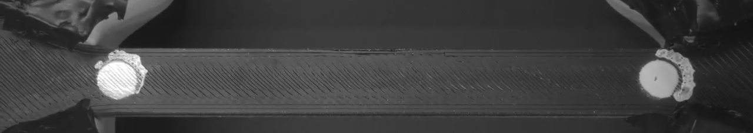
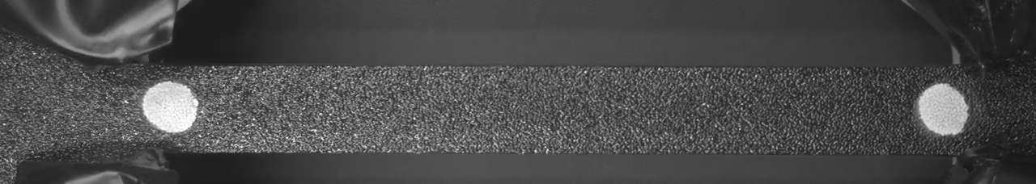
03 · LIVE DEMO
PLA snaps, PETG draws, TPU stretches — then live demo
PLA — S26
PLA
quasi-brittle — snaps in one clean break at ~5 % strain
PETG — S30
LIVE DEMO
PETG
glossier, more ductile — it draws, then tears
TPU — S35
TPU
rubber-like · leaves the frame before it fractures
15-second timelapses of real pulls on this rig — then we switch to the live software and break one for real.
11

Slide 12
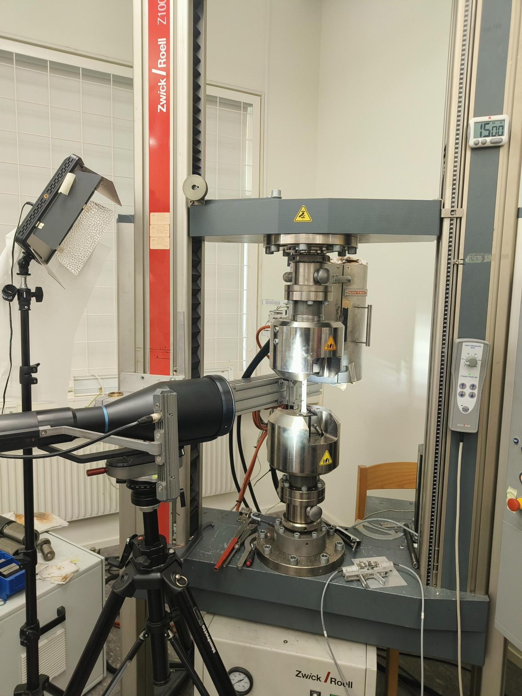
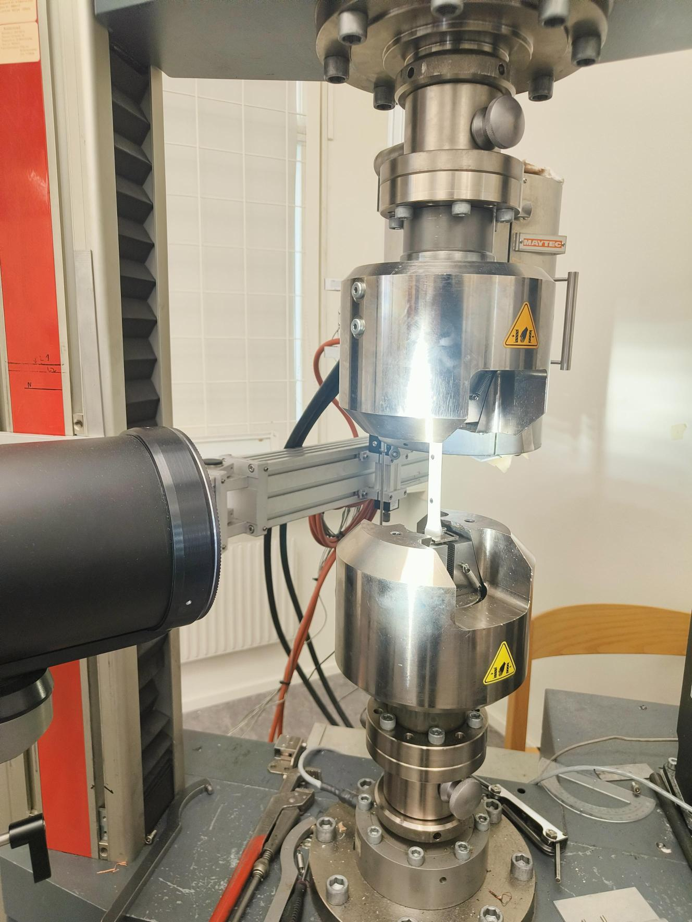
04 · VALIDATION
The same specimen, tested at MOT lab
THE REFERENCE
▪ MOT lab — commercial tensile frame
▪ XT-205 video extensometer: a camera that tracks two painted marks — the same principle as our DIC, in certified form
▪ Two specimens from our own print batch: XT205-S1 and XT205-S2
VALIDATION
TEST CONDITIONS · XT205-S2
45 mm gauge length
2 mm/min
300 N preload
TWO ANALYSES – XT205 at MOT against PPD-UTM DIC rig
▪ Analysis 1 — instrument vs instrument: the XT-205's certified strain readout against our rig's DIC on matched specimens; E, σy, UTS and ε_f each computed twice, independently
▪ Analysis 2 — our calculation method on XT205 at MOT test data and video: the session's raw XT-205 video re-measured frame-by-frame by our DIC post-processor (SF18) on the lab’s machine’s footage
the MOT lab: Zwick/Roell Z100, XT-205 video extensometer on our specimen
12

Slide 13
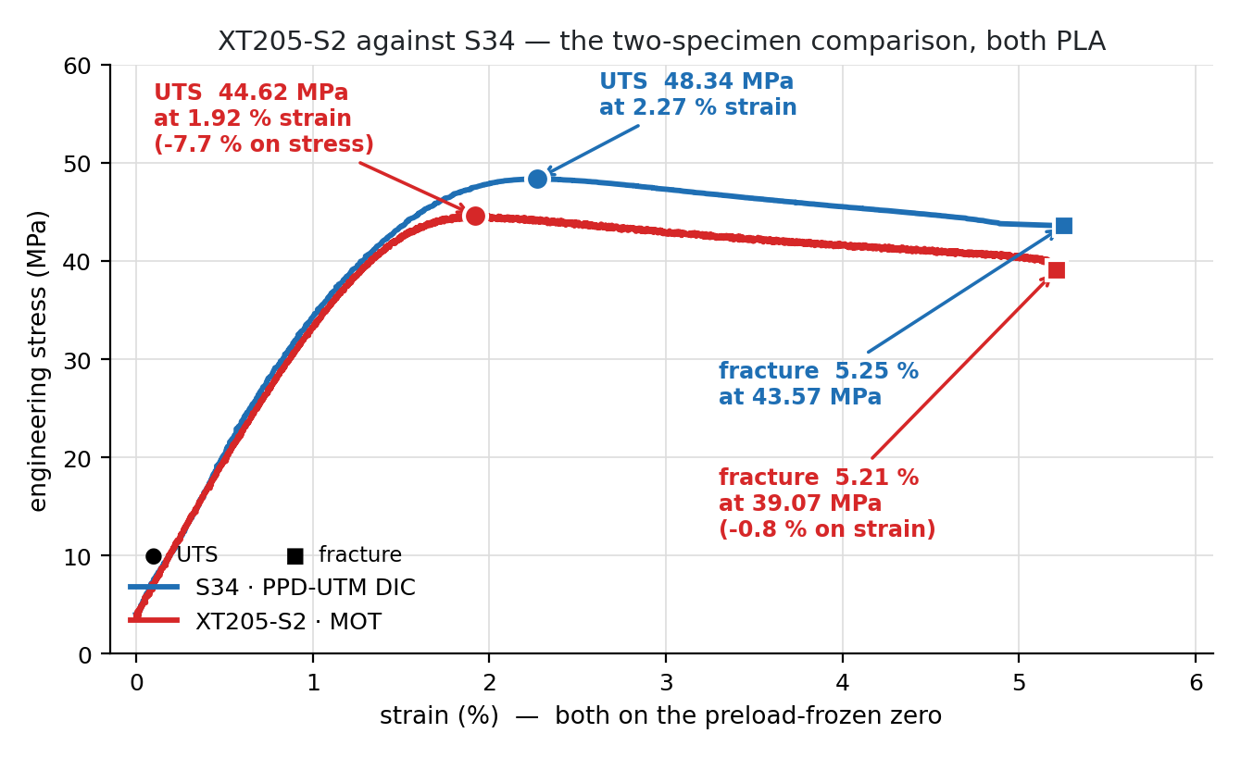
04 · VALIDATION
Analysis 1 : Two rigs, two specimens, one material
S34 (PPD-UTM DIC) / XT205-S2 (MOT)
UTS
48.34 / 44.62 MPa
−7.7 %
Yield σy
39.23 / 39.61 MPa
+1.0 %
VALIDATION
Modulus E
3.45 / 3.23 GPa
−6.4 %
Fracture εf
5.25 / 5.21 %
−0.8 %
▪ UTS and E gaps (6–8 %) carry a 3× speed difference plus normal specimen scatter (CV ≈ 2.5 %) — within family, and the whole curve shape matches
▪ Yield within 1 % — stress scale agrees where the curve is stable
▪ Fracture strain 5.25 vs 5.21 % — two different optical instruments, 0.8 % apart
▪ Analysis 2 closes the loop: their own video through our post-processor lands on the same line (two slides on)
13

Slide 14
04 · VALIDATION
Analysis 1 : why the offset?
Specimen & moisture
Pull speed
Grips & seating
studied
measured
measured
▪ Different print batches, weeks apart, unconditioned storage
▪ even within ONE batch, UTS scatters print-to-print (CV ≈ 2.5 %) — the batch effects sit on top of that
▪ literature: 24 h of humid filament storage already costs PLA ≈8.5 % UTS; 150 h ≈11 % (Hamid 2022)
▪ Travel speed we INPUT is the CROSSHEAD's, in mm/sec (ours 0.1 mm/sec) — an open loop: no feedback tracks whether the specimen is stretched at that speed
▪ → Strain-rate moves the SLOPE (E) more than the UTS — and predicts under 1 % of the stress gap
▪ 50 % of the EARLY crosshead travel (under 1% strain) is eaten by slack in our printed grips before the gauge feels anything
▪ our four runs cluster at 21 % of travel reaching the gauge — a joint that either seats or doesn't
▪ → costs only EARLY crosshead travel and bends the curve's toe — the DIC strain never sees it: the camera watches the gauge, not the crosshead
VALIDATION
Hamid et al. 2022 · doi 10.1007/978-981-16-8954-3_47
14

Slide 15
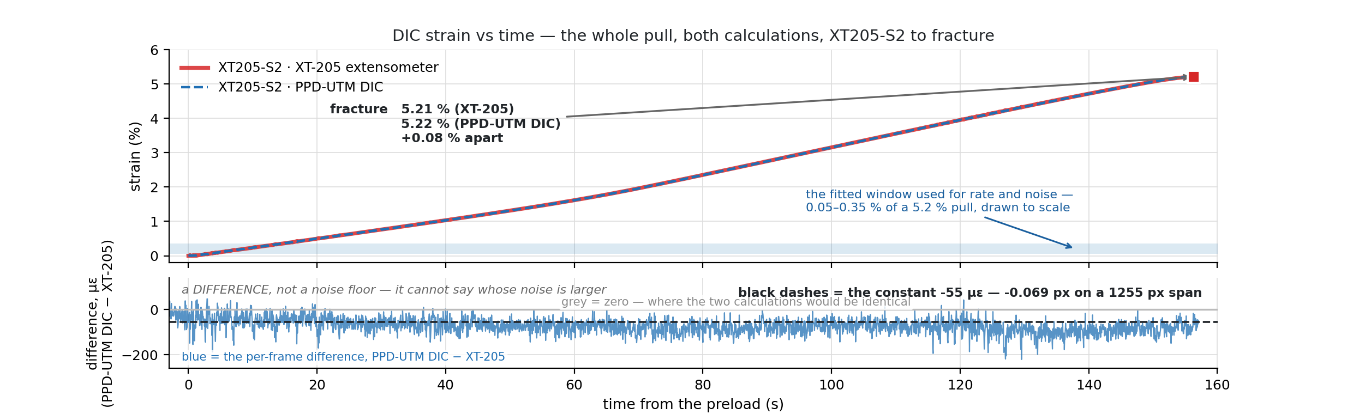
04 · VALIDATION
Analysis 2 : Same video, Same specimen, two calculation methods
VALIDATION
+0.08 %
−55 µε
3.21–3.24 vs 3.23
fracture strain apart
constant difference, flat to fracture
Young's modulus E (GPa), elastic region — PPD-UTM DIC fits on the XT-205 footage vs the XT-205 machine
5.21 (XT-205) vs 5.22 (PPD-UTM DIC), on the same footage
= 0.07 px on a 1255 px gauge
fixed-window fit 3.21 · steepest-window 3.24 · machine 3.23 — the SLOPE agrees, not just the endpoints
15

Slide 16
05 · PROCESS
AI in the loop - Built by one engineer and a coding agent
intent
“the rig must stop itself at fracture”
370
commits · 94 % co-authored with the agent
prompt
precise ask + constraints + how to verify
~26 k
lines of Python in the rig software itself — app, DIC engine, analysis, tests (deck-builder scripts not counted)
PROCESS
Claude Code
writes app code, tests, analysis
853
prompts, measured from the session log (28 May → 6 Sep) — about two per shipped commit
verify on rig
real pulls; failures go straight back in
≈7×
the leverage: 195 h hands-on with the agent over 6 months vs ≈1 300 h estimated solo (26 k lines of hardware-coupled GUI + vision code at ~20 finished lines/hour)
evidence
every claim becomes a measured deck page
▪ the prompt is the engineering: what to build, what would falsify it, how to prove it ran
▪ the agent measures instead of assuming — it renders every page and looks at it
16

Slide 17
06 · OUTLOOK
Future work
Poisson & true stress
2D-DIC strain field
Feed simulation models
four markers → lateral strain, ν, Cauchy stress
full-field strain over the speckled gauge, not just two dots
measured strain fields calibrating FE material cards
HOW
HOW
HOW
maths written and self-tested; blocked on optics — needs a gauge-zoomed second camera or a wider specimen
offline first, in the existing post-processor; needs lower exposure — the white body currently saturates the sensor
export the field per frame; compare predicted vs measured maps on the same geometry
OUTLOOK
Studying fracture behaviour
Correlation, not binary
Design better grips
full-field strain maps around the crack tip; crack propagation speed and direction
sub-pixel tracking that keeps the grey levels
printed jaws that seat deterministically — no low-strain slack, no 21 % / 33 % lottery
HOW
HOW
HOW
film the necking zone at higher magnification and run the 2D-DIC field around the growing crack — builds directly on the strain-field item above
measured gain: 1.1–2.1× less jitter; add as a post-processing option before touching the live loop
size the slack (re-mount one specimen, elastic pulls only), redesign, reprint, re-run — success: one cluster, shorter toe
The upcoming stages are more than features — the 2D-DIC field, fracture behaviour and the simulation coupling are WORTH A THESIS
17

Slide 18
06 · OUTLOOK
Interesting numbers — moisture effects & emissions
MOISTURE → UTS & FAILURE STRAIN
CARBON FOOTPRINT – Rough estimate
our rig: 4.2 % drop in UTS, Fracture strain UP
≈3.2 kg CO₂e
the batch whose filament sat unconditioned 8 days longer prints weaker but more ductile — the plasticizing signature:
For the WHOLE 6-month project — counted:
▪ the PC work (955 h at 60 W → 57.3 kWh)
▪ the AI compute (195 h of sessions, 0.24 Wh per prompt)
OUTLOOK
S7 · (8 days earlier)
batch b–e
offset
▪ the Mk4S printer (60 specimen prints → 5.0 kWh)
UTS
47.82 MPa
45.81 MPa
−4.2 %
▪ the rig + camera (45 W, all 39 fractures → 0.3 kWh)
— all on Sweden's 0.040 kg CO₂e/kWh grid.
εf
0.030
0.05–0.075
↑1.7–2.5×
≈239× — thinking over pulling
literature: 8.5 % drop in 24 h
humid filament storage costs PLA strength (150 h: −11 %); ≤65 % RH keeps UTS within 3.7 %.
the AI + the work PC out-emit the test rig itself by that factor — the rig's whole share, all 39 fractures, is ≈13 g. Honest band for the total: 2.6–3.8 kg.
Hamid et al. 2022 (doi)
Quader et al. 2024 (doi)
18

Slide 19


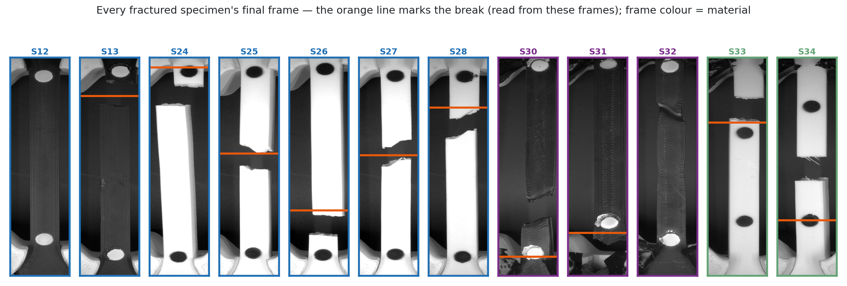
Thank you.
where it began
A big thank you to everyone at PPD — for an amazing time here.
Questions — or welcome to break more specimens with me.
Adithya Sivakumar
adithya.sivakumar@ju.se
adithyasvk@outlook.com
where it went
19

Slide 20
APPENDIX
For the curious
A1
Otsu thresholding
how the camera decides what is a marker
A2
PLA vs PETG vs TPU
APPENDIX
our curves against what literature expects
A3
Noise, rig against rig
how quiet each instrument is, measured at rest
A4
Camera properties
resolution is a window, exposure sets the frame rate — what was set, and based on what
20

Slide 21
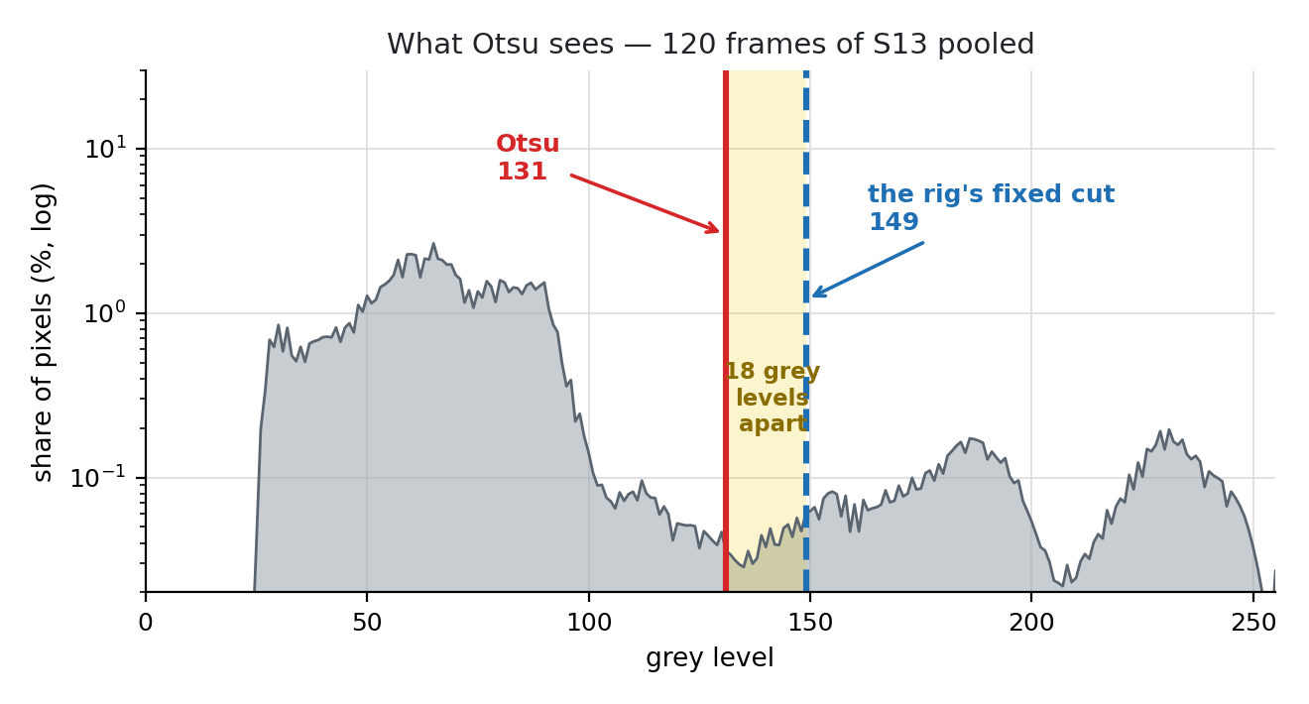
APPENDIX · A1
Otsu — how the camera picks its threshold
▪ WHY it exists
▪ every frame must be split into “marker” and “not marker” — that takes one brightness number
▪ WHAT it does
▪ tries all 254 cuts, keeps the one giving the two tidiest groups — lands in the histogram's empty valley
▪ THE CATCH
▪ it follows the SCENE, not the markers — so the rig scores it against fixed values (auto-calibrate) instead of trusting it blindly
APPENDIX
Otsu (1979), IEEE Trans. SMC 9(1):62–66 · measured here on 120 frames of specimen S13.
21

Slide 22
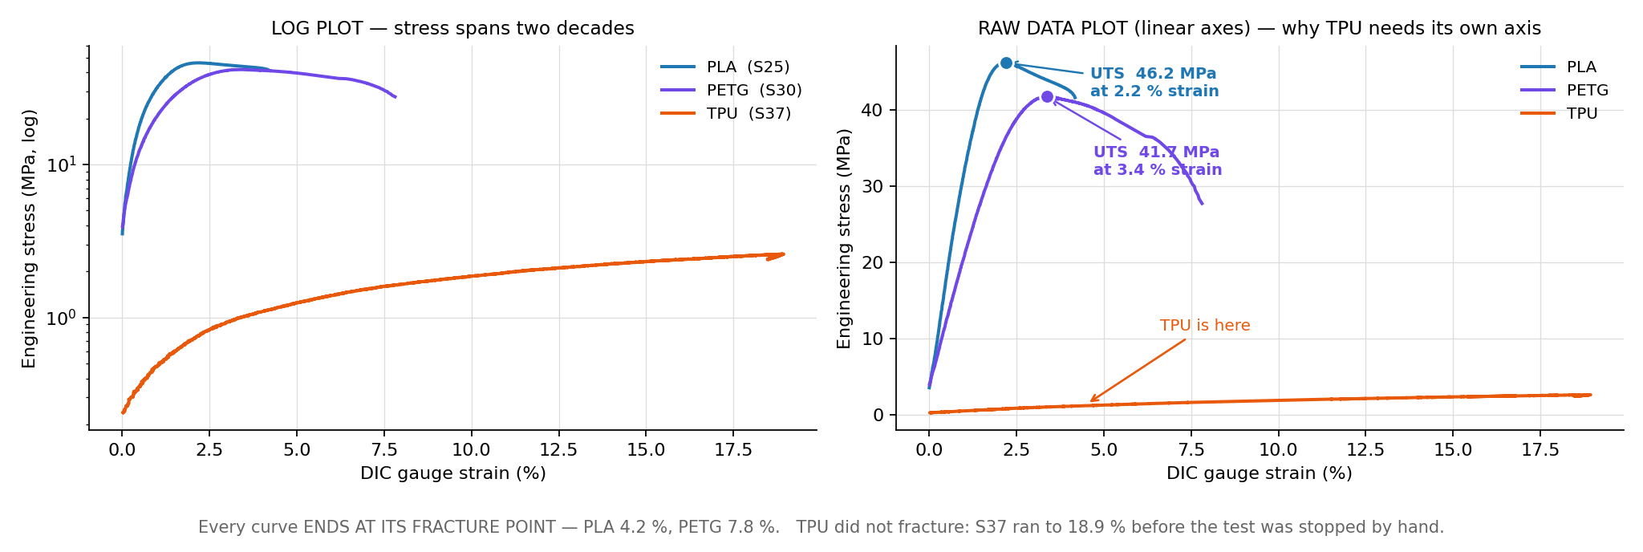
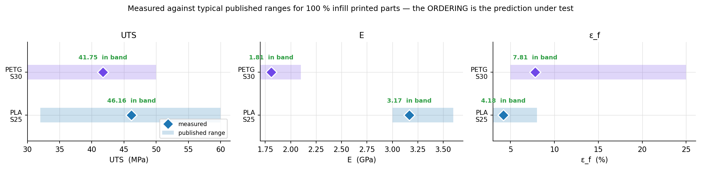
APPENDIX · A2
Three materials — measured, against expectations
APPENDIX
▪ ordering exactly as published
▪ TPU never fractured — it left the frame at 19 % strain
published ranges — PLA: Chacón et al. 2017 · Tymrak et al. 2014 · Prusament PLA TDS
PETG: Durgashyam et al. 2019 · Hsueh et al. 2021 · Prusament PETG TDS — TPU: filament TDS + Hohimer et al. 2020, per the material notes.
22

Slide 23
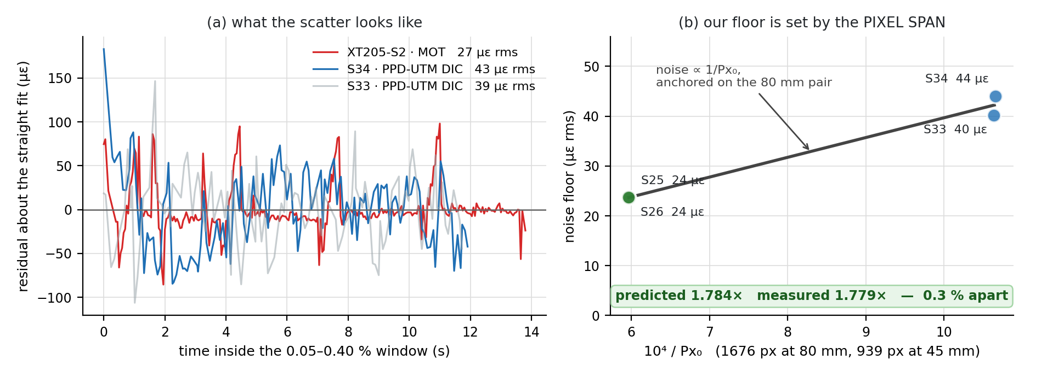
APPENDIX · A3
How quiet is each instrument?
▪ both rigs sit in the tens of microstrain
▪ our floor is set by pixel quantisation: noise ∝ 1/Px₀
▪ predicted 1.78× between our two gauge lengths — measured 1.78×
▪ so the noise is understood, not just small
APPENDIX
23

Slide 24
APPENDIX · A4
Camera properties — resolution & exposure
RESOLUTION — chosen as a window
EXPOSURE — sets the frame rate
▪ the Basler sensor always runs full resolution, 2448 × 2048 px — no binning, no scaling anywhere
▪ what we SET is which pixels to read: ROI [offset 0, 988 · size 2348 × 419], framed with roi_tool.py so both markers sit inside with room to move; rotated 90° → the 420 × 2348 recordings
▪ the ROI is ≈20 % of the sensor (0.98 of 5.0 Mpx) — every frame grabbed, tracked and written is ≈5× lighter, which is what keeps live DIC plus video recording comfortable in real time
▪ the value is a TRAVEL budget: at 2348 px a marker reaches the frame edge at ≈33 % strain — sharpness, scale and noise belong to the optics and exposure, not the ROI
▪ each frame must be exposed before it can be delivered: at 50 ms per frame the ceiling is 1/0.050 s = 20 fps — the app may ask for 35, the camera delivers 19.9
▪ WHY: the requested rate is a ceiling, not a promise — the sensor cannot start sending a frame until it has finished gathering light for it, so the true rate is min(requested, 1/exposure); readout overhead shaves 20 to 19.9, and below 28.6 ms of exposure the full 35 would return
▪ the 19.9 is MEASURED from frame timestamps on every capture; the video container's declared 35 fps is never believed
▪ the value is chosen by Auto-calibrate: it sweeps ×0.3–×2.8 of the current exposure (15–140 ms), scores each setting on measured marker trackability, and proposes the winner — more light means stronger contrast but fewer frames per second
APPENDIX
In short: resolution decides WHERE we look, exposure decides HOW OFTEN — both set once per rig geometry, by tools, not by hand. Full story: the Weekly deck's camera block.
24

