Slide 1
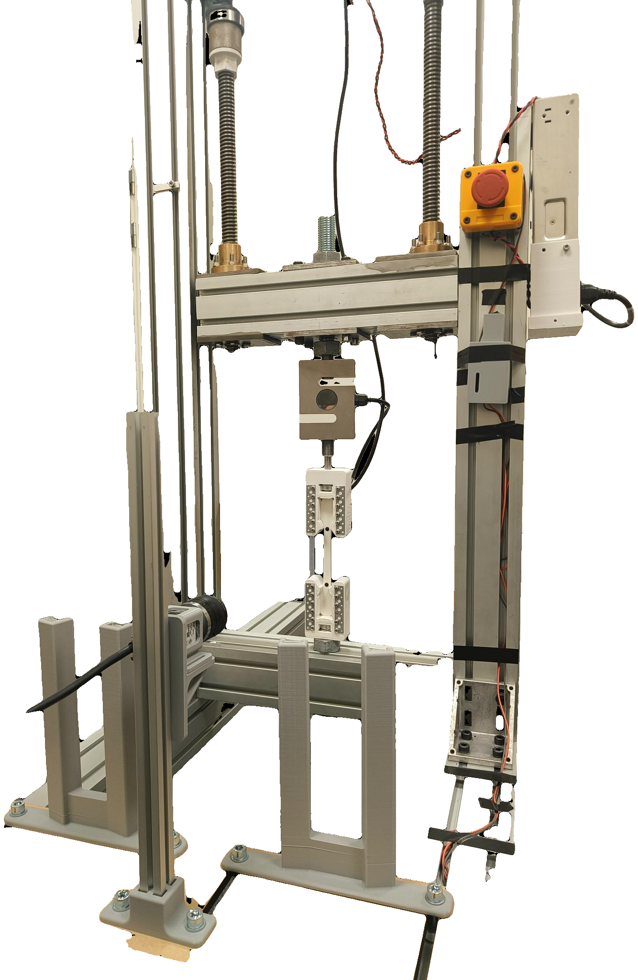
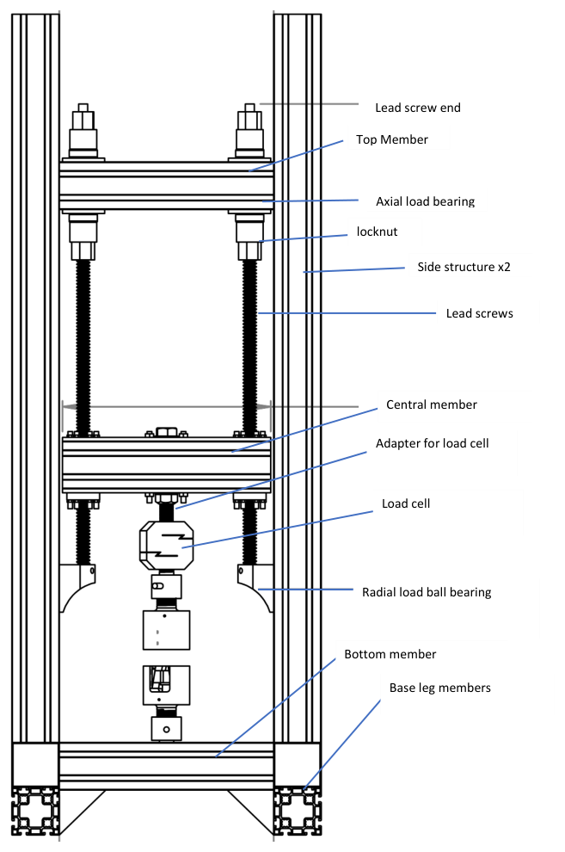
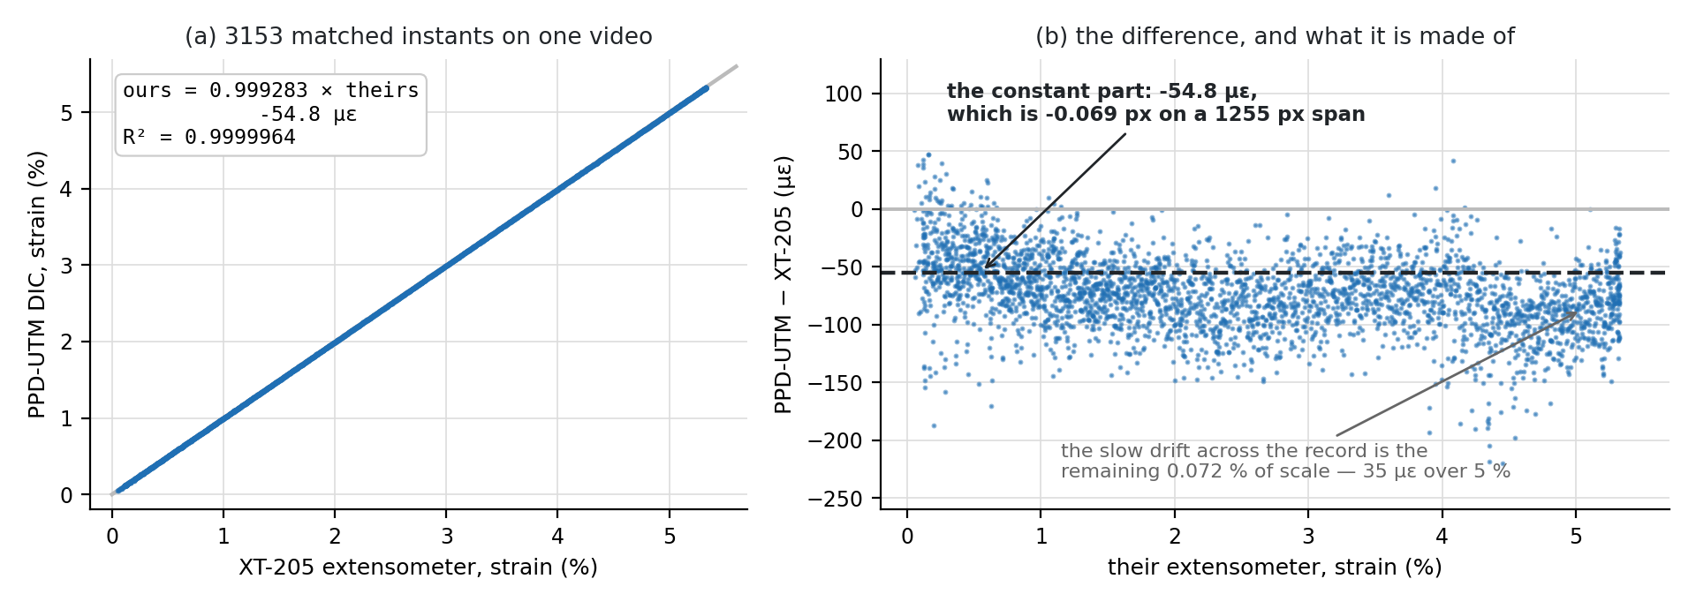
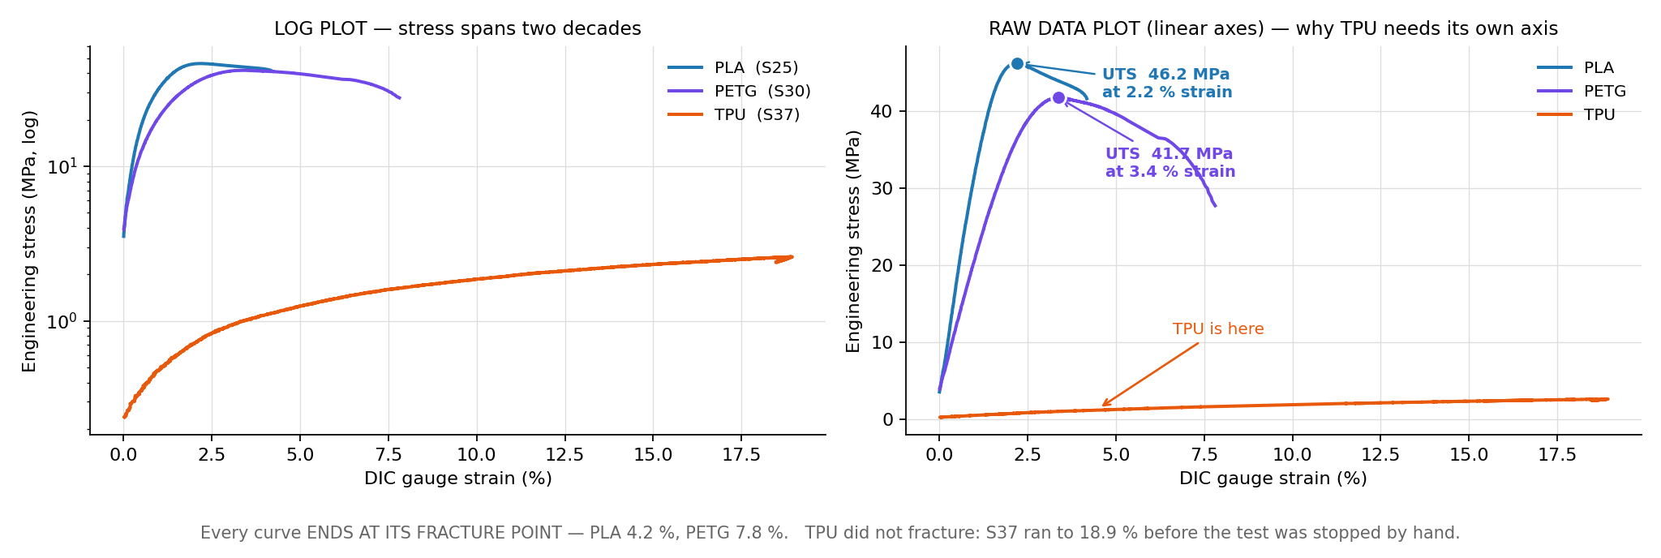
SMART UTM — a tensile rig that runs, watches and stops its own tests
Jönköping University · School of Engineering — Materials & Manufacturing
The camera measures what a certified extensometer measures.
20 smart features and 6 closed-loop protocols on a desktop rig. On the same frames, the rig's DIC agrees with a Zwick/Roell XT-205 video extensometer to 0.07 % in scale and 0.19 % in fracture strain — and PLA, PETG and TPU land inside their published bands.
18 / 20
0.99928
±1 %
12 µε
1.78× / 1.78×
3
smart features
rig-validated (+2 offline)
scale vs XT-205 on the
same frames, R² 0.9999964
yield and fracture strain
vs the laboratory
DIC noise floor, 10 s —
reference instrument 45 µε
noise vs pixel span
predicted / measured
polymers inside their
published bands
THE MACHINE
WHAT THE TESTS SHOWED
WHAT IT MEANS
The rig — built in-house, every control loop closed in software
Validated against a certified video extensometer — on its own frames
Same frames, same answer → the software is a measurement
Given the XT-205's own frames, the rig's algorithm reproduces the certified record to 0.07 % in scale. Whatever still differs between the two machines is the machine or the specimen, not the strain channel.
The noise is centroid noise → design with pixels
Floor 11.9 µε over 10 s, 26 µε over 900 s, below the reference instrument's 45 µε. It scales as 1/Px₀: 1675 vs 939 px across the gauge predicted 1.78× and measured 1.78×. More pixels across the gauge is the only lever, and it needs no code.
The crosshead is not the specimen → an extensometer is not optional
The laboratory's XT-205 video was re-measured by the rig's post-processor: 3153 frames, scale 0.99928, R² 0.9999964, fracture strain 5.21 vs 5.22 %, and a constant offset of -55 µε — 0.069 px on a 1255 px reference — that vanishes from every slope. On separate specimens the two machines agree within 1 % on yield and fracture strain; the -7.7 % UTS gap is pull rate (2.21× the laboratory's), grip seating and batch, not the strain channel.
Only 19–29 % of early crosshead motion reaches the gauge; a crosshead-based curve overstates strain, and understates modulus, by three to five times.
Two steppers (1.85 Nm, 20:1) drive 5 mm lead screws against a fixed base. An ANYLOAD 3 t cell measures force; a Basler camera measures strain optically at 20.8 px/mm from two markers on the 80 mm gauge. The ESP32 runs STEP/DIR/ENABLE only and knows nothing of test protocols — every protocol, guard and measurement here lives in the PyQt6 app, closing the loop at ~11 Hz.
A fixed threshold beats Otsu → material presets, not auto-thresholds
Otsu is set by the specimen body, not the markers (painting them out moves it ≤ 3 grey levels). On translucent PETG it found both markers on 48.5 % of frames; the fixed cut on 99.5 %.
WHY AUTOMATE A TENSILE RIG
Three polymers, three characters — each inside its published band
Material, not machine → the rig can rank materials
A conventional pull gives ONE modulus, ONE yield, ONE strength — and a human presses every button. Crosshead travel is not specimen strain, so the machine reports its own compliance as material behaviour. A destructive test is one irreversible shot. And nothing watches the run, so a stall, a lost marker or a fracture are all noticed late, by a person.
A matched 50 % pair repeats to 0.2 % in strength (19.87 / 19.91 MPa); the 50 % infill knockdown is 2.4 in both strength and modulus, against the 2.0 that volume fraction alone would give; fractures do not cluster at the markers.
Batch is a variable → control the spool
The same PLA spool two months later printed parts with 1.7–2.5× the fracture strain; the literature gives −8.5 % strength after 24 h of ambient exposure. Specimens printed weeks apart are not the same material.
HOW IT WORKS
The cost is the thinking, not the pulling
One control engine
PLA S25: UTS 46.2 MPa, E 3.17 GPa, ε_f 4.1 %. PETG S30: 41.8 MPa, 1.81 GPa, 7.8 %. TPU S37: 2.60 MPa at 18.9 % strain, E 0.024 GPa, unbroken at the travel limit. Two decades of modulus with the same two markers and the same code, in the expected order — the rig measures the material, not itself.
The whole project: 3.2 kg CO₂e, 83 g per recorded test; the rig itself is 13 g per test and the desk computer outweighs it 239×.
All six protocols are one function called on every load sample (~11 Hz) with load, position and time-matched DIC strain in hand. A protocol only returns a speed — it cannot bypass the shared safety net.
LIMITATIONS
Strain from the specimen
Poisson's ratio is not measurable today
A camera tracks two markers; engineering strain is (L−L₀)/L₀ at 20.8 px/mm. The centroid resolves 0.1 px steps at ±0.02 px.
The gauge is too narrow: the elastic width change is sub-pixel at 20.9 px/mm. Every stress here is ENGINEERING (F/A₀); true stress is an estimate. Future work FW1: a second camera or a lens change.
Simulated before hardware
Every policy is replayed against a spring plant and recorded CSVs — 9/9 checks pass before a specimen is risked.
The UTS gap to the laboratory is explained, not yet separated
Four safety layers
-7.7 % on one specimen each side. Pull rate (2.21×), grip seating and batch are the candidates; one pull at the laboratory's 2 mm/min and the laboratory's load channel would split them.
Load-collapse detector · stall guard (< 0.05 mm / 6 s under load) · 4.5 kN and 30 mm backstops · dead-DIC guard (freeze at 0.2 s, halt at 1.0 s). Guards are phase-aware, so the stall guard stays silent through an intentional dwell.
THE SMART FEATURES, SF1 TO SF20
built & rig-validated (18)
built, verified offline (2)
Live DIC health HUD
SF1
Prepare specimen
SF2
Recipes / settings
SF3
One-click report
SF4
Auto-stop at fracture
SF5
A green/amber/red badge shows marker lock, tracking % and jitter live — so a dropout is seen during the test, not found later in the CSV.
2 / 2
One button tares position, force and DIC and clears the plots. It tares DIC only at a green 2/2 lock, so a bad mount cannot be zeroed in.
4 → 1
Saves and restores an entire setup, including all six protocols' parameters — so repeats are identical by construction, not by memory.
1 click
A one-page PDF and every plot, recomputed from the CSV by the same library the app runs live.
1 click
A load-collapse detector halts the motor the moment the specimen breaks. Caught S16 at 3375 N, silent through the ductile draw before it.
1.2 s
markers, live at ~2 Hz
operator actions
restores the whole setup
→ PDF + every graph
collapse → motor halt
Constant-strain-rate testing
SF6
Stall guard
SF7
Release load
SF8
Six closed-loop protocols
SF9
Auto-preload
SF10
Closed loop on the specimen's own dε/dt: the crosshead adapted itself 0.10 → 0.05 mm/s, fast in the elastic region, slow through necking.
0.05 %/s
Halts a motor that has stopped moving under load. It proved the T7 failure was a 2.6 kN stall, not a fracture — the specimen came off intact.
0.05 mm / 6 s
Taring at preload makes the readout say 0 N while 300 N is still on the specimen. This drives past that, down to the true zero.
≤ 5 N
cyclic · staircase · relaxation · creep · staircase→FRACTURE · progressive-cyclic→FRACTURE. One engine, one safety net.
6 / 6
Approaches on a 0.2 → 0.1 → 0.02 mm/s schedule and stops 3 % high, because PLA relaxes about 2 % while held.
1.03 ×
held: 0.051 vs a 0.050 %/s target
trip, armed above 200 N
residual, at 0.20 mm/s
rig-validated
target, pre-paying relaxation
Auto-metadata link
SF11
DIC auto-calibrate
SF12
Guided wizard
SF13
Test registry
SF14
Dead-DIC guard + hard backstops
SF15
Every save links the CSV, the captured video and the registry row by name and proposes the per-specimen folder — nothing a run produces can be orphaned.
3 links
Exposure and threshold are swept on the live camera and scored on marker count, contrast and centroid jitter; the winner is applied with the score shown.
1 click
Connect → camera → data → mode → auto-calibrate → preload → Px₀ → prepare → run → save. Each step refuses to advance until its check passes.
9 / 9
Each run indexed with whatever its loading path supports — UTS, ε_f, E, σ_y, toughness — plus the force anchor that turns a tared reading into a true load.
36 runs
A controller ramping blind on a stale camera reading spikes the force. Speed freezes at 0.2 s of frozen strain, halt at 1.0 s; 4.5 kN and 30 mm caps.
3.0×
CSV · capture · registry, on save
exposure + threshold, scored
steps, on a real run
auto-indexed, 30 specimens
less overshoot on marker loss (518 → 175 N)
Live Px₀ overlay
SF16
Video + image capture
SF17
DIC post-processing
SF18
Noise capture
SF19
Manual blob selection
SF20
The frozen reference pair and the live pair are drawn on the feed with a caption whose Δ agrees with the strain readout — the operator sees the measurement, not only a number.
Δ = ε
PNG stills plus three AVI views (raw, contrast-boosted, adaptive speckle) recorded with the run, at a measured cost that never touches the detection budget.
≈47 µs
Measures strain from ANY recorded video with the rig's own pixel-to-strain rule. On the laboratory's XT-205 footage it reproduced the certified record over 3153 frames.
0.99928
Records the instrument at rest and separates offset and drift (correctable) from the residual sd — the uncertainty, which does not subtract. Verified offline; awaits a rig run.
26 µε
The operator clicks the two markers on a frozen frame and tracking follows the picks with the shape gates off — keeps measuring where automatic detection is deliberately killed.
9 / 9
overlay agrees with readout
per frame, all sinks
scale vs XT-205, same frames
900 s floor, drift separated
offline tests, S13 frames
Code, raw CSVs, the 393-slide progress diary and the project report: Software/UTM_PyQt6/ and documentation/ · Every figure and number here is regenerated from the rig CSVs and the laboratory records by the documentation/scripts analysis suite — none of it is transcribed by hand. · Layout follows the #evenbetterposter / Generation-2 billboard format: a plain-language headline, with methods and limitations kept as full panels rather than sidebars.

