Slide 1
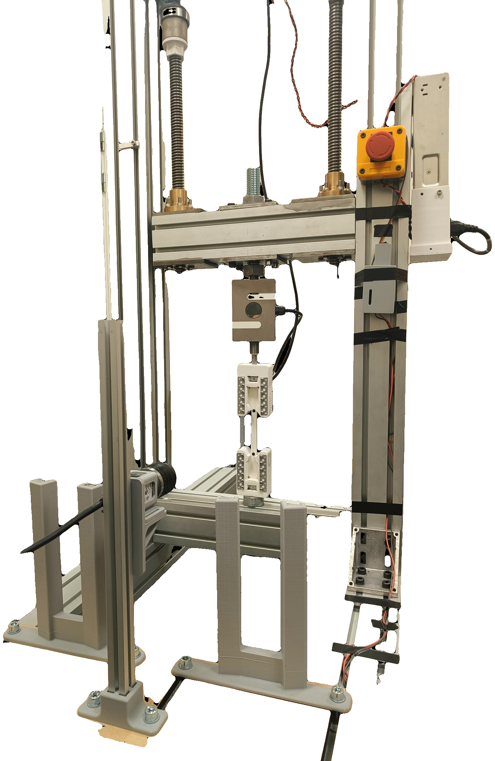
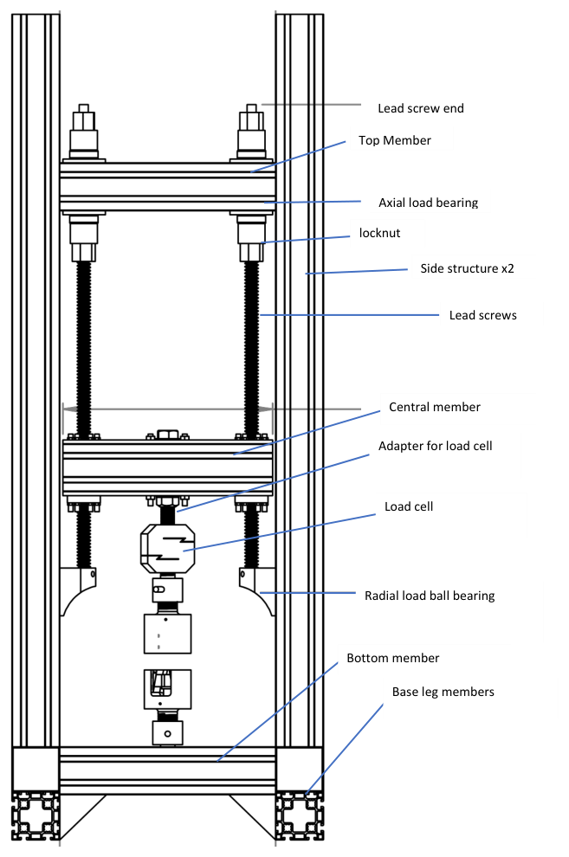
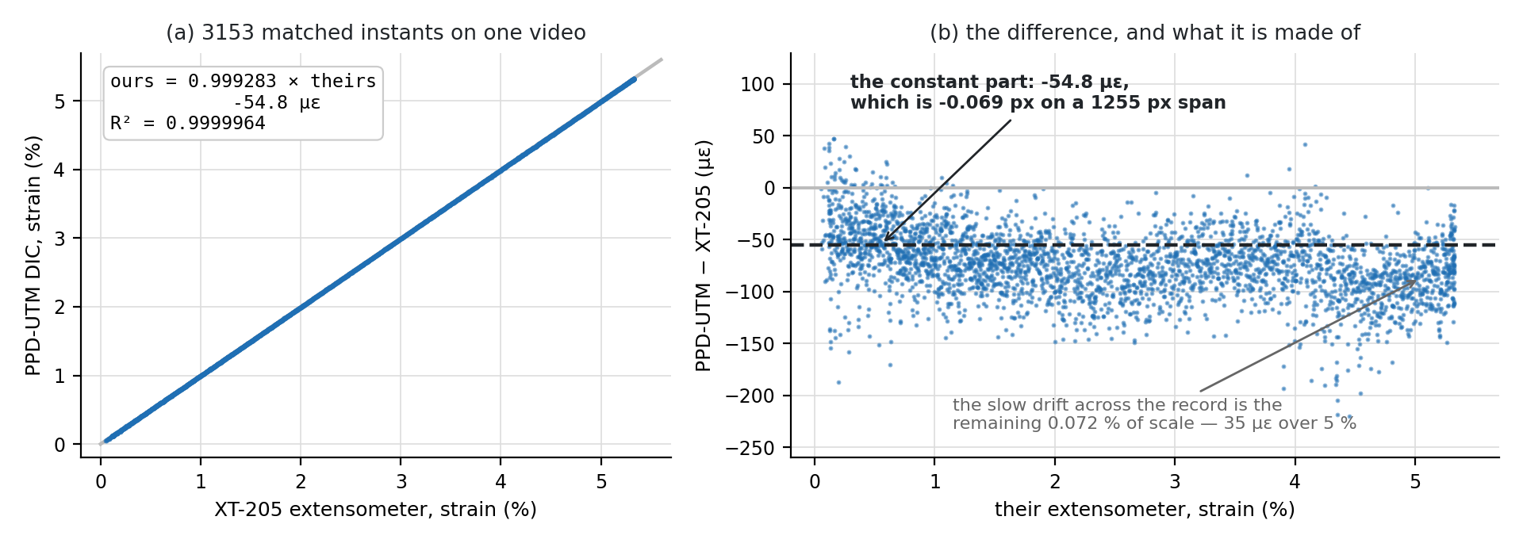
SMART UTM — a tensile rig that runs, watches and stops its own tests
Jönköping University · School of Engineering — Materials & Manufacturing
The camera measures what a certified extensometer measures.
20 smart features and 6 closed-loop protocols on a desktop rig. On the same frames, the rig's DIC agrees with a Zwick/Roell XT-205 video extensometer to 0.07 % in scale and 0.19 % in fracture strain — and PLA, PETG and TPU land inside their published bands.
18 / 20
0.99928
±1 %
12 µε
1.78× / 1.78×
3
smart features
rig-validated (+2 offline)
scale vs XT-205 on the
same frames, R² 0.9999964
yield and fracture strain
vs the laboratory
DIC noise floor, 10 s —
reference instrument 45 µε
noise vs pixel span
predicted / measured
polymers inside their
published bands
THE MACHINE
WHAT THE TESTS SHOWED
The rig — built in-house, every control loop closed in software
Validated against a certified video extensometer — on its own frames
Two steppers (1.85 Nm, 20:1) drive 5 mm lead screws against a fixed base. An ANYLOAD 3 t cell measures force; a Basler camera measures strain optically at 20.8 px/mm from two markers on the 80 mm gauge. The ESP32 runs STEP/DIR/ENABLE only and knows nothing of test protocols — every protocol, guard and measurement here lives in the PyQt6 app, closing the loop at ~11 Hz.
HOW IT WORKS
The laboratory's XT-205 video was re-measured by the rig's post-processor: 3153 frames, scale 0.99928, R² 0.9999964, fracture strain 5.21 vs 5.22 %, and a constant offset of -55 µε — 0.069 px on a 1255 px reference — that vanishes from every slope. On separate specimens the two machines agree within 1 % on yield and fracture strain; the -7.7 % UTS gap is pull rate (2.21× the laboratory's), grip seating and batch, not the strain channel.
One control engine
All six protocols are one function called on every load sample (~11 Hz) with load, position and time-matched DIC strain in hand. A protocol only returns a speed — it cannot bypass the shared safety net.
WHAT IT MEANS
Strain from the specimen
Same frames, same answer → the software is a measurement
A camera tracks two markers; engineering strain is (L−L₀)/L₀ at 20.8 px/mm. The centroid resolves 0.1 px steps at ±0.02 px.
Given the XT-205's own frames, the rig's algorithm reproduces the certified record to 0.07 % in scale. Whatever still differs between the two machines is the machine or the specimen, not the strain channel.
The noise is centroid noise → design with pixels
Floor 11.9 µε over 10 s, 26 µε over 900 s, below the reference instrument's 45 µε. It scales as 1/Px₀: 1675 vs 939 px across the gauge predicted 1.78× and measured 1.78×. More pixels across the gauge is the only lever, and it needs no code.
The crosshead is not the specimen → an extensometer is not optional
Only 19–29 % of early crosshead motion reaches the gauge; a crosshead-based curve overstates strain, and understates modulus, by three to five times.
THE SMART FEATURES, SF1 TO SF20
built & rig-validated (18)
built, verified offline (2)
SF1
Live DIC health HUD — 2 / 2
SF2
Prepare specimen — 4 → 1
SF3
Recipes / settings — 1 click
A green/amber/red badge shows marker lock, tracking % and jitter live — so a dropout is seen during the test, not found later in the CSV
One button tares position, force and DIC and clears the plots
Saves and restores an entire setup, including all six protocols' parameters — so repeats are identical by construction, not by memory
SF4
One-click report — 1 click
SF5
Auto-stop at fracture — 1.2 s
SF6
Constant-strain-rate testing — 0.05 %/s
A one-page PDF and every plot, recomputed from the CSV by the same library the app runs live
A load-collapse detector halts the motor the moment the specimen breaks
Closed loop on the specimen's own dε/dt: the crosshead adapted itself 0.10 → 0.05 mm/s, fast in the elastic region, slow through necking
SF7
Stall guard — 0.05 mm / 6 s
SF8
Release load — ≤ 5 N
SF9
Six closed-loop protocols — 6 / 6
Halts a motor that has stopped moving under load
Taring at preload makes the readout say 0 N while 300 N is still on the specimen
cyclic · staircase · relaxation · creep · staircase→FRACTURE · progressive-cyclic→FRACTURE
SF10
Auto-preload — 1.03 ×
SF11
Auto-metadata link — 3 links
SF12
DIC auto-calibrate — 1 click
Approaches on a 0.2 → 0.1 → 0.02 mm/s schedule and stops 3 % high, because PLA relaxes about 2 % while held
Every save links the CSV, the captured video and the registry row by name and proposes the per-specimen folder — nothing a run produces can be orphaned
Exposure and threshold are swept on the live camera and scored on marker count, contrast and centroid jitter; the winner is applied with the score shown
SF13
Guided wizard — 9 / 9
SF14
Test registry — 36 runs
SF15
Dead-DIC guard + hard backstops — 3.0×
Connect → camera → data → mode → auto-calibrate → preload → Px₀ → prepare → run → save
Each run indexed with whatever its loading path supports — UTS, ε_f, E, σ_y, toughness — plus the force anchor that turns a tared reading into a true load
A controller ramping blind on a stale camera reading spikes the force
SF16
Live Px₀ overlay — Δ = ε
SF17
Video + image capture — ≈47 µs
SF18
DIC post-processing — 0.99928
The frozen reference pair and the live pair are drawn on the feed with a caption whose Δ agrees with the strain readout — the operator sees the measurement, not only a number
PNG stills plus three AVI views (raw, contrast-boosted, adaptive speckle) recorded with the run, at a measured cost that never touches the detection budget
Measures strain from ANY recorded video with the rig's own pixel-to-strain rule
SF19
Noise capture — 26 µε
SF20
Manual blob selection — 9 / 9
Records the instrument at rest and separates offset and drift (correctable) from the residual sd — the uncertainty, which does not subtract
The operator clicks the two markers on a frozen frame and tracking follows the picks with the shape gates off — keeps measuring where automatic detection is deliberately killed
Code, raw CSVs, the 393-slide progress diary and the project report: Software/UTM_PyQt6/ and documentation/ · Every figure and number here is regenerated from the rig CSVs and the laboratory records by the documentation/scripts analysis suite — none of it is transcribed by hand. · Layout follows the #evenbetterposter / Generation-2 billboard format: a plain-language headline, with methods and limitations kept as full panels rather than sidebars.

